Slide 1
“MULTIPLE DISEASE PREDICTION SYSTEM”
Guide
<Mr. A Ramesh>
<Associate Professor>
Project Coordinator
<Mrs.D Aswani>
<Assistant Professor>
By
(22AG1A0521- G Varshini)
(22AG1A0535- M Jayanth Reddy)
(22AG1A0520- G Sai Kumar)
(22AG1A0533- M Gopi Sousheel)

Slide 2
Abstract
The Disease Prediction System using Machine Learning predicts diseases based on user-provided symptoms, improving early diagnosis accuracy. It analyzes Diabetes, Heart Disease, and Parkinson’s Disease using Logistic Regression, a supervised learning algorithm suitable for binary and multi-class classification.
The system processes medical data, applies data preprocessing (cleaning, encoding, and scaling), and trains the model with a train-test split for better accuracy.

Slide 3
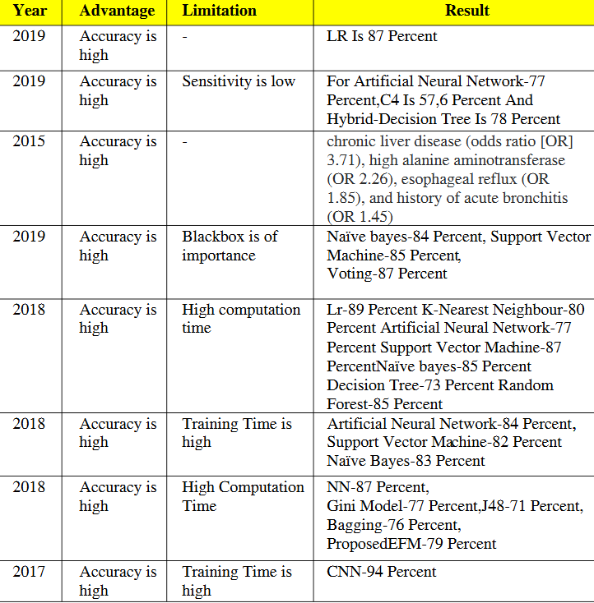
Literature Survey Overview

Slide 4
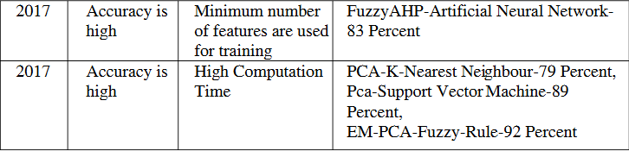
Literature Survey Overview Cont.….

Slide 5
Existing System
IRE Journals is an academic publisher specializing in open-access, peer-reviewed journals across various disciplines, including engineering, technology, and applied sciences. Their mission is to disseminate high-quality research globally, fostering knowledge sharing and academic collaboration.

Slide 6
Disadvantages
Data Quality and Availability Issues
Incomplete Data: Many models rely on incomplete or missing data, which can significantly affect their prediction accuracy. Missing values or unstructured data (e.g., handwritten notes) often require significant preprocessing and data cleaning.
Imbalanced Data: If a dataset has far more examples of one disease than another, the model may become biased toward the more common disease. This can lead to poor predictions for rarer conditions.
Overfitting and Underfitting
Overfitting: Some models, especially complex ones like deep learning networks, might become too specialized to the training data and fail to generalize well to new, unseen data.
Underfitting: In contrast, simpler models may not capture the complexity of the data, leading to poor predictions, especially when there are interdependencies among symptoms or diseases that the model cannot account for.

Slide 7
Proposed system
Description:
1. Logistic Regression for Multi-Disease Prediction
Train separate Logistic Regression models for Heart Disease, Parkinson’s, and Diabetes.
Perform data preprocessing: handling missing values, feature scaling, and 75-25 train-test split.
2. Model Deployment & Real-Time Predictions
Deploy the trained Logistic Regression models via Anaconda Navigator with an API for real-time predictions.
Allow users to input medical data through a web-based interface for disease risk assessment.
3. Explainability with SHAP for Feature Importance
Use SHAP to analyze and interpret model decisions, identifying key features affecting predictions.
Generate SHAP visualizations (summary plots, force plots) to enhance model transparency.
Ensure explainability for medical professionals and users to understand risk factors.

Slide 8
Advantages
1. Enhanced Explainability with SHAP
2. Lightweight & Efficient Logistic Regression
3. Multi-Disease Prediction on a Single Platform
4. Real-Time & Scalable Deployment
5. Trust & Transparency in Healthcare

Slide 9
Requirements
Software Requirements:
Operating system : Windows 11
Coding Language : Python
Technology : Streamlit
Web-Server : Anaconda Navigator
Flask/Django
Hardware Requirements:
System : i5 Processor
Hard Disk : 500 GB
Monitor : 15’’ LED
Input Devices : Keyboard, Mouse
Ram : 4 GB

Slide 10
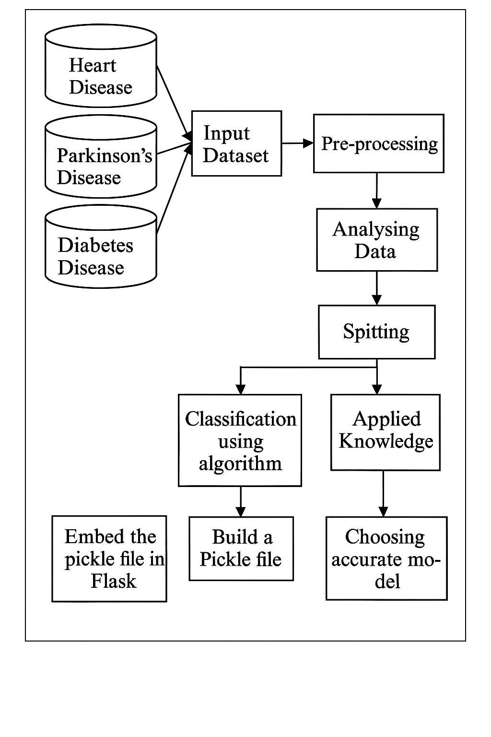
Architecture

Slide 11
Modules
These are the modules which are in our project
Data Collection & Preprocessing Module
Feature Extraction Module
Multi-Disease Prediction Module (ML/DL Model)
Explainability & Interpretability Module (XAI Core)
User Interface Module

Slide 12
Data Collection &Preprocessing Module
Collects data from sources like Electronic Health Records (EHRs), imaging (X-rays, MRIs), genomics, etc.
Preprocessing tasks:
Handling missing values
Data normalization
Feature engineering (e.g., symptom encoding)
Image preprocessing (if using medical images)

Slide 13
Feature Extraction Module
For tabular data: Statistical features (age, BP, glucose level)
For images: CNN-based feature extraction
For text (clinical notes): NLP models (e.g., BERT for healthcare)
Extracts the most relevant features that influence disease presence

Slide 14
Multi-Disease Prediction Module (ML/DL Model)
Classification models (e.g., Random Forest, XGBoost, SVM)
Deep learning (e.g., CNNs for images, RNNs for time series)
Multi-label classification if predicting several diseases at once
Outputs probabilities or labels for diseases (e.g., Diabetes: Yes/No, Pneumonia: Yes/No)

Slide 15
Explainability & Interpretability Module (XAI Core)
Provides transparent explanations of predictions using:
SHAP (SHapley Additive exPlanations)
LIME (Local Interpretable Model-agnostic Explanations)
Grad-CAM (for CNN-based image models)
Attention visualization (for NLP-based models)
Generates insights such as:
Feature importance
Contribution of symptoms/lab values to each disease
Visual heatmaps over images

Slide 16
User Interface Module
Dashboards for clinicians or patients
Visual displays of:
Disease predictions
Feature contributions
XAI heatmaps or charts
Enables user feedback for continuous improvement

Slide 17
Model Monitoring & Feedback Loop
Tracks model performance over time
Monitors drift in data and predictions
Incorporates clinician feedback to improve model
Can trigger re-training if performance drops

Slide 18
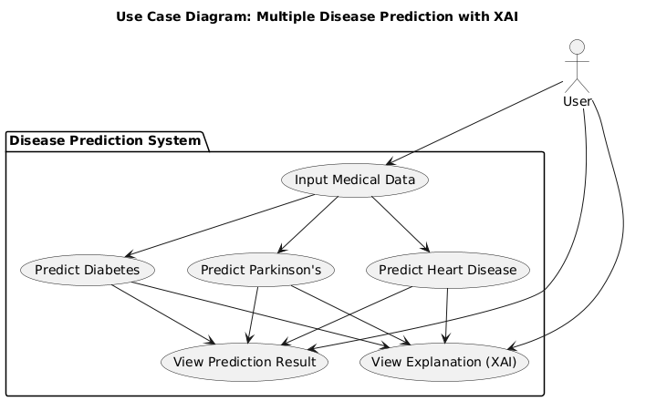
Design
Use Case Diagram

Slide 19
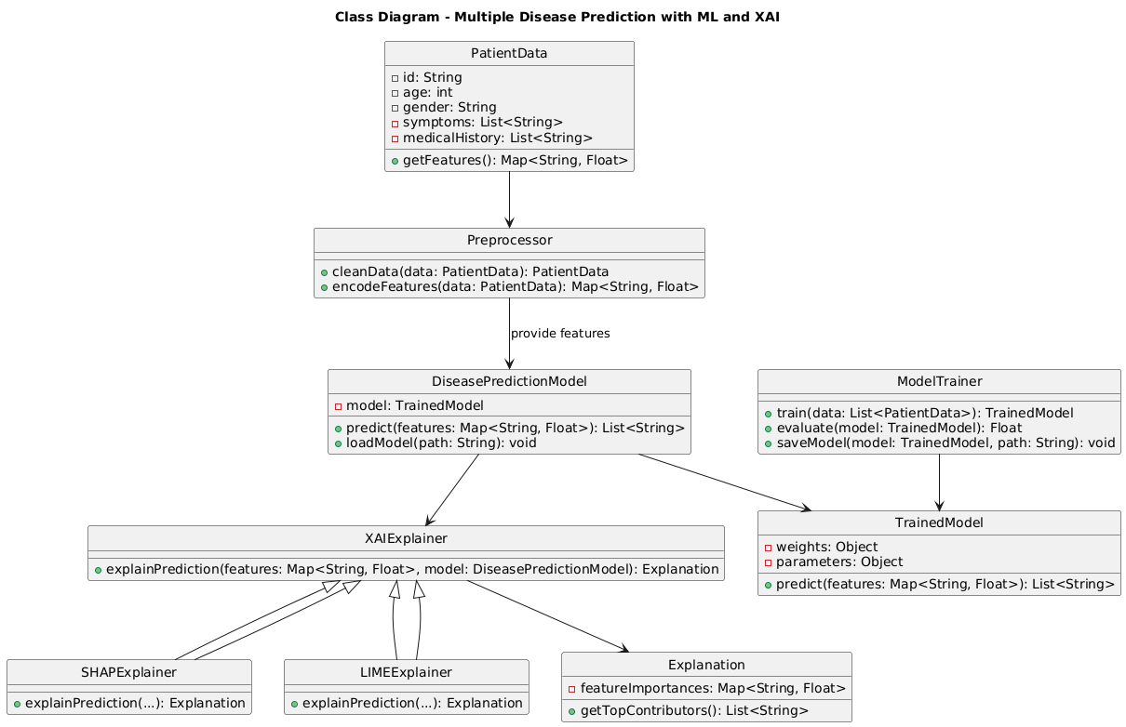
Class diagram

Slide 20
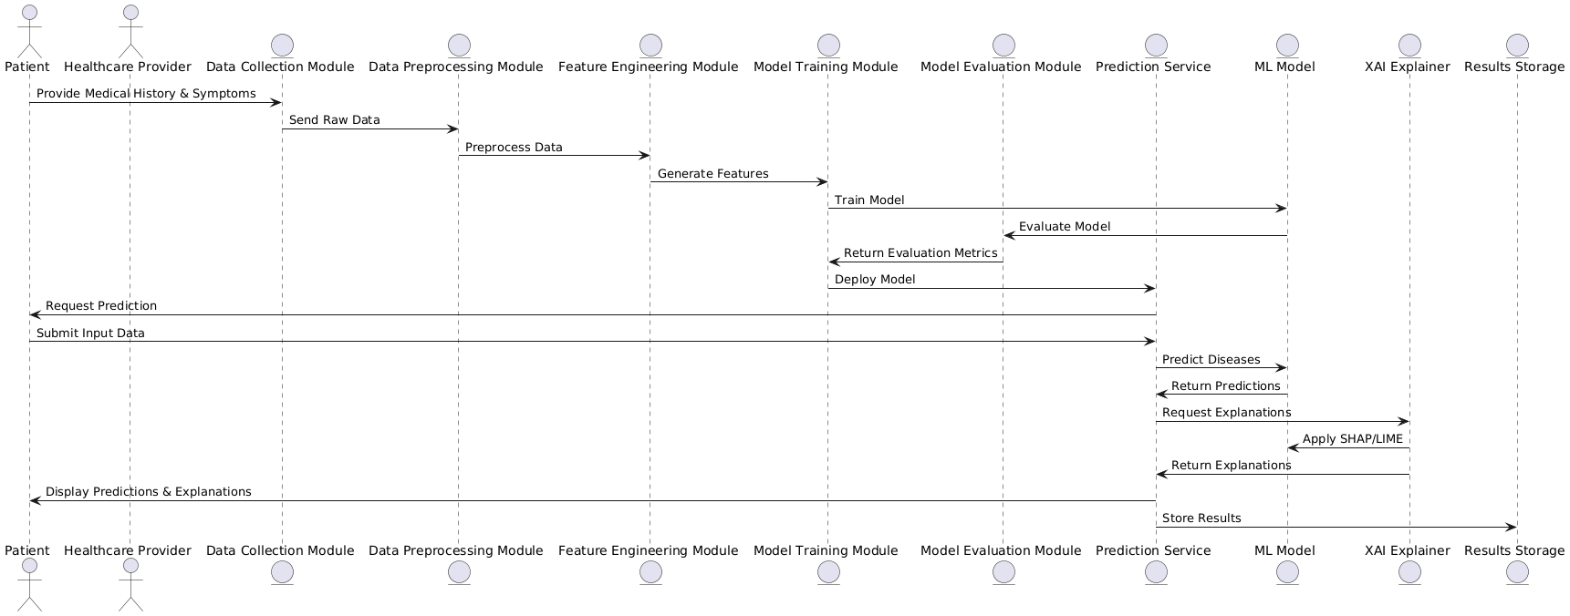
Sequence diagram

Slide 21
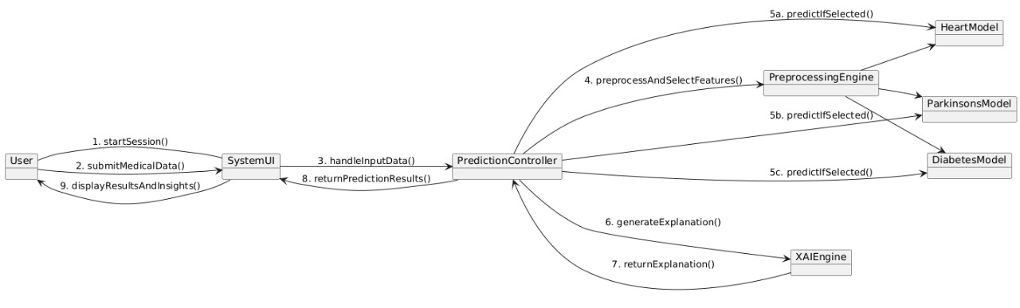
Collaboration diagram

Slide 22
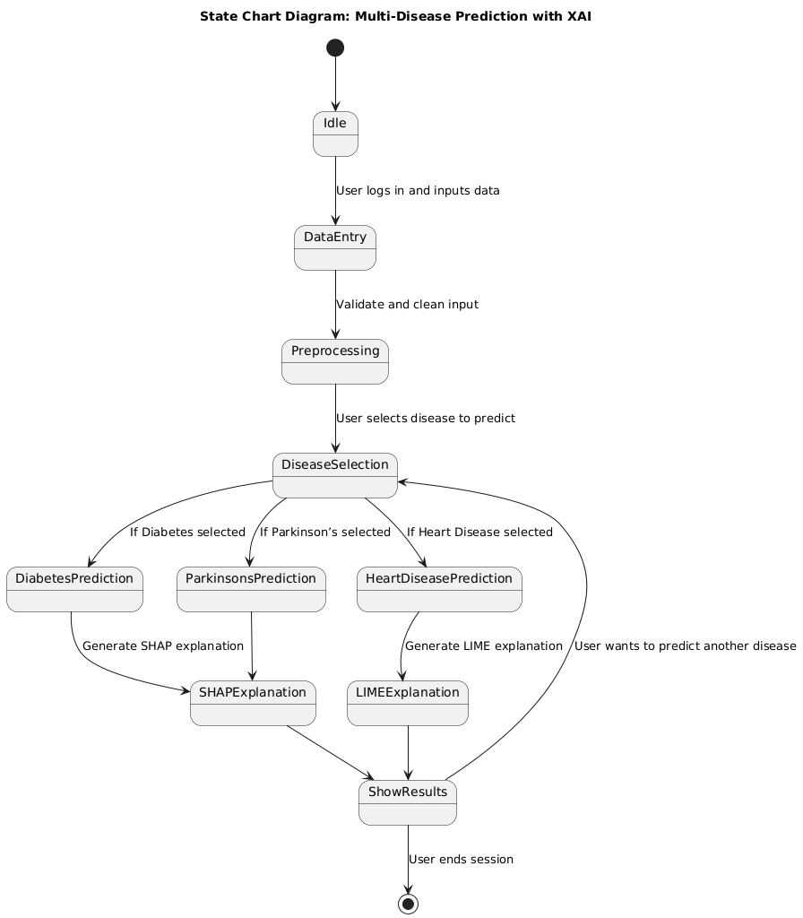
State chart diagram

Slide 23
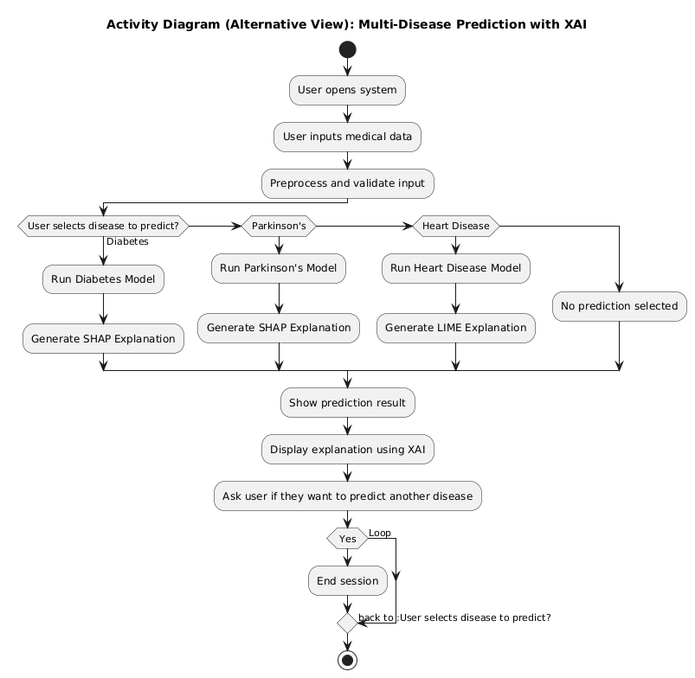
Activity diagram

Slide 24
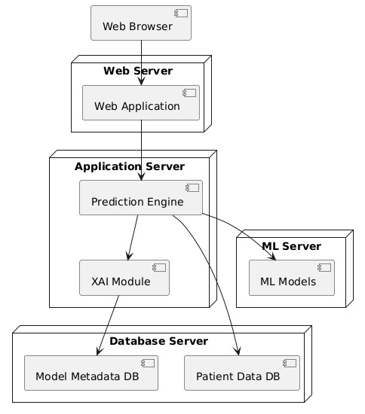
Deployment diagram

Slide 25
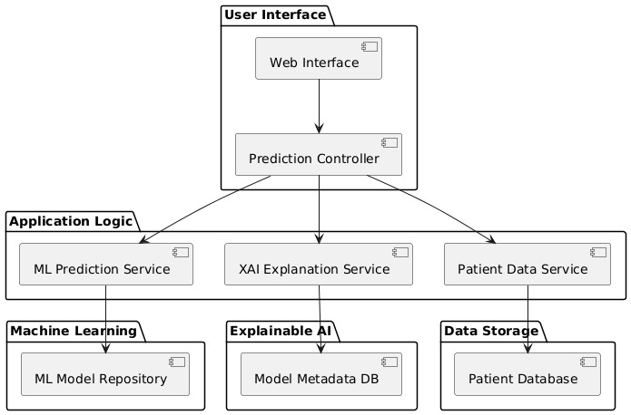
Component diagram

Slide 26
SAMPLE SOURCECODE import pickle import streamlit as st from streamlit_option_menu import option_menu # loading the saved models diabetes_model = pickle.load(open('C:/Users/siddhardhan/Desktop/Multiple Disease Prediction System/saved models/diabetes_model.sav', 'rb')) heart_disease_model = pickle.load(open('C:/Users/siddhardhan/Desktop/Multiple Disease Prediction System/saved models/heart_disease_model.sav','rb')) parkinsons_model = pickle.load(open('C:/Users/siddhardhan/Desktop/Multiple Disease Prediction System/saved models/parkinsons_model.sav', 'rb')) # sidebar for navigation with st.sidebar: selected = option_menu('Multiple Disease Prediction System', ['Diabetes Prediction', 'Heart Disease Prediction', 'Parkinsons Prediction'], icons=['activity','heart','person '], default_index=0) # Diabetes Prediction Page if (selected == 'Diabetes Prediction'): # page title st.title('Diabetes Prediction using ML') # getting the input data from the user col1, col2, col3 = st.columns(3) with col1: Pregnancies = st.text_input('Number of Pregnancies') with col2:

Slide 27
SkinThickness = st.text_input('Skin Thickness value')
with col2:
Insulin = st.text_input('Insulin Level')
with col3:
BMI = st.text_input('BMI value')
with col1:
DiabetesPedigreeFunction = st.text_input('Diabetes Pedigree Function value')
with col2:
Age = st.text_input('Age of the Person')
# code for Prediction
diab_diagnosis = '' # creating a button for
Prediction if
st.button('Diabetes Test
Result'):
diab_prediction = diabetes_model.predict([[Pregnancies, Glucose, BloodPressure, SkinThickness, Insulin, BMI, DiabetesPedigreeFunction, Age]])
if (diab_prediction[0] == 1):
diab_diagnosis = 'The person is
diabetic' else:
diab_diagnosis = 'The person is not diabetic' st.success(diab_diagnosis)
# Heart Disease Prediction Page
if (selected == 'Heart Disease Prediction'):

Slide 28
# page title st.title('Heart Disease Prediction using ML') col1, col2, col3 = st.columns(3) with col1: age = st.text_input('Age') with col2: sex = st.text_input('Sex') with col3: cp = st.text_input('Chest Pain types')with col1:
trestbps = st.text_input('Resting Blood Pressure')with col2:
chol = st.text_input('Serum Cholestoral in mg/dl')
with col3:
fbs = st.text_input('Fasting Blood Sugar > 120 mg/dl')
with col1:
restecg = st.text_input('Resting Electrocardiographic results')
with col2:
thalach = st.text_input('Maximum Heart Rate achieved')
with col3:
exang = st.text_input('Exercise Induced Angina')
with col1:
oldpeak = st.text_input('ST depression induced by exercise')
with col2:
slope = st.text_input('Slope of the peak exercise ST segment')
with col3:
ca = st.text_input('Major vessels colored by flourosopy')
with col1:
,ca,thal]])

Slide 29
oldpeak = st.text_input('ST depression induced by exercise') with col2: slope = st.text_input('Slope of the peak exercise ST segment') with col3: ca = st.text_input('Major vessels colored by flourosopy') with col1: thal = st.text_input('thal: 0 = normal; 1 = fixed defect; 2 = reversable defect') # code for Prediction heart_diagnosis = '' # creating a button for Prediction if st.button('Heart Disease Test Result'): heart_prediction = heart_disease_model.predict([[age, sex, cp, trestbps, chol, fbs, restecg,thalach,exang,oldpeak,slope,ca,thal]]) if (heart_prediction[0] == 1): heart_diagnosis = 'The person is having heart disease' else: heart_diagnosis = 'The person does not have any heart disease' st.success(heart_diagnosis) # Parkinson's Prediction Page if (selected == "Parkinsons Prediction"): # page title st.title("Parkinson's Disease Prediction using ML")

Slide 30
col1, col2, col3, col4, col5 = st.columns(5) with col1: fo = st.text_input('MDVP:Fo(Hz)') with col2: fhi = st.text_input('MDVP:Fhi(Hz)') with col3: flo = st.text_input('MDVP:Flo(Hz)') with col4: Jitter_percent = st.text_input('MDVP:Jitter(%)') with col5: Jitter_Abs = st.text_input('MDVP:Jitter(Abs)') with col1: RAP = st.text_input('MDVP:RAP') with col2: PPQ = st.text_input('MDVP:PPQ') with col3: DDP = st.text_input('Jitter:DDP') with col4: Shimmer = st.text_input('MDVP:Shimmer') with col5: Shimmer_dB = st.text_input('MDVP:Shimmer(dB)') with col1: APQ3 = st.text_input('Shimmer:APQ3') with col2: APQ5 = st.text_input('Shimmer:APQ5') with col3: APQ = st.text_input('MDVP:APQ') with col4:

Slide 31
with col5:
NHR = st.text_input('NHR')
with col1:
HNR = st.text_input('HNR')
with col2: RPDE = st.text_input('RPDE') with col3: DFA = st.text_input('DFA') with col4: spread1 = st.text_input('spread1') with col5: spread2 = st.text_input('spread2') with col1: D2 = st.text_input('D2') with col2: PPE = st.text_input('PPE')

Slide 32
# code for Prediction parkinsons_diagnosis = '' # creating a button for Prediction if st.button("Parkinson's Test Result"): parkinsons_prediction = parkinsons_model.predict([[fo, fhi, floJitter_percent,Jitter_Abs, RAP,PPQ,DDP,Shimmer,Shimmer_dB,APQ3,APQ5,APQ,DDA,NHR,HNR,RPDE,DFA,spr ead1,spread2,D2,PPE]]) if (parkinsons_prediction[0] == 1): parkinsons_diagnosis = "The person has Parkinson's disease" else: parkinsons_diagnosis = "The person does not have Parkinson's disease" st.success(parkinsons_diagnosis)

Slide 33
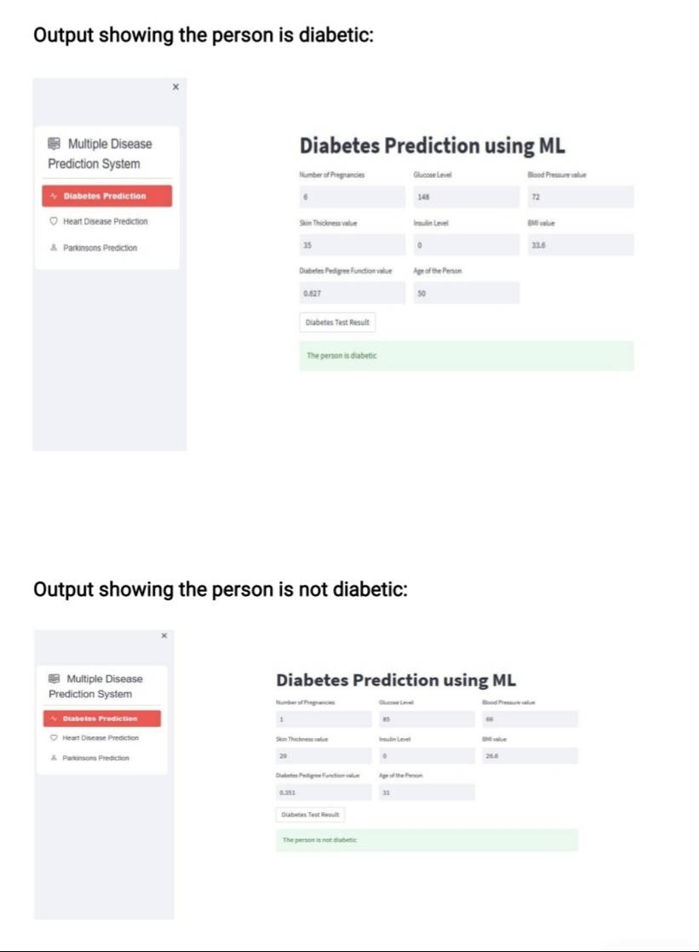

Slide 34
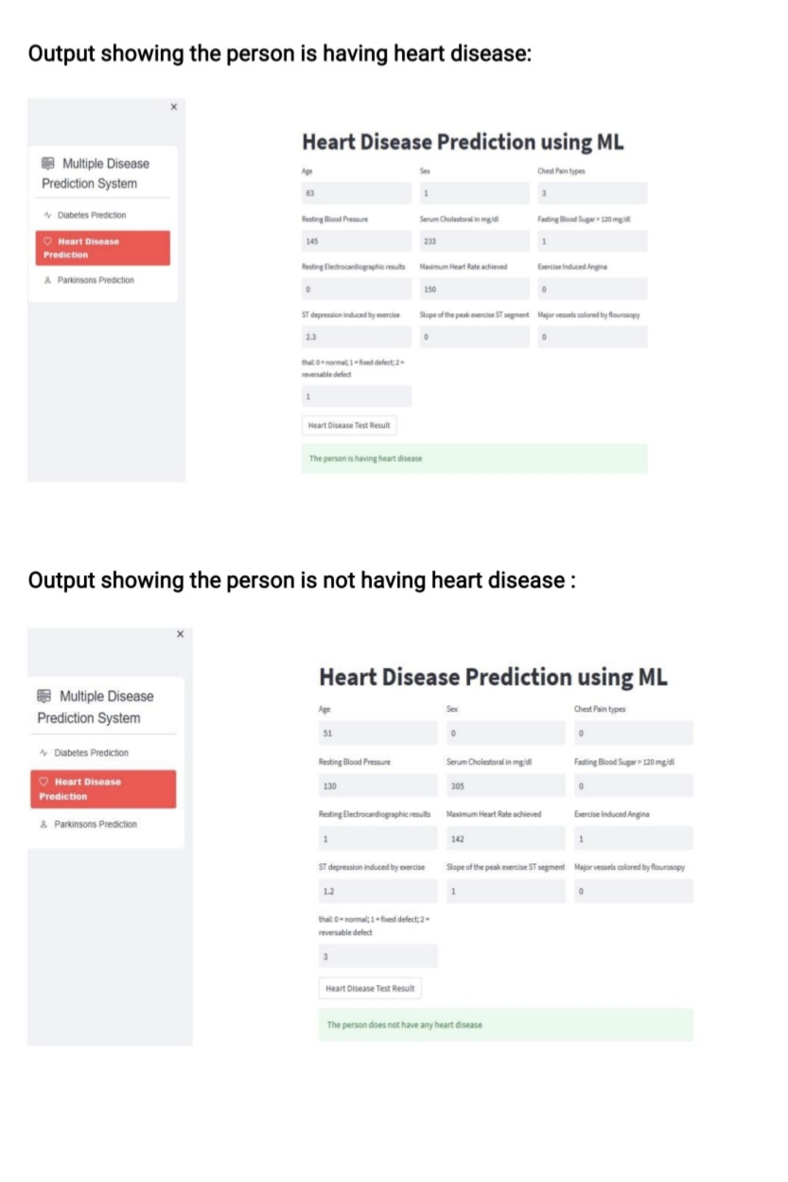

Slide 35
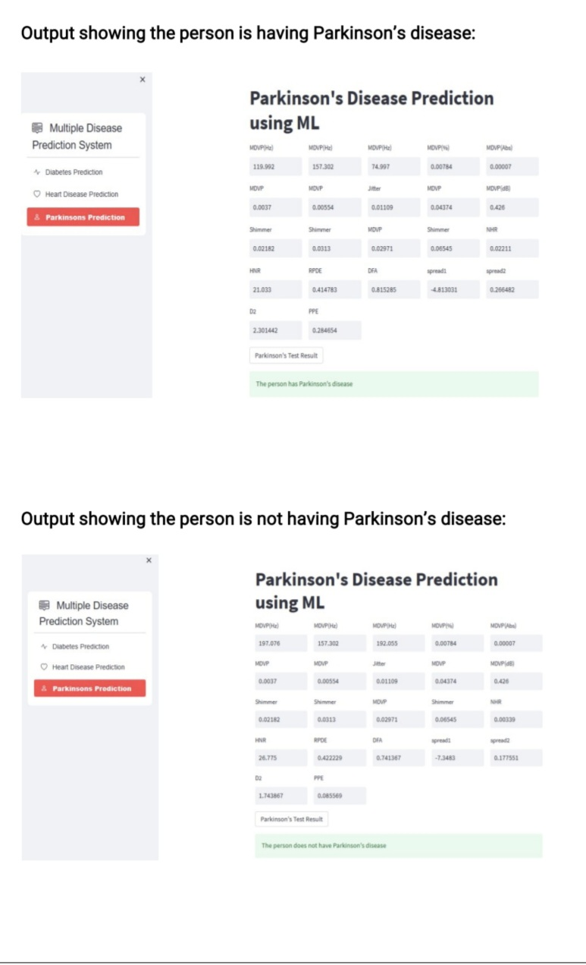

Slide 36
Conclusion
The Multiple Disease Prediction System uses Machine Learning for fast and accurate diagnosis of Diabetes, Heart Disease, and Parkinson’s Disease.
It integrates multiple predictions into a single model, ensuring scalability and real-time results via a web interface.
With high accuracy and AI-driven improvements, it enhances early diagnosis and healthcare efficiency.

