Slide 1
Shield
DEEPFAKE INVESTIGATION SYSTEM
Advanced AI-Powered Digital Forensics & Media Authenticity Verification Platform
EfficientNet-B3
Grad-CAM XAI
OpenCV
Flask REST API
ReportLab PDF
Digital Forensics | AI Research | Media Verification

Slide 2
THE PROBLEM
02
Deepfakes: A Growing Threat to Digital Trust
900%
96%
$25B+
3.8s
Increase in deepfake content online since 2019
Of deepfakes target individuals non-consensually
Projected financial fraud damage by 2027
Average time to generate a convincing deepfake
Key Challenges
Our Solution
• Hyper-realistic AI face-swaps that fool the human eye
• No reliable manual verification method at scale
• Criminal use in disinformation campaigns & identity fraud
• Evidence integrity compromised in legal proceedings
• Rapid evolution of generative AI (GANs, Diffusion Models)
An enterprise-grade AI forensic platform that automatically detects synthetic facial manipulation with: - Deep CNN (EfficientNet-B3) binary classification - Explainable AI heatmaps via Grad-CAM - Frame-level video forensics - Cryptographically-structured forensic reports - Real-time REST API integration

Slide 3
PROJECT OBJECTIVES
03
What We Set Out to Achieve
[Target]
Automated Detection
[Lens]
Explainable AI
[Film]
Video Forensics
Build an end-to-end pipeline that automatically identifies synthetic facial manipulation in uploaded images and videos without manual intervention.
Provide transparency into model decisions using Grad-CAM activation heatmaps that highlight the exact pixel regions triggering deepfake classification.
Implement temporal frame-by-frame analysis for video files, computing per-frame confidence and aggregate fake-ratio metrics.
[Doc]
Forensic Evidence
[Chart]
Analytics Platform
[API]
REST API
Auto-generate structured PDF investigation reports suitable for legal and evidentiary use, including confidence scores, heatmaps and risk assessments.
Provide a real-time interactive dashboard with historical case tracking, trend visualisations, and 1-click CSV export.
Expose a headless JSON REST API endpoint enabling seamless integration with third-party microservices and mobile applications.

Slide 4
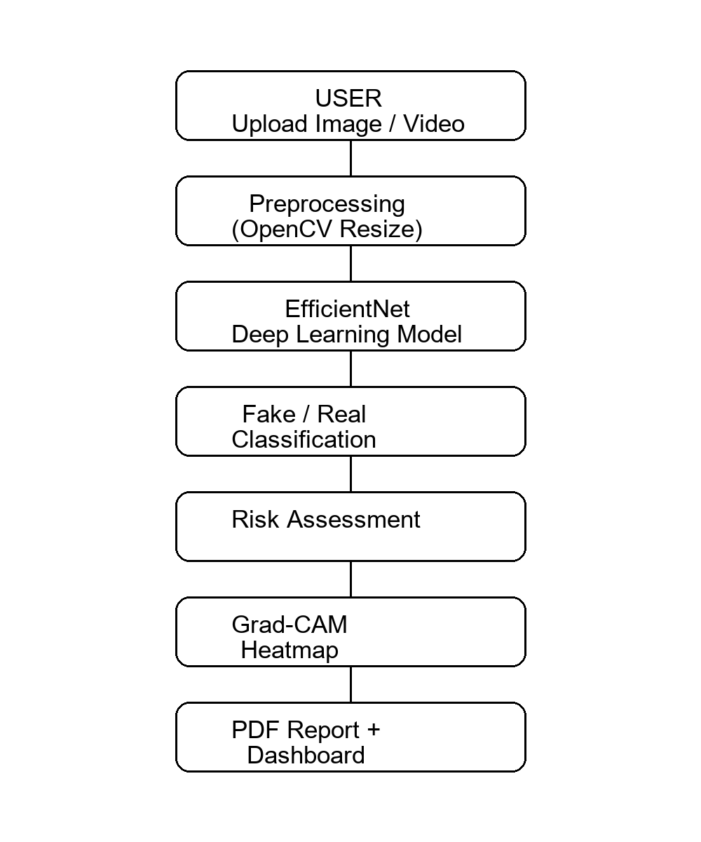
SYSTEM ARCHITECTURE
04
7-Stage Detection Pipeline
01
Input Validation & MIME Guard
Technology Stack
File type and size verification before processing.
>> Python 3.11+
Runtime
02
OpenCV Face Extraction
Haar Cascade face detection + proportional padding crop.
>> TensorFlow / Keras
Deep Learning
03
EfficientNet-B3 Inference
>> EfficientNet-B3
CNN Backbone
300x300 input -> deep CNN binary classification.
>> OpenCV 4
Computer Vision
04
Grad-CAM XAI Heatmap
>> Flask 3
Web Framework
Gradient-weighted activation maps on last conv layer.
>> SQLAlchemy / SQLite
Database ORM
05
Risk & Confidence Scoring
Tiered risk: Low -> Medium -> High -> Very High.
>> ReportLab
PDF Generation
06
SQLite Case Logging
>> Chart.js
Analytics UI
Persistent investigation history with SQLAlchemy ORM.
>> Docker
Containerization
07
PDF Report & Dashboard
>> Render.com
Cloud Deployment
ReportLab PDF + Chart.js real-time analytics.

Slide 5
DEEP LEARNING MODEL
05
EfficientNet-B3 CNN Architecture
Input Shape
Inference Pipeline
300 x 300 x 3 (RGB)
Architecture
01 Input Image
Raw JPEG/PNG upload
EfficientNet-B3 + Custom Head
02 Face Detection
Haar Cascade -> largest face ROI + 20% padding
Task
Binary Classification
03 Resize
cv2.resize -> 300x300 BGR->RGB conversion
Output
Sigmoid -> Fake / Real
04 Normalize
EfficientNet preprocess_input() -> float32
Preprocessing
05 Forward Pass
model.predict(batch) -> score in [0, 1]
EfficientNet preprocess_input()
Optimizer
06 Decision
score < 0.45 = Fake | > 0.55 = Real | else Uncertain
Adam + Binary Cross-Entropy
07 Risk Tier
Confidence -> Low / Medium / High / Very High
08 Grad-CAM
Gradient of class score wrt last conv layer activations

Slide 6
KEY FEATURES
06
Platform Capabilities at a Glance
[Eye]
Face Auto-Extraction
[Brain]
EfficientNet-B3 CNN
[Heatmap]
Grad-CAM Heatmaps
[Video]
Video Frame Forensics
Automatically isolates and centers facial regions using OpenCV Haar Cascades before inference, eliminating background noise.
State-of-the-art binary classification neural network pre-trained on ImageNet, fine-tuned on deepfake forensic datasets.
Generates transparent activation heatmaps highlighting exact pixel regions that triggered the deepfake classification.
Samples sequential frames, computes per-frame fake probability, and aggregates confidence ratios with temporal metrics.
[PDF]
Forensic PDF Reports
[Chart]
Analytics Dashboard
[CSV]
CSV Data Export
[API]
Headless REST API
Compiles case metadata, media snapshots, Grad-CAM attention maps, and breakdown metrics into printable evidence documents.
Interactive Chart.js donut and bar visualizations tracking historical detection distributions and KPI counters in real-time.
1-Click download of complete historical case registry in standard RFC 4180 CSV format for downstream analysis.
POST /api/predict endpoint returns structured JSON results, enabling integration with mobile apps and microservices.

Slide 7
MODEL PERFORMANCE
07
Empirical Evaluation & Benchmark Metrics
Evaluated on FaceForensics++ & Celeb-DF benchmarks
69.86%
74.49%
65.77%
0.684
0.584
Overall Accuracy
Deepfake Recall
Authentic Precision
Macro F1-Score
Validation Loss
Performance Breakdown
Classification Report
Overall Accuracy
69.86%
Class
Precision
Recall
F1
REAL
65.77%
63.28%
0.645
Deepfake Recall
74.49%
FAKE
72.56%
74.49%
0.735
Authentic Precision
65.77%
Macro Avg
69.17%
68.88%
0.690
Weighted
69.36%
69.86%
0.693
F1-Score (x100)
68.4%
Dataset: FaceForensics++ / Celeb-DF | Version: EfficientNet-B3 v3

Slide 8
WEB INTERFACE & REST API
08
Forensic Web Dashboard & Programmatic Integration
Web Routes
REST API -- POST /api/predict
GET
/
Drag-and-Drop Forensic Ingestion Studio
Example JSON Response (Image):
POST
/predict
Processes image/video -> verdict + heatmap
{ "success": true, "media_type": "Image", "filename": "suspect_face.jpg", "prediction": "Fake", "confidence": 89.64, "fake_probability": 89.64, "real_probability": 10.36, "risk": "Very High", "heatmap_url": "/uploads/hm.jpg", "report_download_url": "/download/rpt.pdf" }
GET
/dashboard
KPI counters & Chart.js analytics
GET
/history
Searchable historical case registry
GET
/export_csv
1-Click CSV case history download
GET
/architecture
Interactive pipeline architecture view
GET
/results
Model benchmarks & confusion matrix
Example JSON Response (Video):
GET
/about
Mission overview & tech specifications
{ "prediction": "Fake", "confidence": 74.49, "fake_frames": 26, "real_frames": 9, "fake_percentage": 74.29, "risk": "High", "report_download_url": "/download/report_vid.pdf" }
GET
/health
System heartbeat health check

Slide 9
DEPLOYMENT & INFRASTRUCTURE
09
Containerised & Cloud-Ready Deployment
Windows -- 1-Click
Linux / macOS
Docker Container
$ run.bat
$ start.sh
$ docker-compose up
Double-click to automatically verify Python dependencies, launch Flask server, and open browser.
Bash shell script equivalent for Unix-based systems. python app.py -> http://127.0.0.1:5000
Full containerised stack via Docker Compose. Isolated environment with automatic dependency management.
Dockerfile Highlights
render.yaml (Cloud Deployment)
FROM python:3.11-slim WORKDIR /app COPY requirements.txt . RUN pip install --no-cache-dir -r requirements.txt COPY . . EXPOSE 5000 CMD ["python", "app.py"]
• Platform: Render.com (render.yaml configured)
• Auto-builds from Git push -> zero-downtime deploy
• Gunicorn WSGI production server (not Flask dev)
• Environment: PYTHON_VERSION=3.11
• Persistent disk mount for SQLite case database
• Health check endpoint: GET /health

Slide 10
FUTURE ROADMAP
10
Planned Enhancements & Research Directions
Phase 1 Near-Term
Phase 2 Mid-Term
Phase 3 Long-Term
EfficientNet-V2 / ViT transformer backbone upgrade
Federated learning across distributed investigation nodes
Cross-modal manipulation detection (text, audio, video)
Multi-face detection in group photos & crowd scenes
Blockchain evidence timestamping (Ethereum / IPFS)
Zero-shot generalization to unseen GAN architectures
Audio-visual deepfake detection (voice + face sync)
Real-time video stream analysis (RTSP / WebRTC)
Certified adversarial robustness against evasion attacks
Batch upload API for bulk forensic processing
Mobile companion app (React Native iOS + Android)
Integration with law enforcement forensic frameworks
Target: >85% accuracy | >90% deepfake recall | <5% false-positive rate on production datasets

Slide 11
[ DIS ]
Thank You
Deepfake Investigation System -- AI-Powered Digital Forensics Platform
>> EfficientNet-B3 deep CNN achieving 69.86% accuracy & 74.49% deepfake recall
>> Explainable AI via Grad-CAM activation heatmaps for transparent verdicts
>> Frame-by-frame video forensics with temporal anomaly metrics
>> Auto-generated forensic PDF investigation reports
>> Real-time analytics dashboard & REST API integration
>> Containerised with Docker, deployable to Render.com cloud
Built with TensorFlow | OpenCV | Flask | ReportLab | SQLAlchemy | Chart.js | Docker

