Slide 1
EBay website
Under Guidance of Mrs. Vaishali Sonawane Mam.
BY YELISETTI JAYANTH SRIHARI

Slide 2
Introduction :
eBay is a leading global e-commerce marketplace founded in 1995, enabling individuals and businesses to buy and sell a wide variety of products. With auction-style and fixed-price options, secure payments, and worldwide reach, it connects millions of buyers and sellers every day.

Slide 3
Responsibilities
WE HAVE TO WRITE TEST PLAN FIRST
WE HAVE TO WRITE TEST CASES
AUTOMATE TEST CASES
Execute all the test cases.
Create defect report.

Slide 4
Overview
What is eBay?
eBay is a global e-commerce platform where users can buy and sell a wide variety of products. It offers features like product search, categories, add to cart, profile management, secure payments, and language change options, making shopping easy and accessible for people worldwide..
eBay testing ensures core features like login, search, cart, categories and payments work smoothly.

Slide 5
Modules
Module 1 : Login page
Checked all the functionalities on login page which included personal info as email
and password.
Example: valid credentials(login)
Module 2 : Search bar
The search bar on eBay is designed to help users quickly find items they’re looking for. By typing in keywords or product names, it shows relevant results and lets users refine them with filters.
Example: shoes for men (It shows all the related products).

Slide 6
Module 3 : Add to cart
When a user likes a product, they can add it to the cart to keep it aside while continuing shopping.
Example: shoes (add to cart)
Module 4 : Delete from cart
If the user changes their mind, they can remove the product from the cart with a single click.
Example: shoes (delete from cart)
Module 5 : Profile page
The profile module allows users to manage their personal details such as name, email, password, and shipping address.
example: username (jayanth123 to jayanth)
Module 6 : Categories
The categories module helps users browse products by sections like electronics, fashion, home, and collectibles, making it easier to find items.
EXAMPLE: electronics (It shows all the electronics items)

Slide 7
Module 7 : Change language
The change language option lets users view the website in their preferred language, making it easier for them to browse and shop.
example: Japanese to English (We can change language)

Slide 8
Defects
While running a testcase at certain point filters field is not working as it is expected which is nothing but a defect, so I have created a Defect report on those defects.

Slide 9
Defect identifier :- B_001
Defect summary :- while I am searching for fitness, running and yoga equipment it is showing watch
Ø Test Id :- TC_001
Ø Test case name :- TC_invalid_product
Ø Module name :- categories
Ø Reproducible :-
Ø Severity :- medium
Ø Priority :- medium
Ø Raised by :- jayanth srihari
Ø Assigned to :- developer Team lead
Ø Date of assignment :- 18/08/2025
Ø Status :- pending
Ø Snap shots :-
Ø Fixed by :- developer
Ø Date of fixing :-

Slide 10
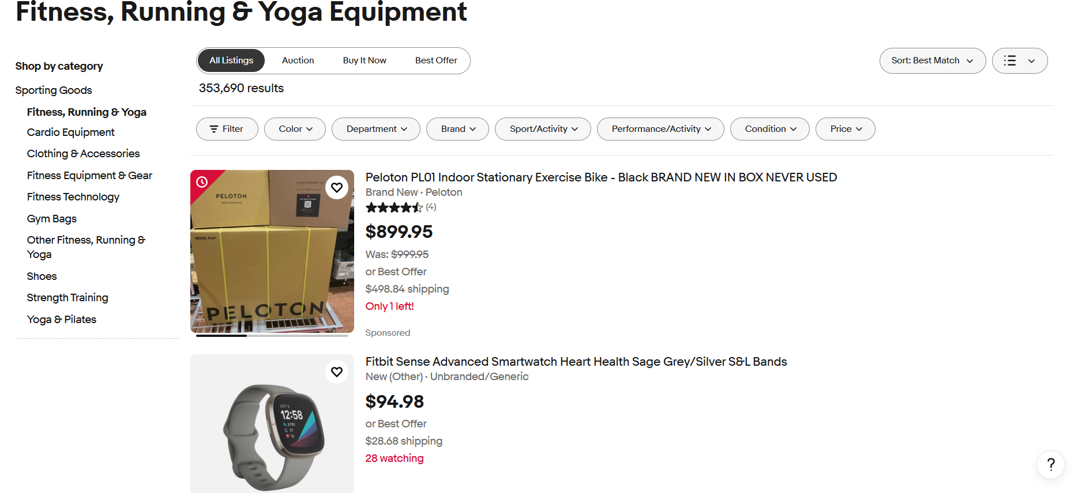

Slide 11
Challenges
While testing eBay website which contains huge data i faced some challenges about:
There is comes difference in writing a test case and while running it.
as eBay is one of the working website so this website consists of less defects
While executing automation test cases , it is asking for verification for every time when we try to execute

Slide 12
Experience
With the help of this project I have learnt automation test cases.
Help to find out bugs.
Real time experience of testng framework
Manual testing needs strong observation and in that testers needs to apply all possibilities in test cases.

Slide 13
Thank You!!!
Vaishali Mam For Guiding Us through out the Project.

