Slide 1
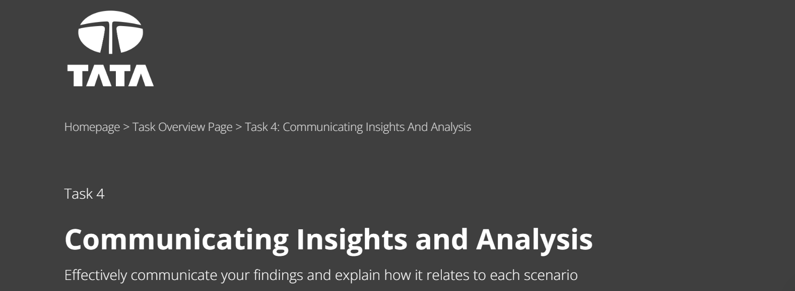

Slide 2
Agenda
Data Exploration
Data Cleaning
Data Visualization
Conclusion

Slide 3
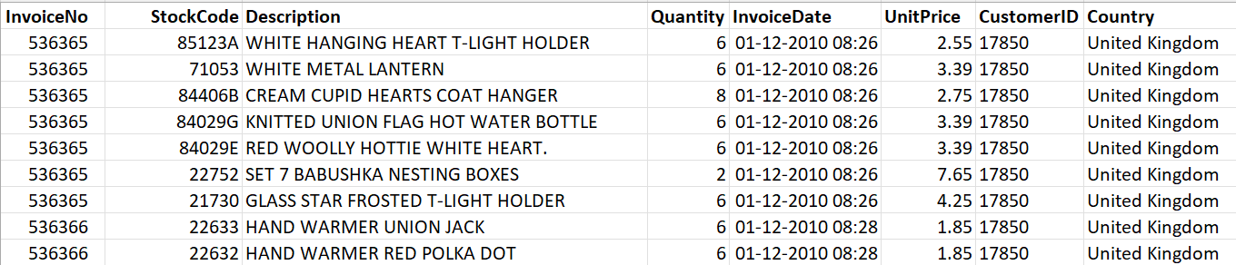
Data Exploration
Initially Data: we have a dataset of 8 columns and 5,41,909 records.
Data Cleaning need to done on the initial data based on 2 conditions :
Create a check that the quantity should not be below 1 unit
Create a check that the Unit price should not be below $0

Slide 4
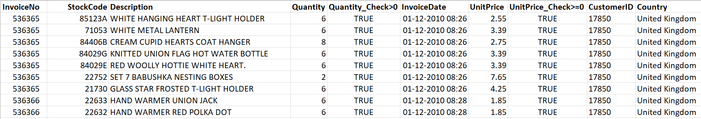
Data Cleaning
As Continuation to the last slide created 2 fields: Quantity_Check and UnitPrice_Check.
After filtering the conditions that satisfies both the clause, we are now ready with the cleaned data of 5,31,283 records which will be used for Data Analysis and Visualization.

Slide 5
Data Visualization
Question 1
The CEO of the retail store is interested to view the time series of the revenue data for the year 2011 only. He would like to view granular data by looking into revenue for each month. The CEO is interested in viewing the seasonal trends and wants to dig deeper into why these trends occur. This analysis will be helpful for the CEO to forecast for the next year.

Slide 6
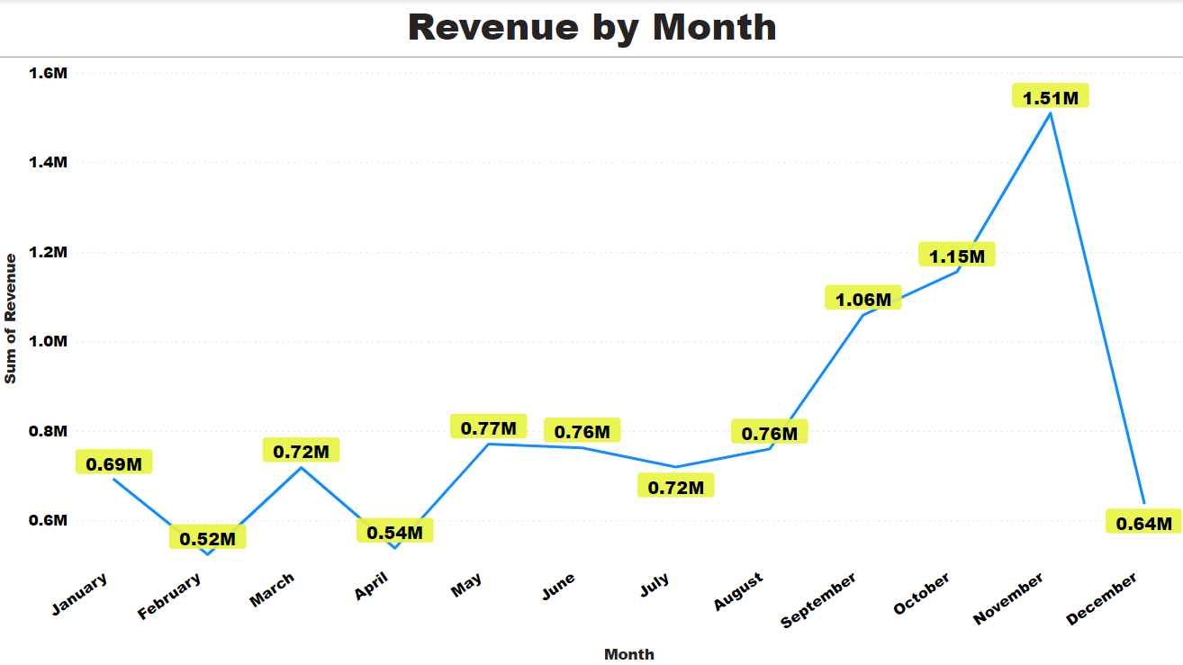
Data Visualization

Slide 7
Data Visualization
Question 2
The CMO is interested in viewing the top 10 countries which are generating the highest revenue. Additionally, the CMO is also interested in viewing the quantity sold along with the revenue generated. The CMO does not want to have the United Kingdom in this visual.

Slide 8
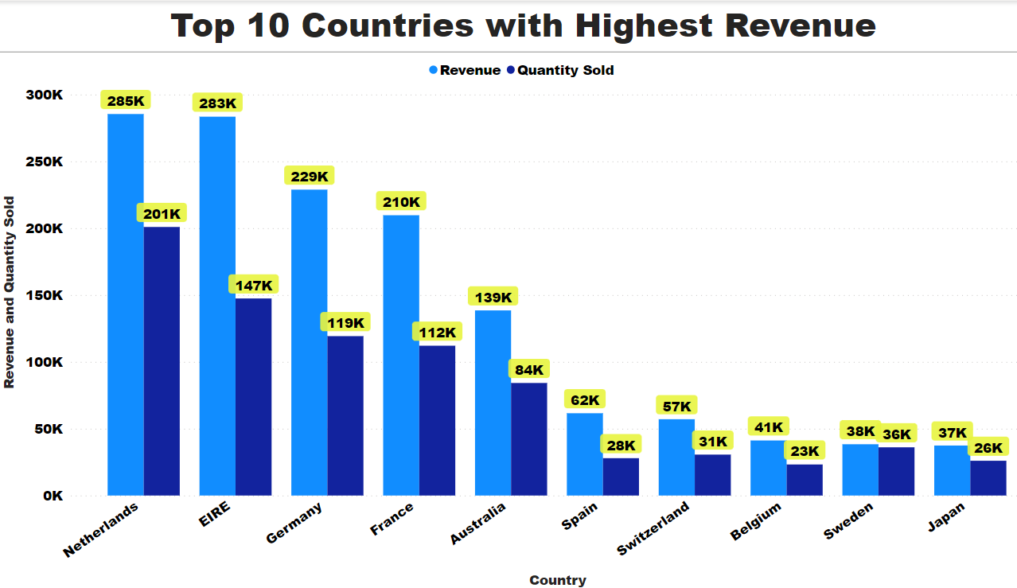
Data Visualization

Slide 9
Data Visualization
Question 3
The CMO of the online retail store wants to view the information on the top 10 customers by revenue. He is interested in a visual that shows the greatest revenue generating customer at the start and gradually declines to the lower revenue generating customers. The CMO wants to target the higher revenue generating customers and ensure that they remain satisfied with their products.

Slide 10
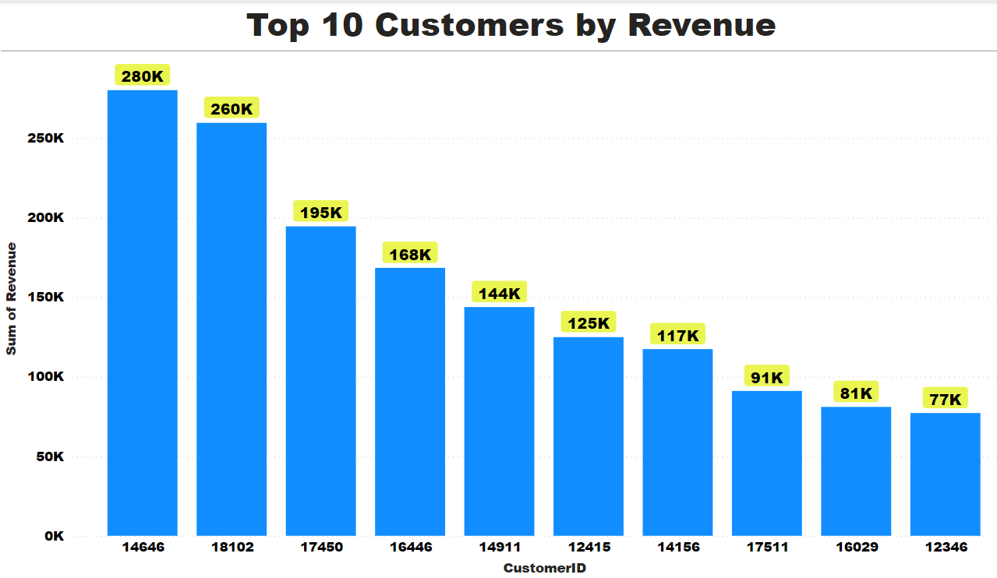
Data Visualization

Slide 11
Data Visualization
Question 4
The CEO is looking to gain insights on the demand for their products. He wants to look at all countries and see which regions have the greatest demand for their products. Once the CEO gets an idea of the regions that have high demand, he will initiate an expansion strategy which will allow the company to target these areas and generate more business from these regions. He wants to view the entire data on a single view without the need to scroll or hover over the data points to identify the demand. There is no need to show data for the United Kingdom as the CEO is more interested in viewing the countries that have expansion opportunities.

Slide 12
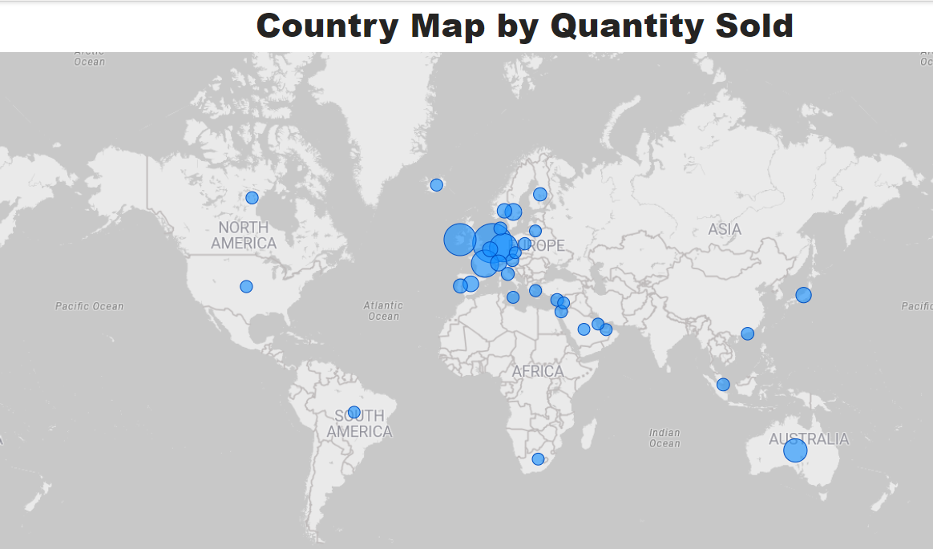
Data Visualization

Slide 13
Conclusion
Below mentioned points are the conclusion identified as a part of this analysis:
In the Year 2011, November month has generated most of the Revenue 15,09,496. The least revenue generated months are February and April with revenue of 5,23,631 and 5,37,808.
Excluding the Country United Kingdom, Netherlands and EIRE are the countries who have generated the highest revenue.
CustomerID 14646 has generated the maximum revenue of 2,80,206.

Slide 14
Thank You

