Slide 1
Deep Visual Semantic Alignments for Generating Image Description Li Fei-Fei Andrej Karpathy
Jayant Kashyap
Group-5
SCU ID: 1433401

Slide 2
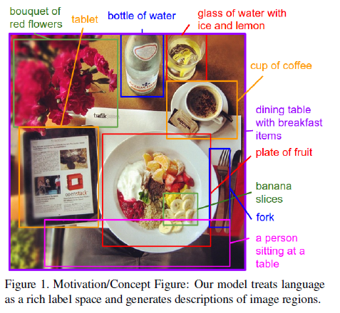
Introduction
This paper presents a model that generates natural language descriptions of images and their regions
The Alignment model is based on a combination of
Convolutional Neural Network over image regions,
Bidirectional Recursive Neural Network over sentences and
Structure Objective that aligns the two modalities through a multimodal embedding
And then a Multimodal RNN architecture that uses these alignments to learn to generate description of image regions.

Slide 3
Introduction (cont.)
The majority of previous attempts in visual recognition has focused on labeling images with fixed set of visual categories
These models were vastly restrictive because of their closed vocabulary when compared to enormous amount of rich descriptions that human can compose
The design goal of this model is to be rich enough to simultaneously reason about contents of images and their representation in the domain of natural language
Also that, the model should be free of specific hard-coded templates, rules or categories

Slide 4
Artificial Neural Network
Neural Network: The connectionist system computational model that imitates the biological principles of human brain and nervous system
Neural Networks has almost no resemblance to the human brain
Connectionist model made of nodes and edges assigned with some weights, signifying the importance of respective nodes on the previous layers
There are various architectures of NN including but not limited to Simple Perceptron Model, Single layer perceptron, MLP, Boltzmann Machines, Deep Neural Networks (Fully Connected NN, CNN, RNN)
Neural Networks differentiates from other traditional ML algorithms in the sense that it does not have to explicitly provided with the input features; this gives very high flexibility to model most of the complex non-linear models

Slide 5
Deep Neural Network
The MLP model that contains multiple hidden layers of computation are termed as DNN; however the definition is blurred over the number of layers
Popular ones are
Fully Connected
Convolutional neural networks
Recurrent neural networks, etc.

Slide 6
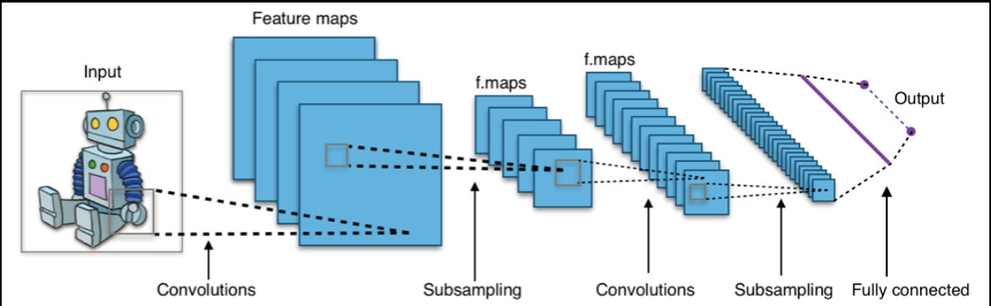
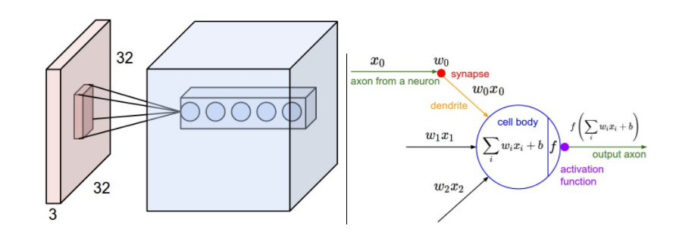
Convolutional Neural Networks
It is a type of representational NN
It borrows the concept of Convolution from digital image processing
Used primarily for image models but can also be extended to temporal models with some model tuning.
In this paper Region CNN is used to detect objects from the image
The CNN is pretrained on ImageNet and fine-tuned on 200 classes of ImageNet Detection Challenge

Slide 7
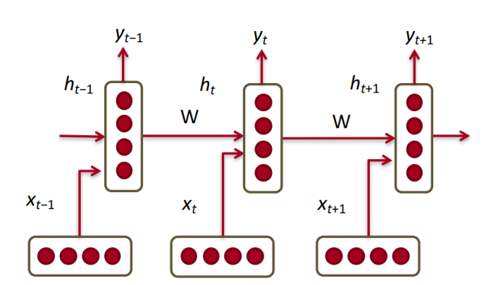
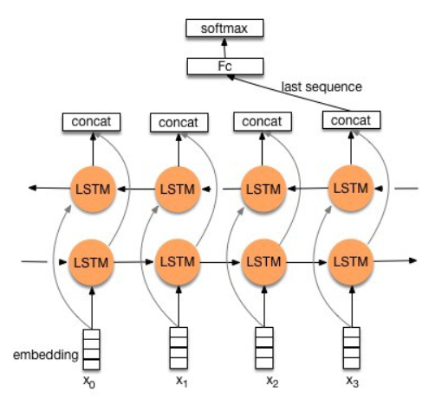
Recurrent Neural Network
Yet another type of DNN to model and train Temporal datasets
The state of the temporal data is also influenced by previous states (variation in time)
In this paper Bidirectional RNN to model word representation

Slide 8
How is it connected to NLP?
The paper aims at generation natural language representation of the image description
RNN is the language model here
Is using LSTM architecture to ensure the generated sentence maintains long term dependency

Slide 9
Related Work
Various pioneering attempts have been made in describing image with sentences
Previous approaches mostly focused on matching pre-trained image templates and define some formal rules to describe images
Some attempted multimodal correspondence between words and images to annotate segments of images
This paper is most closely related to previous works where images and sentences are decomposed into fragments and inferred their inter-modal alignment using a ranking objective

Slide 10
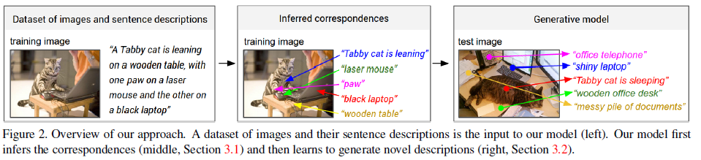
Model
Input:
Set of images
Their corresponding image description
Firstly, a model that aligns sentence snippets to the visual regions that they describe through multimodal embedding
Finally, used these correspondences as training data for a second, multimodal RNN that learns to generate the snippets

Slide 11

Methodology
The sentence descriptions make frequent references to objects and their attributes.
That’s why Region CNN is used
Used top 19 detected locations in addition to the whole image and compute representation based on pixel I_{b}
where CNN(I_{b}) transforms the pixels inside bounding box into 4096-dimensional activations of the fully connected layer
CNN parameter contains 60 million parameters
Matrix W has h x 4096 dimensions (h is the size of multimodal embedding space)
Every image is thus represented as a set of h-dimensional vectors {v_{i}|i = 1,2,…n}

Slide 12
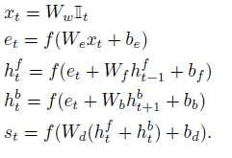
Methodology (cont.)
Bidirectional RNN is used to compute word representation (ensures that network has both forward and backward information about the sequence at every time step)
The BRNN takes a sequence of N words and transforms each one into an h-dimensional vector.
Using t = 1…N to denote the position of a word in a sentence, the precise form of BRNN is as follows:

Slide 13

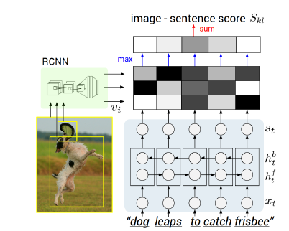
Methodology (cont.)
Typical size of hidden representation in the experiments ranges from 300-600 dimensions
Activation function used here is ReLU (Rectified Linear Unit)
Finally image sentence score is generated for the alignment which is given as
where model interprets the dot product between i-th region and t-th word
g_{k} – image fragments
g_{l} – sentence fragments

Slide 14
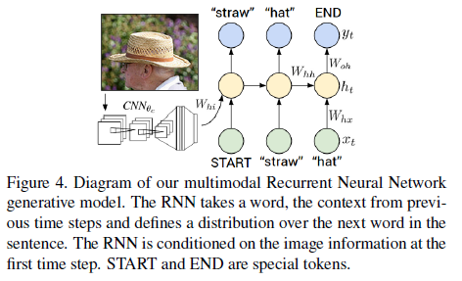

Methodology (cont.)
Finally, multimodal RNN is used to generate the image descriptions
During training the Multimodal RNN takes the image pixels I and the sequence of input vectors (x₁,…, x_{T})
It then computes the hidden sequence (h₁,…,h_{t}) and sequence of outputs (y₁,…,y_{t}) by iterating the following recurrence relation for
t = 1 to T

Slide 15
Dataset
Flickr8K (8000 images)
Flickr30K (31000 images)
MSCOCO (123000 images)
Each is annotated with 5 sentences using Amazon Mechanical Turk

Slide 16
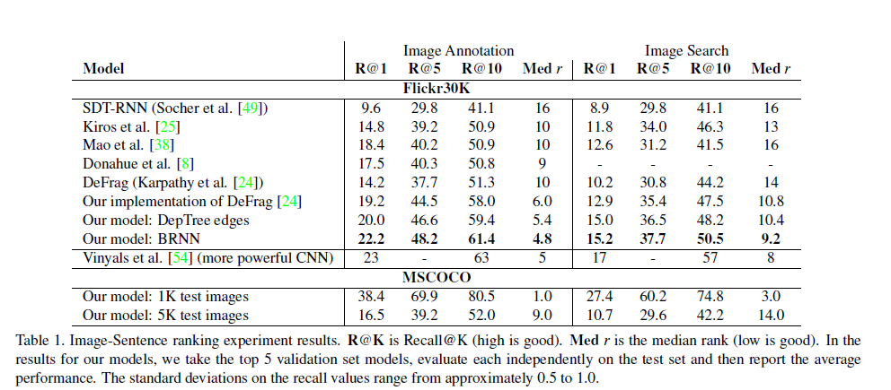
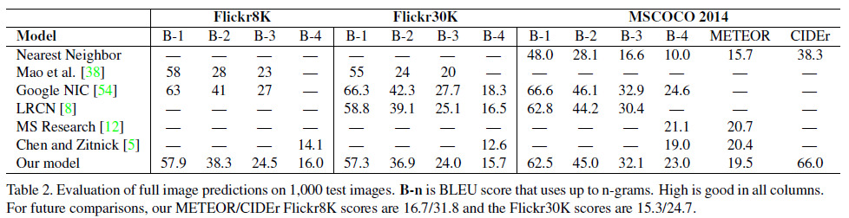
Outcome

Slide 17
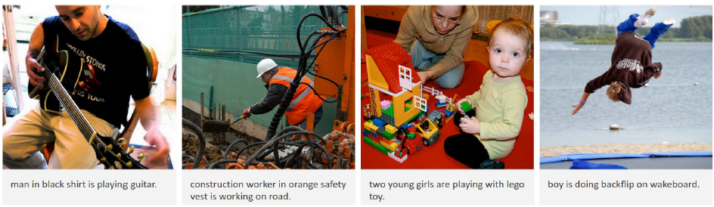
Outcome

Slide 18
Conclusions
This paper introduced a model that generates natural language description of image regions based on weak labels in form of a dataset of images and sentences
This approach features novel ranking model that aligned parts of visual and language modalities through a common multimodal embedding
And finally a multimodal RNN architecture that generates descriptions of visual data

Slide 19
Thank You

