Slide 1
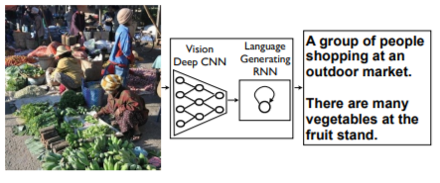
A Neural Network Approach to Image Description Generation
Team 5
Sparsh Grag
Prakhar Maheshwari
Jayant Kashyap

Slide 2
What is the problem?
A image contains a lots of information regarding the elements in the image and the surroundings of the elements
A description must capture the objects contained in the image as well as the relations among the objects
To describe an image a model is needed that can not only detect the objects in the image, but is also able to generate a natural language description of the image
A language model is needed in addition to virtual understanding

Slide 3

How is this Project related to class?
In this project we are using Recurrent Neural Network as the language model
The objective of this project to maximize the log-likelihood of correct textual description in natural language given the image

Slide 4
Our Solution
We would like to present in this work a single joint model that takes an image I as input, and is trained to maximize the likelihood p(S|I) of producing a target sequence of words S = {S₁, S₂,…} where each word S_{t} comes from a given dictionary, that describes the image adequately.
In this proposed model, we are using CNN as image encoder that produce rich representation of the input image by embedding into fixed length vector which in turn used by RNN decoder that generates the sentence
Flow of our solution is as follows:
We present an end-to-end system for the problem
We use state-of-the art Neural Networks for vision and language models which is fully trainable using Stochastic Gradient Descent
Finally we use the trained model for inference over images

Slide 5
Limitations of other Approaches
Some approaches that rely on hard-coded visual concepts and sentence templates are not robust under different visual conditions
Other approaches address the problem of ranking descriptions for a given image and based on the idea of co-embedding the image and text in the same vector space
For a query image this model returns the image which lie close to the image in the embedding space
These models avoid addressing the problem of evaluating how good a generated description is
Recent Neural Network models that use the CNN for image classification use different language models that can generate full sentence descriptions but with fixed window context

Slide 6
Why this approach is better?
In this project we use Convolutional Neural Network for image classification and Recurrent neural Network for sequence generation
We combine the deep CNN and RNN to create single network that generates the descriptions of images
The model is inspired by recent successes of sequence generation in machine translation with exception that instead of starting with sentence we provide an image processed by CNN
Also that we are using LSTM core as a non-linear function in RNN model to deal with vanishing gradient and exploding gradient problems

Slide 7
Hypothesis
We are proposing through this project, to build a architecture which uses multimodal Recurrent neural network that generates descriptions of the visual data.
Positive Hypothesis: The model will generate the correct natural language description in English of the semantic knowledge given in image
Negative Hypothesis: The model will generate the natural language description that is not relevant to the semantic knowledge and labels of the image.

Slide 8

Methodology
Dataset
We will be training our model on Flickr8k and Flickr30K
These datasets can be obtained by the UIUC, Dept. of Computer Science for non-commercial research and educational purpose
Algorithm design
The objective of the proposed project is to directly maximize the probability of the correct description given the image by using the following formulation:
where theta are the parameters of our model, I is an image, and S is correct transcription

Slide 9
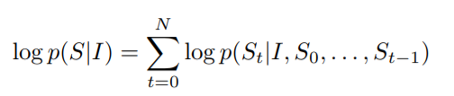
Methodology (cont.)
It is common to apply the chain rule to model the joint probability over S₀,…,S_{N} where N is the length of any particular example:
At training time, (S,I) is a training example pair, and we optimize the sum of the log probabilities over the whole training set using Stochastic Gradient Descent
We are modeling p(S_{t}|I, S₀,…,S_{t-1}) with a Recurrent Neural Network
Here the variable number of words up to t-1 is expressed by a fixed length hidden state h_{t}
This state is updated after seeing new input x_{t} by using a non-linear function f

Slide 10

Methodology (cont.)
We are modeling p(S_{t}|I, S₀,…,S_{t-1}) with a Recurrent Neural Network
Here the variable number of words up to t-1 is expressed by a fixed length hidden state h_{t}
This state is updated after seeing new input x_{t} by using a non-linear function f
Here LSTM is used as the non-linear function
For the image representation we use Inception V3 (GoogLeNet) which has already been trained on the ImageNet dataset
The LSTM model is trained to predict each word of the sentence after it has seen the image and all the preceding words defined by p(S_{t}|I, S₀,…,S_{t-1})

Slide 11
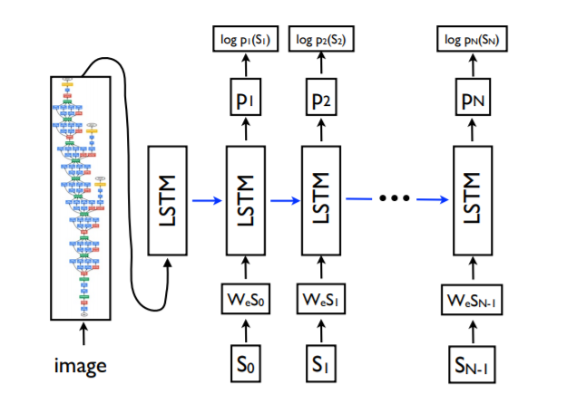
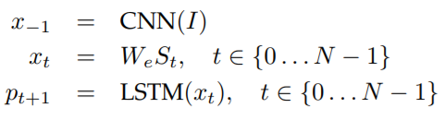
Methodology (cont.)
A copy of the LSTM memory is created for the image and each sentence word all the LSTMs share same parameters
Output m_{t-1} of the LSTM at time t-1 is fed to LSTM at time t (thus all the recurrent connections are transformed to feed-forward connections)
A true sentence S = {S₀,…,S_{N-1}} describing the image I is returned by following sequence of operations:

Slide 12

Methodology (cont.)
Loss as the sum of the negative log likelihood of the correct word at each step, is given as
Language: Python3
Libraries:
Bazel
TensorFlow 1.5
NumPy
NLTK3.0
We would be using AWS cloud infrastructure to train our model over the Nvidia GPU

Slide 13
Methodology (cont.)
For generating the output (inference) we would be using Beam Search
The beam size for the Beam Search approach is 20
Train-test-validation:
Flickr8K (8000): Train – 6000; Test – 1000; Validation – 1000
Flickr30K (31000): Train – 29000; Test – 1000; Validation – 1000
We would be using CIDeR (Consensus Based Image Description Evaluation) for evaluation metric

Slide 14
LSTM
To address the challenge of vanishing and exploding gradient, a particular form of recurrent nets was introduced, called the Long Short-Term Memory
The core of the LSTM model is a memory cell c encoding knowledge at every time step of what inputs have been observed up to this step
The behavior of the cell is controlled by “gates”
In particular three gates are being used:
forget gate (f) : whether to forget the current cell value
input gate (i) : if it should read its input
output gate (o) : whether to output new cell value

Slide 15
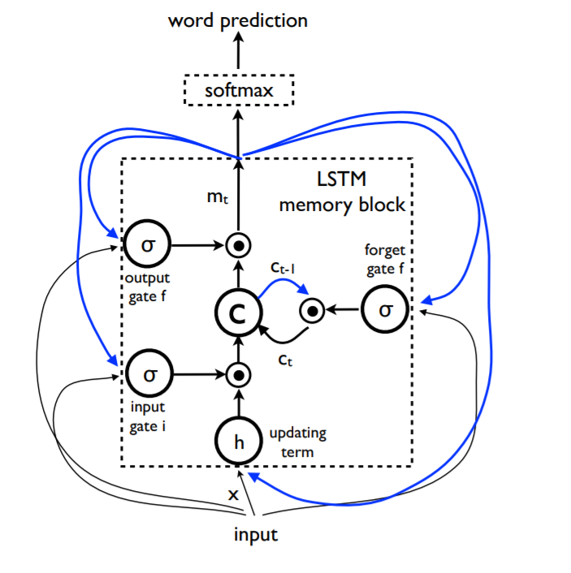
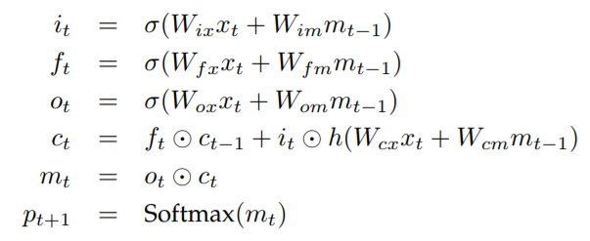
LSTM (cont.)
Following are the definitions of the gates and cell update and output values:

Slide 16
Bibliography
Karpathy, A. and Fei-Fei, L., 2015. Deep visual-semantic alignments for generating image descriptions. In Proceedings of the IEEE conference on computer vision and pattern recognition (pp. 3128-3137).
Vinyals, O., Toshev, A., Bengio, S. and Erhan, D., 2015, June. Show and tell: A neural image caption generator. In Computer Vision and Pattern Recognition (CVPR), 2015 IEEE Conference on (pp. 3156-3164). IEEE.
You, Q., Jin, H., Wang, Z., Fang, C. and Luo, J., 2016. Image captioning with semantic attention. In Proceedings of the IEEE Conference on Computer Vision and Pattern Recognition (pp. 4651-4659).
Pan, J.Y., Yang, H.J., Duygulu, P. and Faloutsos, C., 2004, June. Automatic image captioning. In Multimedia and Expo, 2004. ICME'04. 2004 IEEE International Conference on (Vol. 3, pp. 1987-1990). IEEE.
Meng C, Wang Y, Zhang S. Image-Question-Linguistic Co-Attention for Visual Question Answering
Wang, C., Yang, H., Bartz, C. and Meinel, C., 2016, October. Image captioning with deep bidirectional LSTMs. In Proceedings of the 2016 ACM on Multimedia Conference (pp. 988-997). ACM.

Slide 17
Thank You

