Slide 1
STOCKTRADING · STRATEGY 2
Intraday Index Options
VWAP Pullback + Composite Bias + OI Confirmation
How a single signal is born from 5 gates, 10 confidence factors, and one LLM check.
AT A GLANCE
5
2
10
≥55
3:15
entry gates
trade windows
confidence factors
fire threshold
force-close (IST)

Slide 2
THE BIG PICTURE
What Strategy 2 actually does
Strategy 2 buys index options when price returns to its VWAP in the direction of the established trend.
VWAP is the day's volume-weighted average price — the level around which most of the day's money has changed hands. Institutions defend it. In a trending day, price keeps drifting away from VWAP and then snapping back to it.
Each pullback to VWAP is a low-risk re-entry into the trend. We don't predict the bounce — we wait for a reversal candle, healthy (below-average) pullback volume, and a 10-factor confidence score above 55 before a single signal fires.
Five layers of confirmation must all pass. There is exactly ONE core setup — VWAP pullback — applied to NIFTY, BANKNIFTY, FINNIFTY, SENSEX, and MIDCPNIFTY. CE if pulling back from above VWAP, PE if rallying back from below.
Composite intraday bias
1
Live 6-factor score. STRONG opposing bias vetoes the trade.
2
VWAP proximity
Price must be within 0.15% of VWAP to qualify as a pullback.
3
Reversal candle
Bullish or bearish engulfing / pin / doji on the 5m chart.
4
Healthy volume
Pullback volume must be ≤ 1.2× the 20-period average.
5
Confidence ≥ 55 / 100
10-factor weighted composite. Below threshold = signal suppressed.
Strategy 2 · VWAP Pullback

Slide 3
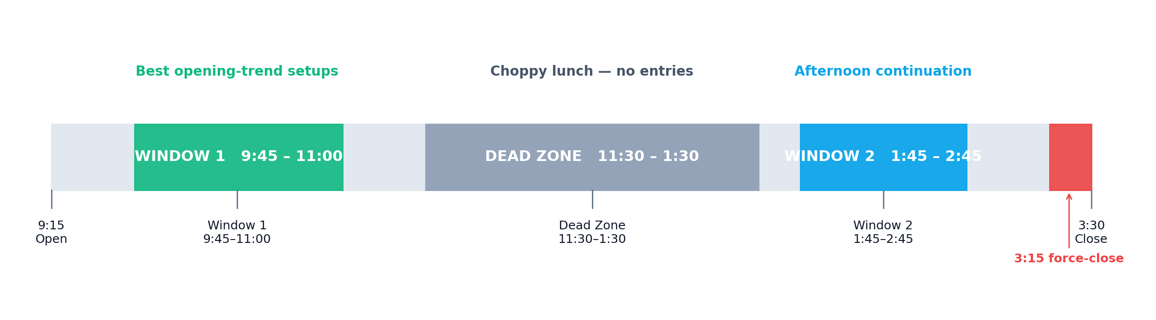
WHEN THE STRATEGY TRADES
Two windows, one dead zone, one hard close
Window 1 — 9:45 to 11:00
Dead Zone — 11:30 to 1:30
Window 2 — 1:45 to 2:45
Opening volatility settles into a clear direction. The first 30 min after open are skipped because VWAP is still finding its level.
Lunch lull. Range-bound chop. Pullbacks here often reverse against us. Signals during the dead zone are persisted as INFORMATIONAL — visible in the UI but never executed.
Afternoon trend resumes. Window closes 30 min before the 3:15 force-close so the trade has time to play out.
Strategy 2 · VWAP Pullback

Slide 4
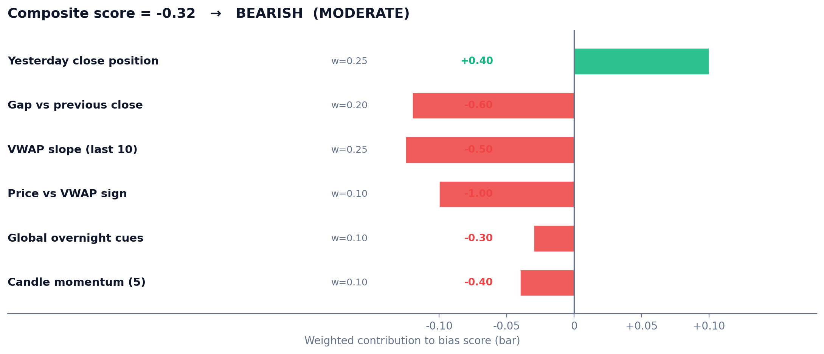
GATE 1 — DIRECTION
Composite intraday bias: 6 factors, one signed score
How direction is decided
Each minute, the strategy computes a signed score in [-1, +1] from six factors with the weights shown.
STRONG |score| ≥ 0.50
Opposing direction is vetoed entirely.
MODERATE |score| ≥ 0.20
Both directions allowed; misalignment hurts confidence.
WEAK |score| < 0.20
Pure structural rule applies — pullback side wins.
EXAMPLE · bearish gap-down after bullish yesterday
Score = -0.32 → MODERATE BEARISH. PE signals can still fire; CE entries take a confidence haircut via bias_alignment.
Strategy 2 · VWAP Pullback

Slide 5
ANATOMY OF A SIGNAL
All 5 gates must pass — every minute, every symbol
GATE 1
GATE 2
GATE 3
GATE 4
GATE 5
Bias gate
VWAP proximity
Reversal candle
Volume sanity
Confidence
Intraday bias is not STRONG opposing.
is_blocked_by_bias() in intraday_bias.py.
|price − VWAP| / VWAP ≤ 0.15%.
is_pullback_to_vwap() in vwap.py.
Bullish/bearish engulfing, pin, or doji+follow on 5-min chart.
is_bullish_reversal() / is_bearish_reversal() in candle_patterns.py.
Current 5m volume ≤ 1.2× 20-period average.
Computed on stock-futures volume when available.
10-factor weighted composite ≥ persist threshold (default 30) to record, ≥ 55 to fire.
compute_confidence() in indicators/confidence.py.
WHY
WHY
WHY
WHY
WHY
STRONG bearish vetoes CE; STRONG bullish vetoes PE.
Sign of (price − VWAP) decides CE vs PE candidate.
Body magnitude and wick cleanliness feed reversal_quality.
Healthy pullback, not panic. Below avg = bonus.
Below threshold → suppressed. Stored for post-mortem only.
Strategy 2 · VWAP Pullback

Slide 6
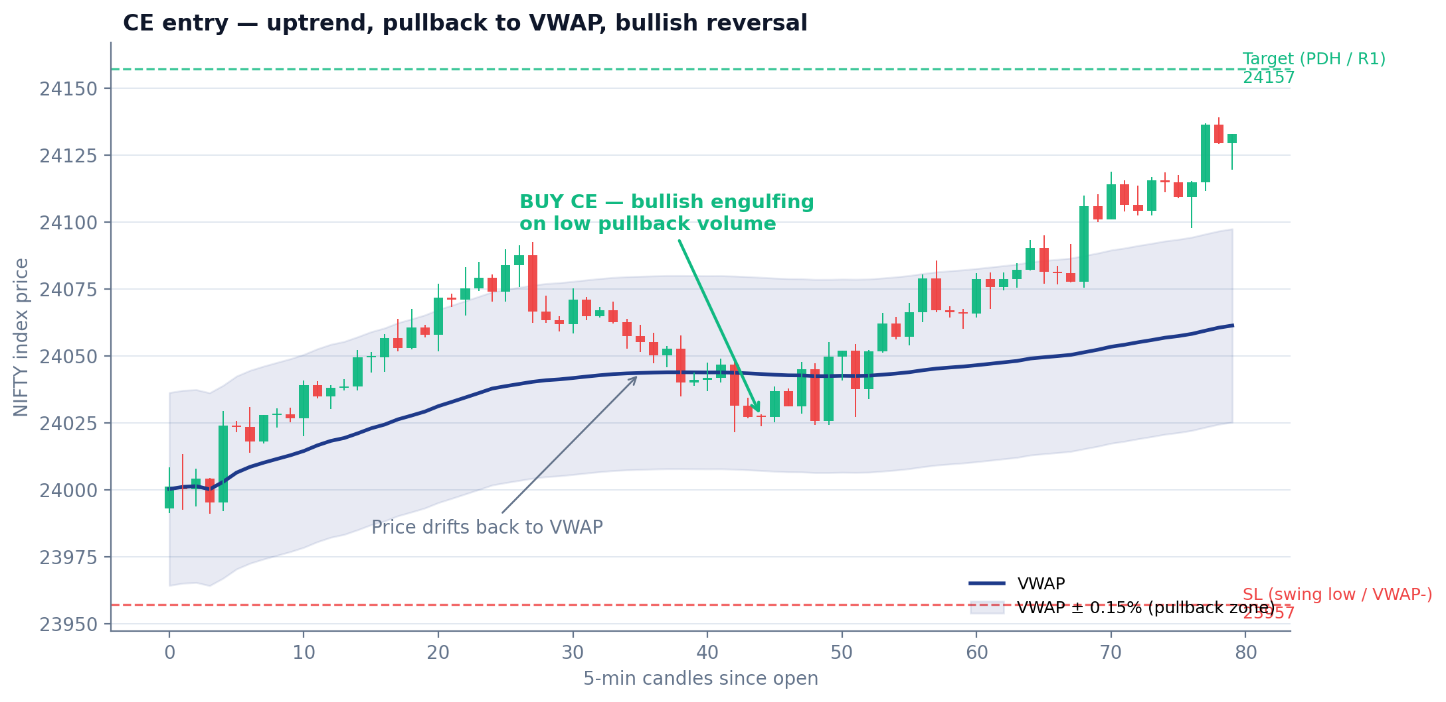
WALKTHROUGH · BUY CE
Uptrend → pullback to VWAP → bullish reversal → buy a call
Step by step
1
Trend up, price > VWAP
Intraday bias is BULLISH MODERATE — CE eligible.
2
Price drifts back to VWAP
Distance closes to within 0.15% — Gate 2 passes.
3
Bullish engulfing prints
Body engulfs prior candle on thin wick — Gate 3 passes.
4
Pullback volume = 0.6× avg
Below 1.2× cap — Gate 4 passes; volume_quality scores high.
5
Confidence = 79.5 / 100
Above 55 fire-threshold — signal fires BUY 24000 CE.
SL = nearest support below entry (VWAP-band → swing-low → CPR-BC → CPR-S1 → PDL → max-PE-OI strike) · Target = nearest resistance above (mirror of above) · R:R must be ≥ 1:1 or signal is discarded
Strategy 2 · VWAP Pullback

Slide 7
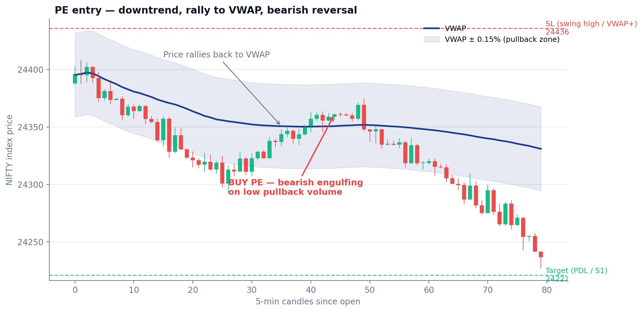
WALKTHROUGH · BUY PE
Downtrend → rally to VWAP → bearish reversal → buy a put
Step by step
1
Trend down, price < VWAP
Intraday bias is BEARISH MODERATE — PE eligible.
2
Price rallies back to VWAP
Returns to within 0.15% from below — Gate 2 passes.
3
Bearish engulfing prints
Body engulfs prior bullish candle — Gate 3 passes.
4
Rally volume = 0.7× avg
Sellers re-engaging on a quiet bounce — Gate 4 passes.
5
Confidence = 72 / 100
Above 55 — signal fires BUY 24400 PE.
SL = nearest resistance above entry (VWAP-band → swing-high → CPR-TC → CPR-R1 → PDH → max-CE-OI strike) · Target = nearest support below · Same R:R ≥ 1:1 hurdle as the CE side
Strategy 2 · VWAP Pullback

Slide 8
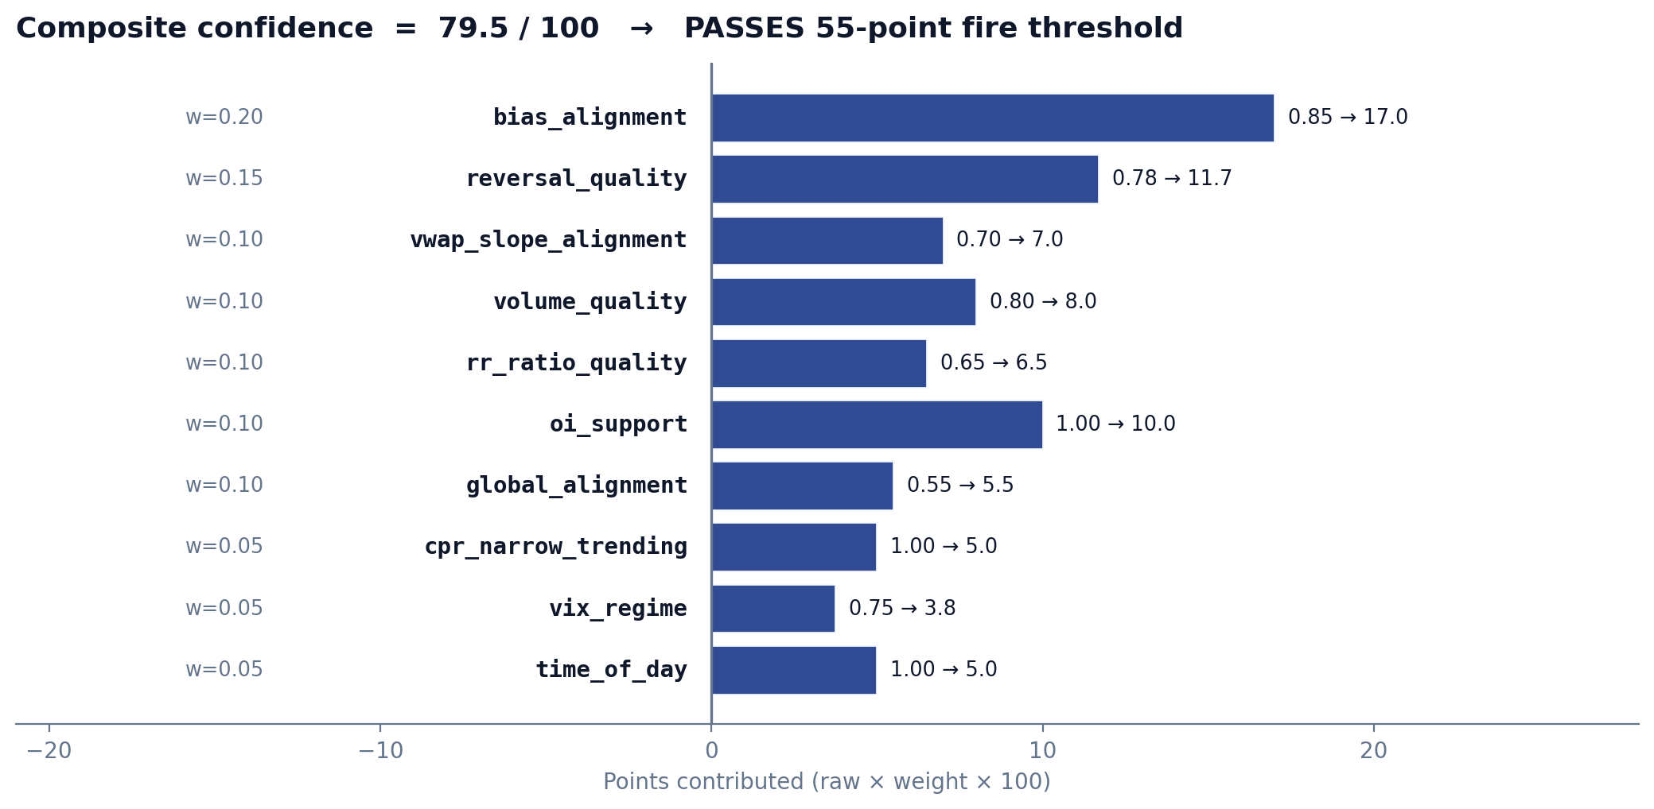
GATE 5 — CONFIDENCE
10-factor weighted composite must clear 55 / 100
How the 79.5 was earned
Each of 10 factors returns a 0–1 raw score; the weighted sum × 100 is the deterministic confidence.
Score ≥ 30 → persisted · Score ≥ 55 → executable
What dominates this score
• bias_alignment carries the heaviest weight (0.20). When the live bias matches the signal direction it can earn ~17 points alone.
• reversal_quality (0.15) rewards clean engulfing bodies with small wicks. A weak doji barely scores.
• cpr_narrow_trending and time_of_day (0.05 each) are small but decisive on borderline setups.
LLM OVERLAY · Gemini
After all 5 gates pass, a Gemini call reviews the full snapshot and returns ±15 confidence adjustment, an ai_summary, ai_rationale, key_supports / key_risks, recommended_action, and suggested_lot_adjustment. 8-second timeout — never blocks the signal if it fails.
Strategy 2 · VWAP Pullback

Slide 9
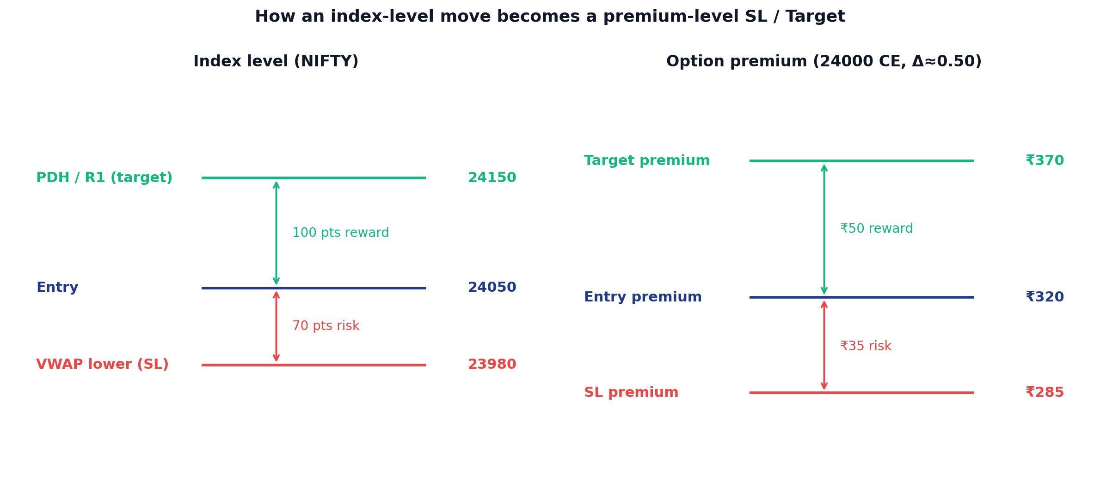
FROM SIGNAL TO A REAL TRADE
Index level → option premium → number of lots
POSITION SIZING
How many lots?
risk_amount = capital × risk_pct
= ₹10L × 2 % = ₹20,000
risk_per_lot = |entry − sl| × lot_size
= ₹35 × 75 = ₹2,625
lots = floor(20000 / 2625) × vix_mul
= 7 × 1.0 = 7
lots = clamp(lots, 1, max_lots=5)
→ 5 lots
VIX MULTIPLIER
premium_sl = entry_premium − Δ × (index_entry − index_sl)
premium_target = entry_premium + Δ × (index_target − index_entry)
< 14
1.1×
14 – 18
1.0×
18 – 22
0.9×
ATM strike → Δ ≈ 0.50 · 1-strike ITM → Δ ≈ 0.60. If no market-structure level exists, fall back to 30 % SL (35 % when bias opposes) with 1.5× R:R on the premium itself.
> 22
0.8× (also blocks at 22)
Strategy 2 · VWAP Pullback

Slide 10
AFTER THE TRADE FIRES
Exits, LLM actions, and the hard risk floor
EXIT RULES
LLM ACTIONS
HARD RISK FILTERS
SL hit
recommended_action
VIX ≥ 22
premium ≤ premium_sl → close immediately.
PROCEED
Signal saved with blocked_reason = 'VIX extreme'.
Default — execute as sized.
Daily drawdown limit
Target hit
Cumulative losses ≥ 5 % of capital → no further entries today.
premium ≥ premium_target → close.
PROCEED_WITH_CAUTION
One major risk — execute but flag in UI.
Max trades / day
2–3 trades cap. Anything beyond → blocked_reason set, signal saved.
VWAP invalidation
RECONSIDER
For a CE: if price drops below VWAP × 0.998, close. Mirrored for PE.
Two+ major risks · adjustment ≤ -10. Signal still saved.
After 3:15 PM IST
Strategy doesn't even evaluate. No new entries past force-close.
3:15 PM IST
suggested_lot_adjustment
Same-symbol+direction open
Hard force-close on every intraday position. No exceptions.
REDUCE_50_PCT → lots halved (floor 1)
SKIP → executable=False, but signal persisted for study
Skipped to prevent stacking the same view.
Strategy 2 · VWAP Pullback

