Slide 1
STOCKTRADING / STRATEGY 5
AT A GLANCE
Intraday Stock Futures
Trade NSE stock futures intraday
4
15-20
How the 4 setups generate signals
Setups (playbooks)
Stocks watched daily
9:30-2:45
3:15
Trading window (IST)
Force-close — no overnight
A beginner's guide
Goal per trade: 1-2% intraday move · Default: 1 lot, max 2

Slide 2
SLIDE 02 · THE BIG PICTURE
What is Strategy 5?
Strategy 5 is an autonomous intraday trading system for Indian stock futures.
Unlike Strategies 1-4, you don't manually pick stocks or push a scan button. Each morning the AI agent:
1. Reviews yesterday's results + global cues at 8:00 AM
2. Scores all ~180 F&O stocks and picks 15-20 for today's watchlist
3. Watches each stock for ANY of 4 setups to trigger
4. Fires a signal only when filters + confidence pass
5. Squares off everything by 3:15 PM — never holds overnight
Why 4 setups?
No single setup works all day. Each one captures a different kind of move — a breakout, a pullback, a level break, or a gap. Running them in parallel gives more high-quality opportunities while the time-of-day rules keep the wrong setup from firing in the wrong conditions.
KEY NUMBERS
Target move
1-2% intraday
Holding type
Intraday only
Force-close
3:15 PM IST
Max trades/day
5
Max simultaneous positions
3
Max daily drawdown
3%
Min confidence to fire
60 / 100
Default position size
1 lot (max 2)
Halts trading if
India VIX > 20
Strategy 5 · Intraday Stock Futures
2 / 10

Slide 3
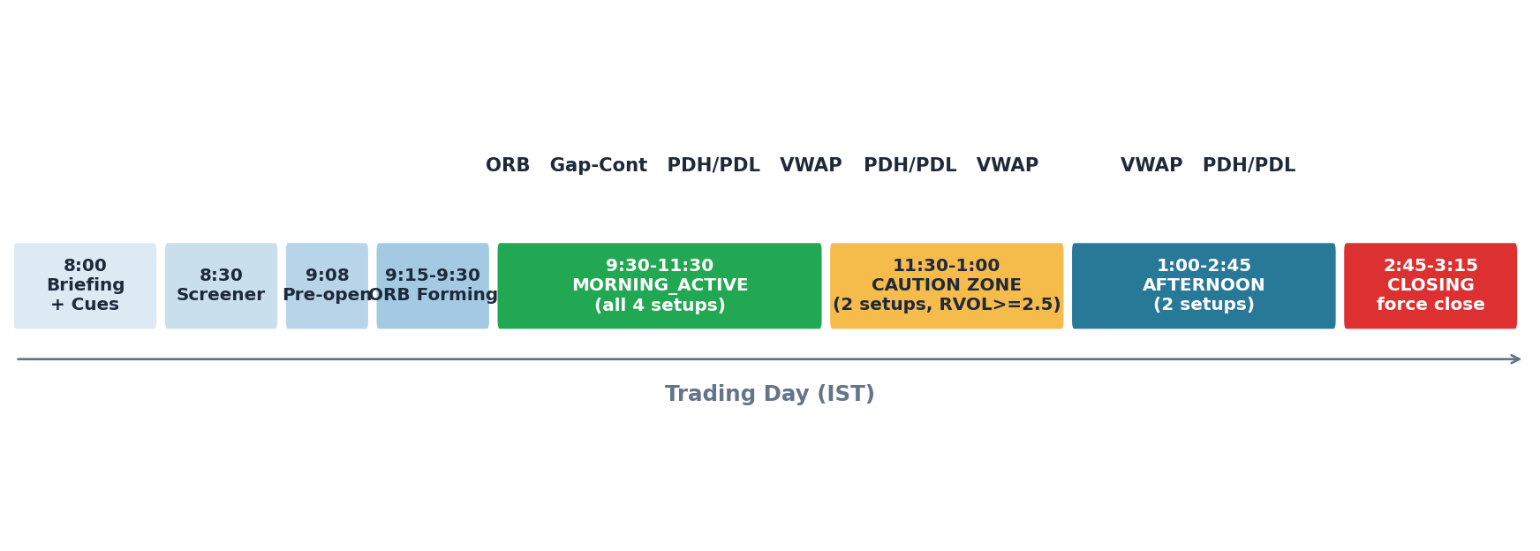
SLIDE 03 · THE TRADING DAY
Different times of day -> different setups
WHY TIME-OF-DAY MATTERS
Markets behave differently through the day. Strategy 5 uses a phase state machine that decides which setups can fire at any moment.
• Morning (9:30-11:30): high volume, fresh news, clear ranges -> all 4 setups eligible
• Caution Zone (11:30-1:00): lunch lull, choppy -> only 2 setups, RVOL bar raised to 2.5x
• Afternoon (1:00-2:45): trends resume -> ORB & Gap have expired, only 2 setups remain
• Closing (2:45-3:15): no new entries — manage and force-close existing positions
Strategy 5 · Intraday Stock Futures
3 / 10

Slide 4
SLIDE 04 · THE PLAYBOOKS
The 4 setups at a glance
1
ORB Breakout
2
VWAP Bounce
9:30 - 11:00 AM
10:00 AM - 2:45 PM
First 15 min sets a range. Break of that range = early-day momentum.
Captures: opening breakouts when news/orders pile up at the open.
In a trend, price pulls back to VWAP and bounces — buy the dip.
Captures: trend-continuation throughout the day. Longest window.
3
PDH / PDL Breakout
4
Gap Continuation
9:30 AM - 2:00 PM
9:30 - 11:00 AM
Yesterday's high/low are key levels. A clean break = new strength/weakness.
Captures: range expansion when the stock pierces a known level.
Stock opens with a >0.5% gap. If price holds the gap for 15 min, momentum continues.
Captures: overnight news translating into directional follow-through.
If two setups trigger on the same stock, the highest-priority one wins (priority depends on the time window).
Strategy 5 · Intraday Stock Futures
4 / 10

Slide 5
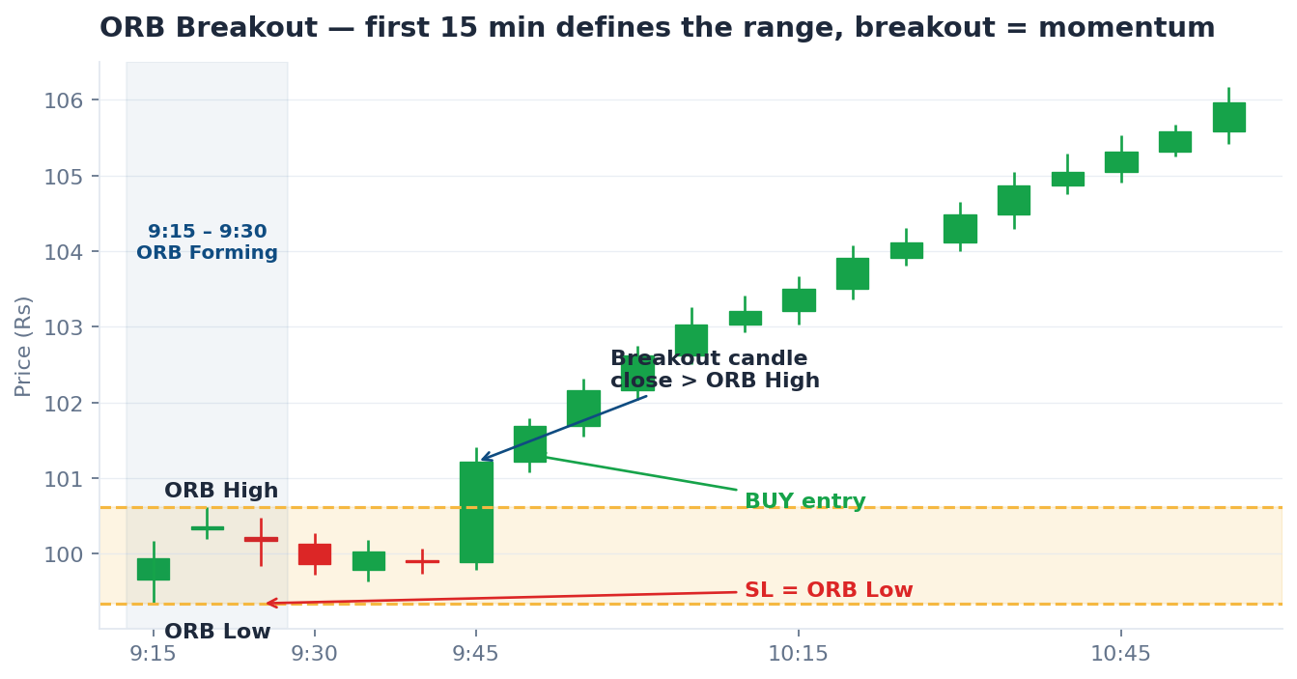
SLIDE 05 · SETUP 1
ORB — Opening Range Breakout
TIME WINDOW
9:30 - 11:00 AM only
HOW IT TRIGGERS
• Record the high & low of the first 15 min (9:15-9:30).
• Wait for a 5-min candle to CLOSE above the high -> BUY.
(Or close below the low -> SELL.)
• Breakout candle volume must be > 1.2x average.
• Price must be on the right side of VWAP.
WHY THIS WORKS
The first 15 min sets the day's pivot. A clean break shows that buyers (or sellers) have decisively taken control of the day.
If price also clears yesterday's high it becomes an 'Enhanced ORB' with higher confidence.
SL / TARGET
Illustrative chart — concept only, not a real trade.
SL: opposite side of the ORB. Target: nearest structure with R:R >= 1.5.
Strategy 5 · Intraday Stock Futures
5 / 10

Slide 6
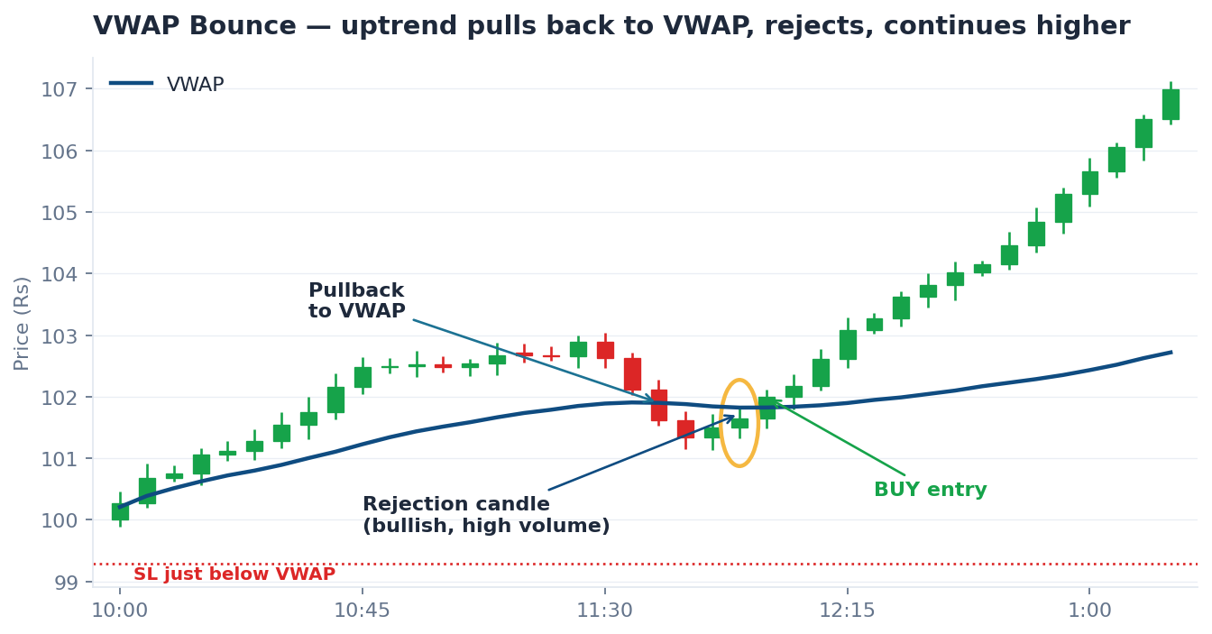
SLIDE 06 · SETUP 2
VWAP Bounce / Pullback
TIME WINDOW
10:00 AM - 2:45 PM (longest window)
HOW IT TRIGGERS
• VWAP = volume-weighted average price (the day's 'fair price').
• Identify trend: price stays above VWAP for 30+ min = uptrend.
• Wait for price to pull back to VWAP (within 0.2%).
• Look for a bullish reversal candle (pin bar / engulfing).
• Rejection candle volume must be > average -> BUY.
WHY THIS WORKS
VWAP is where most of the day's volume traded — institutions defend it. In a trend, pullbacks to VWAP are low-risk re-entries.
It works all day because trends, once established, persist. That's why this setup has the longest active window.
SL / TARGET
Illustrative chart — concept only, not a real trade.
SL: just below VWAP. Target: today's swing high (or 1.5x risk).
Strategy 5 · Intraday Stock Futures
6 / 10

Slide 7
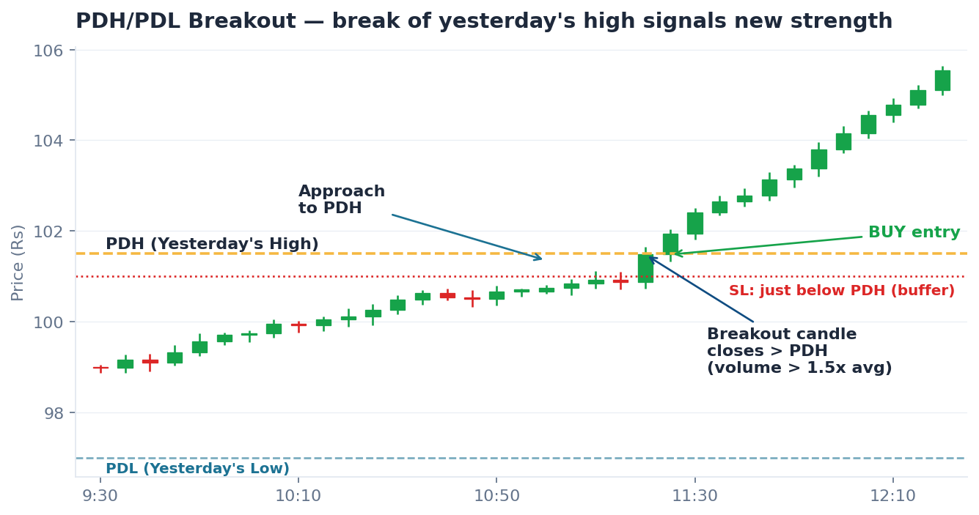
SLIDE 07 · SETUP 3
PDH / PDL Breakout
TIME WINDOW
9:30 AM - 2:00 PM
HOW IT TRIGGERS
• PDH/PDL = Previous Day High/Low. Everyone watches them.
• Wait for a 5-min candle to CLOSE above PDH -> BUY.
(Or close below PDL -> SELL.)
• Breakout volume must be > 1.5x average (stricter than ORB).
• Price must be on the right side of VWAP.
WHY THIS WORKS
PDH/PDL are universal reference points: charts, alerts, algos all key off them. A clean break unlocks a fresh range — supply/demand shifts.
Active most of the day because the level itself doesn't expire. We stop at 2:00 PM so the trade has time to play out before force-close.
SL / TARGET
Illustrative chart — concept only, not a real trade.
SL: just below PDH (longs). Target: measured move of yesterday's range.
Strategy 5 · Intraday Stock Futures
7 / 10

Slide 8
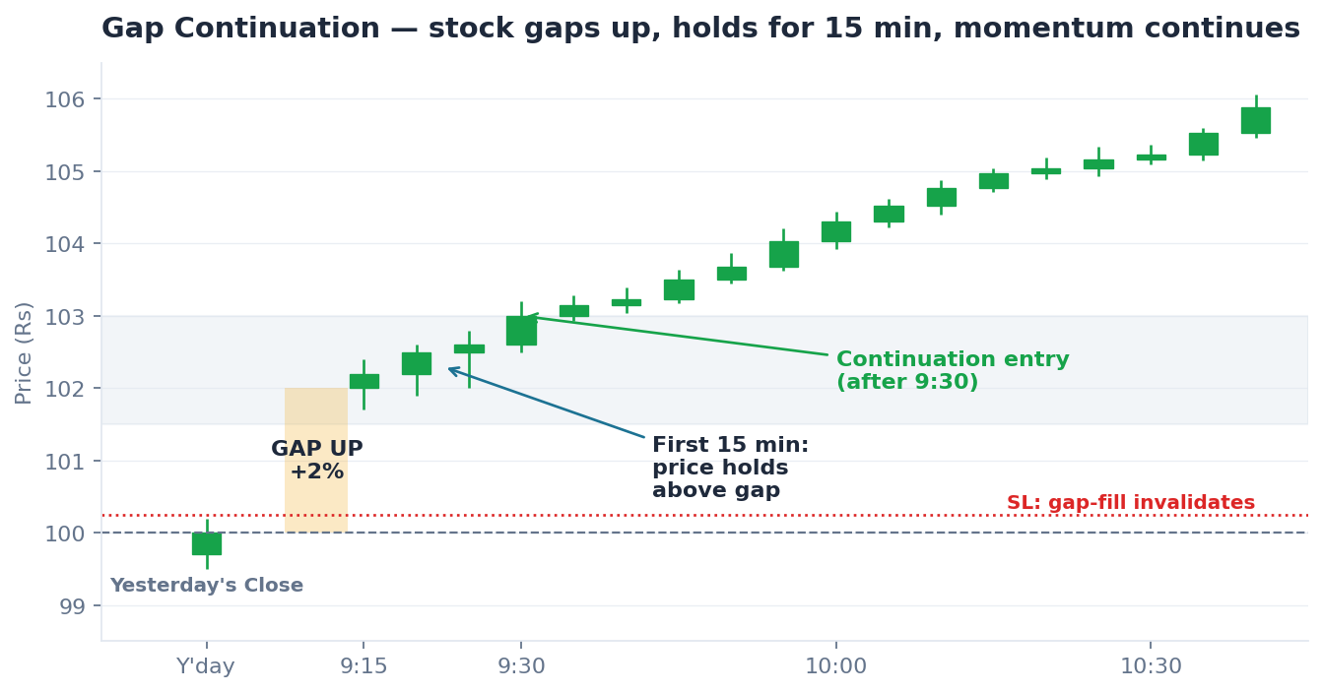
SLIDE 08 · SETUP 4
Gap Continuation
TIME WINDOW
9:30 - 11:00 AM only
HOW IT TRIGGERS
• Gap = today's open is >0.5% above (or below) yesterday's close.
• Watch the first 15 min: does price stay on the gap side?
• Opening 15-min volume must be > 2x average (very strict).
• After 9:30, if price holds -> BUY (continuation).
• If price 'fills' the gap, the thesis is dead — skip.
WHY THIS WORKS
Gaps come from overnight news or earnings. If the market keeps buying after the open, that news is being absorbed positively — momentum continues.
Morning-only because gap energy fades fast: by midday the gap is old news and price tends to mean-revert.
SL / TARGET
Illustrative chart — concept only, not a real trade.
SL: just above previous close (gap-fill = invalidation). Target: gap size projected forward.
Strategy 5 · Intraday Stock Futures
8 / 10

Slide 9
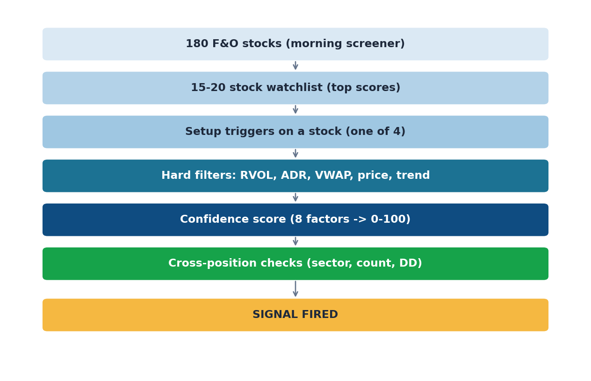
SLIDE 09 · FROM IDEA TO SIGNAL
How a setup turns into an actual signal
THE FILTER STACK
A setup TRIGGER is just the start. Before the system fires a signal, every candidate is checked against a stack of hard filters and a confidence score:
Hard filters (must all pass):
• RVOL >= 1.5x (or 2.5x in caution zone) — volume must be elevated for this time of day
• ADR > 1.5% — stock must move enough to be worth trading
• Stock price > Rs 100 — avoid slippage on cheap tickers
• VWAP alignment — price must be on the right side
• Nifty bias not strongly opposing — don't fight the index
• Stock multi-day trend not strongly opposing
Confidence score (8 factors -> 0-100):
Volume, RVOL, Nifty bias, market phase, setup quality, screener rank, gap alignment, multi-day trend.
>= 60 -> executable signal. 30-60 -> recorded but not executed. < 30 -> discarded.
Cross-position checks:
Max 3 open positions, max 5 trades/day, no two trades from same sector, halt if daily drawdown >= 3%.
Strategy 5 · Intraday Stock Futures
9 / 10

Slide 10
SLIDE 10 · PUTTING IT ALL TOGETHER
Why each setup runs when it does
ORB
VWAP
PDH/PDL
Gap-Cont.
Morning only
All day
Until 2:00 PM
Morning only
WINDOW LOGIC
Range only exists right after the open.
EDGE
Momentum strongest in first 90 min.
EXPIRES BECAUSE
Expires at 11:00 AM — older breakouts fail more often.
WINDOW LOGIC
Trends develop and re-test VWAP repeatedly.
EDGE
Works in trending AND choppy markets.
EXPIRES BECAUSE
Single best 'all-weather' setup in the kit.
WINDOW LOGIC
Levels watched by every trader & algo.
EDGE
Need time for the trade to play out.
EXPIRES BECAUSE
Cut off at 2:00 PM so target can hit before 3:15 force-close.
WINDOW LOGIC
Gap energy lives in first 60-90 min.
EDGE
Needs overnight catalyst (news / earnings).
EXPIRES BECAUSE
By midday the gap is old news — fades.
Bottom line
Each setup runs only when its statistical edge is highest. That's how 4 different playbooks share one trading day.
Strategy 5 · Intraday Stock Futures
10 / 10

