Slide 1

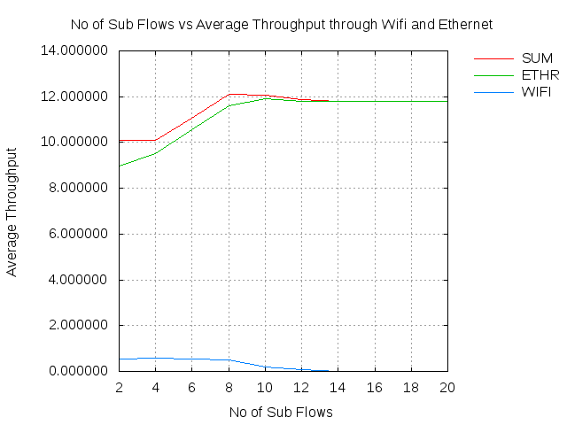
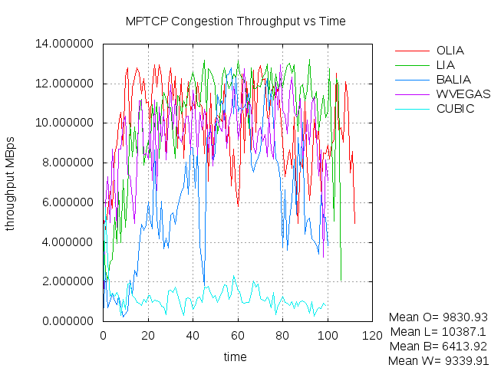
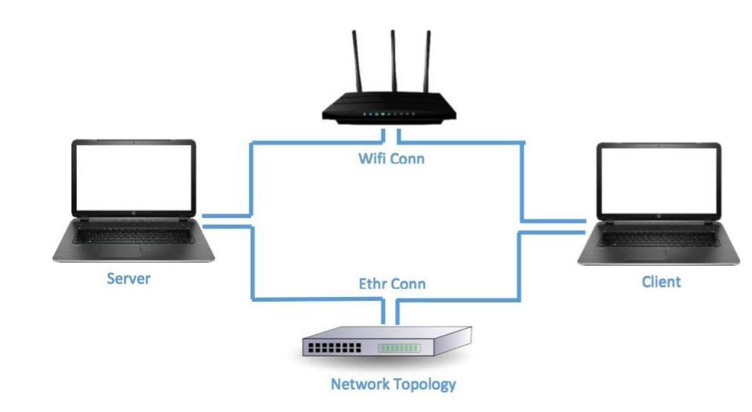
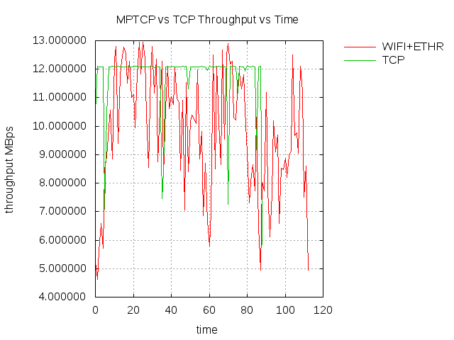
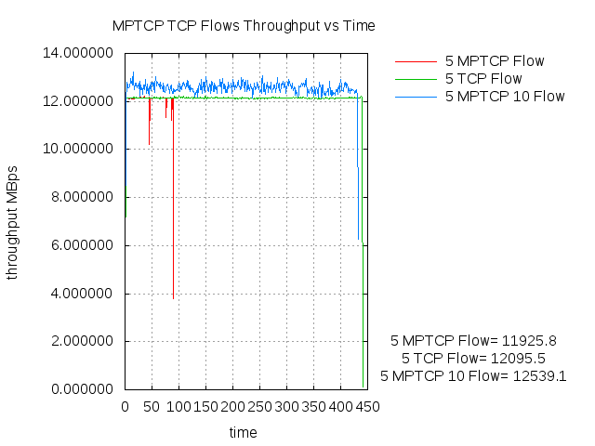
Multipath TCP: A Comparative Analysis for Linux kernel implementation
Agneev Ghosh, Jayant Malani and Heli Utpal Modi
Motivation: Justify MPTCP’s usability
Real Time Simulation & Evaluations
Aim: Using existing MPTCP principles for Linux kernel implementation, develop a framework incorporating a comparative study of MPTCP protocol w.r.t. TCP and UDP protocols.
Crux of the project: Key Results
Graph-1: MPTCP Mean Throughput v/s No. of sub-flows
Graph-4: Comparative Analysis of Congestion Control protocols
Conclusive Remarks with Future Work
Proliferation of multi-homed hosts render the concept of MPTCP as extremely imperative and riveting.
Through our research work, we have been able to evaluate the usability and effectualness of MPTCP under vacillating conditions.
As observed, though there are certain corner cases under which TCP and UDP outperform MPTCP, in the larger scheme of things, MPTCP does increase the reliability and performance factors of the network flow.
Thus, MPTCP allows standard applications to reap the benefits of multipath networks.
As future work, evaluating the scalability w.r.t deploying it over the internet , energy considerations for mobile devices, implementing better window management schemes are some the avenues of interest.
The number of sub-flows(*N), as experimentally found to be optimal, is 10; if sub-flows > *N, secondary path (Wifi) is not utilized.
Hence, MPTCP Protocol performs better than TCP and UDP when the above condition(*N) holds.
For *N sub-flows MPTCP works better than *N number of logical TCP connections.
Introduced delay on Ethernet path, in the MPTCP (sub-flows > *N); however secondary path still unutilized.
Analyzed the throughput and delay as perceived for various congestion control algorithms.
Graph-2: Mean Throughput v/s Time for MPTCP and TCP
Graph-3: *N sub-flows MPTCP v/s *N number of logical TCP connections

