Slide 1

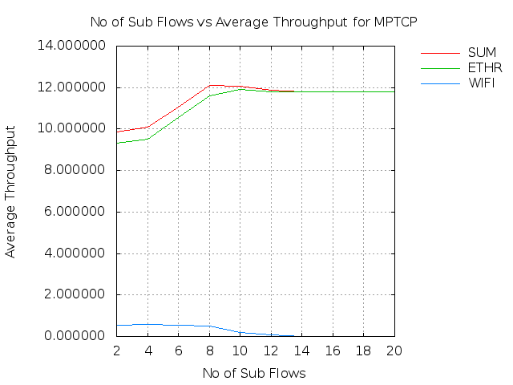
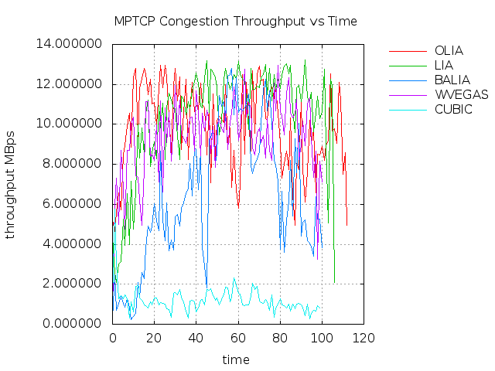
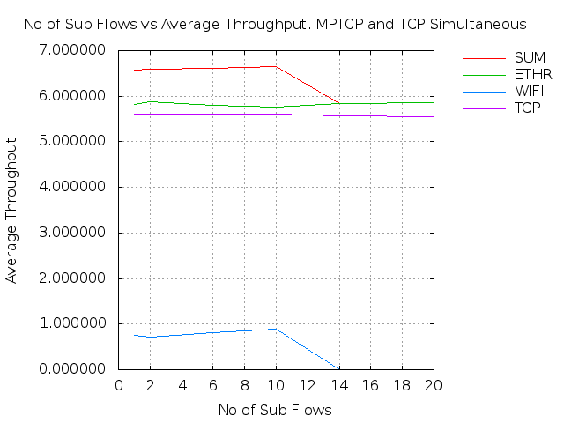
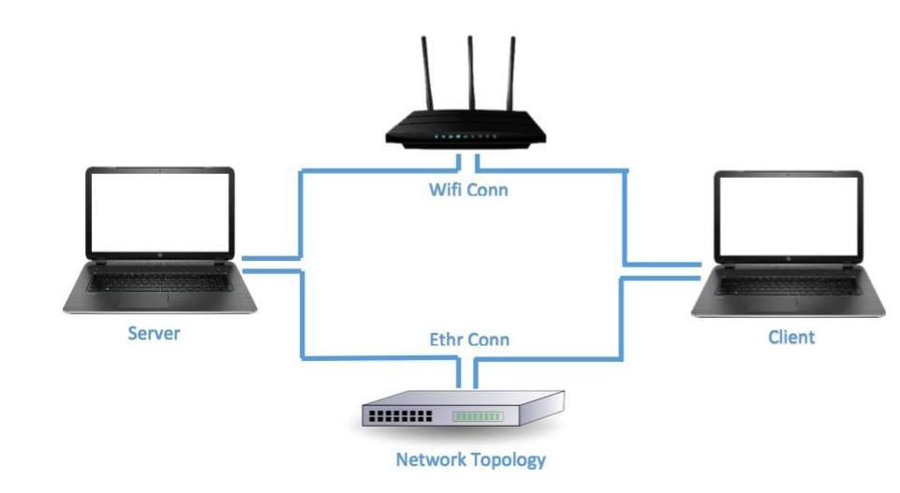
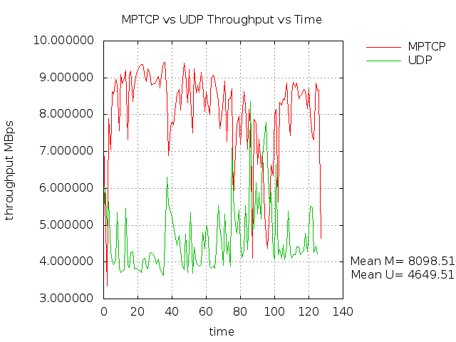
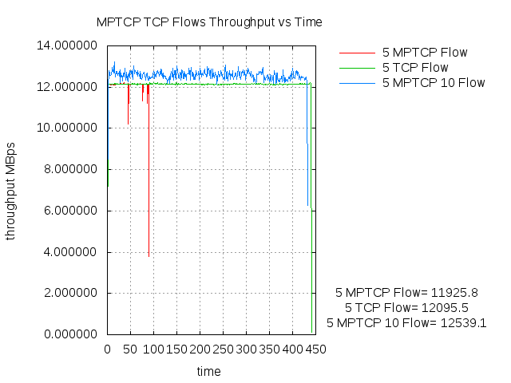
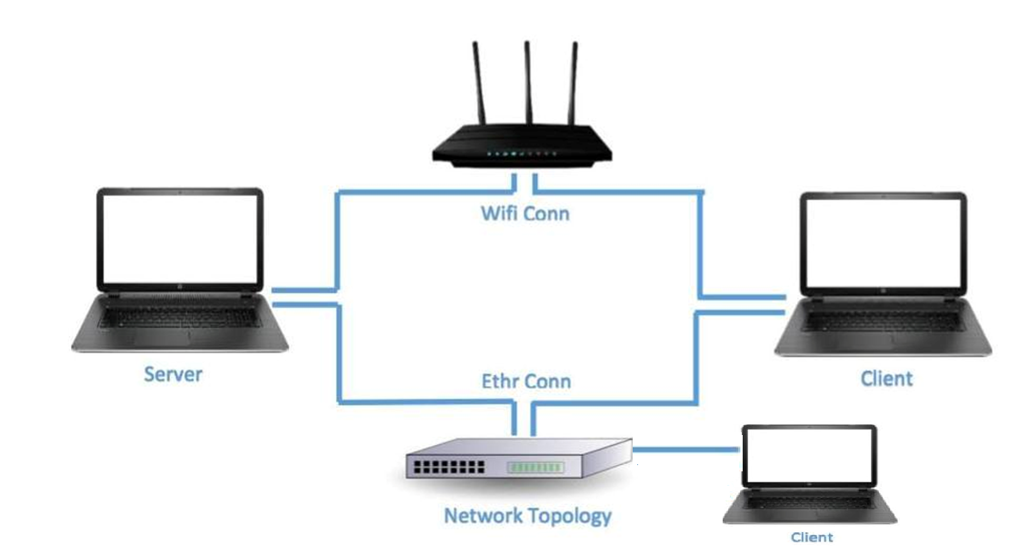
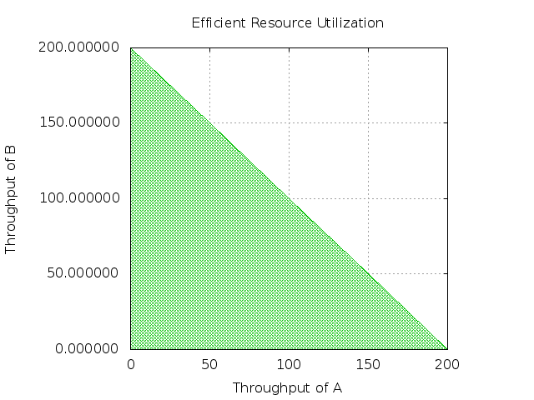
Multipath TCP: A Comparative Analysis for Linux kernel implementation
Agneev Ghosh, Jayant Malani and Heli Utpal Modi
Goal: Analysis & Justify usability
MPTCP Design Goals Validation
Further Simulation & Evaluations
Aim: Using existing MPTCP principles for Linux kernel implementation, develop a framework incorporating a comparative study of MPTCP protocol Design Goals and its performance w.r.t. TCP and UDP protocols.
#1 Fair share with TCP and
#2 Perform at least as well as TCP
Increasing Sub-Flow Analysis.
MPTCP Congestion Control Evaluation
Maximum Throughput
Congestion Control | Time in Seconds to transfer a 1GB File | Mean in KBps
OLIA | 114.350 | 9830
LIA | 118.071 | 10387
BALIA | 159.006 | 6413
wVegas | 120.091 | 1203
Experimental Setup
Graph 3
(in seconds)
Behavior with UDP Congestion
Graph 4
*N sub-flows MPTCP v/s *N number of TCP on Single Path
Graph 1
As observed in the above graph,
MPTCP follows the fair share property while increasing no of sub flows
It performs as well as TCP when there is competing traffic
Figure A
#3 MPTCP should use efficient paths
KBps
KBps
In the experimental setup, MPTCP always preferred Ethernet in spite of increasing RTT delay or packet loss on it.
KBps
KBps
(in seconds)
KBps
(in seconds)
Graph 5
Graph 6
#4 Efficient Resource Utilization
Conclusive Remarks-Key Findings and Future Work
Figure B
Src. B
Eth @100Mbps
Des. A
The Key Findings of the experiment are as follows:
1. As collectively observed in Graphs 3 & 5, we found that the optimal number of sub-flows count(*N) is 10, for which MPTCP outperforms TCP and UDP, always maintaining the property of fair share in both the cases.
2. Graph 4 provides a comparative analysis among the MPTCP congestion control protocols, and it can be concluded that OLIA performs the best by consuming least time for transmission.
3. Graph 6 provides a comparative analysis of 5 independent MPTCP/TCP connections (A), 5 MPTCP connections having *N number of sub-flows (B) and 1 MPTCP connection having 5 sub-flows (C). As observed, A outperforms B which outperforms C, thus justifying the need to use MPTCP connections over TCP connections.
From the extensive analysis of various parameters such as RTT delay, packet drop rate, # of sub-flows, competing TCP and UDP connections and use of different congestion control protocols- we can conclude that MPTCP functions as good as TCP and UDP along with withholding its basic design properties i.e. full utilization of resources
For future work, evaluating the scalability w.r.t. deploying it over the internet and implementing better window management schemes are some avenues of interest.
Figure A depicts the primary experimental setup .
It comprises of a MPTCP enabled client and server having multiple communication paths viz. Ethernet (5-port 12.5MBps Unmanaged Gigabit Switch) and Wi-Fi (1MBps).
Figure B lays out the secondary architectural setup which has an additional (Non MPTCP) client (connected via Ethernet) introduced to compete with the MPTCP client , to emulate pragmatic scenarios.
Wifi @100Mbps
Possible Traffic Flow
Wifi @100Mbps
Src. A
Graph 2
Des. B
Eth @100Mbps
Figure 3
MPTCP utilized full capacity of the resources (i.e. throughput) on available paths as compared to TCP connection.

