Slide 1



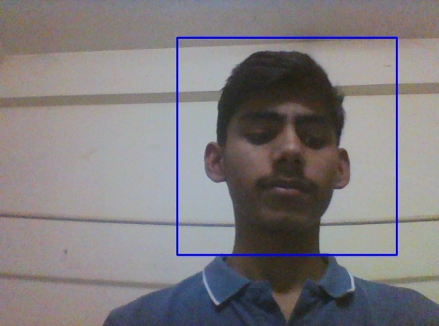
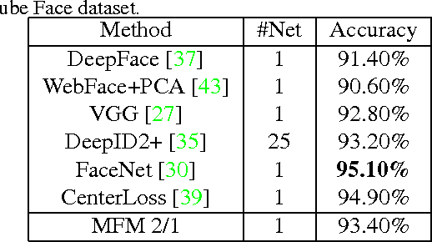
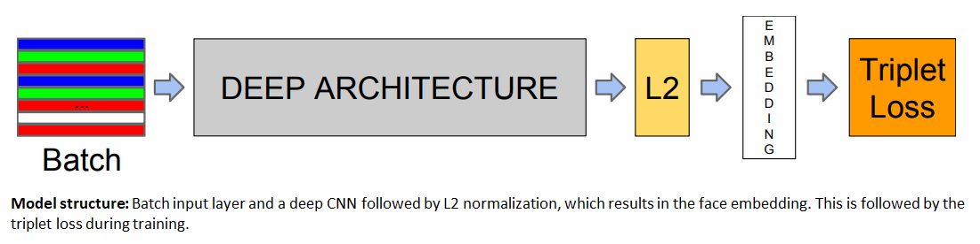
Face-Recognition System
Jayant Prakash Singh, Mukul Ranjan, Chandan Agarwal
IITG.ai
Abstract/Introduction
We are developing a Deep Learning based Face Recognition System for security purposes. A fully automated system was designed to capture the video frame from webcam , preprocess it to extract the face images from the video frame and then fed the extracted images into a deep convolutional network to generate the 128 -dimensional face encoding. A Database was formed consisting of images of persons allowed to access the system. The encodings for those persons were pre-generated and stored in the aforementioned database. The encodings of the images of the persons presently in front of the camera are generated during the runtime using deep learning model. These encodings are compared with those in database using Euclidean distance measure and if the distance falls above a decided threshold, the system claims that corresponding person as unidentified following an alarm. Face Images of persons in video frame are detected using Haar Feature-based Cascade Classifiers of opencv python library. We used FaceNet, a specialized deep learning model for face recognition. Previous face recognition approaches based on deep networks use a classification layer trained over a set of known face identities and then take an intermediate bottleneck layer as a representation used to generalize recognition beyond the set of identities used in training. The downsides of this approach are its indirectness and its inefficiency: one has to hope that the bottleneck representation generalizes well to new faces; and by using a bottleneck layer the representation size per face is usually very large.
Results
Initially, we set the threshold to 0.52 and minimum Euclidean distance of an allowed person was found to be in range of 0.5-0.75. Therefore, some of the images of allowed persons were considered as “unidentified”. As a result, we decreased the threshold to as low as 0.7 after which majority of images video frames were classified as “identified” and “unidentified” correctly. Following are some of the values obtained during our testing : Person 1 Person 2 When Person 1 is in database and Person 2 is outsider, the Euclidean distances are : Person 1 -> 0.66 (“identified”), Person 2 -> 0.83 (“unidentified”). When Person 2 is in database and Person 1 is outsider, the Euclidean distances are : Person 1 -> 0.91 (“unidentified”), Person 2 -> 0.54 (“identified”). Also, the FaceNet model used in our system when proposed achieved the state-of-the-art accuracy of 98.87%.
Methodology
The following pipeline best describes the methodology of our system. Object Detection using Haar feature-based cascade classifiers is an effective object detection method proposed by Paul Viola and Michael Jones in their paper, "Rapid Object Detection using a Boosted Cascade of Simple Features" in 2001. It is a machine learning based approach where a cascade function is trained from a lot of positive and negative images. It is then used to detect objects in other images. Here it is used to detect and extract faces from the video frame repetitively. FaceNet model deployed in our system uses a Deep Inception Network architecture which was trained using Triplet Loss Function.
Conclusion
Here we have tried to implement a face recognition model taking inspiration from original FaceNet paper [1], and found that the method of triplet loss (comparison of Anchor image with positive label as well as with negative label) works very well than other techniques introduced before it. The FaceNet model can be used in various surveillance tasks involving facial recognition. The encodings generated in Euclidean space can also be used for face clustering techniques.
Video frame captured from live webcam containing faces of different persons.
Face detection using Haar Feature-based Cascade Classifiers in opencv.
Generation of 128-dim encodings for each preprocessed face image (96X96) in frame using FaceNet.
Compute Minimum Euclidean distance of each encoding generated with those in database.
Database contains pre-generated encodings of identified people.
If minimum Euclidean distance of any encoding falls above a decided threshold, the system classifies that person “unidentified” following an alarm.
References
Florian Schroff, Dmitry Kalenichenko, James Philbin (2015). [FaceNet: A Unified Embedding for Face Recognition and Clustering](https://arxiv.org/pdf/1503.03832.pdf) Yaniv Taigman, Ming Yang, Marc'Aurelio Ranzato, Lior ^{Wolf} (2014). [DeepFace: Closing the gap to human-level performance in face verification](https://research.fb.com/wp-content/uploads/2016/11/deepface-closing-the-gap-to-human-level-performance-in-face-verification.pdf) Our implementation also took a lot of inspiration from the official FaceNet github repository: https://github.com/davidsandberg/facenet

