Slide 1

NODEMCU ESP 8266
JAYANT RAJWANI+91-8885444431

Slide 2
Internet Pops Up here :D
What is IoT?
Prototyping electronics for IoT
How to connect?
IoT with Blynk and ESP8266

Slide 3
Internet of Things
”IoT is a network of physical objects with embedded electronics that collect and share data”

Slide 4
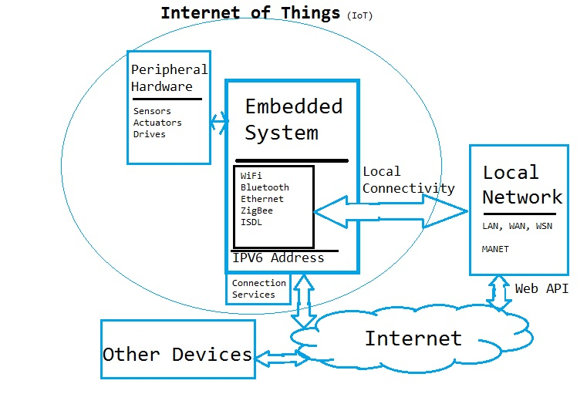

Slide 5
Components for IoT
ESP8266 module
NodeMCU 1.0
Arduino UNO wifi Shield
OTA WeMos D1

Slide 6
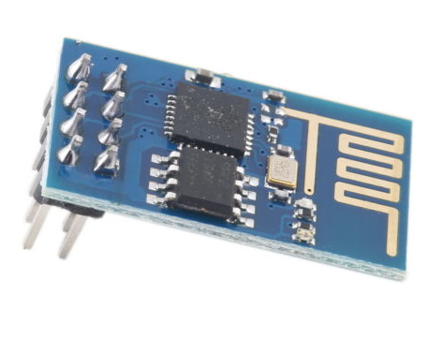
ESP8266 module
We are using this today
Can be programmed by itself but usually connected to Arduino
Price: 2 – 5 €

Slide 7
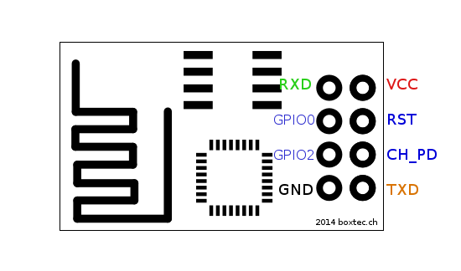
ESP8266 module pinout

Slide 8
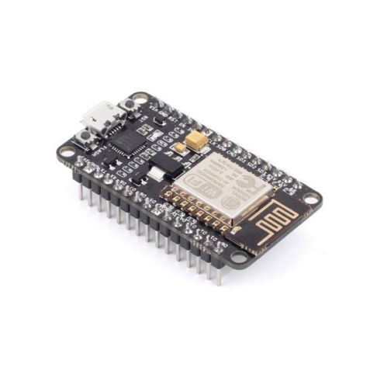
NodeMCU 1.0
Built-in ESP8266, ”ESPduino”
Works with Arduino IDE, not officially though
12 V regulator for input voltage
Price: 5 – 10 €
13 GPIO, only one PWM and ADC (0-1 V)
Pins work with 0 - 3,3 V!

Slide 9
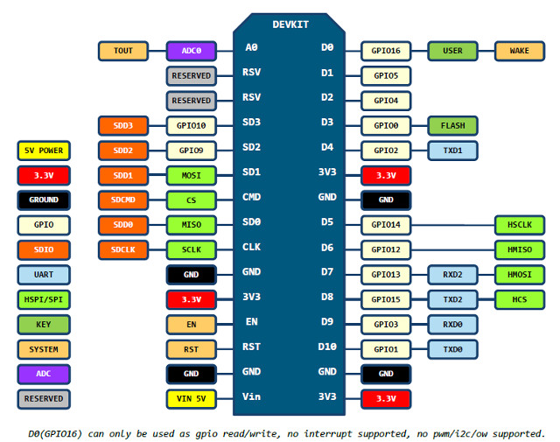
NodeMCU 1.0 Pinout

Slide 10
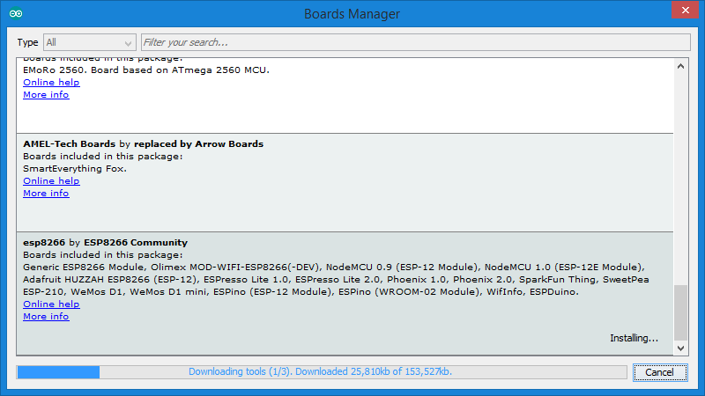
http://arduino.esp8266.com/stable/package_esp8266com_index.json
File > Prefereences
Paste above link in Additional Board
Manage Url's
Click Ok
Tools > Boards > Boards Manager
Select the last option ESP8266 and click install that appears there.

Slide 11
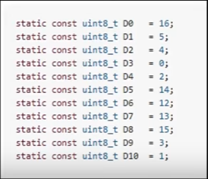
Pin Numbers for NODEMCU in
Arduino

Slide 12
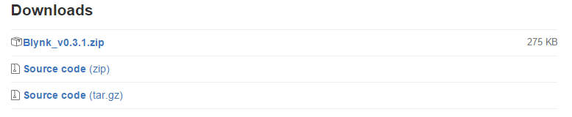
Installing Blynk libraries
http://www.blynk.cc/getting-started/
https://github.com/blynkkk/blynk-library/releases/tag/v0.3.1
Download the Blynk_v0.3.1.zip in the bottom of the page

Slide 13
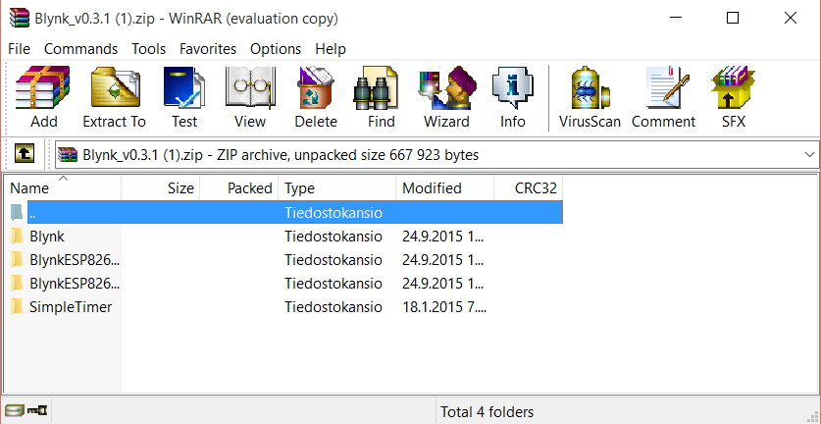
Extracting libraries
Extract the 4 folders inside the .zip to: C:\Program Files (x86)\Arduino\libraries
Done!

Slide 14
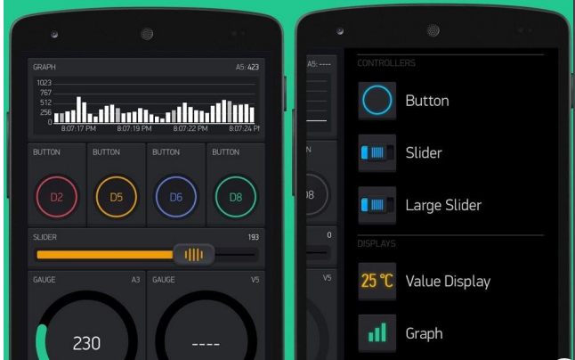
Blynk for phone
Download the app for your phone
You will get a project code to your e-mail
  You need to copy paste it to your Arduino Code

Slide 15
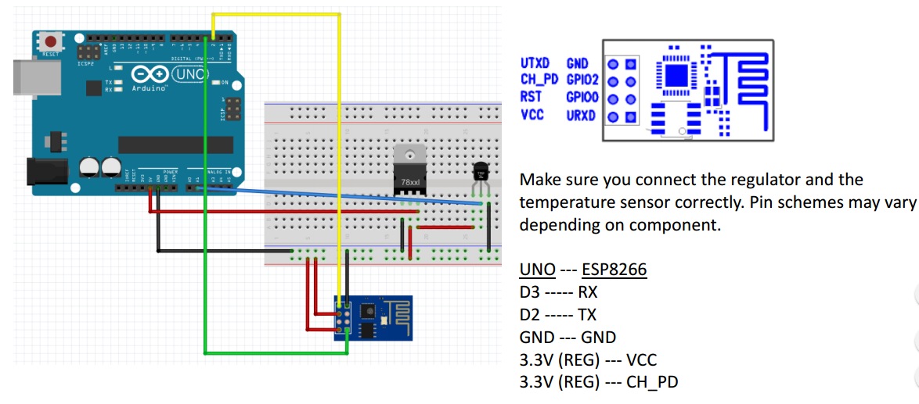
How to connect Arduino?

Slide 16
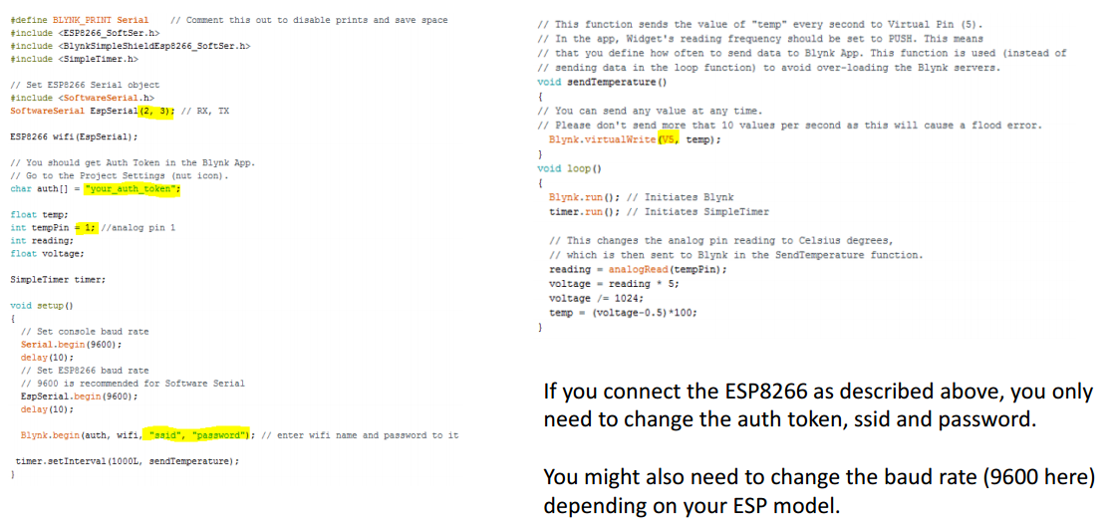
Code for Arduino
In the end of the presentation there is the code in text format

Slide 17
ESP8266 after Blynk
Using the ESP8266 without an app like Blynk requires some coding skills, although lots of ready-made code can be found on the internet.
You can connect with the module directly within its range or anywhere through internet.
For internet connection you’ll need a website to which the module sends data or where you can send data to the module.
A good basic example project can be found here http://allaboutee.com/2015/01/02/esp8266-arduino-led-control-from-webpage/ In this example you have a webpage with buttons that control LEDs connected to an Arduino with an ESP module.
The module acts as a serial device, and you speak to it through AT commands.
  For example AT+CWLAP gives a list of the available access points (Wi-Fi networks). A list of commands can be found here: https://nurdspace.nl/ESP8266#AT_Commands

Slide 18
Resources
• Google & Youtube - search for projects, solutions to occurring problems
and data sheets for components
• http://www.blynk.cc/ - Homepage of the Blynk software, getting started,
community forums
• http://www.esp8266.com/ - Everything on ESP8266, wiki
• https://www.adafruit.com/ - Learning materials, guides, example projects,
forums, store
• https://github.com/ - Largest code host, lots of projects and sample code
• http://allaboutee.com/ - good ESP8266 tutorials
• https://nurdspace.nl/ESP8266/ - ESP8266 info and basic list of AT
commands

Slide 19
#define BLYNK_PRINT Serial // Comment this out to disable prints and save space
#include <ESP8266_SoftSer.h>
#include <BlynkSimpleShieldEsp8266_SoftSer.h>
#include <SimpleTimer.h>
// Set ESP8266 Serial object
#include <SoftwareSerial.h>
SoftwareSerial EspSerial(2, 3); // RX, TX
ESP8266 wifi(EspSerial);
// You should get Auth Token in the Blynk App.
// Go to the Project Settings (nut icon).
char auth[] = "your_auth_token";
float temp;
int tempPin = 1; //analog pin 1
int reading;
float voltage;
SimpleTimer timer;
void setup()
{
// Set console baud rate
Serial.begin(9600);
delay(10);
// Set ESP8266 baud rate
// 9600 is recommended for Software Serial
EspSerial.begin(9600);
delay(10);
Blynk.begin(auth, wifi, "ssid", "password"); // enter wifi name and password to it
timer.setInterval(1000L, sendTemperature);
}

Slide 20
// This function sends the value of "temp" every second to Virtual Pin (5).
// In the app, Widget's reading frequency should be set to PUSH. This means
// that you define how often to send data to Blynk App. This function is used (instead of
// sending data in the loop function) to avoid over-loading the Blynk servers.
void sendTemperature()
{
// You can send any value at any time.
// Please don't send more that 10 values per second as this will cause a flood error.
Blynk.virtualWrite(V5, temp);
}
void loop()
{
Blynk.run(); // Initiates Blynk
timer.run(); // Initiates SimpleTimer
// This changes the analog pin reading to Celsius degrees,
// which is then sent to Blynk in the SendTemperature function.
reading = analogRead(tempPin);
voltage = reading * 5;
voltage /= 1024;
temp = (voltage-0.5)*100;
}

