Slide 1
F R O N T L I N E H C P M O D U L E
Breast Cancer
Your interactive learning journey: recognise, assess, refer, explain, support.
English
Rwanda Biomedical Centre

Slide 2
F R O N T L I N E H C P M O D U L E
Module objectives
Recognise
Distinguish
Examine
Recognise breast cancer risk and the breast changes that need assessment, including urgent findings.
Distinguish screening of a person without symptoms from assessment of a person with a breast change.
Perform and record a systematic breast and axillary examination, and teach breast self-examination.
Explain
Refer
Support
Explain what an abnormal imaging result means, without stating that cancer is present or absent.
Refer with the right urgency, counsel with care, and record what the cancer registry needs.
Support treatment effects, lymphoedema, palliative care, survivorship and follow-up.
Breast Cancer | Frontline HCP | Rwanda Biomedical Centre

Slide 3
F R O N T L I N E H C P M O D U L E
What is inside
Pre-test
Session 1: Understanding
Session 2: Screening
Twenty short questions to check your starting point. Not graded for you.
What breast cancer is, how it develops, how common it is, the types and subtypes, stage and grade.
Who is at risk, benign breast conditions, what to look for, how to examine, and what the tests can do.
Session 3: Referral and counselling
Session 4: Diagnosis and treatment
Session 5: Supportive treatment
How urgently to refer, what to record, and how to counsel about fear, surgery and body image.
How a diagnosis is confirmed, what the receptors mean, and what each treatment is for.
Effects to recognise, lymphoedema, adherence, palliative care, quality of life and follow-up.
Breast Cancer | Frontline HCP | Rwanda Biomedical Centre

Slide 4
B A S E L I N E C H E C K
Pre-test
Twenty questions to check what you already know. Your answers are not graded. You will meet similar ideas again in the post-test.
Breast Cancer | Frontline HCP | Rwanda Biomedical Centre

Slide 5
B A S E L I N E C H E C K
Pre-test (1 of 10)
Q1. Most breast cancers arise from which tissue?
A. Muscle of the chest wall
B. Epithelial cells lining the ducts and lobules
C. Skin of the breast
D. Axillary lymph nodes
Q2. Ductal carcinoma in situ means:
A. Cancer that has already spread to lymph nodes
B. Abnormal malignant cells still confined within the duct
C. A benign breast cyst
D. A tumour arising in the axilla
Breast Cancer | Frontline HCP | Rwanda Biomedical Centre

Slide 6
B A S E L I N E C H E C K
Pre-test (2 of 10)
Q3. A new painless breast lump should be:
A. Ignored, because cancer is painful
B. Assessed clinically, because pain does not exclude cancer
C. Treated with antibiotics
D. Reviewed in one year
Q4. Most breast lumps are:
A. Cancer
B. Benign, although assessment is still needed
C. Infected
D. Impossible to assess
Breast Cancer | Frontline HCP | Rwanda Biomedical Centre

Slide 7
B A S E L I N E C H E C K
Pre-test (3 of 10)
Q5. An abnormal mammogram means:
A. Cancer is confirmed
B. Further assessment is needed and cancer is not yet confirmed
C. No action is needed
D. Surgery should be booked immediately
Q6. Breast cancer is confirmed by:
A. Mammography alone
B. Clinical breast examination alone
C. Biopsy and histopathology
D. Ultrasound alone
Breast Cancer | Frontline HCP | Rwanda Biomedical Centre

Slide 8
B A S E L I N E C H E C K
Pre-test (4 of 10)
Q7. Screening applies to:
A. People who have a breast lump
B. People who have no breast symptoms
C. People already diagnosed
D. People awaiting surgery
Q8. Which is an established breast cancer risk factor?
A. Increasing age
B. Wearing tight clothing
C. A knock or injury to the breast
D. Left-handedness
Breast Cancer | Frontline HCP | Rwanda Biomedical Centre

Slide 9
B A S E L I N E C H E C K
Pre-test (5 of 10)
Q9. A woman with no family history of breast cancer:
A. Cannot develop breast cancer
B. Can still develop breast cancer
C. Needs no assessment of a new lump
D. Has no risk at any age
Q10. Peau d'orange describes:
A. A normal breast appearance
B. Thickened, dimpled breast skin resembling orange peel
C. A simple breast cyst
D. Milky nipple discharge
Breast Cancer | Frontline HCP | Rwanda Biomedical Centre

Slide 10
B A S E L I N E C H E C K
Pre-test (6 of 10)
Q11. Breast cancer in men is:
A. Biologically impossible
B. Uncommon but possible, and suspicious findings need assessment
C. More common than in women
D. Never treated
Q12. Grade describes:
A. How far the cancer has spread
B. How abnormal the cells look under the microscope
C. The imaging score
D. The treatment chosen
Breast Cancer | Frontline HCP | Rwanda Biomedical Centre

Slide 11
B A S E L I N E C H E C K
Pre-test (7 of 10)
Q13. In TNM staging, the letter N describes:
A. Tumour size
B. Regional lymph node involvement
C. Distant spread
D. Cell appearance
Q14. Oestrogen receptor testing of breast cancer tissue helps to:
A. Confirm that cancer is present
B. Guide whether endocrine therapy is likely to help
C. Measure tumour size
D. Replace staging
Breast Cancer | Frontline HCP | Rwanda Biomedical Centre

Slide 12
B A S E L I N E C H E C K
Pre-test (8 of 10)
Q15. Triple negative breast cancer lacks:
A. Any possibility of treatment
B. Oestrogen receptor, progesterone receptor and HER2 overexpression
C. The ability to spread
D. A tissue diagnosis
Q16. A core needle biopsy:
A. Makes cancer spread through the body
B. Obtains tissue so that pathology can give a diagnosis
C. Replaces surgery in every patient
D. Is never required
Breast Cancer | Frontline HCP | Rwanda Biomedical Centre

Slide 13
B A S E L I N E C H E C K
Pre-test (9 of 10)
Q17. Rapid breast redness, swelling and skin thickening should be:
A. Treated with antibiotics alone and not reviewed
B. Assessed promptly, because inflammatory breast cancer can present this way
C. Ignored if there is no lump
D. Reviewed in six months
Q18. Breast cancer surgery:
A. Always means removal of the whole breast
B. May be breast conserving surgery or mastectomy, depending on the situation
C. Never involves the lymph nodes
D. Is the only treatment ever used
Breast Cancer | Frontline HCP | Rwanda Biomedical Centre

Slide 14
B A S E L I N E C H E C K
Pre-test (10 of 10)
Q19. New arm swelling after breast cancer treatment:
A. Is always permanent and untreatable
B. May be lymphoedema and should be assessed
C. Should not be reported
D. Always means the cancer has returned
Q20. In Rwanda, breast cancer in the 2024 estimates is:
A. Not recorded at all
B. The most frequently diagnosed cancer in women
C. The rarest cancer
D. Diagnosed only outside the country
Breast Cancer | Frontline HCP | Rwanda Biomedical Centre

Slide 15
1
S e s s i o n 1
Understanding breast cancer
Build the foundation: what breast cancer is, how it develops and spreads, how common it is in Rwanda, the types and subtypes, and what stage and grade mean.
Breast Cancer | Frontline HCP | Rwanda Biomedical Centre

Slide 16
S E S S I O N 1
Learning objectives
Describe
Interpret
Explain anatomy
Describe what breast cancer is and where in the breast it develops.
Interpret the global, African and Rwandan burden, including the burden ahead.
Explain breast and axillary anatomy relevant to symptoms and examination.
Outline
Differentiate
Distinguish
Outline how breast cancer develops, invades and spreads.
Differentiate in situ from invasive disease and name the main types and subtypes.
Explain TNM and distinguish stage from grade.
Breast Cancer | Frontline HCP | Rwanda Biomedical Centre

Slide 17
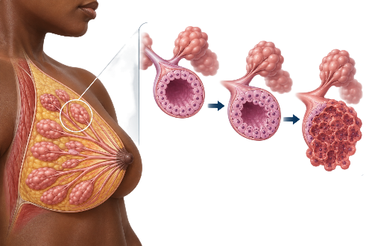
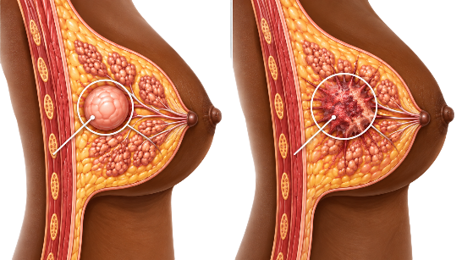
S E S S I O N 1
What breast cancer is
Ducts and lobules
Not one disease
Breast cancer develops when abnormal cells grow without normal control. Most arise from the epithelial cells lining the ducts or lobules.
Breast cancer includes biologically different diseases. Two tumours of the same size can behave very differently.
Breast Cancer | Frontline HCP | Rwanda Biomedical Centre

Slide 18
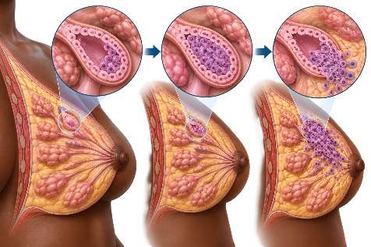
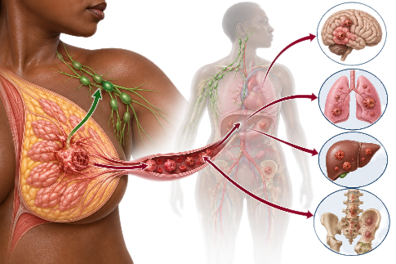
S E S S I O N 1
What breast cancer is
In situ and invasive
Spread
Some disease stays inside the duct or lobule for a period of time. Invasive cancer crosses into surrounding breast tissue.
Invasive disease may reach axillary lymph nodes, and may travel through the bloodstream to bone, liver, lung or brain.
Breast Cancer | Frontline HCP | Rwanda Biomedical Centre

Slide 19
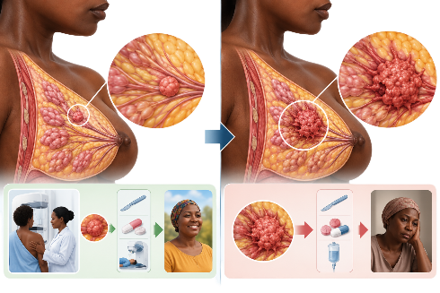
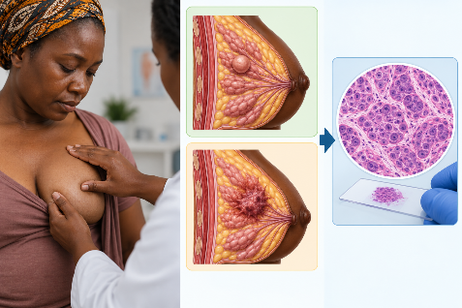
S E S S I O N 1
What breast cancer is
Earlier is better
A lump is not a diagnosis
Cancer found at a smaller size and before nodal spread offers more treatment options and better outcomes.
Most breast lumps are benign. A lump, an abnormal image or a suspicious examination raises suspicion. Tissue confirms the diagnosis.
Breast Cancer | Frontline HCP | Rwanda Biomedical Centre

Slide 20
S E S S I O N 1
How common it is worldwide
2,434,087
693,660
2nd
Estimated new breast cancer cases worldwide, 2024
Estimated breast cancer deaths worldwide, 2024
Most commonly diagnosed cancer overall, worldwide, 2024
Reading the rates
Rates are age-standardised, so populations of different ages can be compared. Rwanda's estimated rate sits close to the Eastern African average and well below the world rate.
Source: IARC Global Cancer Observatory, GLOBOCAN 2024 estimates. Breast cancer, all ages. These are modelled estimates, not registry-confirmed counts.
Breast Cancer | Frontline HCP | Rwanda Biomedical Centre

Slide 21


S E S S I O N 1
Africa and Rwanda
225,643
100,070
1st
Estimated new breast cancer cases in Africa, 2024
Estimated breast cancer deaths in Africa, 2024
Most frequent cancer in Africa, all cancers, 2024
1,684
813
1st
Estimated new breast cancer cases in Rwanda, 2024
Estimated breast cancer deaths in Rwanda, 2024
Most frequent cancer in women in Rwanda, 2024
These are modelled estimates from the IARC Global Cancer Observatory, GLOBOCAN 2024, not a complete count of registry-confirmed cases. Breast cancer occurs mainly in women, and uncommonly in men.
Breast Cancer | Frontline HCP | Rwanda Biomedical Centre

Slide 22
S E S S I O N 1
Where breast cancer sits in Rwanda
What this shows
Breast cancer is the second most frequent cancer in Rwanda in the 2024 estimates, and the most frequent cancer among women, just ahead of cervical cancer.
Why it matters to you
Most people first present because of a change they noticed themselves. The consultation in front of you is the main route to earlier diagnosis.
Source: IARC Global Cancer Observatory, GLOBOCAN 2024 estimates for Rwanda, both sexes, all ages.
Breast Cancer | Frontline HCP | Rwanda Biomedical Centre

Slide 23
S E S S I O N 1
The burden ahead
Breast cancer in Africa
A separate analysis of GLOBOCAN data projects about 1.12 million new breast cancer cases a year in Africa by 2050, from a 2022 baseline.
Read projections carefully
Projections describe what could happen if current patterns continue. They are not guaranteed outcomes. Growth is driven mainly by population growth and ageing.
Sources: Rwanda National Cancer Control Plan 2025 to 2029 (all cancers, 2022 to 2045). Africa breast cancer projection to 2050 is calculated from a GLOBOCAN 2022 baseline and is labelled separately from the GLOBOCAN 2024 estimates used elsewhere.
Breast Cancer | Frontline HCP | Rwanda Biomedical Centre

Slide 24

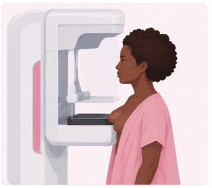

S E S S I O N 1
Diagnosed too late
73%
Below 50%
521,143
Of staged breast cancers in Rwanda were stage III or IV in 2023
National target for late-stage breast cancer diagnosis by 2029
People screened by clinical breast examination in Rwanda, 2019 to 2024
Source: Republic of Rwanda, Ministry of Health. National Cancer Control Plan 2025 to 2029.
Breast Cancer | Frontline HCP | Rwanda Biomedical Centre

Slide 25
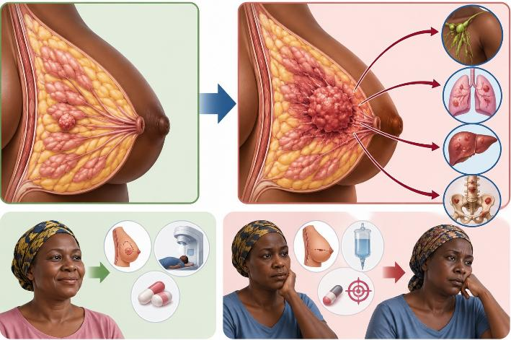
S E S S I O N 1
Diagnosed too late
Why late stage matters
Late-stage disease narrows treatment options, increases the chance that mastectomy and systemic treatment are needed, and lowers survival.

Slide 26
S E S S I O N 1
The WHO Global Breast Cancer Initiative: 60, 60, 80
Launched by WHO in 2021 to reduce breast cancer deaths by 2.5% each year. Rwanda is building these three targets into its national breast cancer guideline.
1
2
3
Early detection
Timely diagnosis
Comprehensive treatment
60% or more
60 days or less
80% or more
of invasive breast cancers diagnosed at stage I or II
from first presentation to diagnosis: assessment, imaging, tissue sampling and pathology
of patients complete their recommended multimodality treatment
Early detection → Timely diagnosis → Complete treatment → Better survival
Your part: every breast change you recognise, examine and refer without delay moves Rwanda closer to the first two targets.
Breast Cancer | Frontline HCP | Rwanda Biomedical Centre

Slide 27
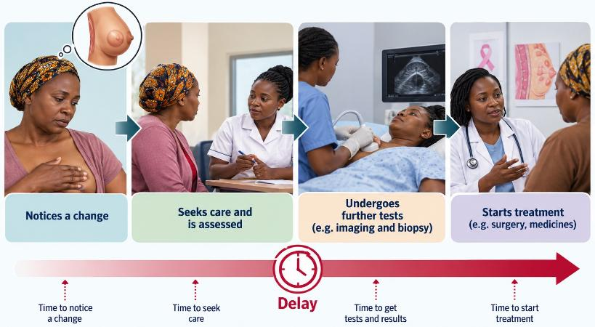
S E S S I O N 1
Diagnosed too late
Where the delay happens
Delay accumulates between noticing a change, seeking care, being assessed, reaching biopsy, and starting treatment. Every one of those steps is shortenable.

Slide 28
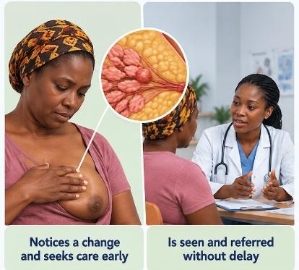
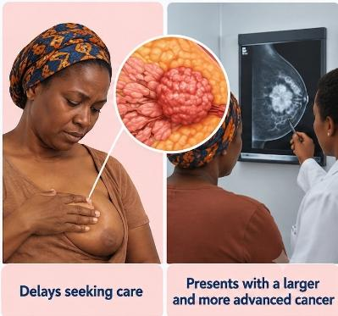
S E S S I O N 1
Diagnosed too late
Your part in it
Recognising a concerning breast change at first contact, and referring without a wait and see period, is the single largest thing you can change.

Slide 29
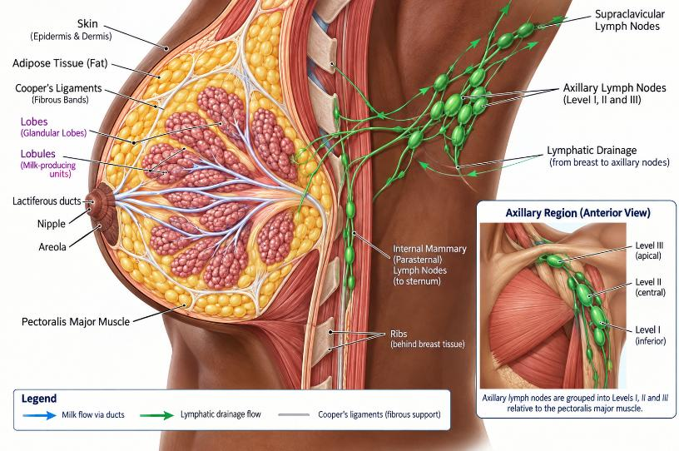
S E S S I O N 1
Breast anatomy
Breast Cancer | Frontline HCP | Rwanda Biomedical Centre

Slide 30
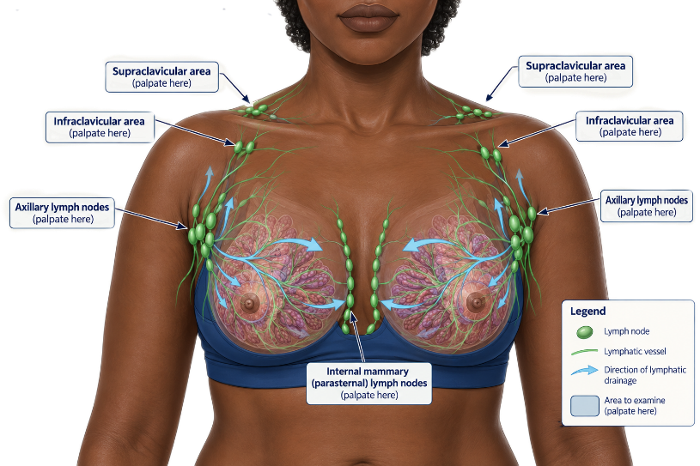
S E S S I O N 1
Lymphatic drainage
Breast Cancer | Frontline HCP | Rwanda Biomedical Centre

Slide 31
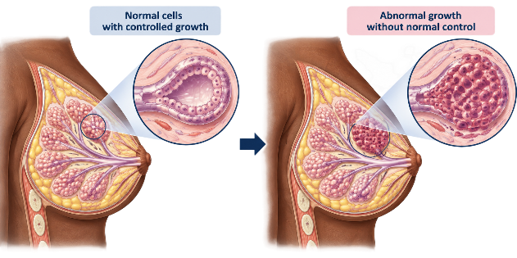
S E S S I O N 1
How breast cancer develops
Abnormal growth
In situ disease
Invasive cancer
Lymph node spread
Distant spread
Time and size
Cells lining a duct or lobule accumulate changes that let them grow without normal control. At this stage there is nothing to feel and nothing to see.
Breast Cancer | Frontline HCP | Rwanda Biomedical Centre

Slide 32
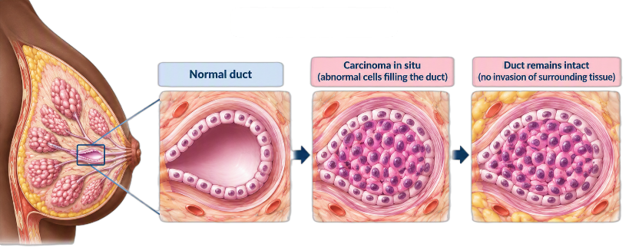
S E S S I O N 1
How breast cancer develops
Abnormal growth
In situ disease
Invasive cancer
Lymph node spread
Distant spread
Time and size
Abnormal malignant cells may fill the duct while remaining inside it. This is carcinoma in situ. It has not invaded surrounding breast tissue, and it does not always progress.
Breast Cancer | Frontline HCP | Rwanda Biomedical Centre

Slide 33
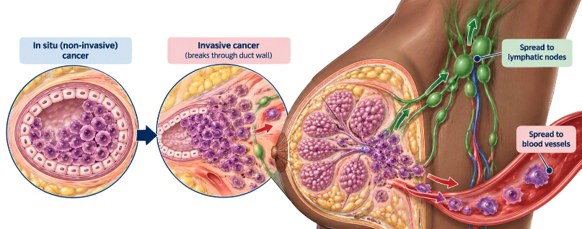
S E S S I O N 1
How breast cancer develops
Abnormal growth
In situ disease
Invasive cancer
Lymph node spread
Distant spread
Time and size
Some disease breaks through the wall of the duct or lobule and invades the surrounding breast tissue. This is invasive breast cancer, and it can now reach lymphatics and blood vessels.
Breast Cancer | Frontline HCP | Rwanda Biomedical Centre

Slide 34
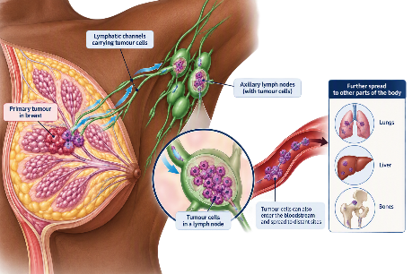
S E S S I O N 1
How breast cancer develops
Abnormal growth
In situ disease
Invasive cancer
Lymph node spread
Distant spread
Time and size
Tumour cells may travel along lymphatic channels and lodge in the axillary lymph nodes. Node involvement indicates that disease has moved beyond the breast.
Breast Cancer | Frontline HCP | Rwanda Biomedical Centre

Slide 35
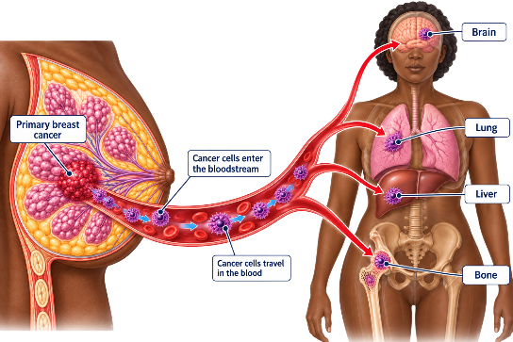
S E S S I O N 1
How breast cancer develops
Abnormal growth
In situ disease
Invasive cancer
Lymph node spread
Distant spread
Time and size
Cells carried in the bloodstream may establish deposits at distant sites. In breast cancer the common sites are bone, liver, lung and brain.
Breast Cancer | Frontline HCP | Rwanda Biomedical Centre

Slide 36
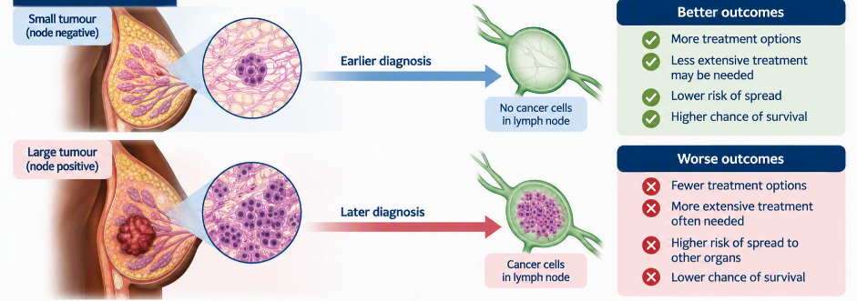
S E S S I O N 1
How breast cancer develops
Abnormal growth
In situ disease
Invasive cancer
Lymph node spread
Distant spread
Time and size
Tumours found while small and node negative are treated very differently from tumours found late. Shortening the interval between a change appearing and a diagnosis is what changes outcomes.
Breast Cancer | Frontline HCP | Rwanda Biomedical Centre

Slide 37
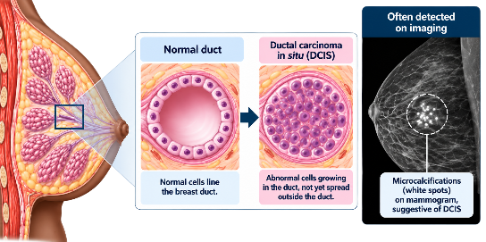
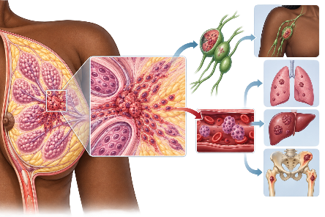
S E S S I O N 1
In situ and invasive disease
In situ disease
Invasive breast cancer
Malignant cells remain inside the duct or lobule where they arose and have not invaded surrounding breast tissue. Ductal carcinoma in situ, DCIS, is the main example. It is most often found through imaging rather than as a lump.
Malignant cells have crossed into surrounding breast tissue. From there they can reach lymphatics and blood vessels, and so may involve axillary nodes or distant organs. Most breast cancers diagnosed are invasive.
Breast Cancer | Frontline HCP | Rwanda Biomedical Centre

Slide 38
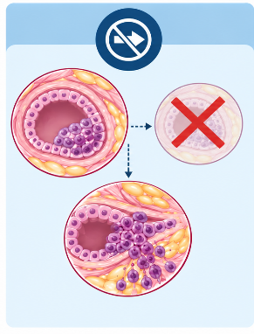
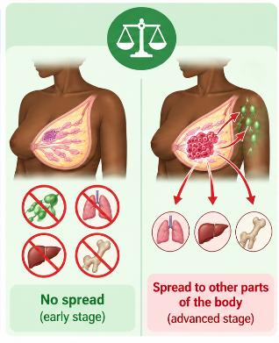

S E S S I O N 1
In situ and invasive disease
Not an inevitable sequence
Why the difference matters
What patients hear
Not all in situ disease progresses to invasive cancer. Treatment of DCIS aims to prevent the proportion that would.
In situ disease does not spread to nodes or distant organs. Staging, prognosis and treatment differ accordingly.
People often hear only the word carcinoma. Explain plainly that in situ means contained, and that this is a different situation from invasive cancer.
Breast Cancer | Frontline HCP | Rwanda Biomedical Centre

Slide 39
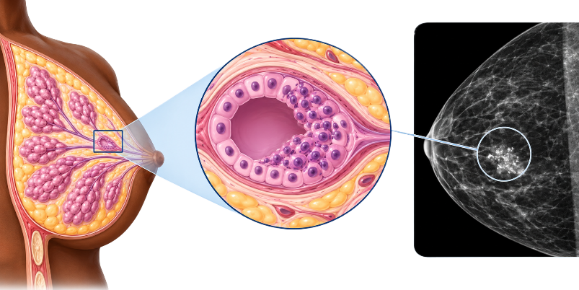
S E S S I O N 1
Types of breast cancer
Ductal carcinoma in situ
Malignant cells confined within the duct. Non-invasive. Often detected as calcifications on mammography rather than as a lump.
Breast Cancer | Frontline HCP | Rwanda Biomedical Centre

Slide 40
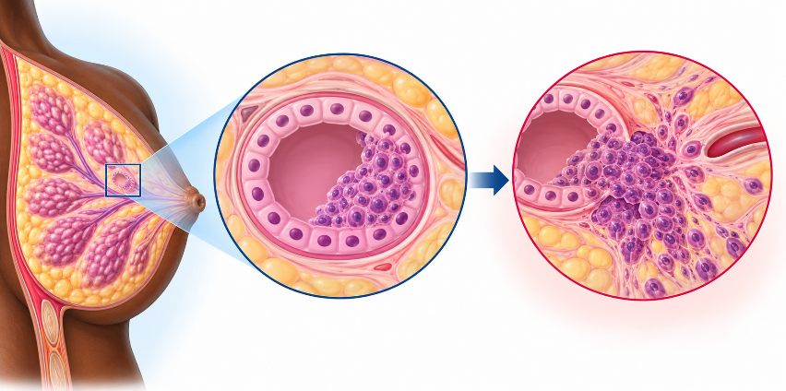
S E S S I O N 1
Types of breast cancer
Invasive carcinoma of no special type
Also called invasive ductal carcinoma. This is the most common invasive breast cancer and usually presents as a firm mass.
Breast Cancer | Frontline HCP | Rwanda Biomedical Centre

Slide 41
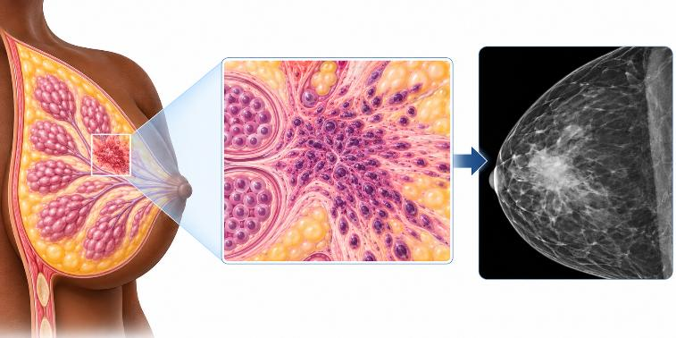
S E S S I O N 1
Types of breast cancer
Invasive lobular carcinoma
The second most common invasive type. It can grow diffusely, so it may present as thickening rather than a discrete lump and can be harder to see on imaging.
Histological type describes what the cells look like. Receptor subtype describes the biology that guides treatment. Both appear on the report.
Breast Cancer | Frontline HCP | Rwanda Biomedical Centre

Slide 42
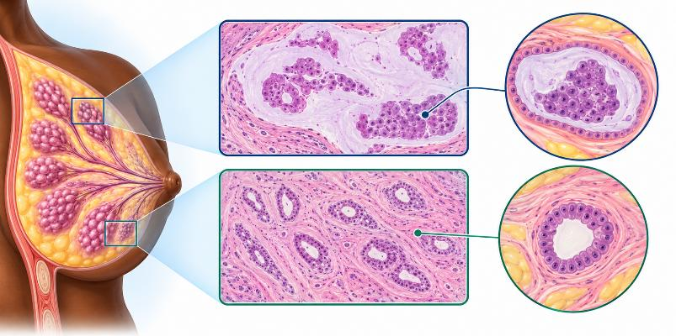
S E S S I O N 1
Types of breast cancer
Other special types
Several less common carcinomas exist, such as mucinous and tubular carcinoma. Their names appear on pathology reports and do not change your actions.
Nearly all breast cancers are carcinomas arising from epithelium. Sarcomas and lymphomas of the breast are rare.
Breast Cancer | Frontline HCP | Rwanda Biomedical Centre

Slide 43
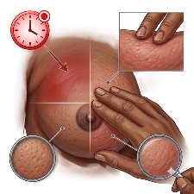
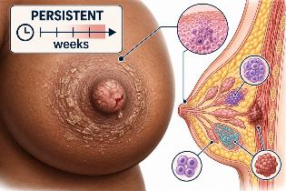
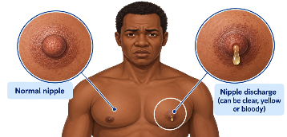
S E S S I O N 1
Presentations you must not miss
Inflammatory breast cancer
Paget disease of the nipple
Male breast cancer
Rapid breast swelling, diffuse redness, warmth, skin thickening and peau d'orange, often with no discrete lump. It can be mistaken for mastitis. Breast changes that do not resolve promptly with appropriate treatment need urgent assessment.
A persistent scaly, eczema-like or ulcerated change of the nipple and areola, sometimes with discharge. It can be associated with underlying in situ or invasive cancer. A nipple change that does not settle needs assessment, not repeated creams.
Uncommon but real. It usually presents as a firm, often painless lump behind or near the nipple, sometimes with nipple retraction or discharge. Assess a male breast mass rather than assuming gynaecomastia.
Rapid redness and swelling of a breast has several causes, including infection. Do not assume that a red breast is inflammatory breast cancer, and do not assume that it is only mastitis. Reassess deliberately and refer if the picture does not settle as expected.
Breast Cancer | Frontline HCP | Rwanda Biomedical Centre

Slide 44
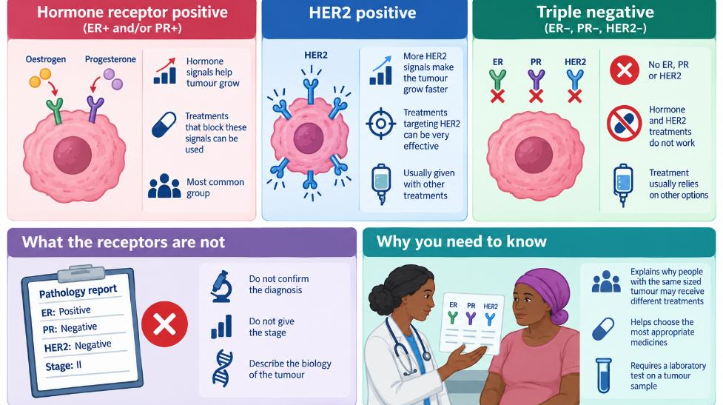
S E S S I O N 1
Tumour biology: the three results that shape treatment
Breast Cancer | Frontline HCP | Rwanda Biomedical Centre

Slide 45
S E S S I O N 1
Check your understanding
Scenario A pathology report describes a 1.8 cm invasive carcinoma of no special type, grade 2, ER positive, PR positive, HER2 negative.
Correct answer: C
Stage describes extent of spread, and it comes from tumour size, node status and distant assessment, not from the receptors. Grade describes how abnormal the cells look under the microscope. ER and PR positivity describes biology and indicates that endocrine therapy is likely to be part of treatment. Invasive carcinoma of no special type is invasive, not in situ.
Which statement is accurate?
A The receptor results tell you how far the cancer has spread
B Grade 2 means the cancer has reached the lymph nodes
C The receptor results describe tumour biology and indicate that endocrine therapy is likely to be relevant ✓
D In situ disease has been described in this report
Breast Cancer | Frontline HCP | Rwanda Biomedical Centre

Slide 46
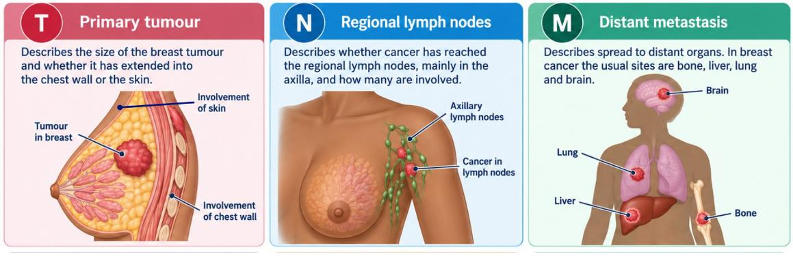
S E S S I O N 1
Staging: the TNM system
Stage combines T, N and M. It communicates how far the disease has spread, informs prognosis, and shapes treatment planning. You are not expected to assign a stage yourself, and you are expected to understand what the stage you are told actually means.
Breast Cancer | Frontline HCP | Rwanda Biomedical Centre

Slide 47
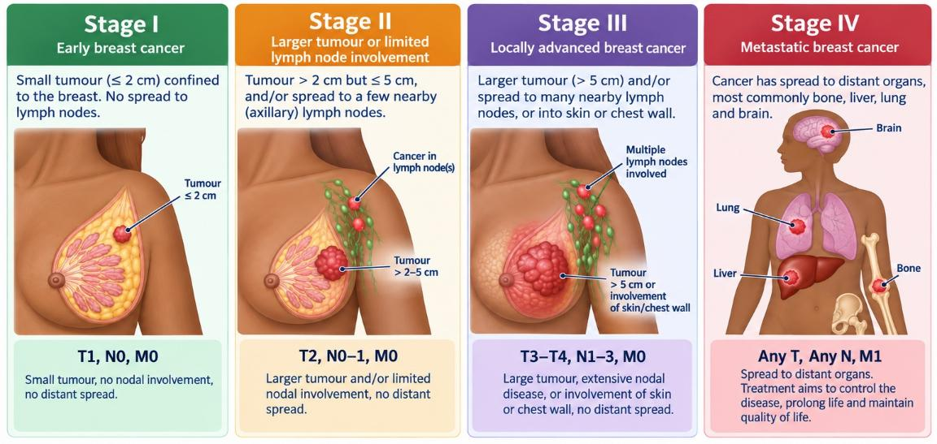
S E S S I O N 1
Stage: the extent or spread of the disease
Breast Cancer | Frontline HCP | Rwanda Biomedical Centre

Slide 48
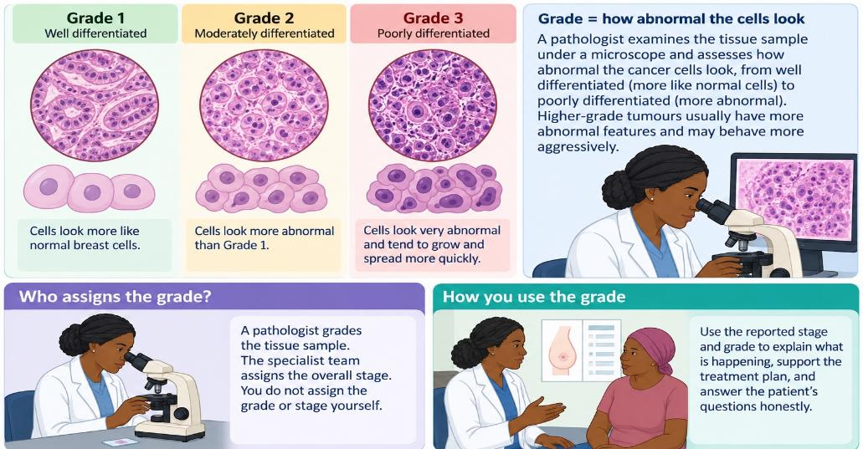
S E S S I O N 1
Grade: how abnormal the cells look
Breast Cancer | Frontline HCP | Rwanda Biomedical Centre

Slide 49
S E S S I O N 1
Knowledge check (1 of 3)
Q1. Most breast cancers arise from which tissue?
A. Chest wall muscle
B. Epithelium of the ducts and lobules
C. Axillary lymph node tissue
D. Fat within the breast
Correct: B. Breast cancers are overwhelmingly carcinomas arising from the epithelial cells lining the ducts and lobules.
Q2. A patient is told she has ductal carcinoma in situ. The accurate explanation is:
A. The cancer has spread to her lymph nodes
B. Abnormal cells are contained within the duct and have not invaded surrounding tissue
C. This is a benign cyst
D. No treatment or follow-up will be needed
Correct: B. In situ means contained within the duct. It has not invaded, so it does not spread to nodes or distant sites, and it is still treated because a proportion would progress.
Breast Cancer | Frontline HCP | Rwanda Biomedical Centre

Slide 50
S E S S I O N 1
Knowledge check (2 of 3)
Q3. Stage and grade differ because:
A. They mean the same thing
B. Stage is extent of spread and grade is how abnormal the cells look
C. Grade is the extent of spread
D. Stage refers only to tumour size
Correct: B. Stage is where and how far, built from T, N and M. Grade is the microscopic appearance of the tumour cells.
Q4. Breast cancer most commonly spreads to distant sites in the:
A. Bone, liver, lung and brain
B. Thyroid and parathyroid
C. Stomach and pancreas
D. Kidneys only
Correct: A. Bone is the most frequent site of distant spread in breast cancer, followed by liver, lung and brain. New persistent bone pain in someone treated for breast cancer should be assessed.
Breast Cancer | Frontline HCP | Rwanda Biomedical Centre

Slide 51
S E S S I O N 1
Knowledge check (3 of 3)
Q5. A tumour that lacks ER, lacks PR and is not HER2 positive is described as:
A. Hormone receptor positive
B. HER2 positive
C. Triple negative
D. In situ
Correct: C. Triple negative describes the absence of all three markers. Endocrine and HER2-directed therapies are not options, so treatment relies on other systemic approaches.
Q6. A woman describes a breast that became red, swollen and warm over two weeks, with thickened skin and no distinct lump. You should:
A. Reassure her that this cannot be cancer without a lump
B. Treat as infection and arrange review, with prompt referral if it does not settle as expected
C. Wait six months
D. Book routine screening
Correct: B. Inflammatory breast cancer can present exactly like this and often has no discrete lump. Infection is more common, so treat appropriately, but reassess deliberately and refer promptly if the picture does not resolve.
Breast Cancer | Frontline HCP | Rwanda Biomedical Centre

Slide 52
S E S S I O N 1
Session reflection
Enter your response in the text box. There is no single correct answer. These prompts are not scored, and are for your own practice and for discussion.
In your own words, how would you explain to a patient that carcinoma in situ is not the same as invasive breast cancer?
1
Which single point about the burden of breast cancer in Rwanda would you most want a community member to understand, and why?
2
Almost three quarters of staged breast cancers in Rwanda were advanced at diagnosis. Where in your own setting does that delay happen, and what part of it could you influence?
3
Breast Cancer | Frontline HCP | Rwanda Biomedical Centre

Slide 53
2
S e s s i o n 2
Screening and early detection
Follow Immaculée, 48, as you work through what screening is, which breast conditions are benign, what to look for, how to examine, and what an abnormal result actually means.
Breast Cancer | Frontline HCP | Rwanda Biomedical Centre

Slide 54
S E S S I O N 2
Learning objectives
Distinguish
Differentiate
Identify
Distinguish screening of a person without symptoms from assessment of a person with a breast change.
Differentiate common benign breast conditions from findings that need urgent assessment.
Identify established risk factors and separate average risk from increased risk.
Recognise
Assess
Interpret
Recognise concerning breast changes and the findings that need action without delay.
Perform a systematic breast and axillary examination and teach breast self-examination.
Interpret an abnormal imaging or examination finding and state the correct next step.
Breast Cancer | Frontline HCP | Rwanda Biomedical Centre

Slide 55
S E S S I O N 2
Meet Immaculée
Breast Cancer | Frontline HCP | Rwanda Biomedical Centre

Slide 56
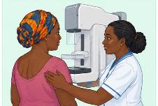

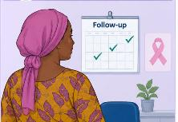
S E S S I O N 2
What screening is
Screening
Diagnostic assessment
Surveillance
Assessing people who have no breast symptoms, in order to find breast cancer earlier than it would otherwise be found.
Investigating a person who has a breast change, a suspicious examination, or an abnormal screening result. This is not screening.
Planned repeat assessment of someone already known to be at higher risk, for example after previous breast cancer or a high-risk lesion.
Never describe the investigation of a symptomatic breast lump as screening. It misrepresents the reason for the test to the patient, and it risks placing a person who needs assessment into a routine queue.
Breast Cancer | Frontline HCP | Rwanda Biomedical Centre

Slide 57
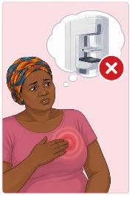
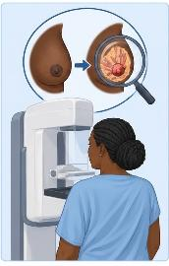
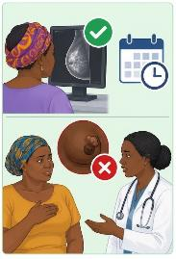
S E S S I O N 2
What screening is not
Immaculée is not a screening candidate
Screening finds what cannot be felt
A normal test does not close the door
Screening aims to detect disease before anything is noticeable. It cannot do its job for a person who already has a change.
She has a persistent breast lump. That is a symptom. She needs assessment of the breast itself, and a screening test would only add delay.
A previous normal screening result says nothing about a new breast change. New symptoms are always assessed on their own merits.
Breast Cancer | Frontline HCP | Rwanda Biomedical Centre

Slide 58
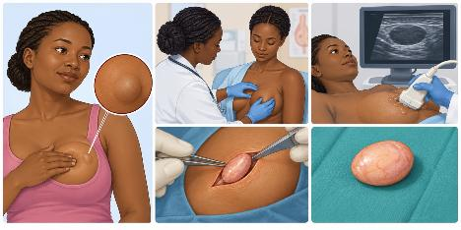
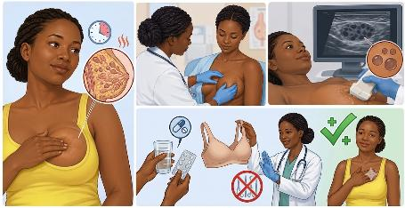
S E S S I O N 2
Benign breast conditions you will see
Fibroadenoma
Fibrocystic change
A smooth, firm, well-defined and often mobile lump, most common in younger women. Benign, and still assessed to confirm what it is.
Confirmed by assessment, then usually observed. Excision is considered if it is large, growing, symptomatic, or if the diagnosis is uncertain.
Lumpy or nodular breast tissue, often tender and often varying with the menstrual cycle. Common and benign.
Reassurance once assessed, with a well-fitting bra and simple analgesia for cyclical discomfort. No procedure is needed for the change itself.
Benign conditions are far more common than cancer, and a benign explanation is never assumed. Two things can coexist, so a finding that does not behave as expected is assessed rather than relabelled.
Breast Cancer | Frontline HCP | Rwanda Biomedical Centre

Slide 59
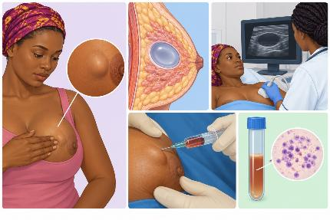
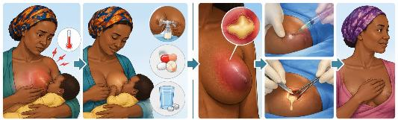
S E S S I O N 2
Benign breast conditions you will see
Simple cyst
Mastitis
Painful, red, warm, swollen breast, often with fever and commonly during breastfeeding. Continue feeding/expressing, ensure effective drainage, give analgesia and antibiotics when indicated; refer if it does not improve.
Breast abscess
Usually a fluctuant collection. It requires drainage by aspiration or incision plus antibiotics, with referral according to local capacity.
A fluid-filled swelling that may appear quickly and feel smooth and tense. Ultrasound distinguishes cystic from solid.
Left alone if it causes no trouble. A tense, painful cyst can be aspirated. Blood stained fluid, or a lump remaining afterwards, needs assessment.
Breast Cancer | Frontline HCP | Rwanda Biomedical Centre

Slide 60
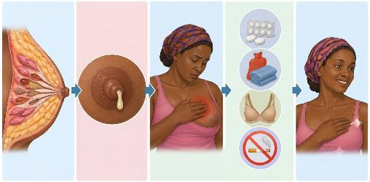
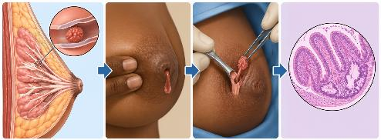
S E S S I O N 2
Benign breast conditions you will see
Duct ectasia and periductal changes
Intraductal papilloma
Dilated ducts beneath the areola, sometimes with thick discharge, nipple tenderness or nipple retraction, usually around the menopause.
Managed conservatively with reassurance, analgesia, warm compresses and smoking cessation where relevant.
A small benign growth within a duct. A common cause of single-duct nipple discharge, which may be blood stained.
Assessed and usually excised, both to treat the discharge and to confirm the diagnosis on tissue.
Gynaecomastia in men is benign enlargement of breast tissue, usually symmetrical, soft and centred behind the nipple. A firm, hard or eccentric mass, skin change, nipple retraction or bloody discharge in a man is not gynaecomastia and needs assessment.
Breast Cancer | Frontline HCP | Rwanda Biomedical Centre

Slide 61
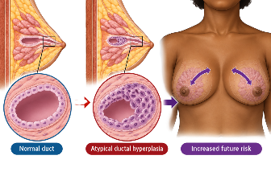
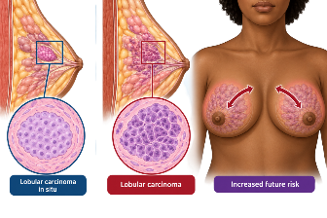
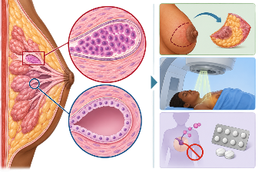
S E S S I O N 2
Lesions that carry increased risk
Atypical ductal hyperplasia
Lobular carcinoma in situ
Ductal carcinoma in situ
Abnormal cells within a duct that fall short of carcinoma in situ. It is not cancer, and it marks an increased future risk in both breasts.
Despite its name it is treated as a risk marker rather than as a cancer that must be removed. It signals increased future risk in both breasts.
A true non-invasive malignancy confined to the duct. It is treated, usually with surgery and sometimes radiotherapy or endocrine therapy.
Normal Duct
Atypical ductal hyperplasia
Increased future risk
Lobular carcinoma in situ
Lobular carcinoma
Increased future risk
Breast Cancer | Frontline HCP | Rwanda Biomedical Centre

Slide 62
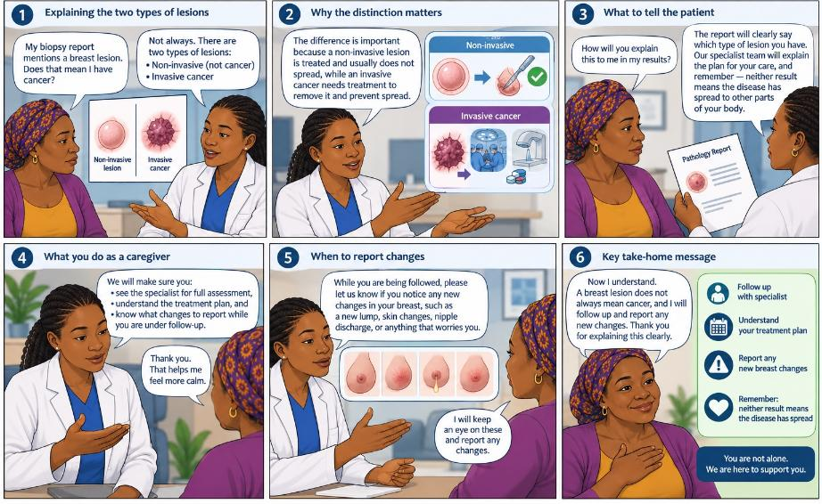
S E S S I O N 2
How to inform about lesions that carry increased risk
Breast Cancer | Frontline HCP | Rwanda Biomedical Centre

Slide 63
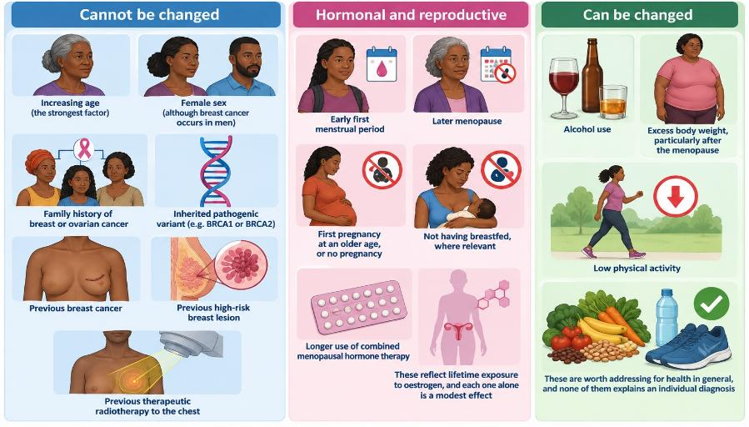
S E S S I O N 2
Risk factors
Risk factors help you decide who needs a lower threshold for assessment and a fuller history. They do not diagnose anyone. Many people who develop breast cancer have no identifiable risk factor beyond age and sex, and no one should be blamed for their diagnosis.
Breast Cancer | Frontline HCP | Rwanda Biomedical Centre

Slide 64
S E S S I O N 2
Family history and hereditary risk
What to ask
Ask about breast, ovarian, prostate and pancreatic cancer in parents, siblings, children and grandparents, and at what age each occurred.
Patterns that stand out
Breast cancer at a young age, breast and ovarian cancer in one family, male breast cancer, cancer in both breasts, or several affected relatives.
BRCA1 and BRCA2
Inherited pathogenic variants in these genes substantially increase breast and ovarian cancer risk. They explain a minority of all breast cancers.
Your role
Take the family history, record it, explain that a pattern may justify specialist assessment, and refer. You are not expected to diagnose a syndrome.
Avoid alarm
A family history is a reason for assessment, not a diagnosis. Say what is known and what the next step is, without predicting an outcome.
Most cancers are not inherited
The majority of people with breast cancer have no strong family history. Absence of family history never makes a breast change less worth assessing.
Breast Cancer | Frontline HCP | Rwanda Biomedical Centre

Slide 65







S E S S I O N 2
Breast changes that need assessment
A new lump or thickening
Change in size or shape
Skin changes
In the breast or in the axilla. Persistent, and often painless. Pain does not confirm or exclude anything.
New asymmetry, a change in contour, or a part of the breast that looks pulled in.
Dimpling, tethering, retraction, thickening, or a peau d'orange appearance resembling orange peel.
Nipple changes
Nipple discharge
Axillary findings
New inversion or retraction, distortion, or a persistent scaly or ulcerated change of the nipple and areola.
Spontaneous discharge, particularly from a single duct, and particularly if blood stained.
A persistent lump or swelling in the armpit, or above or below the collarbone.
Most breast lumps are benign, and pain alone is not the typical presentation of breast cancer. What matters is that a change is new for that person, persistent, and unexplained. Ask how long it has been there, whether it has changed, and whether it varies with the menstrual cycle.
Breast Cancer | Frontline HCP | Rwanda Biomedical Centre

Slide 66
S E S S I O N 2
Findings that need action without delay
Refer urgently: within 24 hours
Refer promptly
Assess, then decide
A rapidly enlarging breast mass
Rapid breast swelling, redness and skin thickening that does not settle as expected with treatment for infection
A fixed or ulcerating breast mass
A persistent scaly or ulcerated nipple change
A fixed or enlarging axillary or supraclavicular node
Any breast finding with new bone pain, breathlessness, jaundice or neurological symptoms
Any new discrete breast lump that persists
Persistent focal thickening or a change in breast contour
New nipple retraction or distortion
Spontaneous single-duct or blood-stained nipple discharge
A new breast mass in a man
A persistent breast change during pregnancy or breastfeeding, which is assessed and not attributed to feeding
Cyclical bilateral breast pain with normal examination
Long-standing nodularity that is unchanged and has been assessed before
Bilateral milky discharge, which prompts a different line of enquiry
Any of these that changes, persists or becomes focal moves into the prompt column
Breast Cancer | Frontline HCP | Rwanda Biomedical Centre

Slide 67

S E S S I O N 2
Breast awareness
Breast Cancer | Frontline HCP | Rwanda Biomedical Centre

Slide 68
S E S S I O N 2
Teaching breast self-examination in a consultation
Say
Know your own normal: Breasts differ between people and change across the cycle, in pregnancy and after the menopause. The aim is to know what is usual for her.
Show
Look and feel, once a month: From age 25, teach monthly breast self-examination: looking in a mirror, then feeling the whole breast and armpit, standing and lying down. The next two screens show the steps.
Name
The changes worth reporting: A new lump or thickened area, a change in size or shape, skin dimpling, a nipple that turns in or changes, discharge, or a lump in the armpit.
Agree
What to do if she finds something: Come to the health centre without waiting for the change to disappear and without waiting for pain. Name the facility.
Close
Remove the blame and the fear: Most changes are not cancer, being checked is normal and private, and finding something is not her fault.
Breast Cancer | Frontline HCP | Rwanda Biomedical Centre

Slide 69

S E S S I O N 2
Breast self-examination (1 of 2): look
Teach this from age 25, once a month. She stands in front of a mirror, undressed to the waist.
1
Arms at her sides: Look at both breasts for anything unusual: a change in size or shape, puckering, dimpling, scaling of the skin, or discharge from a nipple.
2
Hands behind her head: Clasp the hands behind the head and press them forward. Watch closely for any change in shape or contour.
3
Hands on her hips: Press the hands firmly on the hips and bow slightly towards the mirror, pulling the shoulders and elbows forward. Look again.
💡 Steps 2 and 3 tighten the chest muscles, which makes a change in the contour of the breast easier to see.
Breast Cancer | Frontline HCP | Rwanda Biomedical Centre

Slide 70

S E S S I O N 2
Breast self-examination (2 of 2): feel
4
Raise one arm: Raise the left arm. With 3 or 4 fingers of the right hand, press with the flat of the fingers in small circles, from the outer edge towards the nipple, covering the whole breast and the armpit. Repeat on the right.
5
Check the nipples: Gently squeeze each nipple and look for any discharge.
6
Repeat lying down: Lie flat, one arm behind the head and a small pillow or folded cloth under that shoulder. Repeat steps 4 and 5 on each breast.
✅ Any new lump, change in size or skin, nipple change or discharge: come to the health centre promptly. Do not wait for pain.
Breast Cancer | Frontline HCP | Rwanda Biomedical Centre

Slide 71
S E S S I O N 2
Clinical breast examination: the steps at a glance
Prepare
Consent, privacy and a chaperone: Explain what you will do, obtain consent, use a private room, offer a chaperone, and uncover only as long as needed.
Inspect
Sitting, in three positions: Arms relaxed, hands pressed on the hips, then arms raised. Compare size, shape, skin and nipples on both sides.
Nodes
Sitting, on both sides: Cervical, supraclavicular, infraclavicular and axillary nodes, with her arm resting on your shoulder.
Palpate
Lying down, arm above the head: Pads of three fingers, small circles, three levels of pressure, in vertical strips over the whole breast and axillary tail.
Describe
Any finding: Side, clock position and distance from the nipple, size, shape, consistency, borders, mobility and tenderness.
Record
Findings and next step: Record what you found, including a normal examination, and the action taken, then explain what happens next.
Breast Cancer | Frontline HCP | Rwanda Biomedical Centre

Slide 72
S E S S I O N 2
Before you examine: six questions to ask
How long?
When did she first notice the change, and has it changed since?
Other symptoms?
Pain, nipple discharge, skin change, fever, or a lump in the armpit?
Pregnant or breastfeeding?
And does the change vary with her menstrual cycle?
Breast problems before?
Has she had this before, or treatment for this or another breast problem?
Breast cancer before?
Has she ever been treated for breast cancer?
Family history?
Breast or ovarian cancer in close relatives, and at what age?
📋 Record the date she first noticed the change and the date of today’s visit. Together they show how long the diagnosis has been delayed.
Breast Cancer | Frontline HCP | Rwanda Biomedical Centre

Slide 73

S E S S I O N 2
Know the territory: boundaries and quadrants
Boundaries of the breast
Upper: the collarbone. Lower: the fold under the breast.
Inner: the middle of the breastbone. Outer: the mid-axillary line.
The axillary tail
Breast tissue extends up into the armpit. Include it in every examination.
Six areas to name
Upper outer, upper inner, lower inner and lower outer quadrants; the nipple and areola; and the axillary tail.
Breast Cancer | Frontline HCP | Rwanda Biomedical Centre

Slide 74

S E S S I O N 2
Describe the location: use a clock face
Picture a clock on each breast as you face the person: 12 o’clock at the top, the nipple at the centre. You findings should record the side, the clock position, and the distance from the nipple in centimetres.
🔎 Examples
Look at the image. Look at Mass A and Mass B locations.
Mass A
Right breast, 10 o’clock, 3 cm from the nipple. Upper outer quadrant.
Mass B
Left breast, 7 o’clock, 4 cm from the nipple. Lower inner quadrant.
Because you face the person, the same clock position points to a different quadrant on each side. The clock and the distance let the next clinician find the same spot.
Breast Cancer | Frontline HCP | Rwanda Biomedical Centre

Slide 75
S E S S I O N 2
Step 1: Prepare the person
1
Kindness and respect: Greet her, explain why the examination matters and what you will do, and ask if she has any questions.
2
Privacy: Use a private room, close the door or curtain, and offer a chaperone. Offer a female health worker if she prefers.
3
Consent: Ask her permission before you begin, and tell her she can ask you to stop at any time.
4
What to expect: You will examine both breasts and both armpits, first sitting and then lying down. It takes a few minutes.
💬 She undresses from the waist up only when needed. Cover her with a cloth between steps.
Breast Cancer | Frontline HCP | Rwanda Biomedical Centre

Slide 76

S E S S I O N 2
Step 2: Look, with the person sitting
Three positions
1. Arms relaxed at her sides.
2. Hands pressed firmly on her hips.
3. Arms raised, hands pressed together above her head.
Compare both sides
Size, shape and symmetry. Skin: colour, dimpling, puckering, redness, thickening, peau d’orange, ulceration. Nipple: new inversion, scaling, discharge.
🎯 Goal: identify any visible abnormality or asymmetry.
Breast Cancer | Frontline HCP | Rwanda Biomedical Centre

Slide 77

S E S S I O N 2
Step 3: Feel the lymph nodes, sitting
Where to feel, on both sides
Neck: cervical nodes.
Collarbone: supraclavicular and infraclavicular nodes.
Armpit: rest her arm on your shoulder or support it at the elbow, so the muscles relax. Feel high into the armpit and along its walls.
For any node, note
Size, consistency, tenderness, and whether it moves freely or is fixed.
🎯 Goal: identify enlarged nodes. A hard, fixed or enlarging node needs urgent referral.
Breast Cancer | Frontline HCP | Rwanda Biomedical Centre

Slide 78

S E S S I O N 2
Step 4: Feel the breast, lying down
1
Position: She lies flat with the arm of the side you examine raised above her head. This spreads the breast over the chest wall.
2
Fingers: Use the pads of your middle three fingers, not the tips. Keep them in contact with the skin.
3
Pressure: At each spot, make small circles at three levels of pressure: light, medium, then deep.
🎯 Goal: identify any abnormal mass, thickening, tenderness or nipple discharge.
Breast Cancer | Frontline HCP | Rwanda Biomedical Centre

Slide 79

S E S S I O N 2
Step 4 (continued): cover the whole breast
4
Pattern: Move in vertical strips, up and down, from the armpit to the middle of the breastbone, and from the collarbone to below the breast fold.
5
Do not miss: The axillary tail, the area under the nipple and areola, and the fold under the breast.
6
Take your time: About 2 to 3 minutes for each breast. Then examine the other side the same way.
💡 Examine with flat finger pads. Squeezing tissue between thumb and fingers can make normal tissue feel like a lump.
Breast Cancer | Frontline HCP | Rwanda Biomedical Centre

Slide 80
S E S S I O N 2
Normal breast changes through life
Puberty
Ducts grow and branch, and lobules form. The breasts feel dense.
Menstrual cycle
Before a period, breasts can be fuller, tender and more nodular. Examination is easiest in the week after the period.
Pregnancy
Breasts grow, may be tender, and may secrete a little milk.
Breastfeeding
Ducts and lobules are fully developed. The breasts feel full and dense.
After the menopause
Lobules decrease. Breasts become softer and less dense, so a lump is easier to feel.
Always
Soft, fine nodularity on both sides is normal. A firmer ridge along the breast fold is normal.
⚠️ A change that is new, persistent, and different from the other side needs assessment at any age and at any stage of life.
Breast Cancer | Frontline HCP | Rwanda Biomedical Centre

Slide 81
S E S S I O N 2
Step 5: Describe and record what you find
For any mass, record
Location: side, clock position, distance from the nipple.
Size: in centimetres.
Shape and borders: regular or irregular.
Consistency: soft, firm or hard.
Mobility: moves freely, or fixed to skin or chest wall.
Also: tenderness, skin and nipple changes, nodes.
Example of a good record
Left breast, 2 o’clock, 4 cm from the nipple: 2 cm firm, irregular mass, fixed to the skin, with dimpling of the overlying skin. No axillary or supraclavicular nodes felt. Right breast normal.
📋 Record a normal examination too. A written baseline shows later whether something is new.
Breast Cancer | Frontline HCP | Rwanda Biomedical Centre

Slide 82

S E S S I O N 2
At the health centre: breast concern, not breastfeeding
⏱️ How fast: use the urgent and prompt lists. Urgent referral is within 24 hours. Explain the reason, and record the finding and the destination.
Breast Cancer | Frontline HCP | Rwanda Biomedical Centre

Slide 83

S E S S I O N 2
At the health centre: breast concern while breastfeeding
⏱️ Review every treated woman at the health centre in 14 days. Resolved: discharge. Not resolved or worse: refer to the district hospital, because inflammatory breast cancer can look like mastitis.
Breast Cancer | Frontline HCP | Rwanda Biomedical Centre

Slide 84
S E S S I O N 2
What would you do next? (1 of 2)
🩺 Béatrice Mukamana, 45: Not breastfeeding. A lump in the left breast for one month. On examination: skin dimpling at 2 o’clock over a 2 cm firm mass fixed to the skin. No nodes felt.
A. Reassure and review in 14 days
B. Give antibiotics and review
C. Refer to district hospital within 24 hours
D. Book her next routine breast check
Correct: C. A fixed mass with skin dimpling is on the urgent list. Refer within 24 hours, explain that the tests will find out what the lump is, and record it as left breast, 2 o’clock.
🩺 Claudine Uwimana, 27: Breastfeeding a 3-month-old baby. For two days her right breast has been red, hot and tender, with fever. You feel no mass.
A. Tell her to stop breastfeeding
B. Continue feeding; treat mastitis; review in 14 days
C. Refer urgently for drainage
D. No treatment; review in 3 months
Correct: B. This is mastitis without a mass. Breastfeeding continues and helps drainage. If it has not resolved at review, or a mass appears, refer to the district hospital.
Breast Cancer | Frontline HCP | Rwanda Biomedical Centre

Slide 85
S E S S I O N 2
What would you do next? (2 of 2)
🩺 Josiane Ingabire, 34: Not breastfeeding. Both breasts are tender in the week before her period. Examination of both breasts and armpits is normal.
A. Refer urgently
B. Treat symptoms; review in 14 days
C. Start antibiotics
D. Tell her the pain proves it is not cancer
Correct: B. Cyclical pain in both breasts with a normal examination does not need referral. If it persists or worsens, or a new sign appears, refer. Pain alone neither confirms nor excludes cancer.
🩺 Aline Mukeshimana, 30: Breastfeeding. Fever and a painful, red left breast with a soft, tender 3 cm lump that feels full of fluid.
A. Stop breastfeeding and give antibiotics only
B. Continue feeding; refer urgently for drainage
C. Review in 14 days
D. Massage the lump firmly until it goes
Correct: B. A tender, fluid-filled lump with signs of infection suggests an abscess. It needs drainage, which antibiotics alone will not achieve. Breastfeeding can usually continue.
Breast Cancer | Frontline HCP | Rwanda Biomedical Centre

Slide 86

S E S S I O N 2
What clinical breast examination can and cannot do
Breast Cancer | Frontline HCP | Rwanda Biomedical Centre

Slide 87

S E S S I O N 2
Mammography
Breast Cancer | Frontline HCP | Rwanda Biomedical Centre

Slide 88

S E S S I O N 2
Ultrasound and magnetic resonance imaging

Slide 89

S E S S I O N 2
Breast screening in Rwanda: who and how
Rwanda breast cancer early detection, by age:
Age 25 to 29: Monthly breast self-examination, taught at the health facility
Age 30 and above: Annual clinical breast examination (CBE) at the health facility
Age 40 and above: Annual CBE plus mammography where available. Where it is not available, continue annual CBE
Any age with symptoms or a new breast change: Diagnostic assessment and referral to hospital. Do not wait for routine screening.
This approach reflects Rwanda’s national guidance and is aligned with the WHO Global Breast Cancer Initiative.
Breast Cancer | Frontline HCP | Rwanda Biomedical Centre

Slide 90

S E S S I O N 2
Screening programmes: Rwanda
Rwanda’s breast cancer screening program is
in development
The National Cancer Control Plan 2025 to 2029 describes opportunistic breast cancer screening rather than an organised population mammography programme. Clinical breast examination is the method in use, delivered through health centres and alongside cervical cancer screening activities, and mammography exists in only a small number of facilities.
Rwanda’s targets follow the WHO Global Breast Cancer Initiative: at least 60% of invasive breast cancers diagnosed at stage I or II, diagnosis within 60 days of first presentation, and at least 80% of patients completing recommended treatment.
✅ Rwanda’s approach: women aged 30 and above; clinical breast examination every year; mammography from age 40 where available, otherwise continue annual CBE. Referral: any woman with an abnormal breast examination, such as a lump, or any symptom suggesting breast cancer, is referred to hospital.
Breast Cancer | Frontline HCP | Rwanda Biomedical Centre

Slide 91
S E S S I O N 2
Benefits and limitations of screening
🟢 Earlier detection
🟢 Fewer deaths
🟢 Less aggressive treatment
Cancer found before it can be felt is more often smaller and node negative, which widens treatment options.
Effective programmes reduce breast cancer mortality.
Smaller tumours found early are more often suitable for breast conserving surgery.
🟠 False positives
🟠 False negatives
🟠 Overdiagnosis and burden
Many people with an abnormal screening result do not have cancer, yet all of them go through further tests and the anxiety that follows.
A normal result can falsely reassure. A change that appears later must still be assessed.
Some detected disease would never have caused harm, and travel, cost and time away from work are real. Present benefits and limitations neutrally.
Screening only delivers benefit when the whole pathway works. An abnormal result that is never followed by imaging, biopsy and treatment produces anxiety without gain.
Breast Cancer | Frontline HCP | Rwanda Biomedical Centre

Slide 92
S E S S I O N 2
After an abnormal screening or examination finding
Step 1
Say what it is not: State plainly that this does not mean cancer has been found, and that a further test is needed to find out what the change is.
Step 2
Explain the next test: Explain that the breast needs to be imaged and that a small tissue sample may be taken, what each involves, and roughly how long it takes.
Step 3
Arrange it: Make the referral yourself, name the facility, and record where and when it will happen. Do not leave the person to arrange it alone.
Step 4
Address the barriers: Ask about transport, cost, time away from work, childcare, and who can accompany her, and help work around what you can.
Step 5
Close the loop: Agree how the result will be checked, and follow up actively if the person does not attend.
If a breast change is present, assessment goes ahead regardless of any screening result. A previous normal test never overrides a new symptom.
Breast Cancer | Frontline HCP | Rwanda Biomedical Centre

Slide 93
S E S S I O N 2
Apply it to Immaculée
Scenario Immaculée asks whether she could simply come back for the breast check that the health centre offers when the cervical screening team next visits.
Correct answer: B
Immaculée has a persistent breast lump that she believes has grown over five months. That is symptomatic disease, so she needs diagnostic assessment now, not a screening opportunity later. The absence of pain and the absence of family history do not make it less concerning. Explain the reason for referral clearly, without stating that she has cancer.
What is the most appropriate response?
A Agree, and add her name to the list for the next visit
B Explain that because she already has a lump she needs assessment of the breast now, and arrange referral ✓
C Reassure her that a painless lump at her age is almost always harmless
D Advise her to watch it for another three months and return if it grows
Breast Cancer | Frontline HCP | Rwanda Biomedical Centre

Slide 94
S E S S I O N 2
Knowledge check (1 of 4)
Q1. Screening applies to:
A. People with a breast lump
B. People who have no breast symptoms
C. People already diagnosed
D. People awaiting surgery
Correct: B. Screening is early detection in people with no symptoms. A person with a breast change needs diagnostic assessment instead.
Q2. A woman of 52 has an abnormal screening mammogram and feels completely well. The correct next step is:
A. Tell her that she has breast cancer
B. Arrange further breast assessment and explain that cancer is not confirmed
C. Repeat the mammogram in two years
D. Take no action because she has no symptoms
Correct: B. An abnormal mammogram means something needs further evaluation. It triggers additional imaging and, where indicated, tissue diagnosis. It is not a diagnosis in itself.
Breast Cancer | Frontline HCP | Rwanda Biomedical Centre

Slide 95
S E S S I O N 2
Knowledge check (2 of 4)
Q3. A 35 year old has a smooth, firm, mobile 2 cm lump that she has noticed for two months. You should:
A. Tell her it is a fibroadenoma and take no further action
B. Refer her for assessment, since the clinical impression of a benign lump still requires confirmation
C. Prescribe antibiotics
D. Advise a mammogram as a screening test
Correct: B. The description fits a fibroadenoma, and clinical impression alone does not confirm it. A new discrete lump is assessed. Most will prove benign, and that is precisely why assessment is safe to offer without alarm.
Q4. Which statement about breast pain is correct?
A. A painful lump is always benign
B. A painless lump can be ignored
C. Pain characteristics alone neither confirm nor exclude breast cancer
D. Cancer is the usual cause of cyclical breast pain
Correct: C. Pain is a poor discriminator. Most breast cancers are painless, and pain does not exclude malignancy. Assess the whole clinical picture rather than relying on pain.
Breast Cancer | Frontline HCP | Rwanda Biomedical Centre

Slide 96
S E S S I O N 2
Knowledge check (3 of 4)
Q5. A woman says no one in her family has had breast cancer, so she cannot have it. The accurate response is:
A. She is correct and needs no assessment
B. Most people who develop breast cancer have no family history, so her change still needs assessment
C. Family history is the only risk factor that matters
D. She should be screened only if a relative is affected
Correct: B. Family history raises risk, and its absence excludes nothing. The majority of people diagnosed with breast cancer have no strong family history.
Q6. A breastfeeding woman has a red, painful, swollen breast that has not improved after a full course of appropriate treatment. You should:
B. Reassess and refer, because inflammatory breast cancer can present this way
A. Repeat the same antibiotic and review in a month
C. Advise her to stop breastfeeding and take no further action
D. Reassure her that this cannot be cancer while she is breastfeeding
Correct: B. Mastitis is far more common, and inflammatory changes that do not settle require assessment. Pregnancy and breastfeeding do not exclude breast cancer.
Breast Cancer | Frontline HCP | Rwanda Biomedical Centre

Slide 97
S E S S I O N 2
Knowledge check (4 of 4)
Q7. Which palpation technique is most reliable?
A. Fingertips, pressing once in each quadrant
B. Pads of three fingers, small circles at three pressures, in vertical strips
C. Only where the person reports a lump
D. Squeezing tissue between thumb and fingers
Correct: B. A fixed pattern at three depths covers the whole breast, including the axillary tail, so nothing is missed. Grasping tissue can make normal tissue feel like a lump.
Q8. A woman of 32 with no breast symptoms asks which breast check she needs. You advise:
A. Mammography every year from now
B. Annual clinical breast examination at the health facility
C. No check until age 50
D. Self-examination only, with no clinical check
Correct: B. In Rwanda, annual clinical breast examination starts at age 30, and mammography is added from age 40 where available. A new breast change at any age is assessed straight away.
Breast Cancer | Frontline HCP | Rwanda Biomedical Centre

Slide 98
S E S S I O N 2
Session reflection
Enter your response in the text box. There is no single correct answer. These prompts are not scored, and are for your own practice and for discussion.
How would you explain an abnormal mammogram to a patient without telling her that she has cancer, and without dismissing the result?
1
Which breast change is most often dismissed as harmless in your own setting, and what would change that?
2
What barrier most often prevents someone in your setting from completing a breast assessment referral, and what could you do about it?
3
Breast Cancer | Frontline HCP | Rwanda Biomedical Centre

Slide 99
3
S e s s i o n 3
Referral and counselling
Turn a concerning finding into the right next step: refer with the right urgency, record what the registry needs, and counsel about fear, surgery and body image with care.
Breast Cancer | Frontline HCP | Rwanda Biomedical Centre

Slide 100
S E S S I O N 3
Learning objectives
Describe
Decide
Record
Describe the levels of the Rwandan referral system and where breast assessment happens.
Decide whether a breast presentation needs routine, prompt or urgent referral.
Record the information the national cancer registry needs at first contact.
Counsel
Support
Follow up
Counsel clearly about an abnormal result and about what will happen next.
Give basic psychological support, including around fear of surgery and body image.
Support attendance and close the loop when someone does not attend.
Breast Cancer | Frontline HCP | Rwanda Biomedical Centre

Slide 101

S E S S I O N 3
The referral pathway
Breast Cancer | Frontline HCP | Rwanda Biomedical Centre

Slide 102
S E S S I O N 3
How urgently to refer
🔴 Urgent: within 24 hours
🟠 Prompt, do not wait and see
🔵 Routine specialist opinion
Suspected inflammatory breast cancer
A fixed or ulcerating breast mass
A rapidly enlarging mass
A persistent scaly or ulcerated nipple change
A fixed or enlarging axillary or supraclavicular node
Any breast finding with new bone pain, breathlessness, jaundice, or new neurological symptoms
Any new discrete breast lump that persists
Persistent focal thickening or a change in breast contour
New nipple retraction or distortion
Spontaneous single-duct or blood-stained nipple discharge
An abnormal screening or imaging result requiring work-up
A new breast mass in a man
A persistent breast change in pregnancy or breastfeeding
A significant family history in a person with no breast symptoms
A previously assessed benign condition that now needs review
Follow-up of a known risk lesion
Anything in this column that changes, grows or becomes focal moves up a column
Breast Cancer | Frontline HCP | Rwanda Biomedical Centre

Slide 103

SESSION 3
What to record at first contact
Note: In the absence of routine testing, your clinical judgement is the data. A record completed at first suspicion and updated later is far more useful than a blank form waiting for a confirmatory test.
Colorectal Cancer | Frontline HCP | Rwanda Biomedical Centre

Slide 104

S E S S I O N 3
Counselling
Before the person leaves the room: name the facility, give the referral in writing, explain what will happen there, ask what would stop her going, and record the date. A referral a person cannot act on is not a referral.
Breast Cancer | Frontline HCP | Rwanda Biomedical Centre

Slide 105

S E S S I O N 3
Psychological support and sensitive communication
Correct the biopsy myth explicitly whenever you meet it. A biopsy takes a small sample so that pathology can determine whether cancer is present and what type it is. It does not cause cancer to spread, and refusing it only delays the answer.
Breast Cancer | Frontline HCP | Rwanda Biomedical Centre

Slide 106
S E S S I O N 3
Immaculée's story continues
Breast Cancer | Frontline HCP | Rwanda Biomedical Centre

Slide 107
S E S S I O N 3
Apply it
Scenario Immaculée asks whether the hospital will simply remove her breast, and says that if that is what happens she would rather not go.
Correct answer: C
Answer the fear directly and honestly. The operation depends on tumour size and extent, breast size, stage, access to radiotherapy and her own preferences, and breast conserving surgery is possible for many people. Do not promise an outcome you cannot promise. Then deal with the market days, the travel and who she wants to tell, because those decide whether she attends.
What is the most helpful response?
A Tell her that the breast will probably have to be removed, so she should prepare herself
B Promise her that the breast will be saved
C Explain that the operation depends on what the tests show, that many people keep the breast, and work through the practical barriers with her ✓
D Give her the referral letter and end the consultation
Breast Cancer | Frontline HCP | Rwanda Biomedical Centre

Slide 108
S E S S I O N 3
Knowledge check (1 of 3)
Q1. An abnormal breast imaging result should be explained to the patient as:
A. A confirmed cancer
B. A finding that means the breast needs further assessment
C. A normal result
D. A reason to stop investigating
Correct: B. Imaging raises or lowers suspicion and describes extent. It triggers further assessment and, where indicated, a tissue sample. It does not confirm a diagnosis.
Q2. Which presentation requires urgent rather than routine referral?
A. A significant family history in a woman with no symptoms
B. A breast that became red, swollen and thickened over three weeks and has not settled with treatment
C. Cyclical bilateral breast tenderness with a normal examination
D. Long-standing unchanged nodularity previously assessed
Correct: B. This picture raises the possibility of inflammatory breast cancer, which needs urgent referral, within 24 hours. The others need routine or planned review.
Breast Cancer | Frontline HCP | Rwanda Biomedical Centre

Slide 109
S E S S I O N 3
Knowledge check (2 of 3)
Q3. The single most useful pair of items to record at first contact is:
A. The suspected stage and grade
B. The date the change was first noticed and the date of this consultation
C. The person's occupation and marital status
D. The name of the referring clinician
Correct: B. Together those two dates measure diagnostic delay, which is the key indicator in a setting without an organised screening programme.
Q4. Good counselling before referral:
A. Promises that it is not cancer
B. Explains the next step honestly and allows questions
C. Withholds the reason for referral to avoid worry
D. Leaves the person to arrange the appointment
Correct: B. Explain respectfully, allow questions, correct myths, and arrange the referral yourself rather than leaving it to the person.
Breast Cancer | Frontline HCP | Rwanda Biomedical Centre

Slide 110
S E S S I O N 3
Knowledge check (3 of 3)
Q5. A woman refuses biopsy because she believes cutting the lump will make the cancer spread. You should:
A. Accept her decision without discussion
B. Explain that a biopsy takes a small sample so the tissue can be examined, and that it does not cause cancer to spread
C. Tell her the belief is foolish
D. Refer her without addressing the belief
Correct: B. Correct the misconception directly and respectfully. This belief is one of the commonest reasons people decline the one test that gives an answer.
Q6. A woman referred for breast assessment has not attended after six weeks. You should:
A. Assume she chose not to go
B. Contact her, find out what prevented attendance, and re-arrange
C. Remove her from the register
D. Wait for her to return on her own
Correct: B. Loss to follow-up is one of the largest gaps in the pathway, and the reason is usually practical rather than a refusal of care.
Breast Cancer | Frontline HCP | Rwanda Biomedical Centre

Slide 111
S E S S I O N 3
Session reflection
Enter your response in the text box. There is no single correct answer. These prompts are not scored, and are for your own practice and for discussion.
How would you explain to a worried patient that you are referring her, without stating or implying that she has cancer?
1
How would you answer someone who says that she would rather not know, because treatment means losing her breast?
2
What is one thing you could change about how you make a referral, so that more people actually complete it?
3
Breast Cancer | Frontline HCP | Rwanda Biomedical Centre

Slide 112
4
S e s s i o n 4
Diagnosis and treatment
Understand what happens after referral: how the diagnosis is confirmed, what the receptor results mean, and what each treatment is actually for.
Breast Cancer | Frontline HCP | Rwanda Biomedical Centre

Slide 113
S E S S I O N 4
Learning objectives
Outline
Explain
Describe
Outline the diagnostic pathway from first assessment to a confirmed diagnosis.
Explain the role and the limits of examination, laboratory tests and imaging.
Describe biopsy and histopathology well enough to prepare a patient for them.
Interpret
Summarise
Correct
Interpret what ER, PR and HER2 results mean for treatment planning.
Summarise each treatment, what it does, and whether it acts locally or throughout the body.
Correct the misconceptions that most often delay breast cancer care.
Breast Cancer | Frontline HCP | Rwanda Biomedical Centre

Slide 114

S E S S I O N 4
The diagnostic pathway
Breast Cancer | Frontline HCP | Rwanda Biomedical Centre

Slide 115
S E S S I O N 4
Clinical history: what to ask
The change itself
Associated findings
Breast history
When it was first noticed, how it has changed since, whether it varies with the menstrual cycle, and whether it is painful.
Nipple discharge and whether it is spontaneous, from one duct or blood stained. Skin changes. Any axillary swelling.
Previous breast lumps, previous biopsies or breast surgery, previous breast imaging, and any previous breast cancer.
Reproductive and hormonal
Family history
Wider assessment
Age at first period, pregnancies and ages, breastfeeding, menopausal status, and use of hormonal medicines.
Breast, ovarian, prostate and pancreatic cancer in relatives, on both sides of the family, and the age at each diagnosis.
Weight loss, bone pain, breathlessness, or other symptoms that would change the urgency of referral.
Ask what is needed to make a decision, and no more. Do not collect intimate detail that will not change the plan, and record the history in a way that the receiving facility can actually use.
Breast Cancer | Frontline HCP | Rwanda Biomedical Centre

Slide 116
S E S S I O N 4
Physical examination: what the findings mean
🔴 Findings that raise concern
🟢 Findings more often benign
❌ What examination cannot do
A hard or firm mass with irregular borders
A mass fixed to skin or to the chest wall
Skin dimpling, tethering or thickening
Peau d'orange appearance
New nipple retraction or distortion
A scaly or ulcerated nipple change
A hard, fixed or matted axillary node
A smooth, well-defined, mobile lump
Generalised nodularity affecting both breasts
Tenderness that varies with the menstrual cycle
A soft, fluctuant swelling that appeared quickly
Long-standing nipple inversion that is unchanged
A soft, mobile, tender axillary node with a local cause
It cannot confirm breast cancer
It cannot exclude breast cancer
A normal examination in a person reporting a persistent change does not end the assessment
Its purpose is to describe the finding accurately and to decide the next step
Record laterality, quadrant or clock position, distance from the nipple, and size in centimetres. Whoever sees this person next depends on that description to know whether anything has changed.
Breast Cancer | Frontline HCP | Rwanda Biomedical Centre

Slide 117

S E S S I O N 4
Tests
Breast Cancer | Frontline HCP | Rwanda Biomedical Centre

Slide 118

S E S S I O N 4
Histopathology and biomarker testing
Breast Cancer | Frontline HCP | Rwanda Biomedical Centre

Slide 119
S E S S I O N 4
What is the next step
Match the finding to the next step
A well 50 year old with no breast symptoms asking about breast checks
→
A balanced discussion of what early detection can and cannot do, and how to notice change
A new discrete breast lump present for five months
→
Prompt referral for clinical assessment, imaging and tissue diagnosis
A red, swollen, thickened breast that has not settled with treatment
→
Urgent referral for suspected inflammatory breast cancer
An abnormal mammogram in a person with no symptoms
→
Further breast assessment, with a clear explanation that cancer is not confirmed
A confirmed invasive breast cancer, ER positive and HER2 negative
→
Specialist treatment planning, with endocrine therapy expected to be part of it
New persistent bone pain in a person treated for breast cancer two years ago
→
Assessment for possible recurrence rather than reassurance
Breast Cancer | Frontline HCP | Rwanda Biomedical Centre

Slide 120


S E S S I O N 4
Treatment: Surgery
Breast conserving surgery
Mastectomy
The tumour is removed with a margin of surrounding tissue and much of the breast is preserved. Radiotherapy is usually part of the treatment afterwards, so it depends on radiotherapy being accessible. It is appropriate for many, and not for every patient.
Most or all of the breast tissue is removed. It may be chosen because of tumour size relative to the breast, more than one tumour, previous radiotherapy, or the person's own preference. It is not automatically a sign of more advanced disease.
Breast Cancer | Frontline HCP | Rwanda Biomedical Centre

Slide 121



S E S S I O N 4
Treatment: Surgery
What the choice depends on
Reconstruction
What to say early
Tumour size and extent, breast size, stage, access to radiotherapy, the person's health and, importantly, their preferences.
Reconstruction may be considered in some settings and for some patients. Do not promise it without confirming what is available.
Say plainly that mastectomy is not required for everyone. This single sentence removes one of the largest barriers to attending.
Breast Cancer | Frontline HCP | Rwanda Biomedical Centre

Slide 122

S E S S I O N 4
Managing the axilla
Assess the axillary nodes: Node involvement helps show how far the cancer has spread and guides treatment.
Sentinel lymph node assessment: Removes the first draining node(s); if clear, more extensive axillary surgery may be avoided.
Axillary dissection: Removes a larger group of nodes when indicated.
Avoid unnecessary surgery: More extensive node removal increases the risk of lymphoedema.
After treatment: Axillary surgery or radiotherapy can affect lymph drainage.
Tell the patient to report: New arm swelling, heaviness, or tightness.
Breast Cancer | Frontline HCP | Rwanda Biomedical Centre

Slide 123

S E S S I O N 4
Treatment: Radiotherapy
Radiotherapy
Ionising radiation damages the DNA of cancer cells so they cannot continue to divide and survive
It acts locally or locoregionally, only where it is aimed
Usually given after breast conserving surgery
Given after mastectomy in selected patients, for example with larger tumours or involved nodes
Also used to control symptoms, for example painful bone metastases
Common effects are fatigue and skin changes in the treated area, which usually settle after treatment
The Rwanda Cancer Centre in Kigali is the country's radiotherapy provider, so radiotherapy involves travel and time away from home. Raise that at the point of referral rather than at the point of treatment.
Breast Cancer | Frontline HCP | Rwanda Biomedical Centre

Slide 124

S E S S I O N 4
Treatment: Endocrine therapy
Endocrine therapy
Used when the tumour expresses oestrogen receptors and/or progesterone receptors (ER+ and/or PR+).
It reduces or blocks hormonal stimulation of ER+ and/or PR+ breast cancer cells.
Some medicines block the oestrogen receptor; others reduce oestrogen production after menopause.
Ovarian function may be suppressed in selected younger patients.
Endocrine therapy acts throughout the body and is usually taken for several years.
Common effects include hot flushes, joint aches, vaginal dryness, and effects on bone health.
Breast Cancer | Frontline HCP | Rwanda Biomedical Centre

Slide 125

S E S S I O N 4
Treatment: Chemotherapy
What chemotherapy is
Cytotoxic medicines that interfere with cell growth and division throughout the body. They also affect normal dividing cells, which explains the effects.
When chemotherapy is used
Before surgery to shrink a tumour, after surgery to reduce recurrence, or as the main treatment for advanced disease.
Not everyone receives it
The decision depends on stage, tumour biology, receptor results and the person's health. Some people are treated without chemotherapy.
Breast Cancer | Frontline HCP | Rwanda Biomedical Centre

Slide 126


S E S S I O N 4
Treatment: Targeted therapy and immunotherapy
HER2-directed therapy
Immunotherapy
For tumours that are HER2 positive, these medicines interfere with HER2-related growth signalling and are given alongside other treatment.
Modifies the immune response against the cancer. It suits selected tumours, particularly some triple negative disease, and not most.
IMPORTANT: Please confirm of current availability in Rwanda of these therapies for breast cancer, at which facilities, and the referral route for each.
Breast Cancer | Frontline HCP | Rwanda Biomedical Centre

Slide 127
S E S S I O N 4
Common misconceptions
A painless lump is not serious
No family history means no risk
A biopsy makes cancer spread
False. Most breast cancers are painless. Pain is a poor guide in either direction.
False. Most people who develop breast cancer have no strong family history.
False. A biopsy takes a small sample so the tissue can be examined. Declining it only delays the answer.
Every patient loses the breast
Breast cancer only affects older women
Breast cancer always means death
False. Breast conserving surgery is possible for many patients, and the choice depends on the situation.
False. Outcomes depend heavily on stage at diagnosis, which is exactly why earlier assessment matters.
False. Risk rises with age, and breast cancer occurs in younger women, and uncommonly in men.
An injury or a knock to the breast does not cause breast cancer, although it may be the reason a person first notices a lump that was already there. Assess the lump rather than attributing it to the injury.
Breast Cancer | Frontline HCP | Rwanda Biomedical Centre

Slide 128
S E S S I O N 4
Apply it
Scenario A woman has a breast lump, an abnormal ultrasound and an abnormal mammogram. Her daughter asks whether the diagnosis is now certain.
Correct answer: B
Examination and imaging raise or lower suspicion and describe the extent of a finding. Only histopathology confirms that cancer is present, names the type and grade, and allows receptor testing that decides treatment. Say clearly what is known so far and what the next step is, without stating that cancer has been found.
What is accurate?
A The diagnosis is confirmed by these findings together
B Breast cancer is confirmed only when tissue has been examined by histopathology ✓
C The mammogram alone confirms it
D The ultrasound alone confirms it
Breast Cancer | Frontline HCP | Rwanda Biomedical Centre

Slide 129
S E S S I O N 4
Knowledge check (1 of 3)
Q1. Breast cancer is confirmed by:
A. Mammography
B. Clinical breast examination
C. Biopsy and histopathology
D. Breast ultrasound
Correct: C. Tissue examined under the microscope confirms the diagnosis and provides the type, grade and receptor results that determine treatment.
Q2. A normal breast examination in a person reporting a persistent breast change means:
A. Cancer is excluded
B. Cancer is not excluded and assessment must continue
C. No referral is needed
D. A screening test is now sufficient
Correct: B. Not every breast cancer is palpable, particularly in dense breast tissue. Record the normal examination and continue the assessment.
Breast Cancer | Frontline HCP | Rwanda Biomedical Centre

Slide 130
S E S S I O N 4
Knowledge check (2 of 3)
Q3. A tumour is reported as ER positive and HER2 negative. This means:
A. The cancer has spread to lymph nodes
B. Endocrine therapy is likely to be part of the treatment plan
C. HER2-directed therapy will definitely be given
D. Chemotherapy is never needed
Correct: B. ER positivity indicates that the tumour is likely to respond to endocrine therapy. HER2 negative means HER2-directed therapy is not indicated. Neither result describes the stage, and chemotherapy may still be part of the plan depending on other factors.
Q4. Endocrine therapy differs from radiotherapy because it:
A. Acts only where it is aimed
B. Acts throughout the body
C. Requires no monitoring
D. Is always given first
Correct: B. Endocrine therapy is systemic and is usually taken for several years. Radiotherapy is local or locoregional and acts only in the treated area.
Breast Cancer | Frontline HCP | Rwanda Biomedical Centre

Slide 131
S E S S I O N 4
Knowledge check (3 of 3)
Q5. A patient is frightened that surgery will mean losing her breast. The accurate response is:
A. Everyone with breast cancer has the breast removed
B. Breast conserving surgery is possible for many patients, and the choice depends on the situation
C. Nobody needs a mastectomy nowadays
D. The surgeon decides without any discussion
Correct: B. This is one of the commonest fears and one of the commonest reasons for delay. Answer it honestly and early, without promising a particular operation.
Q6. Staging investigations in breast cancer are used mainly to:
A. Confirm that cancer is present
B. Assess the extent of disease and plan treatment
C. Replace biopsy
D. Determine the tumour grade
Correct: B. Staging describes how far disease has travelled. Histopathology confirms the diagnosis and reports the grade and receptor results.
Breast Cancer | Frontline HCP | Rwanda Biomedical Centre

Slide 132
S E S S I O N 4
Session reflection
Enter your response in the text box. There is no single correct answer. These prompts are not scored, and are for your own practice and for discussion.
How would you explain a core needle biopsy, in plain terms, to someone who has never heard of one and is afraid of it?
1
How would you describe the difference between a treatment that acts locally and one that acts throughout the body?
2
Which misconception about breast cancer would you most want to correct in your own setting, and how would you go about it?
3
Breast Cancer | Frontline HCP | Rwanda Biomedical Centre

Slide 133
5
S e s s i o n 5
Supportive treatment
Support people through treatment and beyond: recognise the effects, know which are emergencies, protect the arm and shoulder, and protect quality of life.
Breast Cancer | Frontline HCP | Rwanda Biomedical Centre

Slide 134
S E S S I O N 5
Learning objectives
Recognise
Sort
Assess
Recognise the common effects of surgery, radiotherapy, endocrine therapy and chemotherapy.
Sort effects into expected, needing assessment, and urgent.
Assess and refer arm swelling, and support arm and shoulder recovery.
Support
Discuss
Follow up
Support adherence to endocrine therapy taken over several years.
Discuss body image, sexual health, fertility and menopause respectfully.
Explain the purpose of follow-up and encourage prompt reporting of new symptoms.
Breast Cancer | Frontline HCP | Rwanda Biomedical Centre

Slide 135


S E S S I O N 5
Effects to recognise, by treatment
Surgery
Radiotherapy
Wound pain, swelling and bruising
Wound infection or fluid collection
Numbness of the upper inner arm
Reduced shoulder movement
Scar discomfort and tightness
Change in breast shape or loss of the breast
Fatigue that builds through the course
Redness, dryness and soreness of the treated skin
Breast swelling or heaviness
Longer-term firmness of the treated breast
Contribution to lymphoedema risk when the axilla is treated
Breast Cancer | Frontline HCP | Rwanda Biomedical Centre

Slide 136


S E S S I O N 5
Effects to recognise, by treatment
Chemotherapy
Endocrine therapy
Fatigue, nausea and vomiting
Hair loss, usually temporary
Mouth soreness
Low blood counts and infection risk
Numbness and tingling in hands or feet
Effects on periods and on fertility
Hot flushes and night sweats
Joint and muscle aches
Vaginal dryness and discomfort
Mood changes and sleep disturbance
Effects on bone health with some medicines
Effects that persist for years, which is why adherence suffers
Breast Cancer | Frontline HCP | Rwanda Biomedical Centre

Slide 137
S E S S I O N 5
Sort the symptom
🔴 Urgent, do not wait
🟠 Assess soon
🟢 Expected, manage and review
Fever or rigors during chemotherapy
A hot, red, painful arm or breast with fever, suggesting infection
Breathlessness or chest pain
New neurological symptoms, including severe headache, weakness or confusion
Severe uncontrolled pain
Heavy bleeding or a rapidly expanding wound swelling
New or increasing swelling of the arm or hand
Shoulder stiffness limiting daily activity
New numbness or tingling in hands or feet
Persistent vomiting or poor oral intake
A wound that is not healing, or increasing discharge
Joint pain or low mood that is stopping treatment being taken
New persistent bone pain
Mild fatigue during treatment
Mild nausea controlled by medicines
Hair thinning or hair loss
Mild skin dryness in the radiotherapy area
Hot flushes on endocrine therapy
Mild scar discomfort in the weeks after surgery
Breast Cancer | Frontline HCP | Rwanda Biomedical Centre

Slide 138

S E S S I O N 5
Lymphoedema
What it is: Swelling caused by disrupted lymph drainage, often after axillary surgery or radiotherapy.
Not inevitable: Many patients never develop it.
Watch for: New swelling of the hand or arm, heaviness, tightness, tighter rings/clothing, or reduced movement.
Act early: New or increasing swelling should be assessed promptly.
Exclude infection: A hot, red, painful swollen arm with fever needs urgent evaluation and treatment.
Management: Skin care, regular arm movement, prompt treatment of infection, and referral for specialist assessment and compression therapy where available.
Breast Cancer | Frontline HCP | Rwanda Biomedical Centre

Slide 139
S E S S I O N 5
Arm and shoulder function, and adherence
Arm and shoulder after treatment
Staying on endocrine therapy
Surgery and radiotherapy to the breast and axilla can reduce shoulder movement
Pain, tightness across the chest and scar restriction are common early on
Early gentle movement, and the exercises given after surgery, protect function
Numbness of the upper inner arm after axillary surgery is common and often persists
Ask specifically about washing, dressing, reaching and carrying, because people rarely volunteer it
Refer for rehabilitation where movement is not recovering
Endocrine therapy is taken for several years, long after the person feels well
Hot flushes, joint aches, vaginal dryness and low mood are the usual reasons it is stopped
Ask directly whether the tablets are being taken, without blame
Treat the effect rather than accepting that treatment will be abandoned
Explain what the medicine is doing and why the duration matters
Report persistent effects to the treating team, because alternatives sometimes exist
A person who quietly stops taking endocrine therapy loses a large part of the benefit of everything that came before it. Asking about it at every review is one of the most valuable things a frontline HCP does.
Breast Cancer | Frontline HCP | Rwanda Biomedical Centre

Slide 140

S E S S I O N 5
Body image, sexual health, fertility and menopause

Slide 141

S E S S I O N 5
Palliative care
Palliative care
Symptom relief and quality-of-life support for the person and the family
Provided alongside cancer treatment when appropriate, not only at the end of life
Pain, including bone pain, assessed and treated properly. Oral morphine is available in Rwanda
Breathlessness, nausea, fatigue and neurological symptoms all have treatments
Wound care for a fungating breast wound, with attention to odour and dignity
Clear information for the family, a contact for help, and guidance on what needs urgent care
Palliative care is not the same as stopping treatment. Saying so plainly, to the person and to the family, is often the difference between accepting symptom control and refusing it.
Breast Cancer | Frontline HCP | Rwanda Biomedical Centre

Slide 142

S E S S I O N 5
Palliative care and quality of life
Quality of life
Arm function, pain and fatigue, which shape what a person can actually do
Emotional wellbeing, including fear of recurrence at every review
Body image, sexual health and relationships
Work, income and the practical burden of travelling for treatment
Family roles, childcare and who is caring for whom
Privacy and dignity at every contact, with no blame and no judgement
Breast Cancer | Frontline HCP | Rwanda Biomedical Centre

Slide 143
S E S S I O N 5
Survivorship and follow-up
Monitor recovery
Manage lasting effects
Support ongoing treatment
Wound healing, shoulder movement, arm swelling, weight, fatigue and return to normal activity.
Continue assessing and treating neuropathy, menopausal symptoms, joint pain, lymphoedema and fatigue.
Endocrine therapy continues for years after the person feels well. Ask about it, and treat the effects that threaten it.
Watch for recurrence
Continue breast care
Support the whole person
New breast or chest wall lumps, new axillary swelling, persistent bone pain, breathlessness or neurological symptoms are assessed, not waited out.
The remaining breast tissue still needs attention. Reinforce awareness of change and support any planned imaging.
Emotional wellbeing, family relationships, return to work and financial pressure all belong in follow-up, alongside the physical review.
RBC CONFIRMATION REQUIRED: Confirm the intended follow-up schedule after breast cancer treatment in Rwanda, including which facility level is responsible for each review and what breast imaging is planned during follow-up.
Breast Cancer | Frontline HCP | Rwanda Biomedical Centre

Slide 144
S E S S I O N 5
Apply it
Scenario A woman ten days into a chemotherapy cycle after breast cancer surgery reports fever, shivering and feeling suddenly much worse.
Correct answer: B
Fever during chemotherapy may mean infection at a time when the neutrophil count is low, and this can deteriorate very quickly. Arrange urgent assessment and contact the treating team the same day. Do not wait to see whether the fever settles, and do not treat at home with oral antibiotics alone.
What is the priority?
A Advise paracetamol and review in a week
B Arrange urgent assessment for possible infection with a low neutrophil count ✓
C Advise rest and increased fluids only
D Stop the chemotherapy and take no other action
Breast Cancer | Frontline HCP | Rwanda Biomedical Centre

Slide 145
S E S S I O N 5
Knowledge check (1 of 3)
Q1. Palliative care is:
A. Only for the last days of life
B. Symptom relief and quality of life, alongside treatment when appropriate
C. The same as stopping treatment
D. Only pain medicine
Correct: B. It focuses on symptoms, function and support for the person and the family, and it can run alongside cancer-directed treatment from early in the illness.
Q2. Which of these needs urgent assessment?
A. Mild fatigue in week two of chemotherapy
B. Fever and shivering during chemotherapy
C. Slight hair thinning
D. Mild dry skin in the radiotherapy area
Correct: B. Fever during chemotherapy may indicate infection with a low neutrophil count, which is an emergency. The others are expected effects that are managed and reviewed.
Breast Cancer | Frontline HCP | Rwanda Biomedical Centre

Slide 146
S E S S I O N 5
Knowledge check (2 of 3)
Q3. A woman reports that her arm feels heavy and her ring no longer fits, two years after axillary surgery. You should:
A. Reassure her that this is normal and expected
B. Assess for lymphoedema, exclude infection, and refer for assessment and management
C. Advise her to keep the arm still
D. Tell her the cancer has returned
Correct: B. This describes early lymphoedema. Exclude infection first, then refer. Earlier assessment gives better control, and immobilising the arm is not helpful.
Q4. A woman has stopped her endocrine therapy because of hot flushes and joint pain. The best response is:
A. Accept the decision and record it
B. Explain what the medicine is doing, treat the effects, and report the problem to the treating team
C. Tell her she is putting her life at risk
D. Advise her to double the dose when she restarts
Correct: B. Effects are the usual reason endocrine therapy is abandoned, and they are often manageable. Ask without blame, treat the symptom, and involve the treating team, because alternatives sometimes exist.
Breast Cancer | Frontline HCP | Rwanda Biomedical Centre

Slide 147
S E S S I O N 5
Knowledge check (3 of 3)
Q5. Follow-up after treatment for breast cancer includes:
A. Only wound checks
B. Monitoring recovery, managing lasting effects, supporting ongoing treatment, and assessing new symptoms
C. Nothing once treatment ends
D. Repeating the original operation
Correct: B. Follow-up supports recovery, manages lasting effects, keeps long-term treatment on track, and looks for recurrence when new symptoms appear.
Q6. Sexual health and body image after breast cancer treatment should be:
A. Avoided as too sensitive
B. Raised by you, respectfully and without assumptions
C. Discussed only if the person insists
D. Left entirely to the specialist
Correct: B. People rarely raise these themselves. Asking, in private and without assuming marital status or sexual activity, is what makes it possible to offer help.
Breast Cancer | Frontline HCP | Rwanda Biomedical Centre

Slide 148
S E S S I O N 5
Session reflection
Enter your response in the text box. There is no single correct answer. These prompts are not scored, and are for your own practice and for discussion.
How would you help a patient and her family decide which symptoms to report urgently and which can wait for the next review?
1
How would you talk about the loss of a breast with someone who is frightened of how her family and community will react?
2
What one practical thing could you change in your setting to help people stay on endocrine therapy for the full duration?
3
Breast Cancer | Frontline HCP | Rwanda Biomedical Centre

Slide 149
F I N A L C H E C K
Post-test
Twenty questions covering the whole module. Correct answers and feedback are shown so that you can see the reasoning, not only the score.
Breast Cancer | Frontline HCP | Rwanda Biomedical Centre

Slide 150
F I N A L C H E C K
Post-test (1 of 10)
Q1. Most breast cancers arise from:
A. Chest wall muscle
B. Epithelium of the ducts and lobules
C. Axillary lymph node tissue
D. Breast skin
Correct: B. Breast cancers are carcinomas arising from the epithelial cells lining the ducts and lobules.
Q2. Carcinoma in situ of the breast means that:
A. Disease has reached the lymph nodes
B. Malignant cells remain within the duct or lobule and have not invaded
C. The lesion is benign and needs no treatment
D. Distant spread has occurred
Correct: B. In situ disease is contained. It is still treated, because a proportion would progress to invasive cancer, and it does not spread to nodes or distant sites.
Breast Cancer | Frontline HCP | Rwanda Biomedical Centre

Slide 151
F I N A L C H E C K
Post-test (2 of 10)
Q3. A woman with a painless breast lump present for four months needs:
A. A screening appointment at the next outreach visit
B. Diagnostic assessment of the breast now
C. Reassurance only
D. Review in six months
Correct: B. A persistent breast lump is a symptom, so it requires diagnostic assessment. Absence of pain does not make it less concerning.
Q4. Finding a benign cause for a breast change means:
A. The change is fully explained in every case
B. Assessment may still be needed if the finding does not behave as expected
C. No follow-up is ever required
D. Cancer is excluded for life
Correct: B. Benign conditions are common and can coexist with cancer. A finding that persists, grows or behaves atypically is reassessed rather than relabelled.
Breast Cancer | Frontline HCP | Rwanda Biomedical Centre

Slide 152
F I N A L C H E C K
Post-test (3 of 10)
Q5. Mammography:
A. Confirms breast cancer on its own
B. Uses low-dose X-rays and can detect cancers before they can be felt
C. Is the first imaging test in every young or pregnant patient
D. Never produces false results
Correct: B. Mammography images the breast and can detect masses, distortion and calcifications before they are palpable. It does not confirm a diagnosis, and it produces both false positive and false negative results.
Q6. The correct next step after an abnormal screening mammogram is:
A. Tell the person she has cancer
B. Arrange further breast assessment according to the agreed pathway
C. Repeat the mammogram in five years
D. Start treatment
Correct: B. An abnormal screening result triggers further assessment, which may include additional imaging and a tissue sample. It is not a diagnosis.
Breast Cancer | Frontline HCP | Rwanda Biomedical Centre

Slide 153
F I N A L C H E C K
Post-test (4 of 10)
Q7. Which woman is at increased, rather than average, risk?
A. A 50 year old with no personal or family history
B. A 42 year old whose mother and sister both had breast cancer, one before the age of 40
C. A 55 year old who exercises regularly
D. A 46 year old with cyclical breast tenderness
Correct: B. Several affected close relatives, and disease at a young age, raise risk and may justify earlier or specialist assessment.
Q8. Breast awareness means:
A. A fixed monthly self-examination technique that replaces screening
B. Knowing what is usual for one's own breasts and seeking assessment when something changes
C. Examining only if there is a family history
D. Waiting until a lump becomes painful
Correct: B. Breast awareness is a habit of noticing change and acting on it. In Rwanda, monthly self-examination is taught from age 25; it supports, but never replaces, clinical breast examination.
Breast Cancer | Frontline HCP | Rwanda Biomedical Centre

Slide 154
F I N A L C H E C K
Post-test (5 of 10)
Q9. In TNM staging, the letter N describes:
A. Tumour size
B. Regional lymph node involvement
C. Distant spread
D. Tumour grade
Correct: B. T is the primary tumour, N is regional lymph nodes, M is distant metastasis.
Q10. Grade tells you:
A. How far the cancer has spread
B. How abnormal the cells look under the microscope
C. The imaging score
D. The type of surgery
Correct: B. Grade is the microscopic appearance of the tumour cells. Stage is the extent of spread.
Breast Cancer | Frontline HCP | Rwanda Biomedical Centre

Slide 155
F I N A L C H E C K
Post-test (6 of 10)
Q11. Which finding needs urgent referral?
A. Cyclical bilateral breast tenderness with a normal examination
B. A breast that became red, swollen and thickened over three weeks and has not settled with treatment
C. Long-standing unchanged nodularity
D. A family history in a woman with no symptoms
Correct: B. This raises the possibility of inflammatory breast cancer, which needs urgent referral, within 24 hours. It often presents without a discrete lump.
Q12. Counselling before referral should:
A. Promise that it is not cancer
B. Explain that assessment is needed, and answer questions honestly without creating fear
C. Withhold the reason for referral
D. Leave the person to arrange the appointment
Correct: B. Explain the next step honestly, acknowledge uncertainty, correct myths, and arrange the referral yourself.
Breast Cancer | Frontline HCP | Rwanda Biomedical Centre

Slide 156
F I N A L C H E C K
Post-test (7 of 10)
Q13. What should be recorded at first contact for the cancer registry?
A. Only confirmed diagnoses
B. The finding, the date it was first noticed, the date of this consultation, your examination findings and the referral destination
C. Nothing until the biopsy result arrives
D. Only the person's name
Correct: B. A clinically suspected, unconfirmed case recorded well is valuable registry data. Submit at first suspicion and update the record later.
Q14. Histopathology is needed because it:
A. Measures tumour size on imaging
B. Confirms cancer and describes type, grade and receptor status
C. Replaces staging imaging
D. Detects family history
Correct: B. Tissue diagnosis confirms cancer, names the type and grade, and allows ER, PR and HER2 testing that guides treatment.
Breast Cancer | Frontline HCP | Rwanda Biomedical Centre

Slide 157
F I N A L C H E C K
Post-test (8 of 10)
Q15. A tumour reported as triple negative:
A. Cannot be treated
B. Lacks ER, lacks PR and is not HER2 positive, so endocrine and HER2-directed therapy are not options
C. Is always in situ
D. Has always spread to distant organs
Correct: B. Triple negative describes the absence of all three markers. Treatment relies on other systemic approaches, together with surgery and radiotherapy as indicated.
Q16. Chemotherapy differs from surgery because it:
A. Acts only at the tumour site
B. Acts throughout the body
C. Uses radiation
D. Removes lymph nodes
Correct: B. Chemotherapy is systemic, which is why its effects are felt throughout the body. Surgery and radiotherapy act locally or locoregionally.
Breast Cancer | Frontline HCP | Rwanda Biomedical Centre

Slide 158
F I N A L C H E C K
Post-test (9 of 10)
Q17. Which statement about breast surgery is accurate?
A. Every patient needs a mastectomy
B. Breast conserving surgery is possible for many patients, and the choice depends on the tumour, the breast, access to radiotherapy and the person's preference
C. Mastectomy always means advanced disease
D. Lymph nodes are never assessed
Correct: B. Both operations have a place. Saying early that mastectomy is not inevitable removes one of the largest barriers to attending assessment.
Q18. New arm swelling two years after axillary surgery should be:
A. Ignored as normal
B. Assessed, with infection excluded, and referred for lymphoedema management
C. Treated by keeping the arm still
D. Assumed to mean recurrence
Correct: B. This describes lymphoedema. Exclude infection, then refer. Earlier assessment gives better control, and immobilising the arm does not help.
Breast Cancer | Frontline HCP | Rwanda Biomedical Centre

Slide 159
F I N A L C H E C K
Post-test (10 of 10)
Q19. Follow-up after breast cancer treatment aims to:
A. Prove the cancer will never return
B. Monitor recovery, manage lasting effects, support ongoing endocrine therapy and assess new symptoms
C. Replace palliative care
D. End all contact with services
Correct: B. Follow-up supports recovery, keeps long-term treatment on track, and assesses new symptoms that could indicate recurrence.
Q20. In Rwanda, breast cancer early detection currently relies mainly on:
A. An organised national mammography screening programme
B. Annual clinical breast examination from age 30, with mammography from 40 where available, and recognition of breast changes at first contact
C. Self-examination alone, with no clinical role
D. Assessment outside the country
Correct: B. There is no organised mammography programme. Rwanda offers annual clinical breast examination from age 30, adds mammography from 40 where available, and relies on recognising breast changes at first contact.
Breast Cancer | Frontline HCP | Rwanda Biomedical Centre

Slide 160
A T T R I B U T I O N A N D S O U R C E S
References
1. International Agency for Research on Cancer. Global Cancer Observatory: Cancer Today. Breast fact sheet, GLOBOCAN 2024 estimates (2,434,087 cases; 693,660 deaths). Lyon: IARC / WHO. https://gco.iarc.who.int/today
2. International Agency for Research on Cancer. Global Cancer Observatory: Cancer Today. Rwanda fact sheet, GLOBOCAN 2024 estimates (breast: 1,684 cases; 813 deaths). Lyon: IARC / WHO. https://gco.iarc.who.int/today
3. International Agency for Research on Cancer. Global Cancer Observatory: Cancer Today. Africa and Eastern Africa fact sheets, GLOBOCAN 2024 estimates. Lyon: IARC / WHO.
4. Sung H, Filho AM, Laversanne M, et al. Global cancer statistics 2024: GLOBOCAN estimates of incidence and mortality worldwide for 34 cancers in 186 countries. CA Cancer J Clin. 2026. doi:10.3322/caac.70090
5. International Agency for Research on Cancer. Global Cancer Observatory: Cancer Tomorrow. Projected cancer burden. Lyon: IARC / WHO. https://gco.iarc.fr/tomorrow
6. Republic of Rwanda, Ministry of Health. National Cancer Control Plan 2025 to 2029. Kigali: Ministry of Health / Rwanda Biomedical Centre.
7. Frontiers in Public Health. Global burden and projections of breast cancer incidence and mortality to 2050: a comprehensive analysis of GLOBOCAN data. 2025. doi:10.3389/fpubh.2025.1622954
8. World Health Organization. Guide to Cancer Early Diagnosis. Geneva: WHO, 2017.
9. World Health Organization. Global Breast Cancer Initiative Implementation Framework: assessing, strengthening and scaling up services for the early detection and management of breast cancer. Geneva: WHO, 2023.
Breast Cancer | Frontline HCP | Rwanda Biomedical Centre

Slide 161
A T T R I B U T I O N A N D S O U R C E S
References (continued)
10. World Health Organization. WHO Position Paper on Mammography Screening. Geneva: WHO, 2014.
11. International Agency for Research on Cancer. Breast Cancer Screening. IARC Handbooks of Cancer Prevention, Volume 15. Lyon: IARC, 2016.
12. Loibl S, André F, Bachelot T, et al. Early breast cancer: ESMO Clinical Practice Guideline for diagnosis, treatment and follow-up. Ann Oncol. https://www.esmo.org/guidelines/breast-cancer
13. European Society for Medical Oncology. ESMO Clinical Practice Guideline: metastatic breast cancer. https://www.esmo.org/guidelines/breast-cancer
14. National Comprehensive Cancer Network. NCCN Clinical Practice Guidelines in Oncology: Breast Cancer; Breast Cancer Screening and Diagnosis; and Genetic / Familial High-Risk Assessment, Breast, Ovarian and Pancreatic. https://www.nccn.org
15. American Cancer Society. Breast cancer: risk factors, signs and symptoms, screening, diagnosis, staging and treatment; and Breast cancer in men. https://www.cancer.org
16. WHO Classification of Tumours Editorial Board. Breast Tumours. WHO Classification of Tumours, 5th edition, Volume 2. Lyon: IARC, 2019.
17. Amin MB, Edge SB, Greene FL, et al. AJCC Cancer Staging Manual, 8th edition. American College of Surgeons; and Union for International Cancer Control, TNM Classification of Malignant Tumours.
18. Allison KH, Hammond MEH, Dowsett M, et al. Estrogen and progesterone receptor testing in breast cancer: ASCO / CAP guideline update. J Clin Oncol. 2020;38(12):1346 to 1366.
19. Wolff AC, Somerfield MR, Dowsett M, et al. Human epidermal growth factor receptor 2 testing in breast cancer: ASCO / CAP guideline update. J Clin Oncol. 2023;41(22):3867 to 3872.
20. International Agency for Research on Cancer. Planning and Developing Population-Based Cancer Registration in Low- and Middle-Income Settings. IARC Technical Publication No. 43, 2014; and Manual for Cancer Registry Personnel, Technical Report No. 10, 1995.
21. Rwanda Biomedical Centre. Curriculum in Clinical Breast Exam for Health Center Nurses: breast cancer early detection training materials. Kigali: RBC.
22. Rwanda Biomedical Centre. Monthly Breast Self-Examination leaflet (English and Kinyarwanda). Kigali: RBC.
23. Rwanda Biomedical Centre. National breast cancer early-detection approach: clinical expert review of this module, September 2026.
Breast Cancer | Frontline HCP | Rwanda Biomedical Centre

