Slide 1
COMMUNITY HEALTH WORKER MODULE
Prostate Cancer
Your learning journey: know it, spot it, talk about it, refer, and support.
Rwanda Biomedical Centre | CHW

Slide 2
COMMUNITY HEALTH WORKER MODULE
What you will be able to do
🧭
Know
👁️
Spot
🗣️
Talk
Say what prostate cancer is in simple words.
Know the signs and who is more at risk.
Talk with kindness and correct misconceptions.
🏥
Refer
💙
Support
Help people reach care and know urgent signs.
Support follow-up, comfort, and the family.
Prostate Cancer | CHW | Rwanda Biomedical Centre

Slide 3
COMMUNITY HEALTH WORKER MODULE
What is inside
Pre-test
Session 1: What is prostate cancer?
Session 2: What to look for
Twenty short questions to check your starting point.
What it is, where it is, and how common it is in Rwanda.
Who is at risk, the signs, and when to act.
Session 3: What to do next
Session 4: How it is found and treated
Session 5: What to expect
Where to send people, how to talk, and how to support.
A simple look at how doctors confirm and treat it.
Usual effects, danger signs, and comfort.
Prostate Cancer | CHW | Rwanda Biomedical Centre

Slide 4
Pre-test
Rwanda Biomedical Centre | CHW

Slide 5
BASELINE CHECK
Knowledge check (1/10)
Q1. The prostate is found in:
A. Women only
B. Men only
C. Both men and women
D. No one
Q2. Prostate cancer starts when:
A. Cells in the prostate grow in the wrong way
B. A person drinks too much water
C. A person walks too much
D. The weather is cold
Prostate Cancer | CHW | Rwanda Biomedical Centre

Slide 6
BASELINE CHECK
Knowledge check (2/10)
Q3. Early prostate cancer often causes:
A. No signs at all
B. Strong pain at once
C. Fever every day
D. Loss of hair
Q4. Urinary problems such as a weak stream:
A. Always mean cancer
B. Can have many causes and need a check-up
C. Never need a check-up
D. Only happen in old men
Prostate Cancer | CHW | Rwanda Biomedical Centre

Slide 7
BASELINE CHECK
Knowledge check (3/10)
Q5. Prostate cancer is more common in:
A. Boys
B. Older men
C. Young women
D. Newborns
Q6. A man has trouble passing urine for weeks. You should:
A. Tell him to wait and see
B. Encourage a check-up at the health post or centre
C. Give him medicine yourself
D. Tell him it is nothing
Prostate Cancer | CHW | Rwanda Biomedical Centre

Slide 8
BASELINE CHECK
Knowledge check (4/10)
Q7. A blood test for the prostate:
A. Proves for certain a person has cancer
B. May show more checks are needed, but cannot confirm cancer alone
C. Cures cancer
D. Is never used
Q8. In Rwanda, prostate cancer:
A. Does not exist
B. Is the most common cancer in men
C. Only happens outside Rwanda
D. Only happens in women
Prostate Cancer | CHW | Rwanda Biomedical Centre

Slide 9
BASELINE CHECK
Knowledge check (5/10)
Q9. A man says, “I feel well, so I do not need a check-up.” Best reply:
A. “You are right, stay home.”
B. “Early prostate cancer often has no signs, so a check-up is always good.”
C. “You must be sick.”
D. Say nothing.
Q10. If a man is afraid to go for a check-up, you should:
A. Force him to go
B. Listen, answer questions, and encourage him kindly
C. Laugh at his fear
D. Ignore him
Prostate Cancer | CHW | Rwanda Biomedical Centre

Slide 10
BASELINE CHECK
Knowledge check (6/10)
Q11. New leg weakness or loss of control of urine or stool is:
A. Normal and can wait
B. An urgent danger sign that needs care right away
C. A sign of good health
D. Only tiredness
Q12. Prostate cancer can spread to the:
A. Bones
B. Hair
C. Teeth
D. Nails
Prostate Cancer | CHW | Rwanda Biomedical Centre

Slide 11
BASELINE CHECK
Knowledge check (7/10)
Q13. After a referral, your support includes:
A. Telling the person to forget about it
B. Encouraging the person to attend and follow instructions
C. Doing the tests yourself
D. Nothing
Q14. Which statement is true?
A. All prostate cancers are the same
B. Prostate cancers can behave differently in different men
C. Every prostate cancer needs surgery at once
D. Prostate cancer cannot be treated
Prostate Cancer | CHW | Rwanda Biomedical Centre

Slide 12
BASELINE CHECK
Knowledge check (8/10)
Q15. Cancer is confirmed by:
A. A blood test alone
B. Signs alone
C. Taking a small piece of tissue (a biopsy) and looking at it
D. Guessing
Q16. “If it is cancer, nothing can be done.” This is:
A. True
B. A wrong belief; there are ways to care for and treat people
C. Always correct
D. A good thing to tell people
Prostate Cancer | CHW | Rwanda Biomedical Centre

Slide 13
BASELINE CHECK
Knowledge check (9/10)
Q17. A community health worker should:
A. Decide the treatment
B. Read the test results
C. Raise awareness, support, and encourage referral and follow-up
D. Perform the biopsy
Q18. A good comfort action for a man with cancer is:
A. Blame him
B. Listen, help him keep appointments, and reduce shame
C. Tell others his private details
D. Tell him to stop treatment
Prostate Cancer | CHW | Rwanda Biomedical Centre

Slide 14
BASELINE CHECK
Knowledge check (10/10)
Q19. A man on treatment gets severe new back pain with weak legs. You should:
A. Tell him to rest for a month
B. Help him get medical care urgently
C. Give more fluids only
D. Wait and see
Q20. Talking about urine or sexual problems should be done:
A. With respect and privacy
B. In front of everyone
C. With jokes
D. Never
Prostate Cancer | CHW | Rwanda Biomedical Centre

Slide 15
1
SESSION 1
What is prostate cancer?
A simple start: what the prostate is, what prostate cancer is, and how common it is in Rwanda.
Rwanda Biomedical Centre | CHW

Slide 16
SESSION 1
What you will be able to do
🧭
Know
💬
Explain
🧠
Remember
Say what the prostate is and where it is.
Explain in simple words what prostate cancer is.
Remember that early cancer often has no signs.
📍
Recognise
🗣️
Share
Know that it is common in men in Rwanda.
Share clear, calm messages with your community.
Prostate Cancer | CHW | Rwanda Biomedical Centre

Slide 17
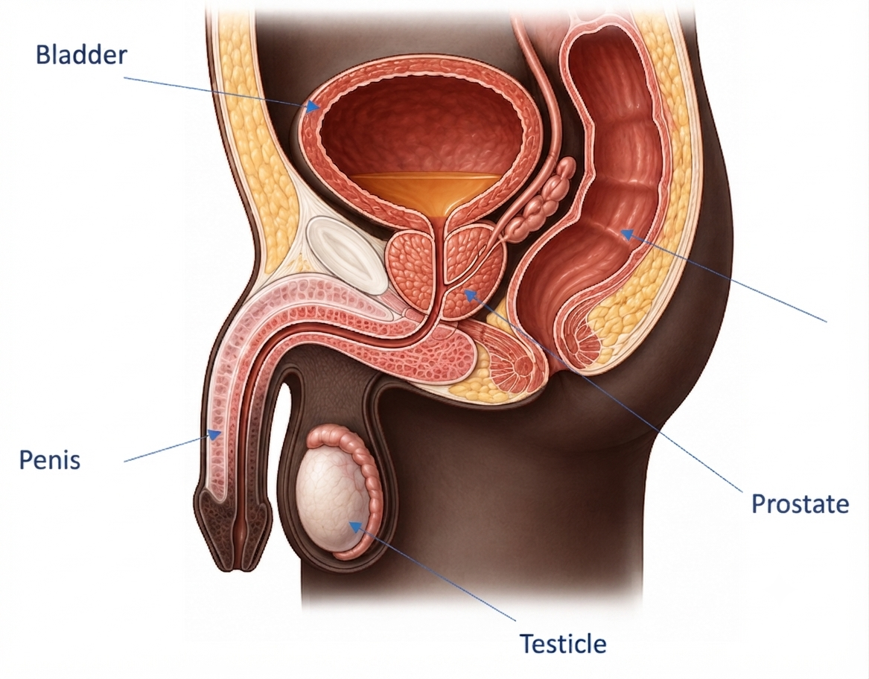
SESSION 1
What the prostate is
A small organ
The prostate is a small organ found only in men.
Where it is
It sits low in the body, below the bladder, around the tube that carries urine.
Rectum
Its job
It helps make some of the fluid that helps form semen.
Prostate Cancer | CHW | Rwanda Biomedical Centre

Slide 18
SESSION 1
What prostate cancer is
Abnormal growth
Not all the same
Cancer starts when some cells in the prostate grow in the wrong way.
Some prostate cancers grow slowly and are not a danger. Others grow faster and may spread throughout the body, causing harm.
Often silent early
Why it matters
A man can have early prostate cancer and still feel completely well.
Finding it early gives more choices for care.
Prostate Cancer | CHW | Rwanda Biomedical Centre

Slide 19
SESSION 1
Prostate cancer in Rwanda
1st
~1,856
~1,179
Most common cancer in men in Rwanda (2024)
New cases in men in one year (2024)
Deaths in men in one year (2024)
These numbers are estimates. Men can become sick and die from it, so awareness, check-ups, and follow-up matter. The numbers are expected to rise in the coming years.
Source: GLOBOCAN 2024 (IARC), Cancer Today, 2024 estimates. Figures are modelled estimates. Future rise is a projection.
Prostate Cancer | CHW | Rwanda Biomedical Centre

Slide 20
SESSION 1
Check your understanding
A man in your village says he feels well, so he cannot have prostate cancer. Is he right?
A Yes, feeling well means no cancer
Correct answer: B
Early prostate cancer is often silent. A man can feel completely well and still have it. That is why a check-up can help, even when he feels fine.
B No, early prostate cancer often has no signs ✓
C Only young men can get it
D It cannot be checked at all
Prostate Cancer | CHW | Rwanda Biomedical Centre

Slide 21
SESSION 1
Knowledge check (1/3)
Q1. The prostate is found in:
A. Women
B. Men ✓
C. Both men and women
D. No one
Correct: B. The prostate is a small gland found only in men.
Q2. Early prostate cancer usually:
A. Causes strong pain
B. Often has no signs ✓
C. Causes fever
D. Causes hair loss
Correct: B. Early disease is often silent.
Prostate Cancer | CHW | Rwanda Biomedical Centre

Slide 22
SESSION 1
Knowledge check (2/3)
Q3. Prostate cancer in Rwanda is:
A. Very rare
B. The most common cancer in men ✓
C. Only in women
D. Not real
Correct: B. It is the leading cancer in men in Rwanda.
Q4. Prostate cancers:
A. Are all the same
B. Can grow slowly or faster in different men ✓
C. Always grow fast
D. Never grow
Correct: B. They behave differently from one man to another.
Prostate Cancer | CHW | Rwanda Biomedical Centre

Slide 23
SESSION 1
Knowledge check (3/3)
Q5. The prostate sits:
A. In the head
B. Below the bladder ✓
C. In the arm
D. In the foot
Correct: B. It sits below the bladder, around the urine tube.
Prostate Cancer | CHW | Rwanda Biomedical Centre

Slide 24
SESSION 1
Session reflection
Enter your response in the text box. There is no single correct answer. These prompts are for your own practice and for discussion.
In your own words, how would you tell a neighbour what the prostate is?
1
Which fact about prostate cancer in Rwanda would you most want people to know?
2
How would you answer someone who says, “I feel well, so I cannot have cancer”?
3
Prostate Cancer | CHW | Rwanda Biomedical Centre

Slide 25
2
SESSION 2
What to look for
Meet Faustin, 67. Learn who is more at risk, what to look for, and when to act.
Rwanda Biomedical Centre | CHW

Slide 26
SESSION 2
What you will be able to do
👥
Recognise
🔎
Spot
🧠
Remember
Know who is more likely to get prostate cancer.
Know the signs that need a check-up.
Remember that early cancer often has no signs.
✅
Act
⚠️
Alert
Know when to encourage a check-up.
Know the urgent danger signs.
Prostate Cancer | CHW | Rwanda Biomedical Centre

Slide 27
SESSION 2
Community case: Faustin
Prostate Cancer | CHW | Rwanda Biomedical Centre

Slide 28
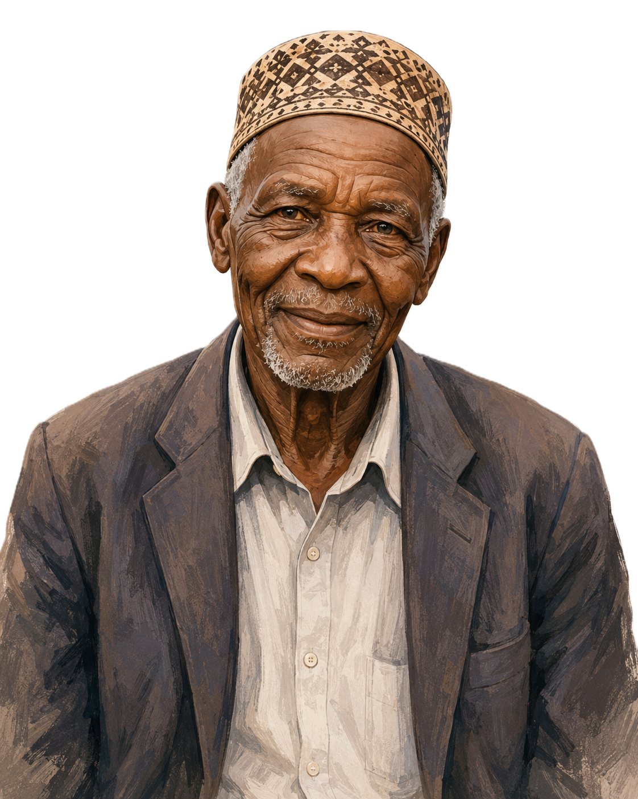

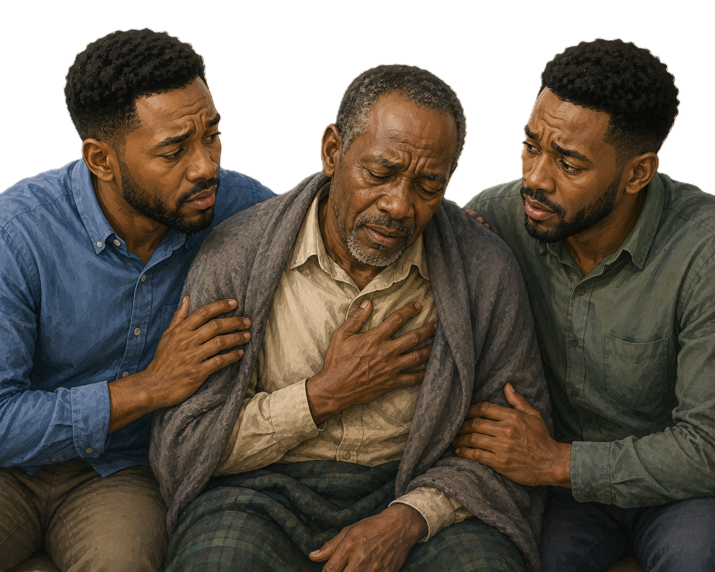
SESSION 2
Who is more at risk
Older age
Family
Family background
The chance goes up as men get older.
A father or brother with prostate cancer raises the chance.
Men of African family background have a higher chance.
Prostate Cancer | CHW | Rwanda Biomedical Centre

Slide 29
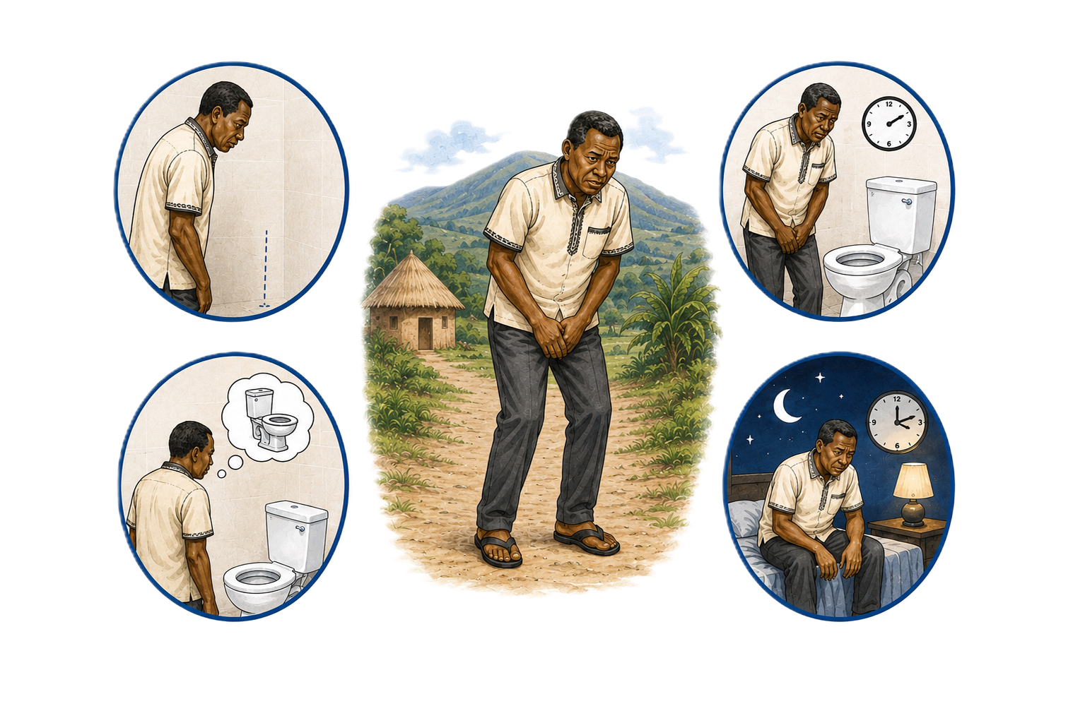

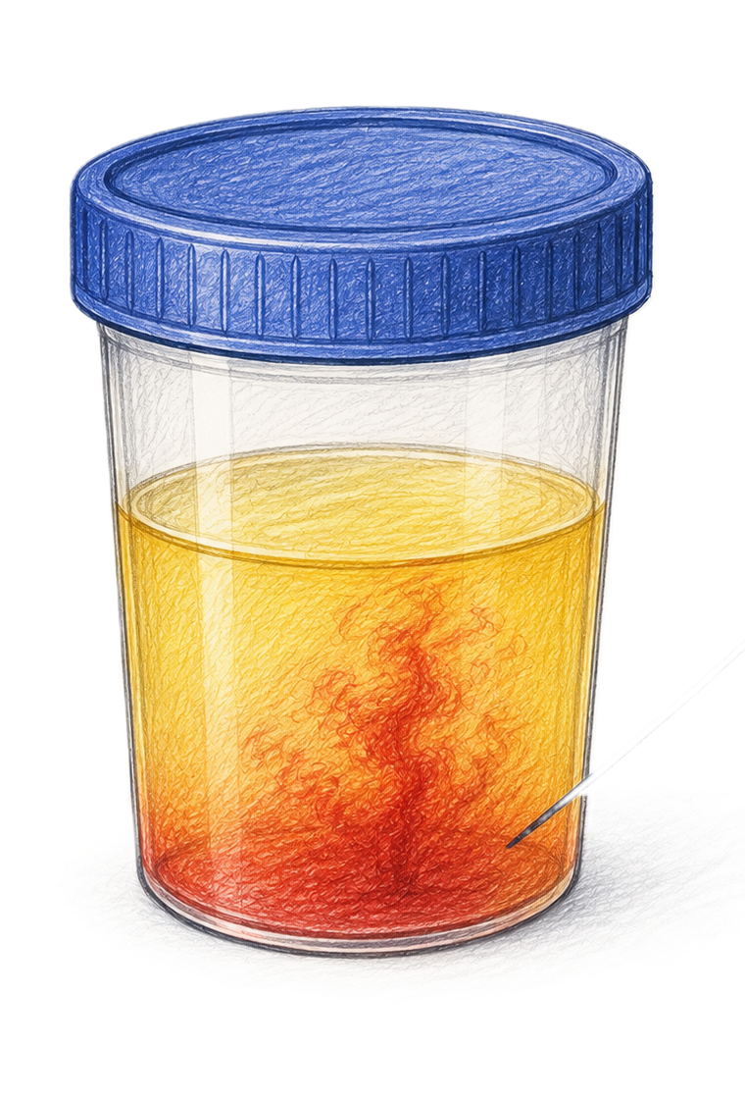
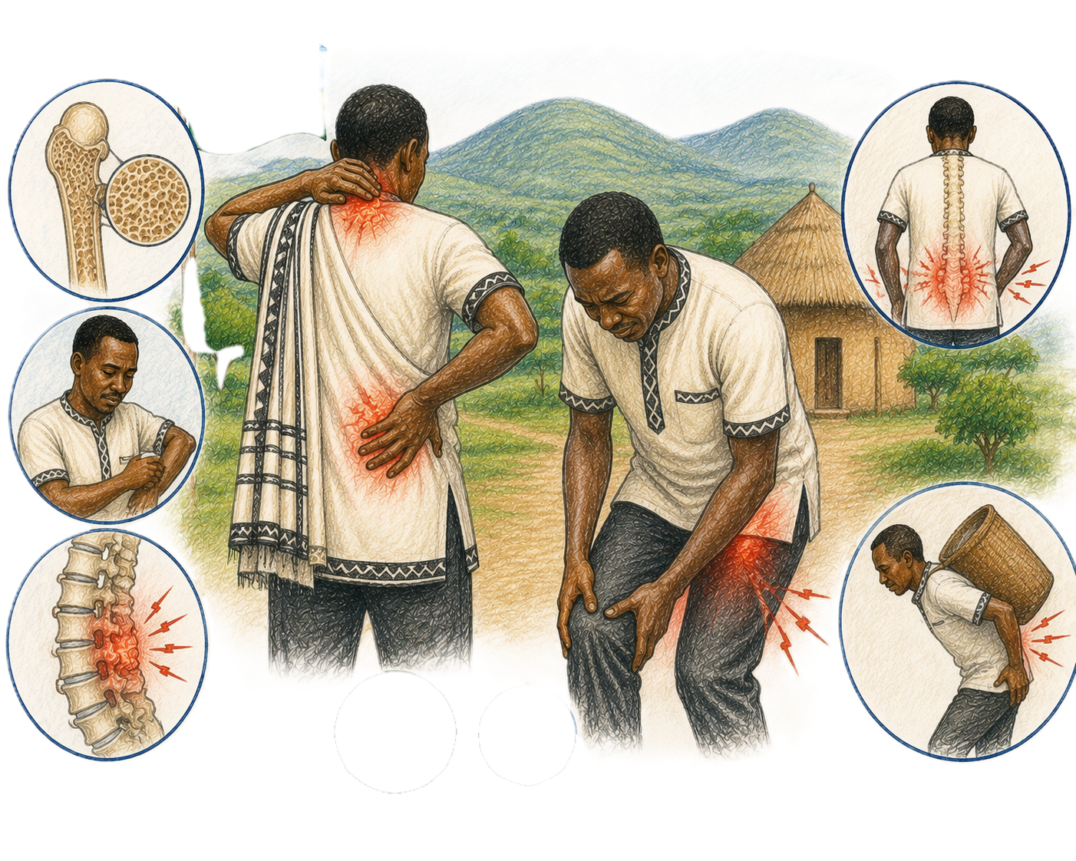
SESSION 2
What to look for
Often no signs early
Urine changes
Many men feel well at first.
Weak stream, trouble starting urination, going often, or getting up at night. These can have other causes too.
Blood in the urine
Bone or back pain
This needs a check-up.
Can happen when the disease is more advanced.
📌 Important: Urine problems do not prove cancer. They mean a check-up is needed. Risk factors raise the chance, but they do not mean a man has cancer.
Prostate Cancer | CHW | Rwanda Biomedical Centre

Slide 30
SESSION 2
What to do
Encourage a check-up
Do not wait
If a man has these signs, kindly encourage him to go to the health centre.
Do not tell him to wait and see. Do not give medicine yourself.
Worried or older
Follow up
Even with no signs, a worried or older man can ask for advice at the health centre.
Help him attend and return for his results.
Prostate Cancer | CHW | Rwanda Biomedical Centre

Slide 31
SESSION 2
Apply it to Faustin
🩺 Case: Faustin tells you about his urine problems but says he feels well and it is just old age.
What is the best thing to do?
A Agree it is just old age and do nothing
B Listen, explain a check-up can help even when he feels well, and encourage him to go to the health centre ✓
C Give him medicine yourself
D Tell other people in the village about it
Correct: B. Encourage assessment kindly and keep his information private. Urine changes can have several causes and need a check-up.
Prostate Cancer | CHW | Rwanda Biomedical Centre

Slide 32
SESSION 2
Knowledge check (1/3)
Q1. Who is more likely to get prostate cancer?
A. Young boys
B. Older men ✓
C. Young women
D. Children
Correct: B. The chance rises with age.
Q2. Urine problems such as a weak stream:
A. Always mean cancer
B. Can have many causes and need a check-up ✓
C. Never need a check-up
D. Only happen in young men
Correct: B. They are common and need a check-up, not proof of cancer.
Prostate Cancer | CHW | Rwanda Biomedical Centre

Slide 33
SESSION 2
Knowledge check (2/3)
Q3. Early prostate cancer:
A. Always hurts
B. Often has no signs ✓
C. Always causes fever
D. Cannot be found
Correct: B. Early disease is often silent.
Q4. A man has new leg weakness and cannot control his urine. This is:
A. Normal
B. An urgent danger sign ✓
C. A good sign
D. Only tiredness
Correct: B. This needs care the same day.
Prostate Cancer | CHW | Rwanda Biomedical Centre

Slide 34
SESSION 2
Knowledge check (3/3)
Q5. If a man has urine changes, you should:
A. Tell him to wait and see
B. Encourage a check-up at the health centre ✓
C. Give him medicine
D. Ignore it
Correct: B. Encourage assessment kindly.
Prostate Cancer | CHW | Rwanda Biomedical Centre

Slide 35
SESSION 2
Session reflection
Enter your response in the text box. There is no single correct answer. These prompts are for your own practice and for discussion.
What would you say to a man who feels shy about urine problems?
1
Which danger sign will you always remember?
2
How would you encourage someone to go for a check-up?
3
Prostate Cancer | CHW | Rwanda Biomedical Centre

Slide 36
3
SESSION 3
What to do next
Turn worry into action: help people reach care, talk with kindness, and support follow-up.
Rwanda Biomedical Centre | CHW

Slide 37
SESSION 3
What you will be able to do
🧭
Guide
🏥
Explain
💬
Talk
Know where to send a person first.
Explain the referral journey in simple words.
Talk with kindness and correct wrong beliefs.
🤝
Support
⚠️
Alert
Support the person to attend and follow up.
Know when referral is urgent.
Prostate Cancer | CHW | Rwanda Biomedical Centre

Slide 38
SESSION 3
The referral journey in Rwanda
1
2
3
➡
➡
Health post or centre
District hospital
Referral or cancer centre
The person goes here first for a check-up.
If needed, they are sent here for more checks.
For special care and treatment planning.
⚠ Urgent: For danger signs, help the person get care the same day. Do not wait for the normal steps.
Prostate Cancer | CHW | Rwanda Biomedical Centre

Slide 39
SESSION 3
Talking with care
“I feel well, so I do not need a check-up.”
“I am afraid they will find cancer.”
Early prostate cancer often has no signs. A check-up can still help.
It is normal to feel afraid. Finding problems early gives more choices.
“If it is cancer, nothing can be done.”
“A blood test means I have cancer.”
Not true. There are ways to care for and treat people.
A blood test can show more checks are needed, but it cannot confirm cancer alone.
Prostate Cancer | CHW | Rwanda Biomedical Centre

Slide 40
SESSION 3
Support and follow-up
Encourage attendance
Return for results
Reduce shame
Help the person reach the health centre.
Remind them to go back for their results.
Keep their information private and treat them with respect.
Support the family
Know when to get more help
Do not blame
Help the family understand why continued care matters.
If distress is heavy, encourage extra support.
Listen, be patient, and never use fear.
Prostate Cancer | CHW | Rwanda Biomedical Centre

Slide 41
SESSION 3
Faustin's story continues
🩺 Case: After you encourage a check-up, Faustin says quietly, “If it is cancer, nothing can be done, so why go?”
What is the most helpful response?
A Agree that little can be done
B Gently say this is not true, that a check-up guides care and options exist, and encourage him to go ✓
C Tell him not to worry
D End the conversation
Correct: B. Acknowledge his fear, correct the wrong belief kindly, and support him to attend without pressure.
Prostate Cancer | CHW | Rwanda Biomedical Centre

Slide 42
SESSION 3
Knowledge check (1/3)
Q1. The first place for a check-up is usually:
A. The cancer centre
B. The health post or health centre ✓
C. A private shop
D. Nowhere
Correct: B. First contact is at the health post or centre.
Q2. “If it is cancer, nothing can be done” is:
A. True
B. A misconception ✓
C. Always correct
D. Good to repeat
Correct: B. There are ways to treat and support people.
Prostate Cancer | CHW | Rwanda Biomedical Centre

Slide 43
SESSION 3
Knowledge check (2/3)
Q3. Good counselling means:
A. Blaming the person
B. Listening and encouraging without fear ✓
C. Withholding information
D. Rushing them
Correct: B. Listen, respect, and give time.
Q4. After a referral, a community health worker should:
A. Do nothing
B. Encourage attendance and return for results ✓
C. Do the tests
D. Forget about it
Correct: B. Support attendance and follow-up.
Prostate Cancer | CHW | Rwanda Biomedical Centre

Slide 44
SESSION 3
Knowledge check (3/3)
Q5. Danger signs need:
A. A wait-and-see plan
B. Care the same day ✓
C. A visit next month
D. No action
Correct: B. Urgent signs need care the same day.
Prostate Cancer | CHW | Rwanda Biomedical Centre

Slide 45
SESSION 3
Session reflection
Enter your response in the text box. There is no single correct answer. These prompts are for your own practice and for discussion.
What would you tell someone who is afraid to seek a check-up?
1
How could you help someone complete a referral?
2
What wrong belief about prostate cancer would you most like to correct?
3
Prostate Cancer | CHW | Rwanda Biomedical Centre

Slide 46
4
SESSION 4
How is cancer found and treated?
A simple look at what happens after referral: how doctors find out, and the kinds of treatment.
Rwanda Biomedical Centre | CHW

Slide 47
SESSION 4
What you will be able to do
💬
Explain
🧪
Reassure
💊
Outline
❌
Correct
Explain in simple words how cancer is found.
Explain that a blood test alone cannot confirm cancer.
Name the main kinds of treatment simply.
Correct common wrong beliefs.
Prostate Cancer | CHW | Rwanda Biomedical Centre

Slide 48
SESSION 4
How doctors find out
1
The health facility checks the person.
2
Some tests may be done like a prostate specific antigen (PSA) in blood.
3
Pictures of the inside of the body (imaging) may be taken.
4
A small piece of tissue (a biopsy) may be taken to confirm.
5
Specialists use the results to plan care with the person.
📌 Remember: A blood test or signs alone cannot confirm cancer. Only looking at the tissue can confirm it.
Prostate Cancer | CHW | Rwanda Biomedical Centre

Slide 49
SESSION 4
Kinds of treatment
Careful monitoring
Surgery
Radiation treatment
Some slow cancers are watched closely instead of treated at once.
An operation to remove the prostate.
Special rays used to treat the cancer.
Hormone medicines
Other cancer medicines
Decided with the specialist
Medicines that lower hormones to slow the cancer.
Used in some cases, decided by specialists. An example is chemotherapy.
Not everyone gets the same treatment. It depends on the cancer and the person.
Prostate Cancer | CHW | Rwanda Biomedical Centre

Slide 50
SESSION 4
Myth or fact
❌ Urine problems always mean cancer
➡
✅ They are common and often have other causes, but they still need a check-up.
❌ No signs means no cancer
➡
✅ Early prostate cancer is often silent.
❌ A biopsy makes cancer spread
➡
✅ This is not how it works.
❌ Every prostate cancer is the same
➡
✅ They behave differently in different men.
❌ If it is cancer, nothing can be done
➡
✅ There are ways to treat and support people.
Prostate Cancer | CHW | Rwanda Biomedical Centre

Slide 51
SESSION 4
Knowledge check (1/3)
Q1. Cancer is confirmed by:
A. A blood test alone
B. A small tissue sample (biopsy) ✓
C. Signs alone
D. Guessing
Correct: B. Only looking at the tissue confirms cancer.
Q2. A blood test for the prostate:
A. Confirms cancer
B. May show more checks are needed, but cannot confirm alone ✓
C. Cures cancer
D. Is never used
Correct: B. It guides more checks; it does not confirm cancer.
Prostate Cancer | CHW | Rwanda Biomedical Centre

Slide 52
SESSION 4
Knowledge check (2/3)
Q3. Treatment for prostate cancer:
A. Is the same for everyone
B. Depends on the cancer and the person ✓
C. Is always surgery
D. Is never given
Correct: B. Doctors decide with the person.
Q4. Some slow-growing prostate cancers may be:
A. Ignored
B. Watched closely instead of treated at once ✓
C. Never checked
D. Cured with rest
Correct: B. This is careful monitoring, not neglect.
Prostate Cancer | CHW | Rwanda Biomedical Centre

Slide 53
SESSION 4
Knowledge check (3/3)
Q5. “A biopsy makes cancer spread.” This is:
A. True
B. False ✓
C. Always true
D. Sometimes true
Correct: B. This is a misconception.
Prostate Cancer | CHW | Rwanda Biomedical Centre

Slide 54
SESSION 4
Session reflection
Enter your response in the text box. There is no single correct answer. These prompts are for your own practice and for discussion.
How would you explain, in simple words, how doctors confirm cancer?
1
Which wrong belief about treatment would you most like to correct?
2
How would you reassure someone who is waiting for test results?
3
Prostate Cancer | CHW | Rwanda Biomedical Centre

Slide 55
5
SESSION 5
What to expect from disease and treatment
Support people through treatment and beyond: know the usual effects, the danger signs, and how to bring comfort.
Rwanda Biomedical Centre | CHW

Slide 56
SESSION 5
What you will be able to do
🧩
Recognise
🔀
Sort
⚠️
Alert
💙
Comfort
Know the usual effects of disease and treatment.
Tell usual effects apart from danger signs.
Know the urgent danger signs.
Give practical comfort and support.
Prostate Cancer | CHW | Rwanda Biomedical Centre

Slide 57
SESSION 5
Common side effects of prostate cancer treatment
You may hear about these effects. Your job is to recognise them and reassure, not to treat them.
Treatment
Common effects CHWs may hear about
Surgery
Urine leakage; difficulty with erections; loss of ejaculation or fertility.
Radiotherapy
Tiredness; needing to urinate more often or urgently; bowel changes such as loose stools or urgency; erection problems can develop over time.
Hormone therapy (ADT)
Hot flushes; tiredness; reduced sexual desire or erections; weight and body changes; weaker bones over time.
Chemotherapy
Tiredness; nausea or vomiting; reduced appetite; hair loss; higher chance of infection; numbness or tingling may occur.
Prostate Cancer | CHW | Rwanda Biomedical Centre

Slide 58
SESSION 5
Treatment effect or possible disease problem?
Often related to treatment
Needs assessment
Urgent warning signs
Urine leakage
Hot flushes
Tiredness
Sexual difficulties
Bowel changes after therapy
Nausea or hair loss during chemotherapy
New or worsening pain
New or clearly worsening urinary symptoms
Bowel problems that do not settle
Unexplained worsening tiredness or weakness
Anything that worries the person
New leg weakness or numbness
Trouble walking
New loss of bladder or bowel control
Severe or fast-worsening back pain
During chemotherapy: fever or signs of infection
📌 Remember: Do not assume a new symptom is just a treatment side effect. New, severe, or worsening symptoms should be reported to the healthcare team.
Prostate Cancer | CHW | Rwanda Biomedical Centre

Slide 59
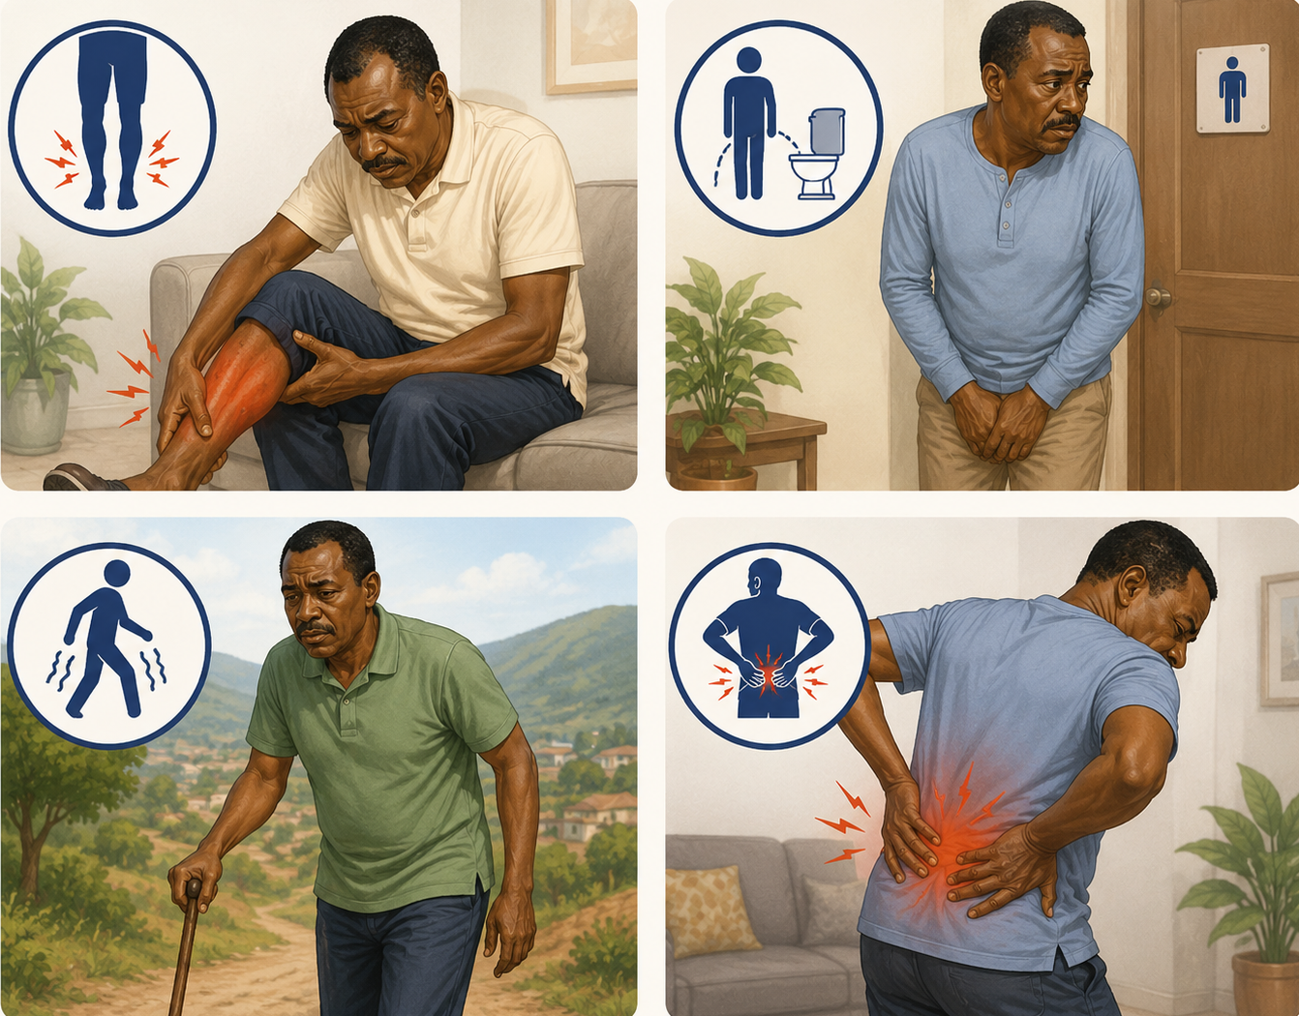
SESSION 5
Urgent danger signs to act on
⚠ Urgent danger signs
● New leg weakness or numbness
● Loss of control of urine or stool
● Trouble walking
● Severe or fast-worsening pain
➡ What to do: Help the person get medical care the same day. Do not wait.
Prostate Cancer | CHW | Rwanda Biomedical Centre

Slide 60
SESSION 5
What should you do?
Listen
Ask what has changed and how it is affecting the person.
1
Reassure
Explain that many treatment side effects are common and support is available.
2
Report
Encourage the person to tell their healthcare team about new, lasting, or troublesome symptoms.
3
Escalate
Urgent warning signs need immediate medical assessment. During chemotherapy, fever or signs of infection are urgent.
4
Prostate Cancer | CHW | Rwanda Biomedical Centre

Slide 61
SESSION 5
Comfort and quality of life
Listen
Keep appointments
Encourage reporting
Give time and listen without judging.
Help the person attend follow-up visits.
Ask them to tell you about new problems.
Reduce shame
Support the family
Everyday comfort
Keep information private and treat the person with respect.
Help the family understand why care continues.
Support rest, food, and company.
Prostate Cancer | CHW | Rwanda Biomedical Centre

Slide 62
SESSION 5
Faustin comes back
Prostate Cancer | CHW | Rwanda Biomedical Centre

Slide 63
SESSION 5
Apply it
🩺 Case: Faustin is now on treatment. He tells you he has new, severe back pain and his legs feel weak.
What is the best action?
A Tell him to rest for a month
B Help him get medical care urgently ✓
C Give him more fluids only
D Wait and see
Correct: B. New severe back pain with leg weakness is an urgent danger sign. Help him reach care the same day.
Prostate Cancer | CHW | Rwanda Biomedical Centre

Slide 64
SESSION 5
Knowledge check (1/3)
Q1. Which is an urgent danger sign?
A. A little tiredness
B. New leg weakness with loss of urine control ✓
C. One hot flush
D. Mild nausea
Correct: B. This needs care the same day.
Q2. Hot flushes and tiredness during treatment are:
A. Always an emergency
B. Usual effects that can be discussed at follow-up ✓
C. A sign to stop care
D. Never seen
Correct: B. These are usual and can be discussed at follow-up.
Prostate Cancer | CHW | Rwanda Biomedical Centre

Slide 65
SESSION 5
Knowledge check (2/3)
Q3. A new, worsening symptom should be:
A. Ignored
B. Reported and checked ✓
C. Left for months
D. Treated at home only
Correct: B. Encourage reporting and a check-up.
Q4. Talking about sexual or urine problems should be:
A. Done with respect and privacy ✓
B. Done in public
C. Done with jokes
D. Avoided always
Correct: A. Be respectful and keep it private.
Prostate Cancer | CHW | Rwanda Biomedical Centre

Slide 66
SESSION 5
Knowledge check (3/3)
Q5. A good comfort action is:
A. Blaming the person
B. Listening and helping keep appointments ✓
C. Sharing private details
D. Telling them to stop care
Correct: B. Listen and support follow-up.
Prostate Cancer | CHW | Rwanda Biomedical Centre

Slide 67
SESSION 5
Session reflection
Enter your response in the text box. There is no single correct answer. These prompts are for your own practice and for discussion.
How would you help someone know which symptoms to report urgently?
1
How would you raise urine or sexual health with respect?
2
What support could help someone keep going to follow-up?
3
Prostate Cancer | CHW | Rwanda Biomedical Centre

Slide 68
ATTRIBUTION AND SOURCES
References
1. International Agency for Research on Cancer. Global Cancer Observatory: Cancer Today (2024 estimates, version 1.0). Lyon: IARC/WHO. https://gco.iarc.who.int/today
5. American Cancer Society. Prostate cancer: detection, diagnosis and staging. https://www.cancer.org
2. Sung H, Filho AM, Laversanne M, et al. Global cancer statistics 2024: GLOBOCAN estimates of incidence and mortality worldwide. CA Cancer J Clin. 2026. doi:10.3322/caac.70090
6. US Centers for Disease Control and Prevention. Prostate cancer screening. https://www.cdc.gov/prostate-cancer/screening/index.html
3. Journal of Global Medicine. Rising prostate cancer incidence in Africa: socioeconomic impact and 25-year projection to 2050. 2026. https://globalmedicine.co.uk
7. African Cancer Registry Network. Rwanda National Cancer Registry. https://afcrn.org
4. World Health Organization. Guide to Cancer Early Diagnosis. Geneva: WHO, 2017.
8. International Agency for Research on Cancer. Manual for Cancer Registry Personnel (Technical Report No. 10, 1995); Planning and Developing Population-Based Cancer Registration in Low- and Middle-Income Settings (IARC Technical Publication No. 43, 2014).
Prostate Cancer | CHW | Rwanda Biomedical Centre

