Slide 1
FRONTLINE HCP MODULE
Gastric Cancer
Your interactive learning journey: prevent, recognise, refer, understand, support.
English
Rwanda Biomedical Centre | Frontline HCP

Slide 2
FRONTLINE HCP MODULE
Learning objectives
Prevent
Recognise
Refer
Understand H. pylori and modifiable risks that lower future gastric-cancer risk.
Recognise risk, premalignant conditions, and concerning symptoms.
Refer correctly and know the urgent warning signs.
Understand diagnosis
Understand treatment
Support
Understand how gastric cancer is confirmed, staged, and graded.
Understand treatment options and their common effects.
Support follow-up, nutrition, quality of life, and palliative care.
Gastric Cancer | Frontline HCP | Rwanda Biomedical Centre

Slide 3
FRONTLINE HCP MODULE
What is inside
Pre-test and Post-test
Session 1: Understanding
Session 2: Screening
Twenty short questions to check your starting and finish points.
What gastric cancer is, how common it is, and what stage and grade mean.
Prevention, risk, symptoms, and the balance of screening and early detection.
Session 3: Referral & counselling
Session 4: Diagnosis & treatment
Session 5: Supportive care
How urgently to refer, red flags, and how to counsel with care.
How a diagnosis is confirmed and an overview of treatment.
Effects to recognise, emergencies to escalate, nutrition and quality of life.
Gastric Cancer | Frontline HCP | Rwanda Biomedical Centre

Slide 4
FRONTLINE HCP MODULE
Module syllabus
This module follows the gastric-cancer patient journey, keeping prevention, risk recognition, early detection, and timely referral at the centre. Diagnosis, staging, treatment, and supportive care are included so you can understand what happens after concerning findings or a confirmed diagnosis.
1. Awareness & prevention
2. Risk recognition
3. Premalignant conditions
4. Early detection
5. Symptom recognition
6. Assessment
7. Referral
8. Diagnostic confirmation
9. Staging
10. Treatment orientation
11. Follow-up
12. Supportive care
Gastric Cancer | Frontline HCP | Rwanda Biomedical Centre

Slide 5
BASELINE CHECK
Pre-test
Twenty questions to check your starting point. This is not graded for you; it simply shows where you begin.

Slide 6
BASELINE CHECK
Question set (1/10)
Choose the best answer.
Q1. Most gastric cancers are:
A. Lymphomas
B. Adenocarcinomas
C. Sarcomas
D. Melanomas
Q2. Which infection is an important, preventable cause of gastric cancer?
A. Helicobacter pylori
B. Hepatitis A
C. Malaria
D. Tuberculosis
Gastric Cancer | Frontline HCP | Rwanda Biomedical Centre

Slide 7
BASELINE CHECK
Question set (2/10)
Choose the best answer.
Q3. Early gastric cancer usually causes:
A. Severe pain
B. Few or non-specific symptoms
C. Immediate weight loss
D. High fever
Q4. Persistent dyspepsia with weight loss should be:
A. Ignored
B. Assessed and considered for referral
C. Treated only with antacids
D. Assumed benign
Gastric Cancer | Frontline HCP | Rwanda Biomedical Centre

Slide 8
BASELINE CHECK
Question set (3/10)
Choose the best answer.
Q5. Gastric intestinal metaplasia is:
A. Confirmed cancer
B. A premalignant condition
C. A normal finding
D. An infection
Q6. Which is an alarm (red-flag) feature?
A. Occasional bloating
B. Melena or hematemesis
C. Mild burping
D. Transient nausea
Gastric Cancer | Frontline HCP | Rwanda Biomedical Centre

Slide 9
BASELINE CHECK
Question set (4/10)
Choose the best answer.
Q7. Gastric cancer is confirmed by:
A. Symptoms alone
B. A blood test
C. Endoscopic biopsy and histopathology
D. Physical examination
Q8. Stage describes:
A. How abnormal cells look
B. Where the cancer is and how far it has spread
C. The patient's age
D. The chosen treatment
Gastric Cancer | Frontline HCP | Rwanda Biomedical Centre

Slide 10
BASELINE CHECK
Question set (5/10)
Choose the best answer.
Q9. In the TNM system, N refers to:
A. Depth of tumor
B. Regional lymph nodes
C. Distant spread
D. Tumor grade
Q10. Screening means testing:
A. People with symptoms
B. Asymptomatic people to detect disease early
C. Only people with cancer
D. Everyone once
Gastric Cancer | Frontline HCP | Rwanda Biomedical Centre

Slide 11
BASELINE CHECK
Question set (6/10)
Choose the best answer.
Q11. H. pylori infection means the person:
A. Definitely has gastric cancer
B. Has an increased risk and needs to be treated. It is not considered itself cancer.
C. Needs surgery
D. Has no risk
Q12. Upper Gastro-Intestinal endoscopy allows:
A. Direct visualisation and biopsy of the stomach
B. Only blood sampling
C. Bone assessment
D. No tissue sampling
Gastric Cancer | Frontline HCP | Rwanda Biomedical Centre

Slide 12
BASELINE CHECK
Question set (7/10)
Choose the best answer.
Q13. Surveillance applies to people who:
A. Have no risk
B. Already have premalignant conditions
C. Are fully healthy
D. Refuse care
Q14. Chemotherapy is:
A. A local treatment
B. A systemic treatment
C. A type of surgery
D. A form of imaging
Gastric Cancer | Frontline HCP | Rwanda Biomedical Centre

Slide 13
BASELINE CHECK
Question set (8/10)
Choose the best answer.
Q15. Surgery for gastric cancer may involve:
A. Removing part or all of the stomach and lymph nodes resection if indicated
B. Only removing lymph nodes
C. No tissue removal
D. Radiotherapy planning
Q16. Radiotherapy works by:
A. Adding hormones
B. Damaging cancer-cell DNA with radiation
C. Being a type of surgery
D. Doing nothing
Gastric Cancer | Frontline HCP | Rwanda Biomedical Centre

Slide 14
BASELINE CHECK
Question set (9/10)
Choose the best answer.
Q17. A biopsy of a gastric lesion:
A. Causes cancer to spread
B. Is needed to confirm diagnosis
C. Replaces endoscopy
D. Confirms stage alone
Q18. After gastrectomy, patients often need:
A. Larger less frequent meals
B. Smaller more frequent meals
C. No dietary change
D. Only intravenous fluids
Gastric Cancer | Frontline HCP | Rwanda Biomedical Centre

Slide 15
BASELINE CHECK
Question set (10/10)
Choose the best answer.
Q19. Palliative care is:
A. Only for the last days of life
B. Symptom relief and quality of life, alongside treatment when appropriate
C. The same as stopping care
D. Only pain medicine
Q20. In Rwanda, gastric cancer is:
A. Not recorded
B. Among the more common cancers and a notable cause of cancer death
C. Only found abroad
D. Extremely rare
Gastric Cancer | Frontline HCP | Rwanda Biomedical Centre

Slide 16
1
SESSION 1
Understanding gastric cancer
Build the foundation: what gastric cancer is, how common it is, and what stage and grade mean.

Slide 17
SESSION 1
Learning objectives
Describe
Interpret
Explain anatomy
Describe what gastric cancer is and how it develops.
Interpret the global, regional, and Rwanda burden, with projections.
Explain stomach anatomy relevant to symptoms and investigations.
Outline
Distinguish
Recognise conditions
Outline how gastric cancer develops through premalignant change.
Explain TNM and distinguish stage from grade.
Recognise conditions that increase gastric-cancer risk.
Gastric Cancer | Frontline HCP | Rwanda Biomedical Centre

Slide 18
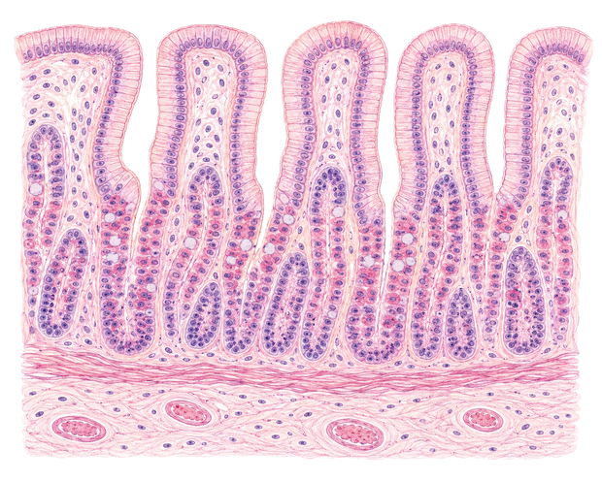
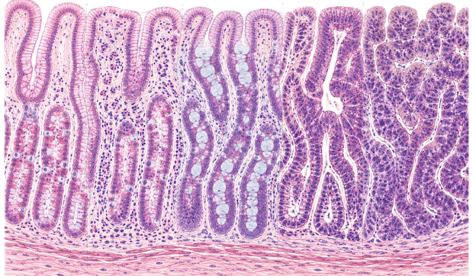
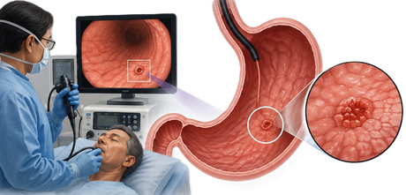
SESSION 1
What gastric cancer is
Where it starts
How it develops
Why early action matters
Is also named stomach cancer where it develops. Most are adenocarcinomas, arising from the gastric's glandular mucosa.
In many patients it follows a long sequence of chronic mucosal injury and premalignant change before cancer appears.
Early disease often causes few or non-specific symptoms. Prevention, risk recognition, and timely referral widen the options for care.
Gastric Cancer | Frontline HCP | Rwanda Biomedical Centre

Slide 19
SESSION 1
How common it is worldwide
980,286
New cases worldwide, 2024
641,554
Deaths worldwide, 2024
5th
Most common cancer worldwide
Source: GLOBOCAN 2024 (IARC), Global Cancer Observatory, 2024 estimates version 1.0. Values are estimates.
Gastric Cancer | Frontline HCP | Rwanda Biomedical Centre

Slide 20
SESSION 1
The burden in Africa
33,234
26,218
Eastern Africa
New gastric cancer cases in Africa, 2024 (3.4% of the global total)
Gastric cancer deaths in Africa, 2024 (4.1% of the global total)
The African sub-region with the highest gastric cancer incidence rates
Incidence is high in Eastern Africa relative to other African sub-regions, which makes it the closest compatible comparison for Rwanda. Counts are lower than in Asia or Europe, but mortality is proportionally high because many cases present late.
Source: GLOBOCAN 2024 (IARC), Global Cancer Observatory, 2024 estimates version 1.0. Values are estimates.
Gastric Cancer | Frontline HCP | Rwanda Biomedical Centre

Slide 21
SESSION 1
Gastric cancer in Rwanda
895
Estimated new gastric cancer cases in Rwanda, 2024
728
Estimated gastric cancer deaths in Rwanda, 2024
5th
Most common cancer overall; 4th leading cause of cancer death
Source: GLOBOCAN 2024 (IARC), Rwanda fact sheet, 2024 estimates version 1.0. Values are estimates, not registry-confirmed counts.
Gastric Cancer | Frontline HCP | Rwanda Biomedical Centre

Slide 22
SESSION 1
The burden is projected to rise
↑ Rising
Ageing + growth
Preventable share
Cancer cases in low- and medium-development countries are projected to rise steeply to 2050
Population ageing and growth drive most of the projected increase
A large proportion of future gastric cancers are attributable to H. pylori and are preventable
If current demographic patterns continue, the number of gastric cancers in Rwanda is expected to increase over the coming decades. These are projections, not guaranteed outcomes. Prevention through H. pylori control and earlier detection can change the trajectory.
Gastric Cancer | Frontline HCP | Rwanda Biomedical Centre

Slide 23
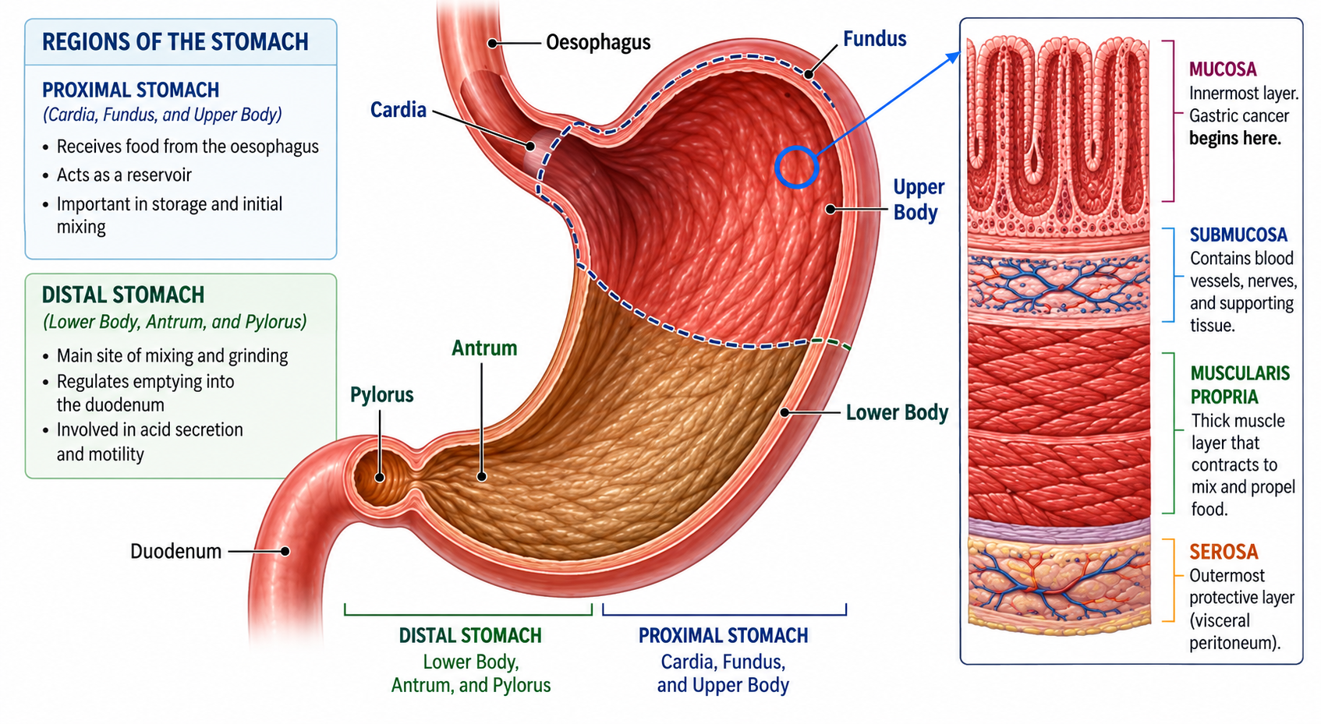
SESSION 1
Stomach anatomy
Position
Between the oesophagus above and the duodenum below, in the upper abdomen.
Regions
Cardia, fundus, body, antrum, and pylorus. Tumor location can influence symptoms.
Wall and lining
Most cancers begin in the inner mucosa and can grow through the deeper layers.
Gastric Cancer | Frontline HCP | Rwanda Biomedical Centre

Slide 24
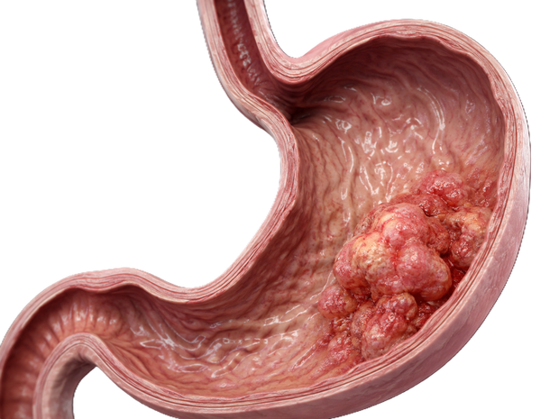
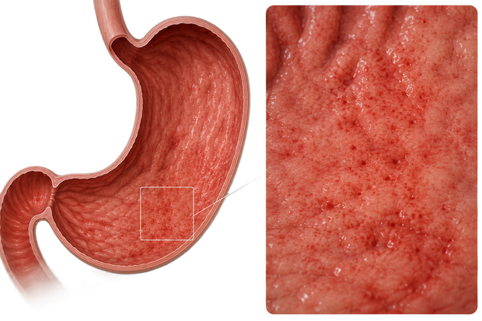
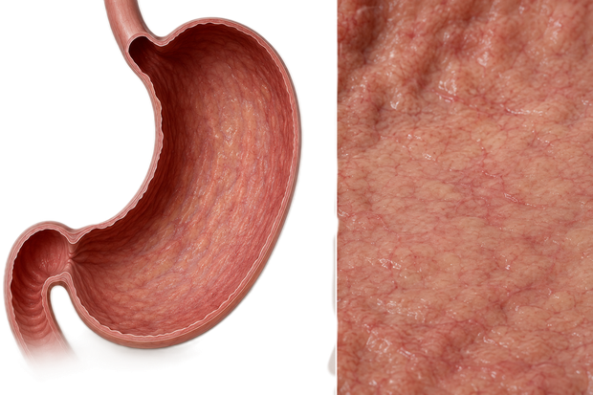
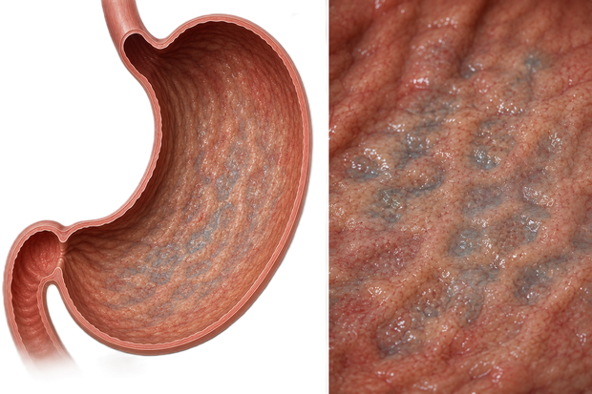
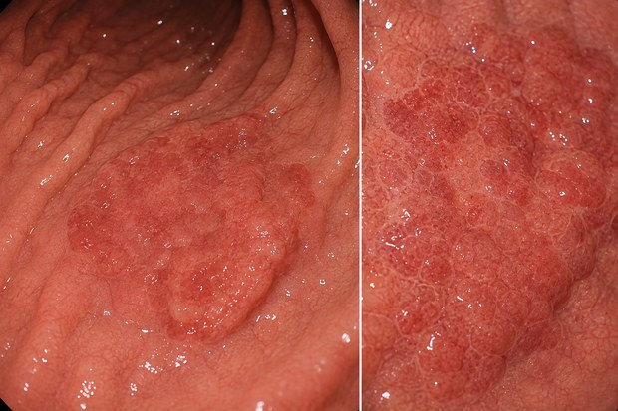
SESSION 1
How gastric cancer develops
Select each stage to reveal what is happening.
1
2
3
4
5
Chronic active gastritis
Atrophic gastritis
Intestinal metaplasia
Dysplasia
Gastric adenocarcinoma
Long-standing inflammation of the lining.
→
Loss of normal gastric glands.
→
The lining changes to an intestinal type.
→
Clearly abnormal cells.
→
Invasive cancer.
Not everyone follows this sequence and not every premalignant change becomes cancer. H. pylori is an important modifiable cause of chronic active gastritis, and gastric cancer has more than one biological pathway.
Gastric Cancer | Frontline HCP | Rwanda Biomedical Centre

Slide 25
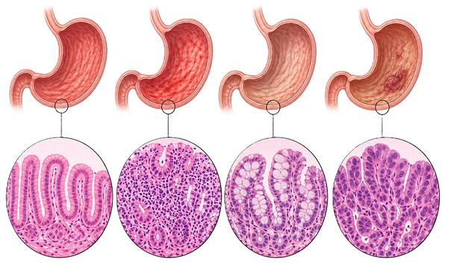
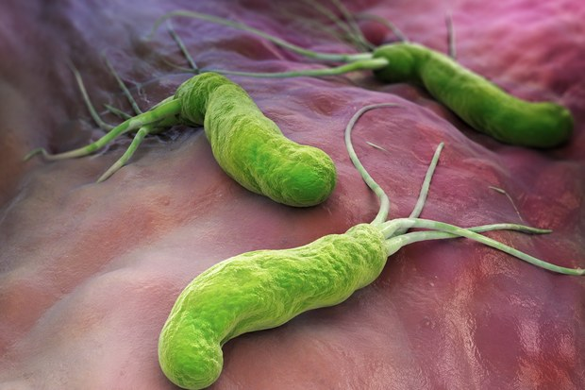
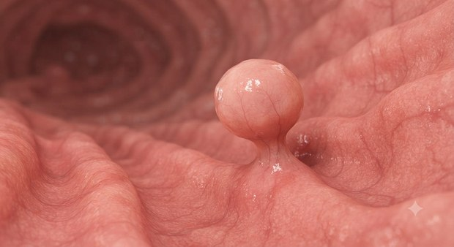
SESSION 1
Conditions linked to higher risk
Premalignant conditions
H. pylori-related
Other risk conditions
Atrophic gastritis, intestinal metaplasia, and dysplasia. Increased risk, not confirmed cancer.
Chronic H. pylori gastritis. An important, treatable driver of long-term risk.
Certain gastric polyps, previous gastric surgery, and some hereditary syndromes raise risk.
A premalignant condition does not mean the patient already has cancer. Distinguish risk factor, premalignant condition, and confirmed cancer.
Gastric Cancer | Frontline HCP | Rwanda Biomedical Centre

Slide 26
SESSION 1
Helicobacter pylori
What it is
Why it matters
Prevention, not diagnosis
A bacterium that can chronically infect the gastric lining and cause long-standing inflammation.
Chronic infection increases gastric-cancer risk. Eradication reduces future risk in appropriate people.
Testing and treating H. pylori is primary prevention. It is not the same as screening for gastric cancer.
Most people with H. pylori never develop gastric cancer. Infection raises risk; it is not a diagnosis of cancer. Testing and treatment are covered next.
Gastric Cancer | Frontline HCP | Rwanda Biomedical Centre

Slide 27
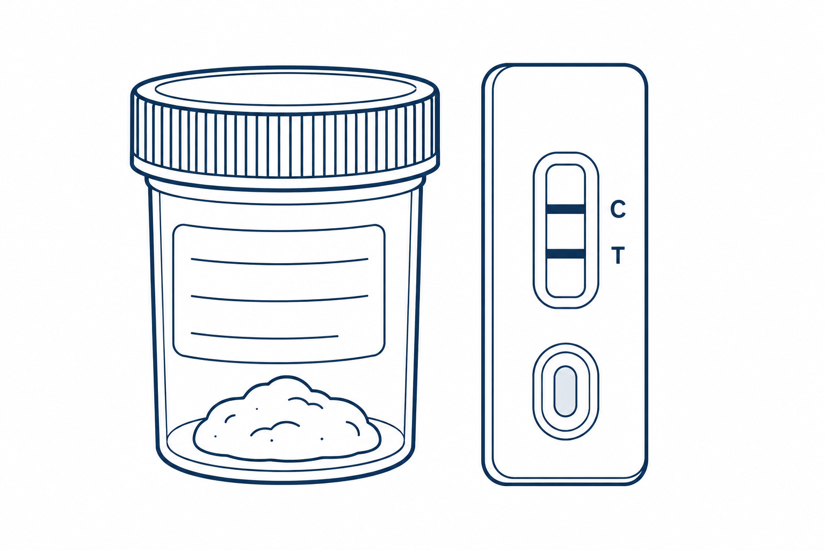

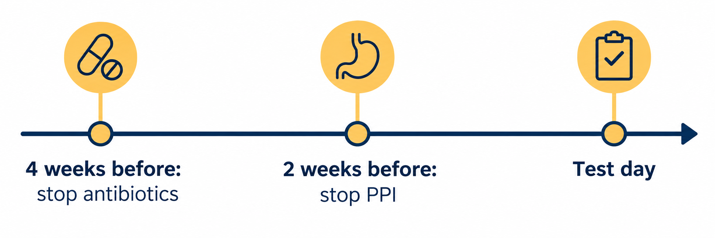
SESSION 1
Testing for
Preferred test
Prepare before testing
What not to rely on
A locally validated monoclonal stool antigen test. It is simple, low cost, and can be done at health centre level.
Stop antibiotics 4 weeks before the test and proton pump inhibitors 2 weeks before it. The same conditions apply to the urea breath test.
Blood or serum antibody testing is discouraged. The urea breath test is accurate and easy but is not widely available.
Testing without the correct preparation gives false negative results. Ask about recent antibiotics and acid-suppressing medicines before you request the test.
Gastric Cancer | Frontline HCP | Rwanda Biomedical Centre

Slide 28

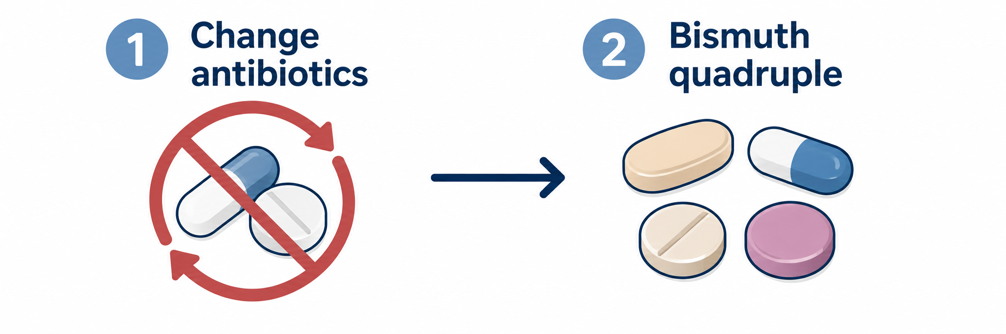

SESSION 1
Treating
First-line treatment
Adherence matters
If treatment fails
A proton pump inhibitor with two antibiotics, taken for 14 days.
Explain that the full 14 days must be completed. Stopping early is a common reason eradication fails and resistance develops.
Do not repeat the same regimen. Change the antibiotics. If a second course fails, bismuth-containing quadruple therapy is the next step.
Confirm eradication after treatment with a stool antigen or urea breath test, using the same preparation rules: no antibiotics for 4 weeks and no proton pump inhibitors for 2 weeks.
Gastric Cancer | Frontline HCP | Rwanda Biomedical Centre

Slide 29
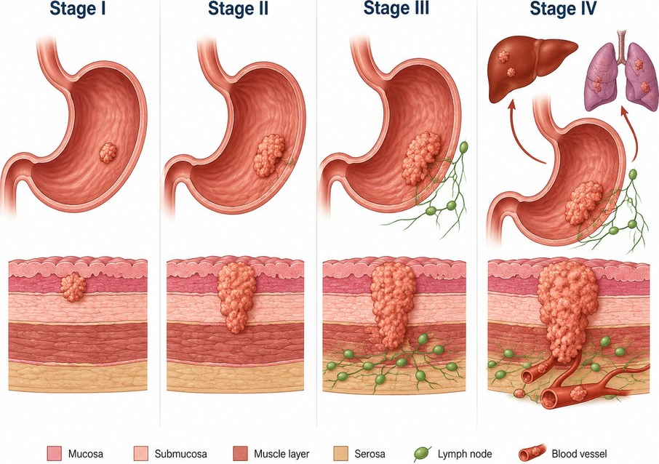
SESSION 1
Staging: the TNM system
Select T, N, or M to reveal what each describes. You are not expected to stage patients yourself.
T: primary tumor
Stage = how far it has spread
How deeply the tumor has grown through the gastric wall and nearby structures.
Stage combines T, N, and M. It communicates extent of disease, helps predict prognosis, and guides treatment planning.
N: regional lymph nodes
Whether lymph nodes near the stomach are involved.
M: distant metastasis
Whether distant spread is present, e.g. peritoneum or liver.
Gastric Cancer | Frontline HCP | Rwanda Biomedical Centre

Slide 30
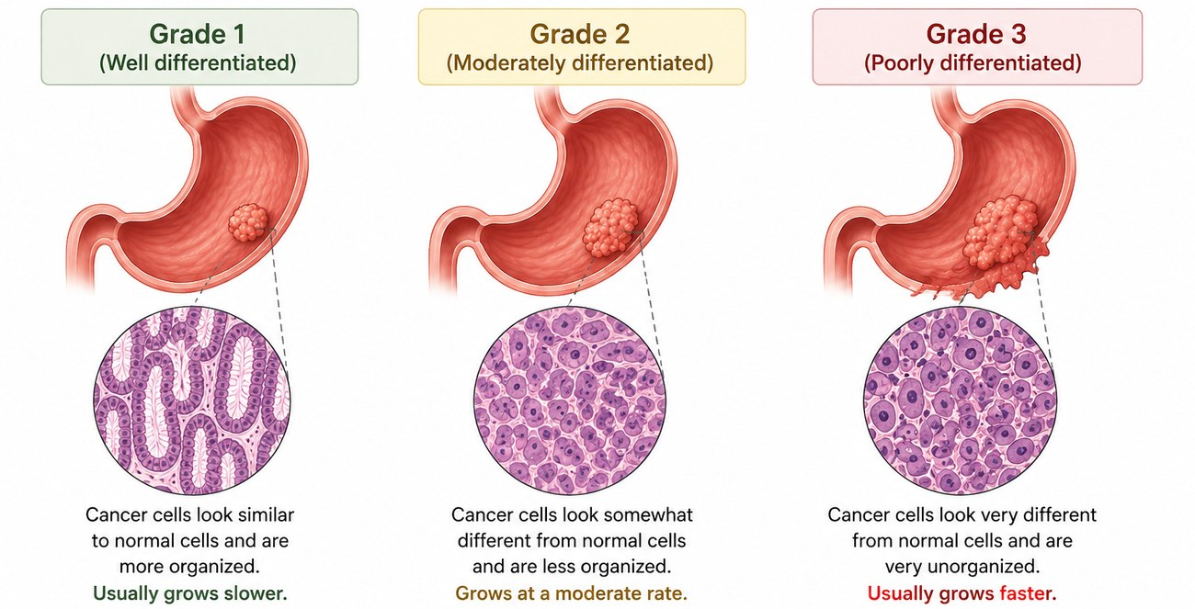
SESSION 1
Stage and grade are different
Grade = how abnormal the cells look
A pathologist assesses how differentiated the cancer cells appear under the microscope. Higher grade generally means more aggressive tissue. You do not grade it yourself.
Gastric Cancer | Frontline HCP | Rwanda Biomedical Centre

Slide 31
SESSION 1
Check your understanding
Which sequence best reflects how intestinal-type gastric cancer typically develops?
Correct answer: B
Dysplasia, then chronic active gastritis, then normal mucosa
Why The intestinal-type pathway usually progresses through chronic and atrophic gastritis, intestinal metaplasia, and dysplasia before invasive cancer. Not every person follows this sequence, and early disease is often silent.
A
B
Chronic active gastritis, atrophic gastritis, intestinal metaplasia, dysplasia, then cancer
✓
C
Cancer first, with no earlier premalignant phase in any patient
D
Metastasis first, then a localised tumor
Gastric Cancer | Frontline HCP | Rwanda Biomedical Centre

Slide 32
SESSION 1
Knowledge check (1/3)
Choose the best answer.
Q1. Most gastric cancers arise from which tissue?
A. Glandular mucosa (adenocarcinoma) ✓
B. Smooth muscle
C. Nerve sheath
D. Fat
Correct: A. They are adenocarcinomas of glandular origin.
Q2. Which best describes the stomach's position?
A. Above the kidneys
B. Between the oesophagus and duodenum ✓
C. Behind the spleen
D. Within the pelvis
Correct: B. This position explains upper-GI symptoms and the endoscopic route.
Gastric Cancer | Frontline HCP | Rwanda Biomedical Centre

Slide 33
SESSION 1
Knowledge check (2/3)
Choose the best answer.
Q3. Intestinal metaplasia is best described as:
A. Confirmed invasive cancer
B. A premalignant, increased-risk change ✓
C. A normal variant
D. An acute infection
Correct: B. It increases risk but is not cancer.
Q4. Stage and grade differ because:
A. They are the same
B. Stage is extent; grade is cell appearance ✓
C. Grade is the extent
D. Stage is the biopsy result
Correct: B. Stage is where and how far; grade is how abnormal the cells look.
Gastric Cancer | Frontline HCP | Rwanda Biomedical Centre

Slide 34
SESSION 1
Knowledge check (3/3)
Choose the best answer.
Q5. Chronic H. pylori infection:
A. Means the person has cancer
B. Increases gastric-cancer risk over time ✓
C. Has no effect on risk
D. Is untreatable
Correct: B. It is an important, treatable risk factor; most infected people never develop cancer.
Q6. In TNM, the M category describes:
A. Tumor depth
B. Lymph nodes
C. Distant metastasis ✓
D. Grade
Correct: C. M describes distant spread.
Gastric Cancer | Frontline HCP | Rwanda Biomedical Centre

Slide 35
SESSION 1
Session reflection
Enter your response in the text box. There is no single correct answer.
In your own words, how would you explain to a patient that a premalignant condition is not the same as cancer?
1
Which single point about the gastric-cancer burden in Rwanda would you most want a colleague to understand, and why?
2
How does the difference between stage and grade change what you would tell a worried patient?
3
Gastric Cancer | Frontline HCP | Rwanda Biomedical Centre

Slide 36
2
SESSION 2
Screening and early detection
Follow Uwase as you work through prevention, risk, symptoms, and how screening differs from assessing a person with symptoms.

Slide 37
SESSION 2
Learning objectives
Distinguish
Identify
Recognise red flags
Distinguish prevention, screening, surveillance, and diagnostic assessment.
Identify established risk factors and concerning symptoms.
Recognise alarm features needing prompt or urgent assessment.
Explain
Apply
Explain how gastric-cancer screening approaches differ between settings.
Apply Rwanda-appropriate judgement to a symptomatic patient.
Gastric Cancer | Frontline HCP | Rwanda Biomedical Centre

Slide 38
SESSION 2
Meet Uwase
🩺 Clinical Case: Uwase Mukamana
Patient
58-year-old woman, works as a market trader in a district town.
Setting
Health centre outpatient clinic in Rwanda.
Presenting situation
Three months of upper abdominal discomfort and feeling full quickly when she eats.
What you know so far
She has lost some weight without trying. She was treated for H. pylori several years ago but did not complete follow-up. No vomiting of blood so far.
Learner task As you move through this session, decide what her symptoms mean and what should happen next. Her final diagnosis is not revealed yet.
Gastric Cancer | Frontline HCP | Rwanda Biomedical Centre

Slide 39
SESSION 2
Four things that are not the same
Primary prevention
Screening
Reducing future risk before cancer develops, e.g. detecting and treating H. pylori where appropriate.
Testing people without symptoms to detect gastric cancer or significant precursors in a defined population.
Surveillance
Diagnostic assessment
Planned follow-up of people already known to have conditions that increase future risk.
Investigating a person who has symptoms or concerning findings. This is not screening.
Do not call the investigation of a symptomatic patient screening. Keep these four ideas distinct throughout.
Gastric Cancer | Frontline HCP | Rwanda Biomedical Centre

Slide 40
SESSION 2
Risk factors
Modifiable
Non-modifiable
Premalignant conditions
H. pylori infection
Tobacco use
Diet high in salted, smoked, charred/grilled, or highly processed foods and meats
Low fruit and vegetable intake
Alcohol consumption
Overweight/obesity
Increasing age
Family history of gastric cancer
Previous stomach surgery
Epstein–Barr virus (EBV) infection
Type A blood
Gastroesophageal reflux disease (GERD)
Atrophic gastritis
Intestinal metaplasia
Dysplasia
Note: Globally, approximately 76% of gastric cancer cases are estimated to be attributable to H. pylori infection
Do not oversimplify risk to one food. Discuss overall dietary exposures with evidence, without blame or cultural stereotyping. No single food causes or prevents gastric cancer. Most of the risk factors are modifiable.
Gastric Cancer | Frontline HCP | Rwanda Biomedical Centre

Slide 41

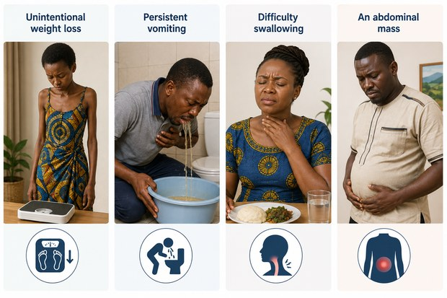
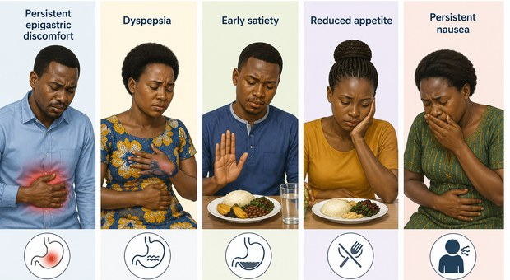
SESSION 2
Signs and symptoms
Often subtle early
Persistent upper-GI symptoms
More advanced features
Early gastric cancer may cause no symptoms or only non-specific ones.
- Persistent epigastric discomfort
- Dyspepsia
- Early satiety
- Reduced appetite
- Persistent nausea
- Unintentional weight loss
- Persistent vomiting
- Difficulty swallowing
- An abdominal mass
No single symptom is diagnostic of cancer. Persistent or concerning symptoms need assessment.
Gastric Cancer | Frontline HCP | Rwanda Biomedical Centre

Slide 42
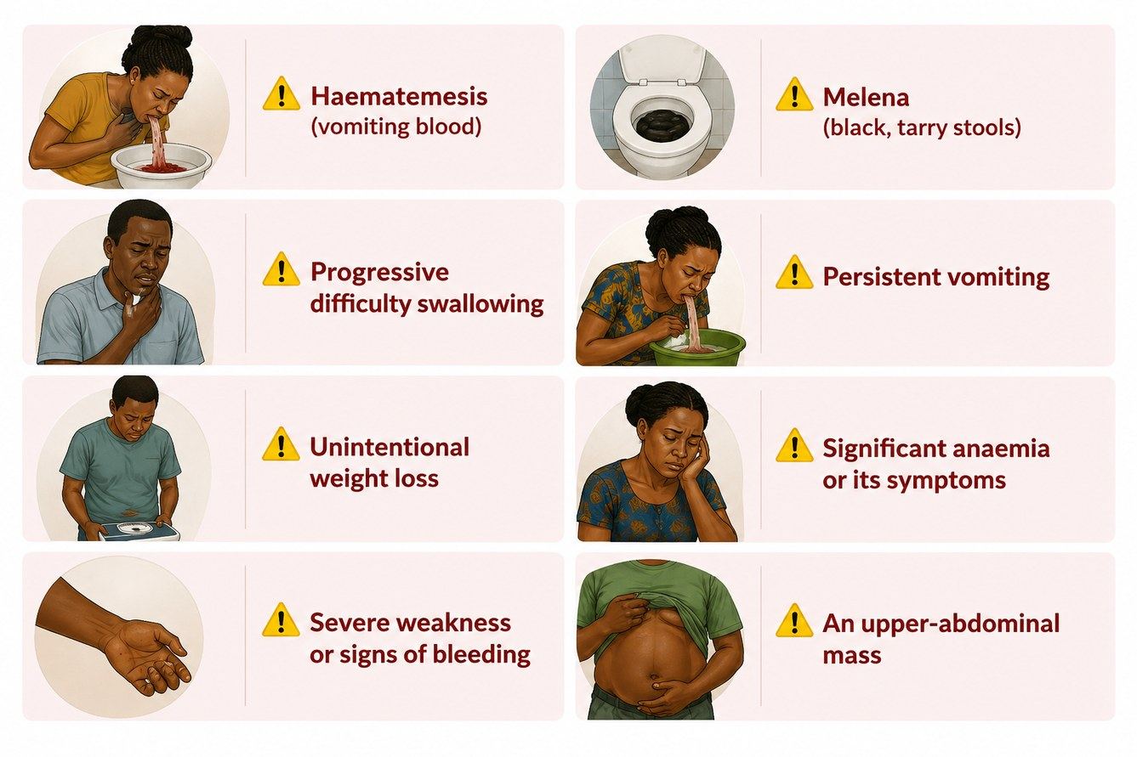
SESSION 2
Alarm and red-flag features
These features need prompt or urgent assessment. Make the urgency explicit when you refer.
Gastric Cancer | Frontline HCP | Rwanda Biomedical Centre

Slide 43
SESSION 2
Prevention and screening approaches vary
H. pylori screen-and-treat
Population endoscopic screening
Risk-based surveillance
A primary-prevention strategy to lower future risk, distinct from screening for cancer itself. Stool antigen testing is simple, low cost, and can be done at health centre level.
Used in some high-incidence settings with strong endoscopy capacity. Not universal.
Follow-up targeted at people with premalignant conditions or high-risk profiles.
There is no single global gastric-cancer screening programme. Approaches depend on incidence, endoscopy capacity, cost-effectiveness, and national policy.
Gastric Cancer | Frontline HCP | Rwanda Biomedical Centre

Slide 44
SESSION 2
The recommendation in Rwanda
Risk-based approach
H. pylori prevention
Surveillance of premalignant conditions
Assess risk and investigate people with persistent or alarm symptoms promptly. Population endoscopic screening is not cost-effective at Rwanda's incidence level.
Risk-based and symptomatic H. pylori test-and-treat as primary prevention, rather than a population-wide screen-and-treat programme.
Confirmed atrophic gastritis, intestinal metaplasia, or dysplasia is followed through specialist referral, guided by endoscopy and pathology availability.
A risk-based approach concentrates limited endoscopy capacity on the people most likely to benefit.
Gastric Cancer | Frontline HCP | Rwanda Biomedical Centre

Slide 45
SESSION 2
Apply it to Uwase
Scenario Uwase has three months of upper-abdominal discomfort, early satiety, and unintentional weight loss. She asks whether this is just an ulcer.
Correct answer: B
Why Persistent upper-GI symptoms with unintentional weight loss are alarm features. Symptoms cannot confirm or exclude cancer, so she needs assessment and referral for endoscopy rather than empirical reassurance.
What is the most appropriate response?
A
Reassure her it is only an ulcer and treat with antacids
B
Explain that persistent symptoms with weight loss need assessment, and arrange referral
✓
C
Tell her to return only if she vomits blood
D
Start cancer treatment now
Gastric Cancer | Frontline HCP | Rwanda Biomedical Centre

Slide 46
SESSION 2
Knowledge check (1/3)
Choose the best answer.
Q1. Screening applies to:
A. People with symptoms
B. Asymptomatic people in a defined population ✓
C. Only people already diagnosed
D. No one
Correct: B. Screening is early detection in people without symptoms.
Q2. Testing and treating H. pylori is best described as:
A. Gastric-cancer screening
B. Primary prevention ✓
C. Surveillance
D. Palliative care
Correct: B. It lowers future risk; it is prevention, not cancer screening.
Gastric Cancer | Frontline HCP | Rwanda Biomedical Centre

Slide 47
SESSION 2
Knowledge check (2/3)
Choose the best answer.
Q3. Which is an established risk factor?
A. Family history of gastric cancer ✓
B. High water intake
C. Left-handedness
D. Living at altitude
Correct: A. Age, family history, H. pylori, and tobacco are established.
Q4. A red flag needing prompt action is:
A. Occasional burping
B. Melena or hematemesis ✓
C. Mild transient nausea
D. One episode of heartburn
Correct: B. Gastrointestinal bleeding needs prompt or urgent assessment.
Gastric Cancer | Frontline HCP | Rwanda Biomedical Centre

Slide 48
SESSION 2
Knowledge check (3/3)
Choose the best answer.
Q5. Investigating a patient who already has symptoms is:
A. Screening
B. Surveillance
C. Diagnostic assessment ✓
D. Prevention
Correct: C. Symptomatic investigation is diagnostic assessment, not screening.
Q6. Persistent dyspepsia with weight loss should be:
A. Assumed benign
B. Assessed and considered for referral ✓
C. Ignored for a year
D. Treated only with diet
Correct: B. Alarm features warrant assessment and referral.
Gastric Cancer | Frontline HCP | Rwanda Biomedical Centre

Slide 49
SESSION 2
Session reflection
Enter your response in the text box. There is no single correct answer.
Which gastric-cancer risk factor would you most consistently assess in your practice, and how?
1
Which persistent or red-flag signs and symptoms would increase your concern about gastric cancer and prompt further assessment or referral? Why?
2
What barrier might delay a patient like Uwase from being assessed, and how could you help?
3
Gastric Cancer | Frontline HCP | Rwanda Biomedical Centre

Slide 50
3
SESSION 3
Referral and counselling
Turn assessment into the right next step: refer with the correct urgency, recognise emergencies, and counsel with care.

Slide 51
SESSION 3
Learning objectives
Refer
Recognise
Counsel
Refer according to urgency for concerning gastric findings.
Recognise urgent complications such as significant GI bleeding.
Counsel clearly about endoscopy, biopsy, and the next step.
Support
Follow up
Give basic psychological support without false reassurance.
Encourage attendance and support completion of referral.
Gastric Cancer | Frontline HCP | Rwanda Biomedical Centre

Slide 52
SESSION 3
The referral pathway in Rwanda
Community health worker
First contact: Recognise concerning upper GI symptoms, encourage early care seeking, and refer promptly.
District hospital
Further assessment and onward referral where endoscopy or specialist input is needed.
Health post / health centre
Referral / specialist centre
First or second contact: assess, record, start the referral, and give clear information.
Endoscopy, biopsy, pathology, staging, and treatment planning.
Gastric Cancer | Frontline HCP | Rwanda Biomedical Centre

Slide 53
SESSION 3
How urgently to refer
Routine referral
Prompt referral
Urgent / emergency
For findings needing specialist assessment without time pressure.
For persistent concerning symptoms or premalignant findings that should be assessed soon.
For significant GI bleeding or rapid deterioration. Do not wait; arrange immediate assessment.
⚠️ Treat as an emergency
Ongoing hematemesis or melena • signs of significant blood loss or shock • complete inability to keep down fluids with rapid deterioration
Gastric Cancer | Frontline HCP | Rwanda Biomedical Centre

Slide 54
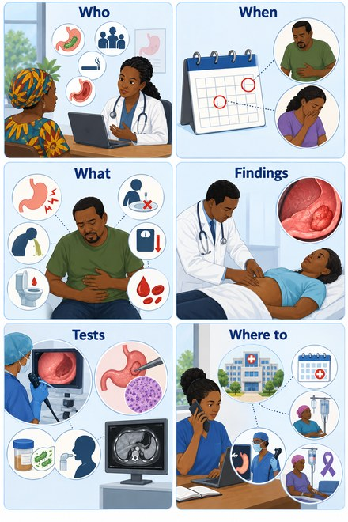
SESSION 3
What to record at first contact
Who: Full name, age, sex, and residence by village and district, so records can be linked and duplicates avoided.
When: Date the symptoms began, as the person reports it, and the date of this consultation. This pair measures diagnostic delay.
What: The specific symptom that triggered the referral.
Findings: What you actually found on examination, including a normal examination. Record it even when no test was available.
Tests: Whether a screening or other test was done, and the result once it is available. Submit the record even if nothing was done yet.
Where to: The referral destination and date, and whether the person is known to have arrived. This is how loss to follow-up is measured.
Note: In the absence of routine testing, your clinical judgement is the data. A record completed at first suspicion and updated later is far more useful than a blank form waiting for a confirmatory test.
Gastric Cancer | Frontline HCP | Rwanda Biomedical Centre

Slide 55
SESSION 3
Counselling before referral
Why endoscopy and biopsy
Address fear and myths
Prepare and follow up
Explain that symptoms alone cannot diagnose gastric cancer, and that biopsy provides confirmation.
Acknowledge fear of cancer and of the procedure. Correct the myth that biopsy spreads cancer.
Explain what happens next, encourage attendance, and arrange to review results.
Use respectful, informed communication. A biopsy does not cause gastric cancer to spread.
Gastric Cancer | Frontline HCP | Rwanda Biomedical Centre

Slide 56
SESSION 3
Basic psychological support
Listen and allow questions
Be honest
Support the next step
Listen without dismissing concerns. Give time and answer plainly.
Acknowledge uncertainty. Avoid false reassurance and avoid frightening language.
Explain the next step, support autonomy, and encourage family support the patient wants.
Gastric Cancer | Frontline HCP | Rwanda Biomedical Centre

Slide 57
SESSION 3
Uwase's story continues
Gastric Cancer | Frontline HCP | Rwanda Biomedical Centre

Slide 58
SESSION 3
Apply it
Scenario After you explain that her symptoms need assessment, Uwase says that if it turns out to be cancer nothing can be done, so why go.
Correct answer: B
Why Acknowledge the emotion, correct the misconception gently, and support attendance without pressure. Earlier assessment widens the options for care.
What is the most helpful response?
A
Agree that little can be done
B
Acknowledge her fear, explain that assessment guides care and options exist, and encourage her to attend
✓
C
Tell her not to worry about it
D
End the conversation
Gastric Cancer | Frontline HCP | Rwanda Biomedical Centre

Slide 59
SESSION 3
Knowledge check (1/3)
Choose the best answer.
Q1. An abnormal endoscopy result before diagnosis should be explained as:
A. Confirmed cancer
B. A signal that biopsy and further assessment are needed ✓
C. A reason to stop care
D. A normal result
Correct: B. It guides further assessment; tissue confirms the diagnosis.
Q2. Which needs urgent action?
A. Occasional heartburn
B. Ongoing hematemesis with signs of blood loss ✓
C. Mild bloating
D. A single loose stool
Correct: B. Significant GI bleeding is an emergency.
Gastric Cancer | Frontline HCP | Rwanda Biomedical Centre

Slide 60
SESSION 3
Knowledge check (2/3)
Choose the best answer.
Q3. Good counselling before referral:
A. Promises a diagnosis
B. Explains the next step and allows questions ✓
C. Withholds information
D. Pressures the patient
Correct: B. Explain respectfully and allow questions.
Q4. The first point of contact in the pathway is usually:
A. The referral centre
B. The health post or health centre ✓
C. A private pharmacy
D. No facility
Correct: B. First contact assesses, records, and starts the referral.
Gastric Cancer | Frontline HCP | Rwanda Biomedical Centre

Slide 61
SESSION 3
Knowledge check (3/3)
Choose the best answer.
Q5. Basic psychological support includes:
A. Premature reassurance
B. Listening and allowing questions ✓
C. Ignoring fear
D. Rushing the patient
Correct: B. Listen, allow questions, and avoid false reassurance.
Q6. The myth that biopsy spreads gastric cancer should be:
A. Reinforced
B. Corrected explaining clearly the information ✓
C. Left unaddressed
D. Used to discourage biopsy
Correct: B. Biopsy does not cause gastric cancer to spread.
Gastric Cancer | Frontline HCP | Rwanda Biomedical Centre

Slide 62
SESSION 3
Session reflection
Enter your response in the text box. There is no single correct answer.
How would you explain the reason for endoscopy to a patient who is worried about the procedure?
1
What might stop someone completing a gastric-cancer referral in your setting, and how could you help?
2
How would you recognise and act on significant upper-GI bleeding?
3
Gastric Cancer | Frontline HCP | Rwanda Biomedical Centre

Slide 63
4
SESSION 4
Diagnosis and treatment
Understand what happens after referral: how a diagnosis is confirmed, and an overview of treatment and its effects.

Slide 64
SESSION 4
Learning objectives
Outline
Explain
Describe
Outline the diagnostic pathway to confirmation and staging.
Explain the role and limits of examination and laboratory tests.
Describe endoscopy, biopsy, and histopathology for counselling.
Summarise
Correct
Summarise treatment categories and what each one does.
Correct common misconceptions about diagnosis and treatment.
Gastric Cancer | Frontline HCP | Rwanda Biomedical Centre

Slide 65


SESSION 4
Start with a focused history
What to ask
⚠️ Alarm features to ask about directly
• Symptom, how long it has lasted, and whether it is getting worse
• Appetite, early satiety, and any unintentional weight change
• Vomiting, blood in the vomit, or black stools
• Difficulty swallowing
• Previous H. pylori treatment, gastric surgery, or family history of gastric cancer
• Tobacco and alcohol use, and current medicines
• Hematemesis or melena
• Progressive difficulty swallowing
• Persistent vomiting
• Unintentional weight loss
• Severe weakness, or lightheadedness on standing
Any of these needs prompt or urgent assessment. History comes before examination and directs everything that follows.
Gastric Cancer | Frontline HCP | Rwanda Biomedical Centre

Slide 66


SESSION 4
The diagnostic pathway
Physical examination
Laboratory tests
General condition: pallor, weight loss, hydration
Abdomen: tenderness, mass, or distension
Nodes: lymphadenopathy in advanced disease
Examination contributes to assessment but cannot rule gastric cancer in or out by itself.
Complete blood count: assess for anaemia
Iron studies: where anaemia needs evaluation
Renal and liver function: for overall evaluation and treatment planning
A blood test does not confirm gastric cancer. Results guide the wider assessment.
Gastric Cancer | Frontline HCP | Rwanda Biomedical Centre

Slide 67



SESSION 4
The diagnostic pathway
Upper Gastro-Intestinal endoscopy
Biopsy and histopathology
Directly visualises the oesophagus, stomach, and proximal duodenum.
Identifies suspicious gastric lesions.
Allows biopsy of abnormal areas.
Explain what to expect. Endoscopy is not available at every facility.
Tissue samples are taken from suspicious areas during endoscopy.
Pathology examines the tissue to confirm whether cancer is present. It identifies the tumor type and contributes to grade and treatment planning.
Biopsy provides the diagnosis. It does not cause cancer to spread.
Gastric Cancer | Frontline HCP | Rwanda Biomedical Centre

Slide 68

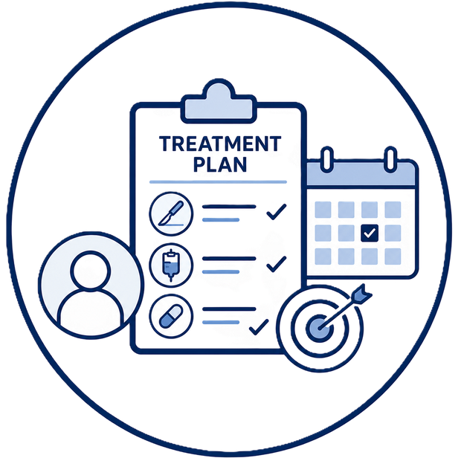
SESSION 4
Imaging, staging, and treatment planning
Imaging and staging
Treatment planning
Imaging helps assess local extent, regional lymph nodes, and distant metastases, and supports treatment planning.
Set by: specialist team, after biopsy and staging.
Guided by: stage, grade, biomarkers, patient fitness.
Resectable: gastrectomy + lymphadenectomy, often peri-operative chemotherapy.
Advanced: systemic therapy + palliative care.
Frontline HCP: explain and support, not select.
Gastric Cancer | Frontline HCP | Rwanda Biomedical Centre

Slide 69


SESSION 4
Treatment overview
Surgery
Radiotherapy
Removes part or all of the stomach depending on tumor location and extent, with appropriate regional lymph nodes.
A local or locoregional treatment; suitability depends on stage and patient factors.
Implications: reduced stomach capacity, changed eating patterns, nutritional consequences, and recovery needs.
Uses ionizing radiation to damage DNA in cancer cells so they cannot keep dividing.
A local or locoregional treatment.
Its role depends on the clinical situation and overall strategy; it is not used identically for every patient.
Gastric Cancer | Frontline HCP | Rwanda Biomedical Centre
Gastric Cancer | Frontline HCP | Rwanda Biomedical Centre

Slide 70
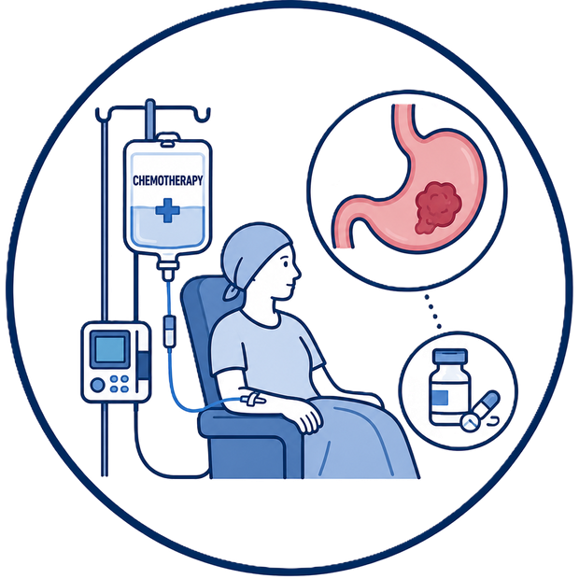

SESSION 4
Systemic treatment
Chemotherapy
Targeted therapy and immunotherapy
Systemic treatment using cytotoxic medicines that interfere with cancer-cell growth and division.
Can also affect normal rapidly dividing cells, causing side effects.
May be used before, after, or around surgery, or for advanced disease, depending on the strategy.
Targeted therapy: acts on specific molecular features when a relevant biomarker is present.
Immunotherapy: modifies immune responses so the immune system can recognise cancer; used in selected cases.
Both depend on biomarker testing and specialist assessment.
Gastric Cancer | Frontline HCP | Rwanda Biomedical Centre
Gastric Cancer | Frontline HCP | Rwanda Biomedical Centre

Slide 71

SESSION 4
Observation and surveillance
Surveillance of premalignant conditions
Not the same as leaving cancer untreated
Certain premalignant gastric conditions may be followed with planned surveillance according to risk and specialist guidance.
Confirmed invasive gastric cancer is not routinely monitored without treatment. Observation has a defined, limited role.
Gastric Cancer | Frontline HCP | Rwanda Biomedical Centre

Slide 72
SESSION 4
What each treatment does
Surgery
Radiotherapy
Chemotherapy
Removes local cancer, with regional lymph nodes.
Damages cancer-cell DNA locally or locoregionally.
Interferes with cancer-cell growth and division, systemically.
Targeted therapy
Immunotherapy
Availability
Acts on a molecular target when one is present.
Modifies immune responses against the cancer.
Access to biomarker testing and newer therapies must be confirmed for Rwanda.
Gastric Cancer | Frontline HCP | Rwanda Biomedical Centre

Slide 73
SESSION 4
Common misconceptions
❌ Dyspepsia means cancer
❌ H. pylori means cancer
❌ No symptoms means no cancer
False. It raises risk, but most infected people never develop cancer.
False. Indigestion has many causes; persistent or alarm features need assessment.
False. Early gastric cancer is often silent.
❌ A premalignant lesion is cancer
❌ Biopsy spreads cancer
❌ Diagnosis means one fixed treatment
False. Biopsy is essential for cancer diagnosis. Cancer spread has nothing to do with taking
small tissue samples.
False. It is an increased-risk change, not confirmed cancer.
False. Treatment depends on stage and the person.
Gastric Cancer | Frontline HCP | Rwanda Biomedical Centre

Slide 74
SESSION 4
Match the clue to the next step
In the module this is an interactive matching activity. The correct pairing is shown here.
Persistent dyspepsia with weight loss
➔
Prompt referral for endoscopic assessment
Ongoing hematemesis with blood loss
➔
Urgent / emergency referral
Known intestinal metaplasia
➔
Surveillance per specialist guidance
Confirmed cancer, planning care
➔
Imaging and biopsy results used for staging
Anxious patient with an abnormal result
➔
Counselling and a clear explanation of the next step
Gastric Cancer | Frontline HCP | Rwanda Biomedical Centre

Slide 75
SESSION 4
Apply it
Scenario A patient has persistent symptoms, an abnormal-looking gastric lesion on endoscopy, and anaemia. A relative asks whether the diagnosis is now certain.
Correct answer: B
Why Symptoms, endoscopic appearance, and blood results raise suspicion, but tissue examined by pathology confirms the diagnosis and its type.
What is accurate?
A
The diagnosis is confirmed by the endoscopy appearance
B
Cancer is not confirmed until biopsy and histopathology
✓
C
Anaemia confirms it
D
Symptoms confirm it
Gastric Cancer | Frontline HCP | Rwanda Biomedical Centre

Slide 76
SESSION 4
Knowledge check (1/3)
Choose the best answer.
Q1. Gastric cancer is confirmed by:
A. A blood test
B. Symptoms alone
C. Endoscopic biopsy and histopathology ✓
D. Examination alone
Correct: C. Tissue confirms the diagnosis.
Q2. A normal examination:
A. Excludes cancer
B. Does not exclude cancer ✓
C. Confirms cancer
D. Replaces biopsy
Correct: B. It cannot rule gastric cancer in or out on its own.
Gastric Cancer | Frontline HCP | Rwanda Biomedical Centre

Slide 77
SESSION 4
Knowledge check (2/3)
Choose the best answer.
Q3. Radiotherapy works by:
A. Adding hormones
B. Damaging cancer-cell DNA with radiation ✓
C. Being a type of surgery
D. Doing nothing
Correct: B. It damages DNA so cells cannot keep dividing.
Q4. Chemotherapy is:
A. A local treatment
B. A systemic treatment ✓
C. A type of imaging
D. A type of surgery
Correct: B. It acts throughout the body.
Gastric Cancer | Frontline HCP | Rwanda Biomedical Centre

Slide 78
SESSION 4
Knowledge check (3/3)
Choose the best answer.
Q5. Surveillance of a premalignant gastric condition means:
A. Ignoring it
B. Planned follow-up per specialist guidance ✓
C. Immediate gastrectomy
D. Palliative care only
Correct: B. It is planned follow-up, not neglect, and differs from treating confirmed cancer.
Q6. Gastric-cancer surgery may involve:
A. Removing part or all of the stomach and lymph nodes resection if indicated ✓
B. Only imaging
C. No tissue removal
D. Radiotherapy planning
Correct: A. Gastrectomy removes part or all of the stomach with regional nodes.
Gastric Cancer | Frontline HCP | Rwanda Biomedical Centre

Slide 79
SESSION 4
Session reflection
Enter your response in the text box. There is no single correct answer.
How would you explain endoscopy and biopsy to a patient in plain terms?
1
How would you describe the difference between a local and a systemic treatment?
2
Which misconception about gastric cancer would you most want to correct in your setting?
3
Gastric Cancer | Frontline HCP | Rwanda Biomedical Centre

Slide 80
5
SESSION 5
Supportive treatment
Support people through treatment and beyond: recognise effects, know the emergencies, protect nutrition and quality of life.

Slide 81
SESSION 5
Learning objectives
Recognise
Escalate
Support nutrition
Recognise and sort common treatment and disease effects.
Escalate urgent warning signs and serious complications.
Support nutrition after gastric-cancer treatment.
Support quality of life
Explain palliative care
Support comfort, quality of life, and follow-up.
Explain palliative care accurately, not only as end of life.
Gastric Cancer | Frontline HCP | Rwanda Biomedical Centre

Slide 82
SESSION 5
Adverse effects and care
Sort effects into what is expected and manageable, what needs assessment, and what is an urgent warning sign.
Expected or manageable
Needs assessment
Urgent warning sign
• Mild nausea
• Persistent vomiting
• Significant GI bleeding
• Reduced appetite
• Ongoing weight loss
• Severe dehydration
• Fatigue
• Worsening anaemia
• Rapid deterioration (marked worsening in overall condition)
• Mild bowel changes
• Poor oral intake
• Signs of obstruction (persistent vomiting, inability to tolerate oral intake, increased abdominal distension, or progressive difficulty swallowing
Gastric Cancer | Frontline HCP | Rwanda Biomedical Centre

Slide 83
SESSION 5
Nutrition after treatment
Smaller, frequent, nutrient-dense meals
Deficiency risk
Monitor weight and intake
There is a risk of nutritional deficiencies. Refer for dietetic or specialist support where available.
After gastrectomy, reduced stomach capacity means smaller, more frequent meals help maintain intake.
Recommend soft, well-cooked foods that are easier to eat and digest, and prioritize protein- and calorie-rich foods such as eggs, yogurt, soft-cooked vegetables, nut butters, and healthy oils.
Watch for ongoing weight loss, early satiety, and inadequate oral intake, and act on them.
Do not treat weight loss as harmless or inevitable. Escalate when oral intake is inadequate.
Gastric Cancer | Frontline HCP | Rwanda Biomedical Centre

Slide 84
SESSION 5
Palliative care
What it is
Not only end of life
In advanced disease
Relief of symptoms and support for quality of life, alongside treatment when appropriate.
It is not limited to the last days of life and can start early in the illness.
Helps with pain, nausea, nutrition-related symptoms, bleeding, obstruction, fatigue, and distress.
Identify serious complications, such as significant bleeding or obstruction, that need urgent escalation.
Gastric Cancer | Frontline HCP | Rwanda Biomedical Centre

Slide 85
SESSION 5
Quality of life
Eating and weight
Physical and emotional
Practical and social
Nutrition, appetite, and weight strongly affect daily life after treatment.
Fatigue, pain, physical function, and emotional wellbeing all matter.
Relationships, work, finances, follow-up, and treatment adherence.
Gastric Cancer | Frontline HCP | Rwanda Biomedical Centre

Slide 86
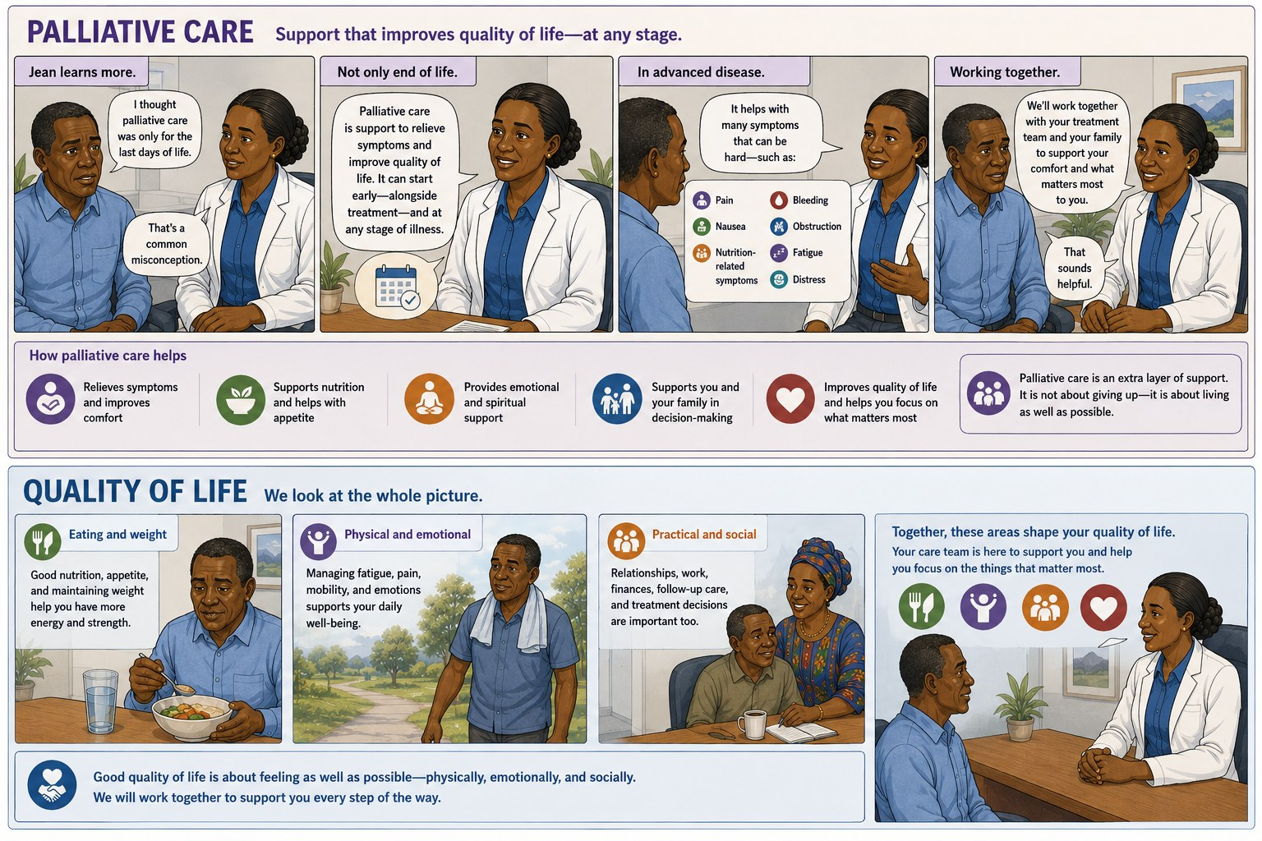
SESSION 5
Gastric Cancer | Frontline HCP | Rwanda Biomedical Centre

Slide 87
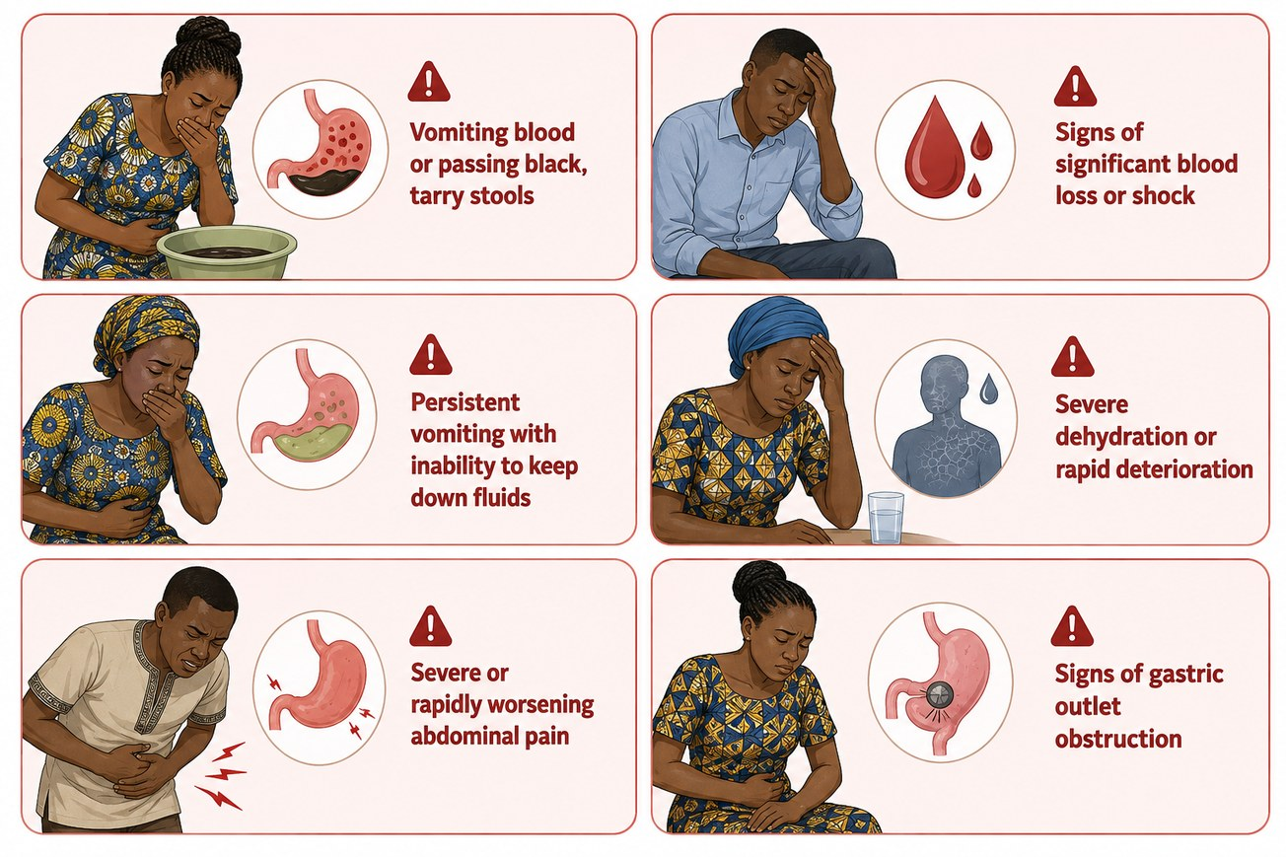
SESSION 5
Urgent warning signs
These need urgent assessment. Recognise them and escalate without delay.
Gastric Cancer | Frontline HCP | Rwanda Biomedical Centre

Slide 88
SESSION 5
Apply it
Scenario A patient on treatment reports vomiting blood, feeling very weak, and lightheadedness when standing.
Correct answer: B
Why Hematemesis with weakness and postural symptoms suggests significant bleeding and possible blood loss. Arrange urgent assessment and escalate without delay.
What is the priority?
A
Reassure and review next month
B
Arrange urgent assessment for significant gastrointestinal bleeding
✓
C
Advise rest and fluids only
D
Wait to see if it settles
Gastric Cancer | Frontline HCP | Rwanda Biomedical Centre

Slide 89
SESSION 5
Knowledge check (1/3)
Choose the best answer.
Q1. Palliative care is:
A. Only for the last days of life
B. Symptom relief and quality of life, alongside treatment when appropriate ✓
C. The same as stopping care
D. Only pain medicine
Correct: B. It focuses on symptoms and quality of life at any stage.
Q2. An urgent warning sign is:
A. Mild fatigue
B. Vomiting blood with weakness ✓
C. An occasional loose stool
D. Mild nausea
Correct: B. This suggests significant GI bleeding.
Gastric Cancer | Frontline HCP | Rwanda Biomedical Centre

Slide 90
SESSION 5
Knowledge check (2/3)
Choose the best answer.
Q3. After gastrectomy, a helpful eating pattern is:
A. Large, infrequent meals
B. Smaller, more frequent meals ✓
C. No change needed
D. Fluids only, long term
Correct: B. Reduced stomach capacity favours smaller, frequent meals.
Q4. Ongoing unintentional weight loss should be:
A. Accepted as normal
B. Assessed and supported ✓
C. Ignored
D. Managed by fasting
Correct: B. Weight loss is not harmless; assess and support nutrition.
Gastric Cancer | Frontline HCP | Rwanda Biomedical Centre

Slide 91
SESSION 5
Knowledge check (3/3)
Choose the best answer.
Q5. A new, worsening symptom during treatment should be:
A. Ignored
B. Reported and assessed ✓
C. Delayed for months
D. Self-treated only
Correct: B. Encourage reporting and assessment.
Q6. Nutrition and eating concerns after treatment should be:
A. Avoided as unimportant
B. Discussed and supported, with referral where available ✓
C. Left entirely to the patient
D. Managed only with medicines
Correct: B. Nutrition strongly affects recovery and quality of life.
Gastric Cancer | Frontline HCP | Rwanda Biomedical Centre

Slide 92
SESSION 5
Session reflection
Enter your response in the text box. There is no single correct answer.
How would you help a patient sort which symptoms to report urgently?
1
How would you support nutrition for someone struggling to eat after gastrectomy?
2
What practical support could help someone continue their follow-up?
3
Gastric Cancer | Frontline HCP | Rwanda Biomedical Centre

Slide 93
BASELINE CHECK
Post-test
Twenty questions covering the whole module. Focus on applying what you can now recognise, decide, and do.

Slide 94
BASELINE CHECK
Question set (1/10)
Choose the best answer.
Q1. Most gastric cancers are:
A. Sarcomas
B. Adenocarcinomas ✓
C. Lymphomas
D. Melanomas
Correct: B. They arise from the glandular mucosa as adenocarcinomas.
Q2. An important, preventable cause of gastric cancer is:
A. Helicobacter pylori ✓
B. Hepatitis A
C. Malaria
D. Influenza
Correct: A. Chronic H. pylori infection is a leading modifiable risk factor.
Gastric Cancer | Frontline HCP | Rwanda Biomedical Centre

Slide 95
BASELINE CHECK
Question set (2/10)
Choose the best answer.
Q3. Early gastric cancer usually causes:
A. Severe pain
B. Few or non-specific symptoms ✓
C. Immediate weight loss
D. High fever
Correct: B. Early disease is frequently silent.
Q4. Persistent dyspepsia with weight loss should prompt:
A. Reassurance only
B. Assessment and referral ✓
C. Antacids alone
D. No action
Correct: B. Alarm features need assessment and referral.
Gastric Cancer | Frontline HCP | Rwanda Biomedical Centre

Slide 96
BASELINE CHECK
Question set (3/10)
Choose the best answer.
Q5. Intestinal metaplasia is:
A. Confirmed cancer
B. A premalignant condition ✓
C. A normal finding
D. An infection
Correct: B. It increases risk but is not cancer.
Q6. A red-flag feature is:
A. Occasional bloating
B. Melena or hematemesis ✓
C. Mild belching
D. Brief nausea
Correct: B. GI bleeding needs prompt or urgent assessment.
Gastric Cancer | Frontline HCP | Rwanda Biomedical Centre

Slide 97
BASELINE CHECK
Question set (4/10)
Choose the best answer.
Q7. Gastric cancer is confirmed by:
A. Symptoms alone
B. A blood test
C. Biopsy and histopathology ✓
D. Examination alone
Correct: C. Tissue confirms the diagnosis.
Q8. Stage describes:
A. How abnormal cells look
B. Where the cancer is and how far it has spread ✓
C. The patient's age
D. The treatment chosen
Correct: B. Stage is extent; grade is cell appearance.
Gastric Cancer | Frontline HCP | Rwanda Biomedical Centre

Slide 98
BASELINE CHECK
Question set (5/10)
Choose the best answer.
Q9. In TNM, N describes:
A. Tumor depth
B. Regional lymph nodes ✓
C. Distant spread
D. Grade
Correct: B. N is regional lymph-node involvement.
Q10. Screening means testing:
A. People with symptoms
B. Asymptomatic people to detect disease early ✓
C. Only people with cancer
D. Everyone once
Correct: B. Screening targets people without symptoms.
Gastric Cancer | Frontline HCP | Rwanda Biomedical Centre

Slide 99
BASELINE CHECK
Question set (6/10)
Choose the best answer.
Q11. H. pylori infection means the person:
A. Definitely has cancer
B. Has an increased risk and needs to be treated. It is not considered itself cancer. ✓
C. Needs surgery
D. Has no risk
Correct: B. Most infected people do not develop gastric cancer.
Q12. Upper Gastro-Intestinal endoscopy allows:
A. Direct visualisation and biopsy ✓
B. Only blood sampling
C. Bone assessment
D. No tissue sampling
Correct: A. It visualises the upper GI tract and enables biopsy.
Gastric Cancer | Frontline HCP | Rwanda Biomedical Centre

Slide 100
BASELINE CHECK
Question set (7/10)
Choose the best answer.
Q13. Surveillance applies to people who:
A. Have no risk
B. Have known premalignant conditions ✓
C. Are fully healthy
D. Refuse care
Correct: B. Surveillance is planned follow-up of increased-risk conditions.
Q14. Chemotherapy is:
A. A local treatment
B. A systemic treatment ✓
C. A type of surgery
D. A form of imaging
Correct: B. It acts throughout the body.
Gastric Cancer | Frontline HCP | Rwanda Biomedical Centre

Slide 101
BASELINE CHECK
Question set (8/10)
Choose the best answer.
Q15. Gastric-cancer surgery may involve:
A. Removing part or all of the stomach and lymph nodes resection if indicated ✓
B. Only removing lymph nodes
C. No tissue removal
D. Radiotherapy planning
Correct: A. Gastrectomy removes part or all of the stomach with regional nodes.
Q16. Radiotherapy works by:
A. Adding hormones
B. Damaging cancer-cell DNA with radiation ✓
C. Being a type of surgery
D. Doing nothing
Correct: B. It damages DNA so cells cannot keep dividing.
Gastric Cancer | Frontline HCP | Rwanda Biomedical Centre

Slide 102
BASELINE CHECK
Question set (9/10)
Choose the best answer.
Q17. A biopsy of a gastric lesion:
A. Causes cancer to spread
B. Is needed to confirm diagnosis ✓
C. Replaces endoscopy
D. Confirms stage alone
Correct: B. Biopsy confirms diagnosis and does not spread cancer.
Q18. After gastrectomy, patients often need:
A. Larger, less frequent meals
B. Smaller, more frequent meals ✓
C. No dietary change
D. IV fluids only
Correct: B. Reduced capacity favours smaller, frequent meals.
Gastric Cancer | Frontline HCP | Rwanda Biomedical Centre

Slide 103
BASELINE CHECK
Question set (10/10)
Choose the best answer.
Q19. Palliative care is:
A. Only for the last days of life
B. Symptom relief and quality of life, alongside treatment when appropriate ✓
C. The same as stopping care
D. Only pain medicine
Correct: B. It supports symptoms and quality of life at any stage.
Q20. In Rwanda, gastric cancer is:
A. Not recorded
B. Among the more common cancers and a notable cause of cancer death ✓
C. Only found abroad
D. Extremely rare
Correct: B. GLOBOCAN 2024 lists gastric cancer among the leading cancers in Rwanda.
Gastric Cancer | Frontline HCP | Rwanda Biomedical Centre

Slide 104
ATTRIBUTION AND SOURCES
References
1. International Agency for Research on Cancer. Global Cancer Observatory: Cancer Today (GLOBOCAN 2024 estimates, version 1.0). Lyon: IARC/WHO. Rwanda and stomach fact sheets. https://gco.iarc.who.int/today
2. Sung H, Filho AM, Laversanne M, et al. Global cancer statistics 2024: GLOBOCAN estimates of incidence and mortality worldwide for 34 cancers in 186 countries. CA Cancer J Clin. 2026. doi:10.3322/caac.70090
3. International Agency for Research on Cancer. Cancer Tomorrow: projections of future incidence and mortality to 2050. https://gco.iarc.who.int/tomorrow
4. World Health Organization. Guide to Cancer Early Diagnosis. Geneva: WHO, 2017.
5. IARC Working Group. Helicobacter pylori Eradication as a Strategy for Preventing Gastric Cancer (IARC Working Group Reports Vol. 8). Lyon: IARC.
6. Ford AC, Yuan Y, Moayyedi P. Helicobacter pylori eradication for the prevention of gastric neoplasia. Cochrane Database of Systematic Reviews. https://www.cochranelibrary.com
7. Best LMJ, Takwoingi Y, Siddique S, et al. Non-invasive diagnostic tests for Helicobacter pylori infection. Cochrane Database of Systematic Reviews. https://www.cochranelibrary.com
8. Lordick F, Carneiro F, Cascinu S, et al. Gastric cancer: ESMO Clinical Practice Guideline for diagnosis, treatment and follow-up. Ann Oncol. 2022. doi:10.1016/j.annonc.2022.07.004
Gastric Cancer | Frontline HCP | Rwanda Biomedical Centre

Slide 105
ATTRIBUTION AND SOURCES
References (continued)
9. National Comprehensive Cancer Network. NCCN Guidelines for Patients: Stomach Cancer. https://www.nccn.org/patientguidelines
10. American Cancer Society. Stomach cancer: causes, risk factors, detection, diagnosis, staging and treatment. https://www.cancer.org/cancer/types/stomach-cancer.html
11. National Cancer Institute. Stomach (gastric) cancer. https://www.cancer.gov/types/stomach
12. Amin MB, Edge SB, Greene FL, et al. AJCC Cancer Staging Manual, 8th edition. American College of Surgeons.
13. Union for International Cancer Control. TNM Classification of Malignant Tumors. https://www.uicc.org/what-we-do/sharing-knowledge/tnm
14. ESMO. Stomach Cancer: A Guide for Patients. https://www.esmo.org
15. Gastric cancer in sub-Saharan Africa: a systematic review, 2022. https://doi.org (open access).
16. African Cancer Registry Network. Rwanda National Cancer Registry. https://afcrn.org
Gastric Cancer | Frontline HCP | Rwanda Biomedical Centre

Slide 106
ATTRIBUTION AND SOURCES
References (continued)
17. World Gastroenterology Organisation. Helicobacter pylori: WGO Global Guideline. Milwaukee: WGO; 2021. https://www.worldgastroenterology.org/guidelines
18. Malfertheiner P, Megraud F, Rokkas T, et al. Management of Helicobacter pylori infection: the Maastricht VI/Florence consensus report. Gut. 2022;71:1724-1762.
19. Park JY, Georges D, Alberts CJ, et al. Global lifetime estimates of expected and preventable gastric cancers across 185 countries. Nature Medicine. https://www.nature.com/articles/s41591-025-03793-6
20. Memorial Sloan Kettering Cancer Center. Eating after your gastrectomy. https://www.mskcc.org/cancer-care/patient-education/eating-after-your-gastrectomy
Gastric Cancer | Frontline HCP | Rwanda Biomedical Centre

