Slide 1
F R O N T L I N E H C P M O D U L E
Cervical Cancer
Prevent. Screen. Treat precancer. Refer. Support.
English
Rwanda Biomedical Centre

Slide 2
MODULE SYLLABUS
What this module covers
Cervical cancer is largely preventable. This module follows the prevention pathway from end to end.
➡️
➡️
➡️
➡️
1
2
3
4
5
Prevent HPV infection
Screen eligible women
Treat cervical precancer
Recognise and refer suspected cancer
Support diagnosis, treatment and follow-up
📌 Central idea: Most cervical cancers can be prevented, through HPV vaccination and through finding and treating precancer before invasive cancer develops.
Cervical Cancer | Frontline HCP | Rwanda Biomedical Centre
Screen 2

Slide 3
MODULE SYLLABUS
How the module is organised
📋
Pre-test. Twenty questions to check your starting point.
🧠
Session 1. Understanding cervical cancer: burden, anatomy and the transformation zone, HPV, precancer, staging.
🔎
Session 2. Screening and prevention: vaccination, risk, symptoms, HPV testing and VIA, managing precancer.
🏥
Session 3. Referral and counselling: urgency, what to record, communication without stigma.
🧪
Session 4. Diagnosis and treatment: biopsy, staging, surgery, radiotherapy, brachytherapy, chemotherapy.
💬
Session 5. Supportive treatment: adverse effects, sexual health, palliative care, follow-up.
📋
Post-test. Twenty questions to check your new knowledge.
Cervical Cancer | Frontline HCP | Rwanda Biomedical Centre
Screen 3

Slide 4
MODULE SYLLABUS
Module objectives
By the end of this module you will be able to:
1
Explain how persistent high-risk HPV infection leads to cervical precancer and, in some women, to invasive cancer.
2
Promote HPV vaccination and answer the concerns that most often reduce uptake.
3
Distinguish screening of a well woman from assessment of a woman who has symptoms.
4
Interpret a screening result and state the correct next step for that woman.
5
Refer with the right urgency, counsel without stigma, and record what the national registry needs.
6
Support women through treatment, follow-up, palliative care and quality of life.
Cervical Cancer | Frontline HCP | Rwanda Biomedical Centre
Screen 4

Slide 5
BASELINE CHECK
Pre-test
Twenty questions to check what you already know before you begin.
📋 Twenty questions
⏱️ Not graded for you
➡️ You will meet these ideas again
One question on each screen, with four answer options.
Your answers set your starting point. They do not affect your result.
The post-test at the end covers the same concepts, with answers and feedback.
Cervical Cancer | Frontline HCP | Rwanda Biomedical Centre
Screen 5

Slide 6
BASELINE CHECK
Pre-test: question 1 of 20
Nearly all cervical cancers are caused by:
A A bacterial infection
B Persistent infection with a high-risk type of HPV
C An inherited gene fault
D Poor diet
Cervical Cancer | Frontline HCP | Rwanda Biomedical Centre
Screen 6

Slide 7
BASELINE CHECK
Pre-test: question 2 of 20
Most cervical cancers are which type of tumour?
A Sarcoma
B Melanoma
C Lymphoma
D Squamous cell carcinoma
Cervical Cancer | Frontline HCP | Rwanda Biomedical Centre
Screen 7

Slide 8
BASELINE CHECK
Pre-test: question 3 of 20
Cervical cancer usually develops from:
A Precancerous changes in the transformation zone
B Uterine fibroids
C Ovarian cysts
D Untreated candidiasis
Cervical Cancer | Frontline HCP | Rwanda Biomedical Centre
Screen 8

Slide 9
BASELINE CHECK
Pre-test: question 4 of 20
Early cervical cancer and cervical precancer usually cause:
A Severe pelvic pain
B Immediate heavy bleeding
C Often no symptoms at all
D High fever
Cervical Cancer | Frontline HCP | Rwanda Biomedical Centre
Screen 9

Slide 10
BASELINE CHECK
Pre-test: question 5 of 20
HPV vaccination works best when it is given:
A Before exposure to HPV, starting at age 9
B After a person becomes sexually active
C Only after the age of 30
D During pregnancy
Cervical Cancer | Frontline HCP | Rwanda Biomedical Centre
Screen 10

Slide 11
BASELINE CHECK
Pre-test: question 6 of 20
A positive HPV test means:
A Cervical cancer is confirmed
B High-risk HPV was detected and the next step in the screening pathway is needed
C No action is needed
D Antibiotics should be started
Cervical Cancer | Frontline HCP | Rwanda Biomedical Centre
Screen 11

Slide 12
BASELINE CHECK
Pre-test: question 7 of 20
Screening applies to:
A Women with concerning symptoms
B Eligible women who have no symptoms
C Women already diagnosed with cancer
D Nobody
Cervical Cancer | Frontline HCP | Rwanda Biomedical Centre
Screen 12

Slide 13
BASELINE CHECK
Pre-test: question 8 of 20
Compared with other women, women living with HIV have:
A The same risk of cervical cancer
B No need for screening
C A lower risk
D A higher risk of persistent HPV infection, precancer and cervical cancer
Cervical Cancer | Frontline HCP | Rwanda Biomedical Centre
Screen 13

Slide 14
BASELINE CHECK
Pre-test: question 9 of 20
Thermal ablation is used to:
A Treat an eligible precancerous lesion of the cervix
B Remove an invasive cancer
C Confirm a diagnosis
D Replace HPV testing
Cervical Cancer | Frontline HCP | Rwanda Biomedical Centre
Screen 14

Slide 15
BASELINE CHECK
Pre-test: question 10 of 20
Invasive cervical cancer is confirmed by:
A An HPV test alone
B Visual inspection with acetic acid alone
C Biopsy and histopathology
D Ultrasound alone
Cervical Cancer | Frontline HCP | Rwanda Biomedical Centre
Screen 15

Slide 16
BASELINE CHECK
Pre-test: question 11 of 20
Bleeding after sexual intercourse in an adult woman should be:
A Assumed to be normal
B Treated with antibiotics only
C Ignored if it is painless
D Assessed properly, because several causes are possible
Cervical Cancer | Frontline HCP | Rwanda Biomedical Centre
Screen 16

Slide 17
BASELINE CHECK
Pre-test: question 12 of 20
An acetowhite area seen on visual inspection with acetic acid means:
A Cervical cancer is confirmed
B The woman has an infection
C Nothing at all
D A cervical change that needs management or further assessment
Cervical Cancer | Frontline HCP | Rwanda Biomedical Centre
Screen 17

Slide 18
BASELINE CHECK
Pre-test: question 13 of 20
Invasive cervical cancer is staged using:
A The FIGO system
B The Gleason score
C The Bethesda system
D The Dukes classification
Cervical Cancer | Frontline HCP | Rwanda Biomedical Centre
Screen 18

Slide 19
BASELINE CHECK
Pre-test: question 14 of 20
Which finding needs urgent, same day assessment?
A Heavy vaginal bleeding with dizziness and pallor
B Mild vaginal discharge
C Occasional backache
D Mild vulval itching
Cervical Cancer | Frontline HCP | Rwanda Biomedical Centre
Screen 19

Slide 20
BASELINE CHECK
Pre-test: question 15 of 20
Stage describes:
A How abnormal the cells look under the microscope
B The HPV type detected
C How far the cancer has spread
D The treatment chosen
Cervical Cancer | Frontline HCP | Rwanda Biomedical Centre
Screen 20

Slide 21
BASELINE CHECK
Pre-test: question 16 of 20
A high-grade cervical precancerous lesion is:
A Invasive cancer
B Not cancer, but a lesion that can progress if it is not treated
C Never important
D A type of fibroid
Cervical Cancer | Frontline HCP | Rwanda Biomedical Centre
Screen 21

Slide 22
BASELINE CHECK
Pre-test: question 17 of 20
Brachytherapy in cervical cancer:
A Has no established role
B Delivers radiation close to the cervix and is an important part of curative treatment for many locally advanced cancers
C Replaces surgery in every case
D Is a type of chemotherapy
Cervical Cancer | Frontline HCP | Rwanda Biomedical Centre
Screen 22

Slide 23
BASELINE CHECK
Pre-test: question 18 of 20
After treatment of a cervical precancerous lesion, a woman:
A Needs no further screening
B Becomes immune to HPV
C Needs planned follow-up testing
D Must stop having children
Cervical Cancer | Frontline HCP | Rwanda Biomedical Centre
Screen 23

Slide 24
BASELINE CHECK
Pre-test: question 19 of 20
Palliative care is:
A Only for the last days of life
B The same as stopping care
C Symptom relief and quality of life support, alongside cancer treatment when appropriate
D Only pain medicine
Cervical Cancer | Frontline HCP | Rwanda Biomedical Centre
Screen 24

Slide 25
BASELINE CHECK
Pre-test: question 20 of 20
A woman with a cervix that looks suspicious for invasive cancer should:
A Receive thermal ablation at the same visit
B Repeat the HPV test
C Be reassured and reviewed in a year
D Be referred for diagnostic assessment and biopsy
Cervical Cancer | Frontline HCP | Rwanda Biomedical Centre
Screen 25

Slide 26
1
S E S S I O N 1
Understanding cervical cancer
What cervical cancer is, where it develops, how a common virus causes it, how much of it there is in Rwanda, and what stage and grade mean.
Cervical Cancer | Frontline HCP | Rwanda Biomedical Centre
Screen 26

Slide 27
SESSION 1
Learning objectives
By the end of this session you will be able to:
1
Describe what cervical cancer is and where in the cervix it develops.
2
Explain the anatomy of the cervix, the squamocolumnar junction and why the transformation zone matters.
3
Explain how persistent high-risk HPV infection leads to cervical precancer.
4
Identify cervical precancerous lesions and distinguish them from invasive cancer.
5
Interpret the global, regional and Rwandan burden of cervical cancer.
6
Explain FIGO staging and distinguish stage from grade.
Cervical Cancer | Frontline HCP | Rwanda Biomedical Centre
Screen 27

Slide 28
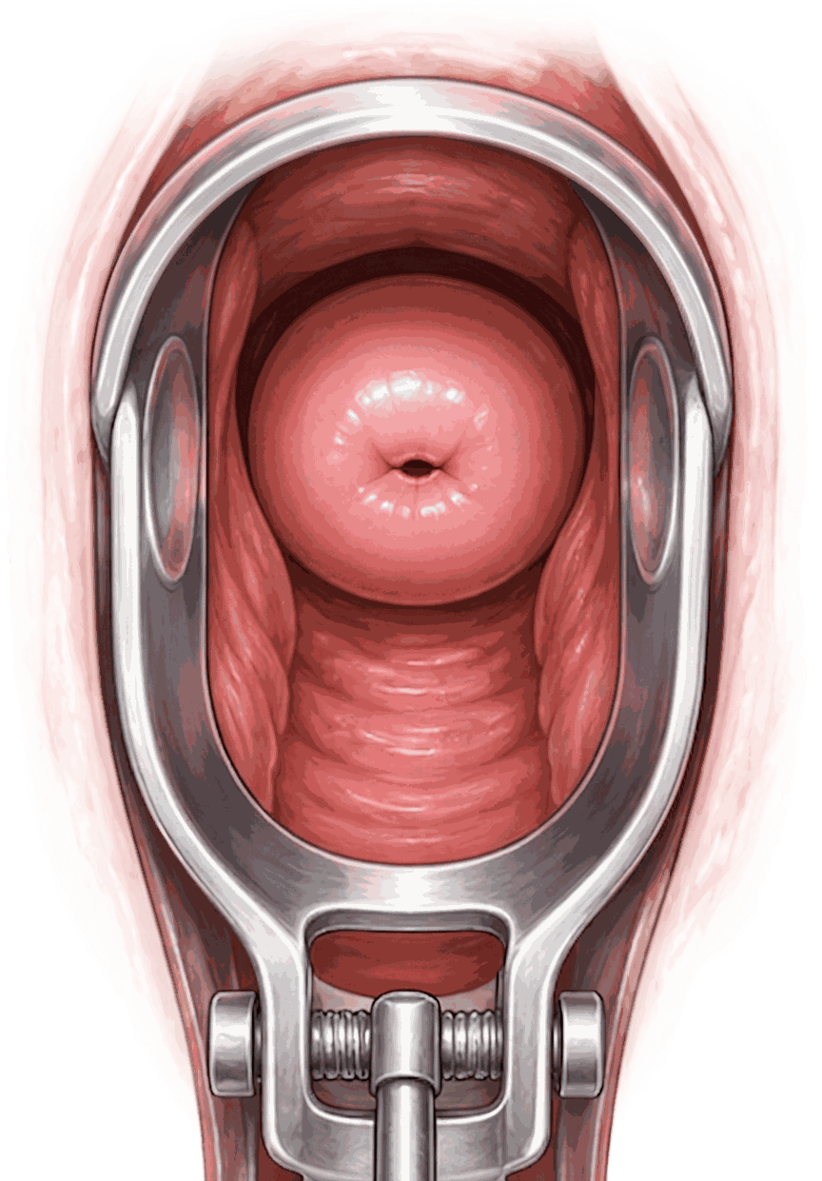
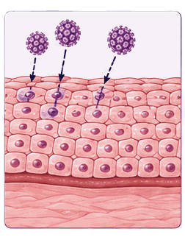
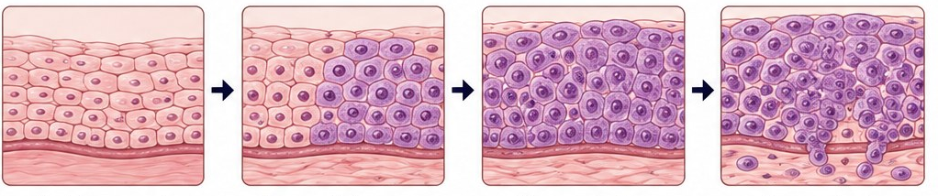
SESSION 1 · BRIEF DESCRIPTION
What cervical cancer is
👤 The cervix
🧠 Where it starts
🧪 What causes it
The cervix is the lower part of the uterus. It opens into the vagina and can be seen directly with a speculum.
Cervical cancer develops from abnormal cells in the cervix, most often squamous cell carcinoma, less often adenocarcinoma.
Persistent infection with high-risk types of human papillomavirus (HPV) is the main cause of cervical cancer.
📌 Remember: Cervical cancer is not the same as cancer of the uterine body or of the ovary. It has a different cause, a different screening pathway and different treatment.
Cervical Cancer | Frontline HCP | Rwanda Biomedical Centre
Screen 28

Slide 29
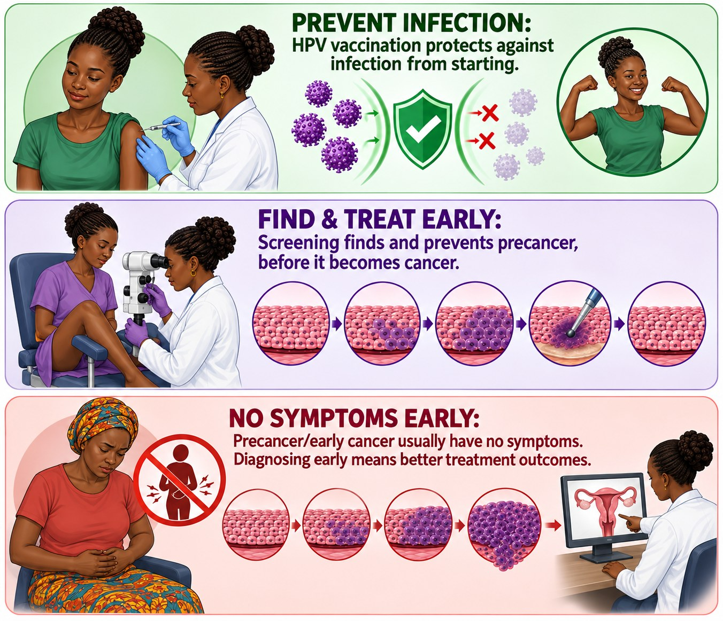
SESSION 1 · BRIEF DESCRIPTION
Why cervical cancer is different
⏱️ It develops slowly
Abnormal cells usually pass through precancerous stages before invasive cancer develops, generally over many years.
✅ It can be prevented
Vaccination prevents the infection of high-risk HPV. Screening finds and treats precancer before cancer develops.
🔎 It is silent early
Cervical precancer and early cervical cancer usually cause no symptoms. Waiting for symptoms means later diagnosis.
💡 Key point: Detecting and treating cervical precancer prevents many cervical cancers. Screening does not only find cancer earlier, it stops cancer from developing.
Cervical Cancer | Frontline HCP | Rwanda Biomedical Centre
Screen 29

Slide 30
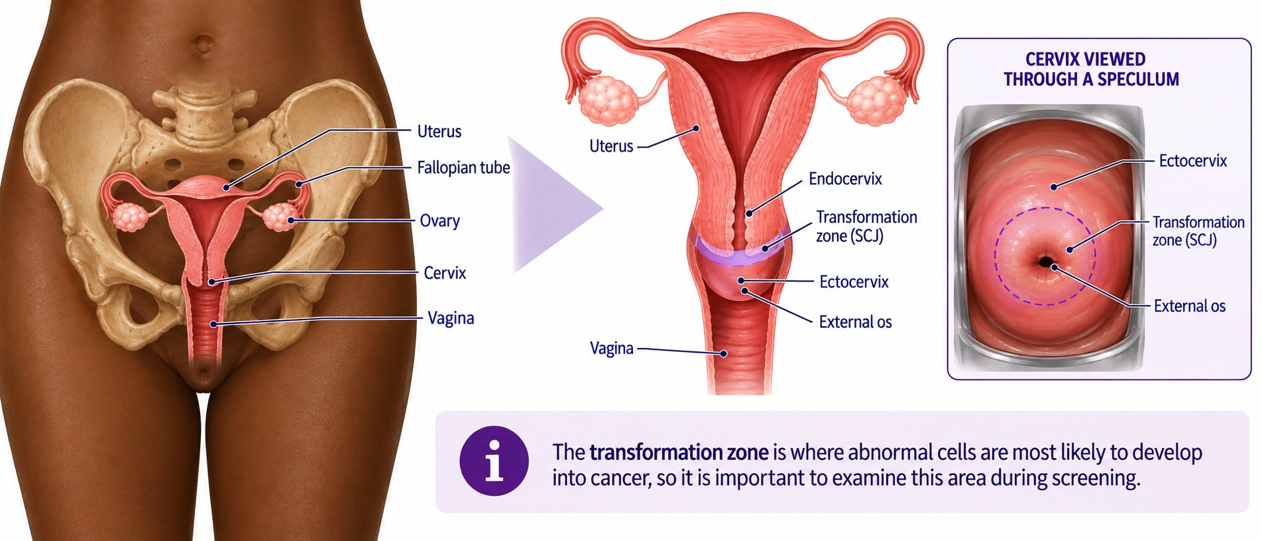
SESSION 1 · ANATOMY
The cervix: where it sits
Cervical Cancer | Frontline HCP | Rwanda Biomedical Centre
Screen 30

Slide 31
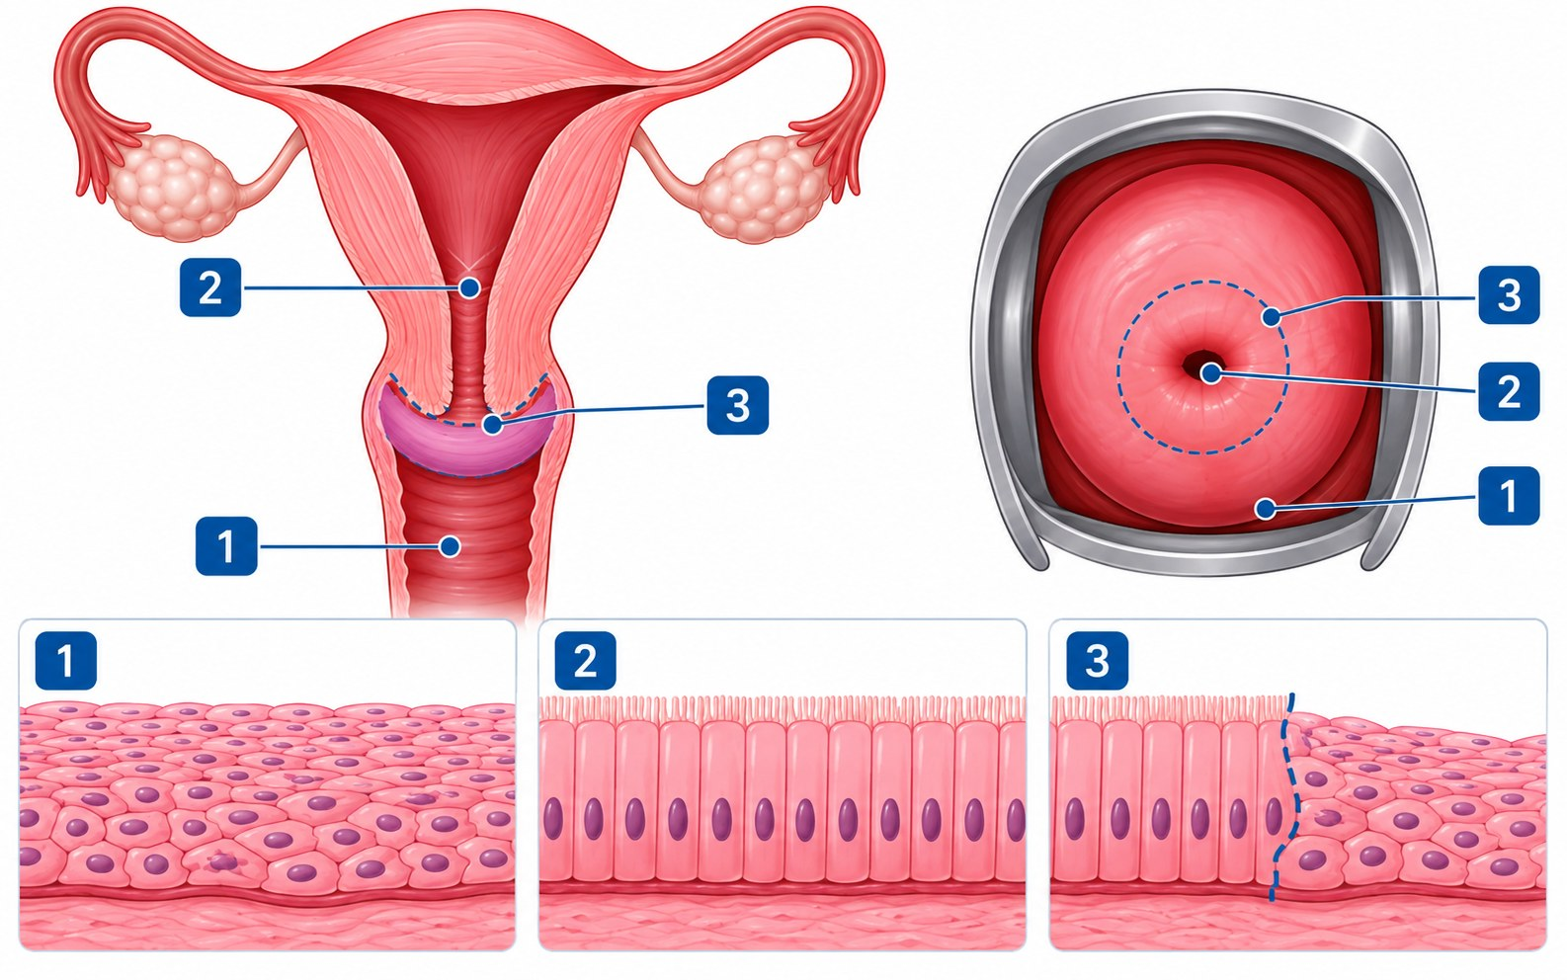
SESSION 1 · ANATOMY
Two linings meet at the cervix
1️⃣ The ectocervix
The outer surface of the cervix, facing the vagina. It is covered by flat squamous cells.
2️⃣ The endocervix
The canal leading up into the uterus. It is lined by tall columnar cells that produce mucus.
3️⃣ The squamocolumnar junction
The line where the two linings meet. Its position moves with age, puberty, childbirth and menopause.
🔎 Why this matters: The junction can be seen at the cervical opening in younger women. After the menopause it usually retreats up inside the canal.
Cervical Cancer | Frontline HCP | Rwanda Biomedical Centre
Screen 31

Slide 32
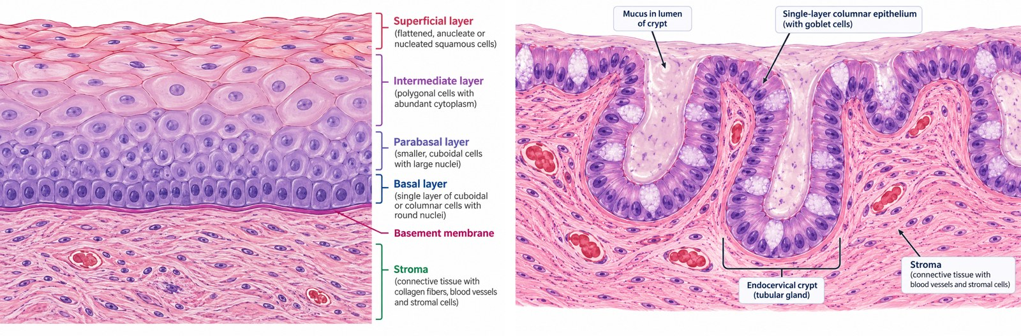
SESSION 1 · ANATOMY
Two linings, seen under the microscope
🔬 Squamous epithelium (ectocervix)
🔬 Columnar epithelium (endocervix)
Many layers of flat cells (15 to 20), resting on a basement membrane.
Four layers: basal, parabasal, intermediate and superficial.
Upper layers are rich in glycogen. Maturation depends on oestrogen.
Looks pale pink on inspection.
A single layer of tall, mucus-secreting cells.
Folds into the stroma to form crypts, about 5 to 8 mm deep.
Contains no glycogen.
Looks red and velvety on inspection.
🔎 Why this matters: The two linings look different with a speculum: a pale pink ectocervix and a red, velvety area around the opening of the canal.
Cervical Cancer | Frontline HCP | Rwanda Biomedical Centre
Screen 32

Slide 33
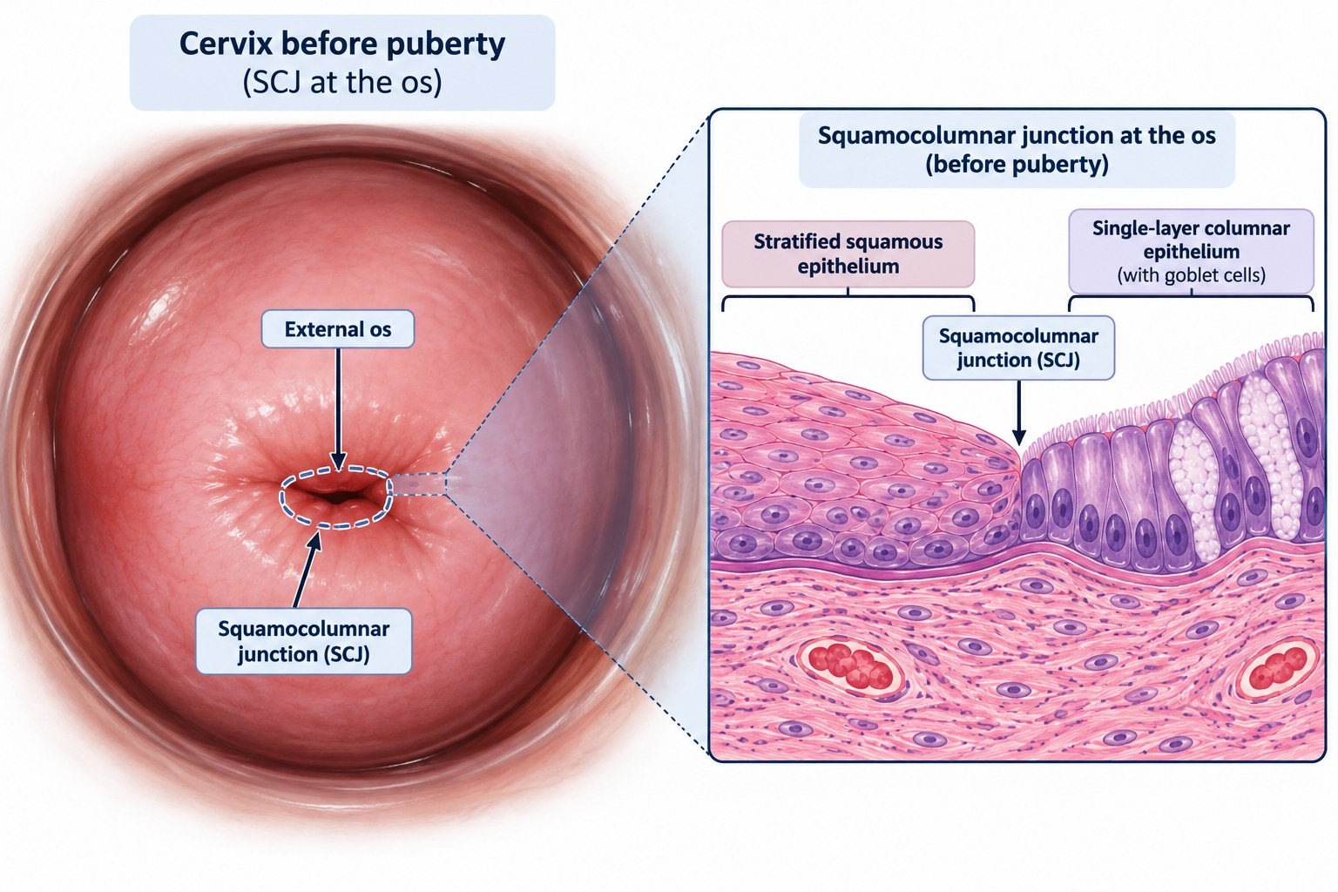
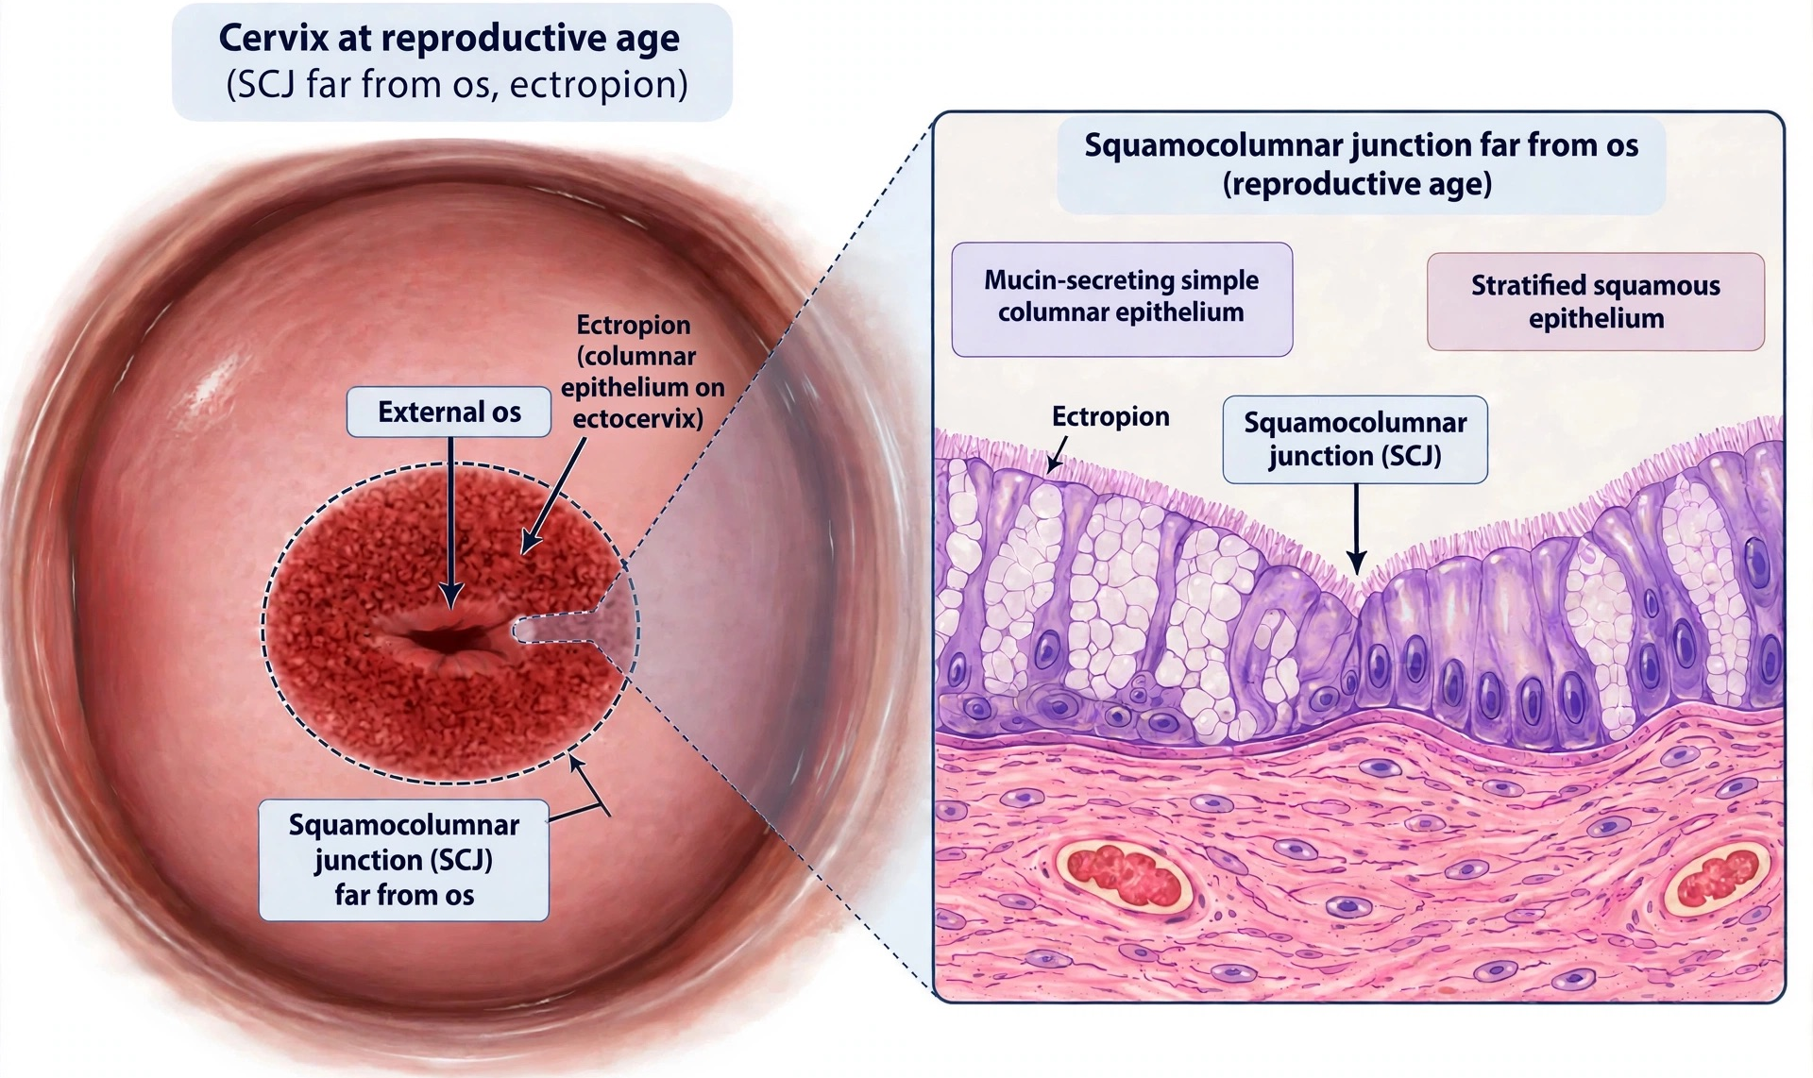
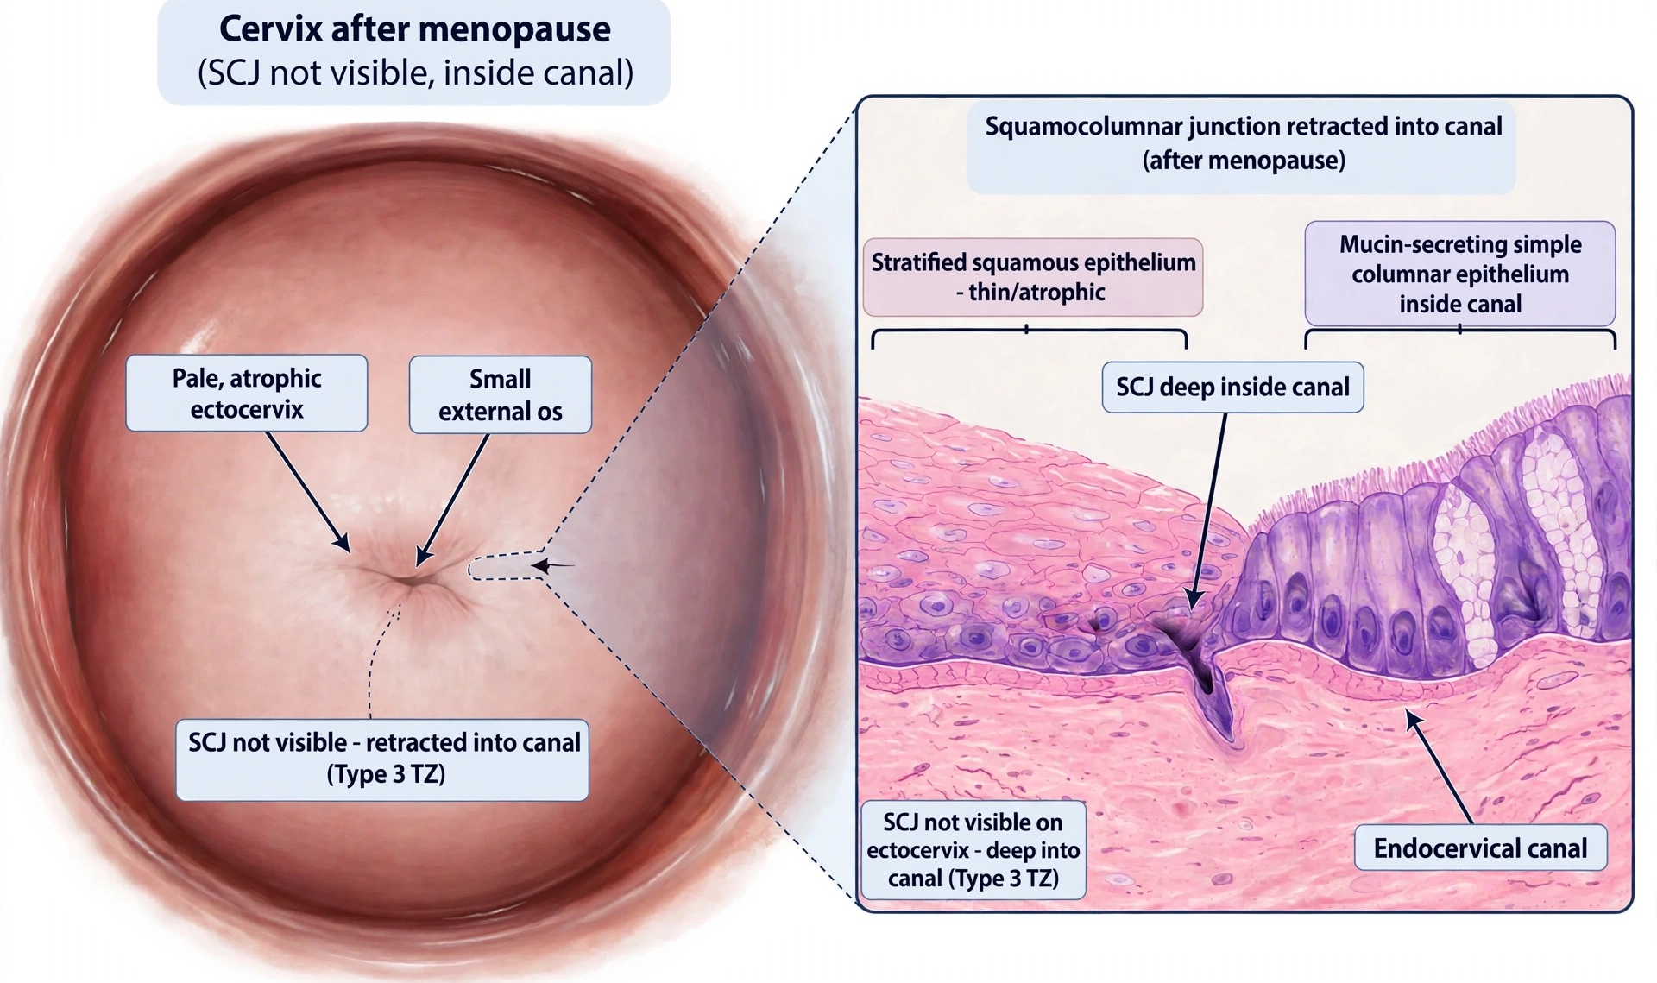
SESSION 1 · ANATOMY
The squamocolumnar junction moves through life
The position of the SCJ changes with age, hormones, pregnancy and childbirth.
🌱 Before puberty
🌸 Puberty and pregnancy
🍂 After menopause
The SCJ lies at, or very close to, the external os.
Under oestrogen the cervix enlarges and the columnar lining turns out onto the ectocervix (ectropion). The SCJ moves out, away from the os. Hormonal contraception can have the same effect.
With less oestrogen the cervix shrinks. The SCJ moves back into the canal and is often not visible.
📌 Remember: When the SCJ lies inside the canal, the whole transformation zone cannot be seen. This is common after the menopause.
Cervical Cancer | Frontline HCP | Rwanda Biomedical Centre
Screen 33

Slide 34
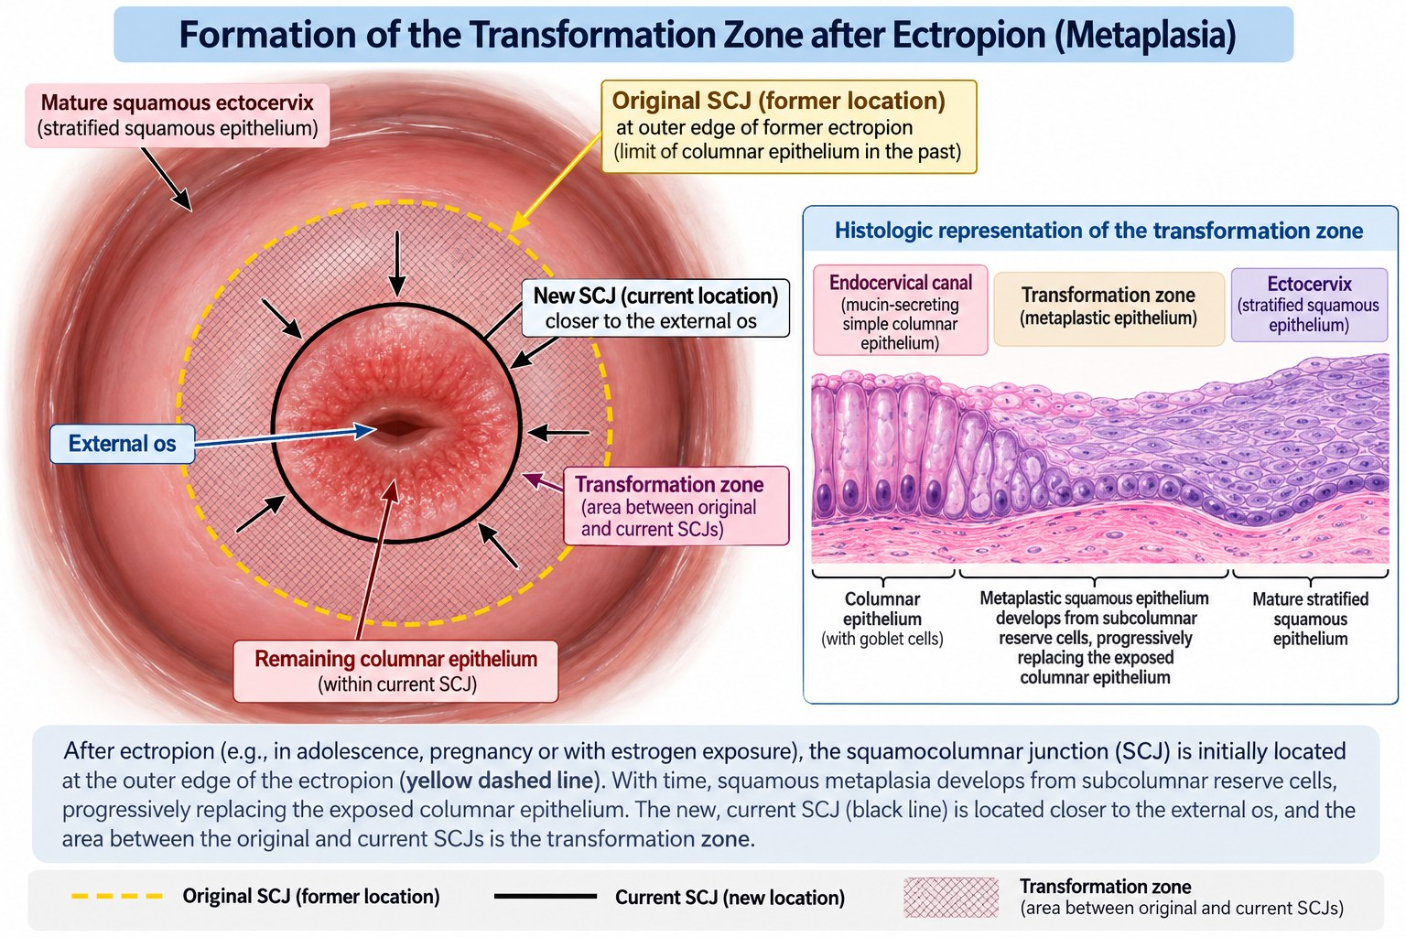
SESSION 1 · ANATOMY
Squamous metaplasia: the original and the new SCJ
1️⃣
The everted columnar lining is exposed to the acidic vaginal environment.
2️⃣
It is gradually replaced by new squamous epithelium. This normal process is called squamous metaplasia.
3️⃣
Metaplasia starts at the original SCJ and moves inwards, towards the external os.
4️⃣
A new SCJ forms, where the new squamous epithelium meets the columnar lining.
✅ Normal, not disease: Squamous metaplasia is a physiological change. It matters because these actively changing cells are the ones most vulnerable to high-risk HPV.
Cervical Cancer | Frontline HCP | Rwanda Biomedical Centre
Screen 34

Slide 35
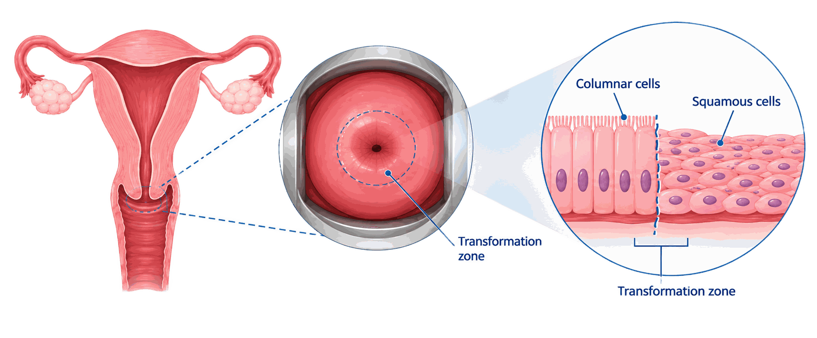
SESSION 1 · ANATOMY
The transformation zone
🧠 What it is
⚠️ Why it matters
🔎 What it changes for you
The area between the original SCJ and the new SCJ, where squamous metaplasia has taken place.
Almost all cervical cancers begin here, because these actively changing cells are the ones HPV affects.
Screening and treatment of precancer both depend on whether this zone can be seen.
📌 Remember: When the transformation zone cannot be fully seen, visual inspection is unreliable and ablative treatment of a lesion is not appropriate.
Cervical Cancer | Frontline HCP | Rwanda Biomedical Centre
Screen 35

Slide 36
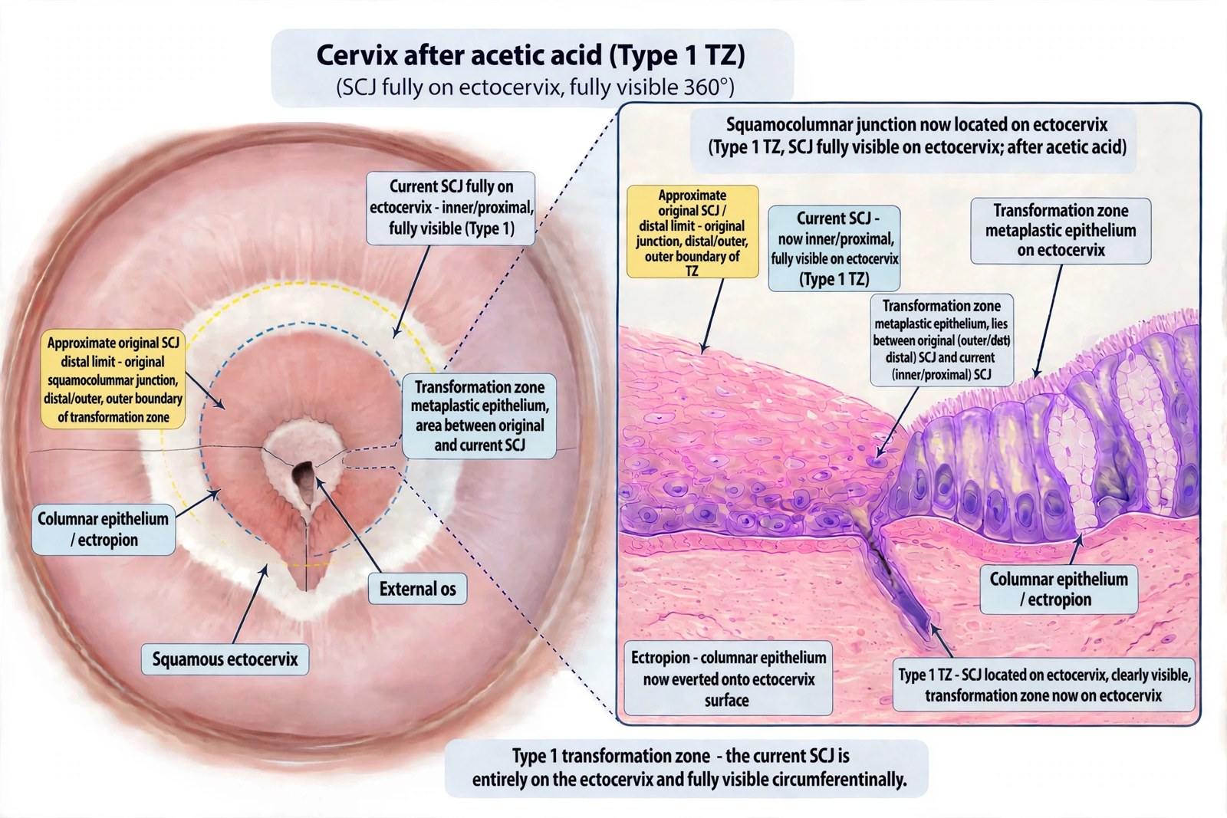
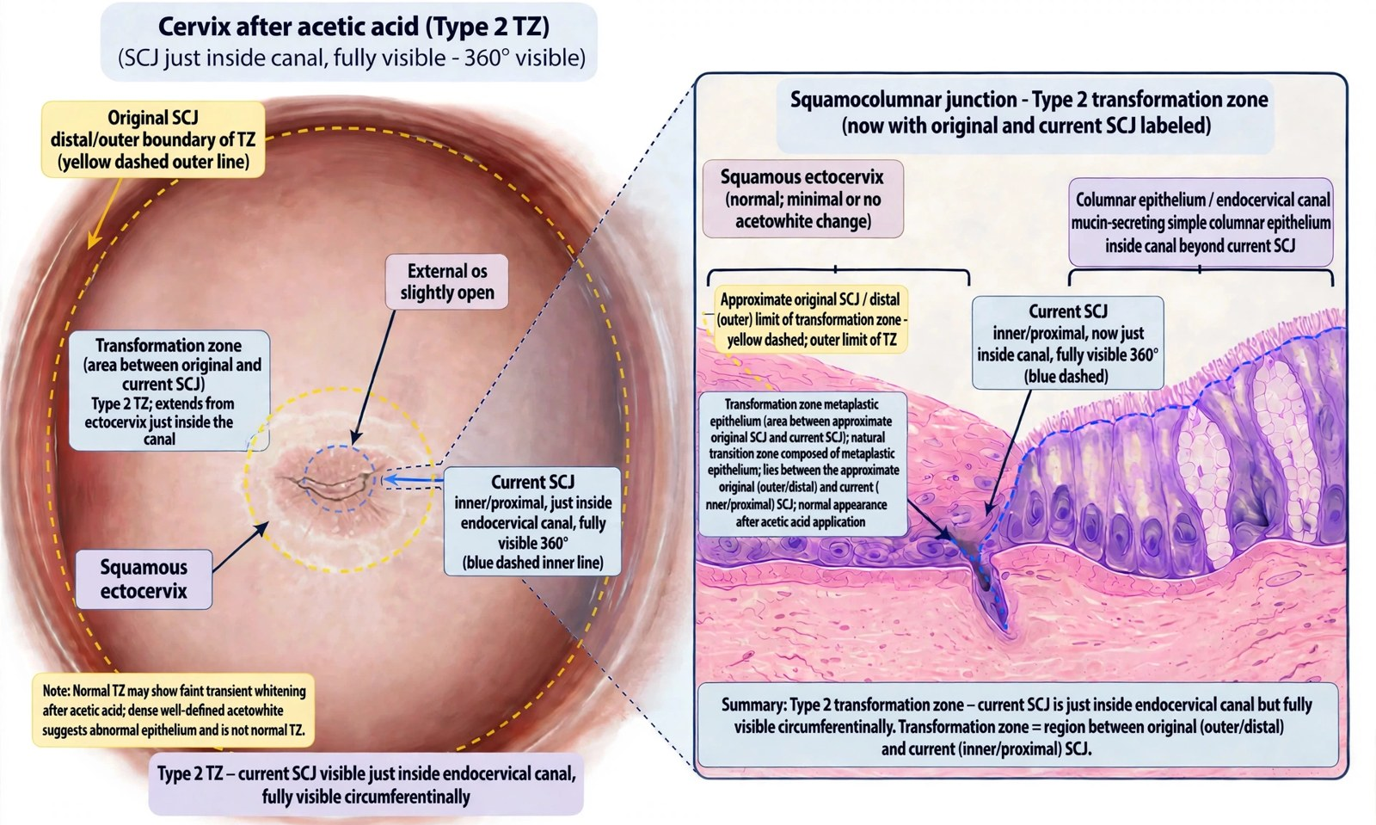
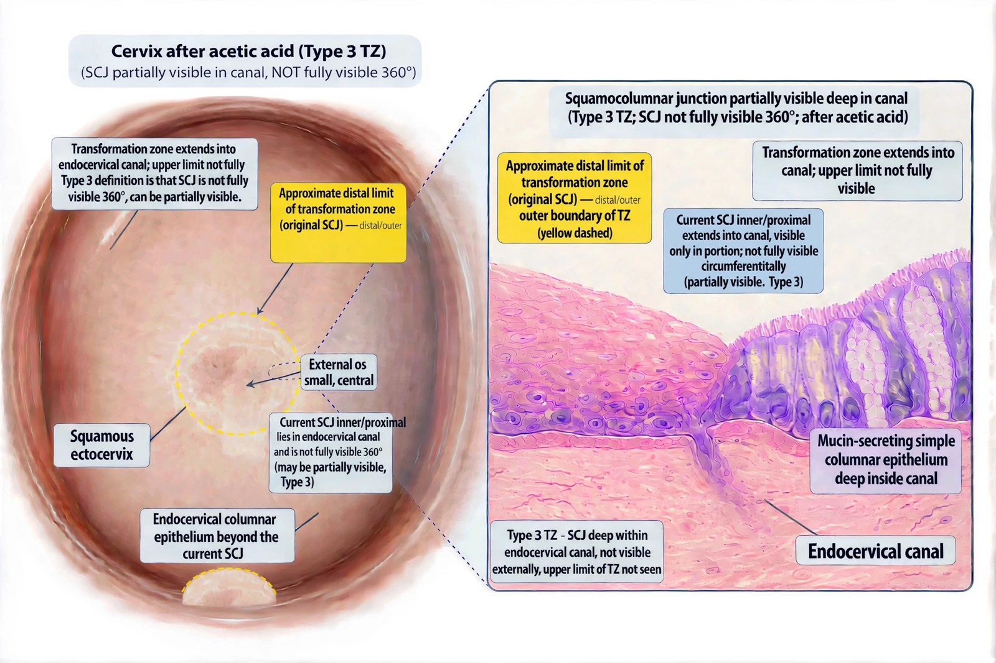
SESSION 1 · ANATOMY
Three types of transformation zone
The type depends on where the SCJ lies and whether all of it can be seen.
1️⃣ Type 1
2️⃣ Type 2
3️⃣ Type 3
Lies entirely on the ectocervix. The whole SCJ can be seen.
Extends into the canal, but the whole SCJ can still be seen, with or without an endocervical speculum.
Extends into the canal, and the SCJ cannot be fully seen.
✅ Ablation possible if other criteria are met.
✅ Ablation possible if other criteria are met.
❌ Not suitable for ablation: refer for LEEP.
🏥 In Rwanda: Transformation zone type 1 or 2 with an eligible lesion: thermal ablation. Type 3: LEEP at the district hospital.
Cervical Cancer | Frontline HCP | Rwanda Biomedical Centre
Screen 36

Slide 37
SESSION 1 · INTERACTIVE
Which transformation zone?
Nyiraneza Josée, aged 52, has a positive HPV test. At VIA, the SCJ lies inside the canal and cannot be fully seen, even with an endocervical speculum. What is the transformation zone type, and what does it mean?
A Type 1, so ablation can be offered today
B Type 2, so any lesion can be ablated
C Type 3, so ablation is not suitable and she is referred for LEEP ✅
D The type does not affect the treatment decision
Correct answer: C
Feedback: When the SCJ cannot be fully seen, the transformation zone is type 3. A lesion may extend out of view, so ablation could leave disease behind. She is referred for excisional treatment (LEEP).
Cervical Cancer | Frontline HCP | Rwanda Biomedical Centre
Screen 37

Slide 38
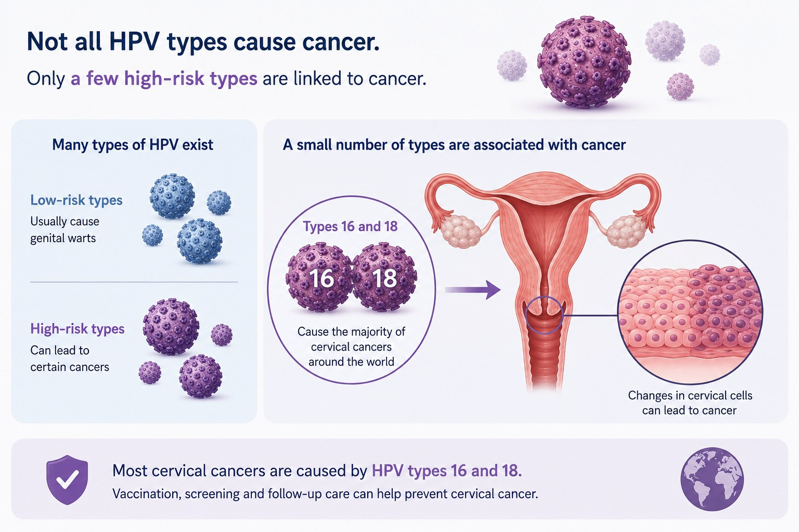
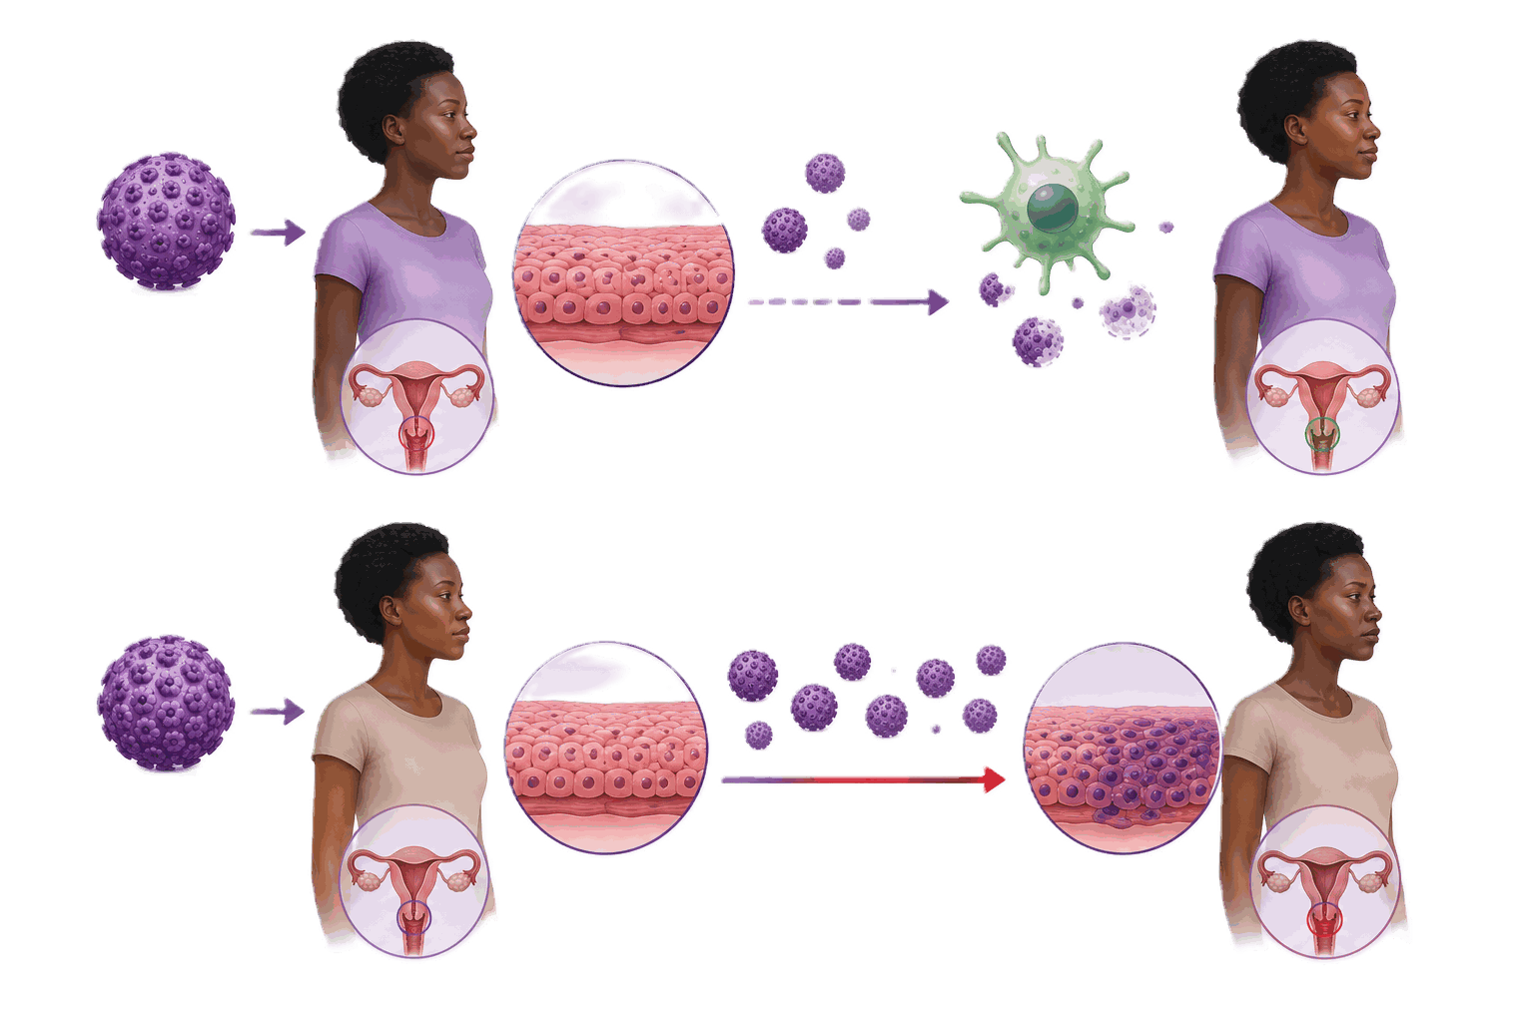
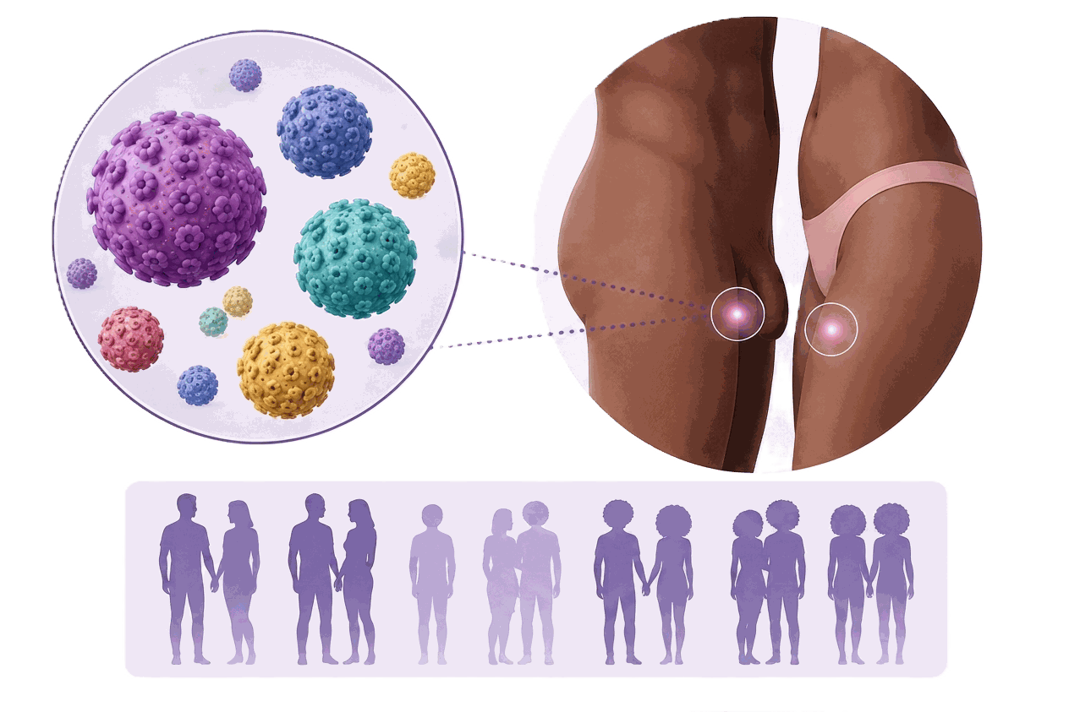
SESSION 1 · HPV
Human papillomavirus
🧪 A very common virus
🧠 High-risk types
⏱️ Persistent infection
HPV is a large group of viruses passed on by direct genital skin or mucosa contact. Most sexually active people acquire it at some point.
A small number of HPV types are linked with cancer. Types 16 and 18 cause most cervical cancers worldwide.
High-risk infection that remains over time is what increases the risk of cervical precancer. Most infections clear on their own.
💬 Say it this way: HPV is common, it usually causes no symptoms, and it can stay silent for years. A positive test says nothing about anyone's behaviour.
Cervical Cancer | Frontline HCP | Rwanda Biomedical Centre
Screen 38

Slide 39
SESSION 1 · HPV
HPV types, and what helps an infection persist
HPV: more than 200 types
⚠️ Co-factors for persistence or progression
About 40 infect the genital tract
HIV infection or other reduced immunity
Tobacco use
Many full-term pregnancies, especially from a young age
Early age at first sexual intercourse (earlier exposure to HPV)
Other genital infections, such as chlamydia
Never having been screened
High-risk (oncogenic)
16, 18, 31, 33, 35, 39, 45, 51, 52, 56, 58, 59, 68 and others
HPV 16 and 18 cause about 70% of cervical cancers worldwide.
Low-risk
6, 11 and others
HPV 6 and 11 cause about 90% of genital warts. They do not cause cervical cancer.
💬 Say it this way: Co-factors describe risk across populations. They never explain an individual woman's diagnosis, and they are never a reason for blame.
Cervical Cancer | Frontline HCP | Rwanda Biomedical Centre
Screen 39

Slide 40
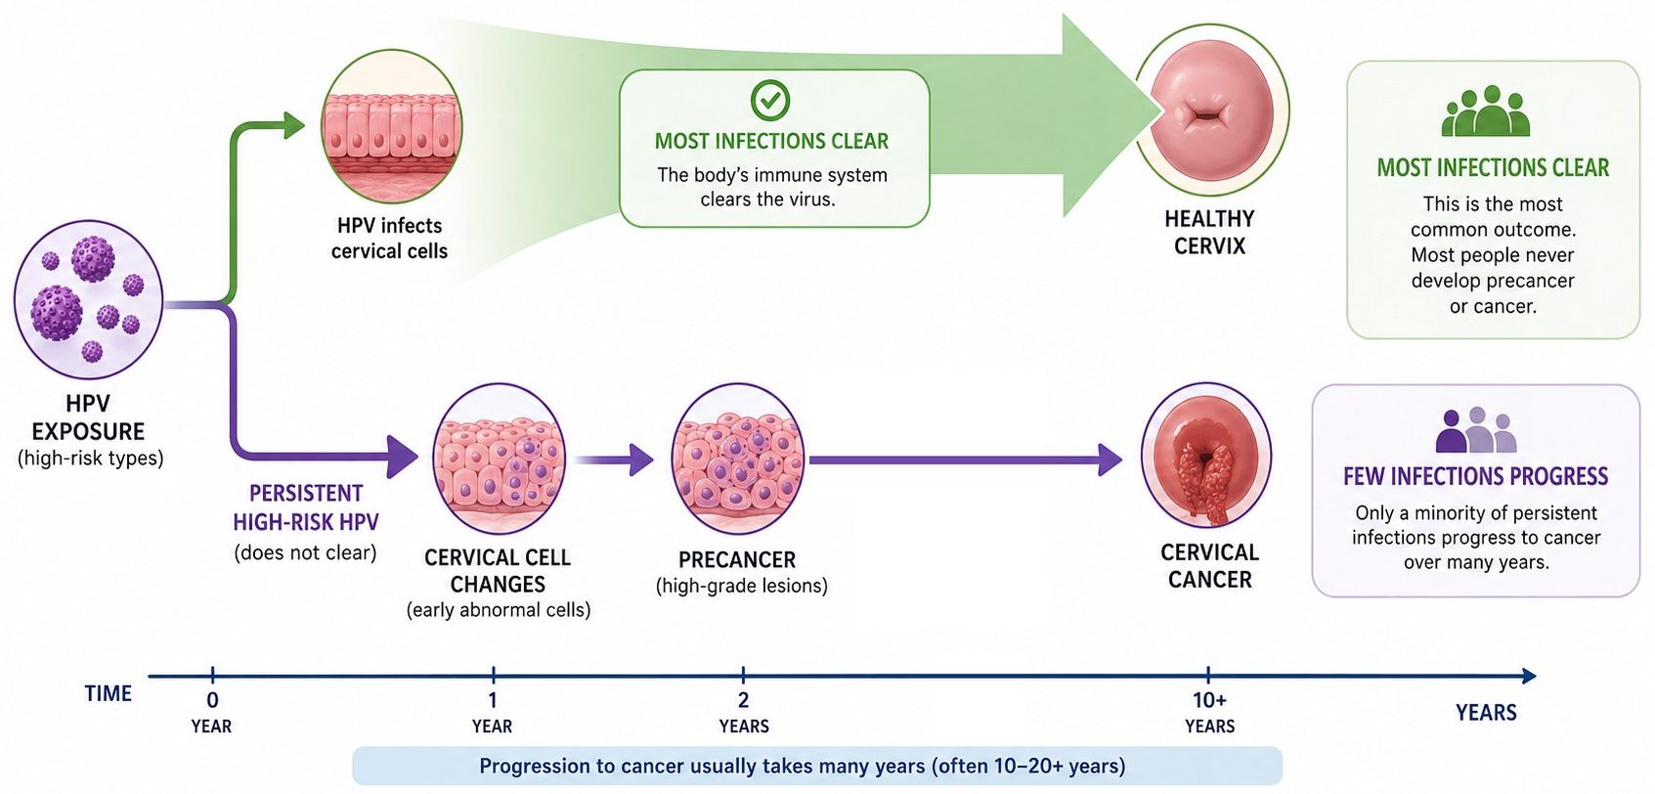
SESSION 1 · PATHOPHYSIOLOGY
The pathway, drawn
⚠️ Do not oversimplify: HPV infection is not the same as cervical cancer, and not every persistent infection progresses. Progression is possible, not inevitable.
Cervical Cancer | Frontline HCP | Rwanda Biomedical Centre
Screen 40

Slide 41
SESSION 1 · INTERACTIVE
Put the pathway in order
💬 Drag the five stages into the order in which they occur, then select Submit.
Which order correctly describes how almost all cervical cancers develop?
A HPV infection, persistent infection, precancer, invasive cancer ✅
B Invasive cancer, then persistent HPV infection, then precancer
C Precancer, HPV infection, invasive cancer, persistent infection
D Symptoms appear first, then HPV infection, then cancer
Correct answer: A
Feedback: HPV infects the transformation zone. Most infections clear. Persistent infection can lead to precancer, and a minority of untreated lesions become cancer.
Cervical Cancer | Frontline HCP | Rwanda Biomedical Centre
Screen 41

Slide 42
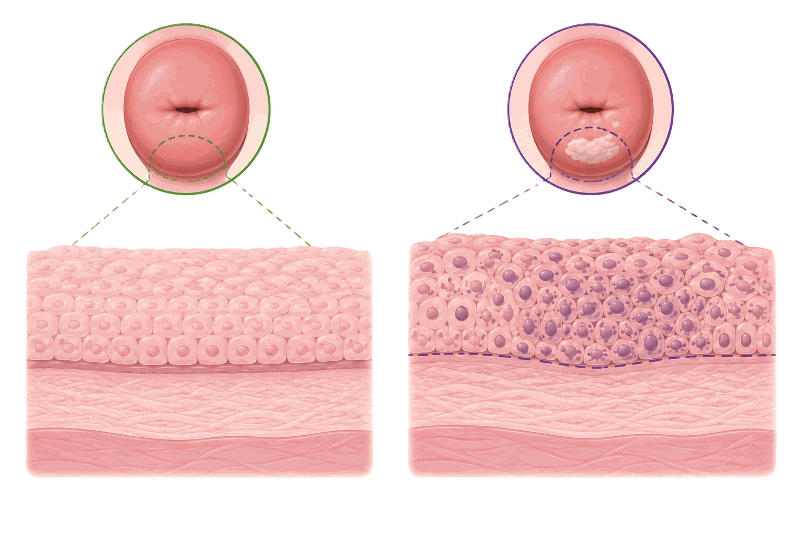
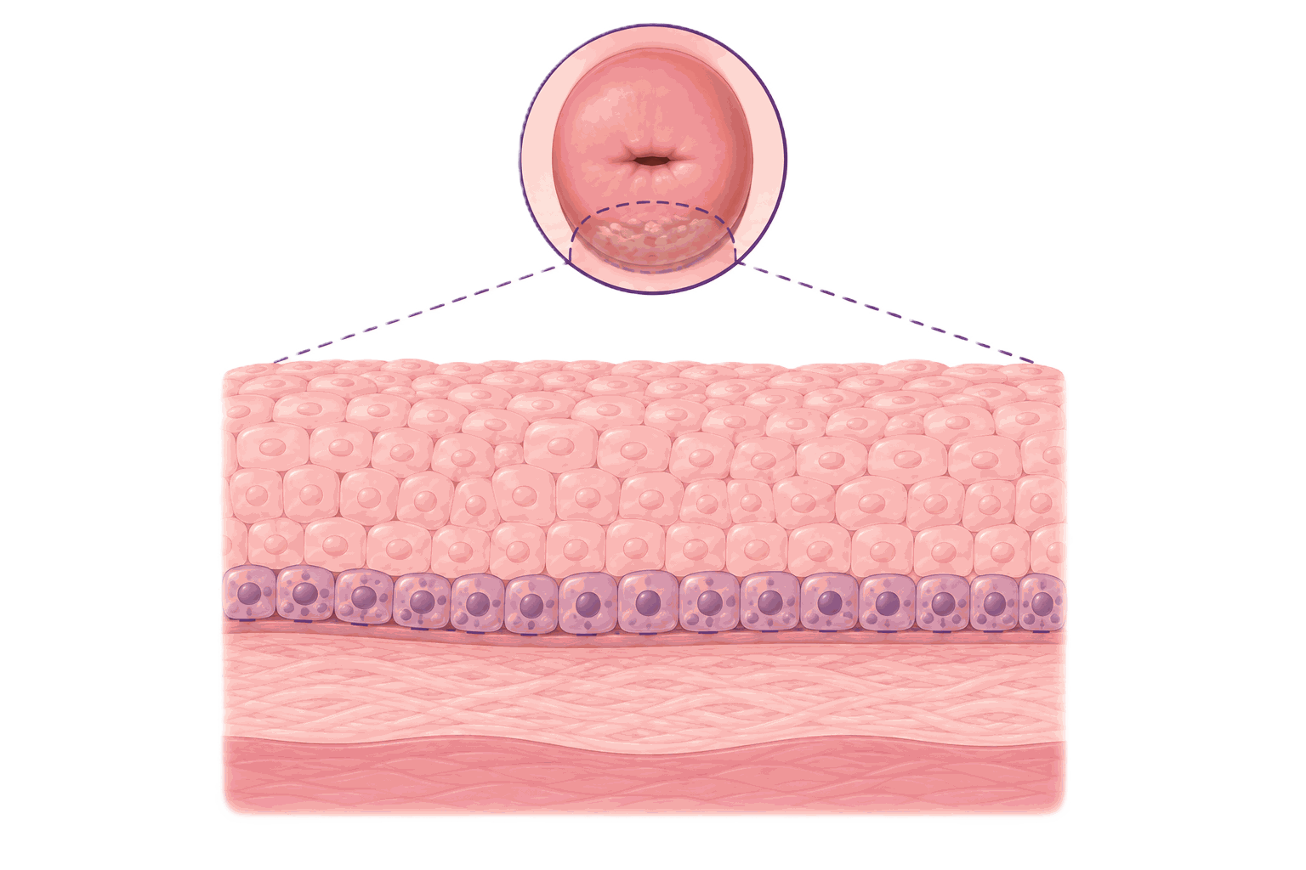
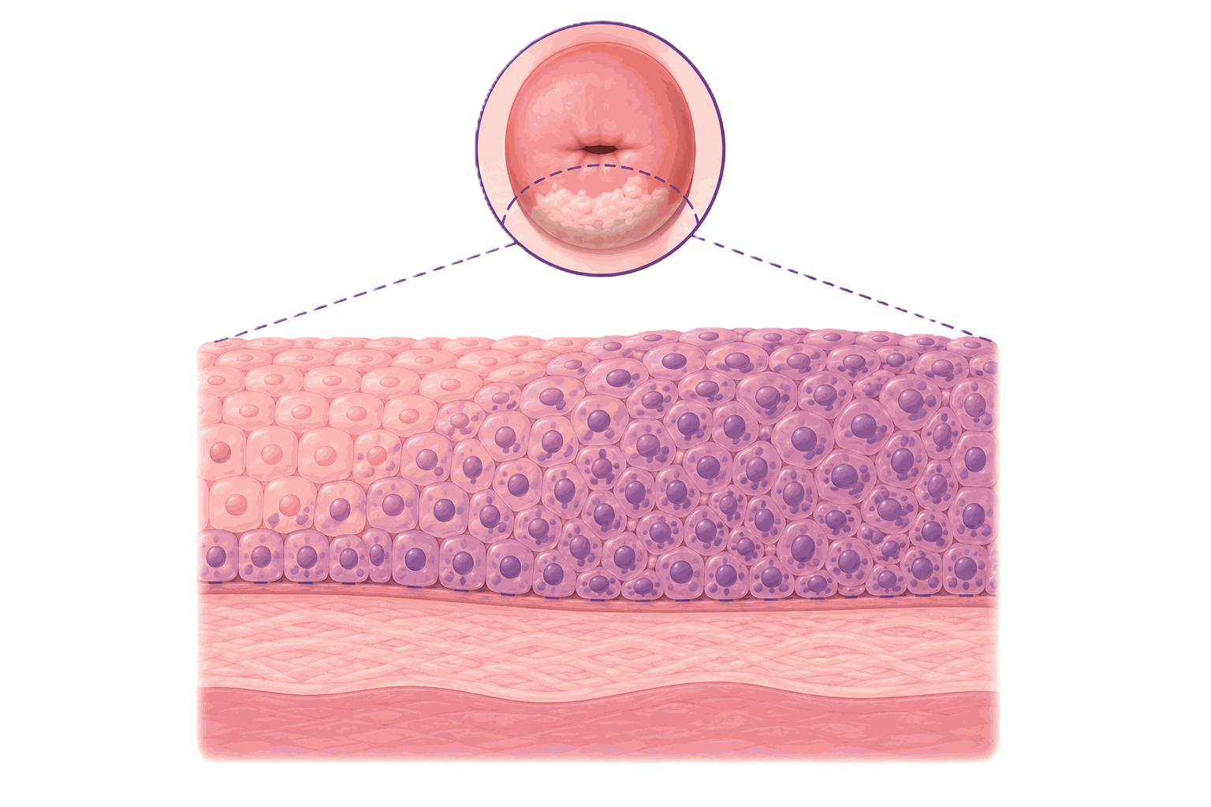
SESSION 1 · PRECANCEROUS LESIONS
What cervical precancer is
🧠 Abnormal, not invasive
📋 Low grade
⚠️ High grade
Precancer means abnormal cells in the surface layer of the cervix that have not invaded deeper tissue.
Changes affecting only the lower part of the surface layer. Many of these regress on their own.
More extensive changes carrying a higher risk of progression. These are treated.
📌 Two vocabularies: A biopsy report may describe cervical intraepithelial neoplasia, or CIN. A cytology report may describe a low-grade or high-grade squamous intraepithelial lesion. Both describe the same spectrum.
Cervical Cancer | Frontline HCP | Rwanda Biomedical Centre
Screen 42

Slide 43
SESSION 1 · PRECANCEROUS LESIONS
CIN grades: how much of the lining is abnormal
basement membrane
CIN 1
Low grade (LSIL)
Lower third of the lining
CIN 2
High grade (HSIL)
Up to two-thirds
CIN 3
High grade (HSIL)
Full thickness, includes carcinoma in situ
Invasive cancer
Not precancer
Cells break through the basement membrane
⏱️ Natural history: Most CIN 1 regresses within 1 to 2 years. CIN 2 and CIN 3 carry a real risk of progression, usually over many years, and are treated.
🧠 Glandular precursor: Adenocarcinoma in situ (AIS) arises from the columnar lining of the canal. It is harder to see at VIA and needs referral for excision.
Cervical Cancer | Frontline HCP | Rwanda Biomedical Centre
Screen 43

Slide 44
SESSION 1 · PRECANCEROUS LESIONS
Precancer is not cancer
🟢 Cervical precancer (precancerous lesion)
🔴 Invasive cervical cancer
Abnormal cells in the surface layer only.
Cannot spread to lymph nodes or other organs.
Usually causes no symptoms.
Treated in a short procedure that keeps the uterus.
Treating it prevents a cancer from developing.
Cancer cells have invaded the deeper tissue of the cervix.
Can spread locally, to lymph nodes and to distant organs.
May cause bleeding, discharge or pain, usually later.
Needs staging and specialist treatment.
Confirmed only by biopsy.
💬 Say it this way: Precancer is not cancer. It is a change that could become cancer in the future. Treating it now prevents cancer.
Cervical Cancer | Frontline HCP | Rwanda Biomedical Centre
Screen 44

Slide 45
SESSION 1 · EPIDEMIOLOGY
The global burden
Cervical cancer remains one of the most common cancers affecting women worldwide.
660,000
350,000
5th
2nd
Estimated new cases worldwide
Estimated deaths worldwide
Most commonly diagnosed cancer in women*
Most commonly diagnosed cancer in African women
🔎 What this shows: The burden falls most heavily on countries with limited access to vaccination, screening and treatment.
Population: world, women, all ages. Year: 2024 estimates. Source: IARC Global Cancer Observatory, GLOBOCAN 2024. These are modelled estimates, not registry-confirmed counts.
* Following breast, lung, colorectal, and corpus uteri cancers)
Cervical Cancer | Frontline HCP | Rwanda Biomedical Centre
Screen 45

Slide 46
SESSION 1 · EPIDEMIOLOGY
Rwanda compared with the region
Population: Women, all ages
Year: 2024 estimates
Measure: Age-standardised incidence rate per 100,000
Source: IARC Global Cancer Observatory, GLOBOCAN 2024
What this shows: Rates are age-standardised so populations can be compared. Rwanda's estimated rate is about two and a half times the world rate, and close to the Eastern African average.
Cervical Cancer | Frontline HCP | Rwanda Biomedical Centre
Screen 46

Slide 47
SESSION 1 · EPIDEMIOLOGY
Where cervical cancer sits in Rwanda
Population: Women in Rwanda, all ages
Year: 2024 estimates
Measure: Estimated new cases
Source: IARC Global Cancer Observatory, GLOBOCAN 2024
What this shows: Cervical cancer is the 2nd most frequent cancer in women in Rwanda, close behind breast cancer, and it is the leading cause of cancer death in women.
Cervical Cancer | Frontline HCP | Rwanda Biomedical Centre
Screen 47

Slide 48
SESSION 1 · EPIDEMIOLOGY
The burden in Rwanda today
1,582
965
30.6
Estimated new cervical cancer cases in Rwanda
Estimated cervical cancer deaths in Rwanda
Age-standardised incidence per 100,000 women
Population: Rwanda, women, all ages. Year: 2024 estimates. Measure: cases, deaths and age-standardised incidence rate. Source: IARC Global Cancer Observatory, GLOBOCAN 2024. These are modelled estimates, not registry-confirmed counts.
🔎 What this shows: More women in Rwanda die of cervical cancer than of any other cancer, and almost all of these cancers could have been prevented.
Cervical Cancer | Frontline HCP | Rwanda Biomedical Centre
Screen 48

Slide 49
SESSION 1 · EPIDEMIOLOGY
What is projected ahead
Population: Rwanda, both sexes, all cancers
Year: 2022 estimate and 2050 projection
Measure: Estimated and projected new cases a year
Source: IARC Global Cancer Observatory, Cancer Tomorrow
What this shows: A projection describes what could happen if current patterns continue. It is not a guaranteed outcome. Cervical cancer is the one major cancer where prevention can change the projection directly.
Cervical Cancer | Frontline HCP | Rwanda Biomedical Centre
Screen 49

Slide 50
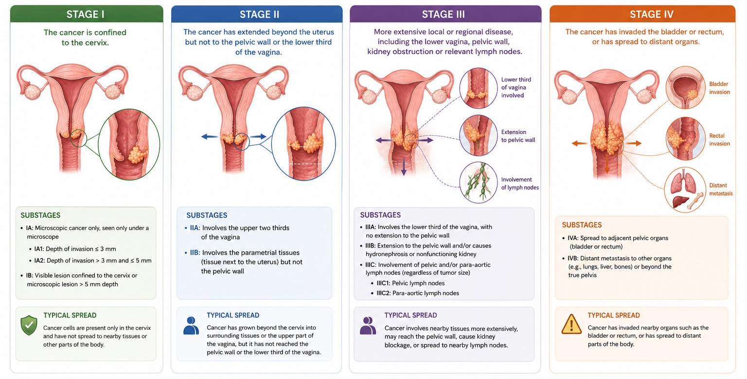
SESSION 1 · STAGING
FIGO staging of invasive cervical cancer
📌 Your role: You do not assign the stage. You use it to understand what the specialist team is planning and to explain it to the woman.
Cervical Cancer | Frontline HCP | Rwanda Biomedical Centre
Screen 50

Slide 51
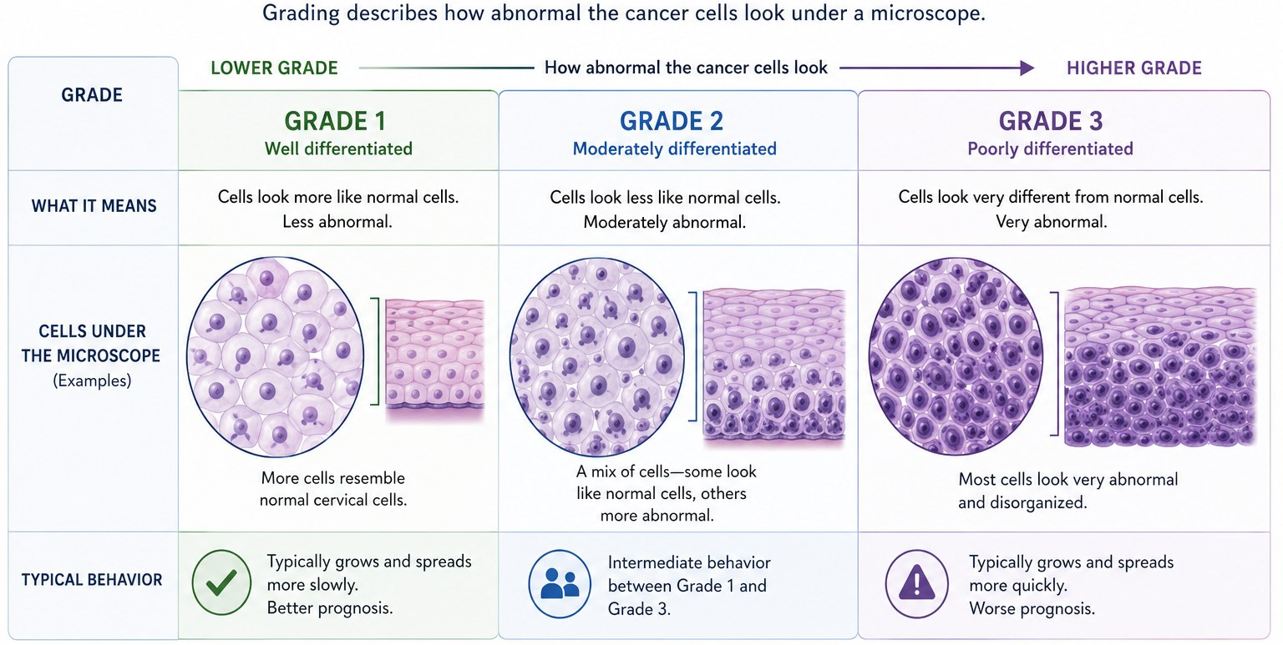
SESSION 1 · GRADING
Grading of cervical cancer
Cervical Cancer | Frontline HCP | Rwanda Biomedical Centre
Screen 51

Slide 52

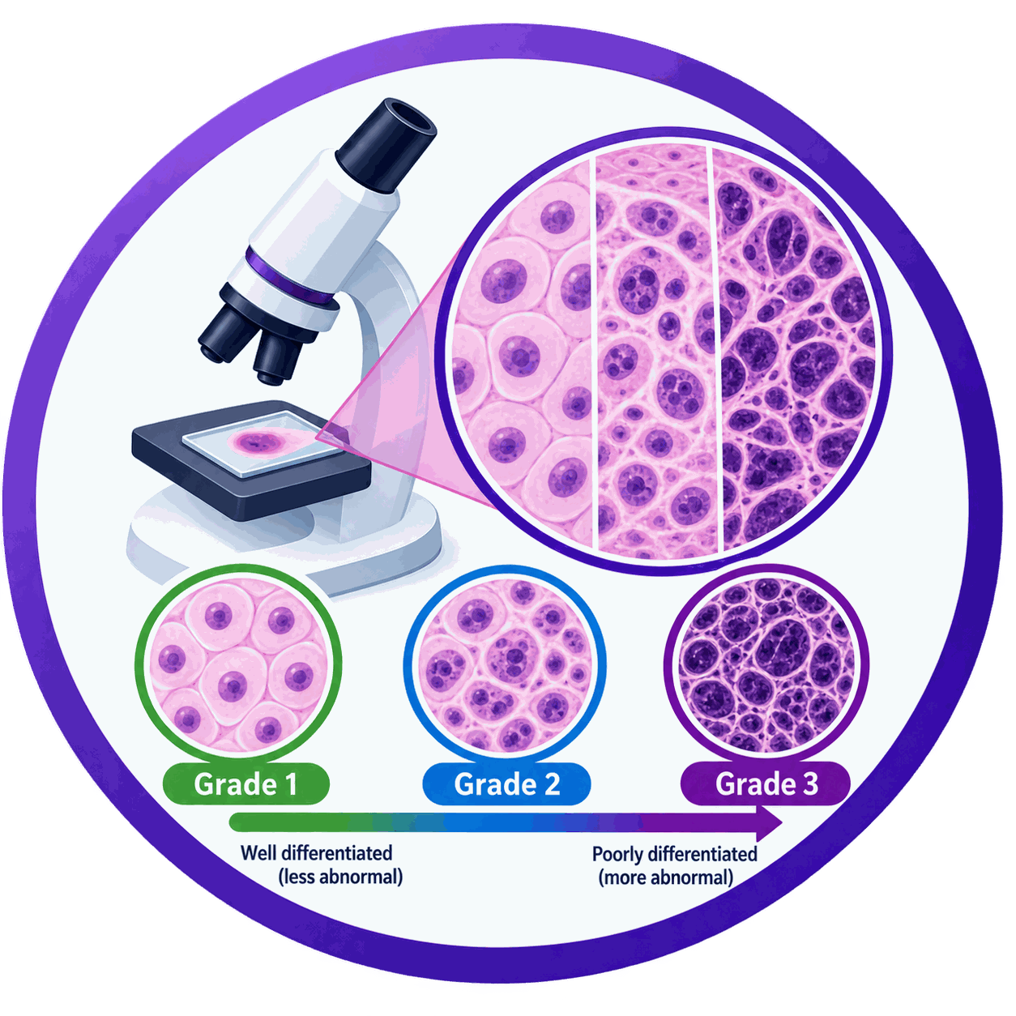
SESSION 1 · STAGING AND GRADING
Stage and grade are different
📏 Stage
🔬 Grade
How far the cancer has spread.
Described using the FIGO system, from stage I to stage IV.
Based on examination, and on imaging and pathology where these are available.
Assigned by the specialist team.
It is the strongest predictor of outcome.
How abnormal the cancer cells look under the microscope.
Reported by the pathologist from the biopsy.
Describes appearance, not extent.
Do not confuse it with the grade of a precancerous lesion, which is not cancer at all.
It is one factor among several in planning treatment.
Cervical Cancer | Frontline HCP | Rwanda Biomedical Centre
Screen 52

Slide 53
SESSION 1 · KNOWLEDGE CHECK
Knowledge check: question 1 of 5
Almost all cervical cancers are caused by:
A A bacterial infection of the cervix
B Persistent infection with a high-risk HPV type ✅
C Repeated childbirth on its own
D An inherited gene fault
Correct answer: B
Feedback: Persistent high-risk HPV infection is the central cause. Other factors influence whether an infection persists and whether changes progress, but they do not cause cervical cancer on their own.
Cervical Cancer | Frontline HCP | Rwanda Biomedical Centre
Screen 53

Slide 54
SESSION 1 · KNOWLEDGE CHECK
Knowledge check: question 2 of 5
Almost all cervical cancers begin in which part of the cervix?
A The transformation zone ✅
B The endometrial cavity
C The uterine fundus
D The vaginal fornix
Correct answer: A
Feedback: The transformation zone is where columnar cells are being replaced by squamous cells. These actively changing cells are the ones affected by HPV, which is why almost all cervical cancers begin here.
Cervical Cancer | Frontline HCP | Rwanda Biomedical Centre
Screen 54

Slide 55
SESSION 1 · KNOWLEDGE CHECK
Knowledge check: question 3 of 5
A woman is told she has a high-grade cervical precancerous lesion. The accurate explanation is:
A She has abnormal surface cells that are not cancer, and treating them prevents cancer ✅
B She has cervical cancer
C Nothing needs to be done
D She caused this herself
Correct answer: A
Feedback: High-grade precancer means abnormal cells confined to the surface layer. It is not cancer and it cannot spread. Saying this plainly reduces fear and makes it far more likely that she returns for treatment.
Cervical Cancer | Frontline HCP | Rwanda Biomedical Centre
Screen 55

Slide 56
SESSION 1 · KNOWLEDGE CHECK
Knowledge check: question 4 of 5
Stage and grade differ because:
A They mean the same thing
B Grade is how far the cancer has spread
C Stage is how far the cancer has spread and grade is how abnormal the cells look ✅
D Stage is tumour size only
Correct answer: C
Feedback: Stage describes extent of disease and is assigned by the specialist team using the FIGO system. Grade describes microscopic appearance and is reported by the pathologist.
Cervical Cancer | Frontline HCP | Rwanda Biomedical Centre
Screen 56

Slide 57
SESSION 1 · KNOWLEDGE CHECK
Knowledge check: question 5 of 5
Which statement about HPV infection is accurate?
A Every HPV infection leads to cervical cancer
B Most HPV infections clear without causing cancer ✅
C HPV infection proves recent sexual exposure
D HPV infection always causes symptoms
Correct answer: B
Feedback: Most infections clear within one to two years. Only persistent high-risk infection carries real risk, and progression is uncommon and slow. HPV can persist silently for years, so a result says nothing about when infection was acquired.
Cervical Cancer | Frontline HCP | Rwanda Biomedical Centre
Screen 57

Slide 58
SESSION 1
Reflection
Learner instruction: Enter your response in the text box. These responses are not scored.
How would you explain the relationship between HPV infection and cervical cancer to a woman, without increasing stigma?
1
How would you explain to a woman that a high-grade precancerous lesion is not a cancer, and that treating it now prevents one?
2
Which single fact about the burden of cervical cancer in Rwanda would you most want a community member to understand, and why?
3
Cervical Cancer | Frontline HCP | Rwanda Biomedical Centre
Screen 58

Slide 59
2
S E S S I O N 2
Screening and prevention
Follow Immaculée through a screening visit as you work through vaccination, risk, symptoms, the screening tests, what a result means, and how cervical precancer is treated.
Cervical Cancer | Frontline HCP | Rwanda Biomedical Centre
Screen 59

Slide 60
SESSION 2
Learning objectives
By the end of this session you will be able to:
1
Distinguish screening of a well woman from assessment of a woman who has symptoms.
2
Explain how HPV vaccination prevents cervical cancer and answer common concerns.
3
Identify risk factors, symptoms and the red flags that need urgent assessment.
4
Compare HPV testing, VIA and cytology, and describe how each is carried out.
5
Interpret a screening result and state the correct next step.
6
Manage an HPV-positive woman using the Rwanda algorithm, including treatment, referral and follow-up.
Cervical Cancer | Frontline HCP | Rwanda Biomedical Centre
Screen 60

Slide 61
SESSION 2 · CLINICAL CASE
Meet Immaculée
🎬 CLINICAL CASE VIDEO PLACEHOLDER
Video to produce: Two minute scene in a health centre consulting room. A woman in her late thirties arrives for a routine visit. A frontline HCP greets her, explains what cervical screening is, asks permission before examining, and describes what will happen. Calm, respectful, unhurried tone. Rwandan health centre setting.
Learning purpose: Learners see how screening is introduced to a woman who feels completely well, and how consent, privacy and plain explanation are handled before any examination.
Suggested placement: Full width, at the start of the Session 2 clinical case.
Mukamana Immaculée
Patient: 38 years old. She has three children and works as a tailor. She has never been screened for cervical cancer.
Setting: A health centre in Nyanza District, on a cervical cancer screening outreach day.
Presenting situation: She feels completely well. She has come because a community health worker encouraged her to attend.
What you know so far: No abnormal bleeding, no unusual discharge, no pelvic pain. Her HIV status is negative and recorded in her file.
Learner task: Decide whether Immaculée is attending for screening or for diagnostic assessment, and what that means for what you offer her today.
Cervical Cancer | Frontline HCP | Rwanda Biomedical Centre
Screen 61

Slide 62
SESSION 2 · CLINICAL CASE
What is Immaculée attending for?
Immaculée feels well and has no symptoms. Which description fits her visit today?
A Diagnostic assessment, because every woman needs her cervix examined
B Screening, because she has no symptoms and is being tested to find changes early ✅
C Surveillance, because she has been treated before
D No test is needed, because she feels well
Correct answer: B
Feedback: Screening means testing an eligible woman who has no symptoms. Immaculée has no symptoms, so she is being screened. A woman with concerning symptoms would need diagnostic assessment instead, which is a different pathway.
Cervical Cancer | Frontline HCP | Rwanda Biomedical Centre
Screen 62

Slide 63



SESSION 2 · PREVENTION
The prevention continuum
1️⃣ Primary prevention
2️⃣ Secondary prevention
3️⃣ Tertiary care
Prevent HPV infection, mainly through HPV vaccination, before exposure.
Detect and treat cervical precancer through screening, before invasive cancer develops.
Diagnose and treat invasive cancer, and provide supportive and palliative care.
💡 Key point: Vaccination and screening are complementary. Neither one replaces the other, and a country needs both to eliminate cervical cancer.
Cervical Cancer | Frontline HCP | Rwanda Biomedical Centre
Screen 63

Slide 64
SESSION 2 · PREVENTION
Rwanda’s cervical cancer elimination goals
90%
70%
90%
Of girls fully vaccinated against HPV by the age of 15
Of women aged 30–49 years screened using high-precision HPV DNA-based testing
Of women with precancer or cancer receiving treatment
🏥 In Rwanda: Rwanda has committed to meeting the 90–70–90 cervical cancer elimination targets by 2027 (Mission 2027), as set out in the national cervical cancer elimination plan.
Cervical Cancer | Frontline HCP | Rwanda Biomedical Centre
Screen 64

Slide 65
SESSION 2 · HPV VACCINATION
How HPV vaccination works
🛡️ What it protects against
⏱️ When it works best
✅ What it achieves
Vaccines protect against the high-risk (oncogenic) HPV types that cause most cervical cancers.
The vaccine prevents infection, so it is given before exposure to HPV, in early adolescence.
It substantially reduces the future risk of cervical precancer and cervical cancer.
📌 Remember: HPV vaccination does not treat an existing infection, an existing lesion or an existing cancer. It prevents new infection.
Cervical Cancer | Frontline HCP | Rwanda Biomedical Centre
Screen 65

Slide 66
SESSION 2 · HPV VACCINATION
What to tell people about the vaccine
✅
The vaccine protects against the HPV types that cause most cervical cancers.
⏱️
It works best when given before sexual activity and before exposure to HPV.
🛡️
It has one of the largest safety records of any vaccine in use.
❌
It does not treat an infection or a lesion that is already present.
🏥 In Rwanda: HPV vaccination is routinely offered to girls around age 12, primarily through school-based vaccination programmes. The programme has traditionally used a 2-dose schedule.
Cervical Cancer | Frontline HCP | Rwanda Biomedical Centre
Screen 66

Slide 67
SESSION 2 · INTERACTIVE
Myth or fact: HPV vaccination
💬 Select each myth to reveal the accurate response.
❌ Myth The vaccine causes infertility.
✅ Fact Very large safety studies show no effect on fertility. Untreated cervical cancer, by contrast, does end fertility.
❌ Myth It encourages earlier sexual activity.
✅ Fact Studies comparing vaccinated and unvaccinated adolescents find no difference in sexual behaviour.
❌ Myth I am vaccinated, so I never need screening.
✅ Fact The vaccine does not cover every high-risk type, so eligible women still need screening.
❌ Myth The vaccine can give you HPV infection.
✅ Fact The vaccine contains no live virus and cannot cause HPV infection.
Cervical Cancer | Frontline HCP | Rwanda Biomedical Centre
Screen 67

Slide 68
SESSION 2 · RISK FACTORS
Cause, risk and screening history
🧪 The cause
⚠️ Increases the risk
🔎 Screening history affects risk of late diagnosis
Persistent infection with a high-risk HPV type.
Without this, cervical cancer does not develop.
Living with HIV, or other causes of reduced immunity.
Tobacco use.
Previous cervical precancer.
Factors that make an HPV infection more likely to persist.
Never having been screened.
An abnormal result that was never followed up.
Most women who develop cervical cancer in Rwanda were never screened.
💬 Say it this way: No woman is to blame for her diagnosis. Language that implies blame delays care and keeps women away from services.
Cervical Cancer | Frontline HCP | Rwanda Biomedical Centre
Screen 68

Slide 69
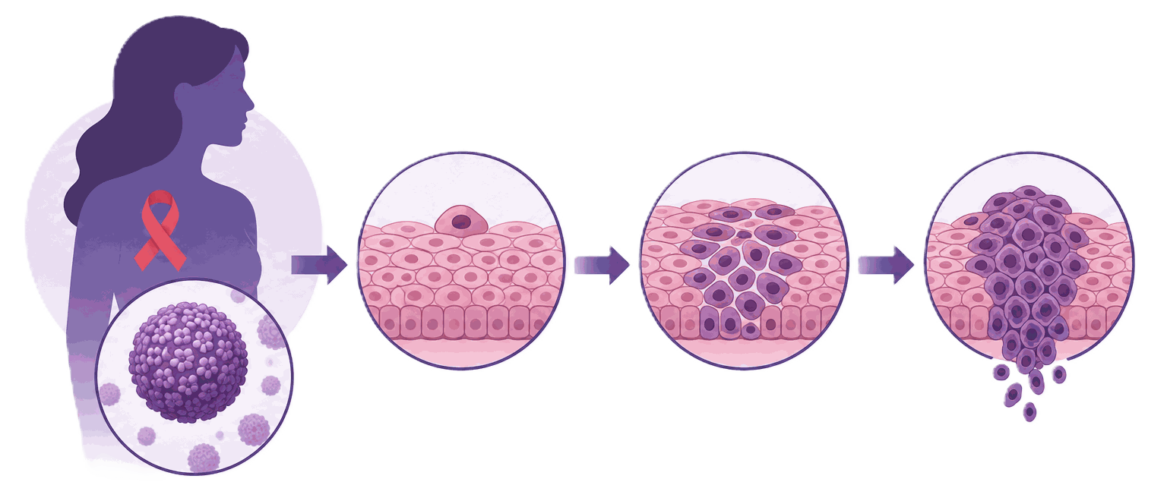
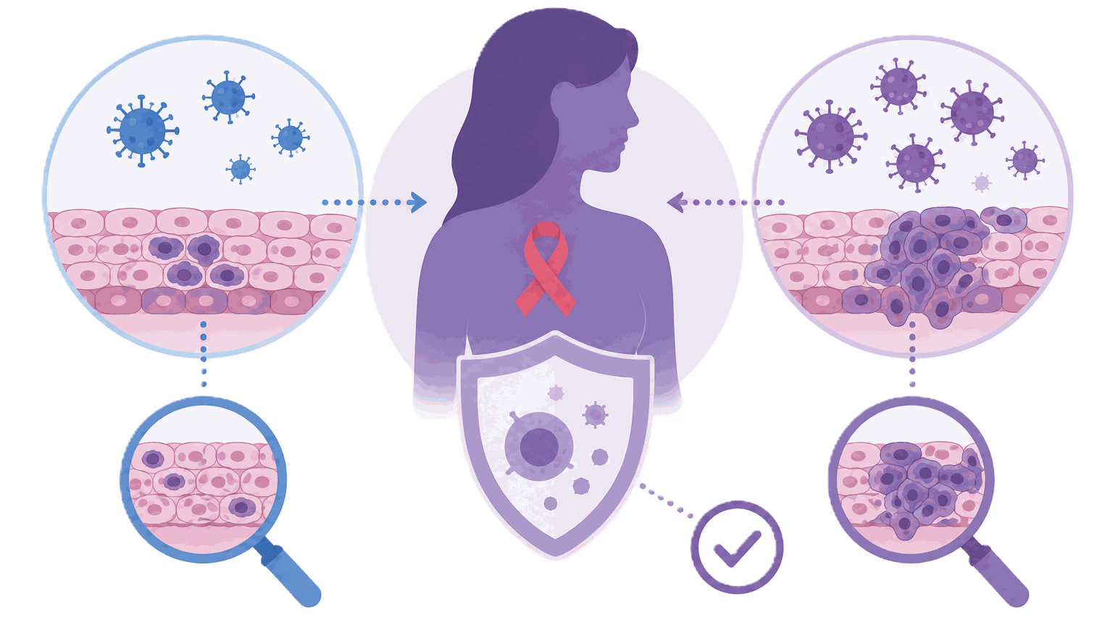

SESSION 2 · RISK FACTORS
HIV and cervical cancer
🧠 Higher risk
🔎 Earlier and more frequent screening
💬 Without stigma
Women living with HIV are more likely to have persistent high-risk HPV infection, cervical precancer and cervical cancer.
Women living with HIV: priority age 25 to 49, HPV test every 5 years.
General population: priority age 30 to 49, HPV test every 10 years.
Aged 50 to 65, never screened: Pap smear, or VIA if Pap is not available.
Explain the reason for closer screening as a clinical fact. Never use language that isolates or blames.
Cervical Cancer | Frontline HCP | Rwanda Biomedical Centre
Screen 69

Slide 70
SESSION 2 · SCREENING
Screening is not symptom assessment
🔎 Screening
🩺 Diagnostic assessment
Testing eligible women who have no symptoms.
Aims to find high-risk HPV infection or cervical changes early.
Follows a defined programme pathway with a set interval.
Can prevent cancer, because precancer can be treated.
Investigating a woman with concerning symptoms.
Also used for a suspicious cervix, or a screening result that needs evaluation.
Aims to find out what is causing the problem.
A screening test is not a substitute for it.
⚠️ Critical distinction: A woman with significant abnormal vaginal bleeding needs assessment, not a routine screening test.
Cervical Cancer | Frontline HCP | Rwanda Biomedical Centre
Screen 70

Slide 71
SESSION 2 · INTERACTIVE
Screening or assessment?
A 44 year old woman describes four months of bleeding after intercourse. What does she need?
A A routine screening test, with the result reviewed in a few weeks
B Treatment for a vaginal infection, with review in three months
C Reassurance, because bleeding after intercourse is normal
D Diagnostic assessment, including examination of the cervix ✅
Correct answer: D
Feedback: She has a concerning symptom, so she needs assessment of the cervix now. Offering a screening test instead would add delay, and a negative result could falsely reassure both of you.
Cervical Cancer | Frontline HCP | Rwanda Biomedical Centre
Screen 71

Slide 72
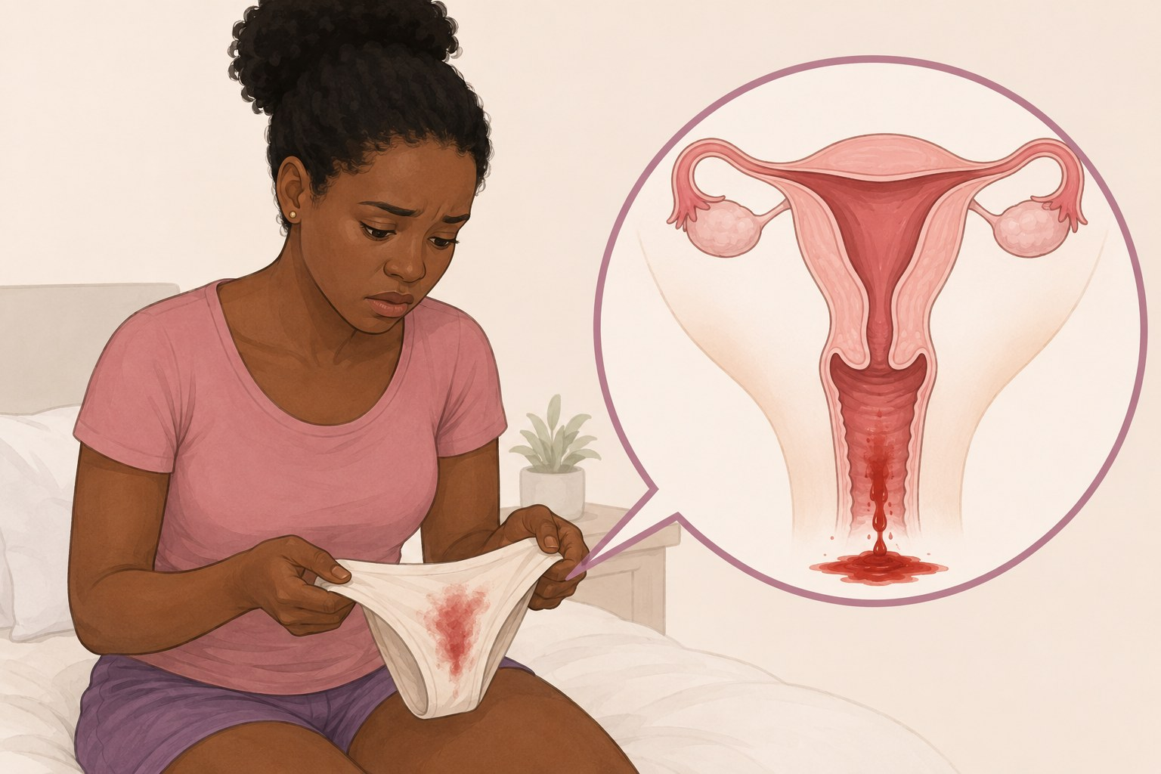
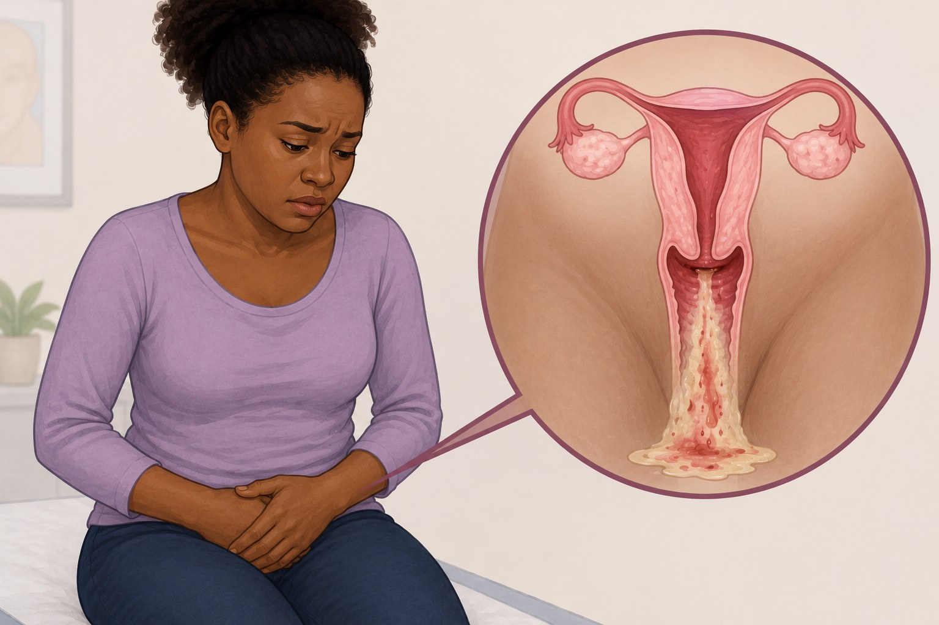

SESSION 2 · SIGNS AND SYMPTOMS
Symptoms of invasive cervical cancer
🩸 Abnormal bleeding
💧 Abnormal discharge
⚡ Pain
Bleeding after intercourse, between periods, or any bleeding after the menopause.
Persistent, watery, blood-stained or foul-smelling discharge that does not settle.
Persistent pelvic, lower back or leg pain, or pain during sexual intercourse.
📌 Remember: Cervical precancer and early cervical cancer usually cause no symptoms at all. These symptoms have other, more common causes, so they do not confirm cancer.
🔎 What matters: A symptom that is persistent, unexplained, or new for that woman needs assessment, whatever else you find.
Cervical Cancer | Frontline HCP | Rwanda Biomedical Centre
Screen 72

Slide 73
SESSION 2 · INTERACTIVE
Sort these findings by urgency
💬 Drag each finding into the correct urgency column, then select Submit.
🔴 Urgent, same day
🟠 Prompt, without waiting
🔵 Routine pathway
Heavy bleeding with dizziness
Severe symptomatic anaemia
Severe pain in an unwell woman
Bleeding after menopause
Bleeding after intercourse
An abnormal-looking cervix
Offensive discharge
A well woman due for screening
A screen-positive well woman
✅ Feedback: Bleeding with haemodynamic compromise cannot wait. Post-menopausal and postcoital bleeding need prompt assessment, not the routine queue.
Cervical Cancer | Frontline HCP | Rwanda Biomedical Centre
Screen 73

Slide 74
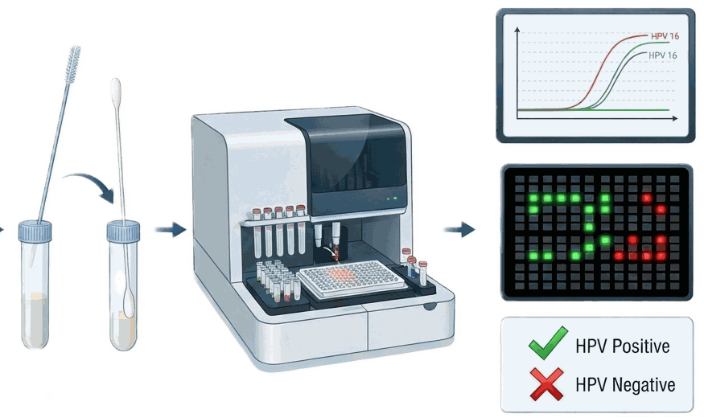
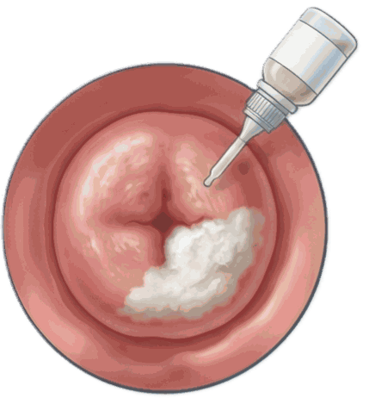
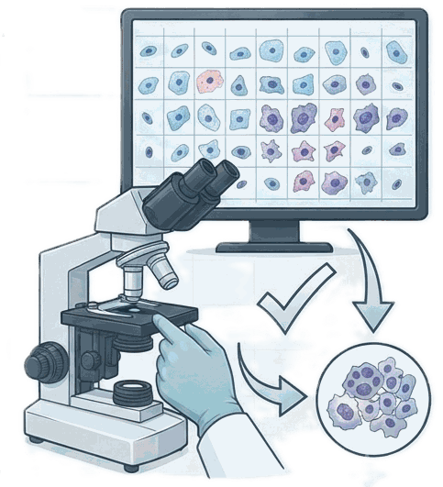
SESSION 2 · SCREENING METHODS
The three screening tests
🧪 HPV DNA testing
👁️ Visual inspection with acetic acid (VIA)
🔬 Cytology (Papanicolaou or Pap smear/test)
Detects high-risk HPV in a cervical or vaginal sample. Used as the primary screening test.
Cervical cells are examined for abnormalities. In Rwanda, used for women aged 50 to 65 never screened.
Acetic acid is applied and the cervix is inspected for acetowhite areas. Used to triage HPV-positive women.
📌 Three different jobs: A primary screening test identifies who needs a closer look. A triage test decides who needs treatment. A diagnostic procedure finds out what the lesion actually is.
Cervical Cancer | Frontline HCP | Rwanda Biomedical Centre
Screen 74

Slide 75
SESSION 2 · RECOMMENDATIONS
What global recommendations are based on
👤
Age, because risk and the value of testing change across a woman's life.
🧠
Immune status, including HIV, which changes how often screening is repeated.
📋
Previous results, and previous treatment for cervical precancer.
🧪
Which screening test the health system can reliably provide.
🏥
Whether triage, treatment and follow-up are actually available after a positive result.
📌 Core principle: A screening programme needs the right population, an available test, a defined interval and guaranteed follow-up. A test without follow-up does not save lives.
Cervical Cancer | Frontline HCP | Rwanda Biomedical Centre
Screen 75

Slide 76
SESSION 2 · SCREENING RESULTS
What a screening result means
🧪 Positive HPV test
👁️ Positive visual inspection
🔬 Abnormal cytology
High-risk HPV was detected. It does not mean cancer, and it does not mean a lesion is present.
A cervical change was seen. It needs management or further assessment, and it is not confirmed cancer.
Abnormal cells were seen. The next step depends on the result and the programme pathway.
⚠️ The rule that matters: An abnormal screening result means the woman needs the next step in the pathway. It never means, on its own, that she has cervical cancer.
Cervical Cancer | Frontline HCP | Rwanda Biomedical Centre
Screen 76

Slide 77
SESSION 2 · RECOMMENDATIONS
The screening pathway in Rwanda
🧪
HPV DNA testing is the primary test for women aged 30 to 49, and 25 to 49 if living with HIV. Samples may be clinician-collected or self-collected.
👁️
Women who test HPV-positive undergo further assessment, including HPV16/18 genotyping and VIA triage, to guide treatment.
✅
Eligible precancerous lesions are treated promptly; women who are not eligible for local treatment are referred for appropriate care.
🏥
A cervix suspicious for invasive cancer is referred for diagnostic assessment.
🏥 Rwanda pathway: HPV DNA test → HPV-positive: genotyping + VIA triage → treat eligible precancer / refer when needed.
Women aged 50 to 65 never screened: Pap smear, or VIA if Pap smear is not available.
Cervical Cancer | Frontline HCP | Rwanda Biomedical Centre
Screen 77

Slide 78
SESSION 2 · RECOMMENDATIONS
Who is screened in Rwanda, and with which test
30 to 49
25 to 49
50 to 65
After 50
Priority age, general population
Priority age, women living with HIV
Never screened, or no documented negative result
When screening can stop
HPV test. If negative, rescreen after 10 years.
HPV test. If negative, rescreen after 5 years.
Pap smear. VIA if Pap smear is not available.
After two consecutive negative results at the recommended interval.
📌 Remember: HPV testing is used for the priority ages. Women aged 50 to 65 who missed screening are still invited, using Pap smear or VIA.
Cervical Cancer | Frontline HCP | Rwanda Biomedical Centre
Screen 78

Slide 79
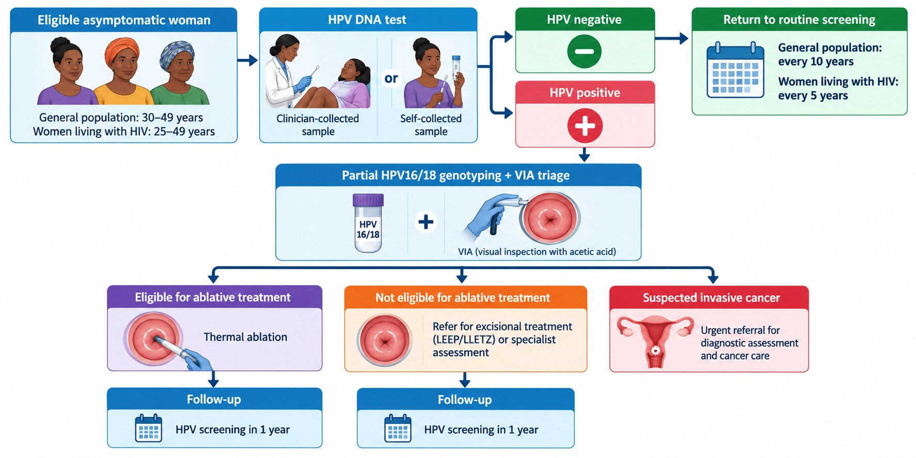
SESSION 2 · RECOMMENDATIONS
The pathway
Cervical Cancer | Frontline HCP | Rwanda Biomedical Centre
Screen 79

Slide 80
SESSION 2 · HPV TESTING
Before you take an HPV sample
✅ Offer the HPV test to
⏸️ Do not take the sample
Women in the priority ages: 30 to 49, or 25 to 49 if living with HIV.
Women due for screening who have no symptoms.
Women who have agreed after counselling.
During menstruation.
During pregnancy, or within 6 weeks of childbirth.
After a total hysterectomy.
When she has symptoms: she needs diagnostic assessment instead.
📋 Before you start: Label the tube with her name, screening ID and date, and complete the laboratory request in the EMR (mUzima or OpenMRS).
Cervical Cancer | Frontline HCP | Rwanda Biomedical Centre
Screen 80

Slide 81

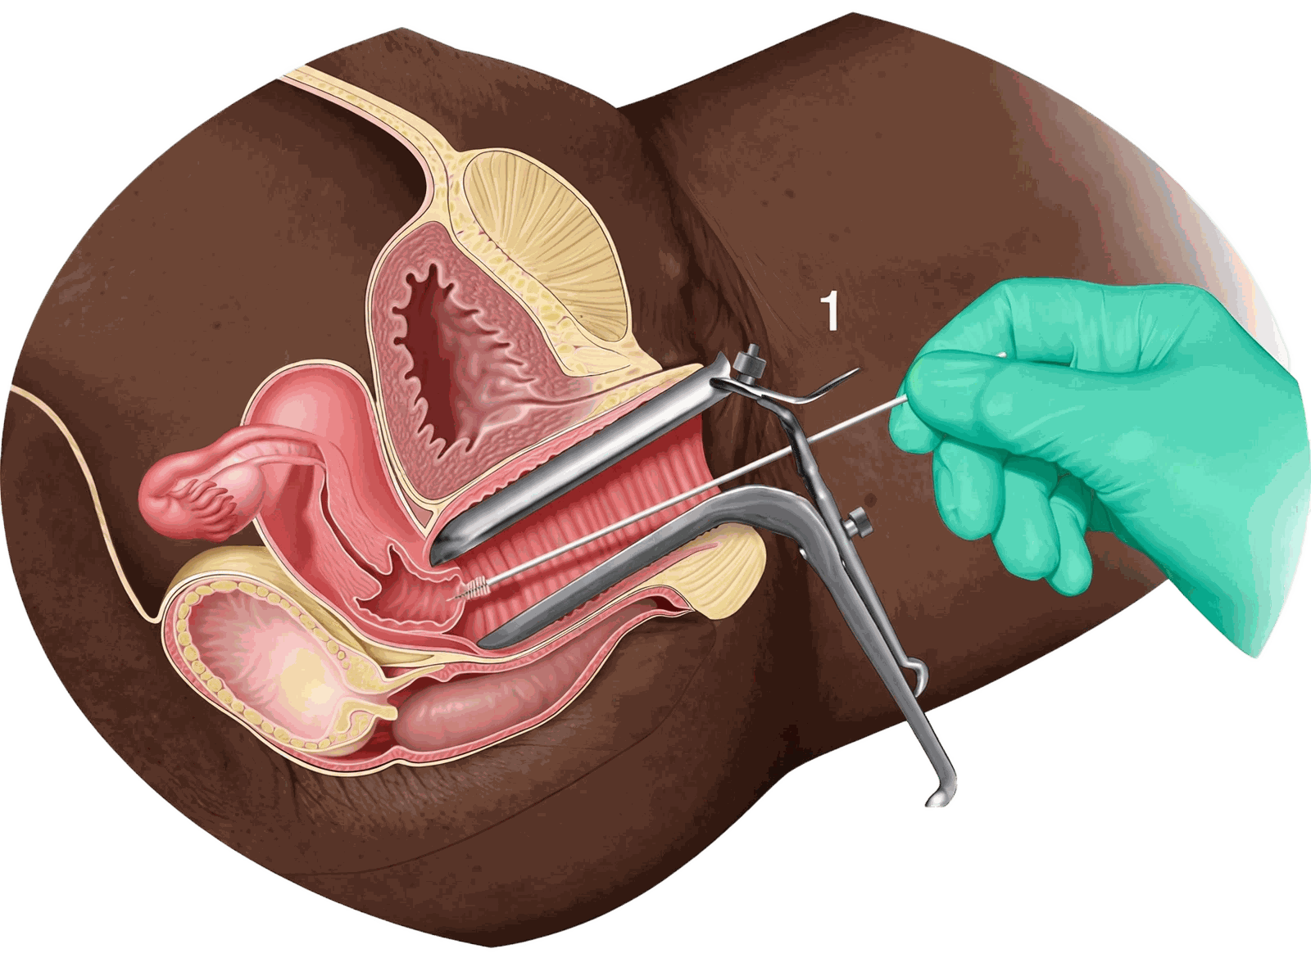
SESSION 2 · HPV TESTING
Two ways to collect the sample
👤 Self-collected
🩺 Clinician-collected
Explain the steps with the instruction poster and give her privacy.
She inserts the swab into the vagina as far as is comfortable, rotates it, and places it in the tube.
Remove the pipette from the kit before handing it to her.
Insert a speculum moistened with water, not gel, and view the whole cervix.
Insert the brush into the os until the outer bristles touch the ectocervix, then rotate clockwise 3 to 5 times.
Rinse the brush in the transport buffer and cap the tube securely.
✅ Both are valid: Self-collection and clinician collection are both used in Rwanda. Self-collection widens access.
Cervical Cancer | Frontline HCP | Rwanda Biomedical Centre
Screen 81

Slide 82
SESSION 2 · INTERACTIVE
Put the collection steps in order
💬 Drag the steps into the correct order for a clinician-collected HPV sample, then select Submit.
A Rotate the brush clockwise 3 to 5 times
B Insert the speculum and view the whole cervix
C Label the tube and complete the request
D Rinse the brush in the buffer and cap the tube
E Insert the brush into the external os
F Place the speculum in 0.5% chlorine solution
Correct order: C → B → E → A → D → F
Feedback: Label first, so the sample cannot be mixed up. Then see the whole cervix, sample the os, rotate, and secure the brush in the buffer. Decontaminate instruments last.
Cervical Cancer | Frontline HCP | Rwanda Biomedical Centre
Screen 82

Slide 83
SESSION 2 · HPV TESTING
After collection: store and send the sample safely
🏷️
Check the label and the EMR request before the sample leaves the room.
🌡️
Store at room temperature for up to 14 days, following the kit instructions.
❄️
If the room is hotter than 30°C, keep samples in a cool box or refrigerator, never in the freezer.
🚚
Transport at room temperature, or in a closed cool box or vaccine carrier when it is hot.
🧤
Place used instruments in 0.5% chlorine solution, and dispose of swabs and gloves safely.
Cervical Cancer | Frontline HCP | Rwanda Biomedical Centre
Screen 83

Slide 84
SESSION 2 · HPV TESTING
Reading an HPV test result
🟢 HPV negative
🟠 Positive: HPV 16 or 18
🟠 Positive: other high-risk type
No high-risk HPV detected. Rescreen after 10 years, or after 5 years for women living with HIV.
The highest-risk types. She needs VIA to decide treatment.
She needs VIA to decide the next step. What happens after a negative VIA depends on her HIV status.
💬 Say it this way: A positive result means the virus was found. It does not mean she has cancer, and it says nothing about anyone's behaviour.
Cervical Cancer | Frontline HCP | Rwanda Biomedical Centre
Screen 84

Slide 85
SESSION 2 · VIA
How visual inspection with acetic acid works
👁️ What it is
🧪 Why lesions turn white
⚠️ Its limits
Naked-eye inspection of the cervix, under a bright light, after applying dilute acetic acid (3 to 5%, vinegar).
Acetic acid coagulates proteins in surface cells. Precancerous cells contain more protein, so they turn white (acetowhite). Higher grades look denser.
Reading VIA needs training and can miss lesions. Ask for a second opinion when unsure. Cancer may appear as a growth rather than a white area.
Cervical Cancer | Frontline HCP | Rwanda Biomedical Centre
Screen 85

Slide 86
SESSION 2 · VIA
Who should have VIA
✅ Perform VIA for
❌ Do not perform VIA
HPV-positive women, to decide treatment.
Women aged 30 to 49 (25 to 49 if living with HIV) when HPV testing is not available.
Women aged 50 to 65 never screened, when Pap smear is not available.
On HPV-negative women.
During pregnancy, or within 6 weeks of childbirth.
After a total hysterectomy.
📌 Menstruation: VIA can still be done during menstruation if the bleeding is not heavy.
Cervical Cancer | Frontline HCP | Rwanda Biomedical Centre
Screen 86

Slide 87
SESSION 2 · VIA
VIA step by step
1️⃣
Prepare fresh 3 to 5% acetic acid, a bright focused lamp, a speculum and swabs. Sit to examine.
2️⃣
Insert the speculum and view the whole cervix. Before applying acid, look for growths, ulcers, white patches or signs of infection.
3️⃣
Identify the external os and the SCJ.
4️⃣
Hold cotton swabs soaked in acetic acid against the cervix, then wait 2 minutes.
5️⃣
Inspect the transformation zone for well-defined acetowhite areas close to the SCJ.
6️⃣
Record the result, explain it to her, and agree the next step before she leaves.
Cervical Cancer | Frontline HCP | Rwanda Biomedical Centre
Screen 87

Slide 88
SESSION 2 · VIA
Four questions to answer at every VIA
1️⃣ Can I see the whole SCJ?
2️⃣ Is there an acetowhite lesion?
3️⃣ How much does it cover?
4️⃣ Could this be cancer?
Yes: transformation zone type 1 or 2. Part of it hidden in the canal: type 3.
Is it dense, well defined and touching the SCJ? Can I see all of it?
Divide the cervix into four quadrants. Less than 75%, or more than 75%?
A growth, an ulcer or a friable area that bleeds on touch: stop and refer.
📌 Remember: Keep the acetic acid bottle closed and pour a fresh amount for each woman. Wait the full 2 minutes, and use a focused lamp: daylight or a ceiling light is not enough.
Cervical Cancer | Frontline HCP | Rwanda Biomedical Centre
Screen 88

Slide 89
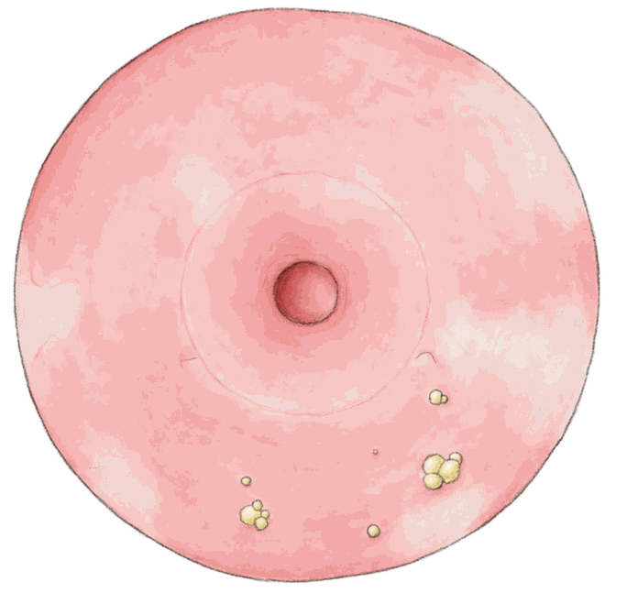
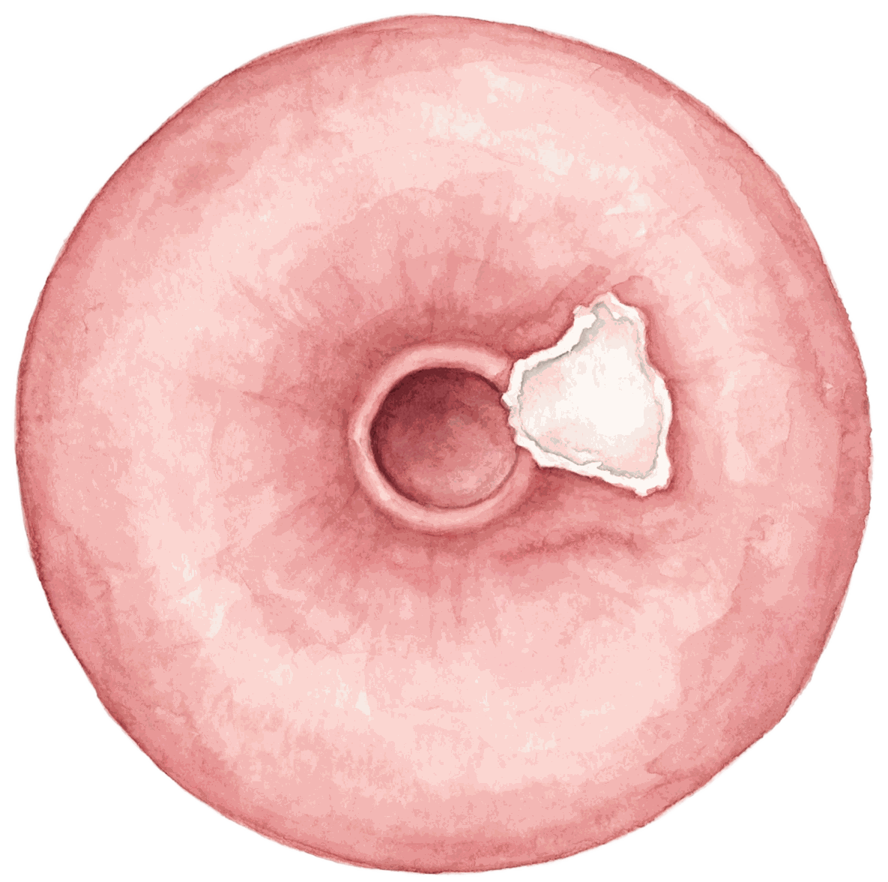
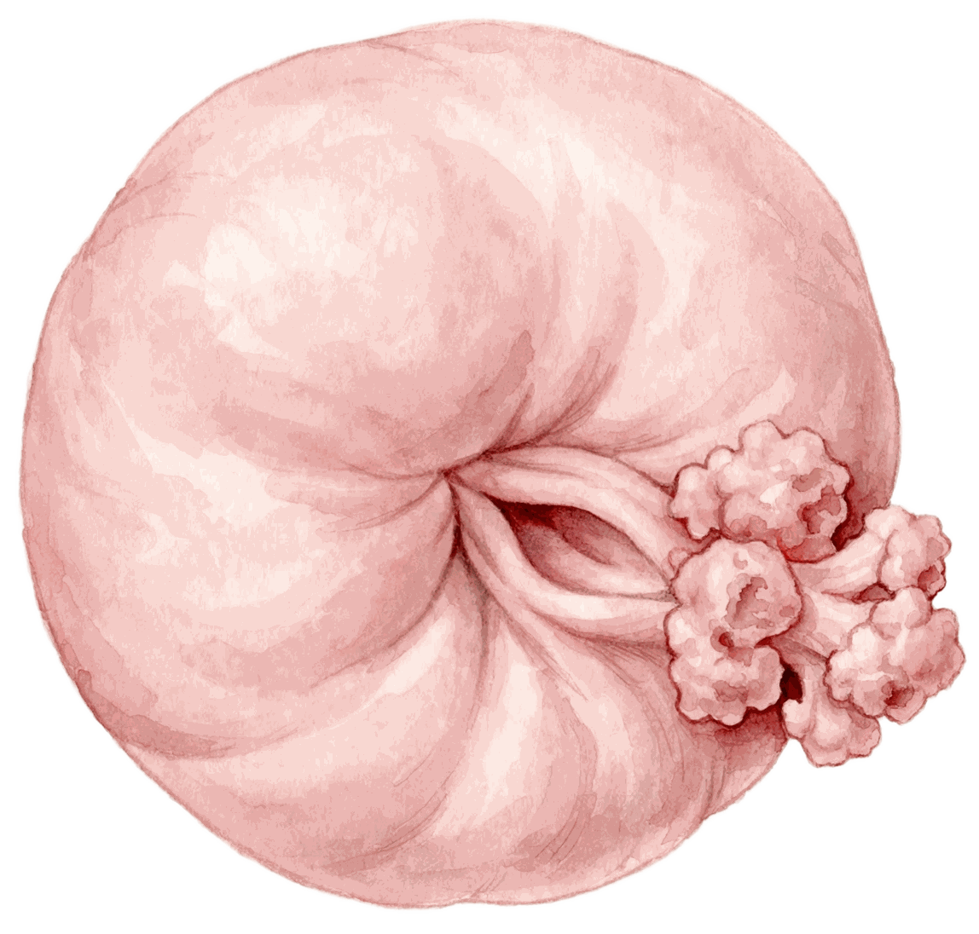
SESSION 2 · VIA
Classifying the VIA result
🟢 VIA negative
🟠 VIA positive
🔴 Suspected cancer
No acetowhite area, or only faint, patchy areas without clear margins. Areas far from the transformation zone, nabothian cysts and a thin line at the SCJ are also negative.
A distinct, opaque acetowhite area with well-defined margins, in the transformation zone and touching the SCJ.
A cauliflower-like growth, fungating mass or ulcer. It may bleed on touch, so an acetowhite change may not be visible.
Cervical Cancer | Frontline HCP | Rwanda Biomedical Centre
Screen 89

Slide 90
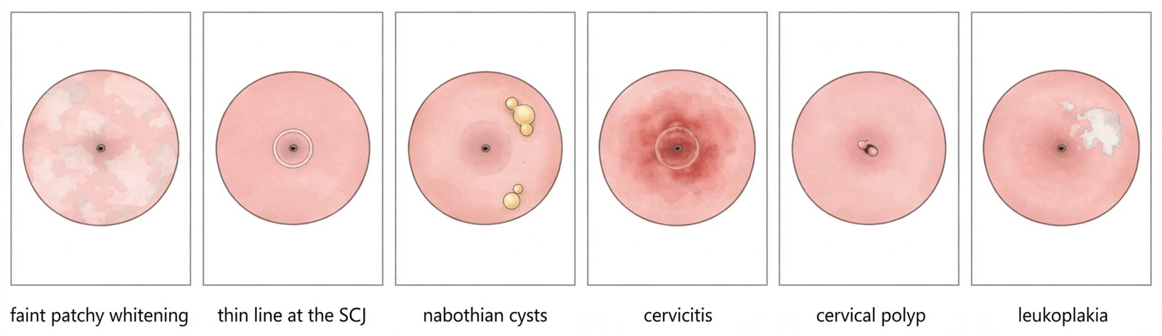
Not every white area is VIA-positive
SESSION 2 · VIA
🔎 Insignificant acetowhite changes
🦠 Benign conditions you may see
A thin line at the edge of the canal
Faint areas without a sharp outline
Areas far away from the SCJ
Dot-like or streak-like pale areas
Nabothian cysts
Cervicitis: diffuse redness and discharge.
Genital warts: mostly caused by HPV 6 and 11.
Polyps: soft red growths from the os. Move them to see the SCJ.
Leukoplakia: a white patch seen before acid. Near the SCJ, refer for colposcopy.
📌 When unsure: VIA can be hard to read at first. Ask for a second opinion rather than miss a lesion.
Cervical Cancer | Frontline HCP | Rwanda Biomedical Centre
Screen 90

Slide 91
SESSION 2 · INTERACTIVE
Classify each VIA finding
💬 Drag each finding into the correct column, then select Submit.
🟢 VIA negative
🟠 VIA positive
🔴 Suspected cancer
Faint, patchy whitening without clear margins
Thin white line at the SCJ
White area far from the transformation zone
Dense white area with sharp margins, touching the SCJ
Opaque acetowhite lesion covering one quadrant
Friable growth that bleeds on touch
Cauliflower-like mass replacing the cervix
✅ Feedback: Only a distinct, well-defined acetowhite area in the transformation zone, touching the SCJ, is VIA-positive. A growth or ulcer is suspected cancer, whatever its colour.
Cervical Cancer | Frontline HCP | Rwanda Biomedical Centre
Screen 91

Slide 92
SESSION 2 · MANAGEMENT
Managing results: general population (HIV-negative)
HPV negative
Rescreen with an HPV test after 10 years
HPV DNA test
Priority age 30 to 49
VIA positive
Lesion <75%, TZ 1 or 2: thermal ablation
Lesion >75% or TZ 3: LEEP
VIA negative, HPV 16/18
TZ 1 or 2: thermal ablation
TZ 3: LEEP
HPV positive
VIA to assess treatment
VIA negative, other high-risk type
Rescreen with an HPV test after 2 years
Suspicious for cancer
Refer to the district hospital for biopsy and diagnosis
📋 After thermal ablation or LEEP: Follow-up test at 12 months, with an HPV test (VIA if HPV testing is not available).
Cervical Cancer | Frontline HCP | Rwanda Biomedical Centre
Screen 92

Slide 93
SESSION 2 · MANAGEMENT
Managing results: women living with HIV
HPV negative
Rescreen with an HPV test after 5 years
HPV DNA test
Priority age 25 to 49
VIA positive
Lesion <75%, TZ 1 or 2: thermal ablation
Lesion >75% or TZ 3: LEEP
HPV positive
VIA to assess treatment
VIA negative (any high-risk type)
TZ 1 or 2: thermal ablation
TZ 3: LEEP
Suspicious for cancer
Refer to the district hospital for biopsy and diagnosis
📋 After thermal ablation or LEEP: Follow-up test at 12 months, with an HPV test (VIA if HPV testing is not available).
Cervical Cancer | Frontline HCP | Rwanda Biomedical Centre
Screen 93

Slide 94
SESSION 2 · MANAGEMENT
Women aged 50 to 65 who were never screened
👤 Who
🔬 Which test
⚠️ What to expect
Women aged 50 to 65 who were never screened, or who have no documented negative result from the priority ages.
Pap smear (cytology). Where Pap smear is not available, use VIA.
After the menopause the SCJ often lies inside the canal (type 3), so VIA is less reliable and ablation is often not suitable.
Cervical Cancer | Frontline HCP | Rwanda Biomedical Centre
Screen 94

Slide 95
SESSION 2 · INTERACTIVE
Match each woman to the next step
💬 Match each result on the left to the correct next step on the right, then select Submit.
HIV-negative, HPV negative
➡️
Rescreen with an HPV test after 10 years
Living with HIV, HPV negative
➡️
Rescreen with an HPV test after 5 years
HIV-negative, other high-risk type, VIA negative
➡️
Rescreen with an HPV test after 2 years
HIV-negative, HPV 16, VIA negative, TZ type 1
➡️
Thermal ablation, if the other criteria are met
VIA positive, lesion covering more than 75%
➡️
Refer for LEEP at the district hospital
Cervical Cancer | Frontline HCP | Rwanda Biomedical Centre
Screen 95

Slide 96
SESSION 2 · INTERACTIVE
What next for Aline?
Mukeshimana Aline is 34 and living with HIV. Her HPV test shows a high-risk type other than 16 or 18. VIA is negative and the transformation zone is type 1. What is the next step?
A Offer thermal ablation, if the other eligibility criteria are met ✅
B Rescreen with an HPV test in 2 years
C Refer for LEEP
D Reassure her and rescreen in 5 years
Correct answer: A
Feedback: For women living with HIV, a positive high-risk HPV result is treated even when VIA is negative, because persistence and progression are more likely. With a type 1 transformation zone, thermal ablation is appropriate. Rescreening in 2 years applies only to HIV-negative women with other high-risk types.
Cervical Cancer | Frontline HCP | Rwanda Biomedical Centre
Screen 96

Slide 97
SESSION 2 · INTERACTIVE
Match the finding to the next step
💬 Match each finding on the left to the correct next step on the right, then select Submit.
A well woman due for routine screening
➡️
Offer screening and explain what the test can and cannot do
Positive HPV test, no symptoms
➡️
Further assessment of the cervix, explaining that cancer is not confirmed
Eligible precancerous lesion seen
➡️
Treat the lesion and book the follow-up test
Lesion extending into the cervical canal
➡️
Refer for excisional treatment or specialist assessment
Cervix suspicious for invasive cancer
➡️
Refer for diagnostic assessment and biopsy, do not ablate
Cervical Cancer | Frontline HCP | Rwanda Biomedical Centre
Screen 97

Slide 98
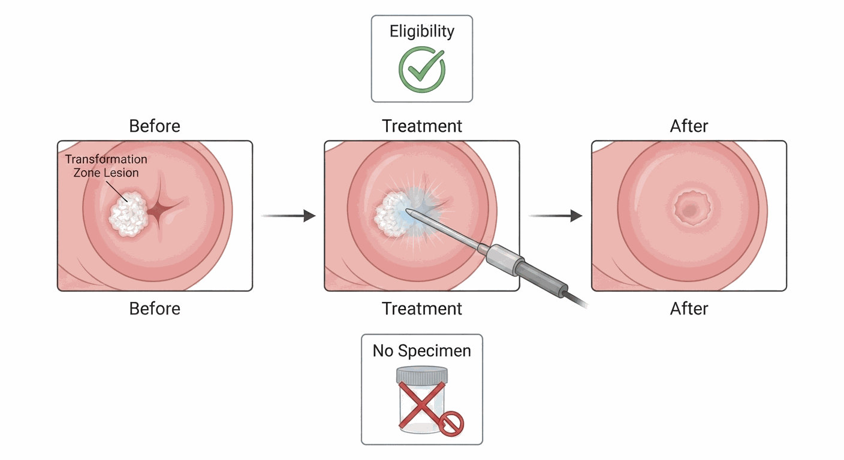
SESSION 2 · TREATING PRECANCER
Ablative treatment
Destroys the abnormal area of the transformation zone.
Thermal ablation uses heat. It is quick and needs no theatre.
Appropriate only when defined eligibility criteria are met.
Provides no tissue specimen and no histology.
Cervical Cancer | Frontline HCP | Rwanda Biomedical Centre
Screen 98

Slide 99
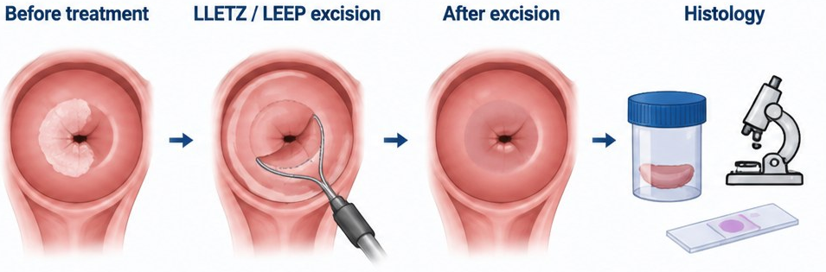
SESSION 2 · TREATING PRECANCER
Excisional treatment: LEEP
Removes the abnormal transformation zone with a thin electrosurgical wire loop (LEEP, also called LLETZ).
Used when ablation is not suitable: TZ type 3, a lesion over 75% of the cervix, or a positive test after treatment. Provided at district hospitals.
Provides tissue for histology, which can identify unsuspected invasive disease.
✅ Both preserve the uterus: Treatment preserves the uterus and usually preserves fertility. Say this early, because fear of infertility stops many women from returning.
Cervical Cancer | Frontline HCP | Rwanda Biomedical Centre
Screen 99

Slide 100
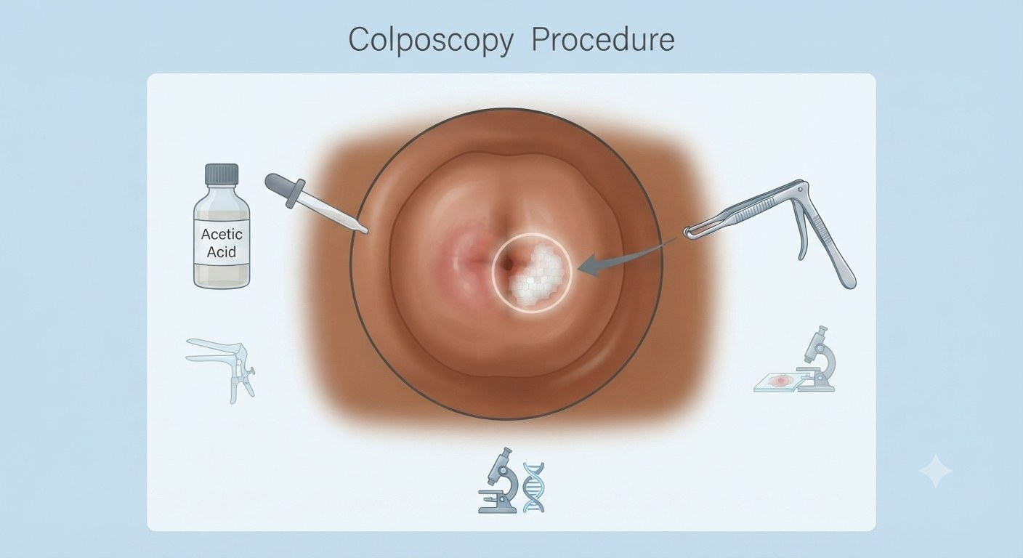
SESSION 2 · TREATING PRECANCER
Colposcopy: a closer look
🔎
What it is: examination of the cervix under magnification and bright light, after acetic acid, using a colposcope.
🎯
Why: to see the full extent of a lesion, plan treatment and guide a biopsy.
🏥
Where: at the district hospital, on referral.
➡️
When to refer: an abnormal Pap smear, leukoplakia near the SCJ, or a lesion that cannot be fully assessed at VIA.
💬 Say it this way: A colposcopy is a closer look at the cervix with a magnifying lamp. It feels much like a speculum examination.
Cervical Cancer | Frontline HCP | Rwanda Biomedical Centre
Screen 100

Slide 101

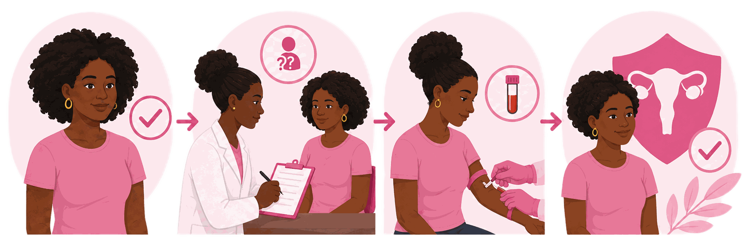
SESSION 2 · TREATING PRECANCER
Two programme strategies
1️⃣ Screen and treat
2️⃣ Screen, triage, treat
A woman with a positive screening result may receive treatment at the same visit if assessment confirms that the lesion is eligible for ablative treatment.
Thermal ablation can be provided at the same visit when eligibility criteria are met.
Same-visit treatment helps reduce loss to follow-up.
Do not use this approach when invasive cancer is suspected.
A positive HPV screening result is followed by triage and assessment, including VIA as indicated.
Assessment determines whether treatment is needed and which treatment is appropriate.
Eligible lesions → thermal ablation.
Lesions not suitable for ablation → LLETZ/LEEP or referral for excisional treatment.
Suspected invasive cancer → urgent referral for diagnostic assessment and cancer care.
✅ In Rwanda: Treatment is selected according to the screening and triage findings. Thermal ablation is used for eligible lesions; LLETZ/LEEP is used when excisional treatment is required, and suspected invasive cancer is referred urgently.
Cervical Cancer | Frontline HCP | Rwanda Biomedical Centre
Screen 101

Slide 102
SESSION 2 · TREATING PRECANCER
When ablation is appropriate
✅ Thermal ablation is appropriate when
🏥 Refer for LEEP or biopsy when
VIA is positive; or VIA is negative with HPV 16/18 (HIV-negative) or any high-risk type (living with HIV).
The whole lesion is visible and does not enter the canal.
The lesion covers less than 75% of the cervix (TZ type 1 or 2).
Cancer is not suspected, and no polyp or deformity prevents probe contact.
She is not pregnant, is over 6 weeks after childbirth, and has no severe cervicitis.
The transformation zone is type 3.
The lesion covers more than 75% of the cervix, or extends into the canal.
A glandular abnormality is suspected.
The follow-up test is positive after previous treatment.
Invasive cancer is suspected: refer for biopsy, never ablate.
🏥 In Rwanda: Thermal ablation is provided at health centres and hospitals. Colposcopy, LEEP and biopsy are provided at district hospitals.
Cervical Cancer | Frontline HCP | Rwanda Biomedical Centre
Screen 102

Slide 103
SESSION 2 · TREATING PRECANCER
Judging lesion size: the quadrant method
1️⃣
Imagine the cervix divided into four quadrants around the os.
2️⃣
Count how many quadrants the acetowhite lesion covers.
3️⃣
Less than 75%, fully visible, TZ type 1 or 2, and covered by the probe: thermal ablation.
Less than 75%
Ablation possible
More than 75%
Refer for LEEP
4️⃣
More than 75%: refer for LEEP at the district hospital.
White area = acetowhite lesion
📌 Remember: Size is only one criterion. The whole lesion must be visible, and there must be no suspicion of cancer.
Cervical Cancer | Frontline HCP | Rwanda Biomedical Centre
Screen 103

Slide 104
SESSION 2 · INTERACTIVE
Eligible for thermal ablation today?
Which of these women can be offered thermal ablation at this visit? Select all that apply.
A HIV-negative, HPV 16 positive, VIA negative, transformation zone type 2 ✅
B VIA-positive lesion covering one quadrant, transformation zone type 1, not pregnant ✅
C VIA-positive lesion, transformation zone type 3
D A friable growth on the cervix that bleeds on touch
Correct answer: A, B
Feedback: A and B meet the criteria: the whole transformation zone is visible, the lesion is small or HPV 16/18 is present, and cancer is not suspected. Type 3 needs LEEP, and a friable growth needs referral for biopsy, never ablation.
Cervical Cancer | Frontline HCP | Rwanda Biomedical Centre
Screen 104

Slide 105
SESSION 2 · TREATING PRECANCER
Thermal ablation: what happens at the visit
✅
Confirm she is not pregnant, and use VIA to confirm that the lesion is eligible.
💬
Explain the procedure and obtain informed consent. No anaesthesia is needed.
🔥
The probe is heated to about 100°C, then applied to cover the lesion and the whole transformation zone.
🔁
Applications are repeated and overlapped until the whole area is covered.
📋
Give post-treatment advice and record the 12-month follow-up date.
Cervical Cancer | Frontline HCP | Rwanda Biomedical Centre
Screen 105

Slide 106
SESSION 2 · COUNSELLING
Counselling before and after thermal ablation
💬 What she may notice
⚠️ Return at once if
🚫 For the next 6 weeks
Cramping, like period pain, during or shortly after treatment.
Watery discharge and light spotting, settling within about 4 weeks.
Foul-smelling discharge
Heavy bleeding
Fever
Severe lower abdominal pain
Nothing in the vagina: no sexual intercourse, tampons, douching or herbal preparations.
This lowers the risk of infection and bleeding.
📋 Before she leaves: Give the advice verbally, and in writing if possible. Write the 12-month follow-up date on her card.
Cervical Cancer | Frontline HCP | Rwanda Biomedical Centre
Screen 106

Slide 107
SESSION 2 · SAFETY RULE
Suspected cancer is never treated as routine precancer
🔴
If the cervix looks suspicious for invasive cancer, stop the screening pathway.
❌
Do not apply ablative treatment. It destroys the tissue needed for diagnosis and does not treat the disease.
🏥
Refer for diagnostic assessment and biopsy instead.
⏱️
Refer promptly. Do not place her in a routine screening queue.
💬
Explain that the cervix needs to be examined properly, without stating that she has cancer.
⚠️ Why this matters: A screen-and-treat algorithm must never override clinical suspicion of invasive cancer.
Cervical Cancer | Frontline HCP | Rwanda Biomedical Centre
Screen 107

Slide 108
SESSION 2 · FOLLOW-UP
Follow-up after an abnormal result
1️⃣
Say plainly what the result is not: cancer has not been found.
2️⃣
Explain the next step, what it involves and roughly how long it takes.
3️⃣
Arrange it before she leaves, and record where and when.
4️⃣
Ask what would stop her attending, and address transport, cost and time away from work.
5️⃣
Close the loop. Follow up actively if she does not attend.
📌 After treatment of precancer: A treated woman needs a planned follow-up test. Treatment removes the lesion, not the infection.
Cervical Cancer | Frontline HCP | Rwanda Biomedical Centre
Screen 108

Slide 109
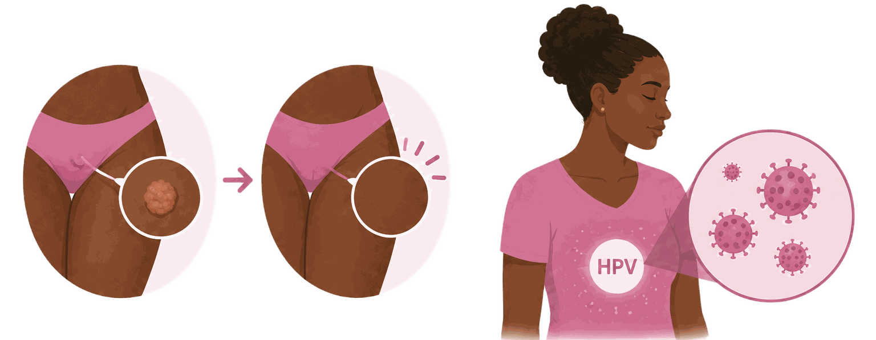
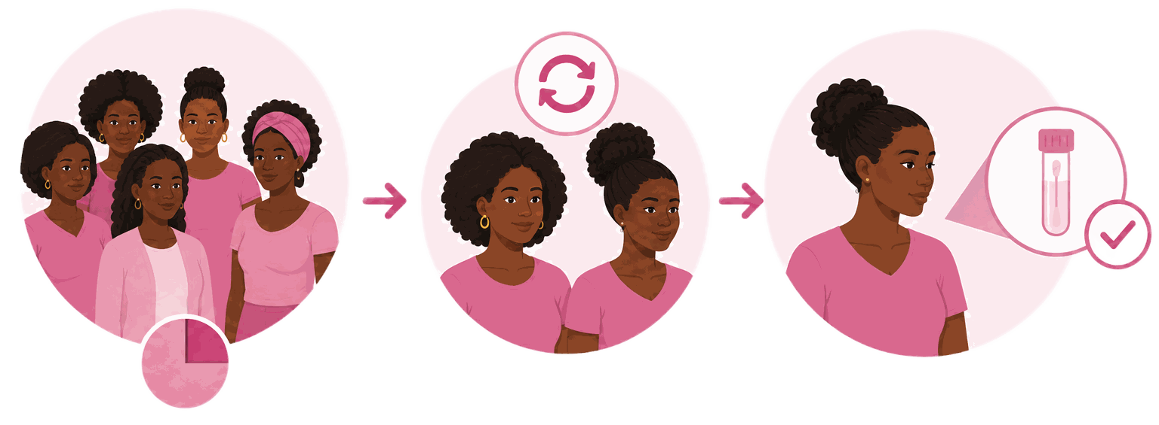
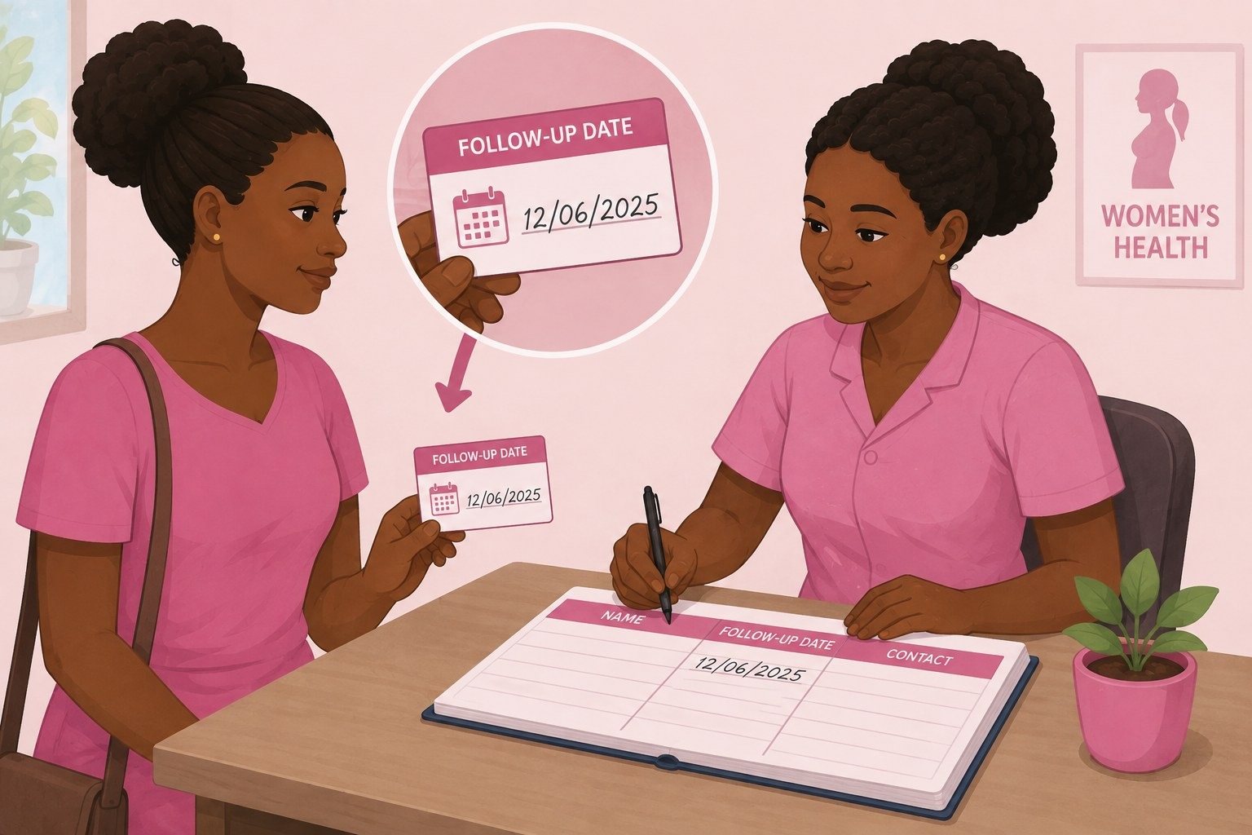
SESSION 2 · FOLLOW-UP
Why follow-up after treatment is not optional
🧪 The infection remains
🔎 Recurrence is found by testing
📋 Record the date
Treatment removes or destroys the lesion. It does not clear HPV from the body.
A proportion of women have persistent or recurrent disease, and only re-testing detects it.
Write the follow-up date on her card and in the register before she leaves.
🏥 In Rwanda: The follow-up test is done 12 months after thermal ablation or LEEP, with an HPV test (VIA if HPV testing is not available).
Cervical Cancer | Frontline HCP | Rwanda Biomedical Centre
Screen 109

Slide 110
SESSION 2 · FOLLOW-UP
The 12-month follow-up test: what the result means
Follow-up result
General population
Women living with HIV
🟢 Negative
Return to routine screening at the usual interval.
Repeat the test within 12 months. If negative again, return to routine screening every 5 years.
🟠 Positive
Re-treat with LEEP (LLETZ).
Re-treat with LEEP (LLETZ).
🔴 Suspected cancer
Refer for evaluation, biopsy and further management.
Refer for evaluation, biopsy and further management.
📌 Applies after: Thermal ablation or LEEP without histology results, or treatment based on histology showing CIN 2, CIN 3 or AIS.
Cervical Cancer | Frontline HCP | Rwanda Biomedical Centre
Screen 110

Slide 111
SESSION 2 · CLINICAL CASE
🩺 Case Progression: Immaculée
Mukamana Immaculée, 38
What you already know: Immaculée attended screening with no symptoms. She has never been screened before and is HIV negative.
New information: Her HPV test is positive. On inspection with acetic acid there is an acetowhite area on the anterior cervix. The upper edge of it disappears into the cervical canal and cannot be seen. The cervix is otherwise smooth and does not bleed on contact.
What she says: She asks whether this means she has cancer, and whether she will still be able to have another child.
What would you do next?: Decide whether she can be treated today, and decide what you will say about her result.
Cervical Cancer | Frontline HCP | Rwanda Biomedical Centre
Screen 111

Slide 112
SESSION 2 · CLINICAL CASE
What is the correct next step for Immaculée?
The whole lesion and the whole transformation zone cannot be seen. What should happen?
A Refer for excisional treatment or specialist assessment ✅
B Ablate the visible part of the lesion today
C Repeat the HPV test in five years
D Reassure her that no action is needed, as she has no symptoms
Correct answer: A
Feedback: Ablation is only appropriate when the whole lesion and the whole transformation zone can be seen. Treating the visible part would leave disease in the canal. She is referred to the district hospital for LEEP. Tell her plainly that this is not cancer and that treatment preserves fertility.
Cervical Cancer | Frontline HCP | Rwanda Biomedical Centre
Screen 112

Slide 113
SESSION 2 · KNOWLEDGE CHECK
Knowledge check: question 1 of 6
Screening applies to:
A Women with concerning symptoms
B Women awaiting surgery
C Women already diagnosed with cancer
D Eligible women who have no symptoms ✅
Correct answer: D
Feedback: Screening tests eligible women who feel well, in order to find high-risk HPV infection or cervical changes early. A woman with symptoms needs diagnostic assessment instead.
Cervical Cancer | Frontline HCP | Rwanda Biomedical Centre
Screen 113

Slide 114
SESSION 2 · KNOWLEDGE CHECK
Knowledge check: question 2 of 6
A 36 year old woman has a positive HPV test and feels completely well. What should you tell her?
A That HPV was detected, that cancer has not been found, and what happens next ✅
B That she has cervical cancer
C That no action is needed
D That she should repeat the test in five years
Correct answer: A
Feedback: A positive HPV test means the virus was detected. Most women with a positive test do not have a lesion. Explain what was found, what it does not mean, and arrange the next step in the pathway.
Cervical Cancer | Frontline HCP | Rwanda Biomedical Centre
Screen 114

Slide 115
SESSION 2 · KNOWLEDGE CHECK
Knowledge check: question 3 of 6
Which statements about HPV vaccination are accurate? Select all that apply.
A It works best when given before exposure to HPV ✅
B It treats an existing cervical lesion
C It reduces the future risk of cervical precancer and cancer ✅
D It removes the need for cervical screening
Correct answer: A, C
Feedback: The vaccine is preventive, not therapeutic, so timing before exposure is what makes it work. It does not treat existing disease, and vaccinated women still need screening because it does not cover every high-risk type.
Cervical Cancer | Frontline HCP | Rwanda Biomedical Centre
Screen 115

Slide 116
SESSION 2 · KNOWLEDGE CHECK
Knowledge check: question 4 of 6
Which finding means a woman should be referred rather than treated with ablation at the screening visit?
A A small lesion that is fully visible
B A woman who has had three children
C A woman aged 34
D A cervix that looks suspicious for invasive cancer ✅
Correct answer: D
Feedback: A cervix suspicious for invasive cancer needs diagnostic assessment and biopsy. Ablation would destroy the tissue needed for diagnosis and would not treat the disease.
Cervical Cancer | Frontline HCP | Rwanda Biomedical Centre
Screen 116

Slide 117
SESSION 2 · KNOWLEDGE CHECK
Knowledge check: question 5 of 6
A woman treated for cervical precancer last year asks whether she still needs screening. The accurate answer is:
A No, treatment cured the infection
B Only if she develops symptoms
C Yes, because treatment removes the lesion, not the infection ✅
D Only if she has another child
Correct answer: C
Feedback: Treated women remain at higher risk for years. Persistent or recurrent disease is found only by re-testing, which is why a planned follow-up test is part of treatment, not an optional extra.
Cervical Cancer | Frontline HCP | Rwanda Biomedical Centre
Screen 117

Slide 118
SESSION 2 · KNOWLEDGE CHECK
Knowledge check: question 6 of 6
A woman living with HIV asks why she is being screened more often than her neighbour. The best explanation is:
A Her neighbour does not need screening at all
B She must have done something differently
C There is no real reason
D HIV makes HPV more likely to persist, so screening is more frequent ✅
Correct answer: D
Feedback: Explain the clinical reason plainly and without blame. Reduced immunity makes persistence and progression more likely, which is why screening starts earlier and is repeated more often.
Cervical Cancer | Frontline HCP | Rwanda Biomedical Centre
Screen 118

Slide 119
SESSION 2
Reflection
Learner instruction: Enter your response in the text box. These responses are not scored.
What would you tell a woman who believes a positive HPV test means she has cancer?
1
How would you explain why screening matters to a woman who feels completely healthy?
2
Which finding would make you refer a woman rather than treat her at the screening visit, and how would you explain that decision to her?
3
What barrier could prevent a woman in your setting from completing follow-up after an abnormal screening result?
4
Cervical Cancer | Frontline HCP | Rwanda Biomedical Centre
Screen 119

Slide 120
3
S E S S I O N 3
Referral and counselling
Turn a finding into the right next step: refer with the right urgency, record what the national registry needs, and communicate without stigma.
Cervical Cancer | Frontline HCP | Rwanda Biomedical Centre
Screen 120

Slide 121
SESSION 3
Learning objectives
By the end of this session you will be able to:
1
Describe the levels of the Rwandan health system and where cervical cancer care happens.
2
Decide whether a finding needs routine follow-up, prompt referral or emergency assessment.
3
Record the information the national cancer registry needs at first contact.
4
Counsel a woman about a positive screening result without stating or implying that she has cancer.
5
Apply the basics of psychological support and stigma-sensitive communication.
6
Support attendance and close the loop when a woman does not attend.
Cervical Cancer | Frontline HCP | Rwanda Biomedical Centre
Screen 121

Slide 122





SESSION 3 · REFERRAL SYSTEM
Where cervical cancer care happens
1
➡️
2
➡️
3
➡️
4
➡️
5
Community: awareness, education, referral support, and helping women attend screening and follow-up
Health centre: HPV DNA screening, VIA and thermal ablation of eligible lesions
District hospital: HPV screening, VIA, colposcopy, LEEP, biopsy and referral
Referral hospital: excisional treatment, biopsy, histopathology, imaging, surgery and chemotherapy
National level: radiotherapy, brachytherapy and specialist oncology care
🏥 Service availability is evolving: HPV DNA testing and VIA are provided at health centres and district hospitals. LEEP and biopsy are provided at district hospitals; specialist cancer services are concentrated at referral hospitals, with capacity expanding over time.
Cervical Cancer | Frontline HCP | Rwanda Biomedical Centre
Screen 122

Slide 123
SESSION 3 · REFERRAL
How urgently to refer
🔴 Emergency, same day
🟠 Prompt, without waiting
🔵 Routine referral
Heavy or continuing bleeding.
Dizziness or pallor with bleeding.
Severe symptomatic anaemia.
Severe pain in an unwell woman.
A cervix suspicious for cancer.
Bleeding after the menopause.
Bleeding after intercourse.
Persistent offensive discharge.
A lesion needing excision, not suspicious.
A follow-up test at a higher level.
Specialist opinion, no time pressure.
Cervical Cancer | Frontline HCP | Rwanda Biomedical Centre
Screen 123

Slide 124
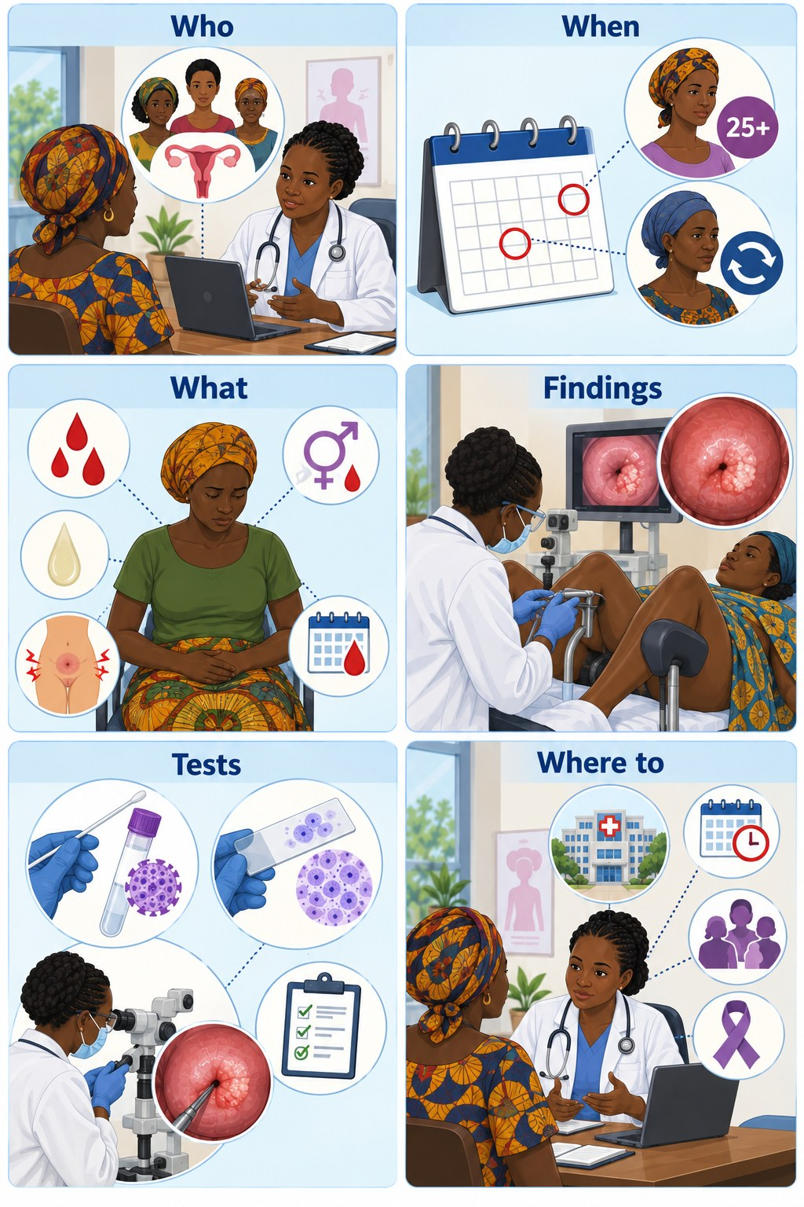
SESSION 3
What to record at first contact
Who: Full name, age, sex, and residence by village and district, so records can be linked and duplicates avoided.
When: Date the symptoms began, as the person reports it, and the date of this consultation. This pair measures diagnostic delay.
What: The specific symptom that triggered the referral.
Findings: What you actually found on examination, including a normal examination. Record it even when no test was available.
Tests: Whether a screening or other test was done, and the result once it is available. Submit the record even if nothing was done yet.
Where to: The referral destination and date, and whether the person is known to have arrived. This is how loss to follow-up is measured.
Note: In the absence of routine testing, your clinical judgement is the data. A record completed at first suspicion and updated later is far more useful than a blank form waiting for a confirmatory test.
Colorectal Cancer | Frontline HCP | Rwanda Biomedical Centre

Slide 125
SESSION 3 · REFERRAL
Before she leaves the room
🏥
Name the facility she is going to, and give the referral in writing.
💬
Explain what will happen there, in plain words.
⏱️
Record the date, and tell her when she is expected.
🔎
Ask directly what would stop her going, and solve what you can solve today.
➡️
Agree how the result will reach her, and who will follow up if she does not attend.
📌 Remember: A referral a woman cannot act on is not a referral. Distance, cost and time away from work decide whether she arrives.
Cervical Cancer | Frontline HCP | Rwanda Biomedical Centre
Screen 125

Slide 126
SESSION 3 · COUNSELLING
Counselling after a positive HPV test
1️⃣
High-risk HPV has been detected.
2️⃣
HPV is common, and most infections cause no harm.
3️⃣
This result does not mean she has cervical cancer.
4️⃣
Explain what the next step is and why it matters.
5️⃣
The result says nothing about a partner's behaviour.
💬 Say it this way: A common virus was found. It is not cancer. The next step is to look at your cervix properly, so that anything that needs treating is treated early.
Cervical Cancer | Frontline HCP | Rwanda Biomedical Centre
Screen 126

Slide 127
SESSION 3 · COUNSELLING
The conversations you will have
💬 Naming uncertainty
👶 Fertility
🩺 What happens next
Say what is known, what is not known, and what the next test is for. Do not promise a result.
Treatment of precancer keeps the uterus and preserves fertility. Say this early and clearly.
Describe the examination, the acetic acid, the biopsy, how long it takes and what she will feel.
❌ Avoid: Frightening language and false reassurance both stop women coming back, which is the outcome that matters most.
✅ Instead: Be honest, be specific about the next step, and allow her questions before she leaves.
Cervical Cancer | Frontline HCP | Rwanda Biomedical Centre
Screen 127

Slide 128
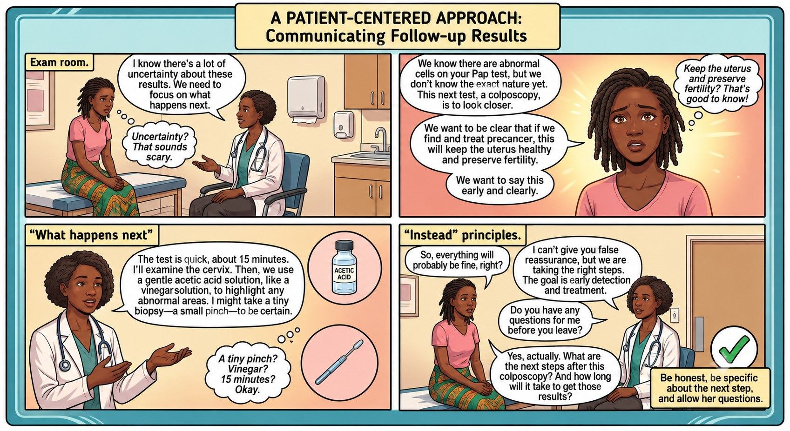
SESSION 3 · COUNSELLING
Cervical Cancer | Frontline HCP | Rwanda Biomedical Centre
Screen 128

Slide 129
SESSION 3 · PSYCHOLOGICAL SUPPORT
The basics that make the difference
👂
Listen without judgment, and allow questions.
❌
Avoid false reassurance, and avoid blame.
🔒
Protect privacy and dignity. Ask what she wants recorded and disclosed.
👤
Support her autonomy, including whom she chooses to tell.
🏥
Recognise when fear about cancer, fertility or a relationship needs more support than you can give, and refer.
🔎 Watch for: Fear of cancer, fear of infertility, fear of a partner's reaction, and the practical fear of losing income. Each has a different answer.
Cervical Cancer | Frontline HCP | Rwanda Biomedical Centre
Screen 129

Slide 130
SESSION 3 · INTERACTIVE
Myth or fact: HPV and stigma
💬 Select each myth to reveal the accurate response.
❌ Myth A positive HPV test proves a partner has been unfaithful.
✅ Fact HPV is common and can persist silently for years. A result says nothing about when or from whom infection was acquired.
❌ Myth Cervical cancer only affects women with many partners.
✅ Fact One lifetime partner is enough to acquire HPV. Framing screening around behaviour drives stigma and keeps women away.
❌ Myth A woman with cervical cancer brought it on herself.
✅ Fact Cervical cancer follows a common virus. No woman is to blame for her diagnosis.
❌ Myth Screening is embarrassing, so it is better not to raise it.
✅ Fact Raising it calmly and privately is exactly what makes screening possible. Silence is what costs lives.
Cervical Cancer | Frontline HCP | Rwanda Biomedical Centre
Screen 130

Slide 131
SESSION 3 · CLINICAL CASE
🩺 Clinical Case Closure: Immaculée
Mukamana Immaculée, 38
What happened next: She was referred to the district hospital for excisional treatment, with the appointment booked before she left. Transport cost was discussed and a community health worker agreed to accompany her.
Final clinical interpretation: Histology from the excised tissue showed a high-grade precancerous lesion with clear margins. There was no invasive cancer.
Key actions: Explained that cancer had not been found. Arranged referral rather than ablation, because the lesion was not fully visible. Booked and recorded her follow-up test.
Outcome: She recovered quickly, kept her uterus, and attended her follow-up appointment.
Cervical Cancer | Frontline HCP | Rwanda Biomedical Centre
Screen 131

Slide 132
SESSION 3 · KNOWLEDGE CHECK
Knowledge check: question 1 of 5
A positive screening result should be explained to a woman as:
A A confirmed cancer
B A reason to stop investigating
C A normal finding
D A signal that her cervix needs to be looked at, and that cancer has not been found ✅
Correct answer: D
Feedback: The result means the next step in the pathway is due. Saying plainly that cancer has not been found is what keeps a frightened woman engaged with care.
Cervical Cancer | Frontline HCP | Rwanda Biomedical Centre
Screen 132

Slide 133
SESSION 3 · KNOWLEDGE CHECK
Knowledge check: question 2 of 5
Which presentation requires same day emergency assessment?
A Heavy vaginal bleeding with dizziness and pallor ✅
B A positive HPV test in a well woman
C Two months of mild discharge
D A woman due for routine screening
Correct answer: A
Feedback: Bleeding with signs of haemodynamic compromise needs resuscitation and immediate transfer. The other findings need prompt or routine management, but not same day emergency care.
Cervical Cancer | Frontline HCP | Rwanda Biomedical Centre
Screen 133

Slide 134
SESSION 3 · KNOWLEDGE CHECK
Knowledge check: question 3 of 5
The single most useful item to record for the national cancer registry at first contact is:
A The suspected stage
B The woman's occupation
C The date symptoms began and the date of this consultation ✅
D The name of the referring clinician
Correct answer: C
Feedback: Together these two dates measure diagnostic delay, which is the key indicator of how well the pathway is working. Record them even when no test has been done.
Cervical Cancer | Frontline HCP | Rwanda Biomedical Centre
Screen 134

Slide 135
SESSION 3 · KNOWLEDGE CHECK
Knowledge check: question 4 of 5
A woman referred six weeks ago has not attended. You should:
A Assume she chose not to go
B Contact her, find out what prevented attendance, and re-arrange ✅
C Remove her from the register
D Wait for her to return
Correct answer: B
Feedback: Loss to follow-up is one of the largest gaps in the pathway, and the reason is usually practical rather than a refusal of care. Finding out what happened is part of the clinical task.
Cervical Cancer | Frontline HCP | Rwanda Biomedical Centre
Screen 135

Slide 136
SESSION 3 · KNOWLEDGE CHECK
Knowledge check: question 5 of 5
A woman is afraid her husband will accuse her of infidelity if she tells him about her HPV result. The best approach is:
A Insist that she must tell him
B Avoid the subject
C Tell him yourself
D Explain that HPV is common and can persist for years, and help her decide what to say ✅
Correct answer: D
Feedback: Accurate information plus a plan she controls protects both her safety and her willingness to continue care. Disclosure is her decision, not yours.
Cervical Cancer | Frontline HCP | Rwanda Biomedical Centre
Screen 136

Slide 137
SESSION 3
Reflection
Learner instruction: Enter your response in the text box. These responses are not scored.
How would you explain to a worried woman that you are referring her, without stating or implying that she has cancer?
1
What most often stops a woman in your setting from completing a referral, and what is one thing you could change about how you refer?
2
How would you raise the subject of bleeding or discharge with a woman who is clearly embarrassed?
3
Cervical Cancer | Frontline HCP | Rwanda Biomedical Centre
Screen 137

Slide 138
4
S E S S I O N 4
Diagnosis and treatment
What happens after a suspicious finding: how invasive cervical cancer is confirmed, how it is staged, and what each treatment actually does.
Cervical Cancer | Frontline HCP | Rwanda Biomedical Centre
Screen 138

Slide 139
SESSION 4
Learning objectives
By the end of this session you will be able to:
1
Outline the diagnostic pathway from clinical assessment to a confirmed, staged diagnosis.
2
Explain the role and the limits of history, examination and imaging.
3
Describe colposcopy, biopsy and histopathology well enough to prepare a woman for them.
4
Summarise what each treatment does and whether it acts locally or throughout the body.
5
Explain why brachytherapy is an important part of curative treatment.
6
Correct the misconceptions that most often delay care.
Cervical Cancer | Frontline HCP | Rwanda Biomedical Centre
Screen 139

Slide 140
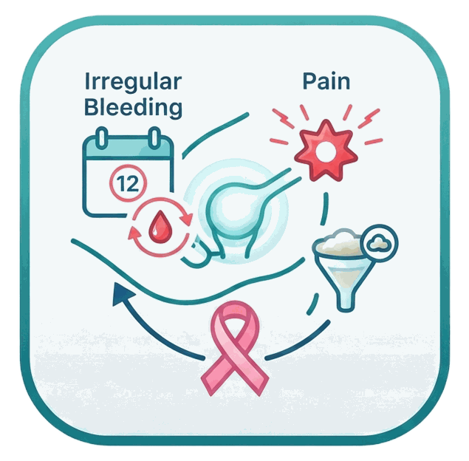

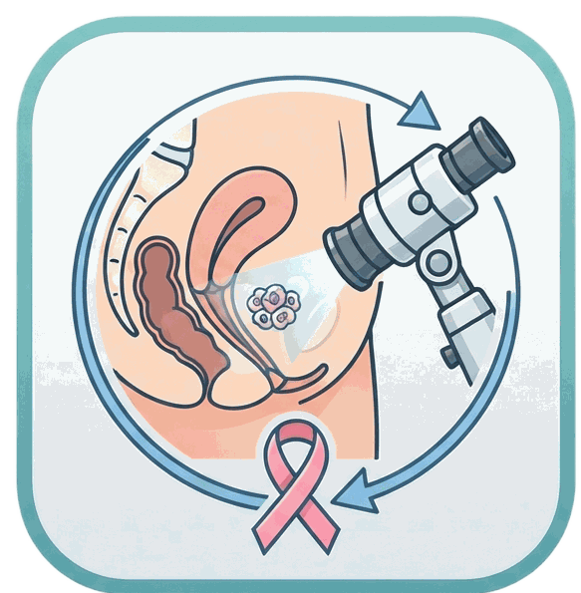


SESSION 4 · DIAGNOSIS
The diagnostic pathway
➡️
➡️
➡️
➡️
1
2
3
4
5
Clinical assessment
Speculum and pelvic examination
Colposcopy
Biopsy and histopathology
Imaging and staging
📌 The sequence varies: A woman who presents with heavy bleeding may be resuscitated and biopsied the same day. What does not change is that tissue confirms the diagnosis.
⚠️ Remember: Screening tests and imaging raise or lower suspicion. Only histopathology confirms invasive cervical cancer.
Cervical Cancer | Frontline HCP | Rwanda Biomedical Centre
Screen 140

Slide 141
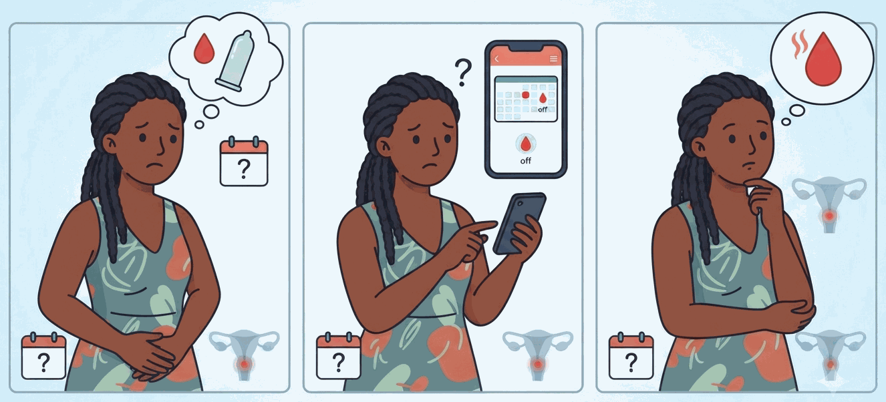


SESSION 4 · DIAGNOSIS
What the history should cover
🩸 Bleeding
💧 Discharge and pain
📋 History and context
Bleeding after intercourse, between periods, or after the menopause, and how long it has been happening.
Persistent or offensive discharge, pelvic or back pain, pain during intercourse.
Previous screening, previous treatment of precancer, HIV status, weight loss, urinary or bowel symptoms.
🔎 Ask directly: Many women do not volunteer bleeding or discharge. Asking calmly and privately is what brings the information out.
Cervical Cancer | Frontline HCP | Rwanda Biomedical Centre
Screen 141

Slide 142



SESSION 4 · DIAGNOSIS
Examination and its limits
👁️ Look at the cervix
🖐️ Assess the pelvis
❌ What it cannot do
Describe what you see: a growth, an ulcer, a surface that bleeds on contact, or a cervix that looks normal.
Note the size and mobility of the uterus and anything that suggests spread beyond the cervix.
A normal examination does not exclude cervical cancer, and it certainly does not exclude precancer.
🧪 No blood test: There is no blood test that confirms or excludes cervical cancer. Findings raise or lower suspicion, and tissue decides.
Cervical Cancer | Frontline HCP | Rwanda Biomedical Centre
Screen 142

Slide 143


SESSION 4 · DIAGNOSIS
Colposcopy, biopsy and histopathology
🔎 Colposcopy
🧪 Biopsy
🔬 Histopathology
The cervix is examined under magnification after acetic acid is applied. It shows where the abnormality is and guides the biopsy.
A small piece of tissue is taken from the abnormal area. It causes cramping and some spotting rather than severe pain.
A pathologist examines the biopsy to confirm whether cancer is present and determine the histological type. Cervical specimens are currently processed mainly at Rwanda’s tertiary hospitals with pathology services.
🏥 Rwanda pathway: Biopsy specimens are sent to a facility with histopathology capacity. Results are returned to the referring clinical team, increasingly through the national E-Ubuzima EMR, so the patient can be contacted and the next step arranged.
Cervical Cancer | Frontline HCP | Rwanda Biomedical Centre
Screen 143

Slide 144
SESSION 4 · DIAGNOSIS
Imaging and staging
📏 Local extent
🔎 Lymph nodes and distant spread
🏥 Imaging depends on availability
Clinical assessment and imaging help determine tumour size and involvement of nearby tissues, including the parametrium, vagina, bladder and rectum.
Where available, imaging assesses pelvic and para-aortic lymph nodes, distant disease and complications such as urinary tract or kidney obstruction.
Advanced imaging is concentrated in referral and tertiary hospitals. Patients may need referral for CT or MRI when these are required for staging. Do not delay essential assessment or treatment planning while waiting for imaging that is not immediately available.
Clinical assessment → biopsy/histology → staging assessment → imaging where indicated/available → multidisciplinary treatment plan
🏥 In Rwanda: Staging combines clinical assessment with available imaging. Advanced imaging and specialist cancer care are mainly accessed through referral/tertiary hospitals, with referral based on clinical findings and local availability.
Cervical Cancer | Frontline HCP | Rwanda Biomedical Centre
Screen 144

Slide 145
SESSION 4 · CLINICAL CASE
What does Béatrice need next?
Her cervix is irregular and bleeds on contact, and she has five months of postcoital bleeding. What is the correct next step?
A Offer a screening test and review the result in a few weeks
B Refer promptly for colposcopy and biopsy, explaining that her cervix must be examined ✅
C Treat the cervix with thermal ablation today
D Treat for infection and review in three months
Correct answer: B
Feedback: A cervix that is irregular and bleeds on contact is suspicious for invasive cancer. She needs assessment and biopsy, not a screening test and not ablation. Explain that the cervix must be examined, without stating that she has cancer.
Cervical Cancer | Frontline HCP | Rwanda Biomedical Centre
Screen 145

Slide 146



SESSION 4 · TREATMENT
Treatment depends on what was found
🟢 Cervical precancer
🔵 Early invasive cancer
🟠 Locally advanced cancer
Treated by destroying or removing the abnormal area, in an outpatient or day procedure that keeps the uterus.
Usually treated with surgery, sometimes with radiotherapy added afterwards, depending on the pathology.
Treated with radiotherapy and chemotherapy together, followed by brachytherapy.
📌 Your role: You do not select the treatment. You explain what each one is for, support the woman through it, and recognise when something needs escalating.
Cervical Cancer | Frontline HCP | Rwanda Biomedical Centre
Screen 146

Slide 147

SESSION 4 · TREATMENT
Surgery
✂️
Surgery removes the cancerous tissue.
📏
How much is removed depends on the stage and the individual situation.
🔵
Some procedures affect fertility. A woman who wants future pregnancy should say so before treatment is planned.
It is used mainly for selected early-stage cervical cancers. Specialist assessment decides whether surgery is appropriate.
👶
💬 Say it this way: Early cervical cancer is treated with the intention of cure. Be honest that treatment is demanding and takes time.
Cervical Cancer | Frontline HCP | Rwanda Biomedical Centre
Screen 147

Slide 148

SESSION 4 · TREATMENT
Radiotherapy
🧠 What it does
Ionising radiation damages the DNA of cancer cells so that they cannot continue to divide and survive.
📍 Where it acts
It acts locally, only where it is aimed. It is not a treatment that travels through the body.
🏥 Where it fits
External beam radiotherapy is delivered from outside the body, and is a major part of treatment for many cervical cancers.
🔎 Also used for symptoms: Radiotherapy is very effective at controlling bleeding from a cervical tumour, even when cure is not the aim.
Cervical Cancer | Frontline HCP | Rwanda Biomedical Centre
Screen 148

Slide 149

SESSION 4 · TREATMENT
Brachytherapy
📍 What it is
Radiation delivered from a source placed close to or within the cervix and the tumour.
🎯 Why it matters
It gives a high dose directly to the tumour while limiting the dose to surrounding tissue.
✅ Where it fits
It is an essential part of curative radiotherapy for many women with locally advanced cervical cancer.
⚠️ Not optional: Brachytherapy is not something that can be left out because external beam radiotherapy has already been given. Outcomes are substantially worse without it.
Cervical Cancer | Frontline HCP | Rwanda Biomedical Centre
Screen 149

Slide 150


SESSION 4 · TREATMENT
Chemotherapy and chemoradiation
💊 Chemotherapy
🔗 Concurrent chemoradiation
Cytotoxic medicines that interfere with cancer cell growth and division.
It acts throughout the body, which is why its effects are felt throughout the body.
It also affects normal cells that divide quickly.
Used for recurrent and metastatic disease, and alongside radiotherapy.
Chemotherapy given during a course of radiotherapy.
The chemotherapy makes the radiation more effective against the cancer cells.
It is the standard approach for locally advanced cervical cancer.
Completing the course on time matters. Long interruptions reduce the chance of cure.
💡 Key point: Helping a woman complete her treatment course is a clinical intervention, not an administrative one.
Cervical Cancer | Frontline HCP | Rwanda Biomedical Centre
Screen 150

Slide 151



SESSION 4 · TREATMENT
Targeted therapy and immunotherapy
🎯 Targeted therapy
🛡️ Immunotherapy
⚠️ Only in selected cases
Acts on a particular biological feature or pathway involved in cancer growth, rather than on dividing cells in general.
Modifies the immune response so that the immune system can better recognise or attack the cancer.
These treatments suit only some cancers. They are not alternatives to surgery or chemoradiation for curable disease.
Cervical Cancer | Frontline HCP | Rwanda Biomedical Centre
Screen 151

Slide 152
SESSION 4 · INTERACTIVE
Myth or fact: diagnosis and treatment
💬 Select each myth to reveal the accurate response.
❌ Myth Surgery makes cancer spread.
✅ Fact Surgery removes cancerous tissue. It does not cause spread. This belief delays treatment that could cure.
❌ Myth Treating precancer causes cancer.
✅ Fact Treating precancer removes or destroys abnormal cells and prevents cancer from developing.
❌ Myth Once cervical cancer is found, nothing can be done.
✅ Fact Early cervical cancer is treated with the intention of cure, and advanced disease can be treated to control symptoms and extend life.
❌ Myth No symptoms means no cancer.
✅ Fact Cervical precancer and early cervical cancer are usually completely silent. That is why screening exists.
Cervical Cancer | Frontline HCP | Rwanda Biomedical Centre
Screen 152

Slide 153
SESSION 4 · KNOWLEDGE CHECK
Knowledge check: question 1 of 5
Invasive cervical cancer is confirmed by:
A An HPV test
B Visual inspection with acetic acid
C Biopsy and histopathology ✅
D Computed tomography
Correct answer: C
Feedback: Tissue examined under the microscope confirms the diagnosis and reports the cancer type. Screening tests and imaging raise or lower suspicion and describe extent, but they do not confirm cancer.
Cervical Cancer | Frontline HCP | Rwanda Biomedical Centre
Screen 153

Slide 154
SESSION 4 · KNOWLEDGE CHECK
Knowledge check: question 2 of 5
A woman has five months of postcoital bleeding. Her cervix looks normal. This means:
A Cancer is excluded
B Cancer is not excluded and assessment must continue ✅
C No referral is needed
D A screening test is now sufficient
Correct answer: B
Feedback: A normal-looking cervix does not exclude cervical cancer, and precancer is invisible to the naked eye. Persistent symptoms are assessed on their own merits.
Cervical Cancer | Frontline HCP | Rwanda Biomedical Centre
Screen 154

Slide 155
SESSION 4 · KNOWLEDGE CHECK
Knowledge check: question 3 of 5
Why is brachytherapy important in cervical cancer treatment?
A It replaces surgery in every case
B It is only used for symptom control
C It is a type of chemotherapy
D It delivers a high dose close to the tumour and is essential to curative treatment ✅
Correct answer: D
Feedback: Brachytherapy places the radiation source close to or within the cervix, giving a high dose to the tumour while sparing surrounding tissue. Cure rates fall substantially when it is not delivered.
Cervical Cancer | Frontline HCP | Rwanda Biomedical Centre
Screen 155

Slide 156
SESSION 4 · KNOWLEDGE CHECK
Knowledge check: question 4 of 5
Chemotherapy differs from surgery and radiotherapy because it:
A Acts only at the tumour site
B Acts throughout the body ✅
C Requires no monitoring
D Is always given first
Correct answer: B
Feedback: Chemotherapy is systemic. That is why its effects, including fatigue, nausea and low blood counts, are felt throughout the body rather than only at the tumour site.
Cervical Cancer | Frontline HCP | Rwanda Biomedical Centre
Screen 156

Slide 157
SESSION 4 · KNOWLEDGE CHECK
Knowledge check: question 5 of 5
A woman is terrified that treatment will mean she can never have children. The accurate response is:
A Everyone loses fertility
B Nobody loses fertility
C Precancer treatment keeps the uterus; for cancer it depends on stage, so discuss it early ✅
D The specialist decides without discussion
Correct answer: C
Feedback: Fear of infertility is one of the commonest reasons women abandon care. Treatment of precancer preserves fertility. For invasive cancer, the honest answer depends on stage and should be raised early, not after treatment starts.
Cervical Cancer | Frontline HCP | Rwanda Biomedical Centre
Screen 157

Slide 158
SESSION 4
Key takeaways
💡
Only histopathology confirms invasive cervical cancer. Everything else raises or lowers suspicion.
💡
A normal-looking cervix does not exclude cancer in a woman with persistent symptoms.
💡
Surgery and radiotherapy act locally. Chemotherapy acts throughout the body.
💡
Brachytherapy is an essential part of curative radiotherapy for many locally advanced cervical cancers.
💡
Fertility, cost and travel should be discussed before treatment starts, not after.
Cervical Cancer | Frontline HCP | Rwanda Biomedical Centre
Screen 158

Slide 159
SESSION 4
Reflection
Learner instruction: Enter your response in the text box. These responses are not scored.
How would you explain a colposcopy and a biopsy, in plain words, to a woman who has never heard of either?
1
How would you describe the difference between a treatment that acts locally and one that acts throughout the body?
2
Which misconception about cervical cancer would you most want to correct in your setting, and how would you go about it?
3
Cervical Cancer | Frontline HCP | Rwanda Biomedical Centre
Screen 159

Slide 160
5
S E S S I O N 5
Supportive treatment
Support women through treatment and beyond: recognise the effects, know which need urgent care, protect sexual and reproductive wellbeing, and keep dignity at the centre.
Cervical Cancer | Frontline HCP | Rwanda Biomedical Centre
Screen 160

Slide 161
SESSION 5
Learning objectives
By the end of this session you will be able to:
1
Recognise the common effects of surgery, radiotherapy, brachytherapy and chemotherapy.
2
Sort effects into expected, needing assessment soon, and urgent.
3
Discuss sexual and reproductive health after treatment, respectfully and without assumptions.
4
Describe what palliative care offers and when it belongs in a woman's care.
5
Support quality of life, including nutrition, work, dignity and emotional wellbeing.
6
Explain the purpose of follow-up and encourage prompt reporting of new symptoms.
Cervical Cancer | Frontline HCP | Rwanda Biomedical Centre
Screen 161

Slide 162



SESSION 5 · ADVERSE EFFECTS
Effects to recognise
✂️ After surgery
☢️ After radiotherapy
💊 After chemotherapy
Pain and fatigue during recovery.
Difficulty emptying the bladder.
Leg swelling after lymph node removal.
Early menopause if ovaries removed.
Fatigue, diarrhoea, bladder irritation.
Skin changes in the treated area.
Vaginal dryness and narrowing later.
Late bowel and bladder effects.
Fatigue, nausea and vomiting.
Low blood counts and infection risk.
Mouth soreness and change in taste.
Kidney effects with some medicines.
📌 Your role: Recognise, explain, monitor, support and escalate. You do not manage the cancer treatment itself.
Cervical Cancer | Frontline HCP | Rwanda Biomedical Centre
Screen 162

Slide 163
SESSION 5 · INTERACTIVE
Sort these symptoms by urgency
💬 Drag each symptom into the correct column, then select Submit.
🟢 Expected: manage and review
🟠 Assess soon
🔴 Urgent: do not wait
Mild fatigue during treatment
Nausea controlled by medicines
Mild skin dryness
Discharge after precancer treatment
Diarrhoea not settling
Poor eating or weight loss
Progressive leg swelling
New vaginal narrowing or pain
Low mood, or missed appointments
Fever during chemotherapy
Heavy bleeding with dizziness
Leakage of urine or stool
Reduced urine output or flank pain
✅ Feedback: Fever during chemotherapy is an emergency until proven otherwise. Leakage from the vagina and reduced urine output both need urgent assessment.
Cervical Cancer | Frontline HCP | Rwanda Biomedical Centre
Screen 163

Slide 164



SESSION 5 · ADVERSE EFFECTS
Complications of advanced disease
💧 Fistula
🔴 Bleeding
⚠️ Kidney obstruction
Continuous leakage of urine or stool from the vagina. It is distressing and isolating, and it needs specialist referral and careful skin care.
Tumour bleeding can be heavy and life threatening. Resuscitate and transfer urgently. Radiotherapy controls it well.
Tumour pressing on the ureters causes kidney failure. Reduced urine output or flank pain is an urgent finding.
💬 Also treatable: An offensive discharge from a tumour is humiliating for the woman and responds well to treatment. Manage it actively and matter of factly.
Cervical Cancer | Frontline HCP | Rwanda Biomedical Centre
Screen 164

Slide 165
SESSION 5 · SEXUAL AND REPRODUCTIVE HEALTH
Raising it, respectfully
💬 Why you must raise it
🩺 What to ask about
✅ What can help
Women rarely raise these problems themselves. If nobody asks, nothing is offered.
Vaginal dryness or narrowing, pain during intercourse, menopausal symptoms, body image and relationships.
Lubricants, vaginal dilators where recommended, treatment of menopausal symptoms, and honest information.
❌ Avoid assumptions: Do not assume anything about a woman's sexual activity, marital status, fertility goals or relationships. Ask, and let her answer.
Cervical Cancer | Frontline HCP | Rwanda Biomedical Centre
Screen 165

Slide 166
SESSION 5 · SEXUAL AND REPRODUCTIVE HEALTH
Fertility and menopause
👶
Treatment of cervical precancer preserves the uterus and fertility.
🩺
For invasive cancer, the effect on fertility depends on the stage and the treatment.
⏱️
Raise fertility before treatment is planned, not afterwards.
🌡️
Loss of ovarian function can cause abrupt menopausal symptoms, sometimes in a young woman.
💬
Loss of fertility is a bereavement. Acknowledge it rather than passing over it.
📌 Remember: Fear of infertility is one of the most common reasons women decline or abandon treatment. Answering it early changes attendance.
Cervical Cancer | Frontline HCP | Rwanda Biomedical Centre
Screen 166

Slide 167



SESSION 5 · PALLIATIVE CARE
What palliative care is
🤝 Symptom relief and support
⏱️ Not only end of life
🏠 Where it happens
Care that addresses pain, bleeding, discharge, fatigue and distress, for the woman and her family.
It can begin early in the illness, and it can run alongside cancer treatment.
Much of it happens at home, supported by district and community services.
❌ Never say: Palliative care does not mean that treatment has stopped or that nothing more can be done. Introducing it early prevents that misunderstanding.
Cervical Cancer | Frontline HCP | Rwanda Biomedical Centre
Screen 167

Slide 168
SESSION 5 · PALLIATIVE CARE
What it addresses
⚡
Pain. Assess it properly and treat it adequately, including with strong analgesia when indicated.
🩸
Bleeding and offensive discharge, both of which have effective treatments.
🚻
Urinary and bowel symptoms, including those caused by a fistula.
🍲
Nausea, poor appetite and fatigue.
💬
Emotional distress, family communication, and a named contact for when things change.
Cervical Cancer | Frontline HCP | Rwanda Biomedical Centre
Screen 168

Slide 169
SESSION 5 · QUALITY OF LIFE
What quality of life depends on
1
Function. Bladder and bowel control, pain, fatigue and mobility.
2
Nutrition. Appetite, weight and anaemia, with family involved in practical support.
3
Wellbeing. Anxiety, low mood, fear of recurrence and body image.
4
Household. Lost income, transport costs and who is caring for the children.
Dignity. Privacy, clear explanation, active management of odour and leakage, and language free of blame.
💡 Key point: The practical burden on a household is often what decides whether a woman completes her treatment at all.
5
Cervical Cancer | Frontline HCP | Rwanda Biomedical Centre
Screen 169

Slide 170



SESSION 5 · FOLLOW-UP
Why follow-up matters
🔎 Detect recurrence
🩺 Manage lasting effects
📋 Continue surveillance
Follow-up aims to find recurrence early, when further treatment may still be possible.
Lymphoedema, vaginal narrowing, menopausal symptoms, bowel and bladder change and fatigue all continue to need attention.
A woman treated for precancer is not discharged. She needs her planned follow-up test and continued screening.
Cervical Cancer | Frontline HCP | Rwanda Biomedical Centre
Screen 170

Slide 171
SESSION 5 · FOLLOW-UP
What she should report without waiting
🩸
New vaginal bleeding, or bleeding that returns after it had stopped.
💧
New or offensive discharge, or any leakage of urine or stool.
⚡
New pelvic, back or leg pain that does not settle.
🦵
New or worsening leg swelling.
⚖️
Unexplained weight loss, or a general sense of becoming unwell.
💬 Say it this way: Do not wait for your next appointment. If any of these happen, come back, and we will look at it.
Cervical Cancer | Frontline HCP | Rwanda Biomedical Centre
Screen 171

Slide 172
SESSION 5 · INTERACTIVE
What is the priority?
A woman ten days into a chemotherapy cycle reports fever, shivering and feeling suddenly much worse. What should happen?
A Advise paracetamol and review in a week
B Advise rest and increased fluids only
C Arrange urgent assessment and contact the treating team the same day ✅
D Stop the chemotherapy and take no other action
Correct answer: C
Feedback: Fever during chemotherapy may mean infection with a low neutrophil count, which can deteriorate very quickly. Arrange assessment the same day and do not wait to see whether it settles.
Cervical Cancer | Frontline HCP | Rwanda Biomedical Centre
Screen 172

Slide 173
SESSION 5 · KNOWLEDGE CHECK
Knowledge check: question 1 of 5
Palliative care is:
A Symptom relief and quality of life support, which can run alongside cancer treatment ✅
B Only for the last days of life
C The same as stopping treatment
D Only pain medicine
Correct answer: A
Feedback: Palliative care addresses symptoms, function and support for the woman and her family. It can begin early in the illness and does not mean that cancer treatment has stopped.
Cervical Cancer | Frontline HCP | Rwanda Biomedical Centre
Screen 173

Slide 174
SESSION 5 · KNOWLEDGE CHECK
Knowledge check: question 2 of 5
Which of these needs urgent assessment?
A Mild fatigue in week two of radiotherapy
B Mild skin dryness in the treated area
C Slight vaginal dryness
D Continuous leakage of urine from the vagina with reduced urine output ✅
Correct answer: D
Feedback: This suggests a fistula and possible obstruction of the kidneys. Both need urgent specialist assessment rather than review at the next appointment.
Cervical Cancer | Frontline HCP | Rwanda Biomedical Centre
Screen 174

Slide 175
SESSION 5 · KNOWLEDGE CHECK
Knowledge check: question 3 of 5
Vaginal narrowing after radiotherapy should be:
A Accepted as unavoidable
B Prevented and managed actively, and raised by you rather than by her ✅
C Ignored unless she raises it
D Treated with antibiotics
Correct answer: B
Feedback: It is common, largely preventable and it also determines whether future examination is possible. Women rarely raise it themselves, so asking is what makes help possible.
Cervical Cancer | Frontline HCP | Rwanda Biomedical Centre
Screen 175

Slide 176
SESSION 5 · KNOWLEDGE CHECK
Knowledge check: question 4 of 5
A woman treated for cervical precancer two years ago now reports new bleeding after intercourse. You should:
A Reassure her, because she was treated
B Repeat the treatment immediately
C Examine and assess her, because new symptoms are assessed on their own merits ✅
D Wait for her next scheduled screening
Correct answer: C
Feedback: Previous treatment lowers risk but does not remove it, and a previous result says nothing about a new symptom. She needs assessment now.
Cervical Cancer | Frontline HCP | Rwanda Biomedical Centre
Screen 176

Slide 177
SESSION 5 · KNOWLEDGE CHECK
Knowledge check: question 5 of 5
Which statements about supporting a woman through treatment are accurate? Select all that apply.
A Transport and cost often decide whether she completes treatment ✅
B Loss of fertility should be raised only after treatment ends
C Fever during chemotherapy needs same day assessment ✅
D Odour from a tumour can be treated effectively ✅
Correct answer: A, C, D
Feedback: Practical barriers, urgent recognition of fever and active management of odour all change outcomes. Fertility must be raised before treatment is planned, not afterwards, because the decision may depend on it.
Cervical Cancer | Frontline HCP | Rwanda Biomedical Centre
Screen 177

Slide 178
SESSION 5
Reflection
Learner instruction: Enter your response in the text box. These responses are not scored.
How would you help a woman and her family decide which symptoms to report urgently and which can wait for the next review?
1
How would you raise sexual health with a woman who has just finished radiotherapy, in a way she would find respectful?
2
What one practical thing could you change in your setting to help women complete follow-up after treatment?
3
Cervical Cancer | Frontline HCP | Rwanda Biomedical Centre
Screen 178

Slide 179
FINAL CHECK
Post-test: question 1 of 20
Almost all cervical cancers are caused by:
A A bacterial infection
B Persistent infection with a high-risk HPV type ✅
C Repeated childbirth on its own
D An inherited gene fault
Correct answer: B
Feedback: Persistent high-risk HPV infection is the central cause. Without it, cervical cancer does not develop.
Cervical Cancer | Frontline HCP | Rwanda Biomedical Centre
Screen 179

Slide 180
FINAL CHECK
Post-test: question 2 of 20
Almost all cervical cancers begin in the:
A Endometrium
B Vaginal fornix
C Ovary
D Transformation zone of the cervix ✅
Correct answer: D
Feedback: The transformation zone is where columnar cells are being replaced by squamous cells. These actively changing cells are the ones HPV affects.
Cervical Cancer | Frontline HCP | Rwanda Biomedical Centre
Screen 180

Slide 181
FINAL CHECK
Post-test: question 3 of 20
Treating a cervical precancerous lesion can:
A Prevent a future cervical cancer ✅
B Cause the lesion to spread
C Confirm metastasis
D Replace staging
Correct answer: A
Feedback: Destroying or removing the abnormal transformation zone interrupts progression. This is why screening prevents cancer as well as detecting it.
Cervical Cancer | Frontline HCP | Rwanda Biomedical Centre
Screen 181

Slide 182
FINAL CHECK
Post-test: question 4 of 20
A woman with five months of bleeding after intercourse needs:
A Diagnostic assessment, including examination of the cervix ✅
B A screening test instead of assessment
C Reassurance only
D A repeat test in five years
Correct answer: A
Feedback: A woman with concerning symptoms needs assessment. A screening test would add delay and a negative result could falsely reassure.
Cervical Cancer | Frontline HCP | Rwanda Biomedical Centre
Screen 182

Slide 183
FINAL CHECK
Post-test: question 5 of 20
An HPV DNA test detects:
A Cancer cells on the cervix
B Inflammation only
C Bacterial infection
D High-risk human papillomavirus ✅
Correct answer: D
Feedback: It detects the virus that causes cervical cancer. It does not by itself diagnose precancer or cancer.
Cervical Cancer | Frontline HCP | Rwanda Biomedical Centre
Screen 183

Slide 184
FINAL CHECK
Post-test: question 6 of 20
The correct next step after a positive HPV screening test is:
A Tell the woman she has cancer
B Repeat the test in five years
C Move to the next step in the pathway, explaining that cancer has not been found ✅
D Start chemotherapy
Correct answer: C
Feedback: A positive result means the virus was detected. Most women with a positive test have no lesion at all.
Cervical Cancer | Frontline HCP | Rwanda Biomedical Centre
Screen 184

Slide 185
FINAL CHECK
Post-test: question 7 of 20
Which woman needs earlier and more frequent screening?
A A 27 year old living with HIV ✅
B A 32 year old with one child
C A 40 year old who exercises
D A 35 year old with mild reflux
Correct answer: A
Feedback: Reduced immunity makes HPV infection more likely to persist and progress, so screening starts earlier and is repeated more often.
Cervical Cancer | Frontline HCP | Rwanda Biomedical Centre
Screen 185

Slide 186
FINAL CHECK
Post-test: question 8 of 20
HPV vaccination is given in early adolescence because:
A It is cheaper then
B It treats existing lesions
C It must precede exposure to HPV in order to prevent infection ✅
D Older girls cannot tolerate it
Correct answer: C
Feedback: The vaccine is preventive, not therapeutic. Timing before exposure is what makes it work.
Cervical Cancer | Frontline HCP | Rwanda Biomedical Centre
Screen 186

Slide 187
FINAL CHECK
Post-test: question 9 of 20
In FIGO staging, stage describes:
A How abnormal the cells look
B How far the cancer has spread ✅
C The HPV type detected
D The treatment chosen
Correct answer: B
Feedback: Stage is extent of disease. Grade is how abnormal the cells look under the microscope.
Cervical Cancer | Frontline HCP | Rwanda Biomedical Centre
Screen 187

Slide 188
FINAL CHECK
Post-test: question 10 of 20
A high-grade cervical precancerous lesion means:
A Abnormal cells confined to the surface layer, which are not cancer ✅
B Invasive cancer
C A benign polyp
D A normal finding
Correct answer: A
Feedback: Precancer cannot spread. It is treated because a proportion of high-grade lesions would progress if left untreated.
Cervical Cancer | Frontline HCP | Rwanda Biomedical Centre
Screen 188

Slide 189
FINAL CHECK
Post-test: question 11 of 20
Ablative treatment of a cervical lesion is appropriate only when:
A The lesion extends into the cervical canal
B The whole lesion and transformation zone are visible and cancer is not suspected ✅
C The cervix bleeds on contact
D A glandular abnormality is suspected
Correct answer: B
Feedback: If you cannot see all of it, or invasive cancer is suspected, excisional treatment or referral is required instead.
Cervical Cancer | Frontline HCP | Rwanda Biomedical Centre
Screen 189

Slide 190
FINAL CHECK
Post-test: question 12 of 20
The main advantage of excisional treatment over ablation is that it:
A Is faster
B Needs no follow-up
C Removes HPV from the body
D Provides tissue for histology ✅
Correct answer: D
Feedback: The specimen confirms the grade and can reveal unsuspected invasion. Neither treatment removes HPV from the body.
Cervical Cancer | Frontline HCP | Rwanda Biomedical Centre
Screen 190

Slide 191
FINAL CHECK
Post-test: question 13 of 20
After treatment of a cervical precancerous lesion, a woman needs:
A No further screening
B A hysterectomy
C Immediate repeat treatment
D A planned follow-up test ✅
Correct answer: D
Feedback: Treatment removes the lesion, not the infection. Persistent or recurrent disease is found only by re-testing.
Cervical Cancer | Frontline HCP | Rwanda Biomedical Centre
Screen 191

Slide 192
FINAL CHECK
Post-test: question 14 of 20
Which finding needs emergency, same day referral?
A A positive HPV test in a well woman
B Mild fatigue
C Heavy vaginal bleeding with dizziness and pallor ✅
D Occasional pelvic cramping
Correct answer: C
Feedback: Bleeding with signs of haemodynamic compromise needs resuscitation and immediate transfer.
Cervical Cancer | Frontline HCP | Rwanda Biomedical Centre
Screen 192

Slide 193
FINAL CHECK
Post-test: question 15 of 20
What should be recorded at first contact for the national cancer registry?
A Only confirmed diagnoses
B The symptom, both dates, your findings and the referral destination ✅
C Nothing until biopsy results arrive
D Only her name
Correct answer: B
Feedback: A suspected, unconfirmed case recorded well is valuable registry data. Submit at first suspicion and update the record later.
Cervical Cancer | Frontline HCP | Rwanda Biomedical Centre
Screen 193

Slide 194
FINAL CHECK
Post-test: question 16 of 20
Invasive cervical cancer is confirmed by:
A An HPV test
B Visual inspection with acetic acid
C Biopsy and histopathology ✅
D Ultrasound
Correct answer: C
Feedback: Tissue examined under the microscope confirms the diagnosis and reports the cancer type.
Cervical Cancer | Frontline HCP | Rwanda Biomedical Centre
Screen 194

Slide 195
FINAL CHECK
Post-test: question 17 of 20
Brachytherapy in cervical cancer:
A Has no established role
B Is a type of chemotherapy
C Delivers radiation close to the cervix and is essential to curative treatment ✅
D Replaces surgery in every case
Correct answer: C
Feedback: It gives a high dose directly to the tumour while sparing surrounding tissue. Cure rates fall substantially without it.
Cervical Cancer | Frontline HCP | Rwanda Biomedical Centre
Screen 195

Slide 196
FINAL CHECK
Post-test: question 18 of 20
Continuous leakage of urine from the vagina after treatment suggests:
A A fistula, which needs urgent specialist assessment ✅
B Normal healing
C An expected effect of ablation
D Dehydration
Correct answer: A
Feedback: A fistula is distressing and isolating. It needs referral, careful skin care and active symptom management.
Cervical Cancer | Frontline HCP | Rwanda Biomedical Centre
Screen 196

Slide 197
FINAL CHECK
Post-test: question 19 of 20
Follow-up after treatment for cervical cancer aims to:
A Prove the cancer will never return
B Monitor recovery, manage lasting effects and detect recurrence ✅
C Replace palliative care
D End all contact with services
Correct answer: B
Feedback: Follow-up supports recovery, manages late effects and looks for recurrence at a point when further treatment may still help.
Cervical Cancer | Frontline HCP | Rwanda Biomedical Centre
Screen 197

Slide 198
FINAL CHECK
Post-test: question 20 of 20
Which statements about counselling a woman with a positive screening result are accurate? Select all that apply.
A Explain that cancer has not been found ✅
B Tell her the result shows her partner has been unfaithful
C Arrange the next step before she leaves ✅
D Explain that treatment of precancer preserves fertility ✅
Correct answer: A, C, D
Feedback: Say what the result is not, arrange the next step yourself, and answer the fertility question early. HPV can persist silently for years, so a result says nothing about anyone's behaviour.
Cervical Cancer | Frontline HCP | Rwanda Biomedical Centre
Screen 198

Slide 199
ATTRIBUTION AND SOURCES
References
1. International Agency for Research on Cancer. Global Cancer Observatory: Cancer Today. Cervix uteri fact sheet, GLOBOCAN 2024 estimates. Lyon: IARC / World Health Organization. https://gco.iarc.who.int/today
2. International Agency for Research on Cancer. Global Cancer Observatory: Cancer Today. Rwanda fact sheet, GLOBOCAN 2024 estimates. Lyon: IARC / World Health Organization.
3. International Agency for Research on Cancer. Global Cancer Observatory: Cancer Today. Africa and Eastern Africa fact sheets, GLOBOCAN 2024 estimates. Lyon: IARC / World Health Organization.
4. International Agency for Research on Cancer. Global Cancer Observatory: Cancer Tomorrow. Projected cancer burden in Rwanda to 2050. Lyon: IARC / World Health Organization. https://gco.iarc.fr/tomorrow
5. Sung H, Filho AM, Laversanne M, et al. Global cancer statistics 2024: GLOBOCAN estimates of incidence and mortality worldwide for 34 cancers in 186 countries. CA: A Cancer Journal for Clinicians. 2026. doi:10.3322/caac.70090
6. Republic of Rwanda, Ministry of Health. National Cancer Control Plan 2025 to 2029. Kigali: Ministry of Health and Rwanda Biomedical Centre.
7. Republic of Rwanda, Ministry of Health. Accelerated Plan for the Elimination of Cervical Cancer in Rwanda 2024 to 2027. Kigali: Ministry of Health.
8. Rwanda Biomedical Centre. Updates in Cancer Care in Rwanda. Kigali: Ministry of Health, Cancer Programme, June 2026.
9. World Health Organization. Cervical cancer fact sheet. Geneva: WHO. https://www.who.int/news-room/fact-sheets/detail/cervical-cancer
10. World Health Organization. Global strategy to accelerate the elimination of cervical cancer as a public health problem. Geneva: WHO, 2020.
11. World Health Organization. WHO guideline for screening and treatment of cervical pre-cancer lesions for cervical cancer prevention, second edition. Geneva: WHO, 2021.
12. World Health Organization. Comprehensive cervical cancer control: a guide to essential practice, second edition. Geneva: WHO, 2014.
Cervical Cancer | Frontline HCP | Rwanda Biomedical Centre
Screen 199

Slide 200
ATTRIBUTION AND SOURCES
References, continued
13. World Health Organization. WHO guideline on the use of thermal ablation for cervical pre-cancer lesions. Geneva: WHO, 2019.
14. World Health Organization. Guide to cancer early diagnosis. Geneva: WHO, 2017.
15. Bhatla N, Aoki D, Sharma DN, Sankaranarayanan R. Cancer of the cervix uteri: FIGO cancer report, and FIGO staging of cancer of the cervix uteri, 2018 revision. International Journal of Gynecology and Obstetrics.
16. National Comprehensive Cancer Network. NCCN Clinical Practice Guidelines in Oncology: Cervical Cancer. https://www.nccn.org
17. European Society for Medical Oncology. ESMO Clinical Practice Guidelines: cervical cancer. https://www.esmo.org/guidelines
18. International Agency for Research on Cancer. Planning and developing population-based cancer registration in low and middle income settings. IARC Technical Publication No. 43, 2014.
19. Rwanda Biomedical Centre. Training of primary health care providers: cervical cancer screening and treatment of precancerous lesions (HPV testing, VIA, VIA results and management, thermal ablation). Kigali: RBC.
20. Bornstein J, Bentley J, Bösze P, et al. 2011 colposcopic terminology of the International Federation for Cervical Pathology and Colposcopy. Obstetrics and Gynecology. 2012;120(1):166-172.
21. Burd EM. Human papillomavirus and cervical cancer. Clinical Microbiology Reviews. 2003;16(1):1-17.
Cervical Cancer | Frontline HCP | Rwanda Biomedical Centre
Screen 200

