Slide 1
C H W M O D U L E
Kanseri y'ibere
Menya. Shishikariza gusuzumwa. Ohereza. Shyigikira. Kurikirana.
Ikinyarwanda
Rwanda Biomedical Centre

Slide 2
INSHAMAKE Y'ISOMO
Ibyo iri somo rikubiyemo
Kanseri y'ibere ikunze kugaragara mu Rwanda. Iri somo rikurikira urugendo rwo kubona impinduka kugeza ku gufasha umuntu binyuze mu kwitabwaho.
1
2
3
4
5
Menya
Menya impinduka z'amabere zikwiye kwitabwaho.
Shishikariza
Shishikariza uwo muntu gufata icyemezo cyo gusuzumwa.
Ohereza
Mwohereze ahantu hakwiye, mu gihe gikwiye.
Shyigikira
Gumana na we mu gihe cy'ibizamini no kuvurwa.
Kurikirana
Genzura neza ko gusurwa bibaho.
>
>
>
>
Icyitonderwa: Kanseri y'ibere yagaragaye hakiri kare ishobora kuvurwa, kandi bigatanga umusaruro mwiza. Icy'ingenzi ni uko impinduka zisuzumwa vuba.
Kanseri y'ibere | CHW (Umujyanama w'ubuzima) | Rwanda Biomedical Centre (RBC)
Igishushanyo cya 2

Slide 3
IGISHUSHANYO CY'ISOMO
Uko isomo riteguye
Igeragezwa rya mbere. Ibibazo makumyabiri byo kureba ibyo basanzwe bazi.
Igice cya 1: Kanseri y'ibere ni iki, ibere riteye gute, n'uko ikunze kugaragara mu Rwanda.
Igice cya 2: Ni iki cyongera ibyago, ibyo kureba cyangwa gusuzuma, n'impinduka zikeneye kwitabwaho byihuse.
Igice cya 3: Aho wohereza umuntu, uburyo bwo kuganira ku ngingo iteye ubwoba, n'uburyo bwo gusura.
Igice cya 4: Uko kanseri y'ibere yemezwa n'uko ivurwa.
Igice cya 5: Ingaruka mbi, kubyimba kw'ukuboko, imiti y'igihe kirekire, ihumure n'ubufasha bw'abaturage.
Igeragezwa rya nyuma. Ibibazo makumyabiri bihuza isomo ryose, hamwe n'ibisubizo bisobanuwe.
Kanseri y'ibere | CHW (Umujyanama w'ubuzima) | Rwanda Biomedical Centre (RBC)
Igishushanyo cya 3

Slide 4
INTUMBERO Y'IGICE
Intego z'igice
Nyuma y’iri somo, uzaba ushobora:
1
Gusobanura mu magambo yoroheje kanseri y'ibere icyo ari cyo n'aho itangirira.
2
Gusobanura ko ibibyimba byinshi by'amabere atari kanseri, kandi ko buri kibyimba gishya kigomba gusuzumwa.
3
Kumenya impinduka z'amabere zikeneye gusuzumwa, n’izikeneye kwitabwaho byihuse.
4
Gushishikariza umuntu kwisuzumisha no kumuyobora ahantu hakwiye.
5
Gusubiza impungenge zijyanye n'ubwoba, isoni n'imyizerere rusange kuri kanseri y'ibere nta muntu n'umwe uhutaje.
6
Gushyigikira umuntu n'umuryango we mu kwivuza, gukurikiranwa no mu buzima bwe bwa buri munsi.
Kanseri y'ibere | CHW (Umujyanama w'ubuzima) | Rwanda Biomedical Centre (RBC)
Igishushanyo cya 4

Slide 5
IGENZURA RYIBANZE
Mbere y'igeragezwa
Ibibazo makumyabiri byo kugenzura ibyo usanzwe uzi. Ibisubizo byawe ntibihabwa amanota, kandi uzahura n'ibitekerezo bisa n'ibyo ku mpera y'iri somo.
Ibibazo makumyabiri
Ikibazo kimwe kuri buri kiganiro, cyakuwe mu matsinda yose uko ari atanu.
Ntabwo bihabwa amanota
Iki ni intangiriro, ntabwo ari igenzura. Subiza nk'uko wabigenza muri sosiyete.
Ibintu by'ukuri
Ibibazo bikubaza icyo wakora, ntabwo bikubaza ibyo ushobora gusubiza.
Kanseri y'ibere | CHW (Umujyanama w'ubuzima) | Rwanda Biomedical Centre (RBC)
Igishushanyo cya 5

Slide 6
IGENZURA RYIBANZE
Ikizamini cy'ibanze: ikibazo cya 1 kuri 20
Kanseri y'ibere itangira mu gihe:
A Uturemangingo tw’ibere dutangira gukura mu buryo budasanzwe
B Umuntu akubiswe ku gituza
C Umuntu yambaye imyenda idakwiriye
D Amaraso yanduye
Kanseri y'ibere | CHW (Umujyanama w'ubuzima) | Rwanda Biomedical Centre (RBC)
Igishushanyo cya 6

Slide 7
IGENZURA RYIBANZE
Ikizamini cy'ibanze: ikibazo cya 2 kuri 20
Akabyimba gashya mu ibere katababaza kagombye:
A Kwirengagizwa kuko kanseri y'ibere irababaza
B Kukirebera mu rugo kugeza gishize
C Gusuzumwa ku ivuriro
D Kuvurwa nka kanseri byihuse
Kanseri y'ibere | CHW (Umujyanama w'ubuzima) | Rwanda Biomedical Centre (RBC)
Igishushanyo cya 7

Slide 8
IGENZURA RYIBANZE
Ikizamini cy'ibanze: ikibazo cya 3 kuri 20
Ku tubyimba twinshi tuboneka mu ibere, ni iki cy'ukuri?
A Kanseri
B Akenshi ntituba kanseri, ariko tugomba gusuzumwa
C Duterwa no gutwara imizigo iremereye
D Ntidushobora gusuzumwa.
Kanseri y'ibere | CHW (Umujyanama w'ubuzima) | Rwanda Biomedical Centre (RBC)
Igishushanyo cya 8

Slide 9
IGENZURA RYIBANZE
Ikizamini cy'ibanze: ikibazo cya 4 kuri 20
Ku bijyanye na kanseri y'ibere ku bagabo, ni iki cy'ukuri?
A Ntibishoboka
B Igaragara cyane mu bagabo kuruta mu bagore
C Ntikunze kugaragara ku bagabo ariko irashoboka, kandi ikibyimba gishya gikeneye gusuzumwa
D Ntivurwa
Kanseri y'ibere | CHW (Umujyanama w'ubuzima) | Rwanda Biomedical Centre (RBC)
Igishushanyo cya 9

Slide 10
IGENZURA RYIBANZE
Ikizamini cy'ibanze: ikibazo cya 5 kuri 20
Muri kanseri zibasira abagore mu Rwanda, kanseri y'ibere ni:
A Ntikunze kugaragara
B Ni yo yibasira cyane abagore
C Igaragara gusa mu bagore bageze mu zabukuru
D Igaragara gusa mu mijyi
Kanseri y'ibere | CHW (Umujyanama w'ubuzima) | Rwanda Biomedical Centre (RBC)
Igishushanyo cya 10

Slide 11
IGENZURA RYIBANZE
Ikizamini cy'ibanze: ikibazo cya 6 kuri 20
Ni ikihe muri ibi cyagombye gusuzumwa ku ivuriro?
A Uruhu rw'ibere rwatebeye rugana imbere mu ibere, rusa n’igishishwa k’ironji
B Inkovu ntoya ku ruhu itarigeze ihinduka
C Iminwa yumye mu gihe cy’ubukonje
D Umunaniro ukabije nyuma y’akazi
Kanseri y'ibere | CHW (Umujyanama w'ubuzima) | Rwanda Biomedical Centre (RBC)
Igishushanyo cya 11

Slide 12
IGENZURA RYIBANZE
Ikizamini cy'ibanze: ikibazo cya 7 kuri 20
Umugore avuga ko nta muntu n'umwe wo mu muryango we wigeze arwara kanseri y'ibere, bityo ko adashobora kuyirwara. Ni iki cy'ukuri?
A Ibyo avuga ni ukuri kandi nta n'ubwo akeneye gusuzumwa
B Ararinzwe ubuzima bwose
C Bashiki be gusa nibo bafite ibyago
D Ashobora kurwara kanseri y’ibere, bityo impinduka zose zikeneye gusuzumwa
Kanseri y'ibere | CHW (Umujyanama w'ubuzima) | Rwanda Biomedical Centre (RBC)
Igishushanyo cya 12

Slide 13
IGENZURA RYIBANZE
Ikizamini cy'ibanze: ikibazo cya 8 kuri 20
Amaraso cyangwa amazi adasanzwe ava mu moko y’ibere ubwayo agomba:
A Kwirengagizwa mu gihe nta bubabare
B Gusuzumwa ku ivuriro, byihuse
C Kubanza kuvurwa n’imiti y’ibyatsi
D Gufatwa nk’ikimenyetso cya kanseri
Kanseri y'ibere | CHW (Umujyanama w'ubuzima) | Rwanda Biomedical Centre (RBC)
Igishushanyo cya 13

Slide 14
IGENZURA RYIBANZE
Ikizamini cy'ibanze: ikibazo cya 9 kuri 20
Ni ikihe kibazo gikeneye ubuvuzi bwihuse?
A Ibere ryatukuye, ryabyimbye, rishyushye kandi ribabara mu minsi mike ishize
B Umugore uri bugufi kwitabira gahunda y’ukwezi yo gusurwa
C Inkovu yakize iturutse ku gisebe kimaze igihe
D Umugore wasibye inama yo mu gace atuyemo
Kanseri y'ibere | CHW (Umujyanama w'ubuzima) | Rwanda Biomedical Centre (RBC)
Igishushanyo cya 14

Slide 15
IGENZURA RYIBANZE
Ikizamini cy'ibanze: ikibazo cya 10 kuri 20
Gusuzuma bigenewe:
A Abantu bamaze kugira utubyimba
B Abantu bumva bameze neza badafite ibimenyetso bya kanseri y’ibere
C Abantu bari ku buvuzi bwa kanseri
D Abana
Kanseri y'ibere | CHW (Umujyanama w'ubuzima) | Rwanda Biomedical Centre (RBC)
Igishushanyo cya 15

Slide 16
IGENZURA RYIBANZE
Ikizamini cy'ibanze: ikibazo cya 11 kuri 20
Umugore ufite ikibyimba gishya cy’ibere arabaza niba agomba gutegereza umunsi ukurikira wo gusuzuma. Ni iki wamubwira?
A Yego, agomba gutegereza uwo munsi
B Oya, Akabyimba kagomba gusuzumwa aka kanya ntagomba gutegereza undi munsi
C Agomba gutegereza amezi atandatu akareba
D Agomba kubanza gukoresha imiti ya gakondo
Kanseri y'ibere | CHW (Umujyanama w'ubuzima) | Rwanda Biomedical Centre (RBC)
Igishushanyo cya 16

Slide 17
IGENZURA RYIBANZE
Ikizamini cy'ibanze: ikibazo cya 12 kuri 20
Ni gute kanseri y'ibere yemezwa?
A Kureba ibere uturutse inyuma
B Kwipimisha amaraso mu kigo nderabuzima
C Gupima akanyama gato kakuwe mu ibere bikorewe muri laboratwari.
D N’umuryango wemera ko ari kanseri.
Kanseri y'ibere | CHW (Umujyanama w'ubuzima) | Rwanda Biomedical Centre (RBC)
Igishushanyo cya 17

Slide 18
IGENZURA RYIBANZE
Ikizamini cy'ibanze: ikibazo cya 13 kuri 20
Umuryango umwe uvuga ko gufata agace k'uturemangingo kugira ngo ujye gupima bizatuma kanseri ikwirakwira. Ni iki cy'ukuri?
A Ni ukuri kandi bagomba guhakana isuzuma.
B Gufata agace gato k'uturemangingo nibwo buryo bwo kubona igisubizo, kandi ntibituma indwara ikwirakwira.
C Kubagwa nibyo byonyine bikwirakwiza uburwayi
D Nta muntu n'umwe wabivugaho
Kanseri y'ibere | CHW (Umujyanama w'ubuzima) | Rwanda Biomedical Centre (RBC)
Igishushanyo cya 18

Slide 19
IGENZURA RYIBANZE
Ikizamini cy'ibanze: ikibazo cya 14 kuri 20
Kuvura kanseri y’ibere ni:
A Kimwe Ku bantu bose.
B Biratandukanye umuntu ku muntu biterwa n’uburemere bw’uburwayi
C Burigihe bisaba gukuraho ibere ryose.
D Ntibikwiye no gutangizwa
Kanseri y'ibere | CHW (Umujyanama w'ubuzima) | Rwanda Biomedical Centre (RBC)
Igishushanyo cya 19

Slide 20
IGENZURA RYIBANZE
Ikizamini cy'ibanze: ikibazo cya 15 kuri 20
Icyo umuntu abwiye umujyanama w’ubuzima ku buzima bwe kigomba:
A Gusangizwa abaturanyi kugira ngo bamufashe
B Kuguma ari ibanga, kigatangazwa gusa iyo bisabwa n'inshingano zo gutanga raporo
C Gutangazwa mu nteko y’abaturage
D Kubwirwa uwo ari we wese ubisabye.
Kanseri y'ibere | CHW (Umujyanama w'ubuzima) | Rwanda Biomedical Centre (RBC)
Igishushanyo cya 20

Slide 21
IGENZURA RYIBANZE
Ikizamini cy'ibanze: ikibazo cya 16 kuri 20
Umugore yanze kujya kwisuzumisha kubera gutinya ko amabere ye ashobora gukurwaho. Igisubizo cyiza ni ikihe?:
A Emera ko ibere rye rizakurwaho
B Sobanura ko ubuvuzi butandukana ku muntu, kandi ko gukuraho ibere bidakorerwa abantu bose, umufashe kugera aho akwiye gusuzumirwa.
C Mubwire ntajyeyo
D Saba umugabo kumufatira umwanzuro
Kanseri y'ibere | CHW (Umujyanama w'ubuzima) | Rwanda Biomedical Centre (RBC)
Igishushanyo cya 21

Slide 22
IGENZURA RYIBANZE
Ikizamini cy'ibanze: ikibazo cya 17 kuri 20
Nyuma yo kubagwa kanseri y'ibere, umuntu akubwira ko ukuboko kwe kwabyimbye, kuremereye kandi gukomeye. Ni iki wakora?
A Mubwire ko nta kintu na kimwe wakora
B Hambira umwenda ku kuboko
C Bivuge kugira ngo asuzumwe n’abaganga
D Mubwire areke gukoresha ukuboko
Kanseri y'ibere | CHW (Umujyanama w'ubuzima) | Rwanda Biomedical Centre (RBC)
Igishushanyo cya 22

Slide 23
IGENZURA RYIBANZE
Ikizamini cy'ibanze: ikibazo cya 18 kuri 20
Umugore amaze imyaka ibiri afata ikinini buri munsi nyuma yo kuvurwa kandi ubu yumva ameze neza. Agomba:
A Guhagarika imiti kuko yumva ameze neza
B Kuyifata gusa mu gihe yumva atameze neza
C Akomeze gufata imiti nk'uko yagenwe, kandi amenyeshe ikibazo ku kigo nderabuzima
D Kubisangira n’uwo mu muryango bahuje uburwayi
Kanseri y'ibere | CHW (Umujyanama w'ubuzima) | Rwanda Biomedical Centre (RBC)
Igishushanyo cya 23

Slide 24
IGENZURA RYIBANZE
Ikizamini cy'ibanze: ikibazo cya 19 kuri 20
Ni iyihe nshingano muri izi itari iy'umujyanama w'ubuzima?
A Gushishikariza umuntu ufite impinduka ku ibere kwisuzumisha
B Kubwira umuntu ko afite cyangwa adafite kanseri
C Kumenya ibimenyetso mpuruza no kohereza kwa muganga
D Gufasha umuntu kubahiriza gahunda ahabwa
Kanseri y'ibere | CHW (Umujyanama w'ubuzima) | Rwanda Biomedical Centre (RBC)
Igishushanyo cya 24

Slide 25
IGENZURA RYIBANZE
Ikizamini cy'ibanze: ikibazo cya 20 kuri 20
Impamvu nyamukuru ushishikariza kwisuzumisha mu gihe hari impinduka ku ibere ni uko:
A Ari itegeko
B Bituma umuntu adakoresha amafaranga menshi
C Birinda ibiganiro bikakaye mu muryango
D Kanseri y’ibere yagaragaye kare iravurwa kandi ibisubizo bikaba byiza
Kanseri y'ibere | CHW (Umujyanama w'ubuzima) | Rwanda Biomedical Centre (RBC)
Igishushanyo cya 25

Slide 26
1
I G I C E C Y A 1
Kanseri y'ibere ni iki?
Aho itangirira, ibere rigizwe n'iki, kuki ikibyimba cyose atari kanseri y'ibere, n'uburyo kanseri y'ibere yiganje mu Rwanda.
Igishushanyo cya 26

Slide 27
IGICE CYA 1
Intego zo kwiga
Nyuma y’iri somo, uzaba ushobora:
1
Gusobanura mu magambo yoroheje kanseri y'ibere icyo ari cyo n'aho itangirira.
2
Kuvuga ibice by'ingenzi by'amabere maze uvuge aho utuzu duto tw'ingirabuzimafatizo (lymph nodes) duherereye.
3
Gusobanura neza ko ikibyimba mu ibere buri gihe bidasobanuye kanseri.
4
Gusobanura ko kanseri y’ibere igaragara no mu bagabo, nubwo itiganje cyane.
5
Gusobanura ubwiganze bwa kanseri y’ibere mu bagore mu Rwanda n'impamvu ibyo bifite akamaro.
Kanseri y'ibere | CHW (Umujyanama w'ubuzima) | Rwanda Biomedical Centre (RBC)
Igishushanyo cya 27

Slide 28
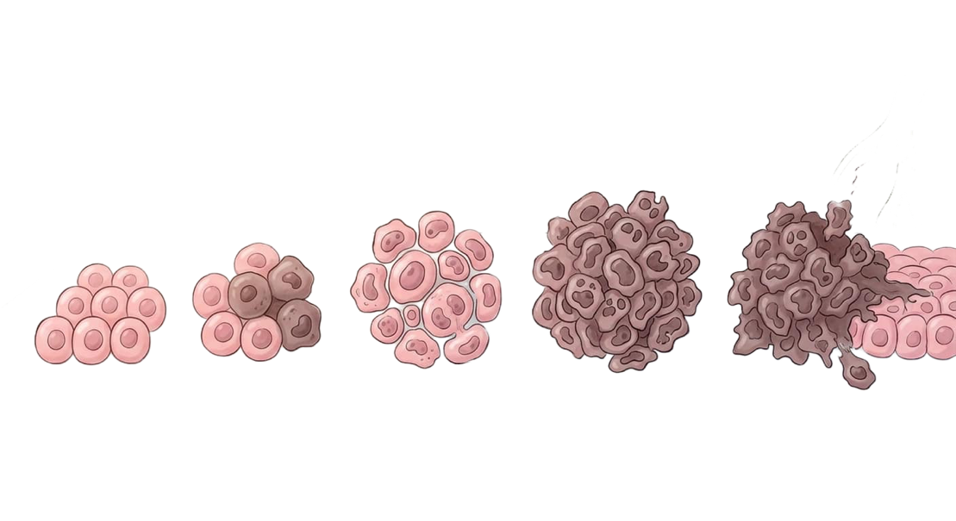
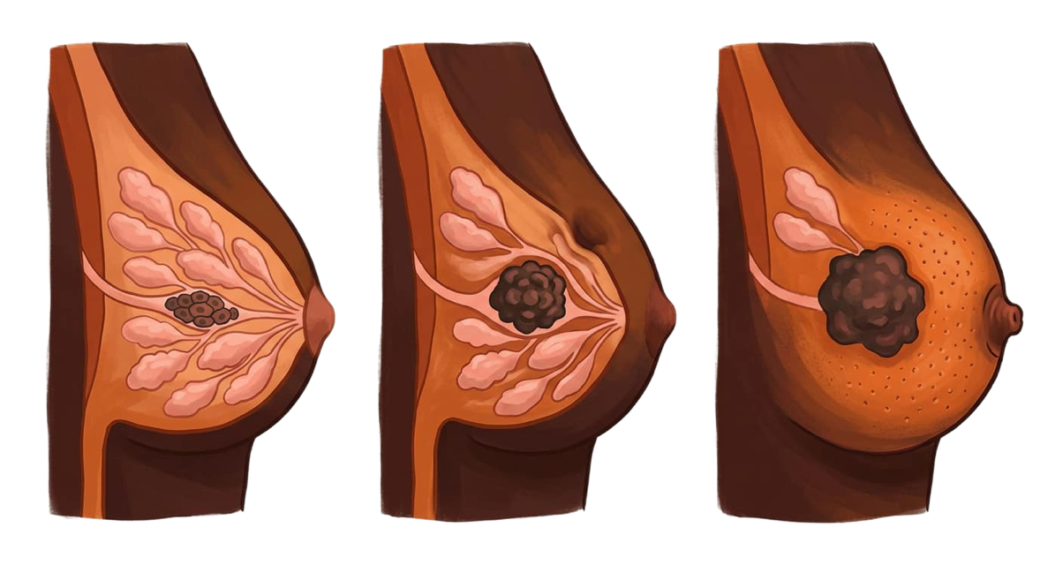
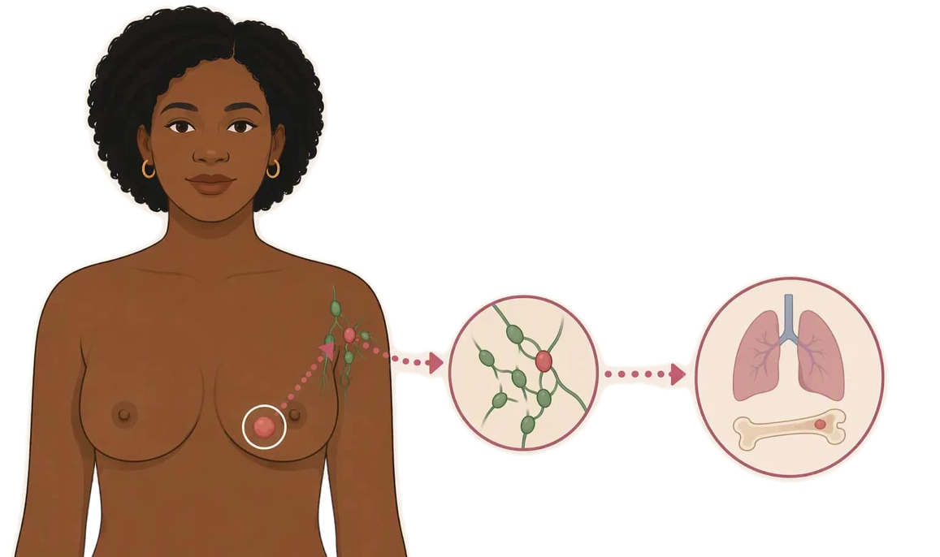
IGICE CYA 1 | ICYO ARI CYO
Kanseri y'ibere mu magambo yoroheje (1/2)
Ishobora gukura
Nyuma y'igihe, uturemangingo tw'umubiri dushobora gukora ikibyimba kandi dushobora guhindura uruhu cyangwa imoko.
Ishobora gutembera
Iyo itavuwe, ishobora kugera mu tubuto two mu kwaha no mu bindi bice by'umubiri.
Aho itangirira
Kanseri y’ibere itangirira mu ibere, aho uturemangingo tumwe na tumwe dutangira gukura mu buryo budasanzwe.
Kanseri y'ibere | CHW (Umujyanama w'ubuzima) | Rwanda Biomedical Centre (RBC)
Igishushanyo cya 28

Slide 29
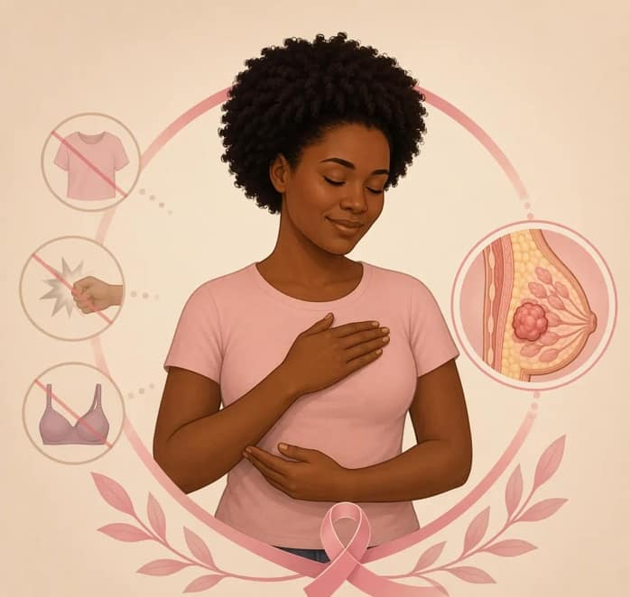
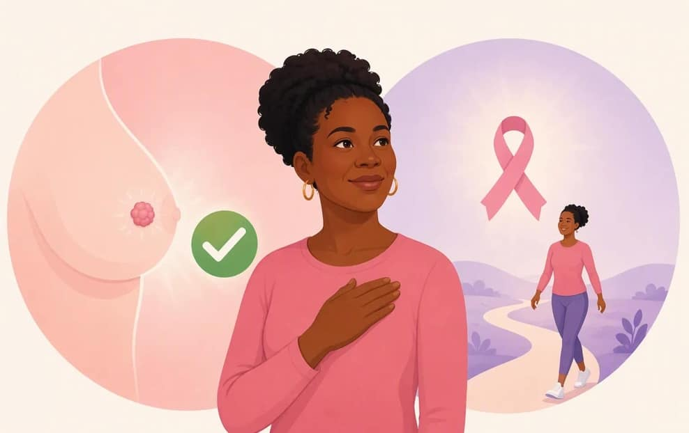
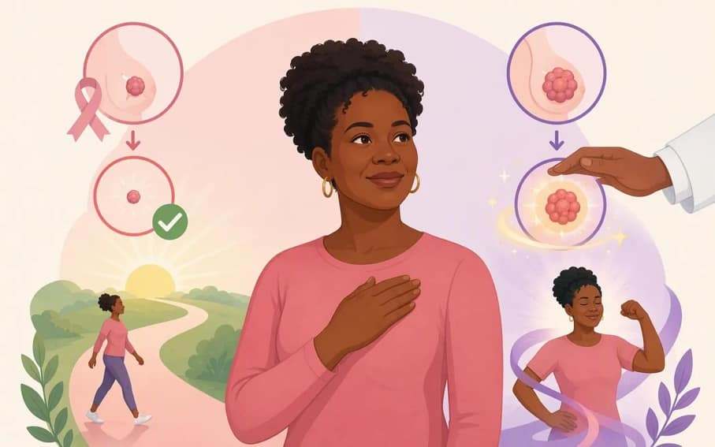
IGICE CYA 1 | ICYO ARI CYO
Kanseri y'ibere mu magambo yoroheje (2/2)
Ntabwo biterwa n'amakosa
Ntabwo iterwa no kwikanga, impinduka nto zo mu mubiri, imyambaro, ubupfumu cyangwa ikindi umuntu yakoze.
Ishobora kuvurwa
Kanseri y'ibere irashobora kuvurwa, kandi ibisubizo biba byiza iyo yagaragaye hakiri kare.
Buri wese ashobora kubibona
Akenshi impinduka ya mbere ibonwa n'umuntu ubwe cyangwa n'umwegereye.
Wibuke ko kanseri y'ibere yibasira ibere. Ni indwara itandukanye na kanseri y'inkondo y'umura n'izindi kanseri, kandi iboneka mu bundi buryo.
Kanseri y'ibere | CHW (Umujyanama w'ubuzima) | Rwanda Biomedical Centre (RBC)
Igishushanyo cya 28

Slide 30
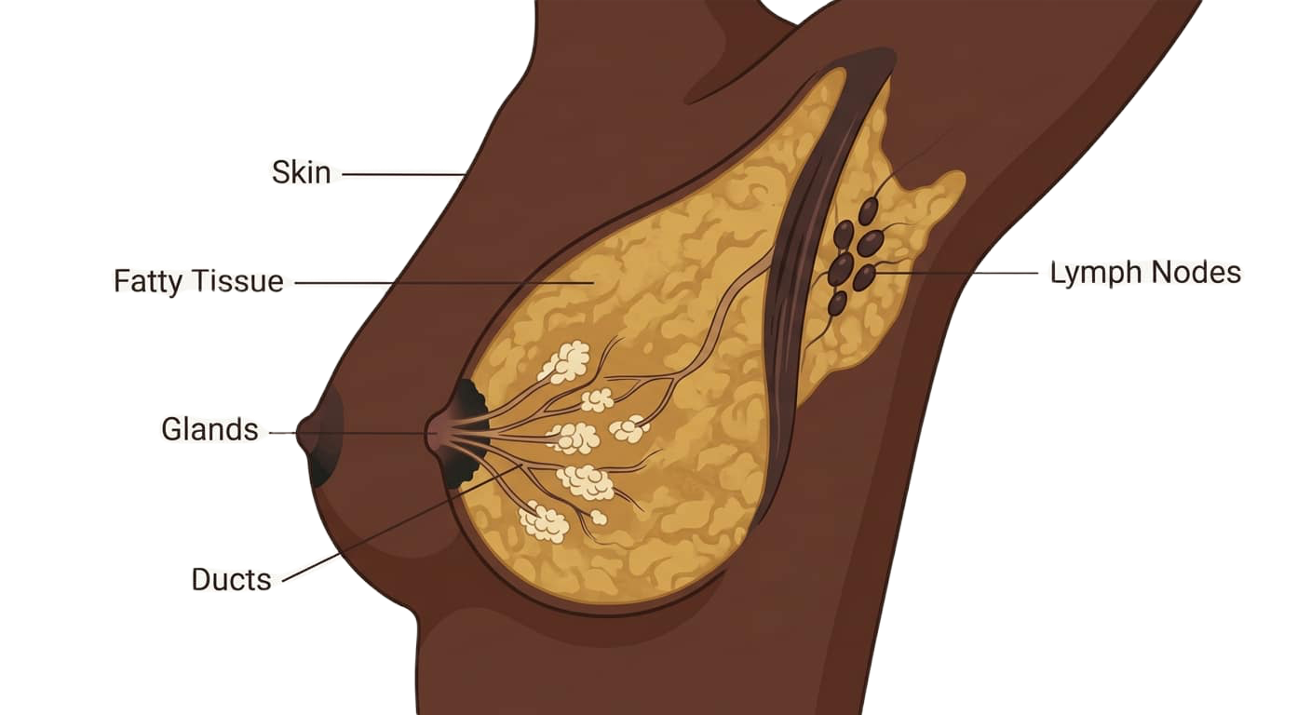


IGICE CYA 1 | IMITERERE Y'UMUBIRI (ANATOMIE)
Imbere mu Ibere
Si ngombwa ko umenya ibere mu buryo burambuye. Ukeneye gusobanukirwa aho ikibyimba gishobora guturuka, n’Impamvu mu kwaha ari ingenzi kuhasuzuma.
Utubuto tubyara amata n'imiyoboro (Glands na ducts)
Utubuto (glands) dukora amata n'imiyoboro (ducts) iyajyana mu mwenge. Kanseri y'ibere ikunze gutangirira hano.
Ibinure n'uruhu
Amabere asigaye ahanini ni amavuta, atwikiriwe n'uruhu. Ni yo mpamvu amabere yumva atandukanye bitewe n'umuntu.
Utubuto twa lymph two mu kwaha (Lymph nodes)
Zisohora amazi mu ibere, bityo ikibyimba mu kwaha ncyo kiba kigomba gusuzumwa
Kanseri y'ibere | CHW (Umujyanama w'ubuzima) | Rwanda Biomedical Centre (RBC)
Igishushanyo cya 29

Slide 31
IGICE CYA 1 | GIKORANA
Itangirira he?
Hitamo igisubizo watanga mu materaniro.
Umugore akubajije Igice cy’umubiri kanseri y’ibere yibasira. Ni iki wamubwira?
A Ibere, aho uturemangingo tumwe dutangira gukura mu buryo budasanzwe
B Amaraso
C Igituza cyose icyarimwe
D Igifu
Igisubizo cyiza: A
Igisubizo: Kanseri y'ibere itangirira mu ibere, akenshi iba mu miyoboro mito itwara amata. Kuvuga ibi bifasha abantu gusobanukirwa impamvu ibere n'ukwaha bisuzumwa hamwe, n'impamvu atari indwara imwe n'izindi kanseri.
Kanseri y'ibere | CHW (Umujyanama w'ubuzima) | Rwanda Biomedical Centre (RBC)
Igishushanyo cya 30

Slide 32
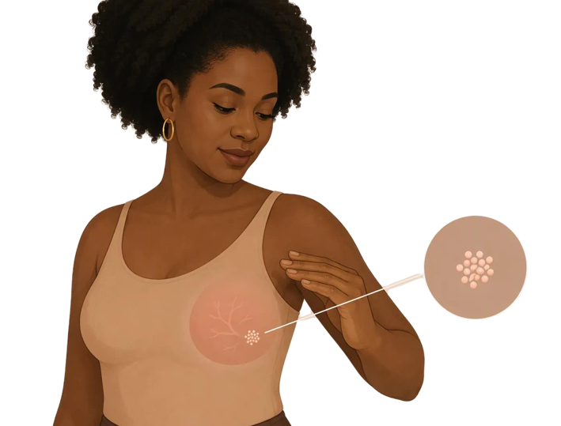
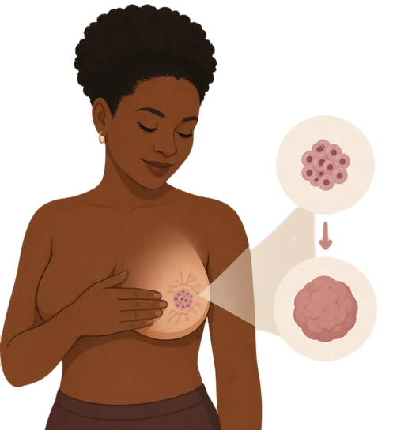
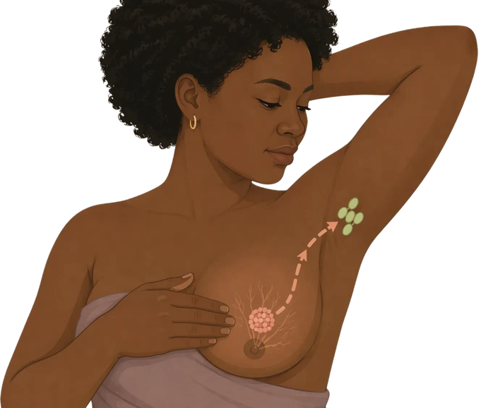
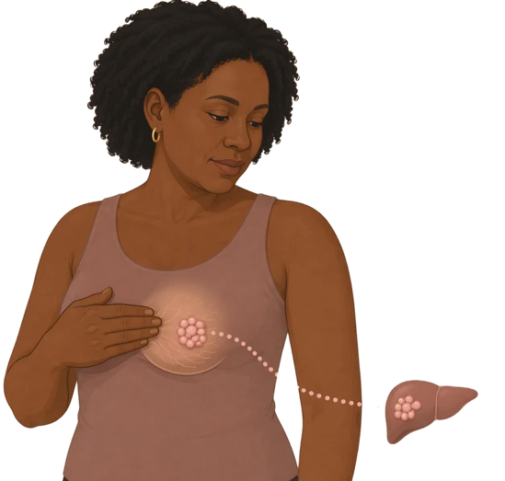
IGICE CYA 1 | UKO IGENDA IKURA
Byagenda bite mu gihe itavuwe
1
Iratangira
2
Irakura
3
Kigera mu kwaha
4
Birakwirakwira kurushaho
Uturemangingo tumwe na tumwe tw'ibere dutangira gukura mu buryo budasanzwe. Kugeza aha nta kintu na kimwe kiba cyumvikana.
Ikibyimba kirakura. Kandi uruhu n’imoko bishobora guhinduka.
Gishobora gukwirakwira mu tubuto turi mukwaha hakanabyimba.
Iyi ndwara ishobora kugera mu bindi bice by'umubiri, bigatuma kuyivura birushaho kugorana.
>
>
>
Impamvu gusuzumwa hakiri kare bifite agaciro: Buri ntambwe ifata igihe; impinduka zisuzumwe hakiri kare zishobora kuvurwa hakiri kare.
Kanseri y'ibere | CHW (Umujyanama w'ubuzima) | Rwanda Biomedical Centre (RBC)
Igishushanyo cya 31

Slide 33
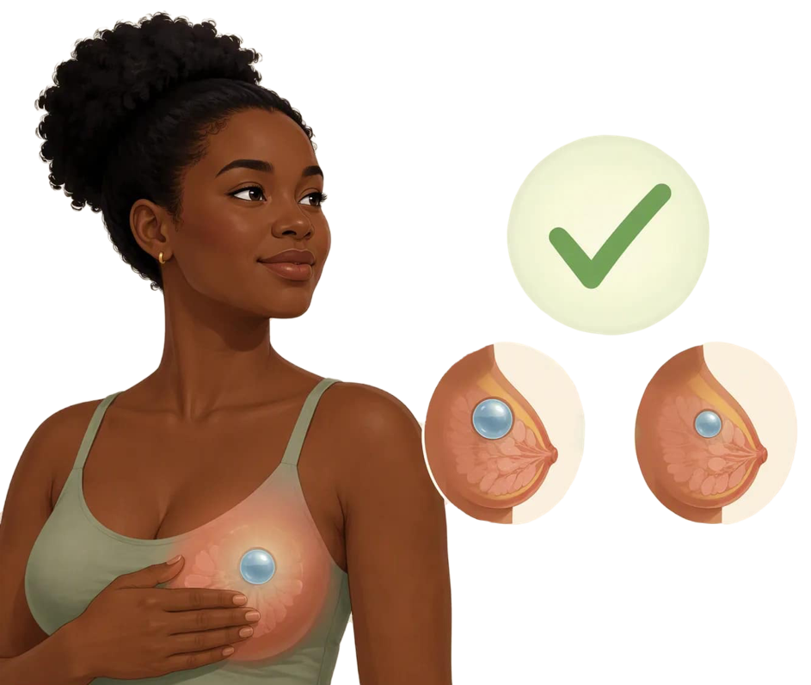
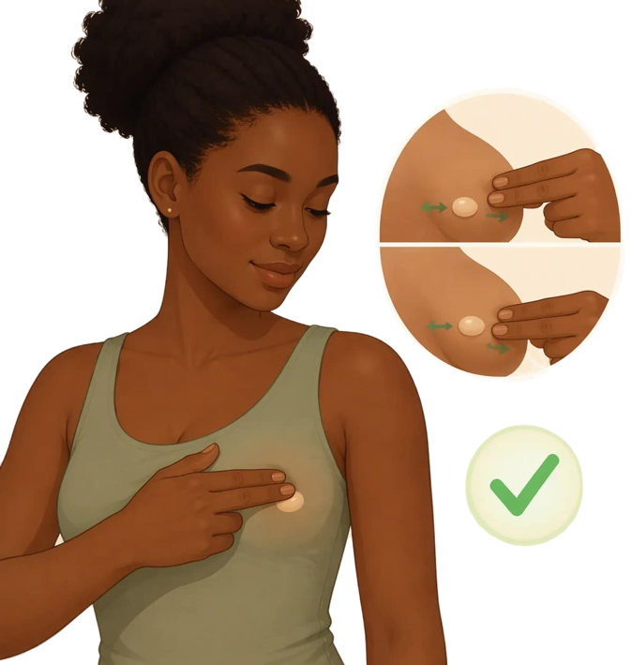
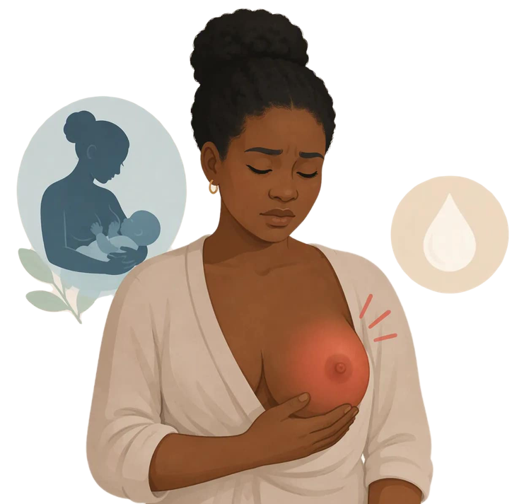
IGICE CYA 1 | SI BURI KIBYIMBA
Ikibyimba mu ibere ntigihora gisobanura ko ari kanseri
Ibibyimba byinshi biboneka mu ibere ntabwo ari kanseri. Dore ingero eshatu z'impinduka zishobora kutaba kanseri.
Ikibyimba cyoroshye, gihamye
Ni ikibyimba gisanzwe kigenda munsi y'intoki mu buryo bworoshye iyo ugikozeho. Ntabwo ari kanseri. Gikunze kugaragara cyane ku bagore bakiri bato.
Akabyimba gato karimo amazi
Akabyimba gato kuzuye amazi gashobora guhinduka bitewe n’ukwezi kw’umugore.
Indwara y’ibere
Ibere rigira ububabare, rigatukura, rigashyuha kandi rikabyimba, rimwe na rimwe mu gihe cyo konsa. Ivurwa hakoreshejwe imiti, kandi igomba gusuzumwa.
Vuga muri ubu buryo: Ibibyimba byinshi ntabwo ari kanseri. Nta muntu n'umwe ushobora kumenya icyo ari cyo mu gihe cyo kurikoraho, bityo buri kibyimba gishya kigomba gusuzumwa, kandi akenshi iryo suzuma rirahumuriza.
Kanseri y'ibere | CHW (Umujyanama w'ubuzima) | Rwanda Biomedical Centre (RBC)
Igishushanyo cya 32

Slide 34
IGICE CYA 1 | RIKORANWA
Niba ibibyimba byinshi atari kanseri, kuki wajya kwisuzumisha?
Umugore yabonye ikibyimba. Avuga ko kubera ko ibibyimba byinshi atari kanseri, adakeneye kugira aho ajya herekeranye no kwisuzumisha. Ni ikihe gisubizo cyiza kurusha ibindi?
A Wamubwira ko ari kanseri y'ibere ku buryo yihutira kugenda vuba
B Ni ukuri kandi ashobora gutegereza kugeza igihe azababara
C Agomba kugikanda buri munsi akareba ko kigenda.
D Ibibyimba byinshi ntabwo ari kanseri, niyo mpamvu igenzura rikwiriye gukorwa, kuko akenshi ritanga amakuru meza kandi ribona bike bifite akamaro
Igisubizo cyiza: D
Igisubizo: impande zombi zifite uburemere. Kumubwira gutegereza bituma kanseri ikura, kandi kumutera ubwoba akenshi bituma ahisha ikibazo. Ubutumwa bw'ukuri nabwo ni bwo butera inkunga, kuko abantu benshi bajyayo barahumurizwa.
Kanseri y'ibere | CHW (Umujyanama w'ubuzima) | Rwanda Biomedical Centre (RBC)
Igishushanyo cya 33

Slide 35
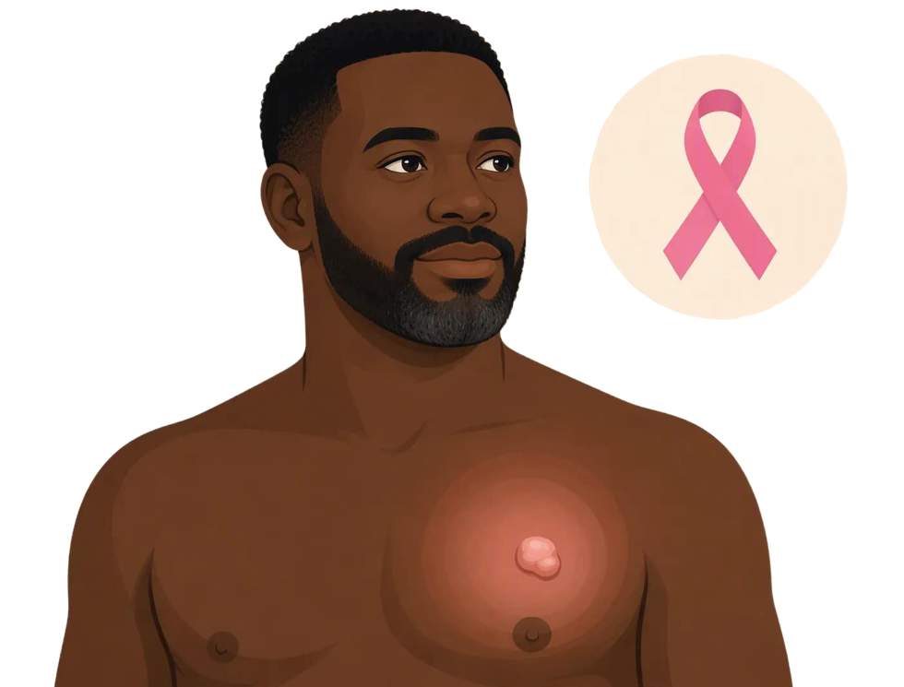
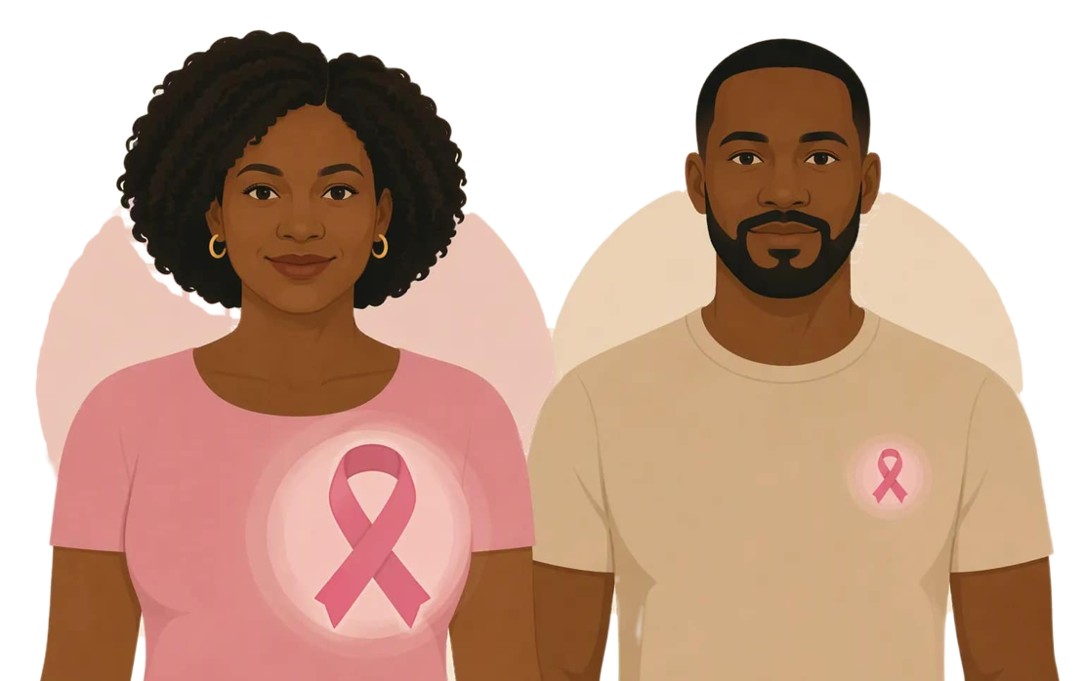
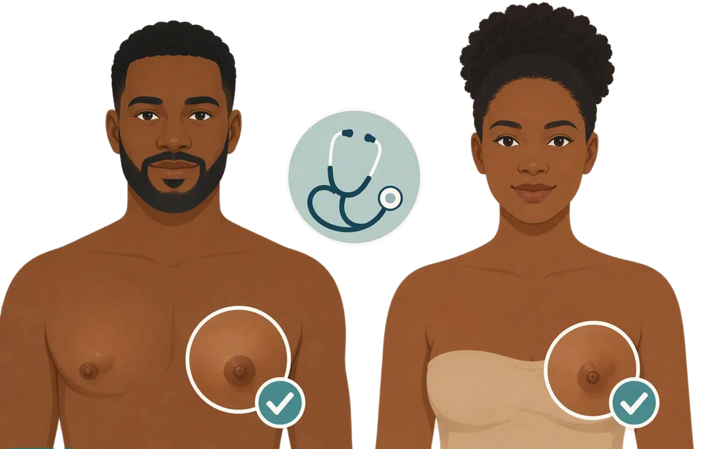
IGICE CYA 1 | ABAGABO
Kanseri y'ibere ishobora no gufata abagabo.
Abagabo bafite uturemangingo tw’ibere.
Abagabo baba bafite uturemangingo duke tw'amabere inyuma y’imoko bityo kanseri ishobora guhera aho.
Ni ibintu bidasanzwe cyane
Kanseri y'ibere yibasira cyane abagore. Ku bagabo ntikunze kugaragara, ariko irashoboka.
Ibikorwa ni kimwe
Ikibyimba gishya kiri inyuma y’imoko, cyangwa guhinduka kw’imoko bisuzumwa kimwe nko ku bagore.
Impamvu ibi ari ngombwa: Abagabo bakunze gutegereza igihe kirekire kubera ko batiteze iyi ndwara. Kuvuga ku mugaragaro ko bishobora kugira ingaruka ku bagabo bituma abagabo barushaho kubivuga mu buryo bworoshye.
Kanseri y'ibere | CHW (Umujyanama w'ubuzima) | Rwanda Biomedical Centre (RBC)
Igishushanyo cya 34

Slide 36
IGICE CYA 1 | RWANDA
Kanseri y'ibere mu Rwanda
Iri ni igereranya ry’imibare yo mu Rwanda
1,684
813
1
Abarwayi bashya ba kanseri y’ibere mu Rwanda
Umubare w’abahitanwa nayo ku mwaka mu Rwanda.
Niyo kanseri yiganje mu bagore mu Rwanda.
Abaturage: Rwanda, imyaka yose. Umwaka: imibare y'ikigereranyo ya 2024. Icyo bapima: abarwayi bashya n'abapfuye bagereranyijwe mu gihe cy'umwaka umwe. Aho byavuye: IARC Global Cancer Observatory, GLOBOCAN 2024. Iyi ni imibare y'ikigereranyo, si inyandiko zabaruwe.
Iki gitekerezo: Kanseri y'ibere ni kanseri ikunze kwibasira abagore mu Rwanda, kandi abagore benshi bahitanwa nayo Abenshi muri bo bamenyekanye nyuma y'uko iyi ndwara yamaze kwiyongera.
Kanseri y'ibere | CHW (Umujyanama w'ubuzima) | Rwanda Biomedical Centre (RBC)
Igishushanyo cya 35

Slide 37
IGICE CYA 1 | RWANDA
Kanseri zikunze kwibasira abagore
Ibyo byerekana
Kanseri y'ibere ni kanseri ikunze kwibasira abagore mu Rwanda, imbere gato ya kanseri y'inkondo y'umura. Izi kanseri zombi zikunze kwibasira abagore benshi.
Ibirebana n'iyi mibare
Abaturage: abagore mu Rwanda, imyaka yose. Umwaka 2024: mu 2024. Igipimo: umubare ugereranyijwe w'abarwaye bashya mu mwaka umwe. Inkomoko: IARC Global Cancer Observatory, GLOBOCAN 2024. Iyi ni imibare y'agereranyo yakozwe hakoreshejwe icyitegererezo, si umubare wuzuye w'abarwaye banditswe.
Inkomoko: IARC Global Cancer Observatory, GLOBOCAN 2024, imibare y'agereranyo y'u Rwanda, abagore, imyaka yose.
Kanseri y'ibere | CHW (Umujyanama w'ubuzima) | Rwanda Biomedical Centre (RBC)
Igishushanyo cya 36

Slide 38
IGICE CYA 1 | U RWANDA
Byabonetse bitinze
Ikibazo mu Rwanda si umubare w'abantu barwaye kanseri y'ibere gusa. Ikibazo ni uburyo ikunze kugaragara itinze.
73%
Munsi ya 50%
521,143
Kanseri z'ibere zifite ibyiciro byanditswe mu 2023 zari zaramaze kwiyongera
Intego y’igihugu mu kuvumbura indwara itarakwirakwira 2029
Ibizamini by'amabere byakorewe mu Rwanda hagati ya 2019 na 2024
Inkomoko: Repubulika y'u Rwanda, Minisiteri y'ubuzima. Gahunda y'igihugu yo kurwanya Kanseri ya 2025-2029.
Icyo ibi bisobanuye kuri wowe: Abantu benshi bahagera indwara yaramaze gukura. Mu muryango cyangwa mu baturage niho uku gutinda gutangirira, n'aho bishobora guhindurirwa.
Kanseri y'ibere | CHW (Umujyanama w'ubuzima) | Rwanda Biomedical Centre (RBC)
Igishushanyo cya 37

Slide 39
IGICE CYA 1 | RWANDA
Icyo iyi mibare isobanuye ku wowe
Ni ibintu bisanzwe. Kanseri y'ibere yibasira abagore benshi mu Rwanda buri mwaka, haba mu bice by’icyaro no mu mijyi.
Ni ibintu bikomeye. Abagore benshi bapfa bazize iyi ndwara, akenshi bitewe n'uko yabonetse imaze gukura.
Akenshi umuntu ni we ubimenya. Kanseri nyinshi z'ibere ziboneka bitewe n'uko umuntu yabonye impinduka, atari uko yakorewe ibizamini.
Gutera intambwe hakiri kare bihindura ibisubizo. Umuntu wese usuzumwa mu minsi mike aho kuba amezi aba afite amahirwe menshi yo kuvurwa neza.
Uruhare rwawe: ntiwemeza ko umuntu arwaye cyangwa atarwaye. Ahubwo urabona, urasobanura, ugashishikariza, ubundi ukagenzura ko gahunda yubahirizwa
Kanseri y'ibere | CHW (Umujyanama w'ubuzima) | Rwanda Biomedical Centre (RBC)
Igishushanyo cya 38

Slide 40
IGICE CYA 1 | ISUZUMA RY'UBUMENYI
Isuzuma ry'ubumenyi: ikibazo cya 1 kuri 4
Kanseri y'ibere itangirira mu kihe gice cy'umubiri?
A Amagufwa
B Mu ibere, akenshi mu miyoboro mito itwara amata
C Umugongo wo hasi
D Igifu
Igisubizo cyiza: B
Igisubizo: Kanseri y'ibere itangirira mu ibere ubwaryo. Kumenya ibi bigufasha gusobanura impamvu ibere n'ukwaha bisuzumwa, n'impamvu ikibyimba mukwaha ari igice kimwe cy'igenzura.
Kanseri y'ibere | CHW (Umujyanama w'ubuzima) | Rwanda Biomedical Centre (RBC)
Igishushanyo cya 39

Slide 41
IGICE CYA 1 | ISUZUMA RY'UBUMENYI
Isuzuma ry'ubumenyi: ikibazo cya 2 kuri 4
Umugore yabonye ikibyimba mu ibere. Ni iki cy'ukuri?
A Nta kibazo kuko ikibyimba kitababaza
B Ibibyimba byinshi ntabwo ari kanseri, kandi buri kibyimba gishya gikeneye gusuzumwa
C Agomba gutegereza amezi atatu kugira ngo arebe niba gikura
D Nta gushidikanya ko ari kanseri
Igisubizo cyiza: B
Igisubizo: Ibibyimba byinshi by'amabere ntabwo ari kanseri, bityo ntibikwiye ko ugira ubwoba. Nta muntu n'umwe ushobora kumenya ko ari kanseri akoresheje gukoraho, bityo igenzura ni ryo rikemura, kandi gutegereza bitwara igihe gusa ntacyo bikemura.
Kanseri y'ibere | CHW (Umujyanama w'ubuzima) | Rwanda Biomedical Centre (RBC)
Igishushanyo cya 40

Slide 42
IGICE CYA 1 | ISUZUMA RY'UBUMENYI
Isuzuma ry'ubumenyi: ikibazo cya 3 kuri 4
Umugabo akubwira ko afite ikibyimba gito inyuma y'amabere ye. Ni iki umubwira?
A Agomba gutegereza kugeza igihe azumva ari kubabara
B Umugabo ntashobora kurwara kanseri y'ibere, niyo mpamvu akwiye kukirengagiza
C Agomba kubyihererana
D Kanseri y'ibere ntikunze kugaragara ku bagabo ariko irashoboka; ni yo mpamvu akabyimba kagomba gusuzumirwa ku ivuriro
Igisubizo cyiza: D
Igisubizo: Abagabo bagira ibice bike by'amabere kandi bashobora kurwara kanseri y'ibere. Kubera ko bibaho gake, abagabo bakunze gutegereza igihe kirekire, kandi gutinda ni byo bituma ingaruka zirushaho kuba mbi.
Kanseri y'ibere | CHW (Umujyanama w'ubuzima) | Rwanda Biomedical Centre (RBC)
Igishushanyo cya 41

Slide 43
IGICE CYA 1 | ISUZUMA RY'UBUMENYI
Isuzuma ry'ubumenyi: ikibazo cya 4 kuri 4
Kanseri y'ibere ihangayikishije ku ruhe rwego mu bagore bo mu Rwanda?
A Yibasira abagore n’abagabo ku kigero kingana
B Ntikunze kubaho
C Niyo kanseri ikunze kwibasira abagore mu Rwanda
D Yibasira gusa abagore barengeje imyaka 70 y’ubukure
Igisubizo cyiza: C
Igisubizo: Mu mibare ya 2024, kanseri y'ibere ni yo kanseri ikunze kugaragara cyane ku bagore mu Rwanda, imbere gato ya kanseri y'inkondo y'umura. Umubare munini w'abarwayi baracyaboneka batinze, ari nacyo abajyanama b’ubuzima bashobora guhindura
Kanseri y'ibere | CHW (Umujyanama w'ubuzima) | Rwanda Biomedical Centre (RBC)
Igishushanyo cya 42

Slide 44
IGICE CYA 1
Ibintu by'ingenzi
Kanseri y'ibere itangirira mu ibere, aho uturemangingo tumwe na tumwe dutangira gukura mu buryo budasanzwe.
Ishobora gukura, mu tubuto two mu kwaha, ndetse no mu bindi bice by'umubiri.
Ibibyimba byinshi by'amabere ntabwo ari kanseri, kandi buri kibyimba gishya kigomba gusuzumwa.
Kanseri y'ibere ishobora no kwibasira abagabo, ariko ntikunze kugaragara cyane.
Iyi kanseri ni yo ikunze kugaragara cyane ku bagore mu Rwanda, kandi abarwayi benshi bayimenya itinze.
Kanseri y'ibere | CHW (Umujyanama w'ubuzima) | Rwanda Biomedical Centre (RBC)
Igishushanyo cya 43

Slide 45
IGICE CYA 1 | KWIYUMVIRA
Kwisuzuma ku isomo ryatanzwe
Amabwiriza ku wiga: Andika igisubizo cyawe mu kazu k'inyandiko. Ibi bisubizo ntibihabwa amanota.
1
Ni gute wasobanurira umuntu utarigeze amenya kanseri y'ibere?
2
Ni iki abantu bo mu gace kawe bemera ku byerekeye ibibyimba byo mu ibere?
3
Ni iki wabwira umugabo ufite ipfunwe ryo kuvuga ku mpinduka mu gituza cye?
Kanseri y'ibere | CHW (Umujyanama w'ubuzima) | Rwanda Biomedical Centre (RBC)
Igishushanyo cya 44

Slide 46
2
I G I C E C Y A 2
Ibyo kwitega muri iri somo.
Ni iki cyongera ibyago, impinduka z'amabere zikeneye gusuzumwa, n'impinduka zikeneye kwitabwaho byihuse.
Igishushanyo cya 45

Slide 47
IGICE CYA 2
Intego zo kwiga
Nyuma y’iri somo, uzaba ushobora:
1
Gusobanura amakuru ajyanye na kanseri y’ibere mu magambo umuturanyi yakumva, no kwigisha abagore kwisuzuma amabere.
2
Gusobanura ibyongera ibyago byo kurwara kanseri y’ibere ntawe ushinje
3
Kumenya impinduka z’ibere zikeneye gusuzumwa ku kigo nderabuzima.
4
Gusobanura impamvu ikibyimba kitababaza gikeneye gusuzumwa.
5
Kumenya impinduka zikeneye kwitabwaho byihuse.
Kanseri y'ibere | CHW (Umujyanama w'ubuzima) | Rwanda Biomedical Centre (RBC)
Igishushanyo cya 46

Slide 48
IGICE CYA 2 | IKIBAZO CY'UMURYANGO
Ikibazo cy'umuryango: Uwimana Vestine
Kanseri y'ibere | CHW (Umujyanama w'ubuzima) | Rwanda Biomedical Centre (RBC)
Igishushanyo cya 47

Slide 49
IGICE CYA 2 | INKURU YO MU MURYANGO
Ni iki wabwira Vestine?
Vestine yemera ko ikibyimba kitababaza kidashobora kuba gikomeye. Igisubizo cyiza ni ikihe?
A Mubwire kukigenzura mu mezi atatu akurikiyeho.
B Mubwire ko ishobora kuba ari kanseri kugirango ahite ajya ku ivuriro.
C Musobanurire ko kanseri z'ibere nyinshi zitababaza mu ntangiriro, ko ibibyimba byinshi atari kanseri, kandi ko uburyo bwonyine bwiza ari ukwisuzumisha, hanyuma umufashe gutegura urugendo rwo kwisuzumisha
D Emeranya nawe, kuko ububabare nibwo bwerekana ko hari ikitagenda
Igisubizo cyiza: C
Igisubizo: Ububabare ntabwo ari ikimenyetso cyizewe. Kanseri nyinshi z'ibere ntizitera ububabare na gato mu ntangiriro, niyo mpamvu akenshi ikibyimba kitagira ububabare kirengagizwa. Kwemeranya na we bimutwara amezi menshi, kandi kumutera ubwoba akenshi bituma umuntu ahisha ikibazo.
Kanseri y'ibere | CHW (Umujyanama w'ubuzima) | Rwanda Biomedical Centre (RBC)
Igishushanyo cya 48

Slide 50
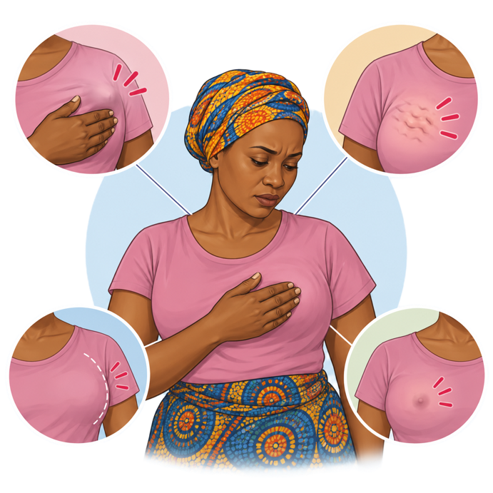
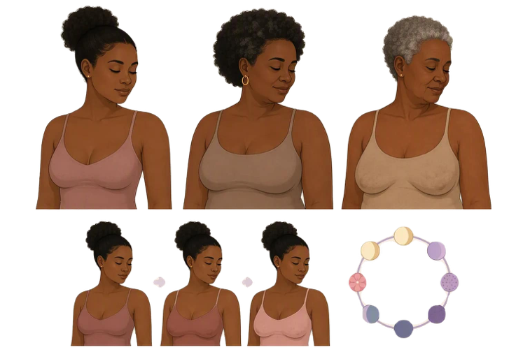
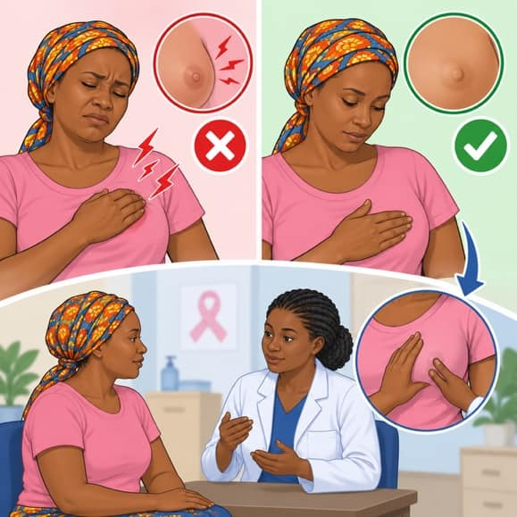
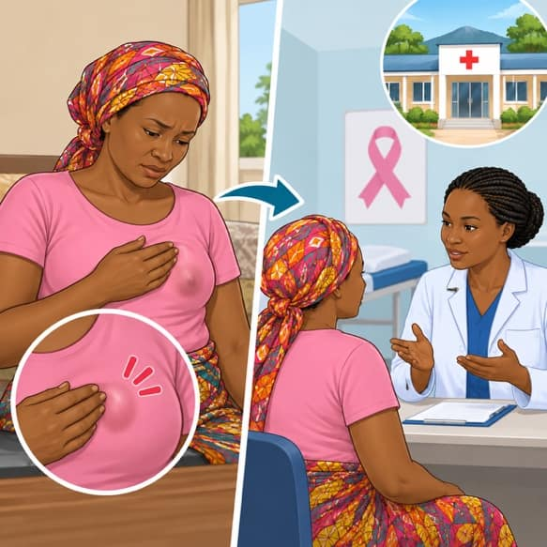
IGICE CYA 2 | KUMENYA AMABERE
Kumenya amabere mu nteruro enye
Menya ibisanzwe kuri wowe
Amabere ahinduka bitewe n'umuntu ku wundi, kandi ahinduka uko imyaka igenda ishira n'uko ukwezi kugenda.
Menya impinduka
Ikibyimba gishya, cyangwa guhinduka kw’uruhu, imoko cyangwa ishusho.
.
Ntugategereze ububabare
Impinduka zitababaza nazo zikeneye gusuzumwa.
Genda usuzumwe.
Ubonye impinduka nshya cyangwa idasanzwe ku ibere, jya ku ivuriro cyangwa ku kigo nderabuzima aho kuyirebera mu rugo.
Vuga muri ubu buryo: Menya amabere yawe. Isuzume amabere rimwe mu kwezi, byiza nyuma y'imihango. Ubonye impinduka, genda wisuzumishe ku ivuriro cyangwa ku kigo nderabuzima mu masaha 48.
Kanseri y'ibere | CHW (Umujyanama w'ubuzima) | Rwanda Biomedical Centre (RBC)
Igishushanyo cya 49

Slide 51
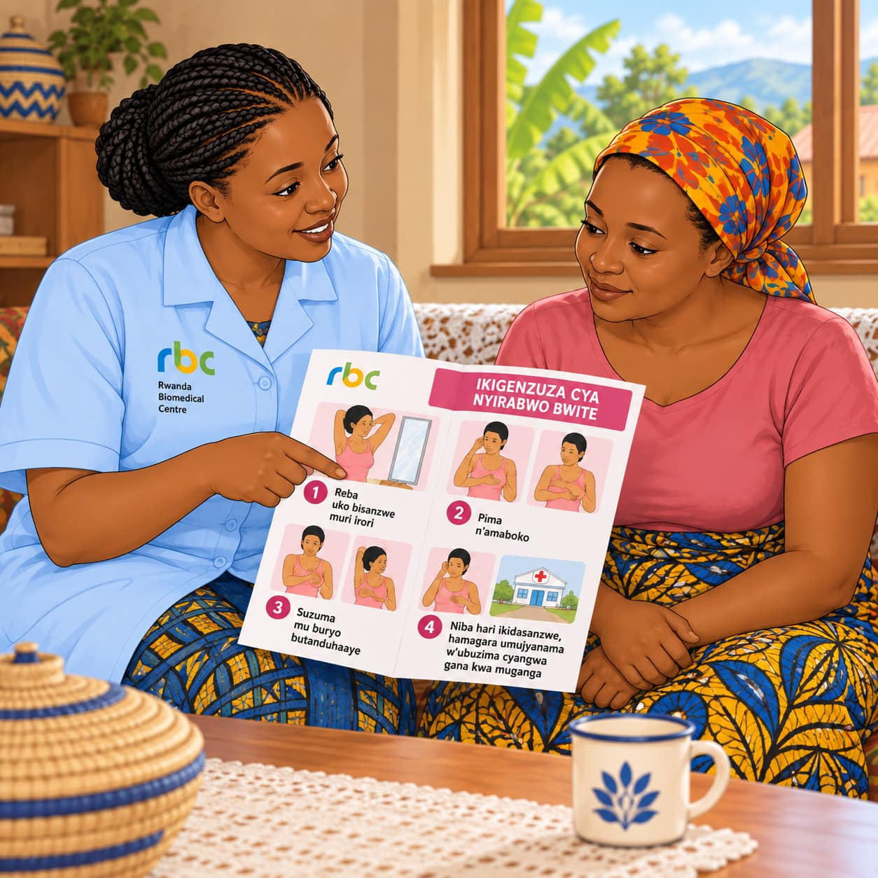
IGICE CYA 2 | KUMENYA AMABERE
Uruhare rwawe: kwigisha, kuyobora, kohereza
Umujyanama w'ubuzima ntasuzuma amabere y'abantu. Dore icyo ukora:
1. Kwigisha
Wigisha abagore ku buzima bw'amabere n'uburyo bwo kwisuzuma amabere buri kwezi.
2. Kuyobora
Ubabwira aho basuzumirwa amabere: ku ivuriro (poste de santé) cyangwa ku kigo nderabuzima.
3. Kohereza
Umugore ufite impinduka mu ibere umwohereza ku ivuriro cyangwa ku kigo nderabuzima kiri hafi mu masaha 48.
4. Gukurikirana
Umufasha kugerayo, hanyuma ukamubaza uko byagenze.
💡 Wibuke: isuzuma ry'amabere rikorwa n'umuforomo wabihuguriwe, ku ivuriro cyangwa ku kigo nderabuzima. Si wowe urikora.
Kanseri y'ibere | CHW (Umujyanama w'ubuzima) | Rwanda Biomedical Centre (RBC)
Igishushanyo cya 49A

Slide 52
IGICE CYA 2 | KUMENYA AMABERE
Ni ryari umugore yisuzuma cyangwa asuzumwa amabere?
Kwisuzuma amabere
Isuzuma ku ivuriro
Hari impinduka
Buri kwezi
Buri mwaka
Mu masaha 48
Ku myaka yose. Byiza nyuma y'imihango. Umugore abikora ubwe, iwe mu rugo.
Abagore bafite imyaka 30 n’abayirengeje. Rikorwa n'umuforomo ku ivuriro cyangwa ku kigo nderabuzima.
Ku myaka yose. Jya ku ivuriro cyangwa ku kigo nderabuzima. Ntutegereze isuzuma rya buri mwaka.
📌 Kwisuzuma amabere ntibisimbura isuzuma rikorwa n'umuforomo. Byombi birakenewe.
Kanseri y'ibere | CHW (Umujyanama w'ubuzima) | Rwanda Biomedical Centre (RBC)
Igishushanyo cya 49B

Slide 53
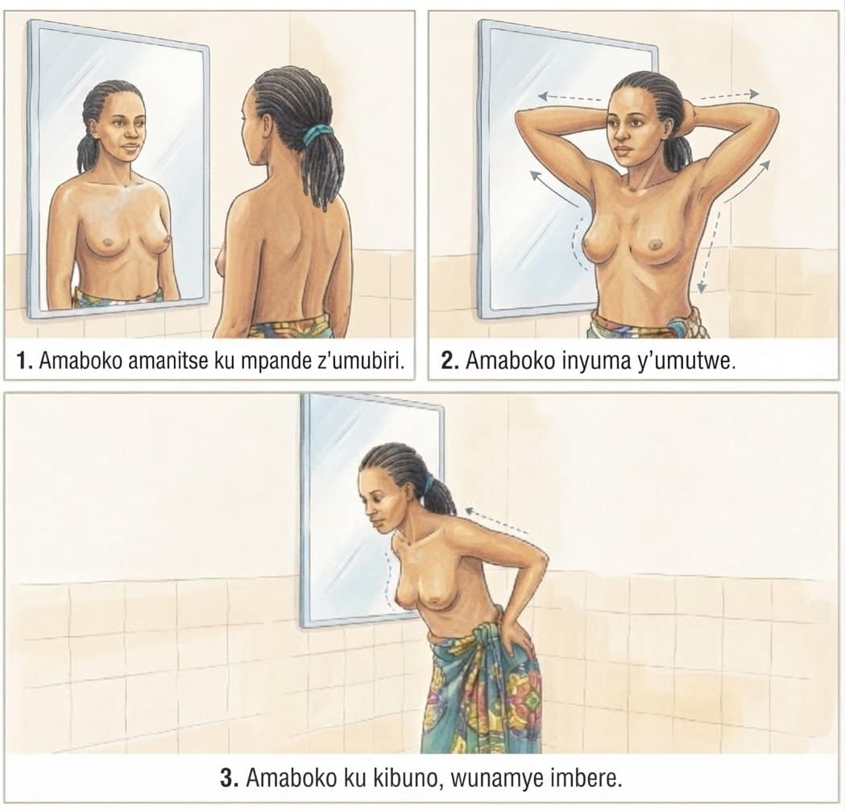
IGICE CYA 2 | KUMENYA AMABERE
Kwisuzuma amabere (1/2): kureba
Rimwe mu kwezi, nyuma y’imihango. Hagarara imbere y’indorerwamo, wambuye imyenda yo hejuru.
Amaboko amanutse: Itegereze amabere yombi: ubunini, imiterere, uruhu n'imoko. Reba niba hari icyahindutse.
1
Ibiganza inyuma y’umutwe: Shyira ibiganza byombi inyuma y'umutwe, ubisunike imbere. Itegereze nanone amabere yombi.
2
Ibiganza ku mayunguyungu: Shyira ibiganza ku mayunguyungu, ukandeho gato, wihese gato, inkokora zerekeza imbere. Itegereze nanone.
3
🔎 Reba: Uruhu rukururira imbere, uruhu rusa n'igishishwa cy'icunga, imoko yinjira imbere, cyangwa ibisohoka mu moko.
Kanseri y'ibere | CHW (Umujyanama w'ubuzima) | Rwanda Biomedical Centre (RBC)
Igishushanyo cya 49C

Slide 54
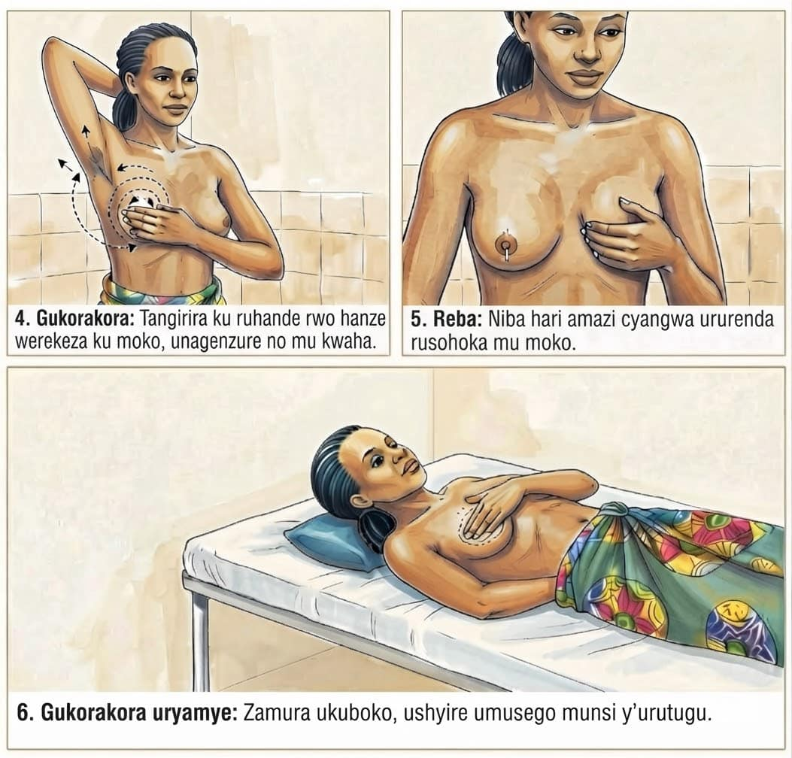
IGICE CYA 2 | KUMENYA AMABERE
Kwisuzuma amabere (2/2): gukorakora
Korakora ibere: Zamura ukuboko kw'ibumoso. Ukoresheje intoki 3 cyangwa 4 z'ikiganza cy'iburyo, korakora ibere ry'ibumoso gahoro, uzenguruka, kuva ku mpera ugana ku moko. Suzuma no mu kwaha. Hanyuma ukore kimwe ku ibere ry'iburyo.
4
Imoko: Kanda gahoro ku moko, urebe niba hari ibisohokamo.
5
Ryama ku mugongo: Shyira umusego muto munsi y’urutugu. Subiramo intambwe ya 4 n'iya 5 ku mabere yombi.
6
✅ Hari impinduka? Jya ku ivuriro cyangwa ku kigo nderabuzima kiri hafi mu masaha 48. Ntutegereze ububabare.
Kanseri y'ibere | CHW (Umujyanama w'ubuzima) | Rwanda Biomedical Centre (RBC)
Igishushanyo cya 49D

Slide 55
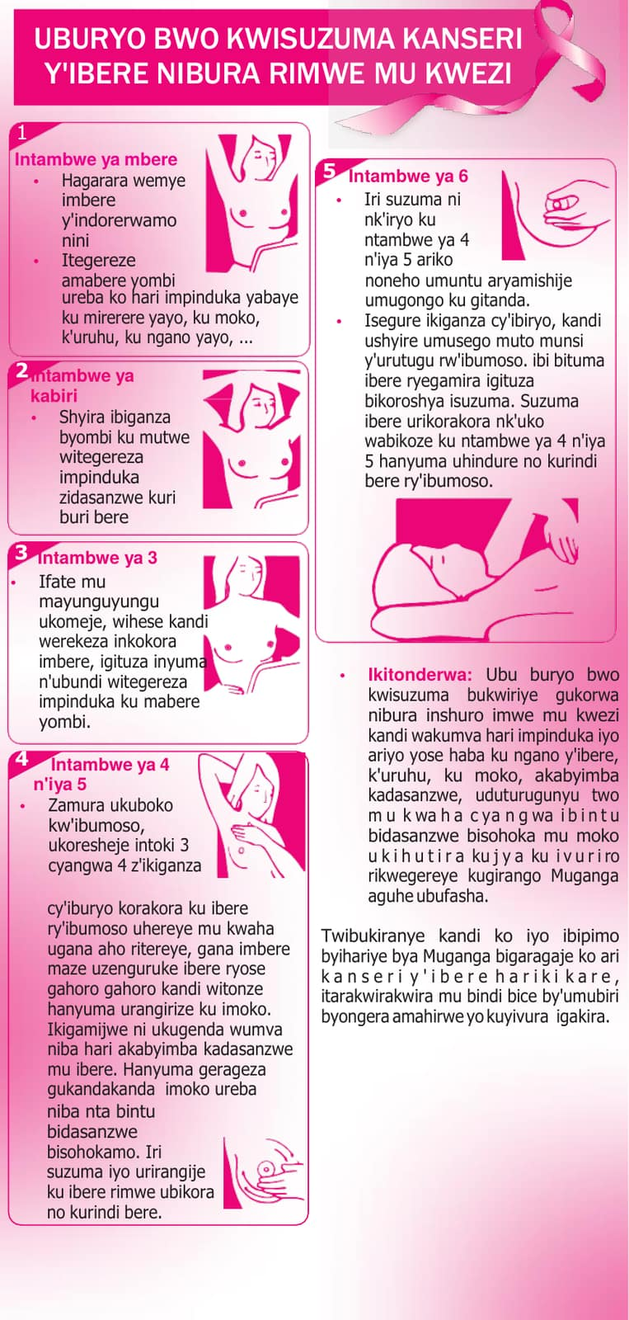
IGICE CYA 2 | KUMENYA AMABERE
Urupapuro rwa RBC: kwisuzuma amabere
Koresha uru rupapuro
Igihe wigisha abagore mu rugo cyangwa mu nama z'umudugudu.
Rugaragaza intambwe 6 zo kwisuzuma amabere, rimwe mu kwezi.
Icyo rwibutsa
Umugore ubonye impinduka agomba kujya ku ivuriro rimwegereye vuba.
Kanseri y'ibere ivurwa neza iyo imenyekanye hakiri kare.
Kanseri y'ibere | CHW (Umujyanama w'ubuzima) | Rwanda Biomedical Centre (RBC)
Igishushanyo cya 49E

Slide 56
IGICE CYA 2 | KUMENYA AMABERE
Uko wigisha umugore kwisuzuma amabere
Tegura
Hitamo ahantu hiherereye. Saba uruhushya, kandi umuhe umwanya wo kubaza.
Sobanura
Kumenya uko amabere ye asanzwe ameze bimufasha kubona impinduka hakiri kare.
Erekana
Koresha urupapuro rwa RBC cyangwa amashusho. Ntusuzume ibere rye wowe ubwawe.
Igihe
Rimwe mu kwezi, nyuma y'imihango. Utakibona imihango ahitamo itariki imwe buri kwezi.
Mwemeranye
Icyo gukora: abonye impinduka, ajya ku ivuriro cyangwa ku kigo nderabuzima mu masaha 48.
Humuriza
Impinduka nyinshi si kanseri. Kwisuzumisha ni ibisanzwe kandi ni ibanga.
Kanseri y'ibere | CHW (Umujyanama w'ubuzima) | Rwanda Biomedical Centre (RBC)
Igishushanyo cya 49F

Slide 57
IGICE CYA 2 | IKIBAZO
Ni iki wakora?
🩺 Mukamana Josiane, w'imyaka 35: Mu gihe umusura, akubwira ko yumvise ikibyimba mu ibere ry'iburyo. Agusaba ko wamusuzuma.
A Kumusobanurira ko isuzuma rikorwa n'umuforomo, no kumwohereza ku ivuriro cyangwa ku kigo nderabuzima mu masaha 48 ✓
B Kumubwira ko ibibyimba byose ari ibisanzwe
C Kumubwira ategereze isuzuma rya buri mwaka
D Kumusuzuma ibere wowe ubwawe
Igisubizo cyiza: A
Igisubizo: Umujyanama w'ubuzima ntasuzuma amabere. Ikibyimba gishya kigomba gusuzumwa n'umuforomo mu masaha 48. Mufashe gutegura urugendo, kandi uzamubaze uko byagenze.
Kanseri y'ibere | CHW (Umujyanama w'ubuzima) | Rwanda Biomedical Centre (RBC)
Igishushanyo cya 49G

Slide 58
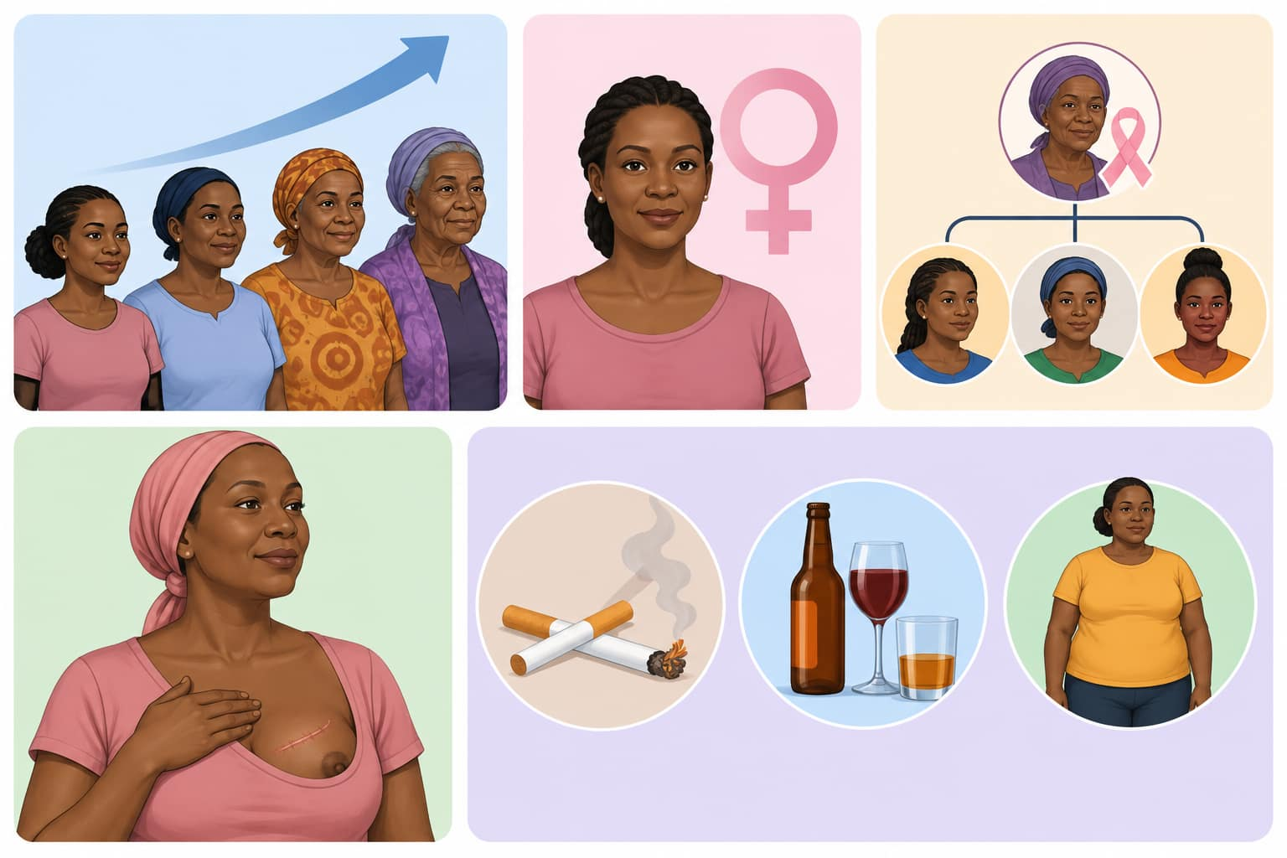
IGICE CYA 2 | IBYAGO
Ni iki cyongera ibyago?
Hari ibintu bimwe na bimwe byongera ibyago. Nta na kimwe muri byo gisobanura ko kuba umuntu agifite azagira kanseri.
Gusaza. Kanseri y'ibere igenda yiyongera uko imyaka igenda yiyongera, nubwo abagore bakiri bato na bo bayirwara.
Kuba umugore. Kanseri y'ibere yibasira cyane abagore. Ishobora kugaragara ku bagabo, ariko ibi ntibikunze kugaragara cyane.
Kanseri y'ibere ku muvandimwe wa hafi. Umubyeyi, umuvandimwe cyangwa umukobwa warwaye kanseri y'ibere byongera ibyago byo kuyirwara.
Waba warigeze kurwara kanseri y'ibere. Umuntu wavuwe mu bihe byashize agomba gukomeza kubahiriza gahunda zo kwa muganga.
Abandi. Harimo kunywa itabi n'inzoga n'umubyibuho ukabije.
Interuro y’ingenzi: Abantu benshi barwara kanseri y'ibere nta kindi kintu cyihariye kibongerera ibyago baba bafite, uretse kuba abagore no gusaza. Umuntu udafite ibyago byo kurwara kanseri y'ibere ashobora kuyirwara. Ntukishinje, nta muntu n'umwe uzana iyi ndwara ku giti cye, kandi kubivuga mu ijwi riranguruye birafasha.
Kanseri y'ibere | CHW (Umujyanama w'ubuzima) | Rwanda Biomedical Centre (RBC)
Igishushanyo cya 50

Slide 59
IGICE CYA 2 | GISHINGIYE KU BUFATANYE
Nta muntu n'umwe wo muri uwo muryango wayirwaye
Umugore ufite ikibyimba gishya avuga ko nta muntu n'umwe wo mu muryango we wigeze arwara kanseri y'ibere, bityo ko adashobora kuyirwara. Ni iki cy'ukuri?
A Abantu benshi barwara kanseri y’ibere nta muntu bahuje isano wa hafi uba waragize ubwo burwayi, bityo ikibyimba gikeneye gusuzumwa.
B Agomba kubaza abo mu muryango akabona gufata umwanzuro
C Umugore umwe wenyine afite amateka ya kanseri mu muryango niwe ugira kanseri
D Afite ukuri ntakeneye kwisuzumisha
Igisubizo cyiza: A
Igisubizo: Iyi myizerere ni imwe mu mpamvu zikunze gutuma umuntu atinda kwisuzumisha. Amateka y'umuryango ni ingenzi ku bantu bamwe, ariko inyinshi muri kanseri z'ibere ziba ku bantu badafite amateka y'umuryango.
Kanseri y'ibere | CHW (Umujyanama w'ubuzima) | Rwanda Biomedical Centre (RBC)
Igishushanyo cya 51

Slide 60
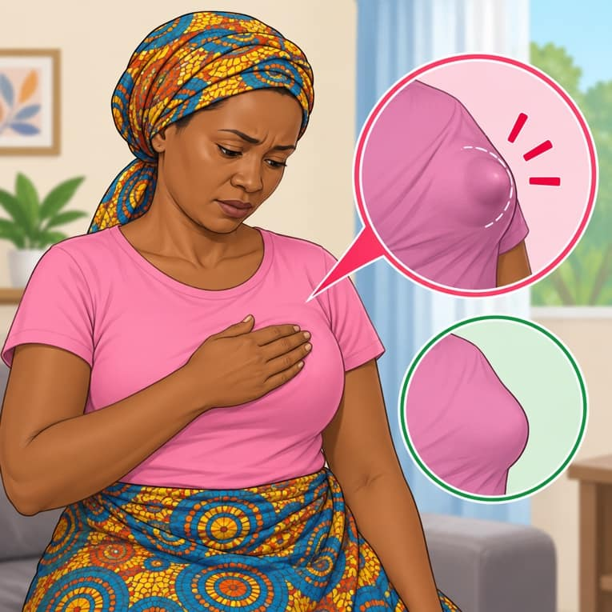
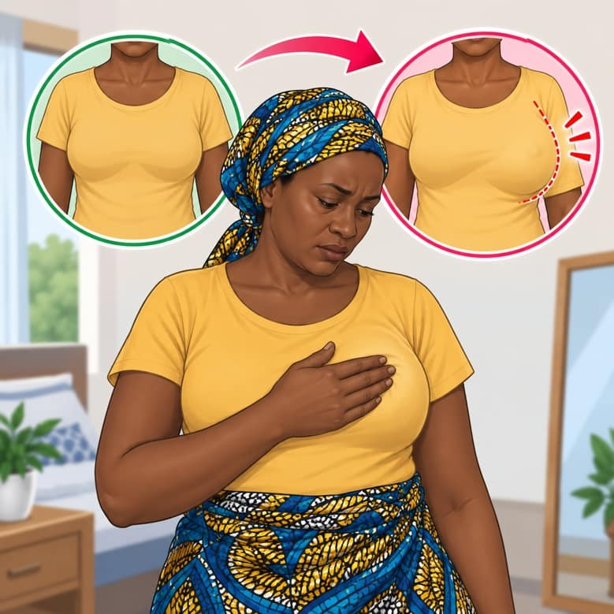
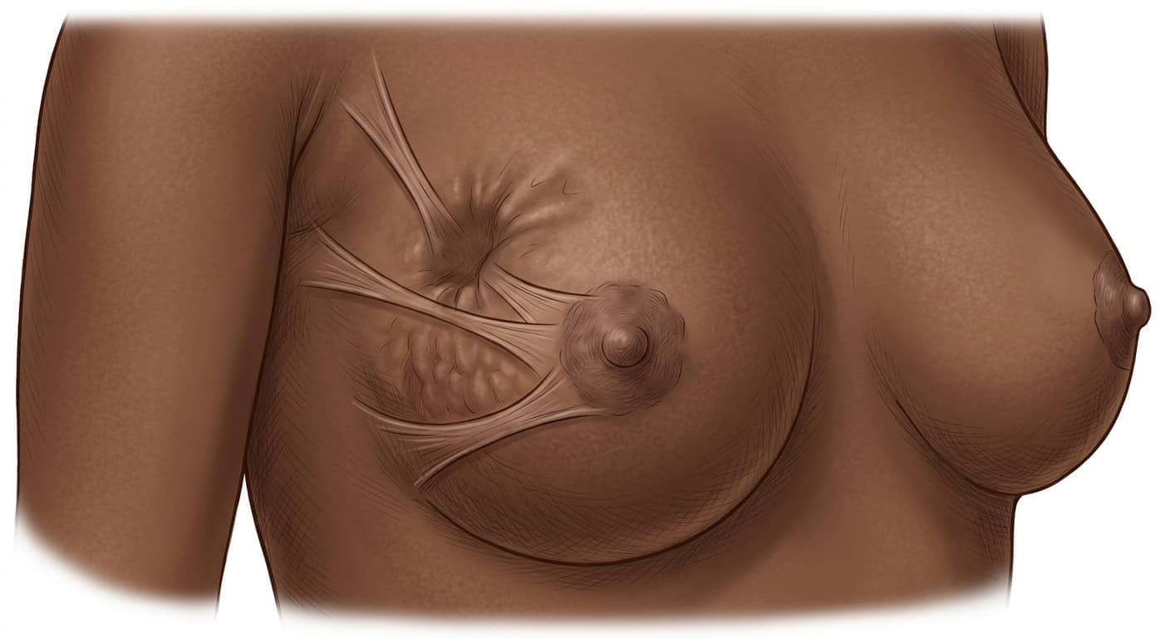
IGICE CYA 2 | IBIMENYETSO
Impinduka zo kwitegereza: Ibere (1/2)
Nta na kimwe muri ibi cyemeza ko ari kanseri. Gusa byose bigomba gusuzumwa ku kigo nderabuzima.
Ikibyimba gishya
Ikibyimba cyangwa agace gakomeye mu ibere kitigeze kibaho mbere, cyaba kibabaza cyangwa kitababaza.
Impinduka mu bunini cyangwa imiterere y’ibere
Ibere rimwe riba rinini, rito cyangwa ritandukanye n'irindi.
Uruhu rwinjira imbere cyangwa rukagira udutobore, cyane cyane iyo umuntu azamuye ukuboko.
Ibuka: Si wowe ugomba kwemeza icyo impinduka ari cyo. Uruhare rwawe ni ugushishikariza umuntu kujya gusuzumwa n'umukozi w'ubuzima wabihuguriwe.
Kanseri y'ibere | CHW (Umujyanama w'ubuzima) | Rwanda Biomedical Centre (RBC)
Igishushanyo cya 52

Slide 61
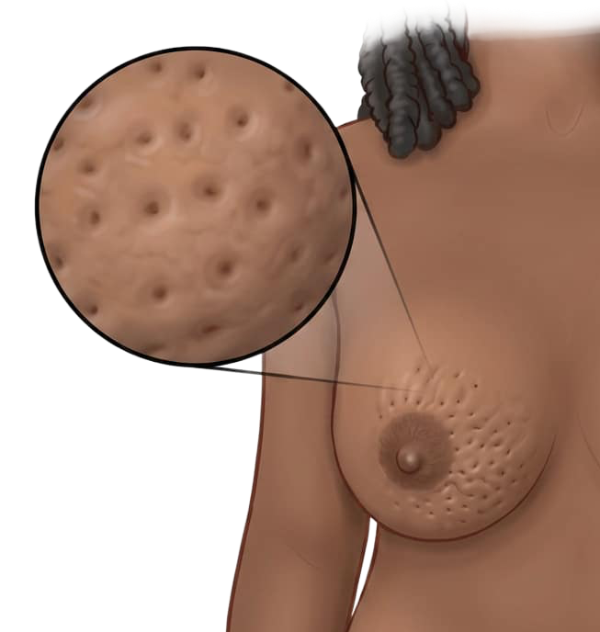
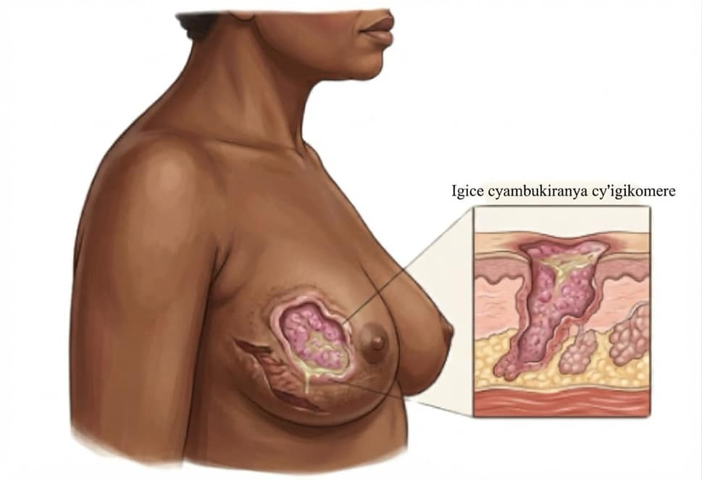
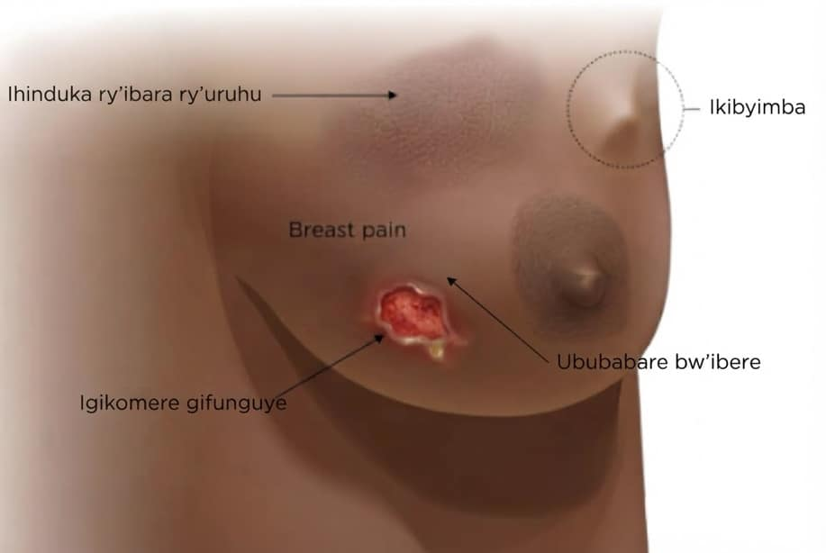
IGICE CYA 2 | IBIMENYETSO
Impinduka zo kwitegereza: Ibere (2/2)
Nta na kimwe muri ibi kigaragaza kanseri. Byose bigomba gusuzumwa ku kigo nderabuzima.
Uruhu rusa n'uruhu rw’ironji
Uruhu rukakaye, rufite uduce duto muri rwo, nk'uruhu rw’ironji.
Igikomere kidakira
Igikomere cyangwa agasebe ku ibere cyangwa ku moko kirenza ibyumweru bibiri.
Impinduka zidasubirayo
Impinduka zose z'amabere ziba zihari nyuma y'ibyumweru bike, kabone nubwo zaba ntoya.
Ibuka: Si wowe ugomba kwemeza icyo impinduka ari cyo. Ugomba kohereza umuntu kugira ngo asuzumwe n'umukozi w'ubuzima wabihuguriwe.
Kanseri y'ibere | CHW (Umujyanama w'ubuzima) | Rwanda Biomedical Centre (RBC)
Igishushanyo cya 52

Slide 62
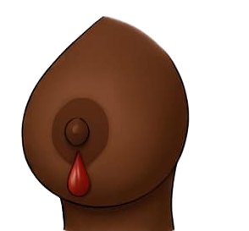
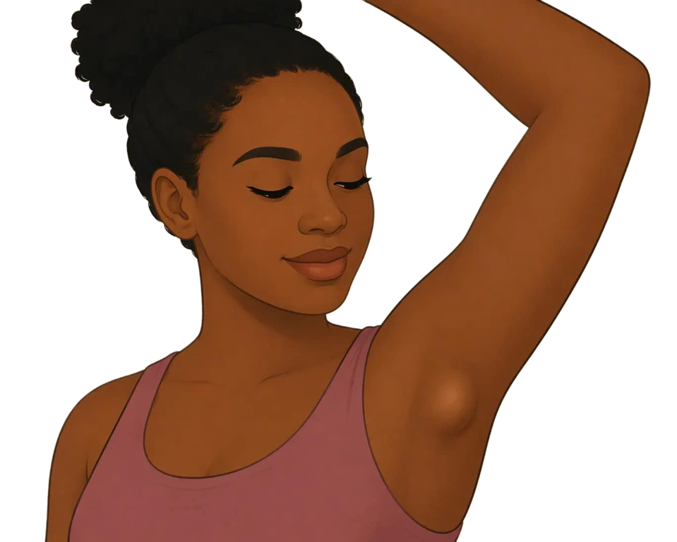
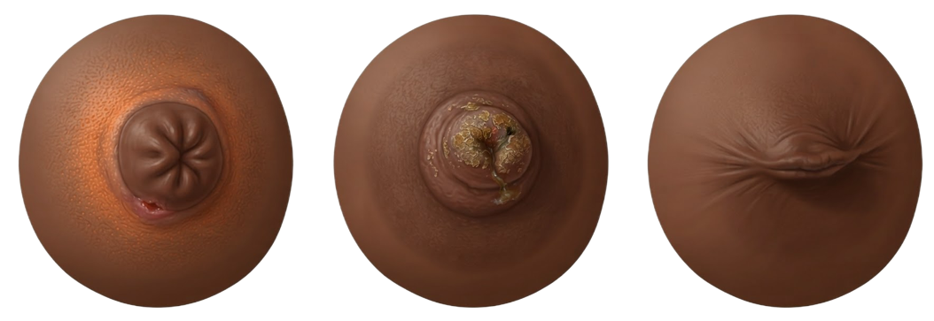
IGICE CYA 2 | IBIMENYETSO
Impinduka ukwiye kwitaho: imoko n ‘ ukwaha
Imoko itebera mo imbere.
Imoko itangiye gutebera ijya imbere bitari bisanzwe. Gusa hari bamwe baba babisanganwe; bitandukanye n’ibi.
Amaraso cyangwa amazi adasanzwe
Amazi ava mu moko ubwayo, udakanze ibere, cyane cyane iyo arimo amaraso.
Akabyimba cyangwa kubyimba mu kwaha.
Ikibyimba mu kwaha, cyangwa kubyimba bidakira nabyo bigomba gusuzumirwa hamwe n'ibere.
Vuga muri ubu buryo: Reba amabere yombi no mu kwaha hose. Icy'ingenzi cyane ni impinduka ku ruhande rumwe itari ihari mbere.
Kanseri y'ibere | CHW (Umujyanama w'ubuzima) | Rwanda Biomedical Centre (RBC)
Igishushanyo cya 53

Slide 63
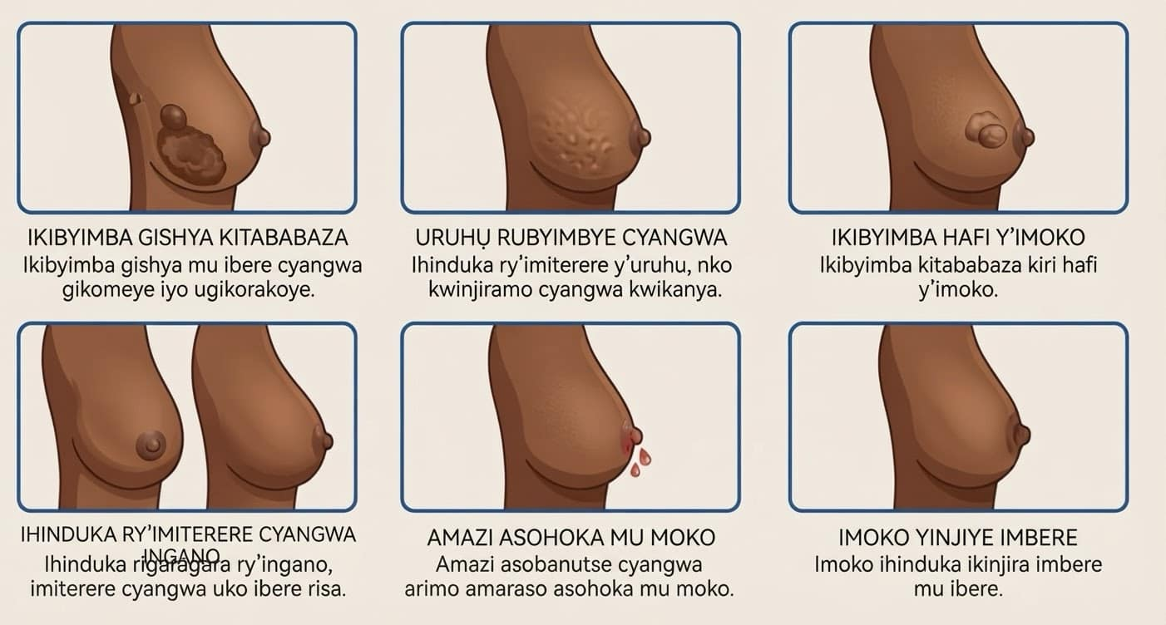
IGICE CYA 2 | IBIMENYETSO
Kureba impinduka
Ishusho yigisha impinduka neza kurusha amagambo, cyane cyane aho gusoma ari imbogamizi cyangwa bigoranye.
Gereranya impande zombi
Impinduka nyinshi ziba ku ruhande rumwe gusa. Kugereranya ibumoso n'iburyo ni bwo buryo bworoshye bwo kubibona.
Impinduka zishobora kuba ntoya
Udutobore ku ruhu, cyangwa imoko yatangiye kwinjira imbere, biroroshye kutabibona ariko ni ingenzi.
Vuga ibyo wabonye.
Mu gihe wohereje umuntu kwa muganga vuga byose wabonye cyangwa yakubwiye n’igihe yabiboneye.
Kanseri y'ibere | CHW (Umujyanama w'ubuzima) | Rwanda Biomedical Centre (RBC)
Igishushanyo cya 54

Slide 64
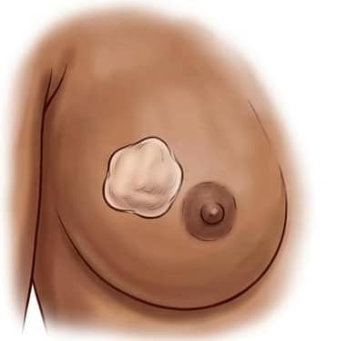
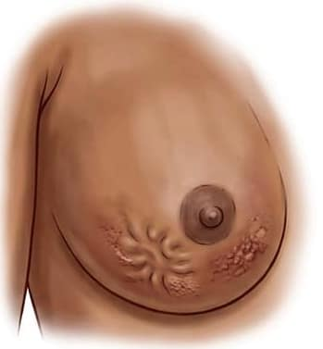
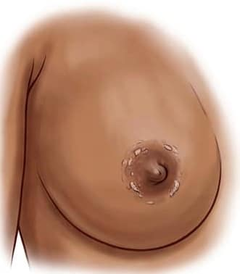
IGICE CYA 2 | UBUTUMWA NGENDERWAHO
Ikibyimba kitababaza gikeneye gusuzumwa.
Ububabare ntabwo ari umuburo
Kanseri nyinshi z'ibere ntizitera ububabare na gato iyo zitangiye. Gutegereza ububabare bisobanura gutegereza kugeza waratinze.
Kubabara nabyo ntibivuga kanseri
Ububabare bw'amabere ni ibintu bisanzwe kandi akenshi biterwa n'izindi mpamvu. Ni ikibyimba cyangwa impinduka zigena icyo gikorwa.
Impinduka ni zo zifata ibyemezo
Ikibyimba gishya cyangwa impinduka ku ruhu cyangwa ku moko bigomba gusuzumwa, byaba bibabaza cyangwa bitababaza.
Iyi ni interuro yo gusubiramo: Ikibyimba kitababaza si ikibyimba kidahangayikishije. Ahubwo Ni ikibyimba kitarasuzumwa.
Kanseri y'ibere | CHW (Umujyanama w'ubuzima) | Rwanda Biomedical Centre (RBC)
Igishushanyo cya 55

Slide 65
IGICE CYA 2 | RY'IMIKORANIRE
Ni uwuhe muri aba wo gufashwa?
Hitamo umuntu ukeneye gusuzumwa.
Abantu bane baganira nawe nyuma y'inama y'abaturage. Ni nde ukeneye gusuzumwa mu kigo nderabuzima?
A Umugore ufite inkovu yarasanganwe kuva akiri umwana muto
B Umugore unaniwe cyane nyuma y’umunsi muremure w’akazi
C Umugore wumva impinduka zoroheje mbere gato y’ukwezi kw’imihango.
D Umugore w'imyaka 52 ufite ikibyimba mu ibere yumvise mbere mu mezi abiri ashize, kitababaza
Igisubizo cyiza: D
Igisubizo: Ikibyimba gishya, gikomeye kandi kitababaza kimaze amezi abiri ni impinduka idakwiye kwirengagizwa. Kugira impinduka nto mbere y'imihango ni ibisanzwe kandi ntabwo ari ikibyimba, kandi inkovu ya kera idahinduka ntabwo ari impinduka nshya.
Kanseri y'ibere | CHW (Umujyanama w'ubuzima) | Rwanda Biomedical Centre (RBC)
Igishushanyo cya 56

Slide 66
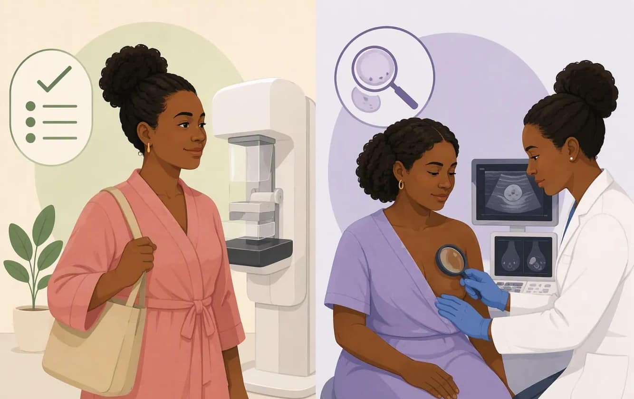
IGICE CYA 2 | GUSUZUMA
Kugenzura no gusuzuma ntabwo ari kimwe
Isuzuma risanzwe ku bantu badafite ibimenyetso
Isuzuma ry'amabere ku bantu bumva bameze neza kandi nta kintu na kimwe babonye. Rishakisha impinduka mbere y’uko umuntu azibona cyangwa azumva.
Igenzura
Igenzura ry’umuntu wabonye impinduka runaka. Rireba iyo mpinduka yihariye hanyuma rigafata umwanzuro ku ntambwe ikurikiraho.
Icy’ingenzi
Iyo habaye ikibyimba cyangwa ikindi gihinduka, uwo muntu akeneye gusuzumwa ubu. Ntabwo ategereza umunsi wo kwisuzuma.
Gahunda mu Rwanda: Kwisuzuma amabere: ku myaka yose, rimwe mu kwezi, byiza nyuma y'imihango. Isuzuma ku ivuriro cyangwa ku kigo nderabuzima: rimwe mu mwaka ku bagore bafite imyaka 30 n’abayirengeje. Umujyanama w'ubuzima yigisha, ayobora kandi yohereza; ntasuzuma amabere.
Kanseri y'ibere | CHW (Umujyanama w'ubuzima) | Rwanda Biomedical Centre (RBC)
Igishushanyo cya 57

Slide 67
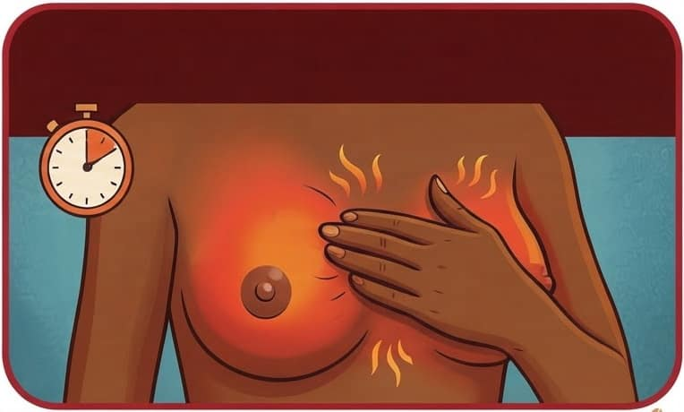
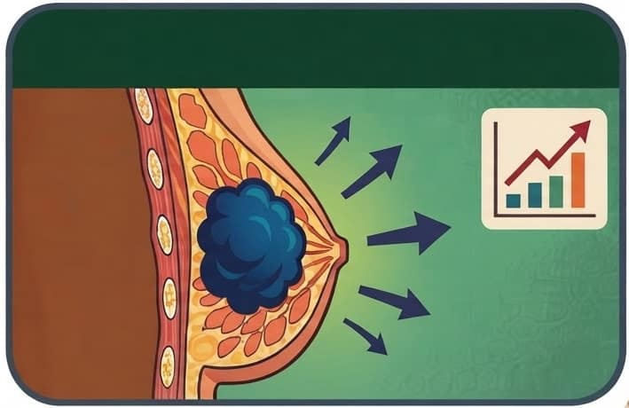
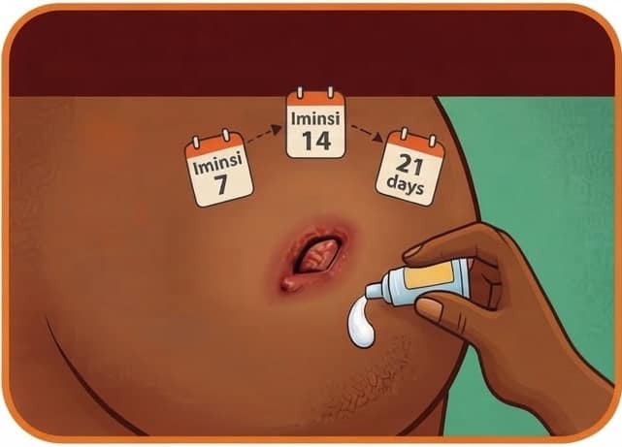
IGICE CYA 2 | IBIMENYETSO BY'UMUBURO
Impinduka zikeneye kwitabwaho vuba (1/2)
Izi mpinduka ntizigomba gutegereza gahunda y’ubutaha y’umujyanama.
1- Ibere ritukuye kandi ribyimbye
Gutukura, kubyimba, gushyuha n’uruhu rukomeye cyangwa rubyimbye bimaze iminsi. Hari impamvu zitandukanye zabitera kandi bigomba guhita bisuzumwa.
2- Ikibyimba kirimo gukura
Ikibyimba kiruta uko cyanganaga mu byumweru bibiri bishize cyangwa ikibyimba gifashe hamwe kitimuka.
3- Igisebe kitakira
Igisebe gifunguye, igisebe cyangwa imoko ifite igisebe cyangwa yasadutse kandi ntikire.
Icyo ukora: Ohereza umuntu ufite ibi bimenyetso ku ivuriro (poste de santé) cyangwa ku kigo nderabuzima kiri hafi mu masaha 48. Umuntu urembye cyane akeneye kwitabwaho uwo munsi.
Kanseri y'ibere | CHW (Umujyanama w'ubuzima) | Rwanda Biomedical Centre (RBC)
Igishushanyo cya 58

Slide 68
IGICE CYA 2 | IBIMENYETSO BY'UMUBURO
Impinduka zikeneye kwitabwaho vuba (2/2)
Izi mpinduka ntizigomba gutegereza gahunda y’ubutaha y’umujyanama.
4- Amaraso ava mu moko
Amatembabuzi avanze n’amaraso ava mu moko atayakanze.
5- Ikibyimba gikura mu kwaha
Ikibyimba mu kwaha cyangwa hejuru y’igufwa ryo ku rutugu kigenda cyiyongera kigomba gusuzumwa.
6- Umuntu ugaragara ko arembye cyane
Ububabare bukabije, umuriro mwinshi, guhumeka nabi cyangwa intege nke zikomeye bigomba kwitabwaho uwo munsi.
Icyo ukora: Ohereza umuntu ufite ibi bimenyetso ku ivuriro (poste de santé) cyangwa ku kigo nderabuzima kiri hafi mu masaha 48. Umuntu urembye cyane akeneye kwitabwaho uwo munsi.
Kanseri y'ibere | CHW (Umujyanama w'ubuzima) | Rwanda Biomedical Centre (RBC)
Igishushanyo cya 58

Slide 69
IGICE CYA 2 | KIGENDANWA
Uyu munsi cyangwa mu minsi iri imbere?
Umugore akubwira ko ibere rye ry'iburyo ryahindutse umutuku, rirabyimba, rirashyushye kandi ribabaza mu minsi ine ishize kandi ubu afite umuriro mwinshi. Ese wakora iki?
A Mubwire ko ari kanseri igaragara nta cyakorwa
B Mufashe kugera ku kigo nderabuzima byihuse, kuko akeneye kwisuzumisha
C Mugire inama yo kwambara imyambaro ishyushye ubundi ategereze gahunda y’ukwezi gutaha
D Mubwire gutegereza kugeza gutukura bishize.
Igisubizo cyiza: B
Igisubizo: Ibere riba ritukura kandi ribyimba vuba rigira impamvu nyinshi, harimo indwara n'ubwoko buke bwa kanseri y'ibere. Si umujyanama usobanura uburwayi ubwo ari bwo. Bisaba kwisuzumisha vuba, kandi gutegereza ni byo byangiza.
Kanseri y'ibere | CHW (Umujyanama w'ubuzima) | Rwanda Biomedical Centre (RBC)
Igishushanyo cya 59

Slide 70
IGICE CYA 2 | INKURU YO MU MURYANGO
Uko inkuru igenda: Uwimana Vestine
Kanseri y'ibere | CHW (Umujyanama w'ubuzima) | Rwanda Biomedical Centre (RBC)
Igishushanyo cya 60

Slide 71
IGICE CYA 2 | IKIBAZO CY'UMURYANGO
Ubu se urimo gukora iki kuri Vestine?
Vestine afite ubwoba ko gufata igipimo bishobora gukwirakwiza indwara, kandi ahangayikishijwe n'urugendo. Ni ikihe gikorwa cyiza gikurikiraho?
A Mubwire ko ari kanseri kugirango abihe agaciro.
B Musobanurire ko gufata akanyama gato ari bwo buryo bwo kubona igisubizo kandi bidakwirakwiza indwara, umufashe gutegura urugendo n'umunsi, kandi umurekere umwanzuro wo kuzabwira umugabo we
C Mubwire ko icyo kizamini kidakenewe
D Bwira umuryango we byose kugirango batume agenda
Igisubizo cyiza: B
Igisubizo: Hari ibintu bibiri bikenewe icyarimwe, igisubizo nyacyo ku bijyanye n’ubwoba na gahunda ituma gusurwa bishoboka. Kubwira umuryango we atabikwemereye bisenya ubuzima bwite bwe, no kumutera ubwoba bishobora kumubuza kugaruka kuri wowe.
Kanseri y'ibere | CHW (Umujyanama w'ubuzima) | Rwanda Biomedical Centre (RBC)
Igishushanyo cya 61

Slide 72
IGICE CYA 2 | ISUZUMA RY'UBUMENYI
Isuzuma ry'ubumenyi: ikibazo cya 1 kuri 5
Kumenya amabere yawe bisobanura iki?
A Kumenya uko amabere yawe asanzwe ameze, kubona impinduka zidasanzwe no kujya kwisuzumisha
B Kureba ku mabere gusa iyo ubabara
C Kwisuzuma amabere bisimbura isuzuma rikorwa n'umuforomo
D Kujya ku kigo nderabuzima buri cyumweru
Igisubizo cyiza: A
Igisubizo: Kumenya amabere ni ukumenya uko amabere yawe asanzwe ameze, ukabona impinduka, ukajya kwisuzumisha. Mu Rwanda, abagore bashishikarizwa kwisuzuma amabere rimwe mu kwezi, nyuma y'imihango. Ibi ntibisimbura isuzuma rikorwa n'umuforomo buri mwaka ku bagore bafite imyaka 30 n’abayirengeje.
Kanseri y'ibere | CHW (Umujyanama w'ubuzima) | Rwanda Biomedical Centre (RBC)
Igishushanyo cya 62

Slide 73
IGICE CYA 2 | ISUZUMA RY'UBUMENYI
Isuzuma ry'ubumenyi: ikibazo cya 2 kuri 5
Ni ikihe muri ibi cyagombye gusuzumirwa ku kigo nderabuzima?
A Akamenyetso kaje nyuma yo kubyara kamaze igihe katajya gahinduka
B Amabere ababara gake mbere gato y'imihango adafite ikindi kimenyetso
C Imoko yatangiye gutebera imbere mu ibere ku ruhande rumwe.
D Agasebe gato ko ku kuboko kakize
Igisubizo cyiza: C
Igisubizo: imoko itangiye gutebera ijyamo imbere kandi ku ruhande rumwe bitari bisanzwe ni impinduka nshya kandi igomba gusuzumwa. Kubabara gake mbere y’imihango cyangwa inkovu imaze igihe yaje nyuma yo kubyara ibyo ni ibintu bisanzwe.
Kanseri y'ibere | CHW (Umujyanama w'ubuzima) | Rwanda Biomedical Centre (RBC)
Igishushanyo cya 63

Slide 74
IGICE CYA 2 | ISUZUMA RY'UBUMENYI
Isuzuma ry'ubumenyi: ikibazo cya 3 kuri 5
Umugore ufite ikibyimba gishya cy'amabere abaza niba agomba gutegereza umunsi ukurikira wo gusuzumwa amabere mu gace ke. Ni iki umubwira?
A Oya, ikibyimba gikeneye gusuzumwa nonaha.
B Agomba gutegereza kugeza igihe aboneye umwanya nyuma yo gusarura.
C Agomba gutegereza kugeza ikibyimba gitangiye kumubabaza
D Yego, niwo munsi we.
Igisubizo cyiza: A
Igisubizo: Isuzuma ry'abantu bumva bameze neza si uburyo bukwiye ku muntu wamaze kubona impinduka. Kumwohereza ngo ategereze bituma isuzuma akeneye by'ukuri ritinda.
Kanseri y'ibere | CHW (Umujyanama w'ubuzima) | Rwanda Biomedical Centre (RBC)
Igishushanyo cya 64

Slide 75
IGICE CYA 2 | ISUZUMA RY'UBUMENYI
Isuzuma ry'ubumenyi: ikibazo cya 4 kuri 5
Ni iyihe nteruro ijyanye n'ububabare bw'ibere ivuga ukuri
A Ububabare ubwabwo ntibwemeza cyangwa ngo buhakane ko ari kanseri, impinduka nizo zigena ikigomba gukorwa
B Amabere ababara gusa niyo agomba gusuzumwa
C Ikibyimba kitababaza gishobora kwirengagizwa
D Ikibyimba kibabaza buri gihe kiba ari kanseri
Igisubizo cyiza: A
Igisubizo: Ububabare bwakuyobora nabi mu mpande zombi. Kanseri nyinshi z'ibere hakiri kare ntizibabaza, kandi ububabare bwinshi bw'ibere buterwa n'izindi mpamvu. Icy'ingenzi ni ukumenya niba hari impinduka nshya kandi iri kuhaguma.
Kanseri y'ibere | CHW (Umujyanama w'ubuzima) | Rwanda Biomedical Centre (RBC)
Igishushanyo cya 65

Slide 76
IGICE CYA 2 | ISUZUMA RY'UBUMENYI
Isuzuma ry'ubumenyi: ikibazo cya 5 kuri 5
Umugore w'imyaka 30 udafite mwene wabo urwaye kanseri y'ibere abaza niba akeneye guhangayikishwa n'ikibyimba gishya. Ni iki cy'ukuri?
A Agomba gutegereza kugeza ageze mu zabukuru.
B Nta kaga afite kandi yareka guhangayika
C Abagore bafite imyaka irenga mirongo itanu ni bo bonyine bakeneye gusuzumisha ikibyimba
D Abantu benshi bagira kanseri y’ibere nta mateka yo mu muryango baba bafite, bityo rero ikibyimba cye gikeneye gusuzumwa
Igisubizo cyiza: D
Igisubizo: Amateka y'umuryango yongerera ibyago ku bantu bamwe, ariko kubura kwayo ntikurinda umuntu uwo ari we wese. Imyaka nayo ifite agaciro, ariko abagore bakiri bato nabo barwara kanseri y'ibere, kandi ikibyimba gishya ku myaka iyo ari yo yose kirasuzumwa.
Kanseri y'ibere | CHW (Umujyanama w'ubuzima) | Rwanda Biomedical Centre (RBC)
Igishushanyo cya 66

Slide 77
IGICE CYA 2
Ibintu by'ingenzi
Kumenya amabere bisobanura: kumenya amabere yawe, gushobora kubona impinduka, no kuzisuzumisha.
Abenshi mu barwayi ba kanseri y'ibere nta mateka y'umuryango baba bafite kandi nta n'impamvu igaragara baba bafite yo kurwara kanseri y'ibere.
Kugira ikibyimba gishya, guhinduka kw’uruhu, guhinduka kw’imoko cyangwa kubyimba mu kwaha bikeneye gusuzumwa.
Kuba ikibyimba kitababaza ntibivuze ko utekanye. Ububabare si ikimenyetso cyizewe cyo kwemeza cyangwa guhakana kanseri.
Ibere ryatukuye kandi ryabyimbye vuba, cyangwa umuntu bigaragara ko atameze neza, akeneye kwitabwaho vuba.
Kanseri y'ibere | CHW (Umujyanama w'ubuzima) | Rwanda Biomedical Centre (RBC)
Igishushanyo cya 67

Slide 78
IGICE CYA 2 | KWIYUMVIRA
Kwiyumvira
Amabwiriza ku wiga: Andika igisubizo cyawe mu kazu k'inyandiko. Ibi bisubizo ntibihabwa amanota.
1
Ni iyihe mpinduka y'ibere washishikariza umuntu wo mu gace kawe kutirengagiza, kandi wayisobanura ute?
2
Ni iki wabwira umuntu utekereza ko ikibyimba kitababaza kitazahinduka ikintu kidasanzwe?
3
Ni iki gikunze gutuma abantu bo mu gace utuyemo batinda kuvuga impinduka cyangwa kujya kwisuzumisha?
Kanseri y'ibere | CHW (Umujyanama w'ubuzima) | Rwanda Biomedical Centre (RBC)
Igishushanyo cya 68

Slide 79
3
I G I C E C Y A 3
Icyo wakora gukurikiraho
Aho wohereza umuntu, uko umuntu akeneye kubonwa byihutirwa, uburyo bwo kuganira ku kintu giteye ubwoba, ni gute wizera ko gusurwa bibaho koko.
Igishushanyo cya 69

Slide 80
IGICE CYA 3
Intego zo kwiga
Nyuma y’iri somo, uzaba ushoboye:
1
Vuga aho ubuvuzi bwa kanseri y'ibere bukorerwa mu Rwanda n'aho wohereza umurwayi.
2
Kugena uburyo umuntu akeneye kubonwa byihutirwa.
3
Gusubiza impungenge ku bijyanye n’ibizamini, kubagwa n’ibisubizo ariko udatanze amakuru atariyo.
4
Gukosora imyumvire itariyo ijyanye na kanseri y’ibere.
5
Gufasha umuntu kubaha gahunda yo koherezwa na gahunda zo gusurwa zikurikira.
Kanseri y'ibere | CHW (Umujyanama w'ubuzima) | Rwanda Biomedical Centre (RBC)
Igishushanyo cya 70

Slide 81
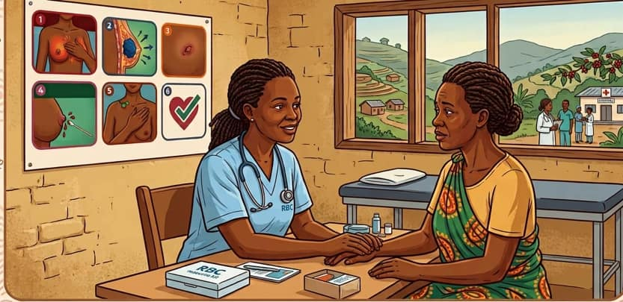
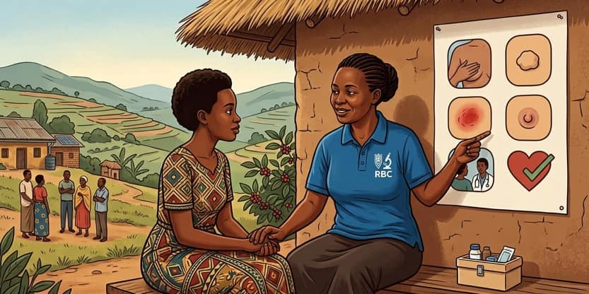
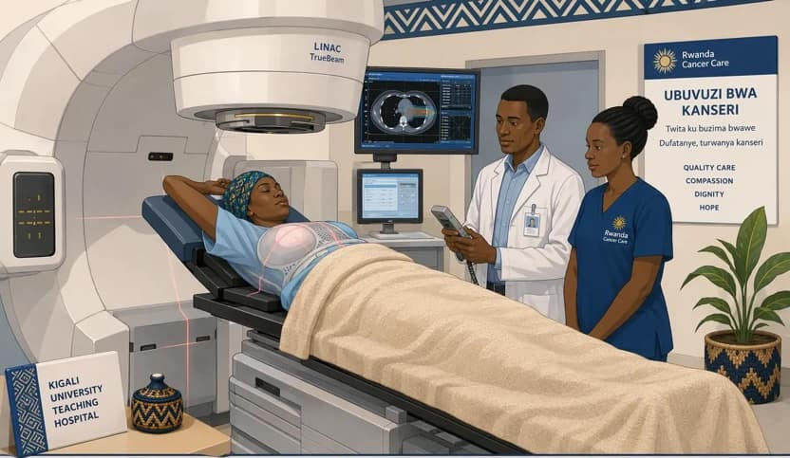
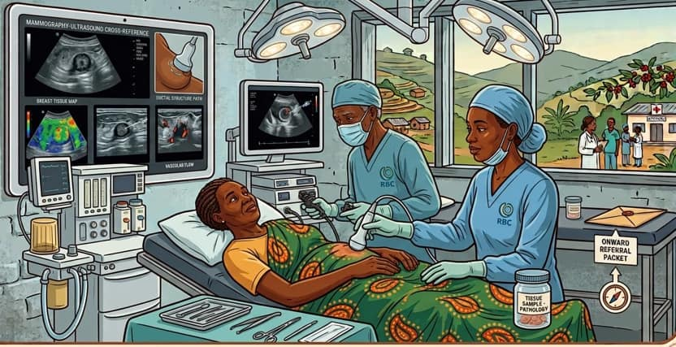
IGICE CYA 3 | KOHEREZWA
Aho kanseri y'ibere iherereye
1
Umuryango aho utuye
2
Ivuriro cyangwa ikigo nderabuzima
3
Ibitaro by'akarere
4
Ibitaro bikuru
Ubonye impinduka, sobanura icyo ivuze, shishikariza gusuzumwa unategure gahunda yo kohereza.
Ibere n’ukwaha birasuzumwa impinduka ziranditswe, intambwe ikurikiyeho iremejwe
Ibindi bipimo, amafoto y'ibere aho biboneka, hamwe n'icyitegererezo gito cy'uturemangingo cyangwa koherezwa.
Ibipimo bya laboratwari, kubagwa, imiti ya kanseri no kuvurwa hifashishijwe imirasire biboneka mu bigo bivura kanseri
>
>
>
Kanseri y'ibere | CHW (Umujyanama w'ubuzima) | Rwanda Biomedical Centre (RBC)
Igishushanyo cya 71

Slide 82
IGICE CYA 3 | KOHEREZWA
Inzira: kuva mu rugo kugera ku buvuzi
1. Mu rugo
Umujyanama w'ubuzima asura ingo, yigisha ku buzima bw’amabere no kwisuzuma amabere.
2. Kubaza no kohereza
Abaza niba hari ikimenyetso, maze yohereza ku ivuriro cyangwa ku kigo nderabuzima.
3. Ivuriro
Umuforomo asuzuma amabere. Nta kibazo kibonetse: akomeza guhabwa ubujyanama. Hari ikibazo: yoherezwa ku bitaro.
4. Ibitaro
Muganga arasuzuma, akemeza ibizamini bikenewe.
5. Amafoto y'ibere
Echographie ikorwa iyo bikenewe.
6. Agace gato
Agace gato k’ibere gafatwa iyo hari ibikekwa, kagapimirwa muri laboratwari.
7. Ibisubizo
Nta kanseri: arabimenyeshwa. Kanseri yemejwe: yoherezwa kuvurwa.
8. Gukurikirana
Umukozi ushinzwe gukurikirana amufasha ku rugendo, ku mafaranga no ku matariki.
Kanseri y'ibere | CHW (Umujyanama w'ubuzima) | Rwanda Biomedical Centre (RBC)
Igishushanyo cya 71A

Slide 83
IGICE CYA 3 | KOHEREZWA
Ni nde wohereza, kandi ryari?
Imyaka 30 kugeza 49
Mubaze niba hari impinduka cyangwa ikimenyetso yumvise cyangwa yabonye mu ibere.
Gihari: mwohereze ako kanya.
Nta kimenyetso: mwigishe, kandi mumushishikarize isuzuma rya buri mwaka ku ivuriro.
Imyaka 50 n’abayirengeje
Mwohereze bose ku ivuriro cyangwa ku kigo nderabuzima gusuzumwa amabere, nubwo nta kimenyetso bafite.
Ku myaka yose
Impinduka mu ibere: kohereza mu masaha 48.
Umuntu urembye cyane: mwohereze kwa muganga uwo munsi.
📌 Munsi y'imyaka 30, nta kimenyetso: mwigishe kwisuzuma amabere buri kwezi.
✅ Nyuma y'isuzuma: nta kibazo, akomeza kwisuzuma no gusuzumwa buri mwaka; hari ikibazo, yoherezwa ku bitaro.
Kanseri y'ibere | CHW (Umujyanama w'ubuzima) | Rwanda Biomedical Centre (RBC)
Igishushanyo cya 71B

Slide 84
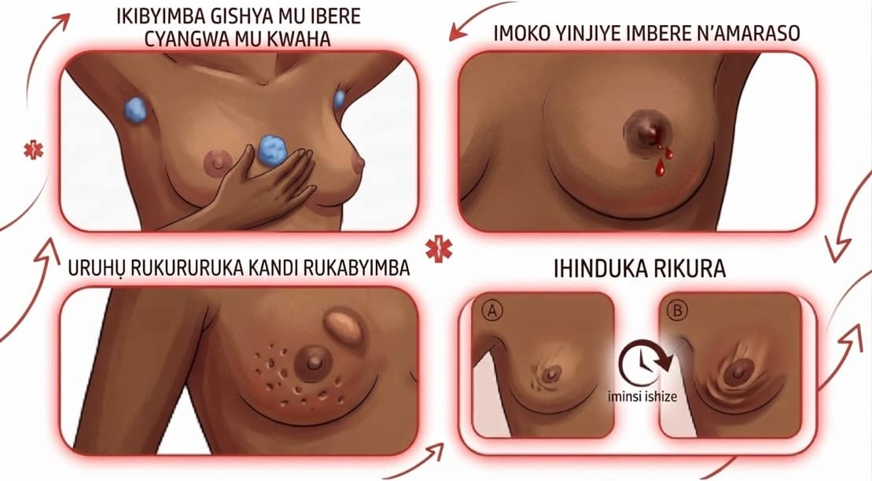
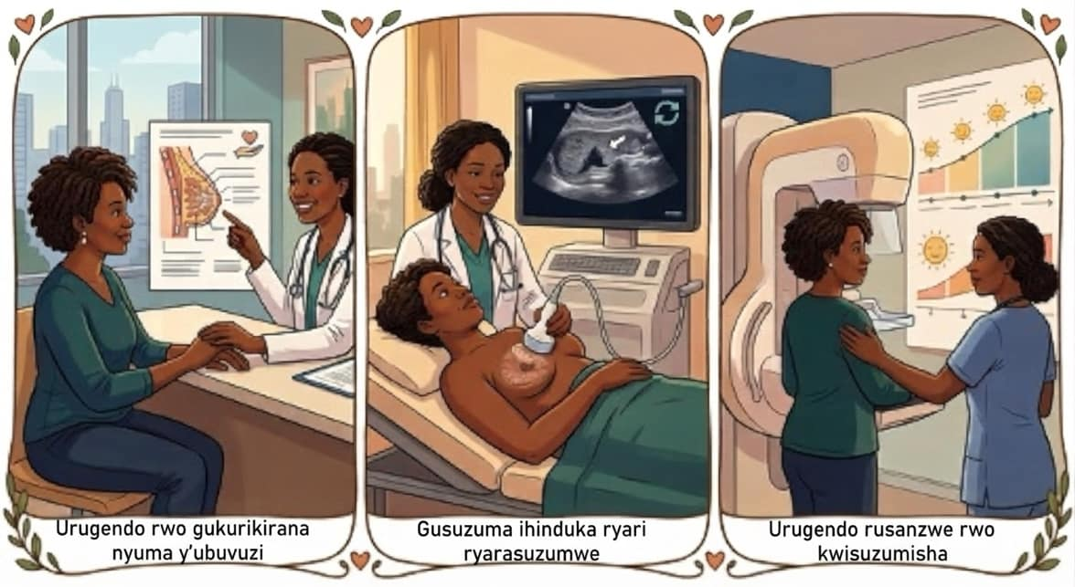
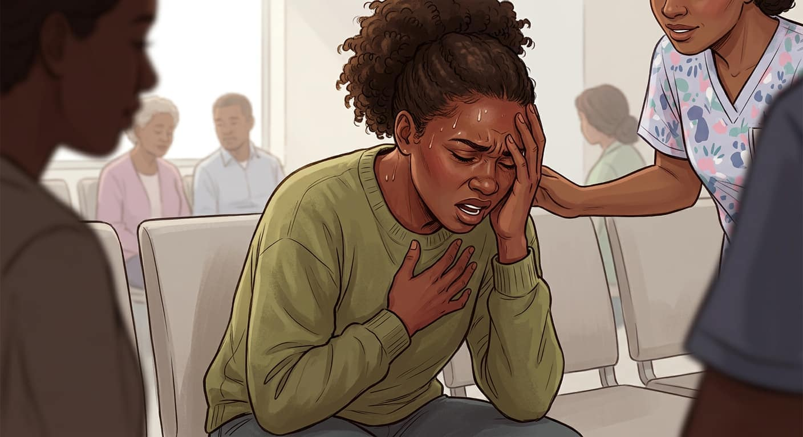
IGICE CYA 3 | KOHEREZWA
Akeneye kubonwa ryari?
Uyu munsi
Ibere ryahindutse ritukura, ribyimba kandi rishyushye mu gihe cy'iminsi, igisebe gifunguye ku ibere, cyangwa umuntu bigaragara ko atameze neza afite ububabare bukabije, umuriro mwinshi cyangwa kunanirwa guhumeka.
Mu masaha 48, nta gutegereza
Ikibyimba icyo ari cyo cyose gishya mu ibere cyangwa mu kwaha, imoko yatebeye cyangwa yinjiye imbere, amaraso ava mu moko, uruhu rukururira imbere cyangwa rukomeye, cyangwa impinduka irimo gukura.
Mu gihe cyateganijwe
Gusurwa nyuma yo kuvurwa, gusuzuma impinduka zamaze gusuzumwa, n’isuzuma risanzwe ryateganyijwe.
Kanseri y'ibere | CHW (Umujyanama w'ubuzima) | Rwanda Biomedical Centre (RBC)
Igishushanyo cya 72

Slide 85
IGICE CYA 3 | KOHEREZA
Mbere y'uko mutandukana
Iyoherezwa umuntu adashobora gukurikiza si iyoherezwa.
1
Vuga aho umwohereje kandi byumvikana nawe agusubiriremo.
2
Musobanurire mu magambo asobanutse uko bizagenda mu gihe azaba ahageze, kugira ngo hatazagira ikimutungura.
3
Mwemeranye umunsi wo kujyayo unawandike niba ari byo byamufasha.
4
Mubaze ibyatuma atajyayo cyangwa atitabira, mubikemure none.
5
Mwemerere ko uzamusura kandi ubikore
Kanseri y'ibere | CHW (Umujyanama w'ubuzima) | Rwanda Biomedical Centre (RBC)
Igishushanyo cya 73

Slide 86
IGICE CYA 3 | INZITIZI
Ni iki kibuza abantu kugenda, kandi ni iki kibafasha
🔴 Ni iki kibuza abantu
🟢 Icyo umujyanama w'ubuzima yakora
Igiciro n'igihe cy'urugendo.
Umunsi w’akazi kenshi cyangwa ubucuruzi.
Nta muntu wo kwita ku bana.
Ubwoba bw'ibizaboneka.
Bafite ubwoba bw'uko ibere rishobora gukurwaho.
Biteye isoni no gusuzumwa.
Kutamenya aho kujya n'ibibera hariya.
Tegura umunsi udahura n’akazi cyangwa isoko.
Gufasha mu gutegura ingendo cyangwa mujyane mu rugendo.
Mufashe kureba uburyo abana bitabwaho.
Vuga ukuri ko ibibyimba hafi ya byose atari kanseri.
Sobanura ko uburyo bwo kuvura butandukanye bitewe n'abantu.
Jya uvugira mu ibanga, ntuzigere uvugira imbere y'abandi.
Muyobore aho agana ndetse n’ibikorerwa cyangwa ibiberayo.
Kanseri y'ibere | CHW (Umujyanama w'ubuzima) | Rwanda Biomedical Centre (RBC)
Igishushanyo cya 74

Slide 87
IGICE CYA 3 | KUGANIRA N'ABANTU
Gutega amatwi neza
Banza utege amatwi. Reka uwo muntu avuge ibimuhangayikishije mbere yo kugira icyo usobanura
Ntugashinje icyaha. Nta muntu n'umwe wizanira iyi ndwara ku giti cye, kandi kubivugaho mu ijwi riranguruye birafasha.
Mujye mubikora mu ibanga. Vuga aho abandi badashobora kumva, kandi ujye ukomeza ibyo akubwiye ubigire ibanga.
Vugisha ukuri. Ntugasezeranye ibisubizo. Vuga ibyo uzi, n'intambwe ikurikiraho.
Soza n’ibikorwa. Buri kiganiro cyose kigomba kurangira n'intambwe ikurikira yemeranijweho.
Kanseri y'ibere | CHW (Umujyanama w'ubuzima) | Rwanda Biomedical Centre (RBC)
Igishushanyo cya 75

Slide 88
IGICE CYA 3 | INAMA
"Mfite ubwoba ko bazankuraho amabere yanjye"
Hitamo igisubizo cy'ukuri kandi cy'ingirakamaro.
Umugore yanze kujya kwisuzumisha kuko atekereza ko ku bitaro bazamukuraho ibere. Ese uvuze ngo iki?
A Mwemerere ko amabere ye azakurwaho, kuburyo yitegura
B Mubwire ko ibi atari ibintu yakwiye kuba abaza.
C Sobanura ko ubuvuzi atari bumwe ku bantu bose, ko gukuraho ibere bidasabwa kuri buri muntu, ko nta cyemezo gifatwa mbere y'ibizamini, kandi umusabe kumuherekeza
D Musezeranye ko amabere ye atazakurwaho
Igisubizo cyiza: C
Igisubizo: Isezerano udashobora gusohoza rizibukwa, kandi risenya icyizere mu gihe bigaragaye ko ari ikosa. Igitangaje kandi gihumuriza ni uko ubuvuzi butandukanye hagati y'abantu, ko nta cyemezo gifatwa mbere y'ibizamini, kandi ko abantu benshi bagumana amabere yabo.
Kanseri y'ibere | CHW (Umujyanama w'ubuzima) | Rwanda Biomedical Centre (RBC)
Igishushanyo cya 76

Slide 89
IGICE CYA 3 | INAMA
"Nzabanza kugerageza ubuvuzi busanzwe"
Umugore ufite ikibyimba cy'amabere gikura akubwira ko azabanza gukoresha ubuvuzi gakondo hanyuma akajya ku kigo nderabuzima nyuma mu gihe bidakora. Ni ubuhe buryo bwiza bwo gukemura iki kibazo?
A Emera, uzagaruke nyuma y’amezi atandatu
B Menyesha inzego zibishinzwe
C Mubwire ko imyemerere ye atari yo kandi ko yibeshya
D Ubaha ibyo yemera, musobanurire utuje ko iki kibyimba gishobora gukura mu gihe ategereje kandi ko gutegereza ari byo bituma ubuvuzi burushaho kugorana, kandi usabe ko na we yakwisuzumisha ubu.
Igisubizo cyiza: D
Igisubizo: Kwibasira ibyo umuntu yemera akenshi birangiza ikiganiro n'umubano. Ikibazo cyo kuvuga ni igihe, ntabwo ari ukwizera. Ikibyimba kigenda gikura muri ayo mezi kandi isuzuma ni icyo adashobora kubona ahandi.
Kanseri y'ibere | CHW (Umujyanama w'ubuzima) | Rwanda Biomedical Centre (RBC)
Igishushanyo cya 77

Slide 90
IGICE CYA 3 | INAMA
"Ntewe ipfunwe no gusuzumwa"
Umugore akubwira mu ibanga ko atewe isoni no kureka umuntu wese areba amabere ye. Ni ikihe gisubizo cyiza kurusha ibindi?
A Kumubwira ko isuzuma atari ngombwa cyane
B Kwemera ko abantu benshi biyumva batyo, kumusobanurira ko isuzuma rimara igihe gito kandi rikorerwa mu mwiherero n'umukozi w'ubuzima wabihuguriwe, no kwemera kumuherekeza
C Kumubwira ko isoni nta cyo zivuze kandi ko agomba kugenda gusa
D Gusaba abandi bagore bo mu mudugudu kumwemeza kugenda
Igisubizo cyiza: B
Igisubizo: Isoni ni impamvu nyayo ituma abantu baguma kure, bityo zigomba gusubizwa aho kwirengagizwa. Kuzivuga, kumusobanurira uko isuzuma rikorwa, no kwemera kumuherekeza bihindura ubwoba bukavamo gahunda ifatika. Kwinjiza abandi bagore muri iki kibazo byamena ibanga rye.
Kanseri y'ibere | CHW (Umujyanama w'ubuzima) | Rwanda Biomedical Centre (RBC)
Igishushanyo cya 78

Slide 91
IGICE CYA 3 | RY'IMIKORANIRE
Imyizerere kuri kanseri y'ibere
Hitamo buri gitekerezo kugira ngo ubone igisubizo nyacyo.
Ikinyoma: Gukubitwa cyangwa gukomereka ku ibere bitera kanseri y'ibere.
Ukuri: Gukomereka bishobora gutuma umuntu abona ikibyimba cyari gisanzwe gihari. Ntabwo ari byo bitera indwara.
Ikinyoma: Kwambara imyenda ifashe cyane, nk'isutiye, cyangwa gukoresha deodorant bitera kanseri y'ibere.
Ukuri: Nta gihamya ifatika ihari kuri ibyo. Kubisubiramo bituma abantu bashakisha impamvu aho kujya kwisuzumisha.
Ikinyoma: Iyi ndwara ni umuvumo cyangwa igihano.
Ukuri: Ni indwara y'uturemangingo tw'ibere. Nta muntu ugomba kubiryozwa, kandi nta muntu wabyiteye.
Ikinyoma: Ushobora kwandura kanseri y'ibere ku wundi muntu.
Ukuri: Ntiyandurira ku muntu binyuze mu kubana, gusangira ibyo kurya cyangwa kwita ku muntu. Nta muntu ugomba guhezwa.
Ikinyoma: Kanseri y'ibere buri gihe isobanura urupfu.
Ukuri: Kanseri y'ibere iravurwa, kandi ibisubizo biba byiza kurushaho iyo imenyekanye hakiri kare.
Kanseri y'ibere | CHW (Umujyanama w'ubuzima) | Rwanda Biomedical Centre (RBC)
Igishushanyo cya 79

Slide 92
IGICE CYA 3 | IBANGA RY'UBUZIMA BWITE
Ubuzima bwite n'icyubahiro
Vuga mu ibanga. Ntuzigere uvuga ku mpinduka yo mu ibere ry'umuntu cyangwa ku bisubizo bye aho abandi bashobora kumva.
Ntugasubiremo ibyo wabwiwe. Ntubibwire abaturanyi, abavandimwe cyangwa abari mu nama z'abaturage.
Amakuru ye, amahitamo ye. Ni we uhitamo abo abibwira, harimo niba azabibwira umugabo we n'igihe azabimubwirira.
Ntugakeke. Ntugire icyo uvuga ku mubano we, ku bana be cyangwa ku mubiri we atabanje kubivuga ubwe.
Koresha amagambo y'icyubahiro. Vuga ku ndwara n'intambwe ikurikira, ntuzigere ucira umuntu urubanza ku buryo yabayeho.
Kanseri y'ibere | CHW (Umujyanama w'ubuzima) | Rwanda Biomedical Centre (RBC)
Igishushanyo cya 80

Slide 93
IGICE CYA 3 | GUKURIKIRANA
Gukora ibishoboka byose kugira ngo bigerweho
Agaciro kanini k'akazi kawe kari mu nshuro umuntu ajya kwa muganga koko.
1
Andika uwoherejwe, aho yoherejwe n'itariki yagenwe.
2
Garuka nyuma y'umunsi mwemeranyijeho, umubaze niba yaragiye.
3
Niba atagiye, mubaze impamvu utamushinja, kandi mufatanye gukemura inzitizi.
4
Tanga amakuru ku kigo nderabuzima nk'uko ubisabwa, kugira ngo hatagira umuntu wibagirana muri gahunda.
Kanseri y'ibere | CHW (Umujyanama w'ubuzima) | Rwanda Biomedical Centre (RBC)
Igishushanyo cya 81

Slide 94
IGICE CYA 3 | IKIBAZO CYO MU MUDUGUDU
Gusoza ikibazo: Uwimana Vestine
Kanseri y'ibere | CHW (Umujyanama w'ubuzima) | Rwanda Biomedical Centre (RBC)
Igishushanyo cya 82

Slide 95
IGICE CYA 3 | IKIBAZO CY'UMURYANGO
Isomo ry'ingenzi kuri Vestine
Ikibyimba nticyababazaga. Ni yo mpamvu yamaze amezi atatu atajya kwisuzumisha, kandi ni yo myizerere ikwiye gukosorwa cyane mu gace kawe.
Ubwoba bwo gutakaza ibere bwatumye aguma mu rugo. Igisubizo cy'ukuri, atari isezerano, ni cyo cyatumye ajya ku kigo nderabuzima.
Ubwoba bwe ku bijyanye no gufata agace gato k'ibere bwasubijwe. Iyo hataba icyo kiganiro, ntiyari kurangiza ibizamini.
Umunsi w'isoko n'urugendo byari inzitizi nyazo. Kuzikemura ni byo byatumye koherezwa kwe kuvamo kujya kwa muganga koko.
Ubuzima bwe bwite bwarubahijwe. Ni we wihitiyemo igihe cyo kubwira umugabo we, kandi ibyo byatumye akomeza kukwizera.
Kanseri y'ibere | CHW (Umujyanama w'ubuzima) | Rwanda Biomedical Centre (RBC)
Igishushanyo cya 83

Slide 96
IGICE CYA 3 | ISUZUMA RY'UBUMENYI
Isuzuma ry'ubumenyi: ikibazo cya 1 kuri 5
Umugore afite ibere ritukura, ribyimba kandi rishyushye mu gihe cy'iminsi ine, ubu afite umuriro mwinshi. Ni iki kigomba gukorwa?
A Agomba gutegereza kugeza umutuku ushize
B Agomba kuruhuka, agasurwa mu kwezi gutaha
C Agomba gusuzumirwa ku kigo nderabuzima nta gutinda
D Agomba guhabwa imiti y'ibyatsi, agakurikiranirwa mu rugo
Igisubizo cyiza: C
Igisubizo: Ibere rihinduka vuba gutya rikeneye gusuzumwa nonaha. Hari impamvu nyinshi zishoboka, zimwe muri zo zikomeye, kandi kumenya impamvu nyayo si inshingano z'abaturage.
Kanseri y'ibere | CHW (Umujyanama w'ubuzima) | Rwanda Biomedical Centre (RBC)
Igishushanyo cya 84

Slide 97
IGICE CYA 3 | ISUZUMA RY'UBUMENYI
Isuzuma ry'ubumenyi: ikibazo cya 2 kuri 5
Ni iki cy'ingirakamaro kurusha ibindi umujyanama w'ubuzima yakora nyuma yo kohereza umuntu?
A Kumubaza icyamubuza kugenda, gukemura ibishoboka, hanyuma ukagaruka kureba uko byagenze
B Kubwira umuryango we ibyabonetse kugira ngo bamuhatire kugenda
C Kubimuharira wenyine
D Kubivuga mu nama y'abaturage itaha kugira ngo abandi bamushishikarize
Igisubizo cyiza: A
Igisubizo: Kohereza umuntu bigira akamaro gusa iyo yagiye kwa muganga koko. Kumenya inzitizi no kuyikemura ni cyo gice gifatika cy'akazi. Kubwira umuryango cyangwa kuvuga ikibazo cye mu ruhame bisenya ibanga rye, kandi bishobora gutuma atongera kukwizera.
Kanseri y'ibere | CHW (Umujyanama w'ubuzima) | Rwanda Biomedical Centre (RBC)
Igishushanyo cya 85

Slide 98
IGICE CYA 3 | ISUZUMA RY'UBUMENYI
Isuzuma ry'ubumenyi: ikibazo cya 3 kuri 5
Umugore arabaza niba ku bitaro bazamukuraho ibere. Ni ikihe gisubizo cy'ukuri kandi gifasha?
A Kumubwira ko atagomba kubitekerezaho
B Kumusezeranya ko ibere rye ritazakurwaho
C Kumusobanurira ko ubuvuzi butandukana ku bantu, ko nta cyemezo gifatwa mbere y'ibizamini, kandi ko gukuraho ibere bidakorerwa abantu bose
D Kumubwira ko nta kabuza ibere rye rizakurwaho
Igisubizo cyiza: C
Igisubizo: Isezerano udashobora kubahiriza rishobora gusenya icyizere, kandi kumutera ubwoba bishobora gutuma aguma mu rugo. Ukuri ni uko ubuvuzi buhitwamo nyuma y'ibizamini, butaba bumwe kuri bose, kandi abantu benshi bagumana ibere ryabo.
Kanseri y'ibere | CHW (Umujyanama w'ubuzima) | Rwanda Biomedical Centre (RBC)
Igishushanyo cya 86

Slide 99
IGICE CYA 3 | ISUZUMA RY'UBUMENYI
Isuzuma ry'ubumenyi: ikibazo cya 4 kuri 5
Umuryango wizera ko iyi ndwara yatewe no gukubitwa ku ibere uyu mugore yagize umwaka ushize. Ubabwira iki?
A Ko gukomereka bishobora gutuma umuntu abona ikibyimba cyari gisanzwe gihari, ariko bidatera kanseri y'ibere
B Ko bavuga ukuri, kandi ko agomba kwirinda gukomereka mu gihe kizaza
C Ko nta muntu n'umwe uzi icyo ari cyo cyose ku bitera iyi ndwara
D Ko batagomba kubivugaho na gato
Igisubizo cyiza: A
Igisubizo: Iyi myizerere irakunze kugaragara, kandi ituma imiryango ishakisha impamvu aho kujya kwisuzumisha. Kuyikosora mu bwitonzi bikuraho kwishinja, kandi bigatuma ikiganiro cyerekeza ku cyo gukora gikurikiyeho.
Kanseri y'ibere | CHW (Umujyanama w'ubuzima) | Rwanda Biomedical Centre (RBC)
Igishushanyo cya 87

Slide 100
IGICE CYA 3 | ISUZUMA RY'UBUMENYI
Isuzuma ry'ubumenyi: ikibazo cya 5 kuri 5
Umugore akubwiye ibisubizo bye mu ibanga. Ni nde ushobora kubiganiraho na we?
A Abaturanyi be, kugira ngo bamushyigikire
B Abakozi b'ubuzima bamwitaho gusa, no mu rugero inshingano zawe zo gutanga raporo zibisaba
C Umuntu wese wo mu mudugudu ubajije amakuru ye
D Inama y'abaturage yose, kugira ngo abere abandi urugero
Igisubizo cyiza: B
Igisubizo: Ibyo akubwira ni ibye. Kubisubiramo bikwirakwiza isoni, kandi byigisha abandi bagore bose bo mu mudugudu kuguhisha ibimenyetso byabo, ibyo bikaba binyuranye n'ibyo akazi kawe gakeneye.
Kanseri y'ibere | CHW (Umujyanama w'ubuzima) | Rwanda Biomedical Centre (RBC)
Igishushanyo cya 88

Slide 101
IGICE CYA 3
Ibintu by'ingenzi
Ikibyimba gishya cyangwa indi mpinduka mu ibere bisaba gusuzumwa vuba, kandi ibere ritukuye rikabyimba vuba risaba kuvurwa nta gutinda.
Kohereza umuntu bigira akamaro gusa iyo ageze kwa muganga, bityo menya inzitizi kandi uyikemure.
Subiza ubwoba bwo kubagwa mu kuri, utamusezeranya ibyo udashobora kwemeza.
Gukomereka, imyambaro n'imivumo ntibitera kanseri y'ibere, kandi iyi ndwara ntiyandura ku muntu ijya ku wundi.
Ibyo umuntu akubwiye biguma mu ibanga, kandi ni we uhitamo abandi bagomba kubimenya.
Kanseri y'ibere | CHW (Umujyanama w'ubuzima) | Rwanda Biomedical Centre (RBC)
Igishushanyo cya 89

Slide 102
IGICE CYA 3 | KWIYUMVIRA
Kwiyumvira
Amabwiriza ku wiga: Andika igisubizo cyawe mu gasanduku k'inyandiko. Ibi bisubizo ntibihabwa amanota.
1
Ni gute wafasha umuntu wo mu gace kawe kugera koko kwa muganga nyuma yo kumwohereza kubera impinduka mu ibere?
2
Ni iki wabwira umuntu ufite ubwoba ko isuzuma rizatuma ibere rye rikurwaho?
3
Ni iyihe myizerere kuri kanseri y'ibere ikomeye cyane mu gace utuyemo, kandi ni gute wayisubiza mu buryo bw'icyubahiro?
Kanseri y'ibere | CHW (Umujyanama w'ubuzima) | Rwanda Biomedical Centre (RBC)
Igishushanyo cya 90

Slide 103
4
I G I C E C Y A 4
Uko kanseri y'ibere yemezwa n'uko ivurwa
Ibikorerwa ku bitaro, mu magambo umuntu n'umuryango we bashobora kumva.
Igishushanyo cya 91

Slide 104
IGICE CYA 4
Intego zo kwiga
Nyuma y'iri somo, uzaba ushobora:
1
Gusobanura mu buryo bworoshye uko umukozi w'ubuzima amenya niba umuntu arwaye kanseri y'ibere.
2
Gusobanura ko isuzuma rya laboratwari ku gace gato k'uturemangingo tw'ibere ari ryo ryonyine ritanga igisubizo cya nyuma.
3
Gusobanura muri rusange uburyo bw'ingenzi bwo kuvura kanseri y'ibere.
4
Gusobanura impamvu abantu babiri barwaye kanseri y'ibere bashobora kuvurwa mu buryo butandukanye.
5
Gusubiza impungenge zikunze kugaragara ku bijyanye n'ibizamini n'ubuvuzi bwo ku bitaro.
Kanseri y'ibere | CHW (Umujyanama w'ubuzima) | Rwanda Biomedical Centre (RBC)
Igishushanyo cya 92

Slide 105



IGICE CYA 4 | ISUZUMA
Uko wabona igisubizo - Igice cya 1
1
Ibibazo
Umukozi w'ubuzima abaza icyahindutse, igihe byatangiriye, n'uko byagiye byiyongera.
2
Isuzuma ry'amabere rikorwa n'umukozi w'ubuzima (CBE): Amabere yombi n'ukwaha kwombi bisuzumwa mu ibanga n'umukozi w'ubuzima wabihuguriwe.
3
Amafoto y'amabere
Mammography ifata amafoto y'amabere hakoreshejwe X-ray.
Echographie (ultrasound) ireba neza ikibyimba cyangwa indi mpinduka.
>
>
Icyo wavuga: Izi ntambwe zifasha kumenya impinduka ziteye inkeke, ariko ntizemeza ko ari kanseri.
Kanseri y'ibere | CHW (Umujyanama w'ubuzima) | Rwanda Biomedical Centre (RBC)
Igishushanyo cya 93

Slide 106



IGICE CYA 4 | ISUZUMA
Uko wabona igisubizo - Igice cya 2
1
Biopsy (gufata agace gato k'uturemangingo)
Agace gato k'uturemangingo tw'ibere gafatwa, akenshi hakoreshejwe urushinge, nyuma yo gutera ikinya ku ruhu.
2
Laboratwari
Agace kafashwe gasuzumwa hakoreshejwe microscope. Ibi byemeza niba kanseri ihari.
3
Ibindi bizamini iyo kanseri yemejwe
Andi mafoto cyangwa ibindi bizamini bishobora gukoreshwa kugira ngo hamenyekane niba kanseri yarakwirakwiriye n'aho igeze, no gutegura uburyo bwo kuvura.
>
>
Wibuke: Isuzuma rya laboratwari ry'agace gato k'uturemangingo ni ryo ryonyine rishobora kwemeza kanseri y'ibere. CBE, mammography na echographie bifasha kubona no gusuzuma impinduka zidasanzwe.
Kanseri y'ibere | CHW (Umujyanama w'ubuzima) | Rwanda Biomedical Centre (RBC)
Igishushanyo cya 94

Slide 107
IGICE CYA 4 | GUPIMA
Icyo wabwira umuryango uhangayitse
Ku bijyanye no gutegereza. Ibisubizo bifata igihe kuko agace kafashwe kagomba gusuzumwa neza muri laboratwari, rimwe na rimwe iri kure.
Ku bijyanye n'agace gato kafashwe. Bikorwa vuba, ni bwo buryo bwonyine bwo kumenya, kandi ntibituma indwara ikwirakwira.
Ku bitaramenyekana. Kugeza igihe ibisubizo bigarukiye, nta muntu uzi igisubizo. Ntukeke kandi ntugire icyo usezeranya.
Ku cyo gukora mu gihe bategereje. Akomeze kubahiriza gahunda yahawe, kandi amenyeshe ako kanya ububabare bukabije, umuriro mwinshi cyangwa igikomere kirushaho kuba kibi.
Kanseri y'ibere | CHW (Umujyanama w'ubuzima) | Rwanda Biomedical Centre (RBC)
Igishushanyo cya 95

Slide 108

IGICE CYA 4 | IMPINDUKA ZOSE NTABWO ARI KANSERI
Ibyo ibizamini bishobora kugaragaza
Abantu benshi basuzumwa kubera impinduka mu ibere basanga nta kanseri bafite. Igisubizo gishobora kuba kimwe muri ibi bitatu.
🟢 Nta kintu na kimwe gikeneye kuvurwa
Ikibyimba kitagira ingaruka cyangwa imiterere isanzwe y'ibere. Abwirwa icyo ari cyo n'icyo yakora niba gihindutse.
🟠 Ikintu cyo gukurikirana cyangwa gukuraho
Impinduka itari kanseri, ariko itsinda ry'ubuzima rishaka kongera kuyisuzuma cyangwa kuyikuraho. Akomeza kubahiriza gahunda yahawe.
🔴 Kanseri y'ibere
Kanseri yemejwe n'isuzuma rya laboratwari ry'agace k'uturemangingo, maze yoherezwa kuvurwa.
Vuga muri ubu buryo: Koherezwa kwisuzumisha ntibivuze ko umuntu arwaye kanseri. Bivuze ko impinduka iri kurebwa neza, kandi akenshi amakuru aba ari meza.
Kanseri y'ibere | CHW (Umujyanama w'ubuzima) | Rwanda Biomedical Centre (RBC)
Igishushanyo cya 96

Slide 109



IGICE CYA 4 | KUVURA
Ubwoko bw'ingenzi bwo kuvura
Kubaga
Kubagwa kugira ngo kanseri ikurwe mu ibere. Utubyimba twa lymph (lymph nodes) two mu kwaha na two dushobora gusuzumwa cyangwa gukurwaho.
Kuvura imirasire
Ubuvuzi bwangiza uturemangingo twa kanseri kugira ngo tudakomeza gukura. Butangirwa mu bitaro byihariye.
Imiti ya kanseri
Imiti inyura mu mubiri wose kandi ikora ku turemangingo twa kanseri. Itangwa mu gihe cy'amezi.
Kanseri y'ibere | CHW (Umujyanama w'ubuzima) | Rwanda Biomedical Centre (RBC)
Igishushanyo cya 97

Slide 110



IGICE CYA 4 | KUVURA
Ubwoko bw'ingenzi bwo kuvura
Ibinini bya buri munsi ku bantu bamwe
Kanseri zimwe z'ibere zivurwa n'ikinini gifatwa buri munsi mu gihe cy'imyaka myinshi nyuma y'ubundi buvuzi.
Kuvura ibimenyetso
Imiti n'ubuvuzi bigabanya ububabare n'ibindi bibazo, bitangwa hamwe n'ubuvuzi buvuzwe haruguru.
Gushyigikirwa mu gihe cyose
Gufashwa mu mirire, mu gukoresha ukuboko, mu guhangayika no mu buzima bwa buri munsi ni bimwe mu bigize ubuvuzi, si inyongera.
Kanseri y'ibere | CHW (Umujyanama w'ubuzima) | Rwanda Biomedical Centre (RBC)
Igishushanyo cya 97

Slide 111
IGICE CYA 4 | UBUVUZI
Impamvu abantu babiri bavurwa mu buryo butandukanye
1
Ubuvuzi biterwa n'urwego indwara igezeho, kandi ibyo bimenyekana nyuma y'ibizamini gusa.
2
Biterwa n'ibyo laboratwari ibona mu gace k'uturemangingo, kuko kanseri z'ibere zose atari kimwe.
3
Biterwa n'umuntu ubwe, ubuzima bwe n'imibereho ye.
4
Abantu bamwe bahabwa uburyo bumwe bwo kuvurwa, abandi benshi bagahabwa uburyo burenze bumwe, bumwe bukurikira ubundi.
5
Itsinda ry'inzobere ku bitaro ni ryo rihitamo uburyo bwo kuvura. Ntibuhitirwamo mu baturage.
Impamvu ibi ari ngombwa: Imiryango iragereranya. Kubisobanura birinda imyizerere mibi y'uko umuntu umwe yitabwaho neza kurusha undi.
Kanseri y'ibere | CHW (Umujyanama w'ubuzima) | Rwanda Biomedical Centre (RBC)
Igishushanyo cya 98

Slide 112



IGICE CYA 4 | KUVURA
Gukuraho ibere ntibikorerwa buri wese
Rimwe na rimwe hakurwaho ikibyimba gusa
Ku bantu bamwe, umuganga abaga akuraho ikibyimba n'agace gato kagikikije, maze igice gisigaye cy'ibere kikaguma.
Rimwe na rimwe ibere ryose rirakurwaho
Ibi bihitirwamo bamwe, bitewe n'uburwayi. Ntibivuze buri gihe ko kanseri ikomeye kurushaho.
Bifatwaho icyemezo nyuma y'ibizamini
Nta muntu ushobora kuvuga uburyo umuntu azabagwa mbere y'uko ibizamini birangira.
Vuga muri ubu buryo: Abagore bamwe bagumana ibere ryabo, abandi rigakurwaho. Nta muntu ubimenya mbere y'ibizamini, bityo si impamvu yo kuguma mu rugo.
Kanseri y'ibere | CHW (Umujyanama w'ubuzima) | Rwanda Biomedical Centre (RBC)
Igishushanyo cya 99

Slide 113
IGICE CYA 4 | GIKORANA
Imyizerere ku bijyanye n'ibizamini n'ubuvuzi bw'ibitaro
Hitamo buri gitekerezo kugira ngo ubone igisubizo nyacyo.
Ikinyoma: Gufata agace gato k'uturemangingo bituma kanseri ikwirakwira.
Ukuri: Bikorwa vuba, ni bwo buryo bwo kubona igisubizo, kandi ntibikwirakwiza indwara.
Ikinyoma: Kubagwa bituma indwara ikwirakwira mu mubiri.
Ukuri: Kubagwa bikuraho kanseri iriho. Ntibikwirakwiza indwara.
Ikinyoma: Umuntu wese urwaye kanseri y'ibere akurwaho ibere ryose.
Ukuri: Ku bantu bamwe hakurwaho gusa ikibyimba n'agace gato kagikikije. Bifatwaho icyemezo nyuma y'ibizamini.
Ikinyoma: Buri wese atakaza umusatsi.
Ukuri: Gutakaza umusatsi biterwa n'imiti imwe n'imwe ya kanseri, si yose, kandi umusatsi wongera kumera nyuma.
Kanseri y'ibere | CHW (Umujyanama w'ubuzima) | Rwanda Biomedical Centre (RBC)
Igishushanyo cya 100

Slide 114
IGICE CYA 4 | ISUZUMA RY'UBUMENYI
Isuzuma ry'ubumenyi: ikibazo cya 1 kuri 4
Ni iki cyemeza burundu kanseri y'ibere?
A Uko umuntu yiyumva
B Ifoto y'ibere yonyine
C Isuzuma rya laboratwari ku gace gato k'uturemangingo kakuwe mu ibere
D Gusuzuma amabere neza
Igisubizo cyiza: C
Igisubizo: Ibibazo, isuzuma n'amafoto y'ibere byongera cyangwa bigabanya gukeka. Agace k'uturemangingo gasuzumwe muri laboratwari ni ko konyine gatanga igisubizo, ni yo mpamvu gahunda ya nyuma mu nzira y'isuzuma itagomba gusibwa.
Kanseri y'ibere | CHW (Umujyanama w'ubuzima) | Rwanda Biomedical Centre (RBC)
Igishushanyo cya 101

Slide 115
IGICE CYA 4 | ISUZUMA RY'UBUMENYI
Isuzuma ry'ubumenyi: ikibazo cya 2 kuri 4
Umuryango uvuga ko gufata agace gato k'ikibyimba bizatuma indwara ikwirakwira mu mubiri, bityo uwo muvandimwe wabo akaba agomba kuguma mu rugo. Ubabwira iki?
A Ko bafite ukuri ko agomba kuguma mu rugo
B Ko kubagwa gukomeye cyane ari byo byonyine bikwirakwiza indwara
C Ko agace gashobora gufatwa nyuma, hashize amezi make
D Ko gufata agace gato bikorwa vuba, ari bwo buryo bwonyine bwo kumenya niba ari kanseri, kandi ko bidakwirakwiza indwara
Igisubizo cyiza: D
Igisubizo: Iyi myizerere irakunze kugaragara kandi itwara abantu amezi. Kuyisubiza utuje, no kwemera kujyana icyo kibazo ku kigo nderabuzima muri kumwe, ni kimwe mu bintu by'ingenzi umujyanama w'ubuzima akora.
Kanseri y'ibere | CHW (Umujyanama w'ubuzima) | Rwanda Biomedical Centre (RBC)
Igishushanyo cya 102

Slide 116
IGICE CYA 4 | ISUZUMA RY'UBUMENYI
Isuzuma ry'ubumenyi: ikibazo cya 3 kuri 4
Abagore babiri bo mu mudugudu umwe barwaye kanseri y'ibere kandi bahabwa ubuvuzi butandukanye. Umuryango umwe uvuga ko undi mugore yitabwaho neza kurusha uwabo. Usobanura iki?
A Ko ubuvuzi buhitwamo n'uwishyura menshi
B Ko bombi bagomba guhabwa ubuvuzi bumwe neza neza
C Ko abakozi b'ubuzima bafata abantu mu buryo butari bwo
D Ko ubuvuzi biterwa n'urwego indwara igezeho, ibyo laboratwari yabonye, na buri muntu, kandi bugenwa n'itsinda ry'inzobere
Igisubizo cyiza: D
Igisubizo: Kanseri z'ibere ntabwo zose ari kimwe, kandi n'abazirwaye ntibameze kimwe. Kubisobanura birinda imiryango yombi kugereranya mu buryo butera uburakari no gushidikanya ku buvuzi bahabwa.
Kanseri y'ibere | CHW (Umujyanama w'ubuzima) | Rwanda Biomedical Centre (RBC)
Igishushanyo cya 103

Slide 117
IGICE CYA 4 | ISUZUMA RY'UBUMENYI
Isuzuma ry'ubumenyi: ikibazo cya 4 kuri 4
Umugore yoherejwe gufatwa ifoto y'ibere n'agace gato k'uturemangingo. Arabaza niba ibi bisobanura ko arwaye kanseri. Ni iki cy'ukuri?
A Nta muntu ushobora kugira icyo amubwira na kimwe
B Oya, ibizamini bikorwa kugira ngo hamenyekane iyo mpinduka iyo ari yo, kandi abantu benshi basuzumwa kubera impinduka mu ibere basanga nta kanseri bafite
C Agomba gutekereza ko ari bibi kurusha ibindi, agategura umuryango we
D Yego, koherezwa kwisuzumisha bivuze ko kanseri yabonetse
Igisubizo cyiza: B
Igisubizo: Koherezwa kwisuzumisha bisobanura ko impinduka igiye kurebwa neza, si uko igisubizo cyabonetse. Kubivuga mu buryo bweruye ni byo bituma umuntu ufite ubwoba akomeza inzira y'isuzuma aho kuyireka.
Kanseri y'ibere | CHW (Umujyanama w'ubuzima) | Rwanda Biomedical Centre (RBC)
Igishushanyo cya 104

Slide 118
IGICE CYA 4
Ibintu by'ingenzi
Ibibazo, isuzuma n'amafoto y'amabere byerekana inzira. Laboratwari itanga igisubizo.
Agace gato k'uturemangingo gasuzumwe muri laboratwari ni ko konyine gashobora kwemeza kanseri y'ibere.
Gufata ako gace ntibituma indwara ikwirakwira, kandi no kubagwa ntibiyikwirakwiza.
Ubuvuzi bushobora kuba kubagwa, kuvura imirasire, imiti ya kanseri, ibinini bya buri munsi, cyangwa uruhurirane.
Ubuvuzi butandukana ku muntu ku wundi, kandi gukuraho ibere ntibikorerwa buri wese.
Kanseri y'ibere | CHW (Umujyanama w'ubuzima) | Rwanda Biomedical Centre (RBC)
Igishushanyo cya 105

Slide 119
IGICE CYA 4 | KWIYUMVIRA
Kwiyumvira
Amabwiriza ku wiga: Andika igisubizo cyawe mu gasanduku k'inyandiko. Ibi bisubizo ntibihabwa amanota.
1
Ni gute wasobanurira umuryango impamvu ibisubizo bya laboratwari bifata igihe?
2
Ni iki wabwira umuryango ushaka ko umugore aguma mu rugo aho kujya gufatwa agace gato k'uturemangingo?
3
Ni gute wasobanurira imiryango ibiri impamvu abavandimwe babo bavurwa mu buryo butandukanye?
Kanseri y'ibere | CHW (Umujyanama w'ubuzima) | Rwanda Biomedical Centre (RBC)
Igishushanyo cya 106

Slide 120
5
I G I C E C Y A 5
Ibyo witega ku ndwara no ku buvuzi
Ibibazo umuntu ashobora guhura na byo, ibikeneye kwitabwaho n'abaganga, n'uburyo umuryango n'abaturage bashobora kumufasha neza.
Igishushanyo cya 107

Slide 121
IGICE CYA 5
Intego zo kwiga
Nyuma y'iri somo, uzaba ushobora:
1
Kumenya ingaruka zikunze guterwa n'ubuvuzi bwa kanseri y'ibere.
2
Gutandukanya ibibazo bikeneye kwitabwaho uyu munsi n'ibishobora gutegereza uruzinduko rukurikira.
3
Kumenya kubyimba kw'ukuboko nyuma y'ubuvuzi n'icyo wakora.
4
Gusobanura impamvu ikinini cya buri munsi gikomeza gufatwa imyaka myinshi, n'iyo umuntu yumva ameze neza.
5
Gushyigikira icyubahiro, isura y'umubiri n'imibereho myiza mu rwego rw'inshingano zawe.
Kanseri y'ibere | CHW (Umujyanama w'ubuzima) | Rwanda Biomedical Centre (RBC)
Igishushanyo cya 108

Slide 122
IGICE CYA 5 | INGARUKA MBI
Ingaruka zishobora guterwa n'ubuvuzi
Izi ngaruka zirakunze kubaho. Ntibisobanura ko ubuvuzi butari gukora.
Umunaniro. Akenshi ni yo ngaruka abantu bumva igoye kurusha izindi. Igenda yiyongera uko ibyumweru by'ubuvuzi bishira.
Isesemi no kuruka. Bikunze guterwa n'imiti imwe n'imwe ya kanseri, kandi hari imiti ibifasha.
Gutakaza umusatsi. Bibaho ku buvuzi bumwe ariko si ku bundi, kandi umusatsi wongera kumera nyuma.
Ububabare cyangwa igikomere kirimo gukira. Ububabare bushobora kuvurwa. Igikomere gitukura, gishyushye cyangwa gifite impumuro mbi kigomba kumenyeshwa abaganga.
Urutugu rukomeye cyangwa rubabara. Bikunze kubaho nyuma yo kubagwa mu kwaha. Kunyeganyeza ukuboko buhoro nk'uko abaganga babigiriyemo inama birafasha.
Agahinda, guhangayika n'ubwoba. Birakunze kubaho cyane, kandi ni byiza kubimubaza mu buryo bweruye aho gutegereza ko akubwira.
Kanseri y'ibere | CHW (Umujyanama w'ubuzima) | Rwanda Biomedical Centre (RBC)
Igishushanyo cya 109

Slide 123



IGICE CYA 5 | ICYO GUKORA
Ibyiciro bitatu bihangayikishije
🔴 Kwitabwaho uyu munsi
Umuriro mwinshi, ububabare bukabije, igikomere kigenda gikwirakwira cyangwa gifite impumuro mbi, kuruka ku buryo adashobora kugumana amazi, guhumeka nabi, kudasobanukirwa ibimukikije cyangwa kugwa.
🟠 Kubonwa vuba
Kubyimba gushya kw'ukuboko, igikomere kidakira, kurya bike cyane mu minsi myinshi, ikibyimba cyangwa impinduka igenda ikura, cyangwa intege nke zigenda ziyongera.
🔵 Bivuge mu ruzinduko rukurikira
Umunaniro woroheje, isesemi yoroheje, guhinduka k'ubushake bwo kurya, agahinda, gutakaza umusatsi, cyangwa ibibazo ku buvuzi.
Niba utizeye neza: Bifate nk'urwego rwihutirwa kurushaho, kandi uvugane n'ikigo nderabuzima. Buri gihe ni byiza kubaza kuruta gutegereza.
Kanseri y'ibere | CHW (Umujyanama w'ubuzima) | Rwanda Biomedical Centre (RBC)
Igishushanyo cya 110

Slide 124
IGICE CYA 5 | RY'IMIKORANIRE
Ni nde ukeneye kwitabwaho muri iki gihe?
Urasura abantu bane bari kuvurwa kanseri y'ibere. Ni uwuhe muri bo ukeneye kugera ku kigo nderabuzima uyu munsi?
A Umugore wumva ananiwe ku mugoroba ariko arya kandi anywa neza
B Umugore watangiye gutakaza umusatsi
C Umugore ufite umuriro mwinshi, umaze kuruka kuva ejo kandi adashobora kugumana amazi
D Umugore uhangayikishijwe n'amafaranga y'urugendo rw'ukwezi gutaha
Igisubizo cyiza: C
Igisubizo: Umuriro hamwe no kuruka no kutagumana amazi ni bibi mu gihe cy'ubuvuzi bwa kanseri, kuko umuntu atakaza amazi vuba kandi ashobora kuba afite indwara yandura (ubwandu). Ibindi bitatu na byo bifite agaciro, kandi bikemurwa mu ruzinduko rukurikira cyangwa mu gihe umufasha gutegura gahunda.
Kanseri y'ibere | CHW (Umujyanama w'ubuzima) | Rwanda Biomedical Centre (RBC)
Igishushanyo cya 111

Slide 125



IGICE CYA 5 | KUBYIMBA KW'UKUBOKO
Kubyimba ukuboko nyuma yo kuvurwa
Bigenda bite
Nyuma yo kubagwa cyangwa kuvurwa n'imirasire mu kwaha, amazi ashobora kwirundanya, maze ukuboko ko kuri urwo ruhande kukabyimba.
Icyo yumva
Ukuboko kumva kuremereye, gufashe, cyangwa kunini kurusha ukundi. Impeta, amaboko y'imyenda cyangwa ibikomo bishobora kumufata cyane.
Icyo ukora
Bimenyeshe kugira ngo asuzumwe. Birafashwa, kandi biroroshye gufasha iyo bimenyeshejwe hakiri kare.
Ntuzigere ugira iyi nama: Ntuzigere uboha ikintu gikomeye ku kuboko kwabyimbye, kandi ntumubwire kureka gukoresha ukuboko. Ukuboko kwabyimbye kandi gutukura, gushyushye cyangwa kubabara bimenyeshwe uwo munsi.
Kanseri y'ibere | CHW (Umujyanama w'ubuzima) | Rwanda Biomedical Centre (RBC)
Igishushanyo cya 112

Slide 126



IGICE CYA 5 | IBININI BIFATWA IGIHE KIREKIRE
Ikinini gikomeza gufatwa imyaka myinshi
Impamvu gitangwa
Kanseri zimwe z'ibere zikura bitewe n'imisemburo y'umubiri. Ikinini cya buri munsi kigabanya izo ngaruka, kandi kigabanya ibyago byo kongera kurwara.
Igihe kingana iki
Gifatwa imyaka myinshi nyuma y'uko ubundi buvuzi burangiye, nk'uko itsinda ry'ubuzima ribigiramo inama.
Impamvu abantu bagihagarika
Bumva bameze neza, cyangwa ikinini kikabatera ubushyuhe butunguranye mu mubiri, kubabara mu ngingo cyangwa agahinda, bakagihagarika batabibwiye umuntu n'umwe.
Icyo wavuga: Ikinini gikora mu ibanga, bityo kumva umeze neza ni cyo kigamije. Ingaruka zacyo zigomba kuvugwa ku kigo nderabuzima aho gukemurwa no kugihagarika.
Kanseri y'ibere | CHW (Umujyanama w'ubuzima) | Rwanda Biomedical Centre (RBC)
Igishushanyo cya 113

Slide 127
IGICE CYA 5 | IKIBAZO
Yifuza guhagarika ibinini bye
Umugore yarangije ubuvuzi bwe hashize amezi cumi n'umunani kandi afata ikinini cya buri munsi. Yumva ameze neza, ikinini kimutera ubushyuhe butunguranye mu mubiri, kandi akubwira ko yafashe icyemezo cyo kugihagarika. Ni ikihe gisubizo cyiza kurusha ibindi?
A Kumwemerera, kuko yarangije ubuvuzi bw'ingenzi
B Kumubwira kugifata gusa ku minsi yibutse
C Kumusobanurira ko ikinini kigabanya ibyago byo kongera kurwara, ko kumva ameze neza ari ibisanzwe, no kumushishikariza kuvuga ikibazo cy'ubushyuhe ku kigo nderabuzima aho kugihagarika
D Kumubwira ko nta kabuza azapfa naramuka agihagaritse
Igisubizo cyiza: C
Igisubizo: Ingaruka z'ikinini ni impamvu nyayo ituma abantu bagihagarika, kandi akenshi zishobora gufashwa. Kumwemerera bimwambura uburinzi agikeneye, naho kumutera ubwoba bikunze guhagarika ikiganiro aho guhindura ibyo akora.
Kanseri y'ibere | CHW (Umujyanama w'ubuzima) | Rwanda Biomedical Centre (RBC)
Igishushanyo cya 114

Slide 128
IGICE CYA 5 | UBUFASHA
Ubufasha bw'ingirakamaro ushobora gutanga
Tega amatwi. Mubaze uko amerewe, kandi umuhe umwanya wo gusubiza atihutishijwe.
Mushishikarize gufata amafunguro mato kenshi no kunywa. Ibi bifasha cyane kurusha kumuhatira kurya ibiryo byinshi icyarimwe.
Mushishikarize kunyeganyeza umubiri buhoro. Ingendo ngufi n'imyitozo y'ukuboko yahawe, uko abishoboye.
Mushishikarize gufata imiti nk'uko yabigiriwemo inama. Harimo n'imiti y'ububabare n'iy'isesemi.
Menyesha ibibazo hakiri kare. Ntugategereze ko ikibazo gikomera mbere yo kuvugana n'ikigo nderabuzima.
Kanseri y'ibere | CHW (Umujyanama w'ubuzima) | Rwanda Biomedical Centre (RBC)
Igishushanyo cya 115

Slide 129
IGICE CYA 5 | KUVUGANA
Amagambo afasha n'amagambo akomeretsa
🟢 Ibifasha
🔴 Ibikomeretsa
"Wamerewe ute muri iki cyumweru?"
"Birumvikana ko bikugoye. Mbwira byinshi."
"Twabibwira umukozi w'ubuzima?"
"Nzagaruka ku wa Kane."
"Nta kosa ufite kuri iyi ndwara."
"Ugomba gukomera, ntukarire."
"Ntugire impungenge, byose bizagenda neza."
"Hari abandi bagore bamerewe nabi kukurusha."
"Ubu nta kintu na kimwe gishobora gukorwa."
"Wagombaga kuza kare."
Ibuka: Ntukeneye amagambo atunganye. Kugaruka igihe wavuze ko uzagarukira bifite agaciro kurusha ibyo wavuga byose.
Kanseri y'ibere | CHW (Umujyanama w'ubuzima) | Rwanda Biomedical Centre (RBC)
Igishushanyo cya 116

Slide 130
IGICE CYA 5 | IMIBEREHO MYIZA
Icyubahiro, isura y'umubiri n'imibereho ya buri munsi
Isura ye imufitiye akamaro. Inkovu, ibere ryahindutse cyangwa umusatsi watakaye bishobora kumugora. Ntubyirengagize, kandi ntumwitegereze cyangwa ngo ugire icyo ubivugaho.
Imyenda n'ibyo kuzuza ahabuze. Agapadi koroshye gashyirwa mu mwenda gafasha abagore bamwe kumva bamerewe neza mu ruhame. Baza itsinda ry'ubuzima icyo gihari.
Ibanga. Gufashwa gukaraba, kwambara no kugira isuku bikorwa mu mwiherero, kandi ntibiganirwaho n'abandi.
Ubuzima bwe busanzwe. Shyigikira uko ashoboye gukomeza akazi ke, ubuzima bw'umuryango we n'isengesho rye.
Kumuba hafi. Kumusura no kumugira umwe mu bandi bifite agaciro nk'ubundi bufasha bufatika.
Ntuzigere ukeka: Ntugakeke ibijyanye n'umubano we, abana be cyangwa umubiri we. Kurikiza ibyo we ubwe azanye mu kiganiro.
Kanseri y'ibere | CHW (Umujyanama w'ubuzima) | Rwanda Biomedical Centre (RBC)
Igishushanyo cya 117

Slide 131



IGICE CYA 5 | KWITABWAHO KUGIRA NGO UMUNTU YISHIMIRE
Ubuvuzi butuma umuntu amererwa neza
Si ubw'iherezo ry'ubuzima gusa
Ubuvuzi bugabanya ububabare n'ibindi bimenyetso butangwa mu cyiciro icyo ari cyo cyose, hamwe n'ubuvuzi bwa kanseri.
Buvura ibimenyetso
Ububabare, isesemi, igikomere kigoye, kubura ibitotsi no guhangayika byose bishobora gufashwa.
Bufasha n'umuryango
Umuryango na wo urafashwa, ugasobanurirwa ibiri kuba.
Kanseri y'ibere | CHW (Umujyanama w'ubuzima) | Rwanda Biomedical Centre (RBC)
Igishushanyo cya 118

Slide 132
IGICE CYA 5 | UMURYANGO
Gufasha umuryango
1
Sobanura impamvu gahunda zo kwa muganga zigomba gukomeza, n'iyo yumva ameze neza kurushaho.
2
Sobanura ko iyi ndwara itandura ku muntu ijya ku wundi binyuze mu kubana cyangwa gusangira ibyo kurya.
3
Shishikariza abagize umuryango gusangira imirimo, kugira ngo umuntu umwe adananirwa.
4
Baza umuryango mu buryo bweruye icyatuma gahunda ikurikira ishoboka.
5
Bagire inama yo kudahagarika ubuvuzi ngo bakoreshe imiti itaragiriwemo inama n'abakozi b'ubuzima.
Kanseri y'ibere | CHW (Umujyanama w'ubuzima) | Rwanda Biomedical Centre (RBC)
Igishushanyo cya 119

Slide 133
IGICE CYA 5 | NYUMA YO KUVURWA
Gufasha umuntu nyuma yo kwivuza
Gahunda zo gukurikiranwa zirakomeza. Yitabira gahunda zose yahawe, n'iyo yumva ameze neza rwose.
Ikinini cya buri munsi kirakomeza. Ku bagihawe, gikomeza gufatwa imyaka myinshi nyuma y'uko ubundi buvuzi burangiye.
Impinduka nshya zigomba kumenyeshwa. Ikibyimba gishya mu ibere iryo ari ryo ryose, kubyimba gushya, cyangwa ububabare bushya budashira bimenyeshwa, ntibyirengagizwe.
Gukira bifata igihe. Umunaniro, urutugu rukomeye n'agahinda bishobora kumara amezi menshi nyuma y'uko ubuvuzi burangiye.
Ashobora gukenera gufashwa kongera kwinjira mu buzima busanzwe. Abantu bamwe bashobora kumufata ukundi nyuma y'uburwayi; urugero rwawe rushobora kubihindura.
Kanseri y'ibere | CHW (Umujyanama w'ubuzima) | Rwanda Biomedical Centre (RBC)
Igishushanyo cya 120

Slide 134
IGICE CYA 5 | ISUZUMA RY'UBUMENYI
Isuzuma ry'ubumenyi: ikibazo cya 1 kuri 4
Umugore akubwira ko ukuboko ko ku ruhande yabagiweho kwabyimbye, kuremereye kandi gufashe. Ni iki wakora?
A Kumubwira kureka burundu gukoresha uko kuboko
B Kumubwira ko nta kintu na kimwe cyakorwa
C Kuboha igitambaro gikomeye ku kuboko kugira ngo kubyimba kugabanuke
D Kubimenyesha kugira ngo asuzumwe n'itsinda ry'ubuzima, kuko bishobora gufashwa
Igisubizo cyiza: D
Igisubizo: Kubyimba kw'ukuboko nyuma yo kuvurwa kanseri y'ibere bigomba gusuzumwa, kandi biroroshye gufasha iyo bimenyeshejwe hakiri kare. Kuboha ikintu gikomeye ku kuboko kwabyimbye bishobora kubirushya, kandi guhagarika burundu gukoresha ukuboko na byo ntacyo bimaze.
Kanseri y'ibere | CHW (Umujyanama w'ubuzima) | Rwanda Biomedical Centre (RBC)
Igishushanyo cya 121

Slide 135
IGICE CYA 5 | ISUZUMA RY'UBUMENYI
Isuzuma ry'ubumenyi: ikibazo cya 2 kuri 4
Ni ikihe muri ibi gikeneye kwitabwaho uwo munsi?
A Umusatsi watangiye gutakara
B Umuriro mwinshi hamwe no kuruka, adashobora kugumana amazi
C Ikibazo ku bijyanye na gahunda ikurikira
D Isesemi yoroheje nyuma yo kurya
Igisubizo cyiza: B
Igisubizo: Umuriro hamwe no kuruka no kutagumana amazi bishobora gutuma umubiri ubura amazi vuba, kandi bishobora kwerekana indwara yandura (ubwandu), ikaba ikomeye mu gihe cy'ubuvuzi bwa kanseri. Ibindi bitatu na byo bifite agaciro, kandi bikemurwa mu ruzinduko rukurikira.
Kanseri y'ibere | CHW (Umujyanama w'ubuzima) | Rwanda Biomedical Centre (RBC)
Igishushanyo cya 122

Slide 136
IGICE CYA 5 | ISUZUMA RY'UBUMENYI
Isuzuma ry'ubumenyi: ikibazo cya 3 kuri 4
Umugore ufata ikinini cya buri munsi nyuma yo kuvurwa kanseri y'ibere avuga ko yumva ameze neza rwose kandi ashaka kugihagarika. Umubwira iki?
A Ko agomba kugifata gusa iyo yumva atameze neza
B Ko kumva ameze neza ari cyo ikinini kigamije, ko kigabanya ibyago byo kongera kurwara, kandi ko ingaruka zacyo zigomba kuvugwa ku kigo nderabuzima
C Ko ashobora kugihagarika kuko yumva ameze neza
D Ko agomba kubyifatira icyemezo wenyine atabwiye undi muntu
Igisubizo cyiza: B
Igisubizo: Ikinini gikora mu ibanga mu mubiri mu gihe cy'imyaka myinshi. Kugihagarika kare bimwambura uburinzi, kandi ingaruka zituma abantu bagihagarika akenshi zishobora gufashwa iyo itsinda ry'ubuzima rizimenye.
Kanseri y'ibere | CHW (Umujyanama w'ubuzima) | Rwanda Biomedical Centre (RBC)
Igishushanyo cya 123

Slide 137
IGICE CYA 5 | ISUZUMA RY'UBUMENYI
Isuzuma ry'ubumenyi: ikibazo cya 4 kuri 4
Umuryango urabaza niba bashobora kwandura kanseri y'ibere bitewe no kwita ku muvandimwe wabo. Ubabwira iki?
A Ko kanseri y'ibere itandura ku muntu ijya ku wundi binyuze mu kubana, gusangira ibyo kurya cyangwa kwita ku muntu
B Ko bagomba kumwitarura kugira ngo birinde
C Ko bagomba gukoresha ibikoresho byo kuriraho bitandukanye
D Ko abana bo mu rugo ari bo bonyine bafite ibyago
Igisubizo cyiza: A
Igisubizo: Kubivuga mu buryo bweruye birinda ko umuntu ahezwa mu gihe akeneye cyane umuryango we hafi. Guhezwa byongera cyane umubabaro, kandi nta cyo bihindura na gato ku ndwara.
Kanseri y'ibere | CHW (Umujyanama w'ubuzima) | Rwanda Biomedical Centre (RBC)
Igishushanyo cya 124

Slide 138
IGICE CYA 5
Ibintu by'ingenzi
Umunaniro, isesemi, gutakaza umusatsi n'agahinda birakunze kubaho mu gihe cy'ubuvuzi, kandi bigomba kumenyeshwa.
Umuriro mwinshi hamwe no kuruka, ububabare bukabije, igikomere kigenda gikwirakwira cyangwa kugwa bikeneye kwitabwaho uwo munsi.
Ukuboko kwabyimbye kandi kuremereye nyuma y'ubuvuzi kumenyeshwa kugasuzumwa, kandi nta kintu gikomeye kibohwa kuri uko kuboko.
Ikinini cya buri munsi gitangwa nyuma y'ubuvuzi gikomeza gufatwa imyaka myinshi, kandi kumva umeze neza si impamvu yo kugihagarika.
Kanseri y'ibere ntiyandura ku muntu ijya ku wundi, bityo nta muntu ugomba guhezwa.
Kanseri y'ibere | CHW (Umujyanama w'ubuzima) | Rwanda Biomedical Centre (RBC)
Igishushanyo cya 125

Slide 139
IGICE CYA 5 | KWIYUMVIRA
Kwiyumvira
Amabwiriza ku wiga: Andika igisubizo cyawe mu gasanduku k'inyandiko. Ibi bisubizo ntibihabwa amanota.
1
Ni gute wafasha umuntu wo mu gace utuyemo uri kuvurwa kanseri y'ibere?
2
Ni iki wabwira umuryango ushaka guhisha abantu bose ubu burwayi?
3
Ni ikihe kintu kimwe uzakora mu buryo butandukanye mu kazi kawe nyuma y'iri somo?
Kanseri y'ibere | CHW (Umujyanama w'ubuzima) | Rwanda Biomedical Centre (RBC)
Igishushanyo cya 126

Slide 140
IGENZURA RYA NYUMA
Ikizamini cya nyuma
Ibibazo makumyabiri bikubiye isomo ryose. Igisubizo nyacyo n'ibisobanuro bikurikira buri kibazo.
Ibibazo makumyabiri
Biva mu bice byose uko ari bitanu, ikibazo kimwe kuri buri paji.
Ibisubizo byasobanuwe
Buri paji igaragaza igisubizo nyacyo n'impamvu ari cyo.
Byubakiye ku bihe bibaho koko
Ibibazo bikubaza icyo wakora, si ibyo wafashe mu mutwe.
Kanseri y'ibere | CHW (Umujyanama w'ubuzima) | Rwanda Biomedical Centre (RBC)
Igishushanyo cya 127

Slide 141
IGENZURA RYA NYUMA
Ikizamini cya nyuma: ikibazo cya 1 kuri 20
Kanseri y'ibere itangirira he?
A Mu maraso
B Mu ibere, iyo uturemangingo tumwe na tumwe twaho dutangiye gukura mu buryo budasanzwe
C Mu gifu
D Mu magufwa
Igisubizo cyiza: B
Igisubizo: Kanseri y'ibere itangirira mu ibere, akenshi mu mvubura cyangwa mu miyoboro mito itwara amashereka. Kumenya ibi bigufasha gusobanura impamvu ibere n'ukwaha bisuzumwa hamwe.
Kanseri y'ibere | CHW (Umujyanama w'ubuzima) | Rwanda Biomedical Centre (RBC)
Igishushanyo cya 128

Slide 142
IGENZURA RYA NYUMA
Ikizamini cya nyuma: ikibazo cya 2 kuri 20
Umugore yabonye ikibyimba mu ibere. Ni iki cy'ukuri?
A Ibibyimba byinshi si kanseri, ariko buri kibyimba gishya kigomba gusuzumwa
B Nta kabuza ni kanseri
C Nta kibazo gifite kuko kitababaza
D Agomba kumara amezi atandatu agikurikirana
Igisubizo cyiza: A
Igisubizo: Gukuka umutima no kubyirengagiza byombi ni bibi. Ibibyimba byinshi byo mu ibere si kanseri, nta muntu ushobora kubimenya akoresheje intoki, kandi isuzuma ni ryo ritanga igisubizo hakiri igihe cyo kugira icyo bakora.
Kanseri y'ibere | CHW (Umujyanama w'ubuzima) | Rwanda Biomedical Centre (RBC)
Igishushanyo cya 129

Slide 143
IGENZURA RYA NYUMA
Ikizamini cya nyuma: ikibazo cya 3 kuri 20
Umugabo akubwira ko afite ikibyimba inyuma y'imoko. Umubwira iki?
A Abagabo ntibashobora kurwara kanseri y'ibere
B Agomba gutegereza kugeza kibabaje
C Kanseri y'ibere ntikunze kugaragara ku bagabo ariko irashoboka, bityo ikibyimba kigomba gusuzumwa
D Ntagomba kugira uwo abibwira
Igisubizo cyiza: C
Igisubizo: Abagabo bagira agace gato k'ibere kandi bashobora kurwara kanseri y'ibere. Kubera ko bitunguranye, abagabo bakunze gutegereza igihe kirekire, kandi uko gutinda ni ko gutuma ingaruka ziba mbi kurushaho.
Kanseri y'ibere | CHW (Umujyanama w'ubuzima) | Rwanda Biomedical Centre (RBC)
Igishushanyo cya 130

Slide 144
IGENZURA RYA NYUMA
Ikizamini cya nyuma: ikibazo cya 4 kuri 20
Mu bwoko bwa kanseri zifata abagore mu Rwanda, kanseri y'ibere ni:
A Ntikunze kugaragara
B Kanseri ikunze kugaragara cyane mu bagore
C Igaragara gusa ku bagore bageze mu zabukuru
D Igaragara i Kigali gusa
Igisubizo cyiza: B
Igisubizo: Mu bigereranyo bya 2024, kanseri y'ibere ni yo kanseri ikunze kugaragara cyane mu bagore mu Rwanda, irusha gato kanseri y'inkondo y'umura, kandi abarwayi benshi baracyamenyekana iyo indwara imaze gukura.
Kanseri y'ibere | CHW (Umujyanama w'ubuzima) | Rwanda Biomedical Centre (RBC)
Igishushanyo cya 131

Slide 145
IGENZURA RYA NYUMA
Ikizamini cya nyuma: ikibazo cya 5 kuri 20
Kuki ukwaha gusuzumwa iyo umuntu afite impinduka mu ibere?
A Kubera ko kanseri y'ibere itangirira mu kwaha
B Kubera ko utubyimba twa lymph (lymph nodes) two mu kwaha twakira amazi ava mu ibere kandi dushobora kugerwaho n'indwara
C Kubera ko ukwaha koroshye gusuzuma kurusha ibere
D Ukwaha ntigusuzumwa
Igisubizo cyiza: B
Igisubizo: Utubyimba twa lymph two mu kwaha twakira amazi ava mu ibere, bityo ikibyimba cyangwa kubyimba aho ni igice cy'isuzuma rimwe. Ni na yo mpamvu kubyimba munsi y'ukuboko kutagomba kwirengagizwa.
Kanseri y'ibere | CHW (Umujyanama w'ubuzima) | Rwanda Biomedical Centre (RBC)
Igishushanyo cya 132

Slide 146
IGENZURA RYA NYUMA
Ikizamini cya nyuma: ikibazo cya 6 kuri 20
Kumenya amabere yawe bisobanura iki?
A Kwisuzuma amabere bisimbura isuzuma rikorwa n'umuforomo
B Kumenya uko amabere yawe asanzwe ameze, kubona impinduka zidasanzwe no kujya kwisuzumisha
C Kujya ku kigo nderabuzima buri kwezi
D Kureba ku mabere gusa iyo ubabara
Igisubizo cyiza: B
Igisubizo: Kumenya amabere ni ukumenya uko amabere yawe asanzwe ameze, ukabona impinduka, ukajya kwisuzumisha. Mu Rwanda, abagore bashishikarizwa kwisuzuma amabere rimwe mu kwezi, nyuma y'imihango. Ibi ntibisimbura isuzuma rikorwa n'umuforomo buri mwaka ku bagore bafite imyaka 30 n’abayirengeje.
Kanseri y'ibere | CHW (Umujyanama w'ubuzima) | Rwanda Biomedical Centre (RBC)
Igishushanyo cya 133

Slide 147
IGENZURA RYA NYUMA
Ikizamini cya nyuma: ikibazo cya 7 kuri 20
Umugore avuga ko ikibyimba kitababaza kidashobora kuba gikomeye. Ni iki cy'ukuri?
A Ari mu kuri, ububabare ni cyo kimenyetso cy'umuburo
B Kanseri nyinshi z'ibere ntizibabaza mu ntangiriro, bityo ikibyimba kitababaza na cyo kigomba gusuzumwa
C Ibibyimba bibabaza ni byo byonyine biba kanseri
D Agomba gutegereza ko kibabaza mbere yo kugenda
Igisubizo cyiza: B
Igisubizo: Ububabare si ikimenyetso cyizewe, haba mu kwemeza cyangwa mu guhakana. Iyi myizerere ni yo mpamvu ikunze gutuma impinduka mu ibere imara amezi menshi itajyanwa kwa muganga, kandi kuyikosora ni kimwe mu bintu by'ingirakamaro ushobora gukora.
Kanseri y'ibere | CHW (Umujyanama w'ubuzima) | Rwanda Biomedical Centre (RBC)
Igishushanyo cya 134

Slide 148
IGENZURA RYA NYUMA
Ikizamini cya nyuma: ikibazo cya 8 kuri 20
Ni ikihe muri ibi kigomba gusuzumirwa ku kigo nderabuzima?
A Amabere ababara gato mu minsi ibiri ibanziriza imihango
B Ikimenyetso cyo kuvuka kimaze imyaka myinshi kidahinduka
C Imoko yatangiye vuba aha kwinjira imbere ku ruhande rumwe
D Umunaniro nyuma y'umunsi muremure w'akazi
Igisubizo cyiza: C
Igisubizo: Impinduka nshya ku ruhande rumwe ni yo y'ingenzi. Imoko itangiye kwinjira imbere ni impinduka y'ubwo bwoko. Kubabara mbere y'imihango n'ikimenyetso cyo kuvuka kidahinduka si byo.
Kanseri y'ibere | CHW (Umujyanama w'ubuzima) | Rwanda Biomedical Centre (RBC)
Igishushanyo cya 135

Slide 149
IGENZURA RYA NYUMA
Ikizamini cya nyuma: ikibazo cya 9 kuri 20
Umugore ufite ikibyimba gishya avuga ko nta muntu n'umwe wo mu muryango we wigeze arwara kanseri y'ibere, bityo ko adashobora kuyirwara. Ni iki cy'ukuri?
A Abantu benshi barwara kanseri y'ibere nta mateka yayo mu muryango bafite, bityo ikibyimba cye kigomba gusuzumwa
B Ari mu kuri, kandi nta isuzuma akeneye
C Abagore bafite amateka ya kanseri y'ibere mu muryango ni bo bonyine bayirwara
D Agomba kubanza kubaza abavandimwe be mbere yo gufata icyemezo
Igisubizo cyiza: A
Igisubizo: Amateka y'umuryango yongera ibyago ku bantu bamwe, ariko kutayagira ntibirinda umuntu n'umwe. Kanseri nyinshi z'ibere zifata abantu badafite mwene wabo wa hafi wayirwaye.
Kanseri y'ibere | CHW (Umujyanama w'ubuzima) | Rwanda Biomedical Centre (RBC)
Igishushanyo cya 136

Slide 150
IGENZURA RYA NYUMA
Ikizamini cya nyuma: ikibazo cya 10 kuri 20
Umugore avuga ko ibere rye ryatukuye, rikabyimba kandi rigashyuha mu minsi ine, kandi afite umuriro. Ni iki kigomba gukorwa?
A Agomba gushyiraho ibitambaro bishyushye, agasuzumwa ukwezi gutaha
B Agomba gusuzumirwa ku kigo nderabuzima nta gutinda
C Agomba gutegereza kugeza umutuku ushize
D Agomba kubwirwa ko nta kabuza ari kanseri
Igisubizo cyiza: B
Igisubizo: Ibere rihinduka vuba gutya rishobora guterwa n'impamvu nyinshi, harimo indwara yandura (ubwandu) n'ubwoko bwa kanseri y'ibere budakunze kubaho. Kumenya impamvu nyayo si inshingano z'abaturage, kandi gutegereza ni byo bitera ingaruka mbi.
Kanseri y'ibere | CHW (Umujyanama w'ubuzima) | Rwanda Biomedical Centre (RBC)
Igishushanyo cya 137

Slide 151
IGENZURA RYA NYUMA
Ikizamini cya nyuma: ikibazo cya 11 kuri 20
Umugore ufite ikibyimba gishya mu ibere arabaza niba agomba gutegereza umunsi utaha wo gusuzuma amabere. Umubwira iki?
A Yego, uwo ni wo munsi umukwiriye
B Agomba gutegereza kugeza ikibyimba gitangiye kubabara
C Oya, isuzuma ry'abantu badafite ibimenyetso ni ikindi kintu, kandi ikibyimba cye gikeneye gusuzumwa nonaha
D Agomba gutegereza kugeza nyuma y'isarura
Igisubizo cyiza: C
Igisubizo: Isuzuma risanzwe ni iry'abantu batabonye impinduka n'imwe. Iyo habaye impinduka, umuntu akenera gusuzumwa iyo mpinduka, kandi kumubwira gutegereza bitinza ubuvuzi akeneye koko.
Kanseri y'ibere | CHW (Umujyanama w'ubuzima) | Rwanda Biomedical Centre (RBC)
Igishushanyo cya 138

Slide 152
IGENZURA RYA NYUMA
Ikizamini cya nyuma: ikibazo cya 12 kuri 20
Ni iki muri ibi kitari mu nshingano z'umujyanama w'ubuzima (CHW)?
A Gushishikariza umuntu ufite impinduka mu ibere kujya kwisuzumisha
B Kumenya ibimenyetso mpuruza no gutegura kohereza umuntu kwa muganga
C Gufasha umuntu kurangiza gahunda ze zo gukurikiranwa
D Kubwira umuntu niba arwaye kanseri cyangwa atayirwaye
Igisubizo cyiza: D
Igisubizo: Kumenya niba umuntu arwaye kanseri bisaba isuzuma n'ibizamini bya laboratwari. Inshingano z'umujyanama w'ubuzima ni ukubona, gusobanura, gushishikariza, kohereza, gushyigikira no gukurikirana, kandi izo nshingano zirokora ubuzima nubwo umujyanama w'ubuzima atemeza indwara.
Kanseri y'ibere | CHW (Umujyanama w'ubuzima) | Rwanda Biomedical Centre (RBC)
Igishushanyo cya 139

Slide 153
IGENZURA RYA NYUMA
Ikizamini cya nyuma: ikibazo cya 13 kuri 20
Ni iki cy'ingirakamaro kurusha ibindi umujyanama w'ubuzima yakora nyuma yo kohereza umuntu?
A Kumubaza icyamubuza kugenda, gukemura ibishoboka, hanyuma ukagaruka kureba uko byagenze
B Kubwira umuryango we ibyabonetse kugira ngo bamuhatire kugenda
C Kubitangaza mu nama y'abaturage itaha
D Kubimuharira wenyine
Igisubizo cyiza: A
Igisubizo: Kohereza umuntu bigira akamaro gusa iyo yagiye kwa muganga koko. Kumenya inzitizi no kuyikemura ni cyo gice gifatika cy'akazi, kandi bikorwa hubahirizwa ibanga rye.
Kanseri y'ibere | CHW (Umujyanama w'ubuzima) | Rwanda Biomedical Centre (RBC)
Igishushanyo cya 140

Slide 154
IGENZURA RYA NYUMA
Ikizamini cya nyuma: ikibazo cya 14 kuri 20
Umugore akubwiye ibisubizo bye mu ibanga. Ni iki wakora kuri ayo makuru?
A Kuyabwira abaturanyi bashobora kumufasha
B Kuyabika mu ibanga, ukayasangiza gusa uko inshingano zawe zo gutanga raporo zibisaba
C Kuyavuga mu nama y'abaturage nk'urugero
D Kuyabwira umuntu wese ubajije amakuru ye
Igisubizo cyiza: B
Igisubizo: Ibyo akubwira ni ibye. Kubisubiramo bikwirakwiza isoni, kandi byigisha abandi bagore bose bo mu mudugudu kuguhisha ibimenyetso byabo, ibyo bikaba binyuranye n'ibyo akazi kawe gakeneye.
Kanseri y'ibere | CHW (Umujyanama w'ubuzima) | Rwanda Biomedical Centre (RBC)
Igishushanyo cya 141

Slide 155
IGENZURA RYA NYUMA
Ikizamini cya nyuma: ikibazo cya 15 kuri 20
Umugore yanze gusuzumwa kubera ko yizera ko ibere rye rizakurwaho. Ni ikihe gisubizo cy'ukuri kandi gifasha?
A Kumusezeranya ko ibere rye ritazakurwaho
B Kwemeranya na we ko nta kabuza rizakurwaho
C Kumusobanurira ko ubuvuzi butandukana ku bantu, ko nta cyemezo gifatwa mbere y'ibizamini, kandi ko gukuraho ibere bidakorerwa abantu bose
D Kumubwira ko atagomba kubitekerezaho
Igisubizo cyiza: C
Igisubizo: Isezerano udashobora kubahiriza risenya icyizere, kandi kumutera ubwoba bituma aguma mu rugo. Icy'ukuri kandi gitera icyizere ni uko ubuvuzi buhitwamo nyuma y'ibizamini, kandi abantu benshi bagumana ibere ryabo.
Kanseri y'ibere | CHW (Umujyanama w'ubuzima) | Rwanda Biomedical Centre (RBC)
Igishushanyo cya 142

Slide 156
IGENZURA RYA NYUMA
Ikizamini cya nyuma: ikibazo cya 16 kuri 20
Ni iki cyemeza burundu kanseri y'ibere?
A Isuzuma rya laboratwari ku gace gato k'uturemangingo kakuwe mu ibere
B Gusuzuma amabere neza
C Ifoto y'ibere yonyine
D Uko umuntu yiyumva arembye
Igisubizo cyiza: A
Igisubizo: Isuzuma n'amafoto y'ibere byerekana inzira. Agace k'uturemangingo gasuzumwe muri laboratwari ni ko konyine gatanga igisubizo, ni yo mpamvu gahunda yo gufata ako gace itagomba gusibwa.
Kanseri y'ibere | CHW (Umujyanama w'ubuzima) | Rwanda Biomedical Centre (RBC)
Igishushanyo cya 143

Slide 157
IGENZURA RYA NYUMA
Ikizamini cya nyuma: ikibazo cya 17 kuri 20
Umuryango wizera ko gufata agace gato k'ikibyimba bizakwirakwiza indwara. Ubabwira iki?
A Ko bafite ukuri, kandi ko agomba kuguma mu rugo
B Ko gufata agace gato bikorwa vuba, ari bwo buryo bwonyine bwo kumenya niba ari kanseri, kandi ko bidakwirakwiza indwara
C Ko gufata agace bishobora gutegereza amezi make
D Ko kubagwa gukomeye ari byo byonyine bikwirakwiza indwara
Igisubizo cyiza: B
Igisubizo: Iyi myizerere irakunze kugaragara kandi itwara abantu amezi. Kuyisubiza utuje, no kwemera kujyana icyo kibazo ku kigo nderabuzima muri kumwe, ni kimwe mu bintu by'ingenzi umujyanama w'ubuzima akora.
Kanseri y'ibere | CHW (Umujyanama w'ubuzima) | Rwanda Biomedical Centre (RBC)
Igishushanyo cya 144

Slide 158
IGENZURA RYA NYUMA
Ikizamini cya nyuma: ikibazo cya 18 kuri 20
Kuki abagore babiri barwaye kanseri y'ibere bavurwa mu buryo butandukanye?
A Kubera ko abakozi b'ubuzima batavuga rumwe
B Kubera ko umuryango umwe wishyuye amafaranga menshi
C Kubera ko ubuvuzi buterwa n'urwego indwara igezeho, ibyo laboratwari yabonye, na buri muntu
D Kubera ko abagore bageze mu zabukuru batavurwa
Igisubizo cyiza: C
Igisubizo: Kanseri z'ibere ntabwo zose ari kimwe, kandi n'abazirwaye ntibameze kimwe. Itsinda ry'inzobere rifata icyemezo nyuma y'ibizamini, kandi kubisobanura birinda imiryango yombi kugereranya mu buryo bubabaza.
Kanseri y'ibere | CHW (Umujyanama w'ubuzima) | Rwanda Biomedical Centre (RBC)
Igishushanyo cya 145

Slide 159
IGENZURA RYA NYUMA
Ikizamini cya nyuma: ikibazo cya 19 kuri 20
Umugore avuga ko ukuboko ko ku ruhande yabagiweho kwabyimbye, kuremereye kandi gufashe. Ni iki wakora?
A Kuboha igitambaro gikomeye ku kuboko
B Kumubwira ko nta kintu cyakorwa
C Kumubwira kureka burundu gukoresha ukuboko
D Kubimenyesha kugira ngo asuzumwe, kuko bishobora gufashwa
Igisubizo cyiza: D
Igisubizo: Kubyimba kw'ukuboko nyuma yo kuvurwa kanseri y'ibere bigomba gusuzumwa, kandi biroroshye gufasha iyo bimenyeshejwe hakiri kare. Kuboha ikintu gikomeye ku kuboko kwabyimbye bishobora kubirushya, kandi guhagarika burundu gukoresha ukuboko na byo ntacyo bimaze.
Kanseri y'ibere | CHW (Umujyanama w'ubuzima) | Rwanda Biomedical Centre (RBC)
Igishushanyo cya 146

Slide 160
IGENZURA RYA NYUMA
Ikizamini cya nyuma: ikibazo cya 20 kuri 20
Umugore umaze imyaka ibiri afata ikinini cya buri munsi nyuma yo kuvurwa yumva ameze neza kandi ashaka kugihagarika. Umubwira iki?
A Ko kumva ameze neza ari cyo ikinini kigamije, ko kigabanya ibyago byo kongera kurwara, kandi ko ingaruka zacyo zigomba kuvugwa ku kigo nderabuzima
B Ko ashobora kugihagarika ubu kuko yumva ameze neza
C Ko agomba kugifata gusa iyo yumva atameze neza
D Ko agomba kwigabanyiriza urugero rw'umuti ubwe
Igisubizo cyiza: A
Igisubizo: Ikinini gikora mu ibanga mu mubiri mu gihe cy'imyaka myinshi. Kugihagarika kare bimwambura uburinzi agikeneye, kandi ingaruka zituma abantu bagihagarika akenshi zishobora gufashwa iyo itsinda ry'ubuzima rizimenye.
Kanseri y'ibere | CHW (Umujyanama w'ubuzima) | Rwanda Biomedical Centre (RBC)
Igishushanyo cya 147

Slide 161
AHO BYAKUWE N'INKOMOKO
Inkomoko
1. International Agency for Research on Cancer. Global Cancer Observatory: Cancer Today. Rwanda fact sheet, GLOBOCAN 2024 estimates (breast: 1,684 estimated new cases; 813 estimated deaths). Lyon: IARC / World Health Organization. https://gco.iarc.who.int/today
2. International Agency for Research on Cancer. Global Cancer Observatory: Cancer Today. Breast fact sheet, GLOBOCAN 2024 estimates. Lyon: IARC / World Health Organization. https://gco.iarc.who.int/today
3. Sung H, Filho AM, Laversanne M, et al. Global cancer statistics 2024: GLOBOCAN estimates of incidence and mortality worldwide for 34 cancers in 186 countries. CA: A Cancer Journal for Clinicians. 2026. doi:10.3322/caac.70090
4. Republic of Rwanda, Ministry of Health. National Cancer Control Plan 2025 to 2029. Kigali: Ministry of Health and Rwanda Biomedical Centre.
5. Rwanda Biomedical Centre. Updates in Cancer Care in Rwanda. Kigali: Ministry of Health, Cancer Programme, June 2026.
6. World Health Organization. Breast cancer fact sheet. Geneva: WHO. https://www.who.int/news-room/fact-sheets/detail/breast-cancer
7. World Health Organization. Global Breast Cancer Initiative Implementation Framework: assessing, strengthening and scaling up services for the early detection and management of breast cancer. Geneva: WHO, 2023.
8. World Health Organization. Guide to Cancer Early Diagnosis. Geneva: WHO, 2017.
9. International Agency for Research on Cancer. Breast Cancer Screening. IARC Handbooks of Cancer Prevention, Volume 15. Lyon: IARC, 2016.
10. Loibl S, André F, Bachelot T, et al. Early breast cancer: ESMO Clinical Practice Guideline for diagnosis, treatment and follow-up. Annals of Oncology. https://www.esmo.org/guidelines/breast-cancer
11. American Cancer Society. Breast cancer: signs and symptoms, risk factors, diagnosis and treatment; and Breast cancer in men. https://www.cancer.org
12. World Health Organization. Integrating palliative care and symptom relief into primary health care: a WHO guide for planners, implementers and managers. Geneva: WHO, 2018.
Kanseri y'ibere | CHW (Umujyanama w'ubuzima) | Rwanda Biomedical Centre (RBC)
Igishushanyo cya 148

