Slide 1


GS Quantify
Team HauntQuant
October 25th, 2013
Ankit Behura | Jayant Thatte | K Nitish Kumar
GS Quantify | October 25, 2013 | HauntQuant, IIT Madras

Slide 2
Problem 1
Algorithmic Trading
GS Quantify | October 25, 2013 | HauntQuant, IIT Madras

Slide 3
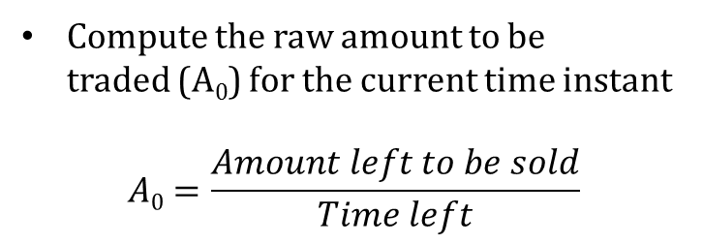
Overview
Problem 1 | Algorithmic Trading
Compute the raw amount to be traded (A₀) for the current time instant
$$A0=\frac{Amount left to be sold}{Time left}$$
Compute
Modify
Trade
Modify the raw amount based on
Departure of price from local avg.
Slope of the price curve
2nd derivative of the price curve
Exercise trade based on
demand / supply
modified amount to be sold
GS Quantify | October 25, 2013 | HauntQuant, IIT Madras

Slide 4
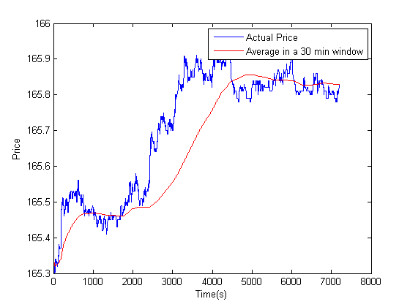
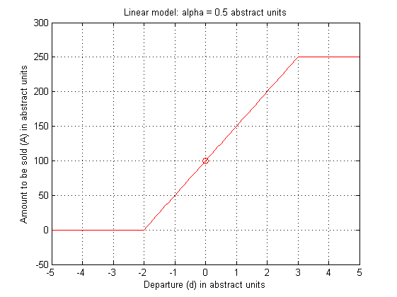

Modifying Raw Quantity: Models I
Problem 1 | Algorithmic Trading
Departure: $d=\left(\frac{f−\overline{f }}{σ}\right)$
Linear Model
$A=A0(1+αd)$
$A$ is limited between 0 and $Amax$
A₀
GS Quantify | October 25, 2013 | HauntQuant, IIT Madras

Slide 5
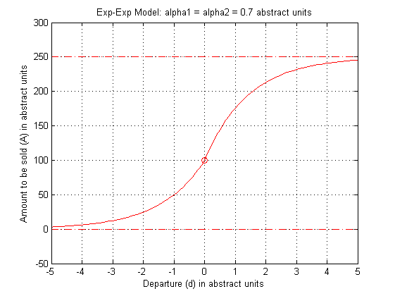
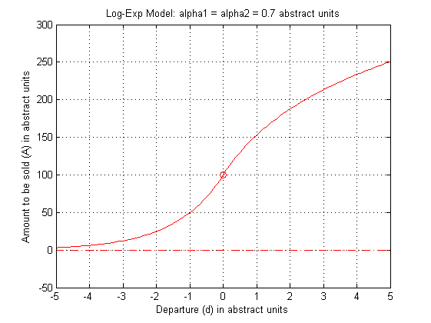
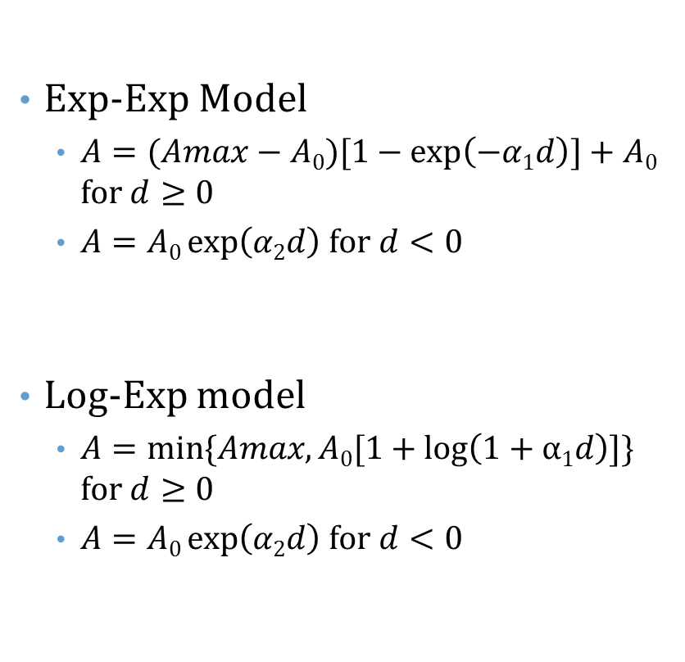
Modifying Raw Quantity: Models II
Problem 1 | Algorithmic Trading
Exp-Exp Model
$A=(Amax−A0)[1−\exp\left(−α1d\right)]+A0$ for $d≥0$
$A=A0\exp\left(α2d\right)$ for $d<0$
Log-Exp model
$A=min⁡\{Amax, A0[1+\log\left(1+α1d\right)]\}$ for $d≥0$
$A=A0\exp\left(α2d\right)$ for $d<0$
A₀
A₀
GS Quantify | October 25, 2013 | HauntQuant, IIT Madras

Slide 6
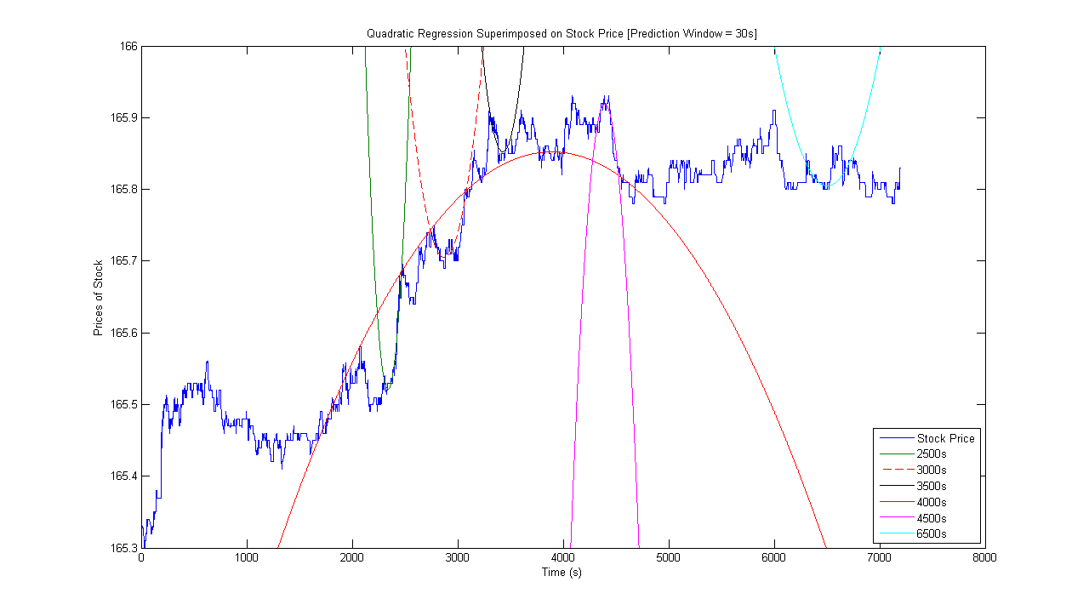

Using Predictions
Problem 1 | Algorithmic Trading
Quadratic fit → 1st and 2nd derivatives
The departure (d) from the previous models is modified using the predictor
$\tilde{d }=d[\exp\left(−β1f^{′}−β{2f}^{′′}\right)]$
GS Quantify | October 25, 2013 | HauntQuant, IIT Madras

Slide 7
Other Considerations I
Problem 1 | Algorithmic Trading
RTL
Keep monitoring prices; don’t trade
Modify A₀ once RTL is over
Trade limits
After computing amount to be sold, only sell as much as “possible”
Buy / Sell
The algorithm always solves sell problem
Buy problem is easily converted to sell problem by inverting the price curve
GS Quantify | October 25, 2013 | HauntQuant, IIT Madras

Slide 8
Other Considerations II
Problem 1 | Algorithmic Trading
Multiple exchanges (algorithm)
Define a new time series that is maximum of the prices across all exchanges at each time instant
Using the raw amount to be traded (A₀), compute the actual amount to be traded (A) using the chosen model
Trade away as much of A as possible on the exchange with best price
Subtract the traded amount from A₀
Having exhausted the “best” exchange, replace the current price of the security with the next best available current price
Using this new current price and the new A₀ computed in step 4, compute the new amount to be computed
Continue this process till the desired amount (original A₀) is traded or all exchanges are exhausted
GS Quantify | October 25, 2013 | HauntQuant, IIT Madras

Slide 9
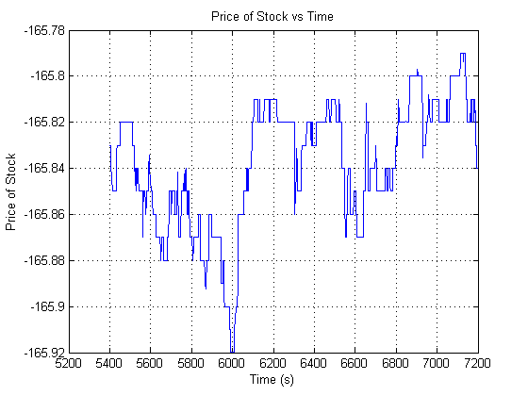
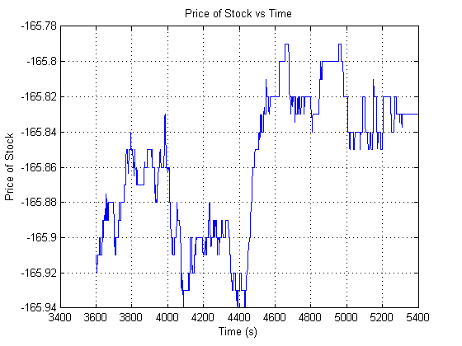
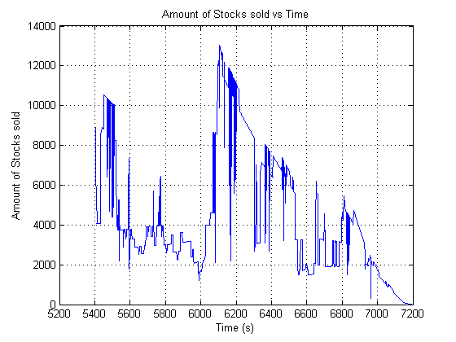
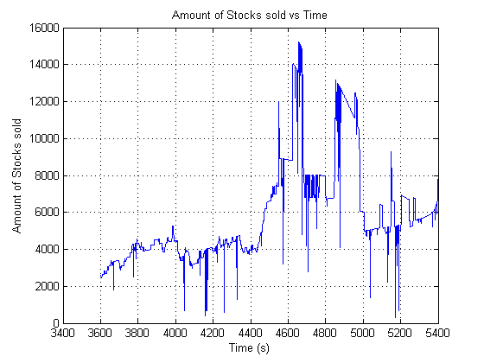
Results
Problem 1 | Algorithmic Trading
I
II
GS Quantify | October 25, 2013 | HauntQuant, IIT Madras

Slide 10
Problem I: Conclusion
Problem 1 | Algorithmic Trading
Departure models
Greater stability
Better average performance
Generic
Predictive models
The size of window for prediction depends on the security
Overall performance is good; can perform very bad in specific cases
Model choice depends on investor profile
Low risk models: Departure models
High risk models: Predictive models
GS Quantify | October 25, 2013 | HauntQuant, IIT Madras

Slide 11
Problem 2
Error Detection in Prices
GS Quantify | October 25, 2013 | HauntQuant, IIT Madras

Slide 12
Breaks: Detection
Problem 2 | Error Detection in Prices
Price Series
The time series of the price of a certain stock
Jump Series
$$jump=price\left(t\right)−price(t−1)$$
𝑗𝑢𝑚𝑝=𝑝𝑟𝑖𝑐𝑒(𝑡)−𝑝𝑟𝑖𝑐𝑒(𝑡−1)
$$μj, σj$$
𝝁_{𝒋}, 𝝈_{𝒋}
Find mean and standard deviation of the jumps ($μj, σj$)
Find mean and standard deviation of the jumps (𝜇_{𝑗}, 𝜎_{𝑗})
Norm jump
Normalized Jump $Nj=(j−μj)/σj$
Normalized Jump 𝑁_{𝑗}=(𝑗−𝜇_{𝑗})/𝜎_{𝑗}
Find jump ($j$) in price for each day
Find jump (𝑗) in price for each day
Break
If the normalized jump is outside ±3 sigma, declare break
GS Quantify | October 25, 2013 | HauntQuant, IIT Madras

Slide 13
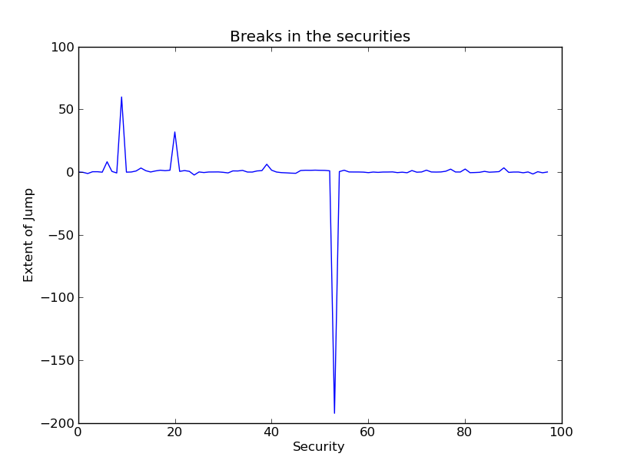
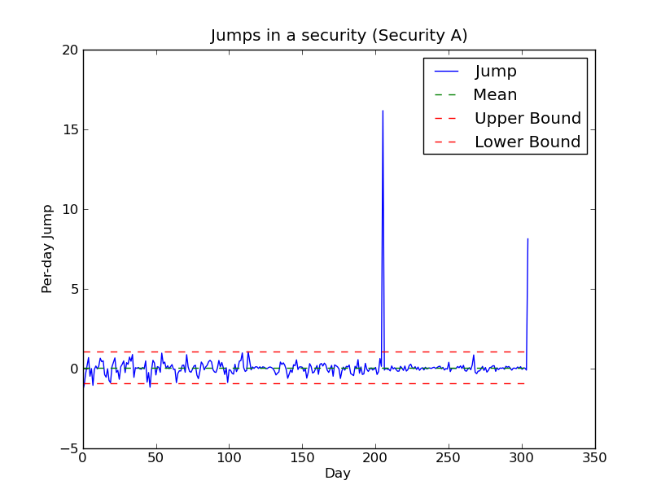
Breaks: Ranking
Problem 2 | Error Detection in Prices
Securities in portfolio
Decreasing order of change in dollar value of the portfolio
Securities not in portfolio
Decreasing order of magnitude of normalized jump
Securities which are in portfolio are always ranked higher
A
Breaks
Inaccurate Historical Data
B
Break
Stock Split
GS Quantify | October 25, 2013 | HauntQuant, IIT Madras

Slide 14
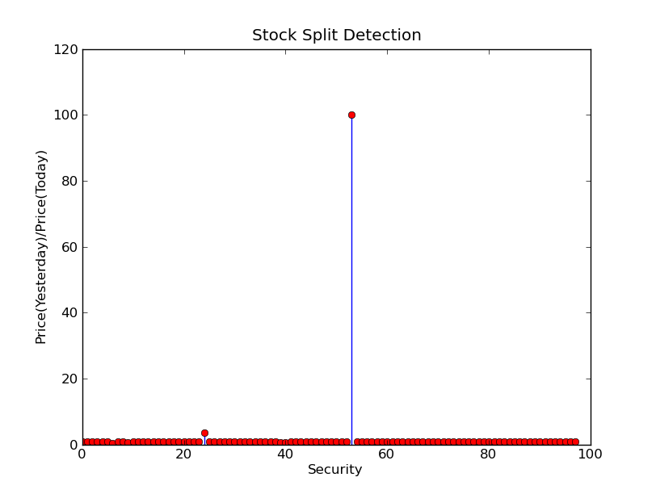
Stock Splits
Problem 2 | Error Detection in Prices
Effect: n-for-1 split
No. of stocks = n*(Old no. of stocks); Stock price = (Old stock price )/ n
Purpose
Very high stock price
Small investors can’t afford the stock
Stock split
More people can afford the stock
Demand rises, liquidity rises
Detection
Price Ratio = Price(d-1)/Price(d)
Ratio usually around 1
Stock split →Price Ratio value approx. integer or simple fraction
Sudden change should be uncorrelated with the market
GS Quantify | October 25, 2013 | HauntQuant, IIT Madras

Slide 15
Security Classification
Problem 2 | Error Detection in Prices
Classification based on 2 parameters
Mean and Variance
k-Means Algorithm
Unsupervised learning: No training data needed
The Algorithm
Start from initial guess on parameters
Classify each point into nearest cluster
Re-compute the class centroids
Iterate till centroids converge
Class Centroids
Compute Distances
Classify into Nearest Class
GS Quantify | October 25, 2013 | HauntQuant, IIT Madras

Slide 16
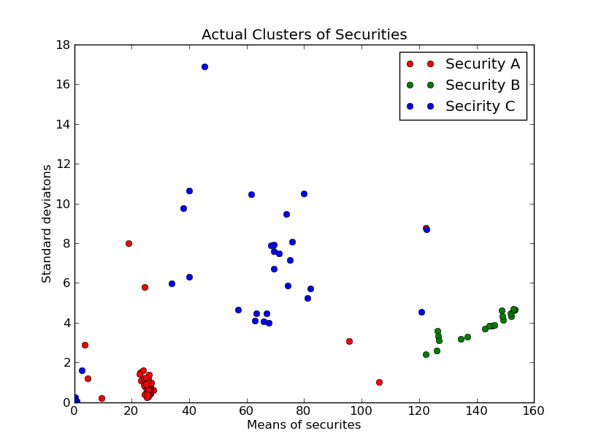
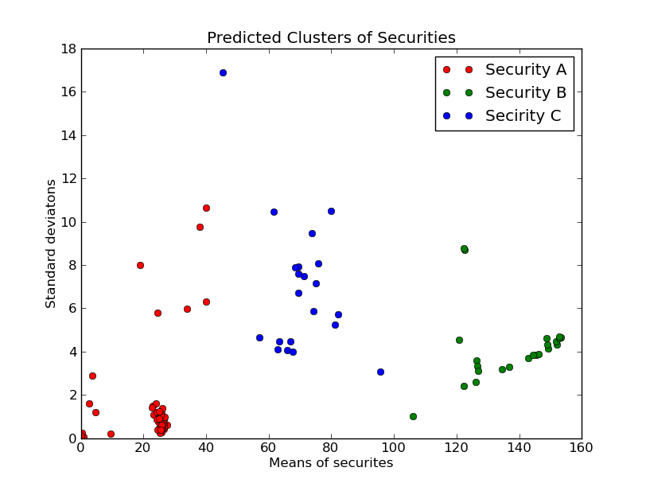
k-Means Classification
Problem 2 | Error Detection in Prices
GS Quantify | October 25, 2013 | HauntQuant, IIT Madras

Slide 17
Accuracy of Historical Data
Problem 2 | Error Detection in Prices
Correlation
For each stock, compute correlation with the market ($ρ$)
For each stock, compute correlation with the market (𝜌)
Expected Movement
Compute expected movement (hence price) knowing
Jump
Define $jump=actual price −expected price$
Define 𝑗𝑢𝑚𝑝=𝑎𝑐𝑡𝑢𝑎𝑙 𝑝𝑟𝑖𝑐𝑒 −𝑒𝑥𝑝𝑒𝑐𝑡𝑒𝑑 𝑝𝑟𝑖𝑐𝑒
Jump corresponds to uncorrelated movement
Market movement for that day
Break
Declare break using the normalized jump approach mentioned earlier
Normalized jump outside ±3 is declared as inaccurate data
$ρ$ value for the stock
𝜌 value for the stock
GS Quantify | October 25, 2013 | HauntQuant, IIT Madras

Slide 18
Market-wide Movements
Problem 2 | Error Detection in Prices
Method 1
Take the average of all prices and check for breaks in this curve
Simple to implement
Method 2
On each day look for breaks in individual stocks (based on that stock’s past price alone)
Report the number of stocks that have breaks
If majority of stocks have breaks on a certain day, declare market-wide movement
A good approach would be to combine both these methods
GS Quantify | October 25, 2013 | HauntQuant, IIT Madras

Slide 19
Problem 3
Monte Carlo in Derivative Pricing
GS Quantify | October 25, 2013 | HauntQuant, IIT Madras

Slide 20

Problem 3: Overview
Problem 3 | Monte Carlo in Derivative Pricing
Poisson Process
$S\left(t\right)=S\left(0\right)\exp\left(X\left(t\right)\right)$
$dX\left(t\right)=yεt−dtθdt$
where,
y = +1 with $p=1−λdt$ y = -1 with $p=λdt$
Stock price | S(t)
Binary option | V
Strike Price | K
Expiration Time | T
n(Y-)
Binomial Distribution
N_{Y-}
Poisson Distribution
t2-t1
Exponential Distribution
GS Quantify | October 25, 2013 | HauntQuant, IIT Madras

Slide 21




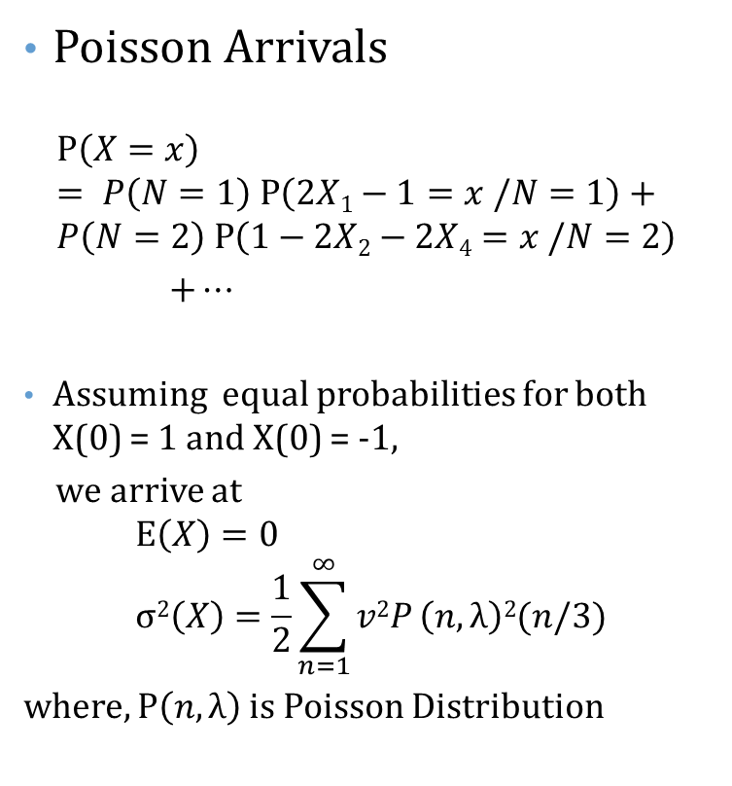
Analytical Solution
Problem 3 | Monte Carlo in Derivative Pricing
$$X1$$
$$X2$$
$$1−X1−X2$$
Poisson Arrivals
$$P\left(X=x\right) \\ = P\left(N=1\right) P\left(2X1−1=x /N=1\right)+ \\ P\left(N=2\right) P\left(1−2X2−2X4=x /N=2\right)$$ $+…$
Assuming equal probabilities for both X(0) = 1 and X(0) = -1,
we arrive at
$$E\left(X\right)=0 \\ σ2\left(X\right)=\frac{1}{2}\sum_{n=1}^{∞}{v2P}\left(n,λ\right)2(n/3)$$
where, $P\left(n,λ\right)$is Poisson Distribution
0
1
$$N=1⇒{ X=2X1−1} \\ N=3⇒{ X=2X1+2X3−1} \\ N=5⇒{ X=2X1+2X3+2X5−1}$$
$$N=2⇒{ X=1−2X2} \\ N=4⇒{ X=1−2X2−2X4} \\ N=6⇒{ X=1−2X2−2X4−2X6}$$
GS Quantify | October 25, 2013 | HauntQuant, IIT Madras

Slide 22
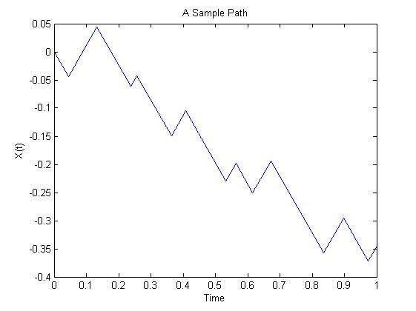
Monte Carlo Solution
Problem 3 | Monte Carlo in Derivative Pricing
t_{d}
1
2
Create Path: Introduce a direction flip at each event
3
Repeat 1 & 2 to generate many paths for Monte Carlo Simulation
Generate exponentially distributed time samples summing to >1
GS Quantify | October 25, 2013 | HauntQuant, IIT Madras

Slide 23
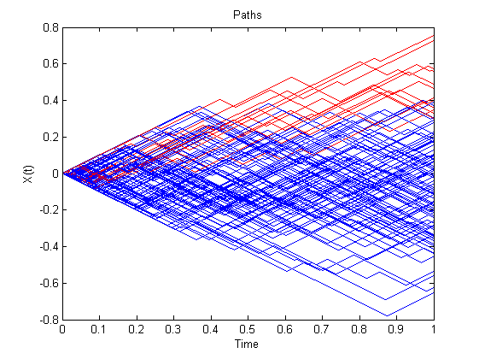

Compute Parameters
Problem 3 | Monte Carlo in Derivative Pricing
Averaging over all the simulation paths
Symmetric Paths
$S\left(t\right)<B$ => Reduced Sample Space
Re-evaluate parameters
Parameter | Average of
Mean | X_{i}
Standard Deviation | (X_{i}-X)²
Skewness | (X_{i}-X)³/σ³
Kurtosis | (X_{i}-X)⁴/σ⁴
GS Quantify | October 25, 2013 | HauntQuant, IIT Madras

Slide 24
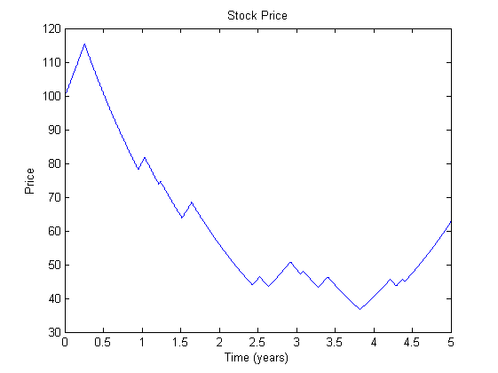
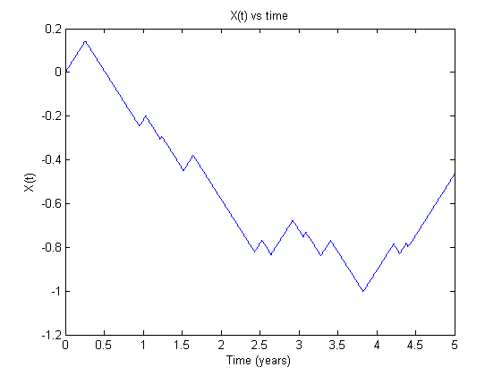

Parameter Extraction
Problem 3 | Monte Carlo in Derivative Pricing
Given, $S\left(t\right) for 0≤t≤5$ To extract : λ , $v$
$X\left(t\right)=\log{\frac{S\left(t\right)}{S\left(0\right)}}$
GS Quantify | October 25, 2013 | HauntQuant, IIT Madras

Slide 25
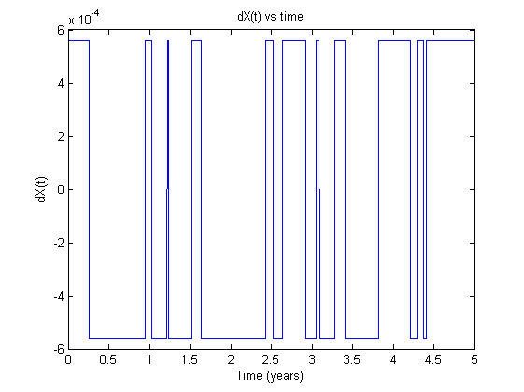
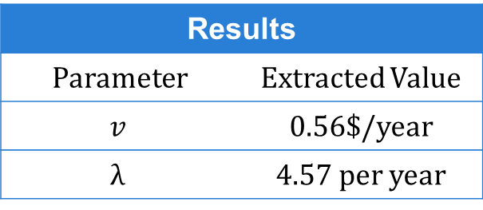
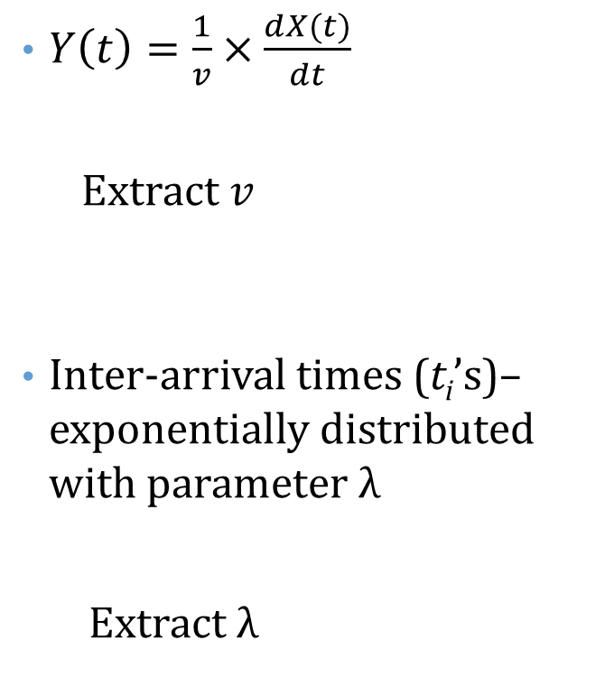
Parameter Extraction
Problem 3 | Monte Carlo in Derivative Pricing
$Y\left(t\right)=\frac{1}{v}×\frac{dX(t)}{dt}$
Extract $v$
Inter-arrival times (t_{i}’s)– exponentially distributed with parameter λ Extract $λ$
t_{i}
Results
Parameter | Extracted Value
$$v$$ | 0.56$/year
$$λ$$ | 4.57 per year
GS Quantify | October 25, 2013 | HauntQuant, IIT Madras

Slide 26
Thank you
Questions?
GS Quantify | October 25, 2013 | HauntQuant, IIT Madras

Slide 27
References
References
Jan Ivar Larsen, “Predicting Stock Prices Using Technical Analysis and Machine Learning”, Norwegian University of Science and Technology
T. Dai et. al., “Automated Stock Trading using Machine Learning Algorithms”, Stanford University
D. Moldovan et. al., “A Stock Trading Algorithm Model Proposal, based on Technical IndicatorsSignals”, Vol 15 no. 1/2011, Informatica Economica
http://www.vatsals.com/Essays/MachineLearningTechniquesforStockPrediction.pdf
Other References
GS Logo: http://www.goldmansachs.com/
IITM Logo: http://researchportal.iitm.ac.in/?q=download-forms
GS Quantify | October 25, 2013 | HauntQuant, IIT Madras

