Slide 1
VitusVet Web Data Analysis
Data Jam by Team 4 - Akhil Gupta, Jai Kapoor, Jayant Tikmani, Arpit Kapoor

Slide 2
What Did We Know?
Given Google Analytics Data for Website/Application Interaction and User Data – 37886 values
Some Knowledge of Digital Analytics
No Knowledge of Customer Analytics
Explain Retention Rate, Power Users Using the Two Data Sets

Slide 3
Investigation of Variables
Time Series Data for Each Day of 11 Months
Aggregated Active Users Weekly, 14days, Monthly
Active Users of two types: New Users and Returning Users
7 day Returning Users = 7 day Active Users – 7 day New Users
Started with visualizing all data points in time series data
Ended up visualizing monthly data
Visualizations shown in the appendix

Slide 4
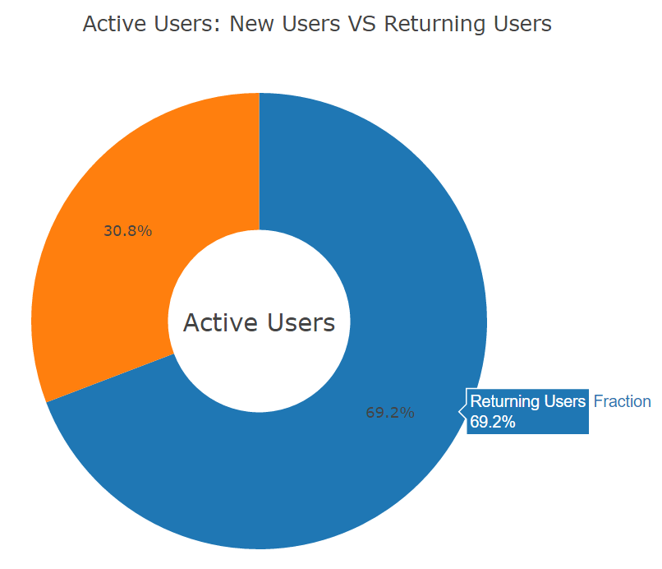
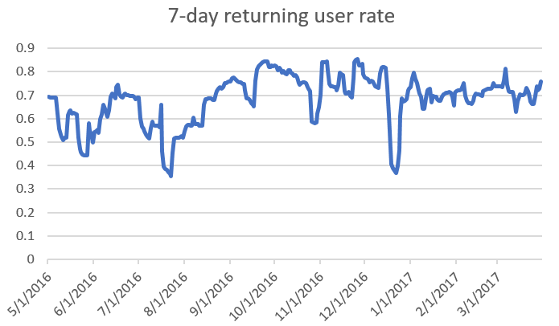
Returning Users Mystery
7 day returning users
10,000 -> 6920
7 day returning users rate over time–

Slide 5
Building Models Around Returning Users
Tried 6 Machine Learning Algorithms to classify whether a user is a returning user or not -
SVM
Knn
Decision Tree
SVC
Logistic Regression
Naiive Bayes
Random Forest
False Positives:
0
False Negatives:
65
Accuracy: 96%
False Positives:
14
False Negatives:
41
Accuracy: 97%
False Positives:
29
False Negatives:
22
Accuracy: 97%
False Positives:
25
False Negatives:
24
Accuracy: 97%
False Positives:
2
False Negatives:
65
Accuracy: 96%
False Positives:
7
False Negatives:
63
Accuracy: 96%
*FP- classifying someone as a returning user who is not a returning user ; FN- classifying someone not a returning user as a returning user

Slide 6
Returning Users Features
All six models provide very good accuracy and any of these models can be selected based on VitusVets’ business requirements (FP?, FN?, Accuracy?)
FP more costly? -> SVM, FN more costly? -> Decision Trees
Lets consider the model logistic regression
The model’s equation is 1.75+2.48*Sessions+2.49*AndroidUser+ 3.56*iOSUser-0.11*Duration i.e., returning user features
For increasing retention rate, focus on most contributing features – iOSUser, AndroidUser, Sessions
*FP- classifying someone as a returning user who is not a returning user ; FN- classifying someone not a returning user as a returning user

Slide 7
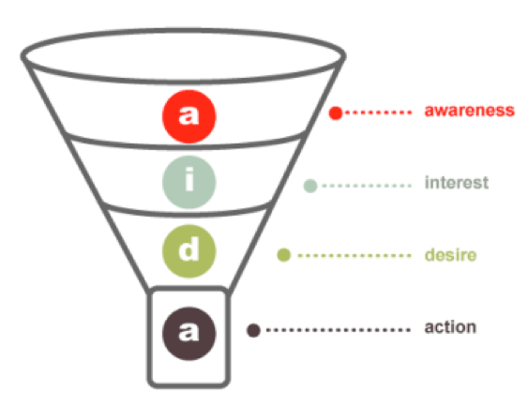
Power User!?
The more time someone spends on your platform, the higher likelihood of him/her travelling down the conversion funnel
So, people spending the most amount of time (i.e., Number of Sessions * Average Session Duration) are your power users

Slide 8
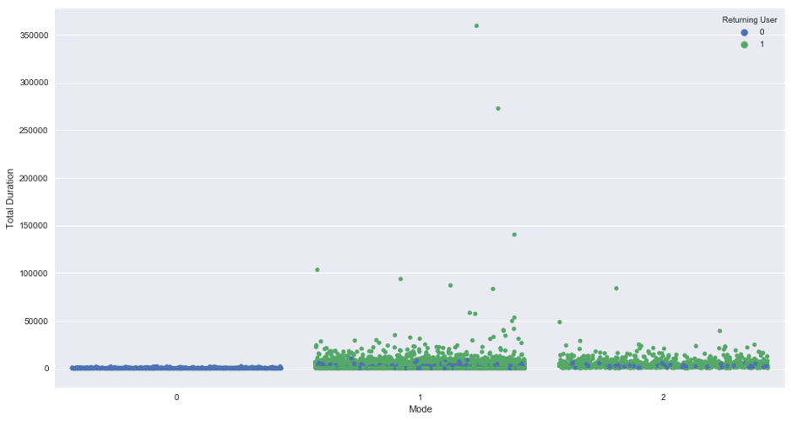
Power User Feature v/s Other Features?
Total Duration v/s devices mode with Returning/Non-Returning Users
iOS users -> highest number, spending most time, most returning users
Other users -> High number, spending least time, no returning users
Android users -> Moderate number, time spent and returning user

Slide 9
Recommendations
The data provided consists of basic and by-default data tracking features of Google Analytics
GA could be used to dig much deeper into the platform use
Geo-targeting? Track locations of returning users, power users and find insights
Track events and transactions – people watching videos, filling forms, users clicking appointment requests
Track conversions at all levels of the conversion funnel – Awareness, Interest, Desire and Action

Slide 10




Meet the Team
We will be happy to answer any questions you may have on our analysis
Akhil Gupta
Jai Kapoor
Jayant Tikmani
Arpit Kapoor
Web Development
Data Science and ML
Data Analytics and Visualization
Web Development and Software Development
file:///C:/Users/Jai/Desktop/cohorts-master/cohorts-master/index.html

Slide 11
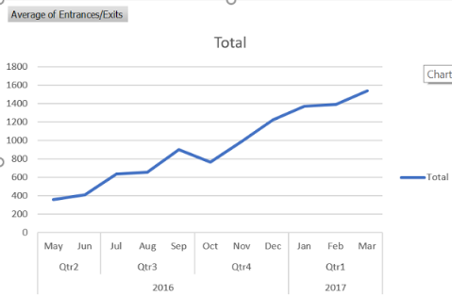
Appendix

Slide 12
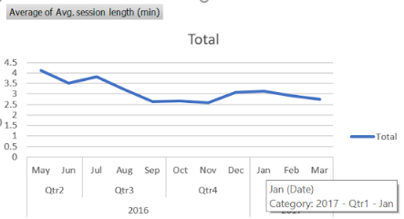
Appendix (Contd..)

Slide 13
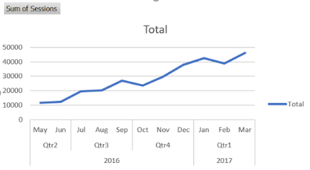
Appendix (Contd..)

Slide 14
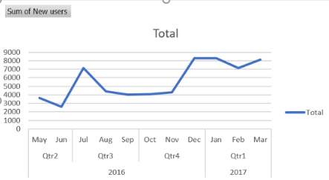
Appendix (Contd..)

Slide 15
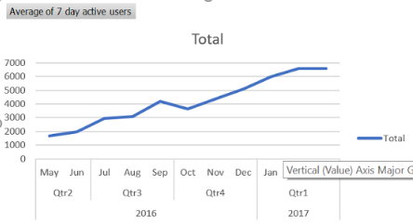
Appendix (Contd..)

Slide 16
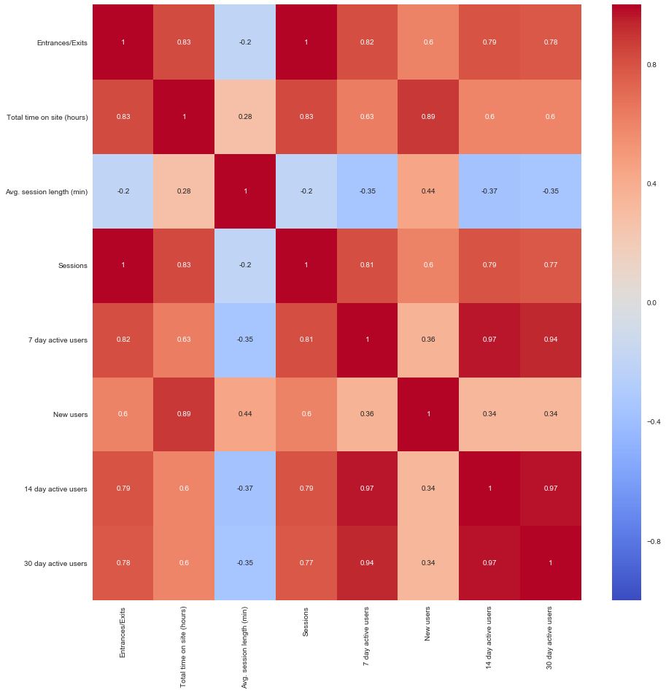
Appendix (Contd..)

Slide 17
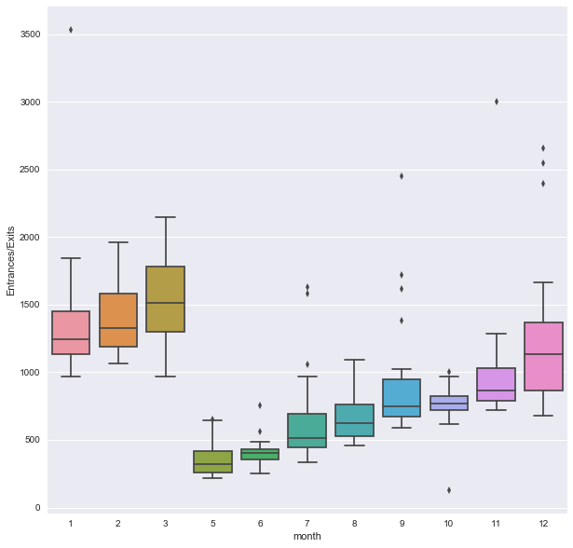
Appendix (Contd..)

