Slide 1
ANLT configuration

Slide 2
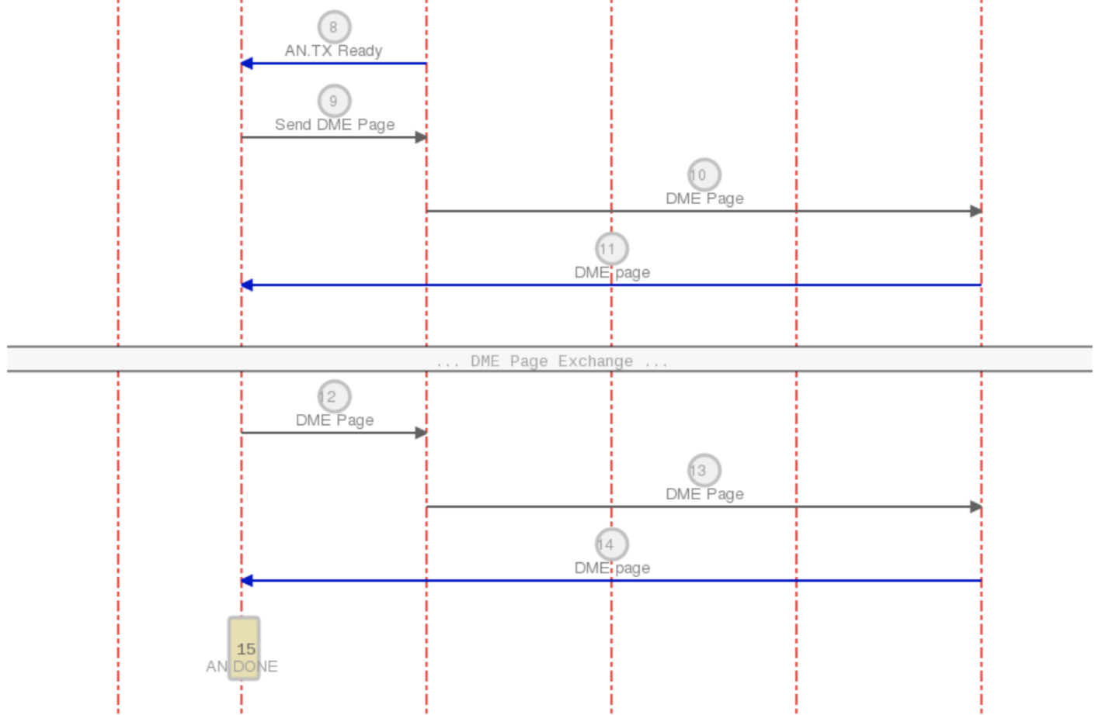
ANLT CrossBar usage

Slide 3
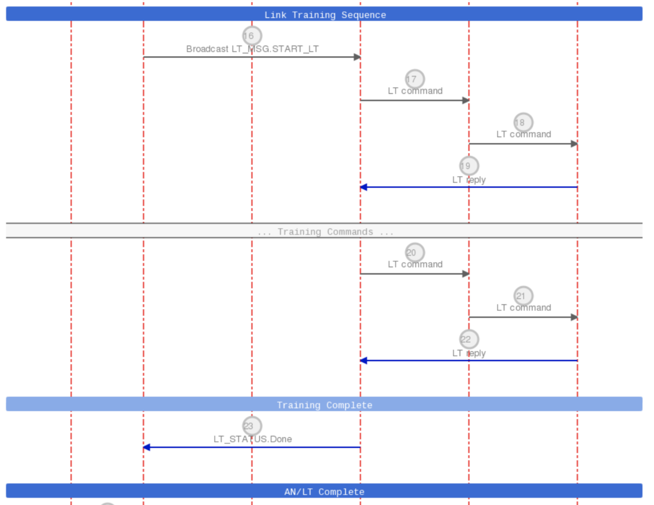
ANLT CrossBar usage

Slide 4
Tx2Rx/Rx2Tx ANLT Messaging
Tx <-> Rx SerDes send ANLT message to each other through Xbar.
Tx SerDes has Send & Receive MSG buffer.
Rx SerDes has Send & Receive MSG buffer.
Control/configuration registers:
serdes_tx_lane_swap_config
serdes_rx_lane_swap_config

Slide 5
ANLT Tx2Rx Messaging
serdes_tx_lane_swap_config:
this configures which Tx to Rx
Index = Rx SerDes number
Value = Tx SerDes number
Configurations:
tx_lane4_source [9:8] = 0x3
tx_lane5_source [11:10] = 0x1
tx_lane6_source [13:12] = 0x2
tx_lane7_source [15:14] = 0x0
Tx | Rx | tx_source
4 | 7 | 0x0
5 | 5 | 0x1
6 | 6 | 0x2
7 | 4 | 0x3

Slide 6
ANLT Rx2Tx Messaging
serdes_rx_lane_swap_config:
this configures which Rx to Tx
Index = Tx SerDes number
Value = Rx SerDes number
Configurations:
rx_lane4_source [9:8] = 0x3
rx_lane5_source [11:10] = 0x1
rx_lane6_source [13:12] = 0x2
rx_lane7_source [15:14] = 0x0
Tx | Rx | rx_source
4 | 7 | 0x3
5 | 5 | 0x1
6 | 6 | 0x2
7 | 4 | 0x0

Slide 7
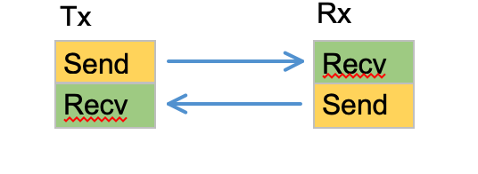
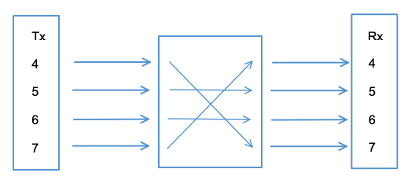
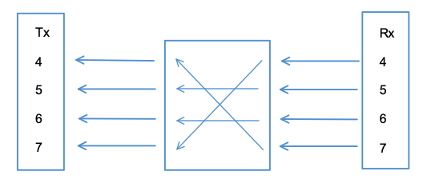
Test case:
Send Tx2Rx MSG on Tx send buffer
Send Rx2Tx MSG on Rx send buffer
Two testing case:
Config Correct Rx Lane swap info, Tx without Lane swap
Config Correct both Tx and Rx Lane swap info.

Slide 8
Testing pattern
TX 4 :Writing tx msg 0x00045a5a
RX 4 :Writing tx msg 0x0004a5a5
TX 5 :Writing tx msg 0x00055a5a
RX 5 :Writing tx msg 0x0005a5a5
TX 6 :Writing tx msg 0x00065a5a
RX 6 :Writing tx msg 0x0006a5a5
TX 7 :Writing tx msg 0x00075a5a
RX 7 :Writing tx msg 0x0007a5a5

Slide 9
Case 1: AN Test without Tx swap
dd.read_register(pool.serdes_pool24.serdes_tx_lane_swap_config)
tx_lane4_source [9:8] = 0x0
tx_lane5_source [11:10] = 0x1
tx_lane6_source [13:12] = 0x2
tx_lane7_source [15:14] = 0x3
TEST:: LT MSG - die 0x200 channel 0
From Rx -> Tx ------
Got error while receiving valid msg. Clear it.
Dir TX :Reading Rx msg 0x0007a5a5, FIFO Depth 1
From Tx -> Rx ------
Dir RX :Reading Rx msg 0x00045a5a, FIFO Depth 1
TEST:: LT MSG - die 0x200 channel 1
From Rx -> Tx ------
Dir TX :Reading Rx msg 0x0005a5a5, FIFO Depth 1
From Tx -> Rx ------
Dir RX :Reading Rx msg 0x00055a5a, FIFO Depth 1
TEST:: LT MSG - die 0x300 channel 0
From Rx -> Tx ------
Dir TX :Reading Rx msg 0x0006a5a5, FIFO Depth 1
From Tx -> Rx ------
Dir RX :Reading Rx msg 0x00065a5a, FIFO Depth 1
TEST:: LT MSG - die 0x300 channel 1
From Rx -> Tx ------
Dir TX :Reading Rx msg 0x0004a5a5, FIFO Depth 1
From Tx -> Rx ------
Dir RX :Reading Rx msg 0x00075a5a, FIFO Depth 1
Rx2Tx swapped in configuration
Tx2Rx swap not configured
dd.read_register(pool.serdes_pool24.serdes_rx_lane_swap_config)
rx_lane4_source [9:8] = 0x3
rx_lane5_source [11:10] = 0x1
rx_lane6_source [13:12] = 0x2
rx_lane7_source [15:14] = 0x0

Slide 10
Case 2: AN Test with Tx swap
TEST:: LT MSG - die 0x200 channel 0
From Rx -> Tx ------
Got error while receiving valid msg. Clear it.
Dir TX :Reading Rx msg 0x0007a5a5, FIFO Depth 1
From Tx -> Rx ------
Got error while receiving valid msg. Clear it.
Dir RX :Reading Rx msg 0x00075a5a, FIFO Depth 1
TEST:: LT MSG - die 0x200 channel 1
From Rx -> Tx ------
Dir TX :Reading Rx msg 0x0005a5a5, FIFO Depth 1
From Tx -> Rx ------
Dir RX :Reading Rx msg 0x00055a5a, FIFO Depth 1
TEST:: LT MSG - die 0x300 channel 0
From Rx -> Tx ------
Dir TX :Reading Rx msg 0x0006a5a5, FIFO Depth 1
From Tx -> Rx ------
Dir RX :Reading Rx msg 0x00065a5a, FIFO Depth 1
TEST:: LT MSG - die 0x300 channel 1
From Rx -> Tx ------
Dir TX :Reading Rx msg 0x0004a5a5, FIFO Depth 1
From Tx -> Rx ------
Dir RX :Reading Rx msg 0x00045a5a, FIFO Depth 1
dd.read_register(pool.serdes_pool24.serdes_tx_lane_swap_config)
tx_lane4_source [9:8] = 0x3
tx_lane5_source [11:10] = 0x1
tx_lane6_source [13:12] = 0x2
tx_lane7_source [15:14] = 0x0
Rx2Tx /Tx2Rx both swapped in configuration
dd.read_register(pool.serdes_pool24.serdes_rx_lane_swap_config)
rx_lane4_source [9:8] = 0x3
rx_lane5_source [11:10] = 0x1
rx_lane6_source [13:12] = 0x2
rx_lane7_source [15:14] = 0x0

Slide 11
LT Error/Done Status
LT leader is the first follower in the bundle.
LT group SerDes members publish LT result Error/Done Status to the entire group.
All SerDes in the group set Done, followers see Done.
One SerDes in the group set Error, followers see Error.
Control/configuration registers:
serdes_an_bitmap_config
Status is sent/receive on the follower’s Rx SerDes.

Slide 12
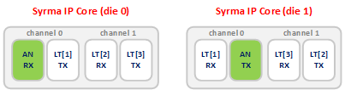
LT Error/Done Status
serdes_an_bitmap_config:
set the bitmap of LT group to all the LT followers, including leader.
it tells Rx followers which SerDes are in the LT group.
Who is the Leader
The Leader SerDes = Rx lane number of the front panel SerDes 0

Slide 13
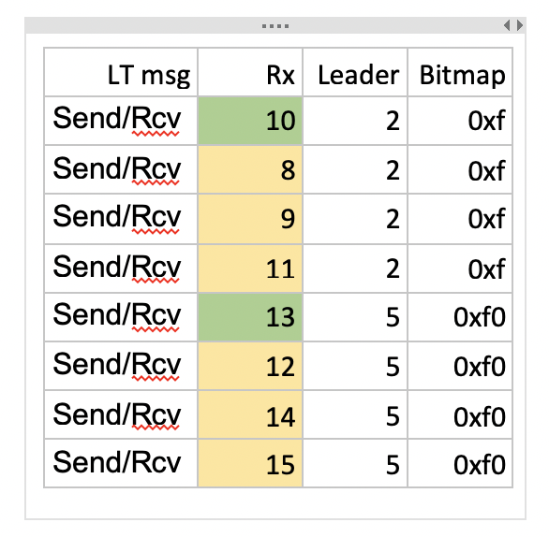
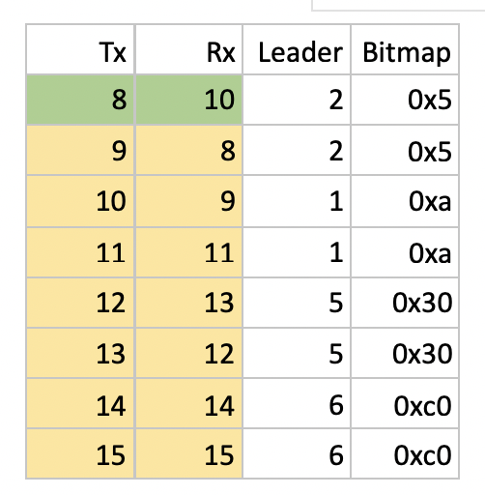
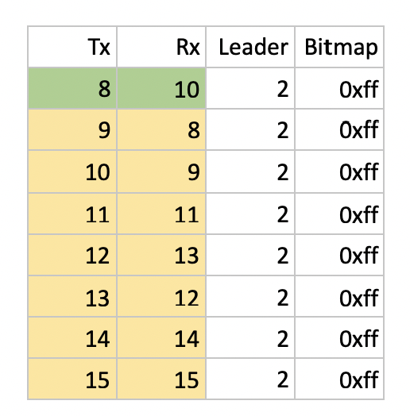
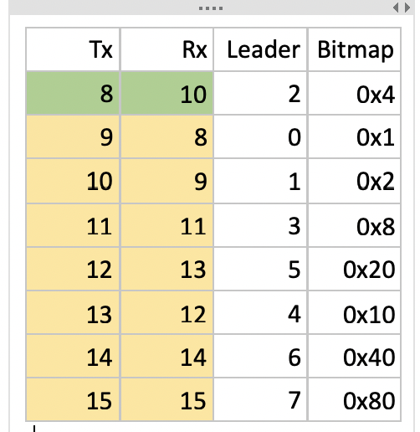
Test case
Set Error status on Tx SerDes, check Master status on Rx SerDes
Set Done status on Tx SerDes, check Master status on Rx SerDes

Slide 14
Case 1 (8 Serdes):
serdes_pool24.serdes_an_bitmap_config
srd8_an_bitmap [71:64] = 0x0ff
srd9_an_bitmap [79:72] = 0x0ff
srd10_an_bitmap [87:80] = 0x0ff
srd11_an_bitmap [95:88] = 0x0ff
srd12_an_bitmap [103:96] = 0x0ff
srd13_an_bitmap [111:104] = 0x0ff
srd14_an_bitmap [119:112] = 0x0ff
srd15_an_bitmap [127:120] = 0x0ff
>>> write_tx_sts(0,0,8,1,1)
>>> read_rx_sts(0,0,8,8)
0
0
0
0
0
0
0
0
>>> write_tx_sts(0,0,9,7,1)
>>> read_rx_sts(0,0,8,8)
1
1
1
1
1
1
1
1
>>> read_rx_sts(0,0,8,8)
0
0
0
0
0
0
0
0
>>> write_tx_sts(0,0,8,1,2)
>>> read_rx_sts(0,0,8,8)
2
2
2
2
2
2
2
2

Slide 15
Case 2 (2 Serdes):
>>> write_tx_sts(0,0,12,1,1)
>>> read_rx_sts(0,0,8,8)
2
2
2
2
0
0
0
0
>>> write_tx_sts(0,0,13,1,1)
>>> read_rx_sts(0,0,8,8)
2
2
2
2
1
1
0
0
serdes_pool24.serdes_an_bitmap_config
srd8_an_bitmap [71:64] = 0x003
srd9_an_bitmap [79:72] = 0x003
srd10_an_bitmap [87:80] = 0x00c
srd11_an_bitmap [95:88] = 0x00c
srd12_an_bitmap [103:96] = 0x030
srd13_an_bitmap [111:104] = 0x030
srd14_an_bitmap [119:112] = 0x0c0
srd15_an_bitmap [127:120] = 0x0c0
>>> write_tx_sts(0,0,8,1,2)
>>> read_rx_sts(0,0,8,8)
2
0
2
0
0
0
0
0
>>> write_tx_sts(0,0,9,1,2)
>>> read_rx_sts(0,0,8,8)
2
2
2
2
0
0
0
0

Slide 16
Case 3 (1 Serdes):
serdes_pool24.serdes_an_bitmap_config
srd8_an_bitmap [71:64] = 0x001
srd9_an_bitmap [79:72] = 0x002
srd10_an_bitmap [87:80] = 0x004
srd11_an_bitmap [95:88] = 0x008
srd12_an_bitmap [103:96] = 0x010
srd13_an_bitmap [111:104] = 0x020
srd14_an_bitmap [119:112] = 0x040
srd15_an_bitmap [127:120] = 0x080
>>> write_tx_sts(0,0,8,1,2)
>>> read_rx_sts(0,0,8,8)
2
0
0
0
0
0
0
0
>>> write_tx_sts(0,0,9,1,2)
>>> read_rx_sts(0,0,8,8)
2
2
0
0
0
0
0
0
>>> write_tx_sts(0,0,10,1,2)
>>> read_rx_sts(0,0,8,8)
2
2
2
0
0
0
0
0
>>> write_tx_sts(0,0,11,1,2)
>>> read_rx_sts(0,0,8,8)
2
2
2
2
0
0
0
0

Slide 17
LT Messaging
LT Leader send message to all SerDes in the LT group.
Each SerDes has one Send MSG buffer and one Receive MSG buffer.
Same mechanism as Tx2Rx/Rx2Tx but broadcast.
Message can only be sent on the Leader SerDes.
Control/configuration registers:
serdes_an_bitmap_config
serdes_an_master_config
LT message is sent from Leader Rx SerDes to follower Rx SerDes.

Slide 18
LT Messaging
serdes_an_bitmap_config:
set the bitmap of LT followers to all the LT group members.
it tells Rx followers which SerDes are in the LT group.
serdes_an_master_config:
set the master SerDes index to all the LT group members.
it tells follower SerDes which Rx SerDes is the master.

Slide 19
Test case
Send MSG on LT send buffer
Receive MSG on LT receive buffer of all SerDes in the LT group

Slide 20
Case (4 SerDes) configuration:
serdes_pool24.serdes_an_bitmap_config
srd0_an_bitmap [7:0] = 0x00f
srd1_an_bitmap [15:8] = 0x00f
srd2_an_bitmap [23:16] = 0x00f
srd3_an_bitmap [31:24] = 0x00f
srd4_an_bitmap [39:32] = 0x0f0
srd5_an_bitmap [47:40] = 0x0f0
srd6_an_bitmap [55:48] = 0x0f0
srd7_an_bitmap [63:56] = 0x0f0
srd8_an_bitmap [71:64] = 0x00f
srd9_an_bitmap [79:72] = 0x00f
srd10_an_bitmap [87:80] = 0x00f
srd11_an_bitmap [95:88] = 0x00f
srd12_an_bitmap [103:96] = 0x0f0
srd13_an_bitmap [111:104] = 0x0f0
srd14_an_bitmap [119:112] = 0x0f0
srd15_an_bitmap [127:120] = 0x0f0
srd16_an_bitmap [135:128] = 0x00f
srd17_an_bitmap [143:136] = 0x00f
srd18_an_bitmap [151:144] = 0x00f
srd19_an_bitmap [159:152] = 0x00f
srd20_an_bitmap [167:160] = 0x0f0
srd21_an_bitmap [175:168] = 0x0f0
srd22_an_bitmap [183:176] = 0x0f0
srd23_an_bitmap [191:184] = 0x0f0
serdes_pool24.serdes_an_master_config)
srd0_an_master_idx [2:0] = 0x0
srd1_an_master_idx [5:3] = 0x0
srd2_an_master_idx [8:6] = 0x0
srd3_an_master_idx [11:9] = 0x0
srd4_an_master_idx [14:12] = 0x7
srd5_an_master_idx [17:15] = 0x7
srd6_an_master_idx [20:18] = 0x7
srd7_an_master_idx [23:21] = 0x7
srd8_an_master_idx [26:24] = 0x2
srd9_an_master_idx [29:27] = 0x2
srd10_an_master_idx [32:30] = 0x2
srd11_an_master_idx [35:33] = 0x2
srd12_an_master_idx [38:36] = 0x5
srd13_an_master_idx [41:39] = 0x5
srd14_an_master_idx [44:42] = 0x5
srd15_an_master_idx [47:45] = 0x5
srd16_an_master_idx [50:48] = 0x2
srd17_an_master_idx [53:51] = 0x2
srd18_an_master_idx [56:54] = 0x2
srd19_an_master_idx [59:57] = 0x2
srd20_an_master_idx [62:60] = 0x4
srd21_an_master_idx [65:63] = 0x4
srd22_an_master_idx [68:66] = 0x4
srd23_an_master_idx [71:69] = 0x4

Slide 21
Case (4 SerDes) result:
Writing 0x0000/0 Tx -> Rx msg 0xf0f00000
Writing 0x0300/1 Tx -> Rx msg 0xf0f00004
Writing 0x0500/0 Tx -> Rx msg 0xf0f00008
Writing 0x0600/1 Tx -> Rx msg 0xf0f0000c
Writing 0x0900/0 Tx -> Rx msg 0xf0f00010
Writing 0x0a00/0 Tx -> Rx msg 0xf0f00014
TEST:: LT MSG TX - die 0x0 channel 0
RX - die 0x0 channel 0
Reading Tx -> Rx msg 0xf0f00000, FIFO Depth 1
TEST:: LT MSG TX - die 0x0 channel 1
RX - die 0x0 channel 1
Reading Tx -> Rx msg 0xf0f00000, FIFO Depth 1
TEST:: LT MSG TX - die 0x100 channel 0
RX - die 0x100 channel 0
Reading Tx -> Rx msg 0xf0f00000, FIFO Depth 1
TEST:: LT MSG TX - die 0x100 channel 1
RX - die 0x100 channel 1
Reading Tx -> Rx msg 0xf0f00000, FIFO Depth 1
TEST:: LT MSG TX - die 0x200 channel 0
RX - die 0x300 channel 1
Reading Tx -> Rx msg 0xf0f00004, FIFO Depth 1
TEST:: LT MSG TX - die 0x200 channel 1
RX - die 0x200 channel 1
Got error while receiving valid msg. Clear it.
Reading Tx -> Rx msg 0x00000000
read again after clear error
Reading Tx -> Rx msg 0xf0f00004, FIFO Depth 1
TEST:: LT MSG TX - die 0x300 channel 0
RX - die 0x300 channel 0
Got error while receiving valid msg. Clear it.
Reading Tx -> Rx msg 0x00000000
read again after clear error
Reading Tx -> Rx msg 0xf0f00004, FIFO Depth 1
TEST:: LT MSG TX - die 0x300 channel 1
RX - die 0x200 channel 0
Got error while receiving valid msg. Clear it.
Reading Tx -> Rx msg 0x00000000
read again after clear error
Reading Tx -> Rx msg 0xf0f00004, FIFO Depth 1
TEST:: LT MSG TX - die 0x400 channel 0
RX - die 0x500 channel 0
Reading Tx -> Rx msg 0xf0f00008, FIFO Depth 1
TEST:: LT MSG TX - die 0x400 channel 1
RX - die 0x400 channel 0
Got error while receiving valid msg. Clear it.
Reading Tx -> Rx msg 0x00000000
read again after clear error
Reading Tx -> Rx msg 0xf0f00008, FIFO Depth 1
TEST:: LT MSG TX - die 0x500 channel 0
RX - die 0x400 channel 1
Got error while receiving valid msg. Clear it.
Reading Tx -> Rx msg 0x00000000
read again after clear error
Reading Tx -> Rx msg 0xf0f00008, FIFO Depth 1
TEST:: LT MSG TX - die 0x500 channel 1
RX - die 0x500 channel 1
Reading Tx -> Rx msg 0xf0f00008, FIFO Depth 1

