Slide 1
CS 325 Analysis of Algorithms
Instructor: Julianne Schutfort
E-mail: schutfoj@engr.oregonstate.edu
Subject: CS325
Textbook:
Introduction to Algorithms by Cormen, Leiserson, Rivest, Stein, 3rd Edition.
Algorithms by Jeff Erickson 0th Edition. http://jeffe.cs.illinois.edu/teaching/algorithms/

Slide 2
Grade Evaluation
Homework 5@ 10--------------- 50%
Project -------------------- 20%
Quizzes 3@ 10 ------------------ 30%
TOTAL ----------------------------- 100%

Slide 3
Homework
There are five homework assignments with both written problems and same programming problems.
Due by 11:59pm
Written portion submitted in Canvas in programming portion submitted to TEACH
A subset of the homework problems will be graded. Assignments that are not neatly written up using a word processor/text editor will not be graded.

Slide 4
Project
Projects may be completed in a group of up to 3 individuals. You may use any other language that can be compiled and run on flip.
Form your group by the fifth week of class and join the group in Canvas.
Students not in a Project Group by week six will be assigned a group.
One project report submitted per group. Report to Canvas. Report and Code to TEACH.

Slide 5
Quizzes
Three quizzes see the calendar in Canvas.
The quizzes are not cumulative.

Slide 6
Grading Policies:
Any requests for extensions/special accommodations must be made in advance, in writing and sent to the instructor via Canvas messaging.
Homework will be accepted up to 1 day late for a 10% penalty.
Any disagreement in scoring must be addressed within one week of the work being graded. All questions about grading must be placed in the “Assignment Comments” section of the Canvas submission for that assignment.
Grading Scale: Note: Numerical scores will be rounded to the nearest integer
Grade | Average
A | 93 or greater
A- | 90 - 92
B+ | 87 - 89
B | 83 - 86
B- | 80 - 82
C+ | 77 - 79
C | 73 - 76
C- | 70 - 72
D+ | 67 - 69
D | 63 - 66
D- | 60 - 62
F | less than 60

Slide 7
CS 325 - Topics
Asymptotic Analysis and Complexity Classes.
Analysis on experimental run time data.
Linear, polynomial, exponential regression
Recursion, recurrences
Performance determines what is feasible and what is impossible.
When to use a Heuristic or an Approximation Algorithm
Travelling Salesman Problem
Knapsack Problem
Scheduling
.

Slide 8
Algorithm Design Paradigms
There is no one “best” method to solve all problems
Brute Force
Divide and Conquer
Greedy
Dynamic Programming
Graph Algorithms
Approximation

Slide 9
Problems vs Algorithms
Many algorithms exist to solve the sorting problem.
Running time is associated with an algorithms.
Bounds on running times may also be associated with the problem.
Example
Problem: Sorting a list of integers
Algorithms: Insertion Sort, Merge Sort, Naive Sort

Slide 10
How do we compare Algorithms?
We need to define a number of objective measures.
Compare execution times?
Not good: times are specific to a particular computer and programming language!!
Count the number of statements executed?
Not good: number of statements vary with the programming language as well as the style of the individual programmer.

Slide 11
Types of Analysis
Worst case
Provides an upper bound on running time
An absolute guarantee that the algorithm would not run longer, no matter what the inputs are
Best case
Provides a lower bound on running time
Input is the one for which the algorithm runs the fastest
Average case = Expected Value
Provides a prediction about the running time
Assumes that the input is random

Slide 12
Input Size
Express running time as a function of the input size n (i.e., f(n)).
size of an array
# of elements in a matrix
# of bits in the binary representation of the input
vertices and edges in a graph

Slide 13
Asymptotic Analysis
To compare two algorithms with running times f(n) and g(n), we need a rough measure that characterizes how fast each function grows.
Running time of an algorithm as a function of input size n for large n.
Compare functions in the limit, that is, asymptotically! (i.e., for large values of n)
Worst Case Analysis

Slide 14
Problems vs Algorithms
For any given problem there are potentially many different types of algorithms to solve it.
Problem: Sorting a list of integers
Algorithms: Insertion Sort, Merge Sort, Naive Sort

Slide 15
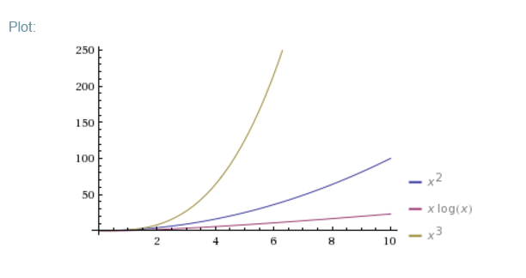
Problems vs Algorithms
For any given problem there are potentially many different types of algorithms to solve it.
Problem: Sorting a list of integers
Algorithms: Insertion Sort, Merge Sort, Naive Sort
Running time
Insertion Sort is O(n²)
Merge Sort is O(nlgn)
Naive Sort is O(n³)

Slide 16
Formally DefineThe Problem of Sorting
Input: sequence ⟨a₁, a₂, …, a_{n}⟩ of numbers.
Output: permutation ⟨a'₁, a'₂, …, a'_{n}⟩ such
that a'₁ ≤ a'₂ ≤ … ≤ a'_{n} .
Example:
Input: 8 2 4 9 3 6
Output: 2 3 4 6 8 9

Slide 17
Importance of Sorting
Maintain a directory of names, phone book, sort by grades of students, …
Find the median
Binary Search assumes array is sorted.
Greedy Algorithms
Problem vs Algorithm
Many algorithms exist to solve the sorting problem.
Running time is associated with an algorithms.
Bounds on running times may also be associated with the problem.

Slide 18
Algorithm 1: Insertion sort
INSERTION-SORT (A, n) ⊳ A[1 . . n]
for j ← 2 to n
do key ← A[ j]
i ← j – 1
while i > 0 and A[i] > key
do A[i+1] ← A[i]
i ← i – 1
A[i+1] = key
“pseudocode”
1
i
j
n
A:
key
sorted

Slide 19
Example of insertion sort
8
2
4
9
3
6

Slide 20
Example of insertion sort
8
2
4
9
3
6

Slide 21
Example of insertion sort
8
2
4
9
3
6
2
8
4
9
3
6

Slide 22
Example of insertion sort
8
2
4
9
3
6
2
8
4
9
3
6

Slide 23
Example of insertion sort
8
2
4
9
3
6
2
8
4
9
3
6
2
4
8
9
3
6

Slide 24
Example of insertion sort
8
2
4
9
3
6
2
8
4
9
3
6
2
4
8
9
3
6

Slide 25
Example of insertion sort
8
2
4
9
3
6
2
8
4
9
3
6
2
4
8
9
3
6
2
4
8
9
3
6

Slide 26
Example of insertion sort
8
2
4
9
3
6
2
8
4
9
3
6
2
4
8
9
3
6
2
4
8
9
3
6

Slide 27
Example of insertion sort
8
2
4
9
3
6
2
8
4
9
3
6
2
4
8
9
3
6
2
4
8
9
3
6
2
3
4
8
9
6

Slide 28
Example of insertion sort
8
2
4
9
3
6
2
8
4
9
3
6
2
4
8
9
3
6
2
4
8
9
3
6
2
3
4
8
9
6

Slide 29
Example of insertion sort
8
2
4
9
3
6
2
8
4
9
3
6
2
4
8
9
3
6
2
4
8
9
3
6
2
3
4
8
9
6
2
3
4
6
8
9
done

Slide 30
Running time
The running time depends on the input: an already sorted sequence is easier to sort.
Major Simplifying Convention: Parameterize the running time by the size of the input, since short sequences are easier to sort than long ones.
T_{A}(n) = time of A on length n inputs
Generally, we seek upper bounds on the running time, to have a guarantee of performance.

Slide 31
Kinds of Analyses
Worst-case: (usually)
T(n) = maximum time of algorithm on any input of size n.
Average-case: (sometimes)
T(n) = expected time of algorithm over all inputs of size n.
Need assumption of statistical distribution of inputs.
Best-case: (NEVER)
Cheat with a slow algorithm that works fast on some input.

Slide 32
Insertion sort analysis
Worst case: Input reverse sorted.
[arithmetic series]
Is insertion sort a fast sorting algorithm?
Moderately so, for small n.
Not at all, for large n.

Slide 33
Insertion sort analysis
Average case: All permutations equally likely.
Is insertion sort a fast sorting algorithm?
Moderately so, for small n.
Not at all, for large n.

Slide 34
Insertion sort analysis
Best Case: Already sorted. Nearly Sorted??
O(n)

Slide 35
Can we sort better?
Insertion upper bound O(n²)
Are there other ways to sort??

Slide 36
Merge Sort
Sorting Problem: Sort a sequence of n elements into non-decreasing order.
Divide: Divide the n-element sequence to be sorted into two subsequences of n/2 elements each
Conquer: Sort the two subsequences recursively using merge sort.
Combine: Merge the two sorted subsequences to produce the sorted answer.

Slide 37
Merge sort – Pseudo code
MERGE-SORT A[1 . . n]
If n = 1, done.
Recursively sort A[ 1 . . ⎡n/2⎤ ] and A[ ⎡n/2⎤+1 . . n ] .
“Merge” the 2 sorted lists.
Key subroutine: MERGE

Slide 38
Merging two sorted arrays
20
13
7
2
12
11
9
1

Slide 39
Merging two sorted arrays
20
13
7
2
12
11
9
1
1

Slide 40
Merging two sorted arrays
20
13
7
2
12
11
9
1
20
13
7
2
12
11
9
1

Slide 41
Merging two sorted arrays
20
13
7
2
12
11
9
1
20
13
7
2
12
11
9
1
2

Slide 42
Merging two sorted arrays
20
13
7
2
12
11
9
1
20
13
7
2
12
11
9
20
13
7
12
11
9
1
2

Slide 43
Merging two sorted arrays
20
13
7
2
12
11
9
1
20
13
7
2
12
11
9
20
13
7
12
11
9
1
2
7

Slide 44
Merging two sorted arrays
20
13
7
2
12
11
9
1
20
13
7
2
12
11
9
20
13
7
12
11
9
20
13
12
11
9
1
2
7

Slide 45
Merging two sorted arrays
20
13
7
2
12
11
9
1
20
13
7
2
12
11
9
20
13
7
12
11
9
20
13
12
11
9
1
2
7
9

Slide 46
Merging two sorted arrays
20
13
7
2
12
11
9
1
20
13
7
2
12
11
9
20
13
7
12
11
9
20
13
12
11
9
20
13
12
11
1
2
7
9

Slide 47
Merging two sorted arrays
20
13
7
2
12
11
9
1
20
13
7
2
12
11
9
20
13
7
12
11
9
20
13
12
11
9
20
13
12
11
1
2
7
9
11

Slide 48
Merging two sorted arrays
20
13
7
2
12
11
9
1
20
13
7
2
12
11
9
20
13
7
12
11
9
20
13
12
11
9
20
13
12
11
20
13
12
1
2
7
9
11

Slide 49
Merging two sorted arrays
20
13
7
2
12
11
9
1
20
13
7
2
12
11
9
20
13
7
12
11
9
20
13
12
11
9
20
13
12
11
20
13
12
1
2
7
9
11
12

Slide 50
Merging two sorted arrays
20
13
7
2
12
11
9
1
20
13
7
2
12
11
9
20
13
7
12
11
9
20
13
12
11
9
20
13
12
11
20
13
12
1
2
7
9
11
13
20
Time = Ο(n) to merge a total of n elements (linear time).

Slide 51
Merge Sort – Example
Original Sequence
Sorted Sequence
18
26
32
6
43
15
9
1
18
26
32
6
43
15
9
1
1
6
9
15
18
26
32
43
18
26
32
6
43
15
9
1
18
26
32
6
43
15
9
1
6
26
32
6
18
26
32
18
1
9
15
43
1
9
15
43
18
26
43
15
9
1
18
26
32
6
43
15
9
1
32
6
18
26
6
32
15
43
18
26
6
32
15
43
1
9
1
9
18
26
32
15
1
15
18
26
32
6
43
15
9
1
18
26
6
43
9
26
32
6
43
15
9
9
1
18
32
6
43
1
18
26
32
6
43
15
9
1
18
26
32
6
43
15
9
1

Slide 52
Analyzing merge sort
T(n)
Θ(1)
2T(n/2)
Ο(n)
MERGE-SORT A[1 . . n]
If n = 1, done.
Recursively sort A[ 1 . . ⎡n/2⎤ ] and A[ ⎡n/2⎤+1 . . n ] .
“Merge” the 2 sorted lists
Sloppiness: Should be T( ⎡n/2⎤ ) + T( ⎣n/2⎦ ) , but it turns out not to matter asymptotically.

Slide 53
Recurrence for merge sort
Θ(1) if n = 1;
T(n) =
2T(n/2) + Ο(n) if n > 1.
We shall usually omit stating the base case when T(n) = Θ(1) for sufficiently small n, but only when it has no effect on the asymptotic solution to the recurrence.
Week 2 provides several ways to find a good upper bound on T(n).

Slide 54
Recursion tree
Solve T(n) = 2T(n/2) + cn, where c > 0 is constant.

Slide 55
Recursion tree
Solve T(n) = 2T(n/2) + cn, where c > 0 is constant.
T(n)

Slide 56
Recursion tree
Solve T(n) = 2T(n/2) + cn, where c > 0 is constant.
cn
T(n/2)
T(n/2)

Slide 57
Recursion tree
Solve T(n) = 2T(n/2) + cn, where c > 0 is constant.
cn
cn/2
cn/2
T(n/4)
T(n/4)
T(n/4)
T(n/4)

Slide 58
Recursion tree
Solve T(n) = 2T(n/2) + cn, where c > 0 is constant.
cn
cn/2
cn/2
cn/4
cn/4
cn/4
cn/4
…
Θ(1)

Slide 59
Recursion tree
Solve T(n) = 2T(n/2) + cn, where c > 0 is constant.
cn
cn/2
cn/2
h = lg n
cn/4
cn/4
cn/4
cn/4
…
Θ(1)

Slide 60
Recursion tree
Solve T(n) = 2T(n/2) + cn, where c > 0 is constant.
cn
cn
cn/2
cn/2
h = lg n
cn/4
cn/4
cn/4
cn/4
…
Θ(1)

Slide 61
Recursion tree
Solve T(n) = 2T(n/2) + cn, where c > 0 is constant.
cn
cn
cn/2
cn/2
cn
h = lg n
cn/4
cn/4
cn/4
cn/4
…
Θ(1)

Slide 62
Recursion tree
Solve T(n) = 2T(n/2) + cn, where c > 0 is constant.
cn
cn
cn/2
cn/2
cn
h = lg n
cn/4
cn/4
cn/4
cn/4
cn
…
…
Θ(1)

Slide 63
Recursion tree
Solve T(n) = 2T(n/2) + cn, where c > 0 is constant.
cn
cn
cn/2
cn/2
cn
h = lg n
cn/4
cn/4
cn/4
cn/4
cn
…
…
Θ(1)
#leaves = n
Θ(n)

Slide 64
Recursion tree
Solve T(n) = 2T(n/2) + cn, where c > 0 is constant.
cn
cn
cn/2
cn/2
cn
h = lg n
cn/4
cn/4
cn/4
cn/4
cn
…
…
Θ(1)
#leaves = n
Ο(n)
Total = Ο(n lg n)

Slide 65
Conclusions
Ο(n lg n) grows more slowly than Ο(n²).
Therefore, merge sort asymptotically beats insertion sort in the worst case.
Nearly Sorted??

Slide 66
A tighter bound
Θ(n lg n) grows more slowly than Θ(n²).
More about Theta Θ in the next lecture.

Slide 67
Bubble Sort
Bubble Sort is the simplest sorting algorithm that works by repeatedly swapping the adjacent elements if they are in wrong order.
Bubblesort( array A)
for i from 1 to n
for j from 0 to n - 1
if A[j] > A[j + 1]
swap( A[j], A[j + 1] )
Worst Case : O(n²)
Average Case: O(n²)
Best Case : O(n²)

Slide 68
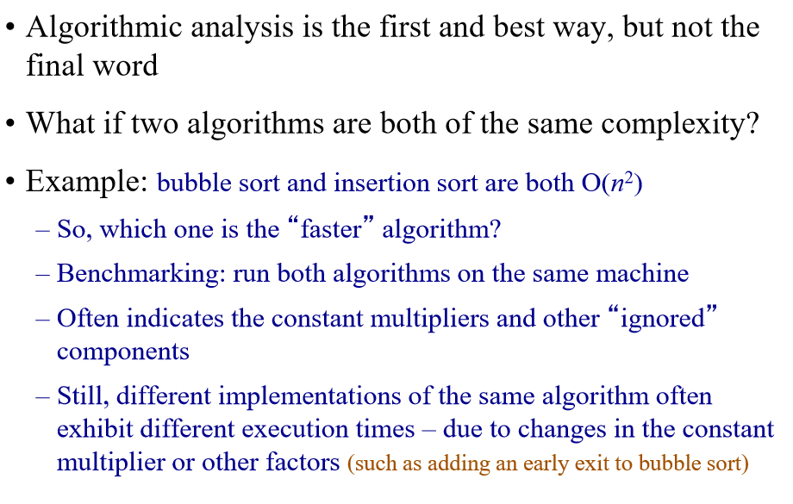
Benchmarking

Slide 69
Experimental Analysis
Implement the algorithm & Collect running time data

Slide 70

Problem:
Sorting
Must be correct
Merge Sort
Insertion Sort
Design Algorithms:
Asymptotic analysis
Theoretical Running Time
O(nlogn)
O(n²)
Implement, run, collect data
Experimental Running Time
T(n) = 0.3nlogn + 0.01
T(n) = 0.06n2 + 0.002n + 0.1
Problem Complexity Class:
Polynomial P

Slide 71
Next Time Fibonacci

