Slide 1
Analyzing merge sort
T(n)
Θ(1)
2T(n/2)
Ο(n)
MERGE-SORT A[1 . . n]
If n = 1, done.
Recursively sort A[ 1 . . ⎡n/2⎤ ] and A[ ⎡n/2⎤+1 . . n ] .
“Merge” the 2 sorted lists
Sloppiness: Should be T( ⎡n/2⎤ ) + T( ⎣n/2⎦ ) , but it turns out not to matter asymptotically.

Slide 2
Recurrence for merge sort
Θ(1) if n = 1;
T(n) =
2T(n/2) + Ο(n) if n > 1.
We shall usually omit stating the base case when T(n) = Θ(1) for sufficiently small n, but only when it has no effect on the asymptotic solution to the recurrence.
Week 2 provides several ways to find a good upper bound on T(n).

Slide 3
Recursion tree
Solve T(n) = 2T(n/2) + cn, where c > 0 is constant.

Slide 4
Recursion tree
Solve T(n) = 2T(n/2) + cn, where c > 0 is constant.
T(n)

Slide 5
Recursion tree
Solve T(n) = 2T(n/2) + cn, where c > 0 is constant.
cn
T(n/2)
T(n/2)

Slide 6
Recursion tree
Solve T(n) = 2T(n/2) + cn, where c > 0 is constant.
cn
cn/2
cn/2
T(n/4)
T(n/4)
T(n/4)
T(n/4)

Slide 7
Recursion tree
Solve T(n) = 2T(n/2) + cn, where c > 0 is constant.
cn
cn/2
cn/2
cn/4
cn/4
cn/4
cn/4
…
Θ(1)

Slide 8
Recursion tree
Solve T(n) = 2T(n/2) + cn, where c > 0 is constant.
cn
cn/2
cn/2
h = lg n
cn/4
cn/4
cn/4
cn/4
…
Θ(1)

Slide 9
Recursion tree
Solve T(n) = 2T(n/2) + cn, where c > 0 is constant.
cn
cn
cn/2
cn/2
h = lg n
cn/4
cn/4
cn/4
cn/4
…
Θ(1)

Slide 10
Recursion tree
Solve T(n) = 2T(n/2) + cn, where c > 0 is constant.
cn
cn
cn/2
cn/2
cn
h = lg n
cn/4
cn/4
cn/4
cn/4
…
Θ(1)

Slide 11
Recursion tree
Solve T(n) = 2T(n/2) + cn, where c > 0 is constant.
cn
cn
cn/2
cn/2
cn
h = lg n
cn/4
cn/4
cn/4
cn/4
cn
…
…
Θ(1)

Slide 12
Recursion tree
Solve T(n) = 2T(n/2) + cn, where c > 0 is constant.
cn
cn
cn/2
cn/2
cn
h = lg n
cn/4
cn/4
cn/4
cn/4
cn
…
…
Θ(1)
#leaves = n
Θ(n)

Slide 13
Recursion tree
Solve T(n) = 2T(n/2) + cn, where c > 0 is constant.
cn
cn
cn/2
cn/2
cn
h = lg n
cn/4
cn/4
cn/4
cn/4
cn
…
…
Θ(1)
#leaves = n
Ο(n)
Total = Ο(n lg n)

Slide 14
Conclusions
Ο(n lg n) grows more slowly than Ο(n²).
Therefore, merge sort asymptotically beats insertion sort in the worst case.
Nearly Sorted??

Slide 15
A tighter bound
Θ(n lg n) grows more slowly than Θ(n²).
More about Theta Θ in the next lecture.

Slide 16
Bubble Sort
Bubble Sort is the simplest sorting algorithm that works by repeatedly swapping the adjacent elements if they are in wrong order.
Bubblesort( array A)
for i from 1 to n
for j from 0 to n - 1
if A[j] > A[j + 1]
swap( A[j], A[j + 1] )
Worst Case : O(n²)
Average Case: O(n²)
Best Case : O(n²)

Slide 17
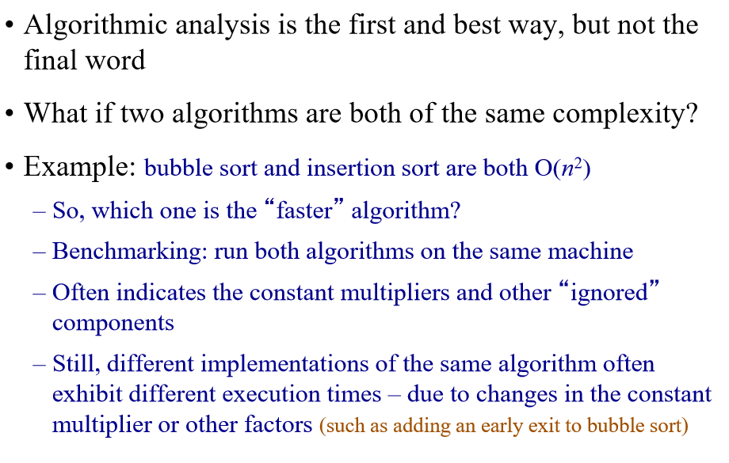
Benchmarking

Slide 18
Experimental Analysis
Implement the algorithm & Collect running time data

Slide 19

Problem:
Sorting
Must be correct
Merge Sort
Insertion Sort
Design Algorithms:
Asymptotic analysis
Theoretical Running Time
O(nlogn)
O(n²)
Implement, run, collect data
Experimental Running Time
T(n) = 0.3nlogn + 0.01
T(n) = 0.06n2 + 0.002n + 0.1
Problem Complexity Class:
Polynomial P

Slide 20
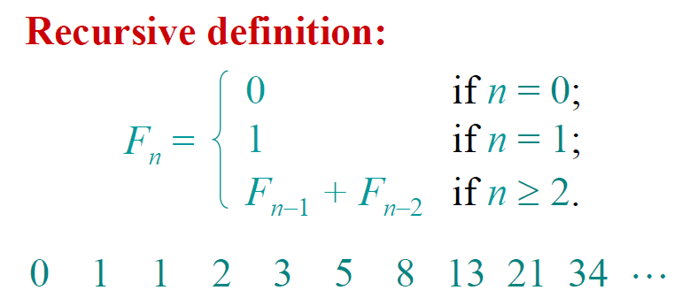
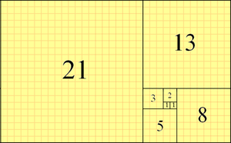
Fibonacci Numbers

Slide 21
Function Analysis for call fib(5)
5
fib(5)
3
2
fib(4)
fib(3)
2
1
1
1
fib(3)
fib(2)
fib(2)
fib(1)
1
1
1
0
1
0
fib(2)
fib(1)
fib(1)
fib(0)
fib(1)
fib(0)
1
0
fib(1)
fib(0)

Slide 22
Fibonacci
long fibonacci (int n) {
// Recursively calculates Fibonacci number
if( n == 0)
return 0;
else if( n == 1)
return 1;
else
return fibonacci(n – 1) + fibonacci(n – 2);
}
The recurrence relation is:
T(n) = 1 if n = 0 or n = 1
T(n) = T(n-1) + T(n-2) + 1 if n ≥ 2
T(n) = Θ(φ^{n} ) where $Φ=\frac{1+\sqrt{5}}{2}$ golden ratio = 1.618..

Slide 23


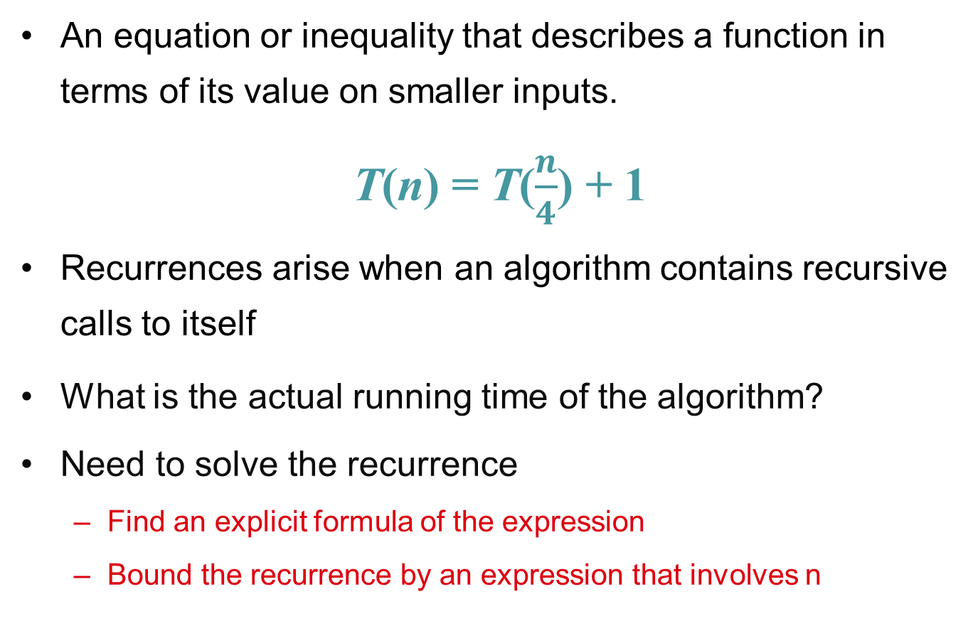
Solve: T(n) = T(n-1)+T(n-2)
Guess: T(n) = O(φ^{n})
Induction goal: T(n) ≤ cφ^{n}, for some c and n ≥ n₀
Induction hypothesis: T(k) ≤ cφ^{k} for k < n
Proof of induction goal:
T(n) = T(n-1) + T(n-2)
≤ cφ^{n-1} + cφ^{n-2}
≤ cφ^{n-2} (φ +1)
≤ cφ^{n-2} (φ²)
T(n) ≤ c φ^{n}
T(n) = O(φ^{n})
Properties
$$Φ=\frac{1+\sqrt{5}}{2}$$
$$Φ^{2}=\frac{3+\sqrt{5}}{2}$$
$$Φ+1=Φ^{2}$$

Slide 24
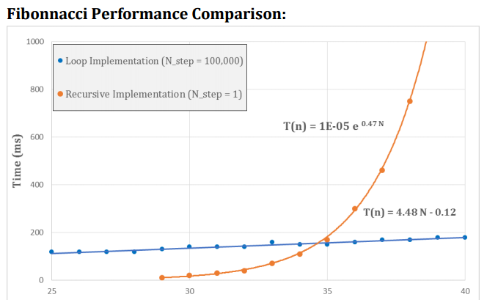
Experimental Running Time
Note: e^{0.47n} ∼ 1.60^{n}

Slide 25
Recursive Fibonacci
e^{.4837} = 1.622..

Slide 27
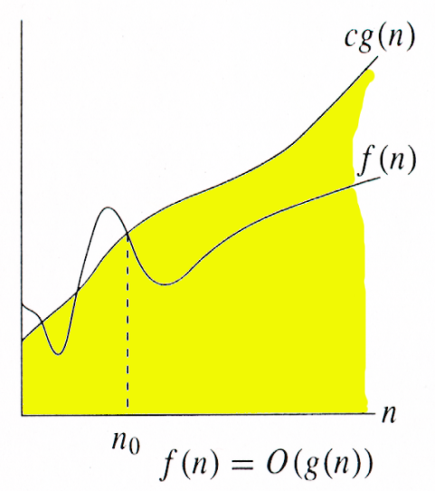
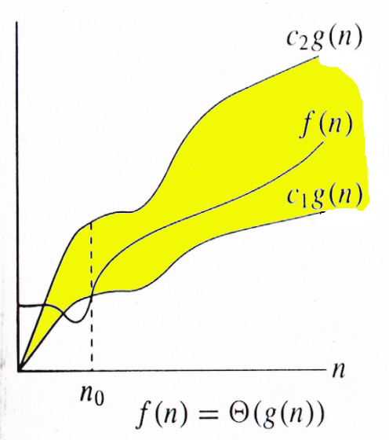
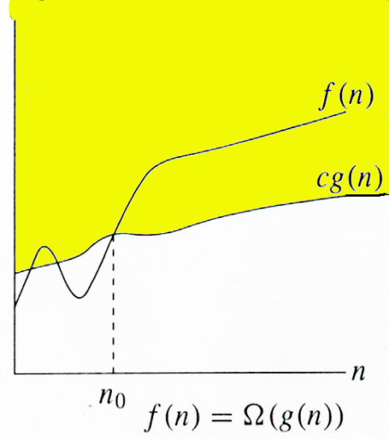
Relations Between Θ, O, Ω

Slide 28

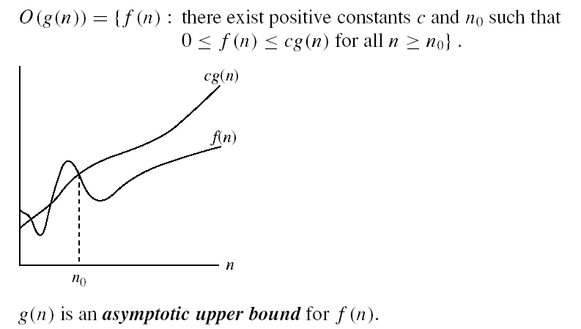
O-notation

Slide 29
Big-O example, graphically
Note 30n+8 isn’t less than n anywhere (n>0).
It isn’t even less than 31n everywhere.
But it is less than 31n everywhere to the right of n=8.
30n+8 is O(n)
cn = 31n
30n+8
Value of function →
n
n>n₀=8 →
Increasing n →

Slide 30
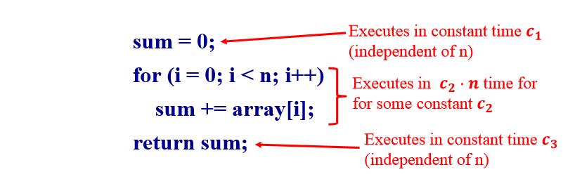
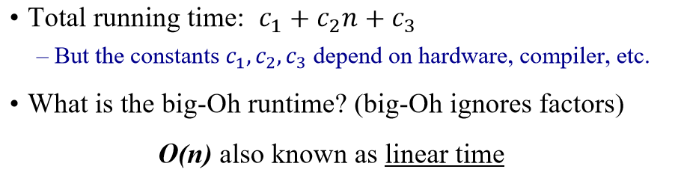
A Simple Code Example

Slide 31
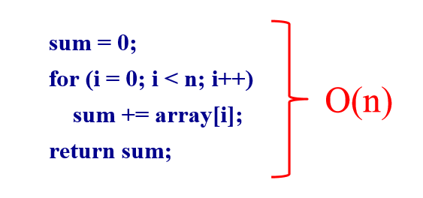
A Simple Example

Slide 32
Non-Linear Times
Consider the Insertion Sort Algorithm
Let n be the size of the input list to be sorted
Runtime is O(n²), also known as quadratic time.
Suppose size doubles, what happens to execution time?
It goes up by a factor of 4. Why?

Slide 33
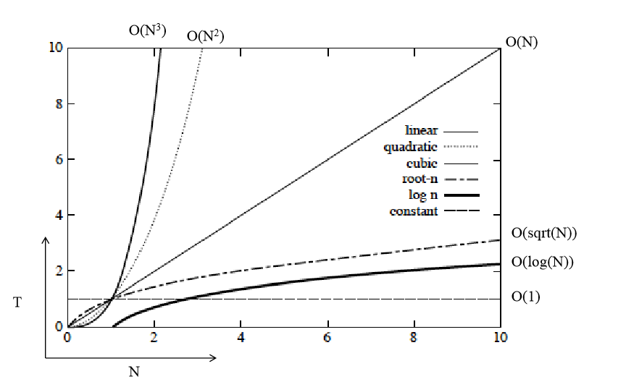
Orders of Growth

Slide 34
Big Oh Classes
Constant O(1)
Logarithmic O(log (n))
Linear O(n)
Quadratic O(n²)
Cubic O(n³)
Polynominal O(n^{k}) for any k>0
Exponential O(k^{n}), where k>1
Factorial O(n!)

Slide 35
Rank the following functions in increasing order of growth
10n, lg(2^{n}), 1000, sqrt(n), 3n², n!, logn, 3^{n}

Slide 36
A polynomial of degree k is O(n^{k})
Recall: f(n) is O(g(n)) if there exist positive constants c and n₀ such that f(n) ≤ c ⋅ g(n) for all n ≥ n₀
Proof:
Suppose f(n) = b_{k}n^{k} + b_{k-1}n^{k-1} + … + b₁n + b₀
Let a_{i} = | b_{i} |
f(n) ≤ a_{k}n^{k} + a_{k-1}n^{k-1} + … + a₁n + a₀
Therefore all polynomial functions f(n) of degree k are O(n^{k}).

Slide 37
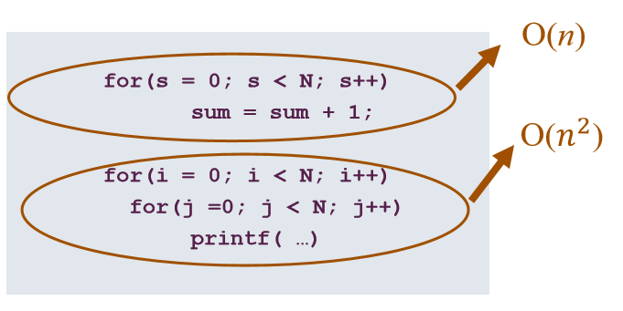
What does this mean in practice?
Total = O(n) + O(n²) = O(n + n²) = O(n²)
Or Θ(n²)

Slide 38
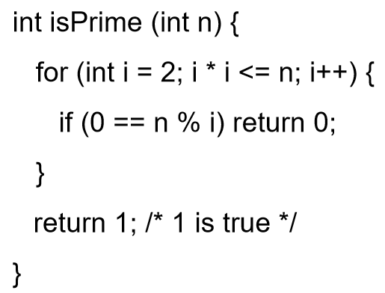
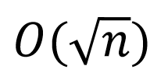
Code Example
What is the “Big-Oh” running time in terms of n?

Slide 39
Trouble with Big-Oh
Just an upper bound. Factually true but practically meaningless.
3n is O(n²)
3n is O(n⁴)
3n is O(n)
Many times only Big-Oh is reported but it is assumed a “tight” upper bound.

Slide 40

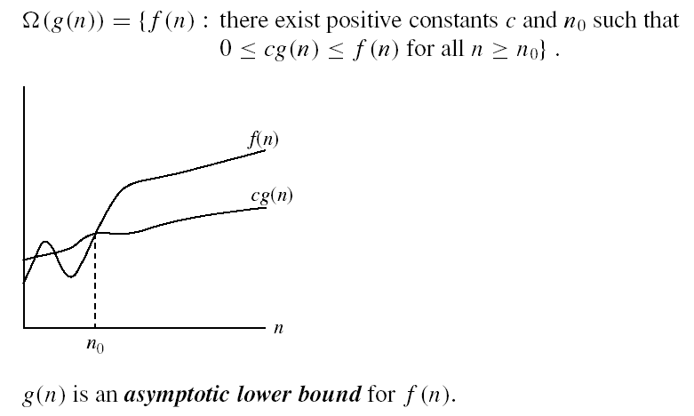
Omega Ω -notation
Ω(g(n)) is the set of functions with larger or same order of growth as g(n)

Slide 41
Omega Graphically
Note 30n+8 isn’t less than n anywhere (n>0).
30n+8 is Ω(n)
30n+8
Value of function →
n
n>0
Increasing n →

Slide 42
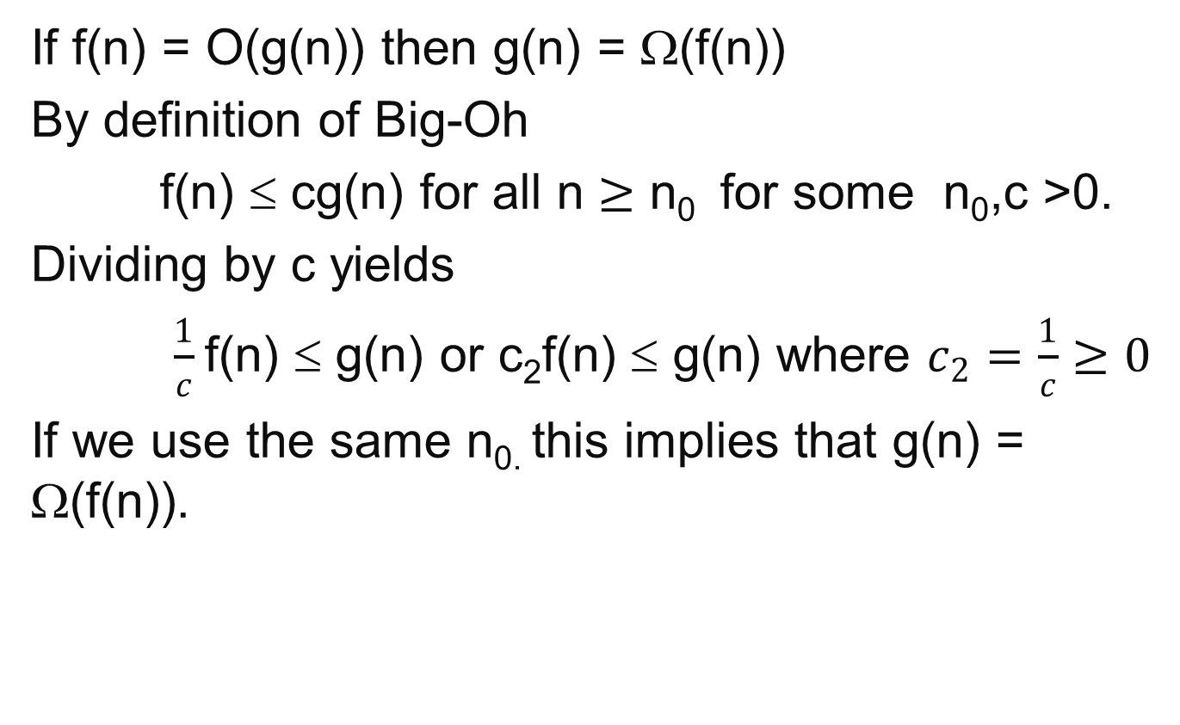
Property of Big-Oh and Omega
If f(n) = O(g(n)) then g(n) = Ω(f(n))
By definition of Big-Oh
f(n) ≤ cg(n) for all n $≥\text{n}\text{0 }$ for some n₀,c >0.
Dividing by c yields
$\frac{1}{c}$f(n) ≤ g(n) or c₂f(n) ≤ g(n) where $c_{2}=\frac{1}{c}≥0$
If we use the same n_{0.} this implies that g(n) = Ω(f(n)).

Slide 43
A non-negative polynomial of degree k is Ω(n^{k})
Proof:
Suppose f(n) = b_{k}n^{k} + b_{k-1}n^{k-1} + … + b₁n + b₀
For large n’s the fractions go to zero, so if we set n₀ large enough we can ignore all terms except b_{k} . Thus a value for n₀ must exist.
Therefore all polynomial functions f(n) of degree k are Ω(n^{k}).

Slide 44


Θ-notation
Θ(g(n)) is the set of functions with the same order of growth as g(n)
g(n) is an asymptotically tight bound for f(n).

Slide 45
Big-Theta example, graphically
Note 30n+8 isn’t less than n anywhere (n>0).
It isn’t even less than 31n everywhere.
But it is less than 31n everywhere to the right of n=8.
30n+8 ∈ Θ(n)
cn = 31n
30n+8
Value of function →
n
n>n₀=8 →
Increasing n →

Slide 46
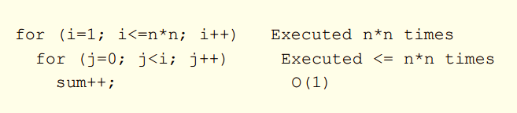
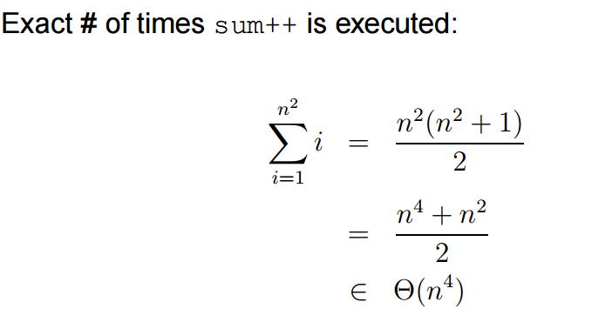
Iterative Algorithm Analysis

Slide 47
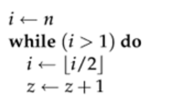
Iterative Algorithm Analysis
Θ(lgn)

Slide 48
A non-negative polynomial of degree k is Θ(n^{k})
Proof: From previous Big-Oh and Omega
f(n) = b_{k}n^{k} + b_{k-1}n^{k-1} + … + b₁n + b₀ is Θ(n^{k} )
Short-cut:
Drop low-order terms; ignore leading constants.
Example: 3n³ + 90n² – 5n + 6046 = Θ(n³)

Slide 49
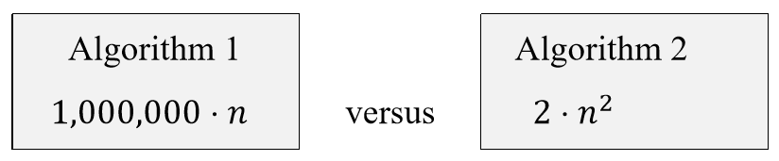
Constant factors and domination
Suppose we have two algorithms with exact running times of:
Is it reasonable to say that runtime of Algorithm 2 dominates (is worse) than Algorithm1?
NO for small values of n Algorithm 2 is better
Yes for large values of n

Slide 50
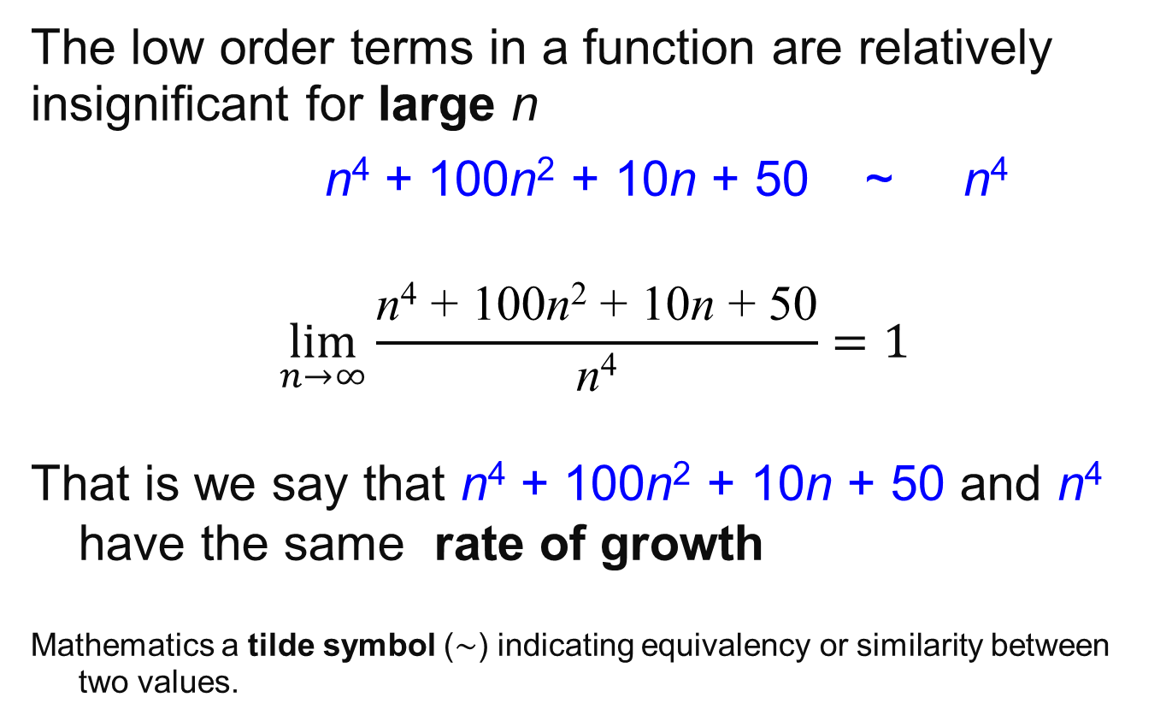
Rate of Growth
The low order terms in a function are relatively insignificant for large n
n⁴ + 100n² + 10n + 50 ~ n⁴
$$\lim_{n→∞}{\frac{\text{n}\text{4}\text{ + 100}\text{n}\text{2}\text{ + 10}\text{n}\text{ + 50}}{\text{n}\text{4}}=1}$$
That is we say that n⁴ + 100n² + 10n + 50 and n⁴ have the same rate of growth
Mathematics a tilde symbol (∼) indicating equivalency or similarity between two values.

Slide 51
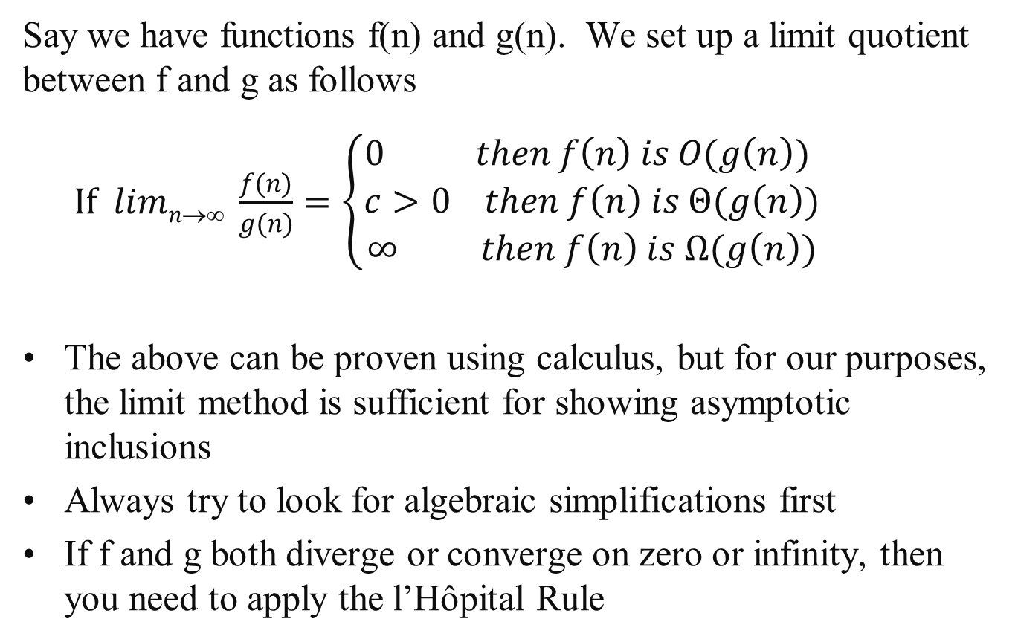
Limit Method: The Process
Say we have functions f(n) and g(n). We set up a limit quotient between f and g as follows
$If limn→∞ \frac{f(n)}{g(n)}=\left\{\begin{aligned}0 then f\left(n\right) is O(g\left(n\right)) \\ c>0 then f\left(n\right) is Θ(g\left(n\right)) \\ ∞ then f\left(n\right) is Ω(g\left(n\right))\end{aligned}\right.$
The above can be proven using calculus, but for our purposes, the limit method is sufficient for showing asymptotic inclusions
Always try to look for algebraic simplifications first
If f and g both diverge or converge on zero or infinity, then you need to apply the l’Hôpital Rule

Slide 52
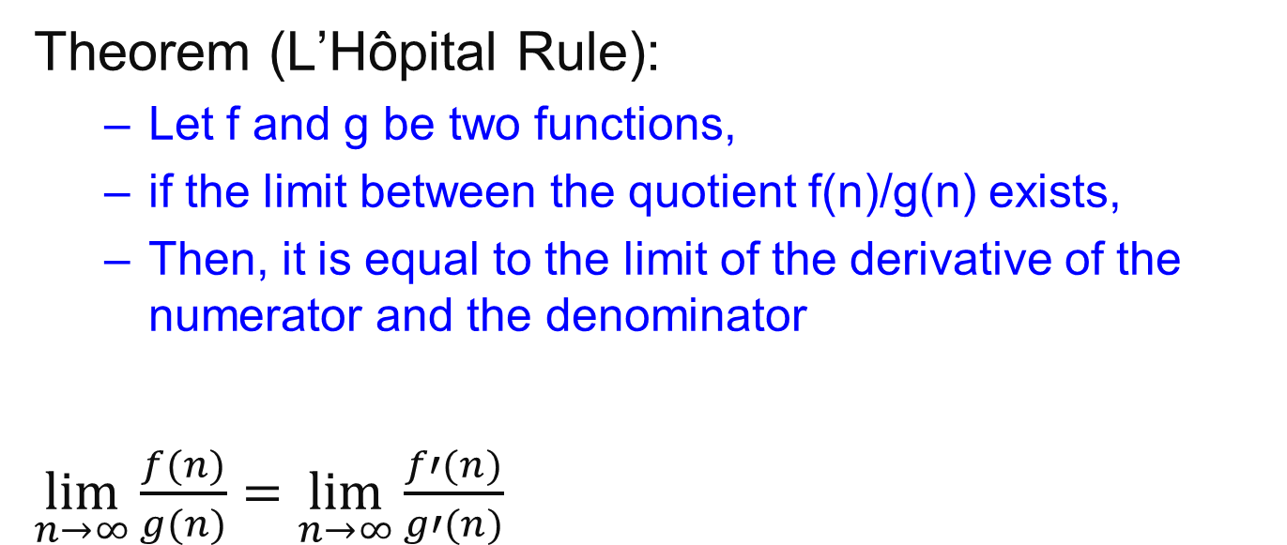
L’Hôpital Rule
Theorem (L’Hôpital Rule):
Let f and g be two functions,
if the limit between the quotient f(n)/g(n) exists,
Then, it is equal to the limit of the derivative of the numerator and the denominator
$\lim_{n→∞}{\frac{f(n)}{g(n)}=}$ $\lim_{n→∞}{\frac{f′(n)}{g′(n)}}$

Slide 53
Limit Method: Example 1
Example: Let f(n) =2^{n}, g(n)=3^{n}. Determine a tight inclusion of the form f(n) ∈ Δ (g(n))
What is your intuition in this case? Which function grows quicker?

Slide 54
Limit Method: Example1
Using algebra
lim_{n→∞} 2^{n}/3^{n} = lim_{n→∞} (2/3)^{n}
Now we use the following Theorem
 | 0 | if α < 1
lim_{n→∞} α^{n} = | 1 | if α = 1
 | ∞ | if α > 1
lim_{n→∞} 2^{n}/3^{n} = lim_{n→∞} (2/3)^{n}
= 0
Therefore we conclude that 2^{n} is O(3^{n})

Slide 55
Limit Method: Example 2
Example: Let f(n) =log₂n, g(n)=log₃n². Determine a tight inclusion of the form
f(n) ∈ Δ(g(n))
What is your intuition in this case?

Slide 56
Limit Method: Example 2
We set up our limit
lim_{n→∞} f(n)/g(n) = lim_{n→∞} log₂n/log₃n²
= lim_{n→∞} log₂n/(2log₃n)
Here we use the change of base formula for logarithms:
log₃n = log₂n / log₂3
lim_{n→∞} log₂n/(2log₃n) = lim_{n→∞} (log₂n log₂3) /(2log₂n)
= lim_{n→∞} (log₂3)/2
= (log₂3) /2
≈ 0.7924, a positive constant
So we conclude that f(n)∈Θ(g(n)) that is
log₂n ∈Θ(log₃n²) which implies that log₃n² ∈Θ(log₂n)

Slide 57
Using Wolfram Alpha
https://www.wolframalpha.com/
lim(x->inf)(2^x/3^x)

Slide 58
Important Result
All logs have the same asymptotic growth rate no what the base is.
In many CS algorithms the base is 2.
But we get sloppy since lg(n) is Θ(logn)

Slide 59
Properties
Theorem:
f(n) = Θ(g(n)) ⇔ f = O(g(n)) and f = Ω(g(n))
Transitivity:
f(n) = Θ(g(n)) and g(n) = Θ(h(n)) ⇒ f(n) = Θ(h(n))
Same for O and Ω
Reflexivity:
f(n) = Θ(f(n))
Same for O and Ω
Symmetry:
f(n) = Θ(g(n)) if and only if g(n) = Θ(f(n))
Transpose symmetry:
f(n) = O(g(n)) if and only if g(n) = Ω(f(n))

Slide 60
Let f, g and h be asymptotically positive functions. Prove or disprove each of the following conjectures.
Transitivity f(n) = Θ(g(n)) and g(n) = Θ(h(n)) ⇒ f(n) = Θ(h(n))
By definition f(n) = Θ(g(n)) implies there exist positive constants c₁, c₂, and n₀ such that 0 ≤ c₁ g(n) ≤ f (n) ≤ c₂ g(n) for all n ≥ n₀
2. By definition g(n) = Θ(h(n)) implies there exist positive constants c₃, c₄, and n₁ such that 0 ≤ c₃ h(n) ≤ g(n) ≤ c₄ h(n) for all n ≥ n₁
3. Show f(n) = Θ(h(n)) that is there exist positive constants c₅, c₆, and n₂ such that 0 ≤ c₅ h(n) ≤ f (n) ≤ c₆ h(n) for all n ≥ n₂
By combining 1 and 2: c₁c₃ h(n) ≤ c₁ g(n) ≤ f (n) let c₅ = c₁c₃ so c₅ h(n) ≤ f (n)
Again from 1 and 2: f (n) ≤ c₂ g(n) ≤ c₂ c₄ h(n) let c₆ = c₂c₄ so f (n) ≤ c₆ h(n)
So c₅ h(n) ≤ f (n) ≤ c₆ h(n) for all n ≥ n₂
And let n₂ = max {n₀ , n₁}

Slide 61
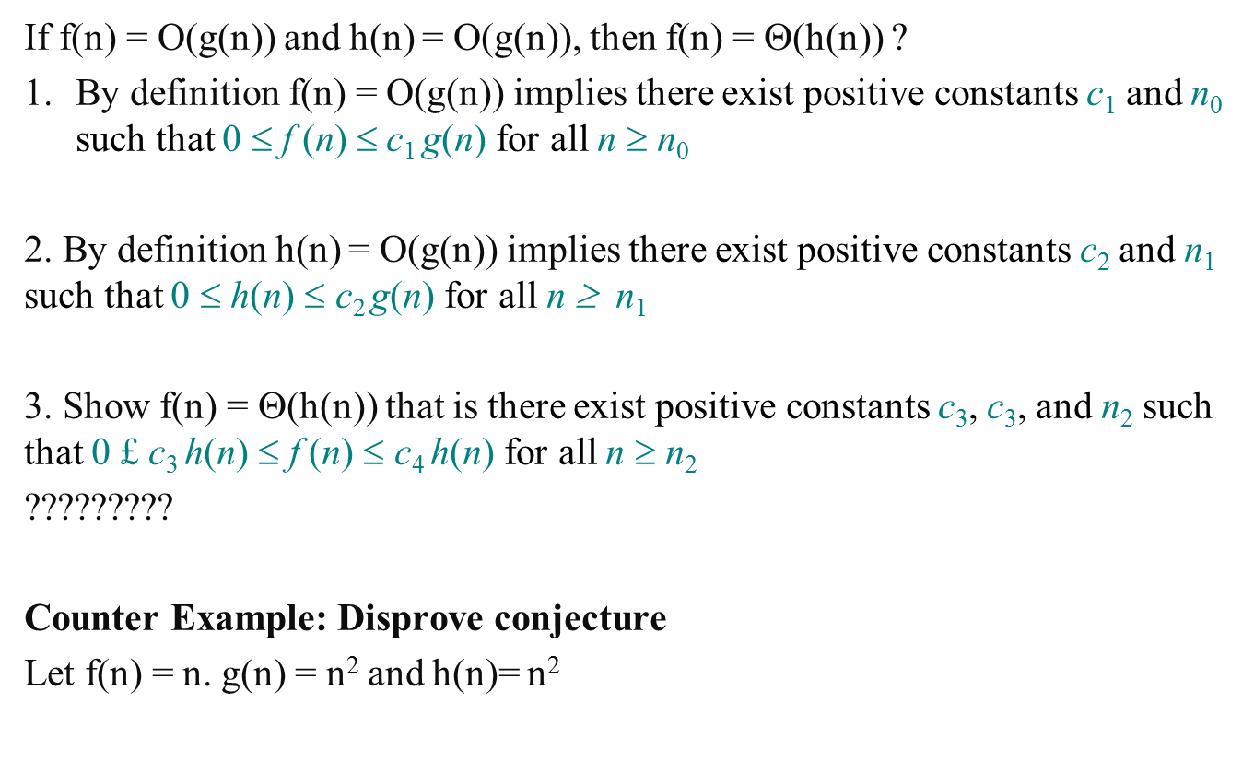
Let f, g and h be asymptotically positive functions. Prove or disprove each of the following conjectures.
If f(n) = O(g(n)) and h(n) = O(g(n)), then f(n) = Θ(h(n)) ?
By definition f(n) = O(g(n)) implies there exist positive constants c₁ and n₀ such that 0 $$ f (n) $$c₁ g(n) for all n ≥ n₀
2. By definition h(n) = O(g(n)) implies there exist positive constants c₂ and n₁ such that 0 $$ h(n) $$ c₂ g(n) for all n ≥ n₁
3. Show f(n) = Θ(h(n)) that is there exist positive constants c₃, c₃, and n₂ such that 0 £ c₃ h(n) $$ f (n) $$ c₄ h(n) for all n ≥ n₂
?????????
Counter Example: Disprove conjecture
Let f(n) = n. g(n) = n² and h(n)= n²

