Slide 1
Chapter 3
Growths of Functions
Asymptotic Analysis
Looking at large input datasets
Limiting behavior

Slide 2
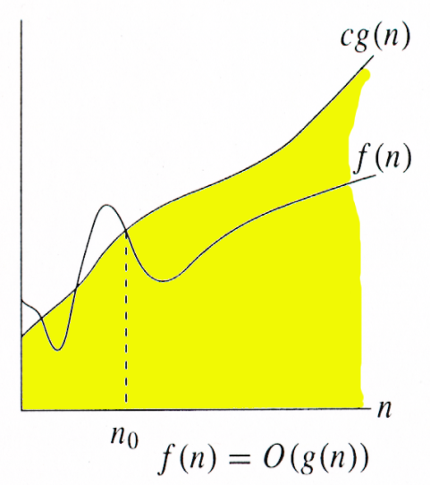
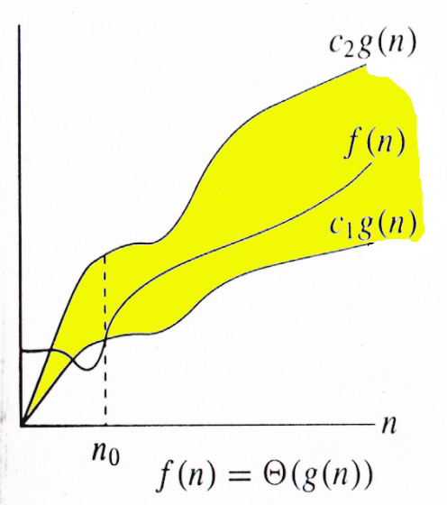
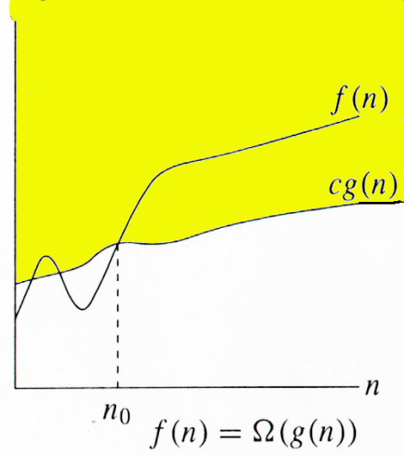
Relations Between Θ, O, Ω

Slide 3

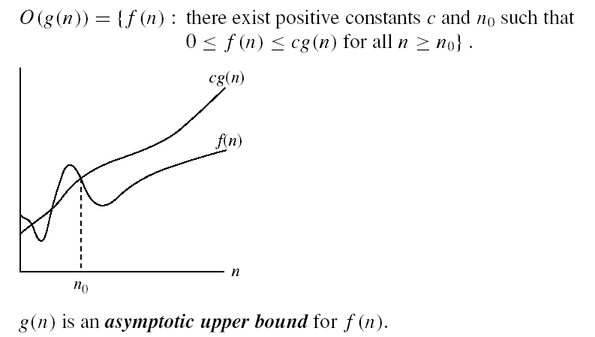
O-notation

Slide 4
Big-O example, graphically
Note 30n+8 isn’t less than n anywhere (n>0).
It isn’t even less than 31n everywhere.
But it is less than 31n everywhere to the right of n=8.
30n+8 is O(n)
cn = 31n
30n+8
Value of function →
n
n>n₀=8 →
Increasing n →

Slide 5
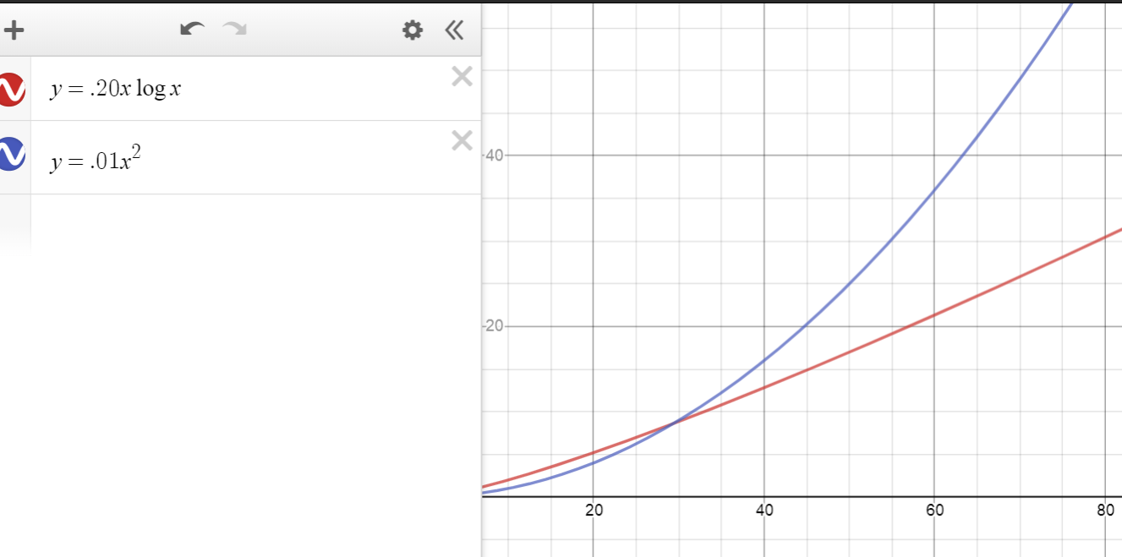
Comparing functions
f(n) = .2nlogn vs g(n) = .0.01n²
^{f(n) = O(g(n))}

Slide 6
Examples
2n² = O(n³):
n² = O(n²):
1000n²+1000n = O(n²):
n = O(n²):
2n² ≤ cn³ ⇒ 2 ≤ cn ⇒ c = 2 and n₀= 1
n² ≤ cn² ⇒ c = 1 and n₀= 1
1000n²+1000n ≤ 1000n²+ n² =1001n²⇒ c=1001 and n₀ = 1000
n ≤ cn² ⇒ cn ≥ 1 ⇒ c = 1 and n₀= 1

Slide 7
More Examples …
n⁴ + 100n² + 10n + 50 is O(n⁴)
10n³ + 2n² is O(n³)
n³ - n² is O(n³)
constants
10 is O(1)
1273 is O(1)

Slide 8
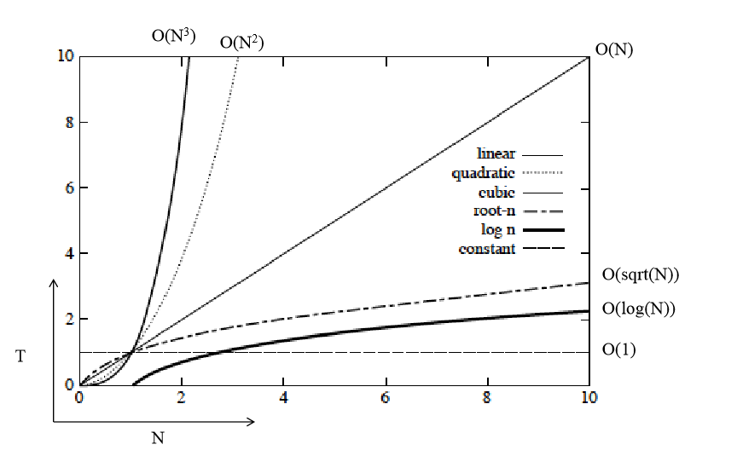
Orders of Growth

Slide 9
A polynomial of degree k is O(n^{k})
Recall: f(n) is O(g(n)) if there exist positive constants c and n₀ such that f(n) ≤ c ⋅ g(n) for all n ≥ n₀
Proof:
Suppose f(n) = b_{k}n^{k} + b_{k-1}n^{k-1} + … + b₁n + b₀
Let a_{i} = | b_{i} |
f(n) ≤ a_{k}n^{k} + a_{k-1}n^{k-1} + … + a₁n + a₀
Therefore all polynomial functions f(n) of degree k are O(n^{k}).

Slide 10
Big Oh Classes
Constant O(1)
Logarithmic O(log (n))
Linear O(n)
Quadratic O(n²)
Cubic O(n³)
Polynominal O(n^{k}) for any k>0
Exponential O(k^{n}), where k>1
Factorial O(n!)

Slide 11
Rank the following functions in increasing order of growth
10n, lg(2^{n}), 1000, sqrt(n), 3n², n!, logn, 3^{n}

Slide 12
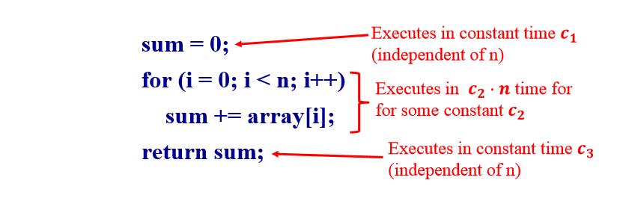
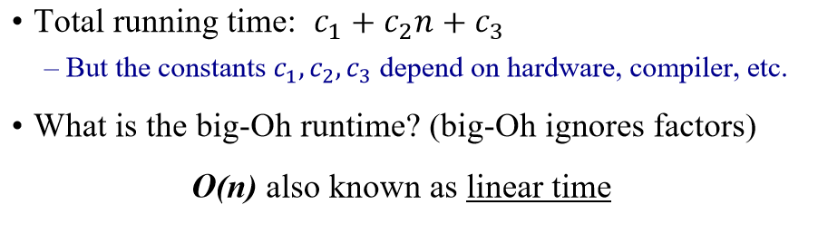
A Simple Code Example

Slide 13
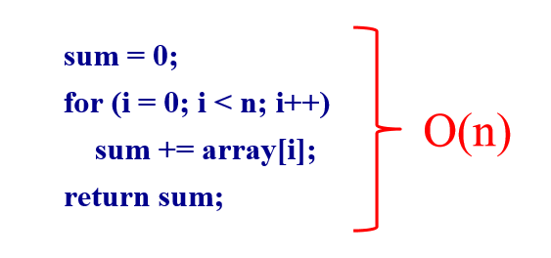
A Simple Example

Slide 14
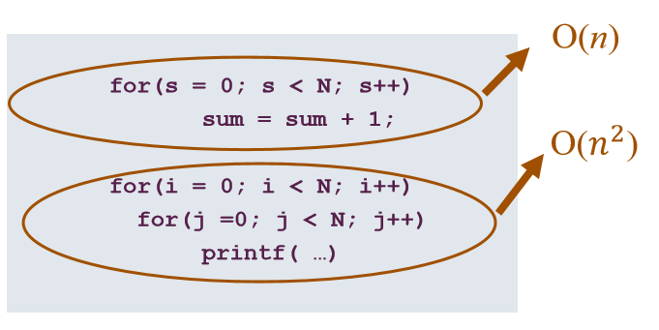
What does this mean in practice?
Total = O(n) + O(n²) = O(n + n²) = O(n²)
Or Θ(n²)

Slide 15
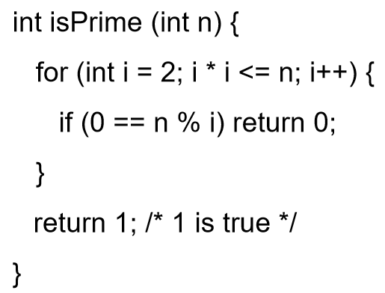
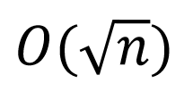
Code Example
What is the “Big-Oh” running time in terms of n?

Slide 16
Trouble with Big-Oh
Just an upper bound. Factually true but practically meaningless.
3n is O(n²)
3n is O(n⁴)
3n is O(n)
Many times only Big-Oh is reported but it is assumed a “tight” upper bound.

Slide 17

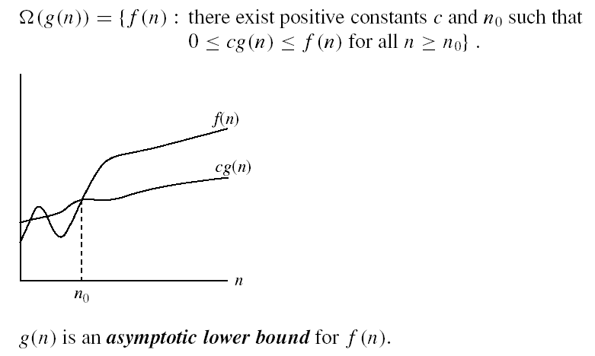
Omega Ω -notation
Ω(g(n)) is the set of functions with larger or same order of growth as g(n)

Slide 18
Omega Graphically
Note 30n+8 isn’t less than n anywhere (n>0).
30n+8 is Ω(n)
30n+8
Value of function →
n
n>0
Increasing n →

Slide 19
Examples
5n² = Ω(n)
100n + 5 ≠ Ω(n²)
n = Ω(2n), n³ = Ω(n²), n = Ω(logn)
∃ c, n₀ such that: 0 ≤ cn ≤ 5n²
⇒ cn ≤ 5n²
⇒ c = 1 and n₀ = 1
∃ c, n₀ such that: 0 ≤ cn² ≤ 100n + 5
100n + 5 ≤ 100n + 5n (∀ n ≥ 1) = 105n
cn² ≤ 105n
⇒ n(cn – 105) ≤ 0
Since n is positive ⇒ cn – 105 ≤ 0
⇒ n ≤ 105/c
⇒ contradiction: n cannot be smaller than a constant

Slide 20
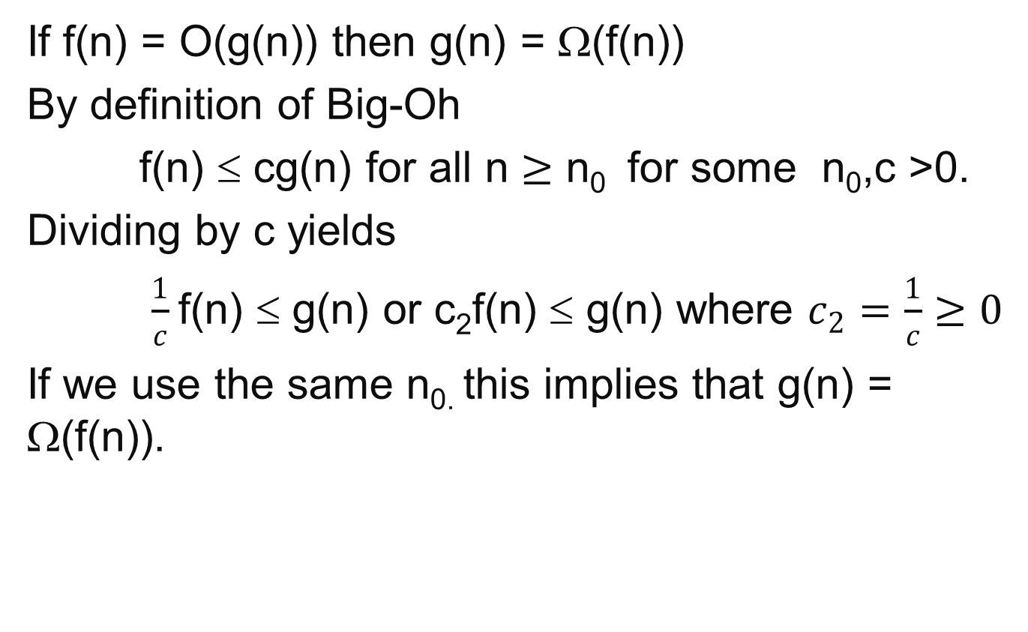
Property of Big-Oh and Omega
If f(n) = O(g(n)) then g(n) = Ω(f(n))
By definition of Big-Oh
f(n) ≤ cg(n) for all n $≥\text{n}\text{0 }$ for some n₀,c >0.
Dividing by c yields
$\frac{1}{c}$f(n) ≤ g(n) or c₂f(n) ≤ g(n) where $c_{2}=\frac{1}{c}≥0$
If we use the same n_{0.} this implies that g(n) = Ω(f(n)).

Slide 21
A non-negative polynomial of degree k is Ω(n^{k})
Proof:
Suppose f(n) = b_{k}n^{k} + b_{k-1}n^{k-1} + … + b₁n + b₀
For large n’s the fractions go to zero, so if we set n₀ large enough we can ignore all terms except b_{k} . Thus a value for n₀ must exist.
Therefore all polynomial functions f(n) of degree k are Ω(n^{k}).

Slide 22


Θ-notation
Θ(g(n)) is the set of functions with the same order of growth as g(n)
g(n) is an asymptotically tight bound for f(n).

Slide 23
Big-Theta example, graphically
Note 30n+8 isn’t less than n anywhere (n>0).
It isn’t even less than 31n everywhere.
But it is less than 31n everywhere to the right of n=8.
30n+8 ∈ Θ(n)
cn = 31n
30n+8
Value of function →
n
n>n₀=8 →
Increasing n →

Slide 24
A non-negative polynomial of degree k is Θ(n^{k})
Proof: From previous Big-Oh and Omega
f(n) = b_{k}n^{k} + b_{k-1}n^{k-1} + … + b₁n + b₀ is Θ(n^{k} )
Short-cut:
Drop low-order terms; ignore leading constants.
Example: 3n³ + 90n² – 5n + 6046 = Θ(n³)

Slide 25
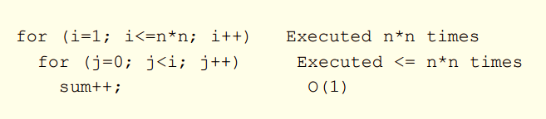
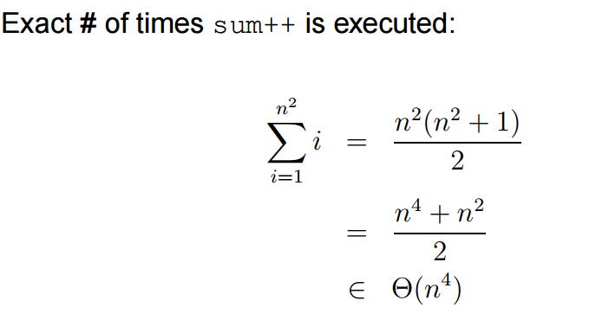
Iterative Algorithm Analysis

Slide 26
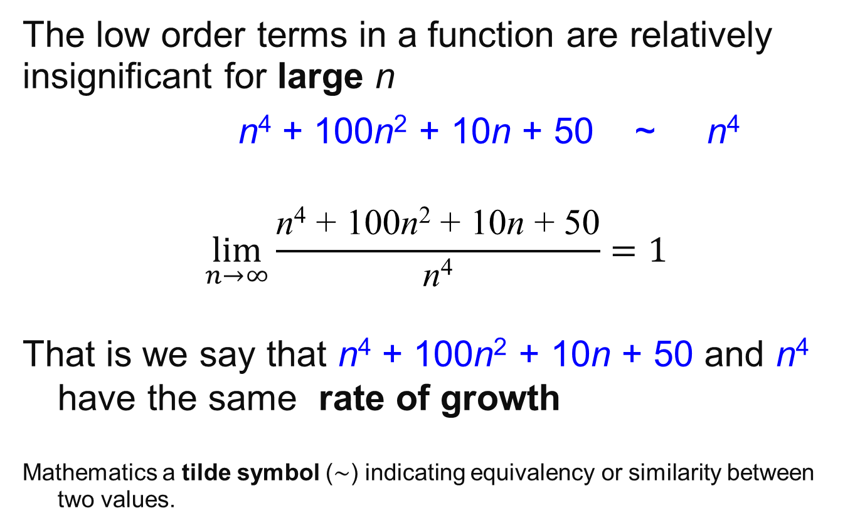
Rate of Growth as limits
The low order terms in a function are relatively insignificant for large n
n⁴ + 100n² + 10n + 50 ~ n⁴
$$\lim_{n→∞}{\frac{\text{n}\text{4}\text{ + 100}\text{n}\text{2}\text{ + 10}\text{n}\text{ + 50}}{\text{n}\text{4}}=1}$$
That is we say that n⁴ + 100n² + 10n + 50 and n⁴ have the same rate of growth
Mathematics a tilde symbol (∼) indicating equivalency or similarity between two values.

Slide 27
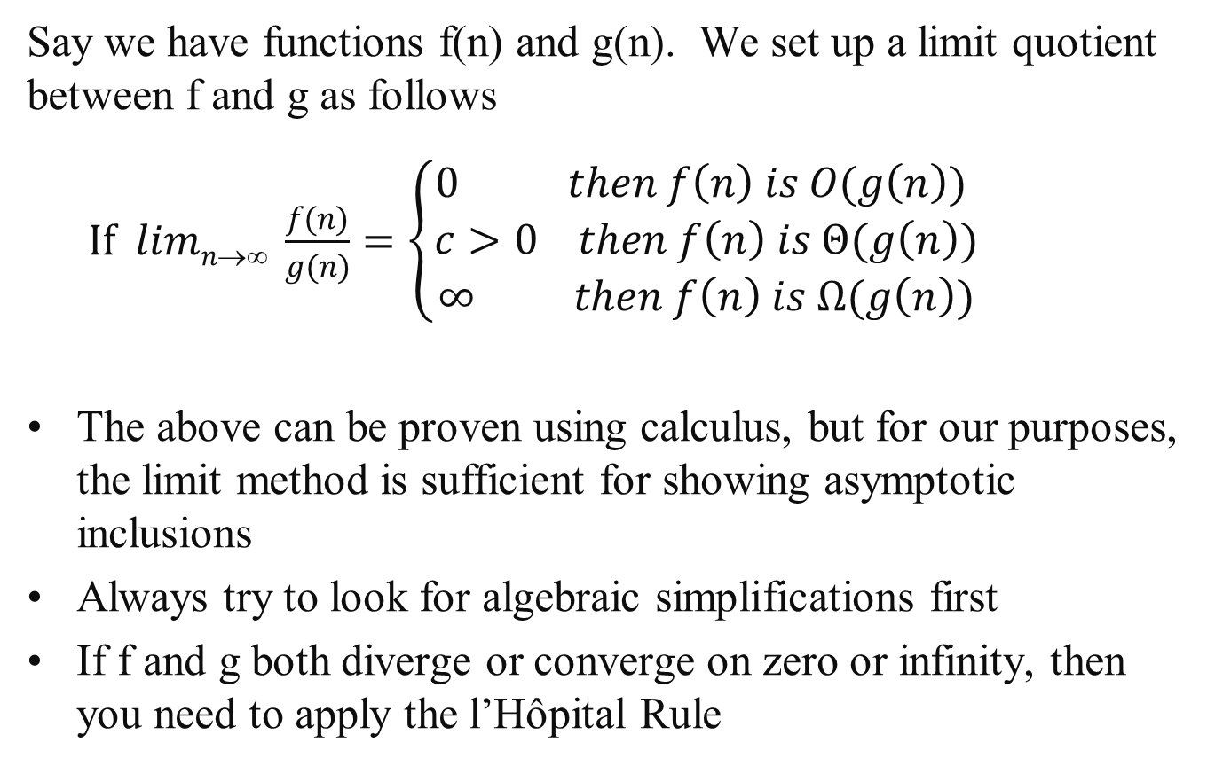
Limit Method: The Process
Say we have functions f(n) and g(n). We set up a limit quotient between f and g as follows
$If limn→∞ \frac{f(n)}{g(n)}=\left\{\begin{aligned}0 then f\left(n\right) is O(g\left(n\right)) \\ c>0 then f\left(n\right) is Θ(g\left(n\right)) \\ ∞ then f\left(n\right) is Ω(g\left(n\right))\end{aligned}\right.$
The above can be proven using calculus, but for our purposes, the limit method is sufficient for showing asymptotic inclusions
Always try to look for algebraic simplifications first
If f and g both diverge or converge on zero or infinity, then you need to apply the l’Hôpital Rule

Slide 28
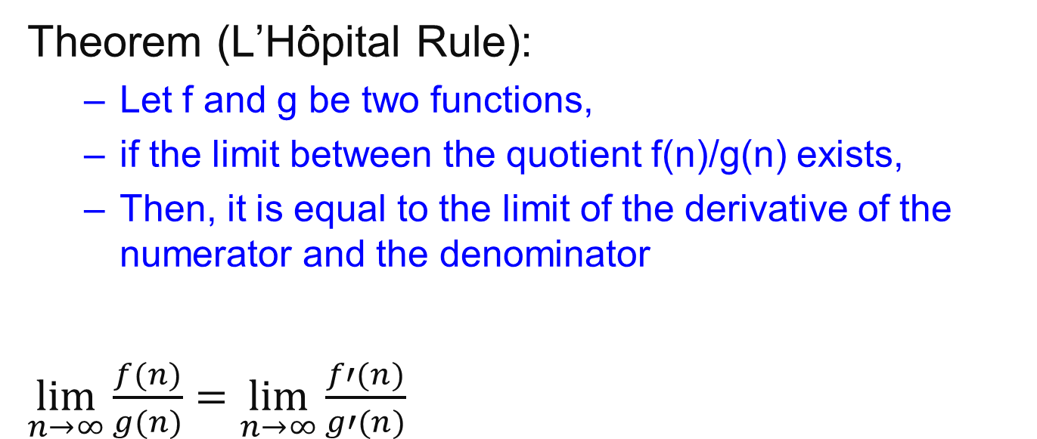
L’Hôpital Rule
Theorem (L’Hôpital Rule):
Let f and g be two functions,
if the limit between the quotient f(n)/g(n) exists,
Then, it is equal to the limit of the derivative of the numerator and the denominator
$\lim_{n→∞}{\frac{f(n)}{g(n)}=}$ $\lim_{n→∞}{\frac{f′(n)}{g′(n)}}$

Slide 29
Limit Method: Example 1
Example: Let f(n) =2^{n}, g(n)=3^{n}. Determine a tight inclusion of the form f(n) ∈ Δ (g(n))
What is your intuition in this case? Which function grows quicker?

Slide 30
Limit Method: Example1
Using algebra
lim_{n→∞} 2^{n}/3^{n} = lim_{n→∞} (2/3)^{n}
Now we use the following Theorem
 | 0 | if α < 1
lim_{n→∞} α^{n} = | 1 | if α = 1
 | ∞ | if α > 1
lim_{n→∞} 2^{n}/3^{n} = lim_{n→∞} (2/3)^{n}
= 0
Therefore we conclude that 2^{n} is O(3^{n})

Slide 31
Limit Method: Example 2
Example: Let f(n) =log₂n, g(n)=log₃n². Determine a tight inclusion of the form
f(n) ∈ Δ(g(n))
What is your intuition in this case?

Slide 32
Limit Method: Example 2
We set up our limit
lim_{n→∞} f(n)/g(n) = lim_{n→∞} log₂n/log₃n²
= lim_{n→∞} log₂n/(2log₃n)
Here we use the change of base formula for logarithms:
log₃n = log₂n / log₂3
lim_{n→∞} log₂n/(2log₃n) = lim_{n→∞} (log₂n log₂3) /(2log₂n)
= lim_{n→∞} (log₂3)/2
= (log₂3) /2
≈ 0.7924, a positive constant
So we conclude that f(n)∈Θ(g(n)) that is
log₂n ∈Θ(log₃n²) which implies that log₃n² ∈Θ(log₂n)

Slide 33
Using Wolfram Alpha
https://www.wolframalpha.com/
lim(x->inf)(2^x/3^x)

Slide 34
Important Result
All logs have the same asymptotic growth rate no what the base is.
In many CS algorithms the base is 2.
But we get sloppy since lg(n) is Θ(logn)

Slide 35
Properties
Theorem:
f(n) = Θ(g(n)) ⇔ f = O(g(n)) and f = Ω(g(n))
Transitivity:
f(n) = Θ(g(n)) and g(n) = Θ(h(n)) ⇒ f(n) = Θ(h(n))
Same for O and Ω
Reflexivity:
f(n) = Θ(f(n))
Same for O and Ω
Symmetry:
f(n) = Θ(g(n)) if and only if g(n) = Θ(f(n))
Transpose symmetry:
f(n) = O(g(n)) if and only if g(n) = Ω(f(n))

Slide 36
Let f, g and h be asymptotically positive functions. Prove or disprove each of the following conjectures.
Transitivity f(n) = Θ(g(n)) and g(n) = Θ(h(n)) ⇒ f(n) = Θ(h(n))
By definition f(n) = Θ(g(n)) implies there exist positive constants c₁, c₂, and n₀ such that 0 ≤ c₁ g(n) ≤ f (n) ≤ c₂ g(n) for all n ≥ n₀
2. By definition g(n) = Θ(h(n)) implies there exist positive constants c₃, c₄, and n₁ such that 0 ≤ c₃ h(n) ≤ g(n) ≤ c₄ h(n) for all n ≥ n₁
3. Show f(n) = Θ(h(n)) that is there exist positive constants c₅, c₆, and n₂ such that 0 ≤ c₅ h(n) ≤ f (n) ≤ c₆ h(n) for all n ≥ n₂
By combining 1 and 2: c₁c₃ h(n) ≤ c₁ g(n) ≤ f (n) let c₅ = c₁c₃ so c₅ h(n) ≤ f (n)
Again from 1 and 2: f (n) ≤ c₂ g(n) ≤ c₂ c₄ h(n) let c₆ = c₂c₄ so f (n) ≤ c₆ h(n)
So c₅ h(n) ≤ f (n) ≤ c₆ h(n) for all n ≥ n₂
And let n₂ = max {n₀ , n₁}

Slide 37
Common Summations
Arithmetic series:
Geometric series:
Special case: |x| < 1:
Harmonic series:
Other important formulas:

