Slide 1
Graph Algorithms

Slide 2
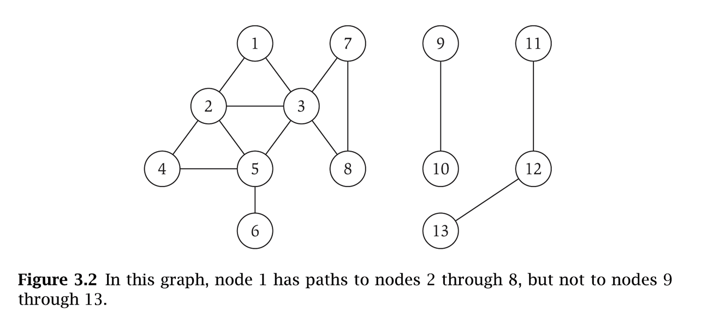
Introduction to graph theory
Graph – mathematical object consisting of a set of:
Denoted by G = (V, E).
V = vertices (nodes, points). V(G) and V_{G}
E = edges (links, arcs) between pairs of vertices. Also denoted by E(G) and E_{G} ; E ⊆ V x V
Graph size parameters: n = |V|, m = |E|.
V = { 1, 2, 3, 4, 5, 6, 7, 8 }
E = { (1,2), (1,3), (2,3), (2,4), (2,5), (3,5), (3,7), (3,8), (4,5), (5,6) } n = 8
m = 11

Slide 3
Introduction to graph theory
For graph G(V,E):
If edge e=(u,v) ∈ E(G), we say that u and v are adjacent or neighbors
u and v are incident with e
u and v are end-vertices of e
An edge where the two end vertices are the same is called a loop, or a self-loop
V = { 1, 2, 3, 4, 5, 6, 7, 8 }
E = { (1,2), (1,3), (2,3), (2,4), (2,5), (3,5), (3,7), (3,8), (4,5), (5,6) } n = 8
m = 11
3
3

Slide 4
Directed graph (digraph)
Directed edge - ordered pair of vertices (u,v)
A graph with directed edges is called a directed graph or digraph
Undirected edge- unordered pair of vertices (u,v)
A graph with undirected edges is an undirected graph or simply a graph

Slide 5
Terminology
End vertices (or endpoints) of an edge
u and v are the endpoints of a
Edges incident on a vertex
a, d, and b are incident on v
Adjacent vertices
u and v are adjacent
Degree of a vertex
x has degree 5
Self-loop
j is a self-loop
v
a
b
h
j
u
d
x
z
c
e
i
w
g
f
y

Slide 6
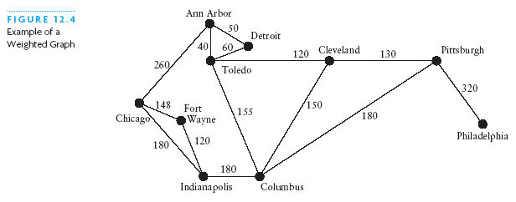
Weighted Graphs
The edges in a graph may have values associated with them known as their weights
A graph with weighted edges is known as a weighted graph

Slide 7
Terminology
A walk in an undirected graph G = (V, E) is a sequence P of vertices v₁, v₂, …, v_{k-1}, v_{k} with the property that each consecutive pair v_{i}, v_{i+1} is joined by an edge in E.
A walk is a path if all vertices are distinct.
A cycle is a path in which the first and final vertices are the same
A cycle is simple if all the vertices except the first and final are distinct
Cycles can be denoted by C_{k}, where k is the number of vertices in the cycle
(1, 3, 7, 8, 3, 5) is a walk
( 6, 5, 3, 2) is a path
(1, 2, 4, 5, 2, 3, 1) is a cycle
(1, 2, 3, 1) is a simple cycle
C₃
C₄
C₅

Slide 8
Subgraphs
A subgraph S of a graph G is a graph such that
The vertices of S are a subset of the vertices of G
The edges of S are a subset of the edges of G
A spanning subgraph of G is a subgraph that contains all the vertices of G
Subgraph
Spanning subgraph

Slide 9
Connectivity
A graph is connected if there is a path between every pair of vertices
A connected component of a graph G is a maximal connected subgraph of G
Connected graph
Non connected graph with two connected components

Slide 10
Trees and Forests
A tree is an undirected graph T such that
T is connected
T has no cycles
A forest is an undirected graph without cycles
The connected components of a forest are trees
Tree
Forest

Slide 11
Spanning Trees and Forests
A spanning tree of a connected graph is a spanning subgraph that is a tree
A spanning tree is not unique unless the graph is a tree
Graph
Spanning tree

Slide 12
Directed graphs
A directed walk is a sequence of directed edges, where the head of each edge is the tail of the next; a directed path is a directed walk without repeated vertices.
Vertex v is reachable from vertex u in a directed graph G if and only if G contains a directed walk (and therefore a directed path) from u to v.
A directed graph is strongly connected if every vertex is reachable from every other vertex.

Slide 13
DAG
A directed acyclic graph (DAG) is a digraph that has no directed cycles
D
E
B
C
A
DAG G

Slide 14
Representation of Graphs
Two standard ways:
Adjacency List
preferred for sparse graphs (|E| is much less than |V|^2)
Unless otherwise specified we will assume this representation
Adjacency Matrix
Preferred for dense graphs

Slide 15
Adjacency List
1
2
3
4
5
2
5
1
1
5
4
5
2
4
2
3
5
4
3
4
1
2
An array Adj of |V| lists, one per vertex
For each vertex u in V,
Adj[u] contains all vertices v such that there is an edge (u,v) in E (i.e. all the vertices adjacent to u)
Space required Θ(|V|+|E|) (Following CLRS, we will use V for |V| and E for |E|) thus Θ(V+E)

Slide 16
Adjacency Matrix (weights)
1
1
1 2 3 4 5
8
7
1
2
3
4
5
0 | 7 | 0 | 0 | 8
7 | 0 | 0 | 6 | 6
0 | 0 | 0 | 8 | 0
0 | 6 | 8 | 0 | 9
8 | 6 | 0 | 9 | 0
6
5
5
2
2
9
6
4
4
3
3
8

Slide 17
Comparisons
 | Standard Adj list (linked list) | Adj Matrix
Space | Θ(V+E) | Θ(V²)
Test if (u,v)∈ E
Test if u->v∈ E
List v’s (out)neighbors
List all edges
Insert edge (u,v)
Delete edge (u,v)

Slide 18
Comparisons
 | Standard Adj list (linked list) | Adj Matrix
Space | Θ(V+E) | Θ(V²)
Test if (u,v)∈ E | O(min{deg(u),deg(v)} ) = O(V) | O(1)
Test if u->v∈ E | O(deg(u) ) = O(V) | O(1)
List v’s (out)neighbors | Θ(deg(v) ) = O(V) | Θ(V)
List all edges | Θ(V+E) | Θ(V²)
Insert edge (u,v) | O(1) | O(1)
Delete edge (u,v) | O(deg(u)+deg(v) ) = O(V) | O(1)

Slide 19
Adjacency List (weights)
1
2
3
4
5
2,7
5,8
1
8
7
1,7
5,6
4,6
6
5
2
4,8
9
6
2,6
3,8
5,9
4
3
8
4,9
1,8
2,6
An array Adj of |V| lists, one per vertex
For each vertex u in V,
Adj[u] contains all vertices v such that there is an edge (u,v) in E (i.e. all the vertices adjacent to u)
Space required Θ(|V|+|E|) (Following CLRS, we will use V for |V| and E for |E|) thus Θ(V+E)

Slide 20
Adjacency Matrix
1
1 2 3 4 5
1
2
3
4
5
0 | 1 | 0 | 0 | 1
1 | 0 | 0 | 1 | 1
0 | 0 | 0 | 1 | 0
0 | 1 | 1 | 0 | 1
1 | 1 | 0 | 1 | 0
5
2
4
3

Slide 21
Graph Traversals
For solving most problems on graphs
Need to systematically visit all the vertices and edges of a graph
Two major traversals
Breadth-First Search (BFS)
Depth-First Search(DFS)

Slide 22
BFS
Starts at some source vertex s
Discover every vertex that is reachable from s
Also produces a BFS tree with root s and including all reachable vertices
Discovers vertices in increasing order of distance from s
Distance between v and s is the minimum number of edges on a path from s to v
i.e. discovers vertices in a series of layers

Slide 23
BFS : vertex colors stored in color[]
Initially all undiscovered: white
When first discovered: gray
They represent the frontier of vertices between discovered and undiscovered
Frontier vertices stored in a queue
Visits vertices across the entire breadth of this frontier
When processed: black

Slide 24
Review: Breadth-First Search
“Explore” a graph, turning it into a tree
One vertex at a time
Expand frontier of explored vertices across the breadth of the frontier
Builds a tree over the graph
Pick a source vertex to be the root
Find (“discover”) its children, then their children, etc.

Slide 25
Breadth-First Search
Again will associate vertex “colors” to guide the algorithm
White vertices have not been discovered
All vertices start out white
Grey vertices are discovered but not fully explored
They may be adjacent to white vertices
Black vertices are discovered and fully explored
They are adjacent only to black and gray vertices
Explore vertices by scanning adjacency list of grey vertices

Slide 26
Review: Breadth-First Search
BFS(G, s) {
initialize vertices;
Q = {s}; // Q is a queue initialize to s
while (Q not empty) {
u = DEQUEUE(Q);
for each v ∈ G.Adj[u] {
if (v.color == WHITE)
v.color = GREY;
v.d = u.d + 1;
v.p = u;
ENQUEUE(Q, v);
}
u.color = BLACK;
}
}

Slide 27
Breadth-First Search: Example
r
s
t
u
∞
∞
∞
∞
∞
∞
∞
∞
v
w
x
y

Slide 28
Breadth-First Search: Example
r
s
t
u
∞
0
∞
∞
∞
∞
∞
∞
v
w
x
y
Q:
s

Slide 29
Breadth-First Search: Example
r
s
t
u
1
0
∞
∞
∞
1
∞
∞
v
w
x
y
Q:
w
r

Slide 30
Breadth-First Search: Example
r
s
t
u
1
0
2
∞
∞
1
2
∞
v
w
x
y
Q:
r
t
x

Slide 31
Breadth-First Search: Example
r
s
t
u
1
0
2
∞
2
1
2
∞
v
w
x
y
Q:
t
x
v

Slide 32
Breadth-First Search: Example
r
s
t
u
1
0
2
3
2
1
2
∞
v
w
x
y
Q:
x
v
u

Slide 33
Breadth-First Search: Example
r
s
t
u
1
0
2
3
2
1
2
3
v
w
x
y
Q:
v
u
y

Slide 34
Breadth-First Search: Example
r
s
t
u
1
0
2
3
2
1
2
3
v
w
x
y
Q:
u
y

Slide 35
Breadth-First Search: Example
r
s
t
u
1
0
2
3
2
1
2
3
v
w
x
y
Q:
y

Slide 36
Breadth-First Search: Example
r
s
t
u
1
0
2
3
2
1
2
3
v
w
x
y
Q:
Ø

Slide 37
BFS: The Code Again
BFS(G, s) {
initialize vertices;
Q = {s}; // Q is a queue initialize to s
while (Q not empty) {
u = DEQUEUE(Q);
for each v ∈ G.Adj[u] {
if (v.color == WHITE)
v.color = GREY;
v.d = u.d + 1;
v.p = u;
ENQUEUE(Q, v);
}
u.color = BLACK;
}
}
Touch every vertex: O(V)
u = every vertex, but only once
So v = every vertex that appears in some other vert’s adjacency list
What will be the running time?
Total running time: O(V+E)

Slide 38
Breadth-First Search: Properties
BFS calculates the shortest-path distance to the source vertex
Shortest-path distance δ(s,v) = minimum number of edges from s to v, or ∞ if v not reachable from s
BFS builds breadth-first tree, in which paths to root represent shortest paths in G
Thus can use BFS to calculate shortest path from one vertex to another in O(V+E) time

Slide 39
Analysis
Each vertex is enqueued once and dequeued once : O(V)
Each adjacency list is traversed once:
Total: O(V+E)

Slide 40
BFS and shortest paths
Theorem: Let G=(V,E) be a directed or undirected graph, and suppose BFS is run on G starting from vertex s. During its execution BFS discovers every vertex v in V that is reachable from s. Let δ(s,v) denote the number of edges on the shortest path form s to v. Upon termination of BFS, d[v] = δ(s,v) for all v in V.

Slide 41
Print vertices on shortest path from s to v.
PrintPath(G,s,v) {
if v == s
print s;
elseif v.p == nil
print “No Path”;
else PrintPath(G, s, v.p)
print v;
}

