Slide 1
Greedy Algorithms
Knapsack
Huffman Code
Scheduling
Coins

Slide 2
Activity Scheduling: Greedy Algorithms
Greedy. Consider activities in some natural order. Take each activity provided it's compatible with the ones already taken.
[Earliest start time] Consider activities in ascending order of s_{j}.
[Earliest finish time] Consider activities in ascending order of f_{j}.
[Shortest interval] Consider activities in ascending order of
f_{j} - s_{j}.
[Fewest conflicts] For each activity j, count the number of conflicting activities c_{j}. Schedule in ascending order of c_{j}.

Slide 3
Greedy Algorithms are not always Optimal
Counterexample for earliest start time
Counterexample for shortest interval
Counterexample for fewest conflicts

Slide 4
Earliest Finish Greedy Strategy
Select the activity with the earliest finish
Eliminate the activities that could not be scheduled
Repeat!
Greedy in the sense that it leaves as much opportunity as possible for the remaining activities to be scheduled
The greedy choice is the one that maximizes the amount of unscheduled time remaining

Slide 5
0 1 2 3 4 5 6 7 8 9 10 11 12 13 14 15

Slide 6
0 1 2 3 4 5 6 7 8 9 10 11 12 13 14 15

Slide 7
0 1 2 3 4 5 6 7 8 9 10 11 12 13 14 15

Slide 8
0 1 2 3 4 5 6 7 8 9 10 11 12 13 14 15

Slide 9
0 1 2 3 4 5 6 7 8 9 10 11 12 13 14 15

Slide 10
0 1 2 3 4 5 6 7 8 9 10 11 12 13 14 15

Slide 11
0 1 2 3 4 5 6 7 8 9 10 11 12 13 14 15

Slide 12
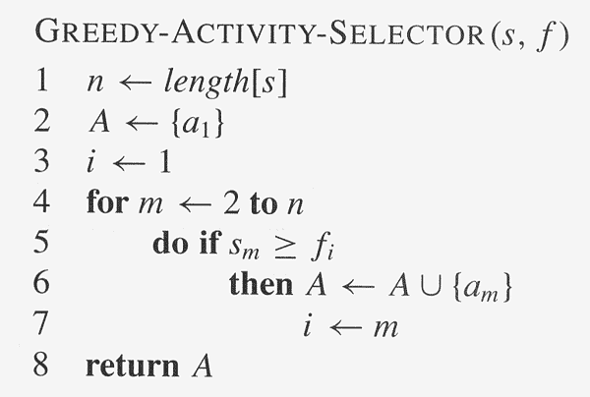
Assuming activities are sorted by finish time

Slide 13
Elements of Greedy Strategy
An greedy algorithm makes a sequence of choices, each of the choices that seems best at the moment is chosen
NOT always produce an optimal solution
Two ingredients that are exhibited by most problems that lend themselves to a greedy strategy
Optimal substructure
Greedy-choice property

Slide 14
Optimal Substructures
Step 1: Characterize optimality
Without loss of generality, we will assume that the a's are sorted in non-decreasing order of finishing times, i.e. f₁ ≤ f₂ ≤ ... ≤ f_{n}.
Define the set S_{ij}
S_{ij} = {a_{k} ∈ S : f_{i} ≤ s_{k} < f_{k} ≤ s_{j}} as the subset of activities that can occur between the completion of a_{i} (f_{i}) and the start of a_{j} (s_{j}).
Note that S_{ij} = ∅ for i ≥ j since otherwise f_{i} ≤ s_{j} < f_{j} ⇒ f_{i} < f_{j} which is a contradiction for i ≥ j by the assumption that the activities are in sorted order.

Slide 15
Optimal Substructures
Define the set S_{ij}
S_{ij} = {a_{k} ∈ S : f_{i} ≤ s_{k} < f_{k} ≤ s_{j}} as the subset of activities that can occur between the completion of a_{i} (f_{i}) and the start of a_{j} (s_{j}).
Let A_{ij} be the maximal set of activities for S_{ij}. Using a "cut-and-paste" argument, if A_{ij} contains activity a_{k} then we can write
A_{ij} = A_{ik} ∪ {a_{k}} ∪ A_{kj}
where A_{ik} and A_{kj} must also be optimal (otherwise if we could find subsets with more activities that were still compatible with a_{k} then it would contradict the assumption that A_{ij} was optimal).

Slide 16

Step 2: Define the recursive solution (top-down)
Let c[i,j] = |A_{ij}|, then
i.e. compute c[i,j] for each k = i+1, ..., j-1 and select the max.
Step 3: Compute the maximal set size (bottom-up)
Construct an nxn table which can be done in polynomial time since clearly for each c[i,j] we will examine no more than n subproblems giving an upper bound on the worst case of O(n³).

Slide 17
BUT WE DON'T NEED TO DO ALL THAT WORK!
Instead at each step we could simply select (greedily) the activity that finishes first and is compatible with the previous activities. Intuitively this choice leaves the most time for other future activities.
Greedy Algorithm Solution
To use the greedy approach, we must prove that the greedy choice produces an optimal solution (although not necessarily the only solution).

Slide 18
Greedy Choice Property
To use the greedy approach, we must prove that the greedy choice produces an optimal solution (although not necessarily the only solution).
Let S_{k} = {a_{i} ∈ S _{k} : s_{i} ≥ f_{k}} be the set of activities that start after activity a_{k} finishes
Consider any non-empty subproblem S_{k} with activity a_{m} having the earliest finishing time, Then a_{m} included in some maximum-size subset of mutually compatible activities of S_{k} .

Slide 19
Greedy Choice Property
Note: If we make the greedy choice of a₁ then S₁ remains the only subproblem to solve. That is S₀₁ = ∅.
f_{m} = min{f_{k} : a_{k} ∈ S_{ij}}
then the following two conditions must hold
a_{m} is used in an optimal subset of S_{ij}
S_{im} = ∅ leaving S_{mj} as the only subproblem
meaning that the greedy solution produces an optimal solution.

Slide 20
Consider any non-empty subproblem S_{k} with activity a_{m} having the earliest finishing time, Then a_{m} included in some maximum-size subset of mutually compatible activities of S_{k} .
Let A_{k} be an optimal solution for S_{k} and a_{j} be the activity in A_{k}
with the earliest finish time.
If a_{j} = a_{m} then the condition holds.
If a_{j} ≠ a_{m} then construct A_{k}' = A_{k} - {a_{j}} ∪ {a_{m}}.
Since f_{m} ≤ f_{j} ⇒ A_{k}' is still optimal.
The activities in are disjoint since the activites in are disjoint and
f_{m} ≤ f_{j} . Since |A_{k} | = | A_{k}' |, we conclude that A_{k} is a maximum-size subset of mutually compatible activates for S_{k} and include a_{m}.

Slide 21
Machine Scheduling with start times
Given: a set T of n tasks, each having:
A start time, s_{i}
A finish time, f_{i} (where s_{i} < f_{i})
Goal: Perform all the tasks using a minimum number of “machines.”
Machine 3
Machine 2
Machine 1
1
2
3
4
5
6
7
8
9

Slide 22
Example
Given: a set T of n=7 tasks, each having:
A start time, s_{i}
A finish time, f_{i} (where s_{i} < f_{i})
[1,4], [1,3], [2,5], [3,7], [4,7], [6,9], [7,8] (ordered by start)
Goal: Perform all tasks on min. number of machines
Machine 3
Machine 2
Machine 1
1
2
3
4
5
6
7
8
9

Slide 23
Machine Scheduling Algorithm
Greedy choice: consider tasks by their start time and use as few machines as possible with this order.
Run time: O(n log n) depending on data structure used.
Correctness: Suppose there is a better schedule.
We can use k-1 machines
The algorithm uses k
Let i be first task scheduled on machine k
Task i must conflict with k-1 other tasks
K mutually conflict tasks
But that means there is no non-conflicting schedule using k-1 machines
Algorithm TaskSchedule(T)
Input: set T of tasks w/ start time s_{i} and finish time f_{i}
Output: non-conflicting schedule with minimum number of machines
m ← 0 {no. of machines}
while T is not empty
remove task i w/ smallest s_{i}
if there’s a machine j for i then
schedule i on machine j
else
m ← m + 1
schedule i on machine m

Slide 24
To get O(log(n)) for each iteration, keep the machines in a heap using as key the latest finishing time assigned to that machine. This tells you when that machine will be free. When you select the next task i with start time s_{i}, and finishing time f_{i} check the min element of the machine heap say machine j with key fj indicate it is free at time fj
If machine j is free at time s_{i} (s_{i} >= fj) then it is free forever starting at s_{i}. We can now
Remove the machine j from the heap (removeMin), O(logn).
Assign the current job to the removed machine j, Θ(1).
Now machine j is free at f_{i} and we re-insert it into the heap, O(logn).
If machine j is not free at s_{i}, then no machine is free at s_{i} since this was the minimum free time, so
Increase m generating a new machine, Θ(1).
Assign i to the new machine m, Θ(1).
Insert machine m (which has key fi) into the heap, O(logn).
Note there are n iterations if n jobs that need to be scheduled on machines so O(nlgn) overall running time.

Slide 25
Job Scheduling Problem
There is no specified start times only durations.
You have to run nine jobs, with running times of 3, 5, 6, 10, 11, 14, 15, 18, and 20 minutes
You have three processors on which you can run these jobs
You decide to do the longest-running jobs first, on whatever processor is available
P1
P2
P3
20
10
3
18
11
6
15
14
5
Time to completion: 18 + 11 + 6 = 35 minutes
This solution isn’t bad, but we might be able to do better
Notes:
5

Slide 26
Another approach
What would be the result if you ran the shortest job first?
Again, the running times are 3, 5, 6, 10, 11, 14, 15, 18, and 20 minutes
P1
P2
P3
3
10
15
5
11
18
6
14
20
That wasn’t such a good idea; time to completion is now 6 + 14 + 20 = 40 minutes
Note, however, that the greedy algorithm itself is fast
All we had to do at each stage was pick the minimum or maximum
Notes:
6

Slide 27
An optimum solution
P1
P2
P3
20
14
18
11
5
15
10
6
3
This solution is clearly optimal (why?)
Clearly, there are other optimal solutions (why?)
How do we find such a solution?
One way: Try all possible assignments of jobs to processors
Unfortunately, this approach can take exponential time
Notes:
7

Slide 28
Huffman Codes
Text Compression (Zip)
On a computer: changing the representation of a file so that it takes less space to store or/and less time to transmit.
Original file can be reconstructed exactly from the compressed representation
- Very effective technique for compressing data, saving 20% - 90%.

Slide 29
Huffman Coding
As an example, lets take the string:
“ABRACADABRA”
We first to a frequency count of the characters:
A:5, B:2, C:1, D:1, R:2
Next we use a Greedy algorithm to build up a Huffman Tree
We start with nodes for each character
A,5
B,2
R,2
D,1
C,1

Slide 30
Huffman Coding
We then pick the nodes with the smallest frequency and combine them together to form a new node
The selection of these nodes is the Greedy part
The two selected nodes are removed from the set, but replace by the combined node
This continues until we have only 1 node left in the set

Slide 31
Huffman Coding
A,5
B,2
R,2
D,1
C,1

Slide 32
Huffman Coding
A,5
B,2
R,2
2
D,1
C,1

Slide 33
Huffman Coding
A,5
4
B,2
R,2
2
D,1
C,1

Slide 34
Huffman Coding
A,5
4
B,2
R,2
2
D,1
C,1

Slide 35
Huffman Coding
A,5
6
B,2
4
R,2
2
D,1
C,1

Slide 36
Huffman Coding
11
0
1
A,5
6
0
1
B,2
4
0
1
A = 0
B = 10
R = 110
D = 1110
C = 1111
R,2
2
0
1
D,1
C,1

Slide 37

Code word
01011001111011100101100 = 23 bits << 33 bits
A = 0
B = 10
R = 110
D = 1110
C = 1111

Slide 38
However…
There are some concerns…
Suppose we have
A-> 01
B-> 0101
If we have 010101, is this AB? BA? Or AAA?
Therefore: prefix codes, no codeword is a prefix of another codeword, is necessary

Slide 39
Prefix Codes
Any prefix code can be represented by a full binary tree
Each leaf stores a symbol.
Each node has two children – left branch means 0, right means 1.
codeword = path from the root to the leaf interpreting suitably the left and right branches

Slide 40
How do we find the optimal coding tree?
It is clear that the two symbols with the smallest frequencies must be at the bottom of the optimal tree, as children of the lowest internal node
This is a good sign that we have to use a bottom-up manner to build the optimal code!
Huffman’s idea is based on a greedy approach, using the previous notices.

Slide 41
Huffman codes
Idea: build tree bottom-up and make greedy choice (what is it?)
joining two symbols commits to a bit to distinguish them; which should we choose?
build heap H with frequencies as keys
for i = 1 to n-1
allocate new node z
z.left = x = EXTRACT-MIN(H)
z.right = y = EXTRACT-MIN(H)
z. freq = x.freq + y.freq; INSERT(H, z)
return EXTRACT-MIN(H)

Slide 42
Running time
Build-Min-Heap O(n)
Each Extract-Min O(lgn) for a total of O(nlgn)
Overall O(nlgn)

Slide 43
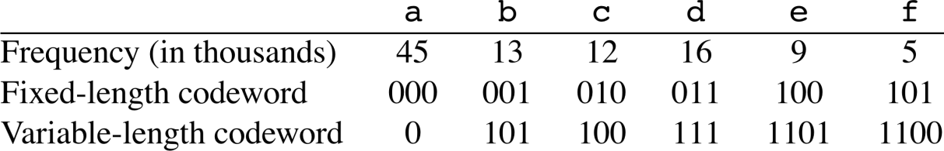
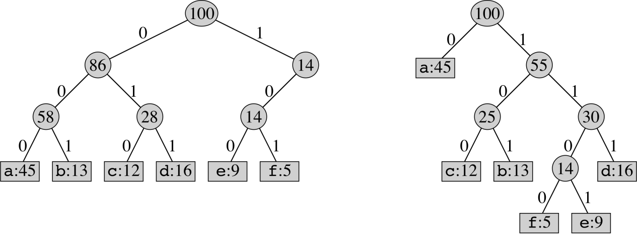
Another Example
can represent prefix-free encoding scheme by binary tree T:
Example:
Problem: given frequencies, construct optimal tree (prefix-free encoding scheme)

Slide 44
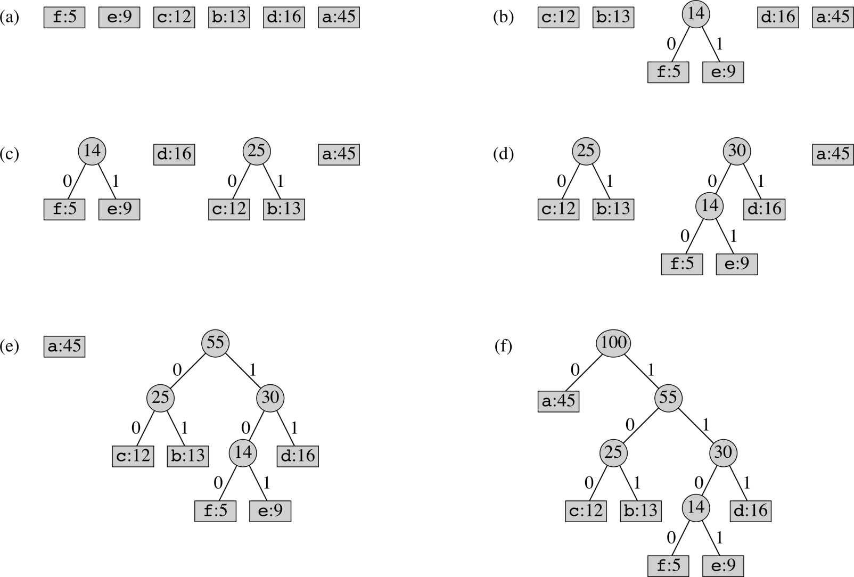
Huffman example from CLRS

Slide 45
Huffman example from CLRS

Slide 46
Decoding
Suppose we have the
Following code:
1010111
What is the decode
result?

Slide 47
Decoding
Suppose we have the
Following code:
1010111
What is the decode
result? b

Slide 48
Decoding
Suppose we have the
Following code:
1010111
What is the decode
result? ba

Slide 49
Decoding
Suppose we have the
Following code:
1010111
What is the decode
result? bad

Slide 50

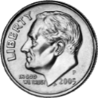
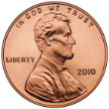
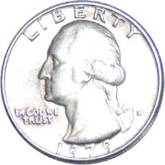
Coin Change
Coin changing problem (informal):
Given certain amount of change: A
The denominations of coins are: 25, 10, 5, 1
How to use the fewest coins to make this change?
A = 25q + 10d + 5n + p, what are the q, d, n, and p, minimizing (q+d+n+p)
Can you design an algorithm to solve this problem?
Notes:
3

Slide 51
Coin changing problem
Greedy choice
Choose as many of the largest coins available.
Optimal substructure
After the greedy choice, assuming the greedy choice is correct, can we get the optimal solution from a subproblem.
Given A = 63 cents
Assuming we have chosen 2*25 = 50
Is two quarters + optimal coin(63-50) the optimal solution of 63 cents?

Slide 52
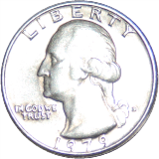
Coin Change
Step 1: A = 63
Notes:
3

Slide 53
Coin Change
Step 1: A = 63, q = 2
Notes:
3

Slide 54
Coin Change
Step 1: A = 63, q = 2
Step 2: (63-50) = 13
Notes:
3

Slide 55
Coin Change
Step 1: A = 63, q = 2
Step 2: (63-50) = 13, d = 1
Notes:
3

Slide 56
Coin Change
Step 1: A = 63, q = 2
Step 2: (63-50) = 13, d = 1
Step 3: (13-10) = 3
Notes:
3

Slide 57
Coin Change
Step 1: A = 63, q = 2
Step 2: (63-50) = 13, d = 1
Step 3: (13-10) = 3
Notes:
3

Slide 58
Coin Change
Step 1: A = 63, q = 2
Step 2: (63-50) = 13, d = 1
Step 3: (13-10) = 3, p = 3
Notes:
3

Slide 59
Coin Change
Step 1: A = 63, q = 2
Step 2: (63-50) = 13, d = 1
Step 3: (13-10) = 3, p = 3
Number of coins = 6
Notes:
3

Slide 60
Coin Change
Step 1: A = 63, q = 2
Step 2: (63-50) = 13, d = 1
Step 3: (13-10) = 3, p = 3
Number of coins = 6
For coin denominations of 25, 10, 5, 1
The greedy choice property is not violated
Notes:
3

Slide 61
A failure of the Greedy Algorithm
Suppose in a fictional monetary system, we have 1 cent, 7 cent, and 10 cent coins
The greedy algorithm results in a solution, but not in an optimal solution
Notes:
4

Slide 62
Coin Change Fail
Step 1: A = 15
10
7
1
Notes:
3

Slide 63
Coin Change Fail
Step 1: A = 15
Step2: (15-10) = 5
10
10
7
1
Notes:
3

Slide 64
Coin Change Fail
Step 1: A = 15
Step2: (15-10) = 5
This is six coins
The optimal solution is three coins
10
1
1
1
1
1
10
7
7
1
7
1
Notes:
3

Slide 65
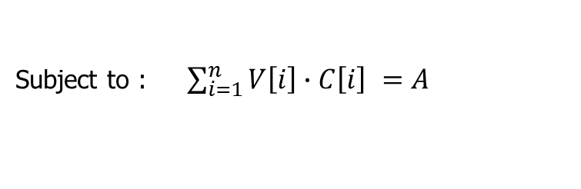
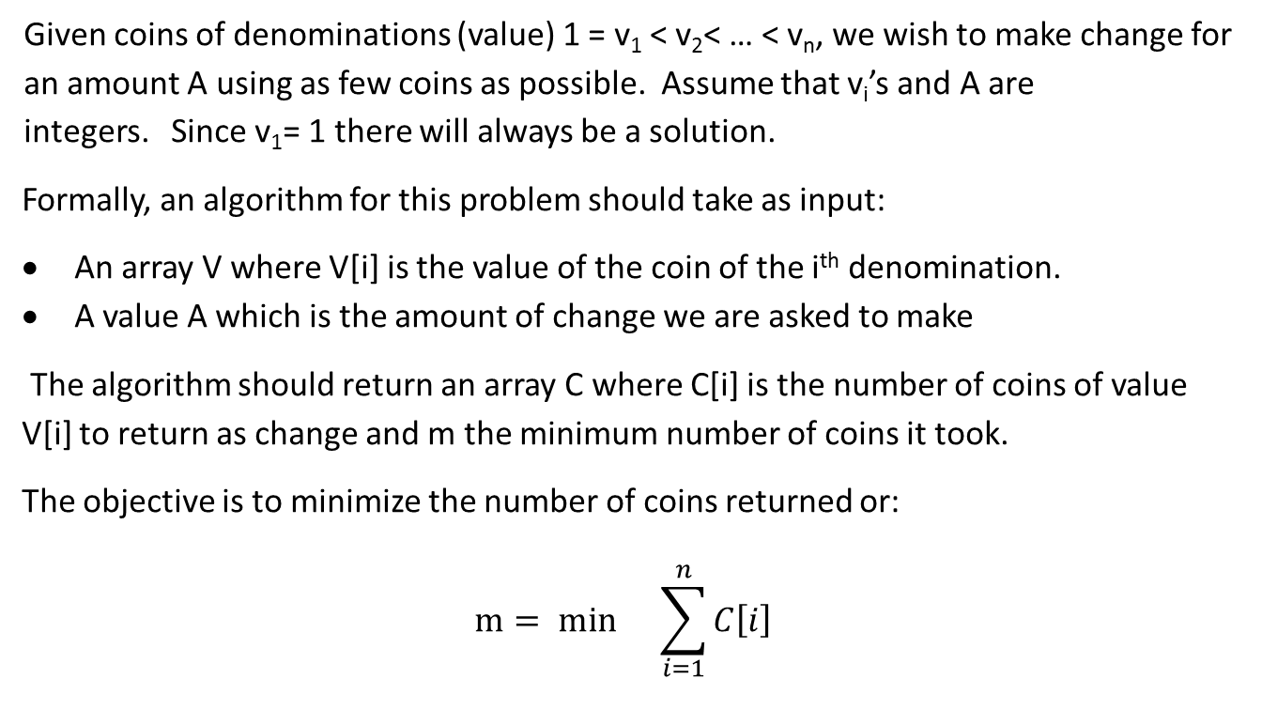
Making Change DP
Given coins of denominations (value) 1 = v₁ < v₂< … < v_{n}, we wish to make change for an amount A using as few coins as possible. Assume that v_{i}’s and A are integers. Since v₁= 1 there will always be a solution.
Formally, an algorithm for this problem should take as input:
An array V where V[i] is the value of the coin of the i^{th} denomination.
A value A which is the amount of change we are asked to make
The algorithm should return an array C where C[i] is the number of coins of value V[i] to return as change and m the minimum number of coins it took.
The objective is to minimize the number of coins returned or:
$$m= min{}\sum_{i=1}^{n}{C\left[i\right] }$$
Subject to : $\sum_{i=1}^{n}{V\left[i\right]∙C\left[i\right] =A}$

Slide 66

coins[i] = inf if i < 0
coins[0] = 0
coins[1]= 1
coins[j] = $\min_{1≤i≤n}\left\{1+coins[j−v_{i}]\right\}$
minCoins(A, v[], n)
coins[0]=0; coins[1] = 1;
for j = 2 to A do {
min = inf
for i = 1 to n do {
if ( j >= v[i] )
if (coins[j-v[i]] < min )
min = coins[j-v[i]]
}
coins[j] = min + 1;
}
return coins[A]
Running Time?

