Slide 1
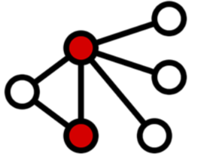
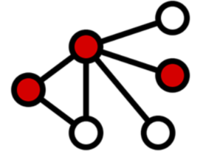
Vertex-cover problem
Vertex cover: Given an undirected graph G=(V,E), then a subset C ⊆ V is a vertex cover if for all (u,v)∈E, then u∈C or v ∈C (or both).
Size of a vertex cover C: is the number of vertices in it.
Vertex-cover Optimization Problem: Find a vertex-cover of minimum size.
Size 2
Size 3

Slide 2
Vertex-cover problem
Decision Vertex-cover problem is NP-complete. Does there exist a vertex cover for graph G with size ≤ K.
Vertex-cover belongs to NP.
Vertex-cover is NP-Complete (CLIQUE ≤_{P} Vertex-cover.)
Reduce <G,k> where G=<V,E> of a CLIQUE instance to <G',|V|-k> where G'=<V,E'> where E'={(u,v): u,v∈V, u≠v and <u,v>∉E} of a vertex-cover instance.
So find an approximate algorithm for vertex-cover.

Slide 3
Greedy Approximate Vertex-Cover algorithm
APPROX-VERTEX-COVER(G)
1 C ← Ø
2 E′ ← E[G]
3 while E′ ≠ Ø
4 let (u, v) be an arbitrary edge of E′
5 C ← C U {u, v}
6 remove every edge in E′ incident on u or v
7 return C
Running time using an adjacency list is O(V+E).

Slide 4
Greedy Approximation for Vertex Cover
Near Optimal
size=6
Optimal
Size=3

Slide 5
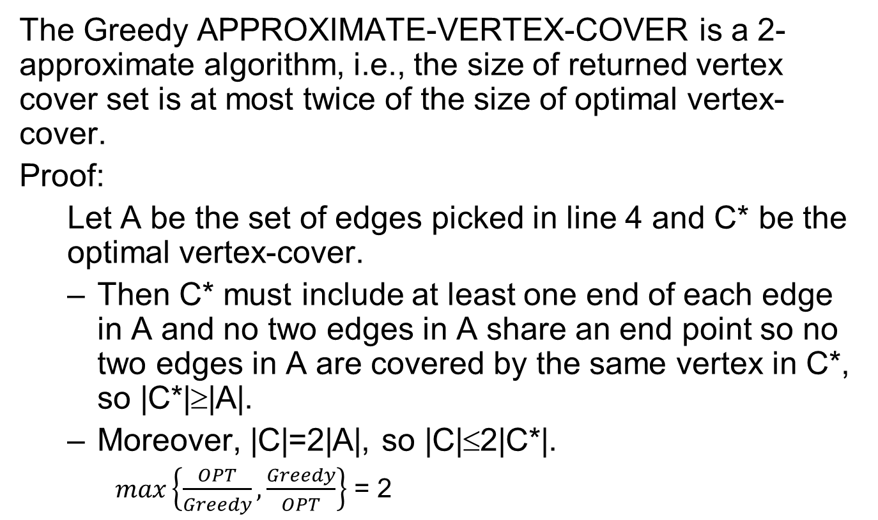
2-approximate Vertex-Cover
The Greedy APPROXIMATE-VERTEX-COVER is a 2-approximate algorithm, i.e., the size of returned vertex cover set is at most twice of the size of optimal vertex-cover.
Proof:
Let A be the set of edges picked in line 4 and C* be the optimal vertex-cover.
Then C* must include at least one end of each edge in A and no two edges in A share an end point so no two edges in A are covered by the same vertex in C*, so |C*|≥|A|.
Moreover, |C|=2|A|, so |C|≤2|C*|.
$max\left\{\frac{OPT}{Greedy}, \frac{Greedy}{OPT}\right\}$ = 2

Slide 6
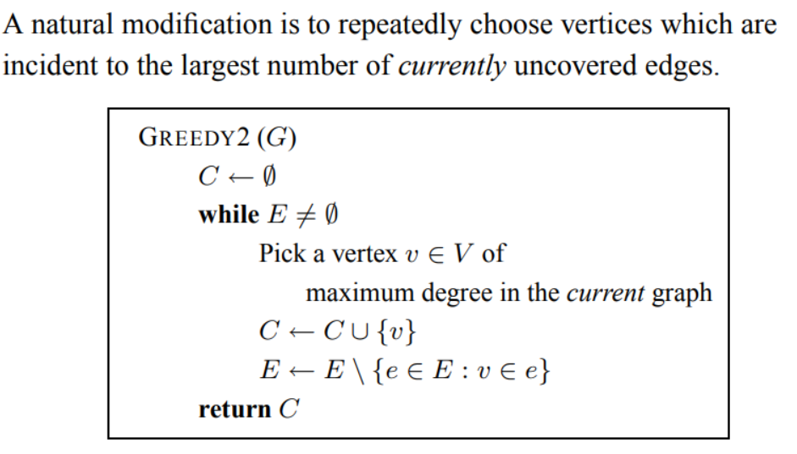
Vertex Cover Selecting Vertices

Slide 7
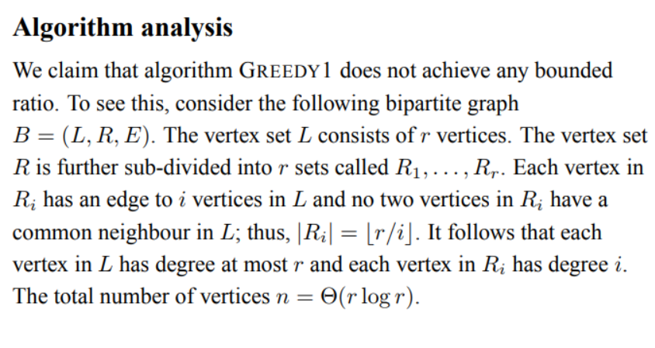
Greedy2 is bad for some graphs
2

Slide 8
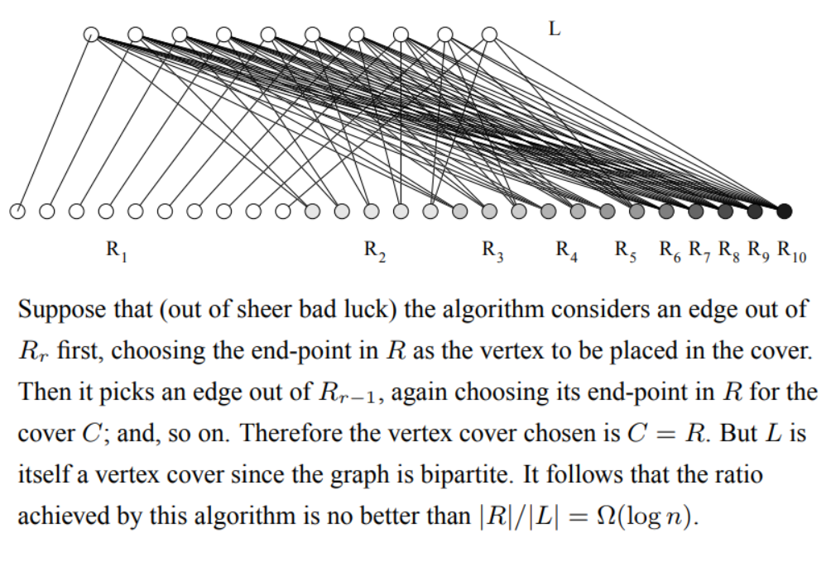
Bad luck Graph for Greedy2

