Slide 1
Approximation Algorithms

Slide 2
Coping With NP-Compleness
Stick with small problems
Develop clever enumeration strategies.
Guaranteed to find optimal solution.
No guarantees on running time, but problem is small.
Special Cases
Look at specific types of input
Find an algorithm that runs in polynomial time
Gives correct solution.
Example: vertex cover in bipartite graphs, perfect graphs.
Heuristics.
Develop intuitive algorithms.
Guaranteed to run in polynomial time.
No guarantees on quality of solution.

Slide 3
Coping With NP-Compleness
Approximation algorithms.
Guaranteed to run in polynomial time.
Guaranteed to find "high quality" solution, say within 1% of optimum.
Obstacle: need to prove a solution’s value is close to optimum,
without even knowing what optimum value is!
Unwilling to relax correctness.
Solve in exponential time but faster than brute force..
Example:
Dynamic Programming for Knapsack O(nW)
Brute Force O(2^{n})
Average Case .
Find an algorithm which works well on average.
Average running time is polynomial.

Slide 4
Approximation Algorithm
An algorithm that returns near-optimal solutions is called an approximation algorithm.
We need to find an approximation ratio bound for an approximation algorithm.

Slide 5
Approximation Ratio bound

Slide 6
Approximate Ratio
If ρ(n)=1, then the algorithm is an optimal algorithm
The larger ρ(n), the worse the algorithm

Slide 7
A 2-Approximation Algorithm for Metric TSP
The key to designing approximation algorithm is to obtain a bound on the optimal value OPT.
In the case of TSP, the minimum spanning tree gives a lower bound for OPT the minimum TSP tour.
Note: In metric TSP
d(a,b) ≤ d(a,c) + d(c,b)
Always as fast to go “directly” from a to b.
Eucledian TSP is an example of a metric TSP.

Slide 8
A 2-Approximation Algorithm for Metric TSP
Claim: The cost of a Minimum Spanning Tree is no greater than the cost of an optimal TSP tour.
cost(MST) ≤ OPT
Proof: Notice that deleting an edge from a TSP tour results in a spanning tree. Therefore, the minimum spanning tree give us a lower bound on OPT, the cost of the optimal TSP tour.
This gives us a simple 2-approximation algorithm for metric TSP.

Slide 9
A 2-Approximation Algorithm for Metric TSP
We need the following definition to design the algorithm.
Definition: A (multi-) graph is Eulerian if it has a walk that uses every edge exactly once.
Fact: A connected graph is Eulerian if and only if every vertex has even degree.

Slide 10
The Algorithm
Find a minimum spanning tree of G
Duplicate each edge in the minimum spanning tree to obtain a Eulerian graph
Find a Eulerian tour E of the Eulerian graph
Convert E to a tour T by going through the vertices in the same order of E , skipping vertices that were already visited
Claim: The above algorithm is a 2-approximation algorithm for TSP

Slide 11
Proof
Claim: The above algorithm is a 2-approximation algorithm for Metric TSP
Proof: As noted above, cost(MST) ≤ OPT. Since E contains two copies of each edge in MST,
cost(E )= 2cost(MST).
Finally, by triangle inequality, shortcutting previously visited vertices does not increase the cost. Hence we have
cost(T ) ≤ 2cost(MST) ≤ 2OPT.

Slide 12
Greedy Approximations
Use a greedy algorithm to solve the given problem
Repeat until a solution is found:
Among the set of possible next steps:
Choose the current best-looking alternative and commit to it
Usually fast and simple
Works in some cases…(always finds optimal solutions)
Dijsktra’s single-source shortest path algorithm
Prim’s and Kruskal’s algorithm for finding MSTs
but not in others…(may find an approximate solution)
TSP – always choosing current least edge-cost node to visit next

Slide 13
Knapsack
Given: a set S of n objects with weights and values, and a weight bound:
w₁, w₂, …, w_{n}, W (weights, weight bound).
b₁, b₂, …, b_{n} (benefit).
Find: subset of S with total weight at most B, and maximum total value.
Formally:
Problem is known to be NP-hard

Slide 14
Assumptions
. (every item can be added to T)
. (non-negative benefits)
benefits, weights, and bound are all integers.
Note:
This is a maximum problem.
Define: OPT = The optimal solution.

Slide 15
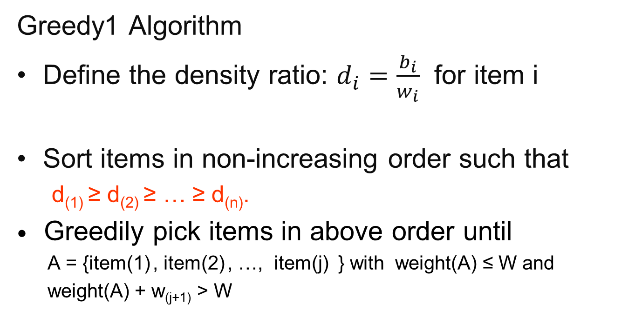
Knapsack Approximation
Greedy1 Algorithm
Define the density ratio: $d_{i}=\frac{b_{i}}{w_{i}}$ for item i
Sort items in non-increasing order such that
d₍₁₎ ≥ d₍₂₎ ≥ … ≥ d_{(n)}.
Greedily pick items in above order until
A = {item(1) , item(2) , …, item(j) } with weight(A) ≤ W and
weight(A) + w_{(j+1)} > W

Slide 16
Knapsack Approximation
Seems like a quick approximation algorithm but it can be very “bad”
Consider the small example:
Greedy picks Item 1 with B = 2
Optimal Item 2 with B = 10
= 10/2 = 5 = W/2
Error grows with W
Item 1
w=1, b=2
d=2
Item 2
w=10, b=10
d=1
Knapsack W = 10

Slide 17
Knapsack Approximation
Seems like a quick approximation algorithm but it can be very “bad”
Consider the small example
Item 1: weight 1 and benefit 2, density d = 2/1 = 2
Item 2: weight W and benefit W, density d = W/W = 1
The greedy algorithm picks the small Item 1with benefit 2 since it has the larger density ratio.
This leaves W-1 empty space in the backpack.
However there is no room for the large item which would have filled the entire backpack and given us total benefit W.
This is W/2 off from optimal. W/2 is not a constant.

Slide 18
Knapsack 2-Approximation
Greedy2 Algorithm
Sort items in non-increasing order such that
d₍₁₎ ≥ d₍₂₎ ≥ … ≥ d_{(n)}.
Greedily pick items in above order until
A = {item(1) , item(2) , …, item(j) } with weight(A) ≤ W and
weight(A) + w_{(j+1)} > W
Pick the better of
A = {item(1) , item(2) , …, item(j ) } and {item(j+1)}
if TotalBenefits(A) > b_{(j+1)} return A
else return item(j+1)
** Note: If weight(A) = W then optimal.

Slide 19
Knapsack 2-Approximation
Greedy2 Algorithm
Pick the better of
A = {item(1) , item(2) , …, item(j ) } and {item(j+1)}
if TotalBenefits(A) > b_{(j+1)} return A
else return item(j+1)
Greedy2 picks Item 2 with b = 10
Optimal Item 2 with b = 10
Item 1
w=1, b=2
d=2
Item 2
w=10, b=10
d=1
Knapsack W = 10

Slide 20
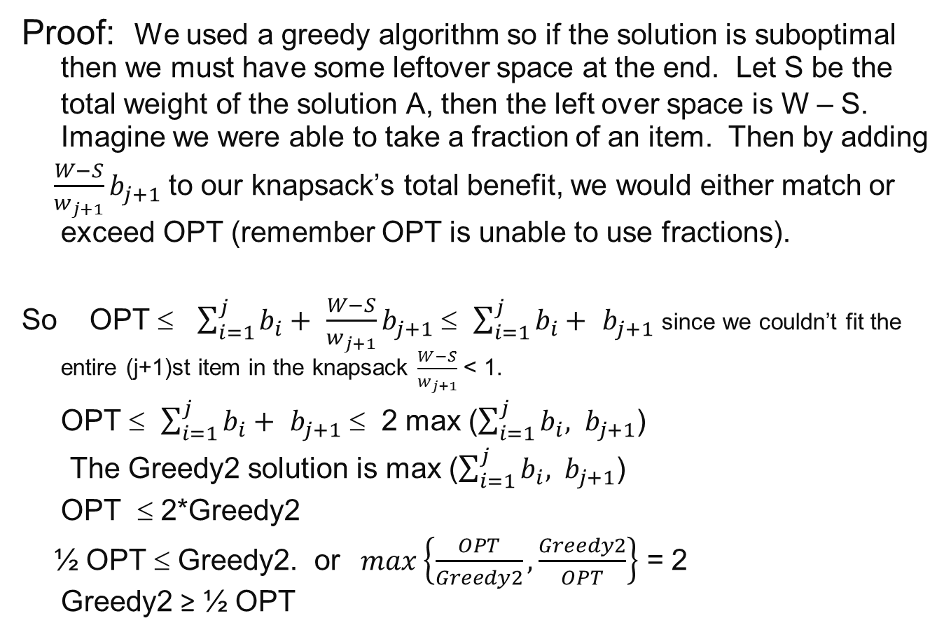
Greedy2 is 2-approximation Knapsack
Proof: We used a greedy algorithm so if the solution is suboptimal then we must have some leftover space at the end. Let S be the total weight of the solution A, then the left over space is W – S. Imagine we were able to take a fraction of an item. Then by adding
$\frac{W−S}{w_{j+1}}b_{j+1}$ to our knapsack’s total benefit, we would either match or exceed OPT (remember OPT is unable to use fractions).
So OPT ≤ $\sum_{i=1}^{j}{b_{i}+ }$ $\frac{W−S}{w_{j+1}}b_{j+1}$ ≤ $\sum_{i=1}^{j}{b_{i}+ }$ $b_{j+1}$ since we couldn’t fit the entire (j+1)st item in the knapsack $\frac{W−S}{w_{j+1}}$ < 1.
OPT ≤ $\sum_{i=1}^{j}{b_{i}+ }$ $b_{j+1}$ ≤ 2 max ($\sum_{i=1}^{j}{b_{i}, }$ $b_{j+1}$)
The Greedy2 solution is max ($\sum_{i=1}^{j}{b_{i}, }$ $b_{j+1}$)
OPT ≤ 2*Greedy2
½ OPT ≤ Greedy2. or $max\left\{\frac{OPT}{Greedy2}, \frac{Greedy2}{OPT}\right\}$ = 2 Greedy2 ≥ ½ OPT

Slide 21
Bin Packing–Dec. is NP-complete
Bin Packing problem: Given n items of sizes a₁, a₂,…, a_{n} (0 < a_{i} ≤ 1), pack these items in at most k bins of size 1.
Bin packing in in NP
To verify a solution
Add the weights of the items in each bin.
Each bin must contain <= 1unit.
Check that each item is in a bin
There are at most k bins used.
This can be done in O(n).
SET-PARTITION reduces to Bin Packing

Slide 22
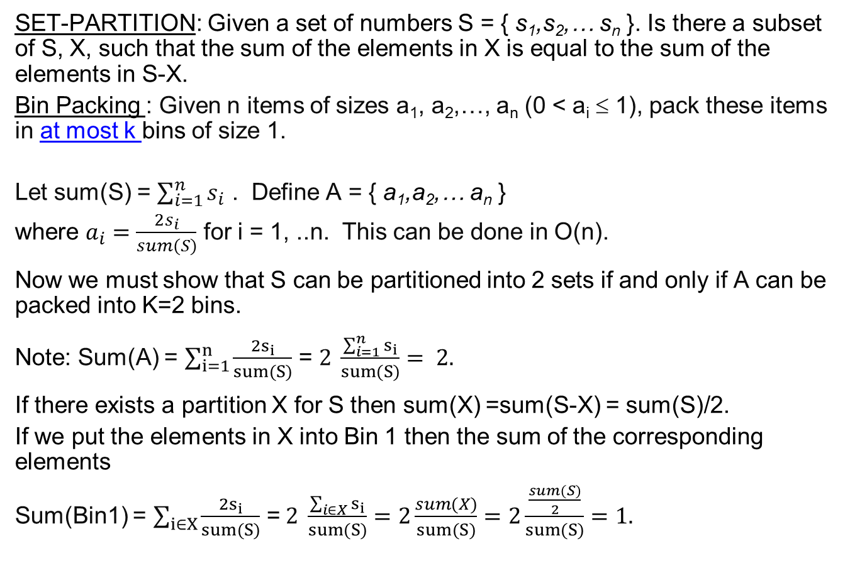
SET-PARTITION ≤_{p} Bin Packing
SET-PARTITION: Given a set of numbers S = { s₁,s₂,… s_{n} }. Is there a subset of S, X, such that the sum of the elements in X is equal to the sum of the elements in S-X.
Bin Packing : Given n items of sizes a₁, a₂,…, a_{n} (0 < a_{i} ≤ 1), pack these items in at most k bins of size 1.
Let sum(S) = $\sum_{i=1}^{n}{s_{i}}$ . Define A = { a₁,a₂,… a_{n} }
where $a_{i}=\frac{2s_{i}}{sum(S)}$ for i = 1, ..n. This can be done in O(n).
Now we must show that S can be partitioned into 2 sets if and only if A can be packed into K=2 bins.
Note: Sum(A) = $\sum_{i=1}^{n}{\frac{2s_{i}}{sum(S)}}$ = $2 \frac{\sum_{i=1}^{n}{s_{i}}}{sum(S)}= 2.$
If there exists a partition X for S then sum(X) =sum(S-X) = sum(S)/2.
If we put the elements in X into Bin 1 then the sum of the corresponding elements
Sum(Bin1) = $\sum_{i∈X}{\frac{2s_{i}}{sum(S)}}$ =$2 \frac{\sum_{i∈X}{s_{i}}}{sum(S)}=2\frac{sum(X)}{sum(S)}=2\frac{\frac{sum(S)}{2}}{sum(S)}=1.$

Slide 23
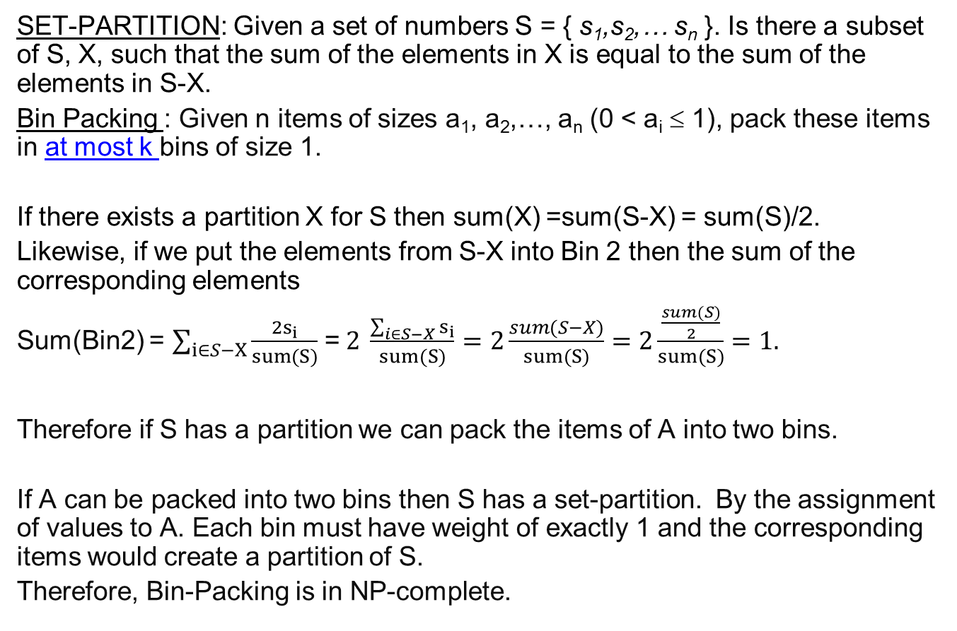
SET-PARTITION ≤_{p} Bin Packing
SET-PARTITION: Given a set of numbers S = { s₁,s₂,… s_{n} }. Is there a subset of S, X, such that the sum of the elements in X is equal to the sum of the elements in S-X.
Bin Packing : Given n items of sizes a₁, a₂,…, a_{n} (0 < a_{i} ≤ 1), pack these items in at most k bins of size 1.
If there exists a partition X for S then sum(X) =sum(S-X) = sum(S)/2.
Likewise, if we put the elements from S-X into Bin 2 then the sum of the corresponding elements
Sum(Bin2) = $\sum_{i∈S−X}{\frac{2s_{i}}{sum(S)}}$ =$2 \frac{\sum_{i∈S−X}{s_{i}}}{sum(S)}=2\frac{sum(S−X)}{sum(S)}=2\frac{\frac{sum(S)}{2}}{sum(S)}=1.$
Therefore if S has a partition we can pack the items of A into two bins.
If A can be packed into two bins then S has a set-partition. By the assignment of values to A. Each bin must have weight of exactly 1 and the corresponding items would create a partition of S.
Therefore, Bin-Packing is in NP-complete.

Slide 24
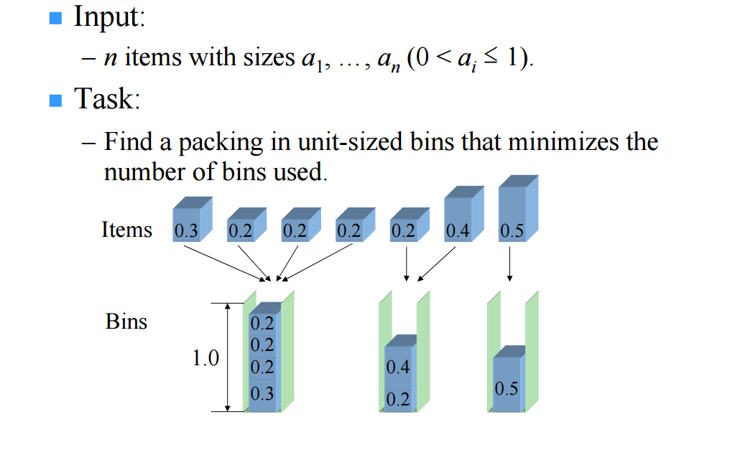
Bin Packing Optimization

Slide 25
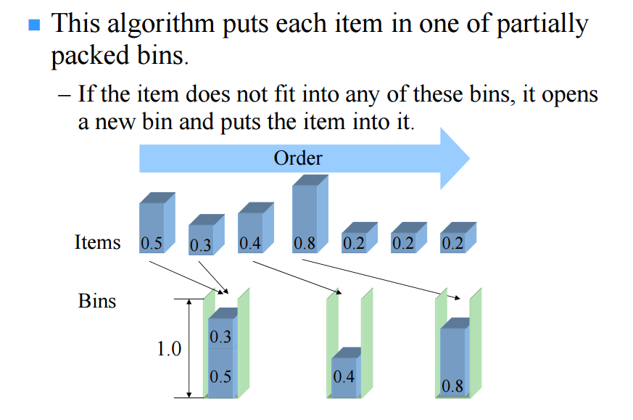
First-Fit Algorithm

Slide 26
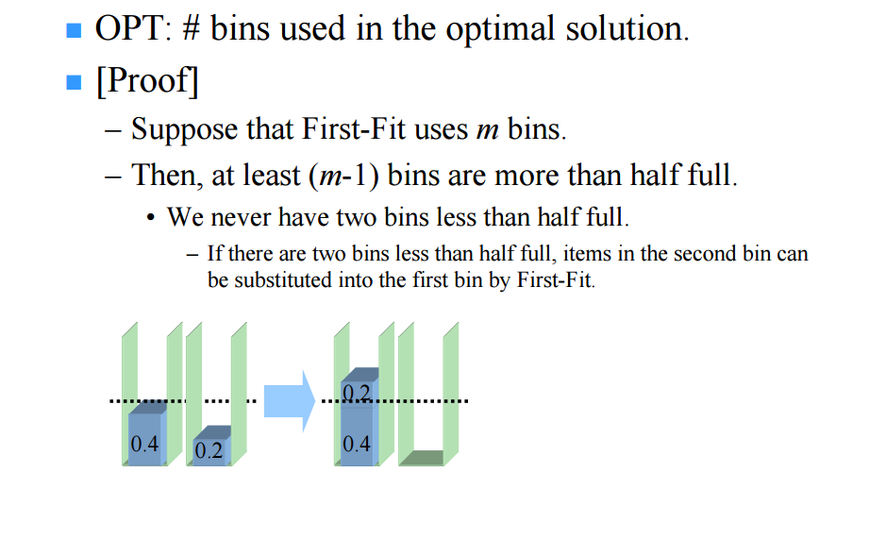
First-Fit finds 2OPT solution

Slide 27
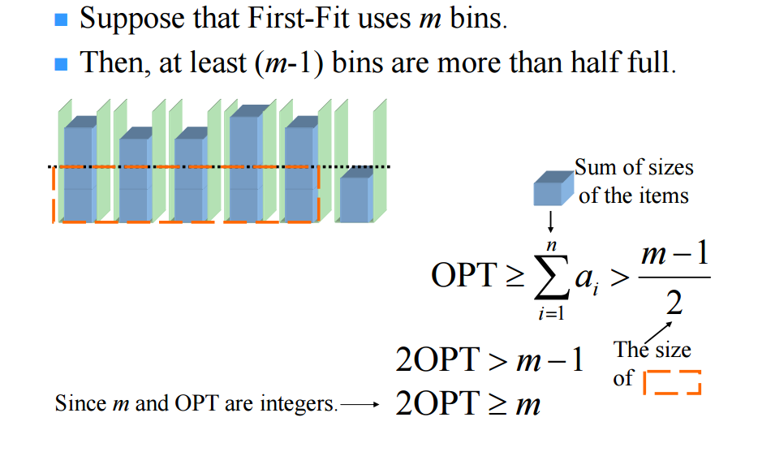
First-Fit finds 2OPT solution

