Slide 1
Proving NP-Completeness
What steps do we have to take to prove a problem B is NP-Complete?
Pick a known NP-Complete problem A. Reduce A to B
Describe a polynomial time transformation/reduction that maps instances of A to instances of B, s.t. “yes” for B = “yes” for A
Prove the transformation works
Prove it runs in polynomial time
By proving step 1 you have proved that problem B is NP-Hard
Prove B ∈ NP
Show that a solution to B can be verified in polynomial time
If you can prove steps 1 and 2 you have proven that B is NP-complete.

Slide 2
NP-Completeness
All problems below are NP-complete and polynomial reduce to one another!
CIRCUIT-SAT
SAT
3-SAT
3-SAT reduces to CLIQUE
CLIQUE
DIR-HAM-CYCLE
GRAPH 3-COLOR
SUBSET-SUM
INDEPENDENT SET
HAM-CYCLE
GRAPH 4-COLOR
KNAPSACK
SET-PARTITION
VERTEX COVER
HAM-PATH
TSP
LONG-PATH
Notes:
Karp analyzed most juicy open problem in discrete math – showed most were NP-complete
x -> y means x reduces to y (if you can solve y, then you can solve x)
Then to join the NP complete club, you need a reduction from SAT (or any other current member) to you

Slide 3
Theorem (Cook-Levin): SAT is NP-complete
Corollary: SAT ∈ P if and only if P = NP

Slide 4
Any thing in NP ≤_{P} SAT
NP
P
SAT
You can think of -> as “easier than”. SAT is the hardest problem in NP.

Slide 7
Satisfiability Problem (SAT)
Satisfiability problem: given a logical expression Φ, find an assignment of values (F, T) to variables x_{i} that causes Φ to evaluate to T
Φ =x₁ ∨ ¬ x₂ ∧ x₃ ∨ ¬ x₄
SAT was the first problem shown to be NP-complete!

Slide 8
CNF Satisfiability
CNF is a special case of SAT
Φ is in “Conjuctive Normal Form” (CNF)
“AND” of expressions (i.e., clauses)
Each clause contains only “OR”s of the variables and their complements
Φ = (x₁ ∨ x₂) ∧ (x₁ ∨ ¬ x₂) ∧ (¬ x₁ ∨ ¬ x₂)
clauses

Slide 9
3-CNF Satisfiability (3-SAT)
A subcase of CNF problem:
Contains three clauses
Φ = (x₁ ∨ ¬x₁ ∨ ¬x₂) ∧ (x₃ ∨ x₂ ∨ x₄) ∧ (¬x₁ ∨ ¬x₃ ∨ ¬ x₄)
3-CNF (3-SAT) is NP-Complete

Slide 10
What we want to prove?
3SAT
NP
P
SAT

Slide 11
How to prove?
We can convert (in polynomial time) a given SAT instance S into a 3SAT instance S’ such that
If S is satisfiable, then S’ is satisfiable.
If S’ is satisfiable, then S is satisfiable.

Slide 12
_{Key Observation}
x₁ ∨ x₂ ∨ x₃ ∨ x₄ ∨ x₅ is satisfiable
if and only if
(x₁ ∨ x₂ ∨ z₁)∧ ( ¬ z₁ ∨ x₃ ∨ z₂ )∧
(¬ z₂ ∨ x₄ ∨ z₃)∧ (¬ z₃ ∨ x₄ ∨ x₅)
is satisfiable.

Slide 13
Polynomial Time Reduction
Clause in SAT
Clauses in 3SAT
x₁
x₁ ∨ ¬ x₂
x₁ ∨ x₂ ∨ x₃
x₁ ∨ x₂ ∨ x₃ ∨ x₄
x₁ ∨ x₂ ∨ x₃ ∨ x₄ ∨ x₅
x₁ ∨ x₁ ∨ x₁
x₁ ∨ x₁ ∨ ¬ x₂
x₁ ∨ x₂ ∨ x₃
(x₁ ∨ x₂ ∨ z₁)∧ ( ¬ z₁ ∨ x₃ ∨ x₄)
(x₁ ∨ x₂ ∨ z₁)∧ ( ¬ z₁ ∨ x₃ ∨ z₂)∧
(¬ z₂ ∨ x₄ ∨ z₃)∧ (¬ z₃∨ x₄ ∨ x₅)

Slide 14
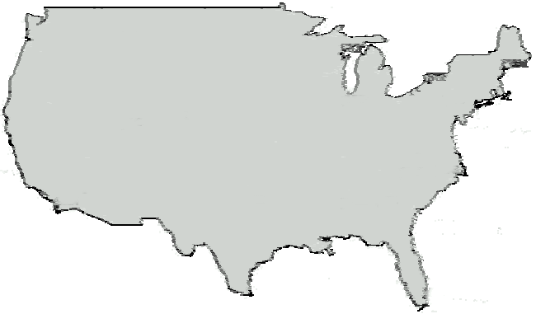
Traveling Salesman Problem
A traveling salesperson needs to visit n cities
Is there a route of at most d length? (decision problem)
Optimization-version asks to find a shortest cycle visiting all vertices once in a weighted graph

Slide 15
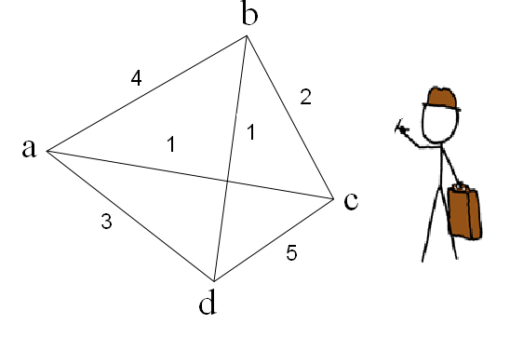
Traveling Salesman Problem
In the traveling salesman problem, a salesman must visit n cities.
Salesman wishes to make a tour visiting each city exactly once and finishing at the city he started.
There is an integer cost c(i,j) to travel from city i to city j.
For example, the salesman must travel to a, b, c, d locations.
Travel costs are given

Slide 16
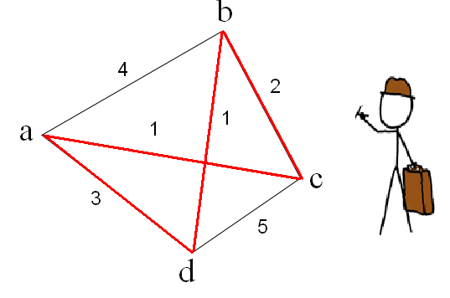
Optimization TSP
The salesman wishes to make the tour whose total cost is minimum.
The total cost is sum of the individual costs along the edges of the tour
In the example the minimum cost tour is a-c-b-d
The cost of this tour is 1+2+1+3 = 7

Slide 17
Decision TSP
The formal language:
TSP = { <G,c,k>: G=(V,E) is a complete graph, c is a function from (V x V)→ N, k ∈ N and G has a traveling salesman tour with cost at most k}
G = ({a, b, c, d},{(a,b),..(c,d)}) c(a,b) = 4, c(a,c) = 1,…c(c,d) = 5
Suppose k = 15
Can we verify the solution certificate
(a,d,c,b) - yes
c(a,d) + c(d,c) + c(c,b) + c(b,a) =
3 + 5 + 2 +4 = 14 < 15

Slide 18
NP-Completeness Proof Method
To show that B is NP-Complete:
Show that B is in NP.
Give a polynomial time algorithm for verifying a solution.
Show that A ≤_{P} B for some A∈NP-Complete
Pick an instance, A, of your favorite NP-Complete problem
Show a polynomial algorithm to transform A into an instance of B
Step 2 alone shows that a problem is NP-Hard

Slide 19
Prove TSP-Decision is NP-complete
1) Show that TSP belongs to NP.
Given an instance of the problem the certificate is the sequence of n vertices (cities) in the tour.
The certifier (verification algorithm) checks that
this sequence contains each vertex exactly once,
sums up the edge costs and checks whether the sum is at most k.
This process can be done in polynomial time.
Therefore TSP-Decision is in NP

Slide 20
Ham-Cycle G
TSP-Decision G’
a
a
0
0
TSP-Decision
<G’, c, 0>
Yes
b
c
1
b
c
1
d
0
0
d
a
a
1
1
TSP-Decision
<G’, c, 0>
No
b
c
b
1
c
0
0
0
d
d

Slide 21
Prove TSP-Decision is NP-complete
2) Prove that TSP is NP-hard. We can show that
Ham-cycle ≤ _{p} TSP.
where Ham-cycle ∈ NP-Complete
Let G=(V,E) be an instance of Ham-cycle. We construct an instance of TSP as follows
Form the complete graph G' = (V,E') where E' = { (i,j) : i, j ∈ V and i≠j} and
Define the cost function c by c(i,j) = { 0 if (i,j) ∈ E, 1 if (i,j) ∉ E }
The instance of TSP is then <G',c,0> which is easily formed in polynomial time.
By proving 2) TSP-Decision is NP-Hard. Since 1) held too then we have shown that TSP-Decision is NP-Complete

Slide 22
We now show that graph G has a Hamiltonian cycle if and only if graph G' has a tour of cost at most 0.
Suppose the graph G has a Hamiltonian cycle h.
Each edge in h belongs to E and thus has a cost 0 in G‘
Thus h is a tour in G' with cost 0
Conversely suppose that graph G' has a tour h' of cost at most 0.
Since the cost of edges in E' are 0 and 1, the cost of tour h' is exactly 0 and each edge on the tour must have cost 0.
Thus h' contains only edges in E.
Hence we conclude that h' is a Hamiltonian cycle in graph G.
By proving 2) TSP-Decision is NP-Hard. Since 1) held too then we have shown that TSP-Decision is NP-Complete

Slide 23
NP-Completeness
All problems below are NP-complete and polynomial reduce to one another!
CIRCUIT-SAT
3-SAT
4-SAT
3-SAT reduces to CLIQUE
CLIQUE
DIR-HAM-CYCLE
GRAPH 3-COLOR
SUBSET-SUM
INDEPENDENT SET
HAM-CYCLE
GRAPH 4-COLOR
KNAPSACK
SET-PARTITION
VERTEX COVER
HAM-PATH
IP-DECISION
TSP
COURSE-TIME
LONG-PATH
Notes:
Karp analyzed most juicy open problem in discrete math – showed most were NP-complete
x -> y means x reduces to y (if you can solve y, then you can solve x)
Then to join the NP complete club, you need a reduction from SAT (or any other current member) to you

Slide 24
SUBSET-SUM
Instance: A set of numbers denoted S and a target number t.
Problem: To decide if there exists a subset S’ ⊆ S, s.t Σ_{y∈S’}y=t.

Slide 25
Examples of SUBSET-SUM
… because 2+8=10
… because 11 cannot be made out of {2,4,8}

Slide 26
SUBSET-SUM is NP-Complete
Proof:
Show SUBSET-SUM is in NP.
Show 3SAT≤_{p}SUBSET-SUM.

Slide 27
SUBSET-SUM is in NP
Given a set S and target t:
Verify that S’⊆S is a solution
The answer is YES iff Σ_{y∈S’}y=t.
The length of the certificate: O(n) (n=|S|)
Time complexity: Is the time to add the numbers in S’ which is O(n).

Slide 28
Reducing 3SAT to SubSet Sum
Proof idea:
Choosing the subset numbers from the set S corresponds to choosing the assignments of the variables in the 3SAT formula.
The different digits of the sum correspond to the different clauses of the formula.
If the target t is reached, a valid and satisfying assignment is found.

Slide 29
Subset Sum
clause:
1 | 2 | 3 | 4
3CNF formula:
+x₁
–x₁
+x₂
–x₂
+x₃
–x₃
+x₄
–x₄
1 | 0 | 0 | 0 | 1 | 0 | 0 | 1
1 | 0 | 0 | 0 | 0 | 1 | 0 | 0
 | 1 | 0 | 0 | 1 | 1 | 0 | 0
 | 1 | 0 | 0 | 0 | 0 | 1 | 0
 |  | 1 | 0 | 1 | 0 | 0 | 0
 |  | 1 | 0 | 0 | 0 | 1 | 1
 |  |  | 1 | 0 | 1 | 0 | 0
 |  |  | 1 | 0 | 0 | 0 | 1
 |  |  |  | 1 | 0 | 0 | 0
 |  |  |  | 1 | 0 | 0 | 0
 |  |  |  |  | 1 | 0 | 0
 |  |  |  |  | 1 | 0 | 0
 |  |  |  |  |  | 1 | 0
 |  |  |  |  |  | 1 | 0
 |  |  |  |  |  |  | 1
 |  |  |  |  |  |  | 1
Make the number table,
and the ‘target sum’ t
dummies
+
1 | 1 | 1 | 1 | 3 | 3 | 3 | 3

Slide 30
Reducing 3SAT to SubSet Sum
Let φ∈3CNF with k clauses and  variables x₁,…,x.
Create a Subset-Sum instance <S_{φ},t> by: 2+2k elements of S_{φ} = {y₁,z₁,…,y,z,g₁,h₁,…,g_{k},h_{k}}
y_{j} indicates positive x_{j} literals in clauses
z_{j} indicates negated x_{j} literals in clauses
g_{j} and h_{j} are dummies
and

Slide 31
Subset Sum
+x₁
–x₁
+x₂
–x₂
+x₃
–x₃
+x₄
–x₄
1 | 0 | 0 | 0 | 1 | 0 | 0 | 1
1 | 0 | 0 | 0 | 0 | 1 | 0 | 0
 | 1 | 0 | 0 | 1 | 1 | 0 | 0
 | 1 | 0 | 0 | 0 | 0 | 1 | 0
 |  | 1 | 0 | 1 | 0 | 0 | 0
 |  | 1 | 0 | 0 | 0 | 1 | 1
 |  |  | 1 | 0 | 1 | 0 | 0
 |  |  | 1 | 0 | 0 | 0 | 1
 |  |  |  | 1 | 0 | 0 | 0
 |  |  |  | 1 | 0 | 0 | 0
 |  |  |  |  | 1 | 0 | 0
 |  |  |  |  | 1 | 0 | 0
 |  |  |  |  |  | 1 | 0
 |  |  |  |  |  | 1 | 0
 |  |  |  |  |  |  | 1
 |  |  |  |  |  |  | 1
Note 1: The “1111”
in the target forces
a proper assignment
of the x_{i} variables.
Note 2: The target
“3333” is only possible
if each clause is satisfied.
(The dummies can add
maximally 2 extra.)
1 | 1 | 1 | 1 | 3 | 3 | 3 | 3

Slide 32
Subset Sum
+x₁
–x₁
+x₂
–x₂
+x₃
–x₃
+x₄
–x₄
1 | 0 | 0 | 0 | 1 | 0 | 0 | 1
1 | 0 | 0 | 0 | 0 | 1 | 0 | 0
 | 1 | 0 | 0 | 1 | 1 | 0 | 0
 | 1 | 0 | 0 | 0 | 0 | 1 | 0
 |  | 1 | 0 | 1 | 0 | 0 | 0
 |  | 1 | 0 | 0 | 0 | 1 | 1
 |  |  | 1 | 0 | 1 | 0 | 0
 |  |  | 1 | 0 | 0 | 0 | 1
 |  |  |  | 1 | 0 | 0 | 0
 |  |  |  | 1 | 0 | 0 | 0
 |  |  |  |  | 1 | 0 | 0
 |  |  |  |  | 1 | 0 | 0
 |  |  |  |  |  | 1 | 0
 |  |  |  |  |  | 1 | 0
 |  |  |  |  |  |  | 1
 |  |  |  |  |  |  | 1
1 | 0 | 0 | 0 | 1 | 0 | 0 | 1
 | 1 | 0 | 0 | 0 | 0 | 1 | 0
 |  | 1 | 0 | 0 | 0 | 1 | 1
 |  |  | 1 | 0 | 1 | 0 | 0
 |  |  |  | 1 | 0 | 0 | 0
 |  |  |  | 1 | 0 | 0 | 0
 |  |  |  |  | 1 | 0 | 0
 |  |  |  |  | 1 | 0 | 0
 |  |  |  |  |  | 1 | 0
 |  |  |  |  |  |  | 1
1 | 1 | 1 | 1 | 3 | 3 | 3 | 3
+
is a satisfying assignment
1 | 1 | 1 | 1 | 3 | 3 | 3 | 3

Slide 33
Subset Sum
+x₁
–x₁
+x₂
–x₂
+x₃
–x₃
+x₄
–x₄
1 | 0 | 0 | 0 | 1 | 0 | 0 | 1
1 | 0 | 0 | 0 | 0 | 1 | 0 | 0
 | 1 | 0 | 0 | 1 | 1 | 0 | 0
 | 1 | 0 | 0 | 0 | 0 | 1 | 0
 |  | 1 | 0 | 1 | 0 | 0 | 0
 |  | 1 | 0 | 0 | 0 | 1 | 1
 |  |  | 1 | 0 | 1 | 0 | 0
 |  |  | 1 | 0 | 0 | 0 | 1
 |  |  |  | 1 | 0 | 0 | 0
 |  |  |  | 1 | 0 | 0 | 0
 |  |  |  |  | 1 | 0 | 0
 |  |  |  |  | 1 | 0 | 0
 |  |  |  |  |  | 1 | 0
 |  |  |  |  |  | 1 | 0
 |  |  |  |  |  |  | 1
 |  |  |  |  |  |  | 1
1 | 0 | 0 | 0 | 0 | 1 | 0 | 0
 | 1 | 0 | 0 | 0 | 0 | 1 | 0
 |  | 1 | 0 | 0 | 0 | 1 | 1
 |  |  | 1 | 0 | 1 | 0 | 0
 |  |  |  | 1 | 0 | 0 | 0
 |  |  |  | 1 | 0 | 0 | 0
 |  |  |  |  | ? | ? | ?
1 | 1 | 1 | 1 | 2 | ? | ? | ?
+
is not a
satisfying assignment
1 | 1 | 1 | 1 | 3 | 3 | 3 | 3

Slide 34
Proof 3SAT ≤_{P} Subset Sum
For every 3CNF φ, take target t=1…13…3 and the corresponding set S_{φ}.
If φ∈3SAT, then the satisfying assignment defines a subset that reaches the target.
Also, the target can only be obtained via a set that gives a satisfying assignment for φ.

Slide 35
0-1 KNAPSACK
Prove the following knapsack problem to be NP complete
Decision version
n objects, each with a weight w_{i} > 0 and a benefit b_{i} > 0 capacity of knapsack : W. Can you fill the knapsack so that the sum of benefits is at least K?
For all item i in the solution set S.
∑b_{i} ≥ K and ∑w_{i} ≤ W

Slide 36
KNAPSACK is NP-Complete
1) Show NP – Verify a solution in polynomial time
2) Show NP-Hard. Reduce SUBSET-SUM to KNAPSACK

Slide 37
KNAPSACK is NP-Complete
1) Show NP – Verify a solution in polynomial time
Given a certificate solution X = { x₁, …, x_{n} } can we verify in poly time.
Sum the weights of x∈X must be ≤ W. Time O(n)
Sum the benefits of x∈X must be ≥ K. Time O(n)

Slide 38
Reduction
Show NP-Hard. SUBSET-SUM ≤_{P} KNAPSACK. How can you use Knapsack to solve Subset-Sum
yes
α
f
β
KNAPSACK
yes
no
no
SUBSET-SUM

Slide 39
2) Show NP-Hard. SUBSET-SUM ≤_{P} KNAPSACK. How can you use Knapsack to solve Subset-Sum
Reduction from SUBSET-SUM to Decision-KNAPSACK:
SUBSET-SUM = { <S, t> | S = {y₁, …, y_{k}} and for some
Subset T = {y_{j}, …, y_{l} } ⊆ S, Σy_{i} = t }
Set
Set W = t and K = t
Then for any subset T ⊆ S
if and only if and

Slide 40
Example: Reduce SUBSET-SUM to KNAPSACK.
SUBSET-SUM = < {12, 6, 8, 13, 20 }, 26 >
Set
Set W = k = 26
item | weight | benefit
1 | 12 | 12
2 | 6 | 6
3 | 8 | 8
4 | 13 | 13
5 | 20 | 20
Knapsack has capacity 26. Is there a subset of items that will fit in the knapsack and have a total benefit of at least 26?
Yes T = { item2, item 5}. This corresponds to a subset sum T = {6, 20} sum 26

Slide 41
3-SAT (CNF)
A special of CNF problem: Each clause contains three boolean literals
Φ = (x₁ ∨ ¬x₁ ∨ ¬x₂) ∧ (x₃ ∨ x₂ ∨ x₄) ∧ (¬x₁ ∨ ¬x₃ ∨ ¬ x₄)
3-SAT is NP-Complete
3-SAT is in NP
SAT ≤_{p} 3-SAT

Slide 42
Is 4-SAT NP-Complete?
Instance: A collection of clause C where each clause contains exactly 4 literals, Boolean literals x.
Question: Is there a truth assignment to x so that each clause is satisfied?
Example Φ = (x₁ ∨ ¬x₁ ∨ ¬x₂ ∨ ¬x₃ ) ∧ (x₁ ∨ x₃ ∨ x₂ ∨ x₄)

Slide 43
NP-Completeness Proof Method
To show that 4-SAT is NP-Complete:
Show that 4-SAT is in NP.
Give a polynomial time algorithm for verifying a solution.
Show that 3-SAT ≤_{P} 4-SAT
Give a polynomial algorithm F to transform 3-SAT into an instance of 4-SAT such that:
For any instance X of 3-SAT if X is True then F(X) is true for 4-SAT and
For any instance F(Y) of 4-SAT if F(Y) is True then Y is true for 3-SAT
Step 2 alone shows that a problem is NP-Hard

Slide 44
1. Show that 4-SAT is in NP.
Give a polynomial time algorithm for verifying a 4-SAT solution. This algorithm takes a 4-SAT instance and proposed truth assignments as input and evaluates the 4-SAT instance. If the 4-SAT instance evaluates to true the algorithm outputs yes; otherwise the algorithm outputs no. Thus runs in polynomial time.
= (x₁ ∨ ¬x₁ ∨ ¬x₂ ∨ ¬x₃ ) ∧ (x₁ ∨ x₃ ∨ x₂ ∨ x₄)
Candidate solution x₁ = 1, x₂ = 1, x₃ = 1, x₄ = 1
yes

Slide 45
2. Show that 3-SAT ≤_{P} 4-SAT
Give a polynomial algorithm F to transform 3-SAT into an instance of 4-SAT such that:
For any instance X of 3-SAT if X is True then F(X) is true for 4-SAT and
For any instance F(Y) of 4-SAT if F(Y) is True then Y is true for 3-SAT
yes
X
F
Y
Problem 4-SAT
yes
no
no
Problem 3-SAT

Slide 46
2. Show that 3-SAT ≤_{P} 4-SAT
Give a polynomial algorithm F to transform 3-SAT into an instance of 4-SAT such that:
For any instance X of 3-SAT if X is True then F(X) is true for 4-SAT and
For any instance F(Y) of 4-SAT if F(Y) is True then Y is true for 3-SAT
yes
X
F
Y
Problem 4-SAT
yes
no
no
Problem 3-SAT

Slide 47
2. Show that 3-SAT ≤_{P} 4-SAT
Give a polynomial algorithm F to transform 3-SAT into an instance of 4-SAT such that:
For any instance X of 3-SAT if X is True then F(X) is true for 4-SAT and
For any instance F(Y) of 4-SAT if F(Y) is True then Y is true for 3-SAT
yes
X
F
Y
Problem 4-SAT
yes
no
no
Problem 3-SAT

Slide 48
2. Show that 3-SAT ≤_{P} 4-SAT
yes
X
F
Y
Problem 4-SAT
yes
no
no
Problem 3-SAT

Slide 49
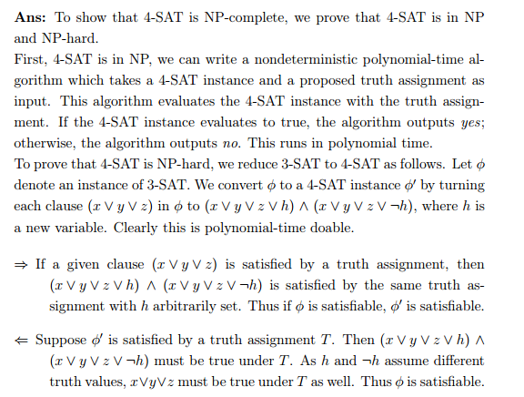

Slide 50
A Hamiltonian path in a graph is a simple path that visits every vertex exactly once. Show that HAM-PATH = { (G, u, v): there is a Hamiltonian path from u to v in G } is NP-complete. You may use the fact that HAM-CYCLE is NP-complete.

Slide 51
NP-Completeness
All problems below are NP-complete and polynomial reduce to one another!
CIRCUIT-SAT
SAT
3-SAT
3-SAT reduces to CLIQUE
CLIQUE
DIR-HAM-CYCLE
GRAPH 3-COLOR
SUBSET-SUM
INDEPENDENT SET
HAM-CYCLE
GRAPH 4-COLOR
KNAPSACK
SET-PARTITION
VERTEX COVER
HAM-PATH
TSP
LONG-PATH
Notes:
Karp analyzed most juicy open problem in discrete math – showed most were NP-complete
x -> y means x reduces to y (if you can solve y, then you can solve x)
Then to join the NP complete club, you need a reduction from SAT (or any other current member) to you

Slide 52
Clique
Clique Problem:
Undirected graph G = (V, E)
Clique: a subset of vertices in V all connected to each other by edges in E (i.e., forming a complete graph)
Size of a clique: number of vertices it contains
Optimization problem:
Find a clique of maximum size
Decision problem:
Does G have a clique of size k?
Clique(G, 2) = YES
Clique(G, 3) = NO
Clique(G, 3) = YES
Clique(G, 4) = NO

Slide 53
Clique Verifier
Given: an undirected graph G = (V, E)
Problem: Does G have a clique of size k?
Certificate:
A set of k nodes
Verifier:
Verify that for all pairs of vertices in this set there exists an edge in E

Slide 54
Example: Clique
CLIQUE = { <G,k> | G is a graph with a clique of size k }
A clique is a subset of vertices that are all connected
Why is CLIQUE in NP?

Slide 55
3-CNF ≤_{p} Clique
Idea:
Construct a graph G such that Φ is satisfiable only if G has a clique of size k

Slide 56
Reduce 3-SAT to Clique
Pick an instance of 3-SAT, Φ, and transform into <G,k> an instance of Clique
If Φ has m clauses, we create a graph with m clusters of 3 nodes each and set k = m.
Each cluster corresponds to a clause.
Each node in a cluster is labeled with a literal from the clause.
We do not connect any nodes in the same cluster
We connect nodes in different clusters whenever they are not contradictory
Any k-clique in this graph corresponds to a satisfying assignment

Slide 57
Example
(x₁ ∨ ¬x₂ ∨ ¬x₃ ) ∧ (¬x₁ ∨ x₂ ∨ x₃) ∧ (x₁ ∨ x₂ ∨ x₃)

Slide 58
(x₁ ∨ x₁ ∨ x₁) ∧ (¬x₁ ∨ ¬x₁ ∨ x₂) ∧
(x₂ ∨ x₂ ∨ x₂) ∧ (¬x₂ ∨ ¬x₂ ∨ x₁)
¬x₁
¬x₁
x₂
x₁
x₂
x₁
x₂
x₁
x₂
¬x₂
¬x₂
x₁

Slide 59
Coping With NP-Compleness
Stick with small problems
Develop clever enumeration strategies.
Guaranteed to find optimal solution.
No guarantees on running time, but problem is small.
Special Cases
Look at specific types of input
Find an algorithm that runs in polynomial time
Gives correct solution.
Example: vertex cover in bipartite graphs, perfect graphs.
Heuristics.
Develop intuitive algorithms.
Guaranteed to run in polynomial time.
No guarantees on quality of solution.

