Slide 1
NP-Completeness
All problems below are NP-complete and polynomial reduce to one another!
CIRCUIT-SAT
3-SAT
4-SAT
3-SAT reduces to CLIQUE
CLIQUE
DIR-HAM-CYCLE
GRAPH 3-COLOR
SUBSET-SUM
INDEPENDENT SET
HAM-CYCLE
GRAPH 4-COLOR
KNAPSACK
SET-PARTITION
VERTEX COVER
HAM-PATH
IP-DECISION
TSP
COURSE-TIME
LONG-PATH
Notes:
Karp analyzed most juicy open problem in discrete math – showed most were NP-complete
x -> y means x reduces to y (if you can solve y, then you can solve x)
Then to join the NP complete club, you need a reduction from SAT (or any other current member) to you

Slide 2
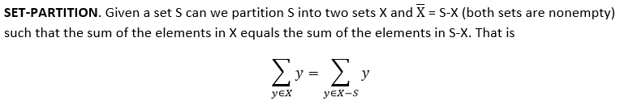
Prove that SET-PARTITION is in NP-complete
To show that SET-PARTITION is NP-Complete, we need to show:
That SET-PARTITION ∈ NP. Given a partition of set S we can verify in polynomial time that the two subsets X and S-X have equal sums by adding the values in each set. This clearly takes time O(n) where n is the number of elements in S.
That some NP-Complete problem A can be reduced to SET-PARTITION in polynomial time and the original problem A has a yes solution if and only if SET-PARTITION has a yes solution.

Slide 3
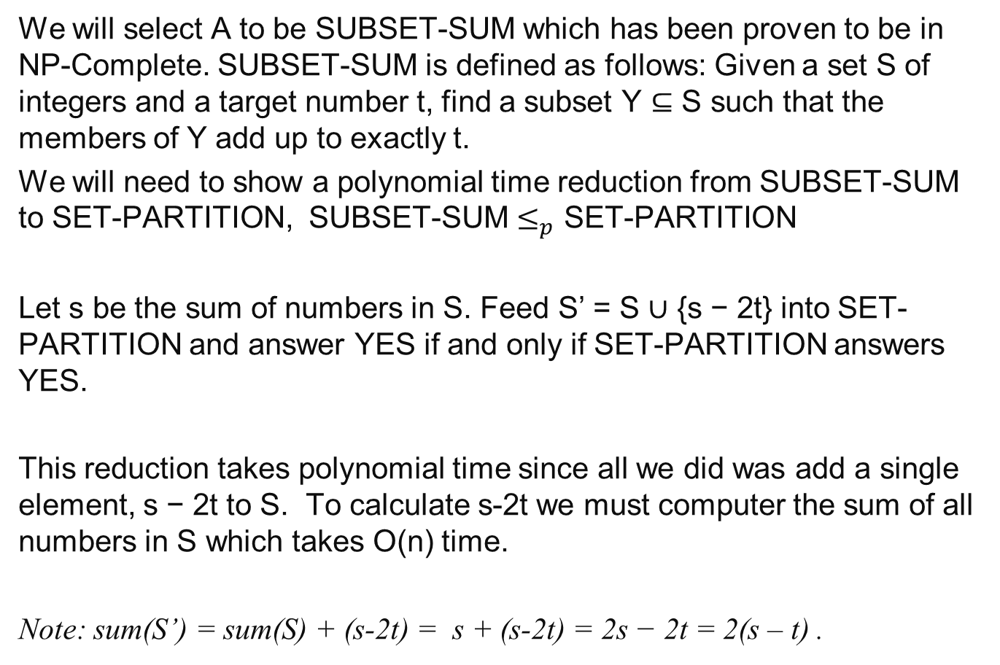
We will select A to be SUBSET-SUM which has been proven to be in NP-Complete. SUBSET-SUM is defined as follows: Given a set S of integers and a target number t, find a subset Y ⊆ S such that the members of Y add up to exactly t.
We will need to show a polynomial time reduction from SUBSET-SUM to SET-PARTITION, SUBSET-SUM $≤_{p}$ SET-PARTITION
Let s be the sum of numbers in S. Feed S’ = S ∪ {s − 2t} into SET-PARTITION and answer YES if and only if SET-PARTITION answers YES.
This reduction takes polynomial time since all we did was add a single element, s − 2t to S. To calculate s-2t we must computer the sum of all numbers in S which takes O(n) time.
Note: sum(S’) = sum(S) + (s-2t) = s + (s-2t) = 2s − 2t = 2(s – t) .

Slide 4
We must show that <S, t> ∈ SUBSET-SUM iff <S’> ∈ SET-PARTITION. In other words There exists a subset of S that sums to t if and only if there exists a set partition of S’ with equal sums.
1) If Y is a solution to <S,t> SUBSET-SUM then S’ has a SET-PARTITION.
If there exists a subset Y of numbers in S that sum to t then the remaining numbers in S-Y sum to s − t. Now S’ = (S-Y) ∪ Y ∪ {s-2t} such that we can partition S’ into two sets (S-Y) and Y ∪ {s-2t} with each partition summing to s − t. Therefore there is a solution to SET-PARTITION.

Slide 5
2) If there exists a partition of S’ then there exists a solution to <S, t> ∈ SUBSET-SUM.
Recall sum(S’) = 2(s – t) and S’ = S ∪{s-2t} .
If there exists a partition of S’ into two sets X and S’-X such that the sum over each set is s−t then one of these sets say X must contain the number s−2t. By removing it, we get a set X’ = X- {s-2t} with sum(X’) = (s – t) - (s-2t) = t, and since S’ = S ∪ {s − 2t} all of the elements in X’ are in S. Therefore there exists a subset X’ of S that sums to t.
Since, SET-PARTITION ∈ NP and SUBSET-SUM ≤_{p} SET-PARTITION, SET-PARTITION is in NP-Complete.

Slide 7
COURSE-TIME is NP-Complete
The COURSE-TIME assignment problem is as follows.
Input: A set of m students S, a set of n classes C, a positive integer K and, for each student x ∈ S, a list L of courses that student x wants to take.
Question: Is it possible to schedule courses into only K time slots such that each student to take all of his or her desired courses, without any time conflicts?
Prove that the COURSE-TIME assignment problem is NP-complete. (Hint: Use that fact that K-COLOR is in NP-Complete.)

Slide 8
COURSE-TIME is NP-Complete
Show that COURSE-TIME is in NP.
Give a polynomial time algorithm for verifying a solution.
Show that K-COLOR ≤_{P} COURSE-TIME
Step 2 alone shows that a problem is NP-Hard

Slide 9
COURSE-TIME is NP-Complete
Show that COURSE-TIME is in NP.
Give a polynomial time algorithm for verifying a solution.
A certificate is an assignment of courses to time slots. To check the certificate, check that each student's list of courses has no time conflicts, and that only the K number of time slots have been used.
Number of students = m
Number of courses n = max size of student list L
Time to check conflicts O(m*n)
Time to check K time slots = O(n)

Slide 10
COURSE-TIME is NP-Complete
2. Show that K-COLOR ≤_{P} COURSE-TIME
The K-COLOR problem is as follows.
Input: An undirected graph G and a positive integer K.
Question: Is it possible to color the vertices of G using no more than K colors (coloring each vertex just one color) so that no two adjacent vertices have the same color?
G=(V,E)
Class
Students
list
yes
F
Course-Time
yes
no
no
K-color

Slide 11
K-COLOR ≤_{P} COURSE-TIME
The K-COLOR problem reduces to the course assignment problem via reduction defined as follows. Given graph G and positive integer K, produce a course assignment problem whose courses are the vertices of G, and with K available time slots. Include, in the problem, a student for each edge of G. The student associated with edge (u,v) wants to take courses u and v, and nothing more.
Instance of COURSE-TIME
Instance of 3-COLOR
Students S = { ab, bc, bd, cd }
Class lists L student
ab = {a, b}
bc = {b, c}
bd = {b, d}
cd = {c, d}
Courses = { a, b, c, d}
K = 3 time slots
a
c
b
d

Slide 12
K-COLOR ≤_{P} COURSE-TIME
Instance of COURSE-TIME
Instance of 3-COLOR
Students S = { ab, bc, bd, cd }
Class lists L student
ab = {a, b}
bc = {b, c}
bd = {b, d}
cd = {c, d}
Courses = { a, b, c, d}
K = 3 time slots
a
c
b
d
a = 9am = red
b = 10am = blue
c = 11am = yellow
d = 9am = red

Slide 13
a. Any K-COLOR solution gives a solution to COURSE-TIME.
Suppose that G can be colored with K colors. Get a K-coloring of G. Assign times slots to the courses by following the coloring. If vertex v is colored by color m, then use time slot m for course v. Since the coloring does not color any two adjacent vertices the same color, there can be no time conflicts.
b. Any COURSE-TIME solution gives a solution to K-COLOR.
Suppose that the courses can be assigned time slots so that there are no conflicts. Then assign colors to G in the same way, using the m-th color for vertex v if course v received the m-th time slot. Since there is a student for each edge, and none of the students have time slot conflicts, this coloring must avoid coloring two adjacent vertices the same color.
Remark. Be sure that your reduction goes the right direction. You need to show how to solve the graph coloring problem, assuming that you already have a solution to the course assignment problem, not the other way around.

Slide 14
Bin Packing–Dec. is NP-complete
Bin Packing problem: Given n items of sizes a₁, a₂,…, a_{n} (0 < a_{i} ≤ 1), pack these items in at most k bins of size 1.
Bin packing in in NP
To verify a solution
Add the weights of the items in each bin.
Each bin must contain < 1unit.
Check that each item is in a bin
There are at most k bins used.
This can be done in O(n).
SET-PARTITION reduces to Bin Packing

Slide 15
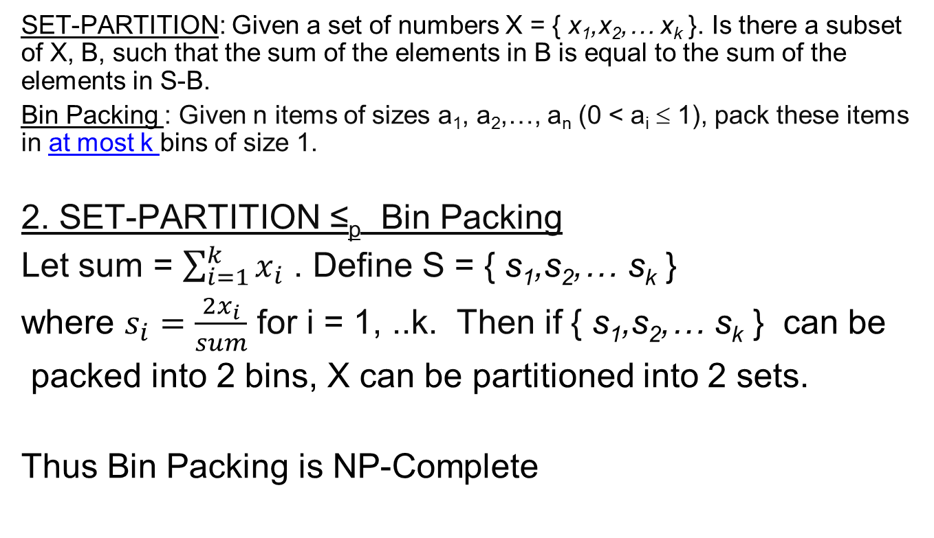
Bin Packing–Dec. is NP-complete
SET-PARTITION: Given a set of numbers X = { x₁,x₂,… x_{k} }. Is there a subset of X, B, such that the sum of the elements in B is equal to the sum of the elements in S-B.
Bin Packing : Given n items of sizes a₁, a₂,…, a_{n} (0 < a_{i} ≤ 1), pack these items in at most k bins of size 1.
2. SET-PARTITION ≤_{p} Bin Packing
Let sum = $\sum_{i=1}^{k}{x_{i}}$ . Define S = { s₁,s₂,… s_{k} }
where $s_{i}=\frac{2x_{i}}{sum}$ for i = 1, ..k. Then if { s₁,s₂,… s_{k} } can be
packed into 2 bins, X can be partitioned into 2 sets.
Thus Bin Packing is NP-Complete

