Slide 1
Chapter 4
Divide and conquer VS iterative algorithms
Recursion
Solving Recurrences
Binary Search
Merge Sort
Towers of Hanoi

Slide 2
Recall from Week 1
Asymptotic Analysis: O, Ω, Θ
Used to compare functions that represent the running times of different algorithms that can be used to solve a problem.
How did we get the functions

Slide 3
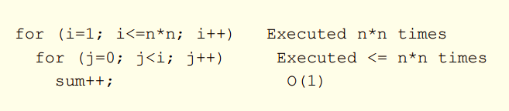
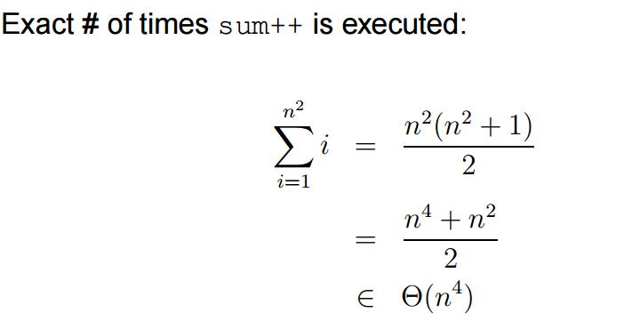
Iterative Algorithm Analysis

Slide 4
The Divide and Conquer Approach
The most well known algorithm design strategy:
Divide the problem into two or more smaller subproblems.
Conquer the subproblems by solving them recursively.
Combine the solutions to the subproblems into the solutions for the original problem.

Slide 5
A Typical Divide and Conquer Case
a problem of size n
subproblem 1
of size n/2
subproblem 2
of size n/2
a solution to
subproblem 1
a solution to
subproblem 2
a solution to
the original problem

Slide 6
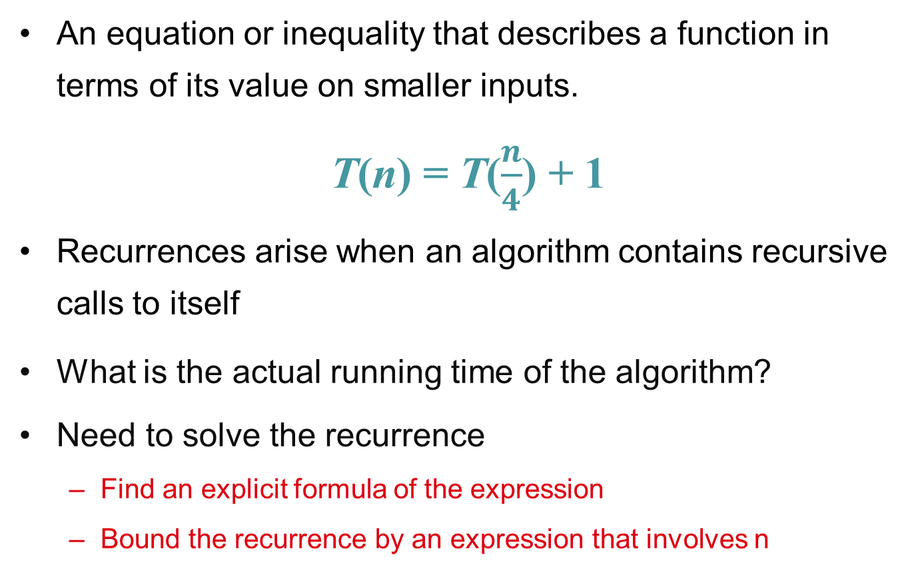
Recurrences and Running Time
An equation or inequality that describes a function in terms of its value on smaller inputs.
T(n) = T($\frac{n}{4}$) + 1
Recurrences arise when an algorithm contains recursive calls to itself
What is the actual running time of the algorithm?
Need to solve the recurrence
Find an explicit formula of the expression
Bound the recurrence by an expression that involves n

Slide 7
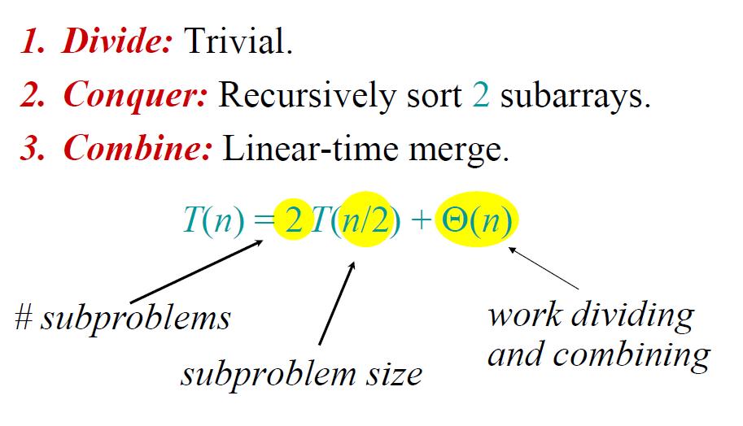

Merge-Sort
Closed form:
$$T\left(n\right)=Θ(nlgn)$$

Slide 8
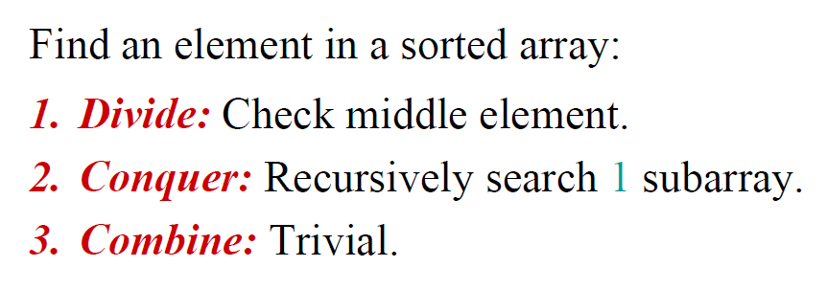
Binary Search

Slide 9
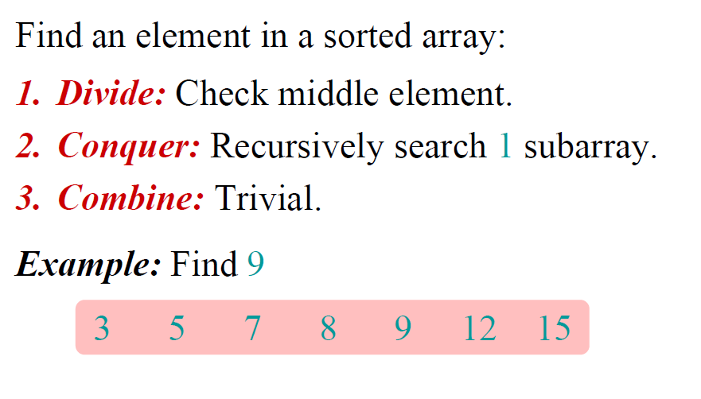
Binary Search

Slide 10
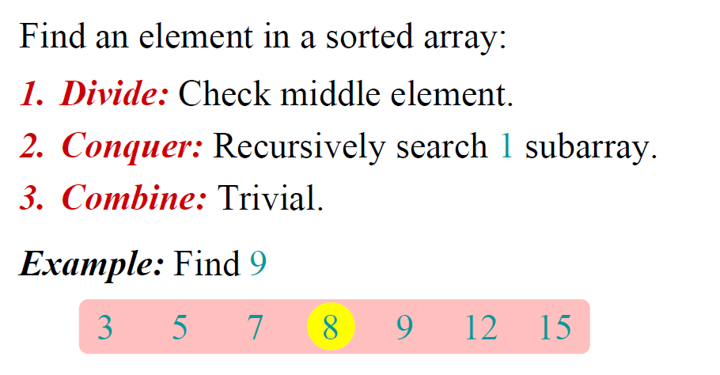
Binary Search

Slide 11
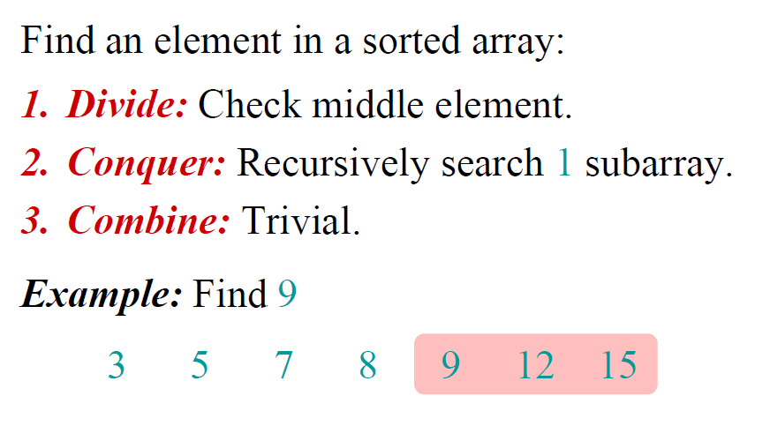
Binary Search

Slide 12
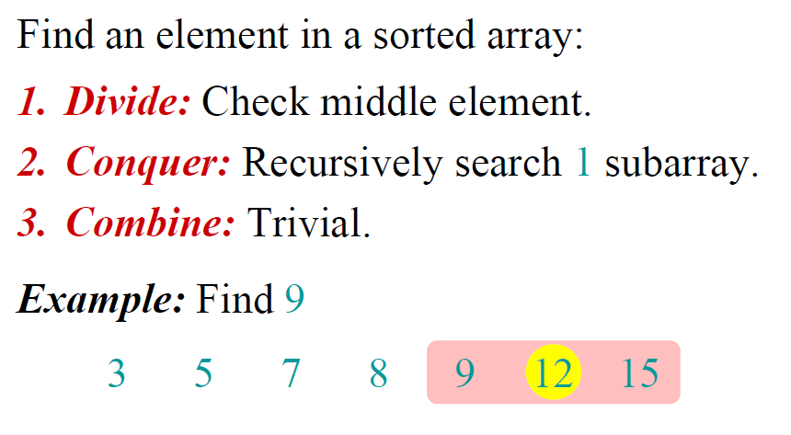
Binary Search

Slide 13
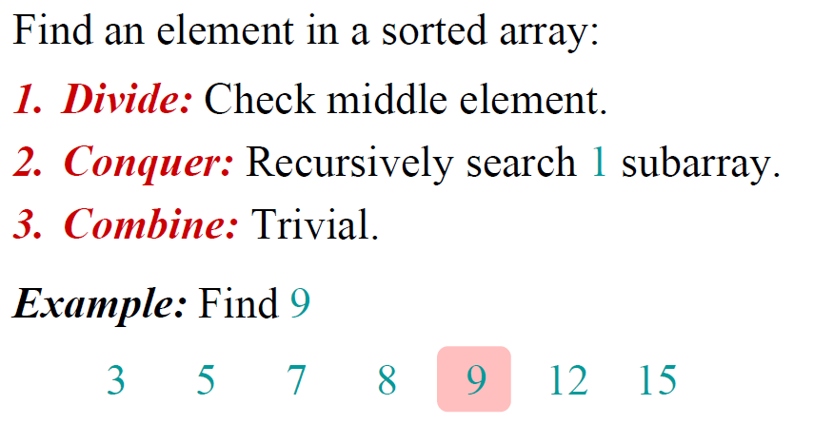
Binary Search

Slide 14
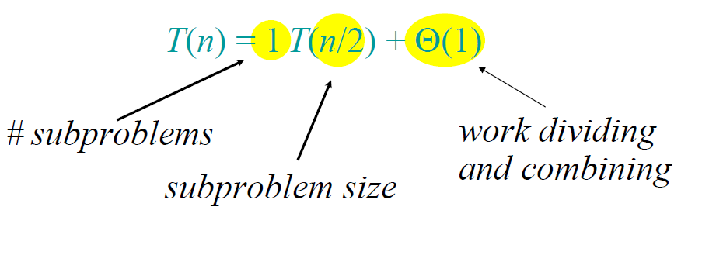

Binary Search
Closed form:
$$T\left(n\right)=Θ(lgn)$$

Slide 15
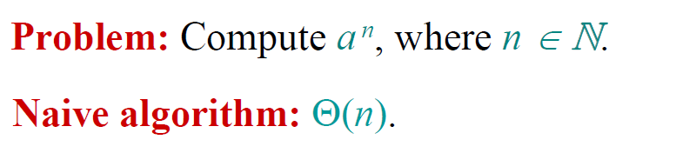
Power of a Number
Counting the number of operations which are multiplications
Example: a^{n} = a*a*…*a
Example: 15⁹ = 15*15*15*15*15*15*15*15*15

Slide 16
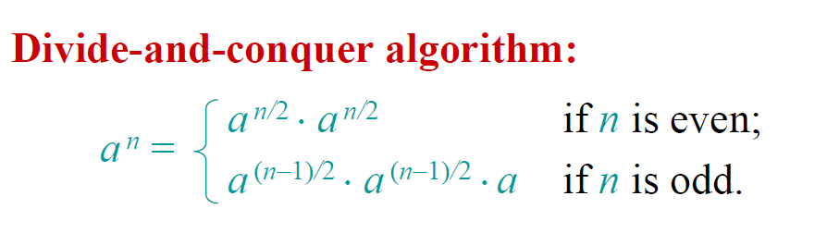

Power of a Number
Base cases a⁰ = 1 and a¹ = a

Slide 17
Base cases a⁰ = 1 and a¹ = a
15⁹
15⁴ * 15⁴ * 15¹
15² * 15² 15² * 15²
15¹ * 15¹ 15¹* 15¹ 15¹ *15¹ 15¹ * 15¹

Slide 18
Extra Recursion
long power (long x, long n) {
if(n == 0) return 1;
else if(n == 1)
return x;
else if ((n % 2) == 0) return power (x, n/2) * power (x, n/2);
else return x * power (x,(n-1)/2) * power (x,(n-1)/2);
}
The recurrence relation is:
T(n) = 1 if n = 0 or n = 1
T(n) = 2T(n /2) + c if n > 2
Running time Θ(n)

Slide 19
Base cases a⁰ = 1 and a¹ = a
15⁹
15⁴ * 15⁴ * 15¹
15² * 15²
15¹ * 15¹

Slide 20
Recurrence Relations from Code
long power (long x, long n) {
if(n == 0) return 1;
else if(n == 1)
return x;
else if ((n % 2) == 0){
temp = power(x, n/2); return temp*temp;
}
else {
temp = power(x,(n-1)/2) return x * temp* temp;
}
}
The recurrence relation is:
T(n) = 1 if n = 0 or n = 1
T(n) = T(n /2) + c if n > 2

Slide 21
Solve the Recurrence
The recurrence relation is:
T(n) = 1 if n = 0 or n = 1
T(n) = T(n /2) + c if n > 2
T(n) = T(n /2) + c
= T(n/4) + c + c
= T(n/8) + c + c + c
….
= T(n/2^{k}) + kc
Stop when k = lgn
T(n) = T(1) + clgn
= 1 + clgn
T(n) = Θ(lgn)

Slide 22
Tower of Hanoi
There are three towers
n gold disks, with decreasing sizes, placed on the first tower
You need to move all of the disks from the first tower to the second tower
Larger disks can not be placed on top of smaller disks
The third tower can be used to temporarily hold disks

Slide 23
Recursive Solution

Slide 24
Recursive Solution

Slide 25
Recursive Solution

Slide 26
Recursive Solution

Slide 27
Tower of Hanoi

Slide 28
Tower of Hanoi

Slide 29
Tower of Hanoi

Slide 30
Tower of Hanoi

Slide 31
Tower of Hanoi

Slide 32
Tower of Hanoi

Slide 33
Tower of Hanoi

Slide 34
Tower of Hanoi

Slide 35
Tower of Hanoi
The disks must be moved within one week. Assume one disk can be moved in 1 second. Is this possible?
To create an algorithm to solve this problem, it is convenient to generalize the problem to the “n-disk” problem, where in our case n = 64.

Slide 36
Towers of Hanoi
The recurrence relation for the running time of the method Hanoi is:
T(1) = 1
T(n) = 2T(n - 1) + 1 if n > 1
Hanoi(n, from, to, temp){
if (n == 1)
Move(from, to);
else{
Hanoi(n - 1, from, temp, to);
Move(from, to);
Hanoi(n - 1, temp, to, from);
}
}
T(n) = Θ(2^{n} )

Slide 37
Guess and Prove
T(n) = 2T(n - 1) + 1
Calculate T(n) for small n and look for a pattern.
Guess the result and prove your guess correct using induction.
n | T(n)
1 | 1
2 | 3
3 | 7
4 | 15
5 | 31
T(n) = 2^{n} - 1

Slide 38
Iteration Method
Unwind recurrence, by repeatedly replacing T(n) by the r.h.s. of the recurrence until the base case is encountered.
T(n) = 2T(n-1) + 1
= 2*[2*T(n-2)+1] + 1
= 2² * T(n-2) + 1+2
= 2² * [2*T(n-3)+1] + 1 + 2
= 2³ * T(n-3) + 1+2 + 2²
….
T(n) = 2^{k} * T(n-k) + 1+2 + 2² + … + 2^{k-1}

Slide 39
Geometric Series
After k steps
T(n) = 2^{k} * T(n-k) + 1+2 + 2² + … + 2^{k-1}
T(n) = 2^{n-1} * T(n-(n-1)) + 1+2 + 2² + … + 2^{n-2}
T(n) = 2^{n-1} * T(1) + 1+2 + 2² + … + 2^{n-2}
= 1 + 2 + … + 2^{n-1} =
Θ(2^{n})
If n=64 the 2⁶⁴ seconds about 1.84 x10¹⁹ seconds or 584+billion years

Slide 40
Forming Recurrence Relations
public void f (int n) {
if (n > 0) {
System.out.println(n);
f(n-1);
}else
return;
}
The recurrence relation is:
T(0) = 1
T(n) = T(n-1) + c if n > 0

Slide 41
T(n) = T(n-1) + c
= T(n-2) + c + c
= T(n-3) + c + c + c
…
= T(n-k) + kc
Stop when k = n
T(n) = T(0) + cn
T(n) = b + cn = Θ(n )
T(n) = Θ(n )

Slide 42
Recurrences Solutions
T(n) = T(n-1) + cn Θ(n²)
Recursive algorithm that loops through the input to eliminate one item
T(n) = T(n/2) + c Θ(lgn)
Recursive algorithm that halves the input in one step
T(n) = T(n/2) + cn Θ(n)
Recursive algorithm that halves the input but must examine every item in the input
T(n) = 2T(n/2) + c Θ(n)
Recursive algorithm that splits the input into 2 halves and does a constant amount of other work

Slide 43
Methods for Solving Recurrences
Iteration method
Substitution method
Recursion tree method
Master method

Slide 44
The Iteration Method
Convert the recurrence into a summation and try to bound it using a known series
Iterate the recurrence until the initial condition is reached.
Use back-substitution to express the recurrence in terms of n and the initial (boundary) condition.

Slide 45
Iteration Method – Binary Search
T(n) = c + T(n/2)
T(n) = c + T(n/2)
= c + c + T(n/4)
= c + c + c + T(n/8)
Stop when n/2^{i} = 1 => i = lgn
T(n) = c + c + … + c + T(1)
= clgn + T(1)
= Θ(lgn)
T(n/2) = c + T(n/4)
T(n/4) = c + T(n/8)
n times

Slide 46
Iteration - Mergesort
T(n) = n + 2T(n/2)
T(n) = n + 2T(n/2)
= n + 2(n/2 + 2T(n/4))
= n + n + 4T(n/4)
= n + n + 4(n/4 + 2T(n/8))
= n + n + n + 8T(n/8)
… = in + 2^{i}T(n/2^{i}) stop at i = lgn
= nlgn + 2^{lgn}T(1)
= nlgn + nT(1)
= Θ(nlgn)
T(n/2) = n/2 + 2T(n/4)

Slide 47
Substitution Method
Guess a solution
T(n) = O(g(n))
Induction goal: apply the definition of the asymptotic notation
T(n) ≤ c g(n), for some c > 0 and n ≥ n₀
Induction hypothesis: T(k) ≤ c g(k) for all k < n
Prove the induction goal
Use the induction hypothesis to find some values of the constants d and n₀ for which the induction goal holds

Slide 48


Substitution: T(n) = T(n-1)+T(n-2)
Guess: T(n) = O(φ^{n})
Induction goal: T(n) ≤ cφ^{n}, for some c and n ≥ n₀
Induction hypothesis: T(k) ≤ cφ^{k} for k < n
Proof of induction goal:
T(n) = T(n-1) + T(n-2)
≤ cφ^{n-1} + cφ^{n-2}
≤ cφ^{n-2} (φ +1)
≤ cφ^{n-2} (φ²)
T(n) ≤ c φ^{n}
T(n) = O(φ^{n})
Properties
$$Φ=\frac{1+\sqrt{5}}{2}$$
$$Φ^{2}=\frac{3+\sqrt{5}}{2}$$
$$Φ+1=Φ^{2}$$

