Slide 1
Chapter 4
Divide and conquer VS iterative algorithms
Recursion
Solving Recurrences
Binary Search
Merge Sort
Towers of Hanoi

Slide 2
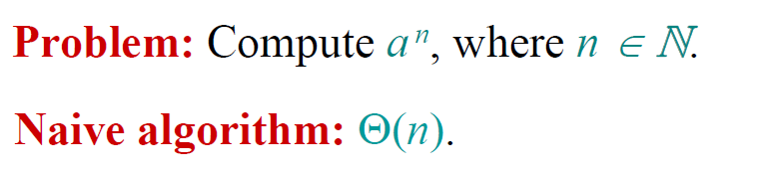
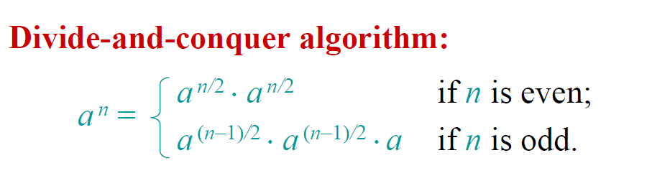

Power of a Number
Base cases a⁰ = 1 and a¹ = a

Slide 3
Base cases a⁰ = 1 and a¹ = a
15⁹
15⁴ * 15⁴ * 15¹
15² * 15² 15² * 15²
15¹ * 15¹ 15¹* 15¹ 15¹ *15¹ 15¹ * 15¹

Slide 4
Extra Recursion
long power (long x, long n) {
if(n == 0) return 1;
else if(n == 1)
return x;
else if ((n % 2) == 0) return power (x, n/2) * power (x, n/2);
else return x * power (x,(n-1)/2) * power (x,(n-1)/2);
}
The recurrence relation is:
T(n) = 1 if n = 0 or n = 1
T(n) = 2T(n /2) + c if n > 2
Running time Θ(n)

Slide 5
Base cases a⁰ = 1 and a¹ = a
15⁹
15⁴ * 15⁴ * 15¹
15² * 15²
15¹ * 15¹

Slide 6
Recurrence Relations from Code
long power (long x, long n) {
if(n == 0) return 1;
else if(n == 1)
return x;
else if ((n % 2) == 0){
temp = power(x, n/2); return temp*temp;
}
else {
temp = power(x,(n-1)/2) return x * temp* temp;
}
}
The recurrence relation is:
T(n) = 1 if n = 0 or n = 1
T(n) = T(n /2) + c if n > 2

Slide 7
Solve the Recurrence
The recurrence relation is:
T(n) = 1 if n = 0 or n = 1
T(n) = T(n /2) + c if n > 2
T(n) = T(n /2) + c
= T(n/4) + c + c
= T(n/8) + c + c + c
….
= T(n/2^{k}) + kc
Stop when k = lgn
T(n) = T(1) + clgn
= 1 + clgn
T(n) = Θ(lgn)

Slide 8
Tower of Hanoi
There are three towers
n gold disks, with decreasing sizes, placed on the first tower
You need to move all of the disks from the first tower to the second tower
Larger disks can not be placed on top of smaller disks
The third tower can be used to temporarily hold disks

Slide 9
Recursive Solution

Slide 10
Recursive Solution

Slide 11
Recursive Solution

Slide 12
Recursive Solution

Slide 13
Tower of Hanoi

Slide 14
Tower of Hanoi

Slide 15
Tower of Hanoi

Slide 16
Tower of Hanoi

Slide 17
Tower of Hanoi

Slide 18
Tower of Hanoi

Slide 19
Tower of Hanoi

Slide 20
Tower of Hanoi

Slide 21
Tower of Hanoi
The disks must be moved within one week. Assume one disk can be moved in 1 second. Is this possible?
To create an algorithm to solve this problem, it is convenient to generalize the problem to the “n-disk” problem, where in our case n = 64.

Slide 22
Towers of Hanoi
The recurrence relation for the running time of the method Hanoi is:
T(1) = 1
T(n) = 2T(n - 1) + 1 if n > 1
Hanoi(n, from, to, temp){
if (n == 1)
Move(from, to);
else{
Hanoi(n - 1, from, temp, to);
Move(from, to);
Hanoi(n - 1, temp, to, from);
}
}

Slide 23
Guess and Prove
T(n) = 2T(n - 1) + 1
Calculate T(n) for small n and look for a pattern.
Guess the result and prove your guess correct using induction.
n | T(n)
1 | 1
2 | 3
3 | 7
4 | 15
5 | 31
T(n) = 2^{n} - 1

Slide 24
Iteration Method
Unwind recurrence, by repeatedly replacing T(n) by the r.h.s. of the recurrence until the base case is encountered.
T(n) = 2T(n-1) + 1
= 2*[2*T(n-2)+1] + 1
= 2² * T(n-2) + 1+2
= 2² * [2*T(n-3)+1] + 1 + 2
= 2³ * T(n-3) + 1+2 + 2²
….
T(n) = 2^{k} * T(n-k) + 1+2 + 2² + … + 2^{k-1}

Slide 25
Geometric Series
After k steps
T(n) = 2^{k} * T(n-k) + 1+2 + 2² + … + 2^{k-1}
T(n) = 2^{n-1} * T(n-(n-1)) + 1+2 + 2² + … + 2^{n-2}
T(n) = 2^{n-1} * T(1) + 1+2 + 2² + … + 2^{n-2}
= 1 + 2 + … + 2^{n-1} =
Θ(2^{n})
If n=64 the 2⁶⁴ seconds about 1.84 x10¹⁹ seconds or 584+billion years

Slide 26
Iteration Method using c
Unwind recurrence, by repeatedly replacing T(n) by the r.h.s. of the recurrence until the base case is encountered.
T(n) = 2T(n-1) + c
= 2*[2*T(n-2)+c] + c
= 2² * T(n-2) + c+2c
= 2² * [2*T(n-3)+c] + c + 2c
= 2³ * T(n-3) + c+2c + 2²c
T(n) = 2^{k} * T(n-k) + c+2c + 4c + … + 2^{k-1}
= c(1 + 2 + … + 2^{n-1} )= Θ(2^{n})

Slide 27
Forming Recurrence Relations
public void f (int n) {
if (n > 0) {
System.out.println(n);
f(n-1);
}else
return;
}
The recurrence relation is:
T(0) = 1
T(n) = T(n-1) + c if n > 0

Slide 28
T(n) = T(n-1) + c
= T(n-2) + c + c
= T(n-3) + c + c + c
…
= T(n-k) + kc
Stop when k = n
T(n) = T(0) + cn
T(n) = b + cn = Θ(n )
T(n) = Θ(n )

Slide 29
Recurrences Solutions
T(n) = T(n-1) + cn Θ(n²)
Recursive algorithm that loops through the input to eliminate one item
T(n) = T(n/2) + c Θ(lgn)
Recursive algorithm that halves the input in one step
T(n) = T(n/2) + cn Θ(n)
Recursive algorithm that halves the input but must examine every item in the input
T(n) = 2T(n/2) + c Θ(n)
Recursive algorithm that splits the input into 2 halves and does a constant amount of other work

Slide 30
Methods for Solving Recurrences
Iteration method
Substitution method
Recursion tree method
Master method

Slide 31
The Iteration Method
Convert the recurrence into a summation and try to bound it using a known series
Iterate the recurrence until the initial condition is reached.
Use back-substitution to express the recurrence in terms of n and the initial (boundary) condition.

Slide 32
Iteration Method – Binary Search
T(n) = c + T(n/2)
T(n) = c + T(n/2)
= c + c + T(n/4)
= c + c + c + T(n/8)
Stop when n/2^{i} = 1 => i = lgn
T(n) = c + c + … + c + T(1)
= clgn + T(1)
= Θ(lgn)
T(n/2) = c + T(n/4)
T(n/4) = c + T(n/8)
n times

Slide 33
Substitution Method
Guess a solution
T(n) = O(g(n))
Induction goal: apply the definition of the asymptotic notation
T(n) ≤ c g(n), for some c > 0 and n ≥ n₀
Induction hypothesis: T(k) ≤ c g(k) for all k < n
Prove the induction goal
Use the induction hypothesis to find some values of the constants d and n₀ for which the induction goal holds

Slide 34


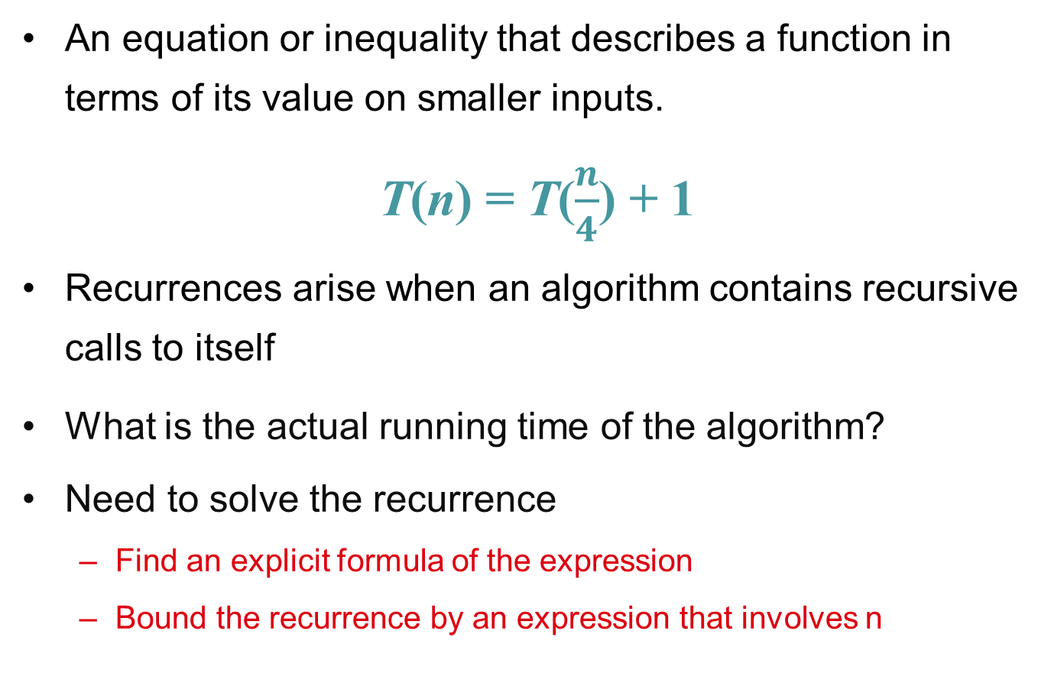
Substitution: T(n) = T(n-1)+T(n-2)
Guess: T(n) = O(φ^{n})
Induction goal: T(n) ≤ cφ^{n}, for some c and n ≥ n₀
Induction hypothesis: T(k) ≤ cφ^{k} for k < n
Proof of induction goal:
T(n) = T(n-1) + T(n-2)
≤ cφ^{n-1} + cφ^{n-2}
≤ cφ^{n-2} (φ +1)
≤ cφ^{n-2} (φ²)
T(n) ≤ c φ^{n}
T(n) = O(φ^{n})
Properties
$$Φ=\frac{1+\sqrt{5}}{2}$$
$$Φ^{2}=\frac{3+\sqrt{5}}{2}$$
$$Φ+1=Φ^{2}$$

Slide 35
Recursion-tree method
A recursion tree models the costs (time) of a recursive execution of an algorithm.
Convert the recurrence into a tree:
Each node represents the cost incurred at various levels of recursion
Sum up the costs of all levels
The recursion-tree method can be unreliable, just like any method that uses ellipses (…).
Usually involves geometric series

Slide 36
Example of recursion tree
Solve T(n) = T(n/4) + T(n/2) + n²:

Slide 37
Example of recursion tree
Solve T(n) = T(n/4) + T(n/2) + n²:
T(n)

Slide 38
Example of recursion tree
Solve T(n) = T(n/4) + T(n/2) + n²:
n²
T(n/4)
T(n/2)

Slide 39
Example of recursion tree
Solve T(n) = T(n/4) + T(n/2) + n²:
n²
(n/4)²
(n/2)²
T(n/16)
T(n/8)
T(n/8)
T(n/4)

Slide 40
Example of recursion tree
Solve T(n) = T(n/4) + T(n/2) + n²:
n²
(n/4)²
(n/2)²
(n/16)²
(n/8)²
(n/8)²
(n/4)²
…
Θ(1)

Slide 41
Example of recursion tree
Solve T(n) = T(n/4) + T(n/2) + n²:
n²
(n/4)²
(n/2)²
(n/16)²
(n/8)²
(n/8)²
(n/4)²
…
Θ(1)

Slide 42
Example of recursion tree
Solve T(n) = T(n/4) + T(n/2) + n²:
n²
(n/4)²
(n/2)²
(n/16)²
(n/8)²
(n/8)²
(n/4)²
…
Θ(1)

Slide 43
Example of recursion tree
Solve T(n) = T(n/4) + T(n/2) + n²:
n²
(n/4)²
(n/2)²
(n/16)²
(n/8)²
(n/8)²
(n/4)²
…
…
Θ(1)

Slide 44
Example of recursion tree
Solve T(n) = T(n/4) + T(n/2) + n²:
n²
(n/4)²
(n/2)²
(n/16)²
(n/8)²
(n/8)²
(n/4)²
…
…
Θ(1)
Total ≤
geometric series
= Ο(n²)

Slide 45
Geometric series
for x ≠ 1
for |x| < 1

Slide 46
Example of recursion tree
Solve T(n) = T(n/4) + T(n/2) + n²:
n²
(n/4)²
(n/2)²
(n/16)²
(n/8)²
(n/8)²
(n/4)²
…
…
Θ(1)
Total ≥ n²
= Ω(n²)
Therefore T(n) = Θ(n²)

Slide 47
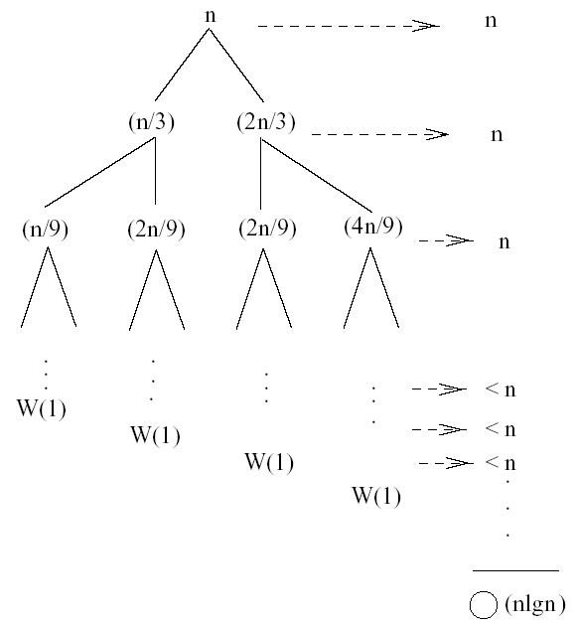
Recursion Tree – Example 2
T(n) = T(n/3) + T(2n/3) + n
The longest path from the root to a leaf is: n → (2/3)n → (2/3)² n → … → 1
Subproblem size hits 1 when 1 = (2/3)^{i}n ⇔ i=log_{3/2}n
cost of the problem at level i = n
Total cost:
⇒ T(n) = O(nlgn)
T(n)

Slide 48
Recursion Tree – Example 3
T(n) = T(n/3) + T(2n/3) + n
T(n) = Ω(n)
T(n) = O(nlgn)

Slide 49
The Master Method
The master method applies to recurrences of the form
T(n) = a T(n/b) + f (n) ,
where a ≥ 1, b > 1, and f is asymptotically positive.

Slide 50
Master Method
“Formula” for solving recurrences of the form:
where, a ≥ 1, b > 1, and f(n) > 0
case 1: if f(n) = O(n^{log}_{b}^{a -ε}) for some ε > 0, then: T(n) = Θ(n^{log}_{b}ª)
case 2: if f(n) = Θ(n^{log}_{b}ª), then: T(n) = Θ(n^{log}_{b}ª lgn)
case 3: if f(n) = Ω(n^{log}_{b}^{a +ε}) for some ε > 0, and if
af(n/b) ≤ cf(n) for some c < 1 and all sufficiently large n, then:
T(n) = Θ(f(n))
regularity

Slide 51
Idea of Master Method
Recursion tree:
f (n)
f (n)
a
f (n/b)
f (n/b)
…
f (n/b)
a f (n/b)
a
h = log_{b}n
f (n/b²)
f (n/b²)
…
f (n/b²)
a² f (n/b²)
…
…
#leaves = a^{h}
= a^{logbn}
= n^{logba}
n^{logba}Τ (1)
Τ (1)

Slide 52
Idea of Master Method
f (n) = O(n^{logba – ε})
Recursion tree:
f (n)
f (n)
a
f (n/b)
f (n/b)
…
f (n/b)
a f (n/b)
a
h = log_{b}n
f (n/b²)
f (n/b²)
…
f (n/b²)
a² f (n/b²)
…
…
CASE 1: The weight increases geometrically from the root to the leaves. The leaves hold a constant fraction of the total weight.
n^{logba}Τ (1)
Τ (1)
Θ(n^{logba})

Slide 53
Three common cases
Compare f (n) with n^{logba}:
f (n) = O(n^{logba – ε}) for some constant ε > 0.
f (n) grows polynomially slower than n^{logba} (by an n^{ε} factor).
Solution: T(n) = Θ(n^{logba}) .

Slide 54
Case 1
Ex. T(n) = 4T(n/2) + n
a = 4, b = 2 ⇒ n^{logba} = n²; f (n) = n.
CASE 1: f (n) = O(n^{2 – ε}) for ε = 1.
∴ T(n) = Θ(n²).

Slide 55
Idea of Master Method
f (n) = Θ(n^{logba})
Recursion tree:
f (n)
f (n)
a
f (n/b)
f (n/b)
…
f (n/b)
a f (n/b)
a
h = log_{b}n
f (n/b²)
f (n/b²)
…
f (n/b²)
a² f (n/b²)
…
…
n^{logba}Τ (1)
Τ (1)
CASE 2: The weight is approximately the same on each of the log_{b}n levels.
Θ(n^{logba}lg n)

Slide 56
Case 2
Ex. T(n) = 4T(n/2) + n²
a = 4, b = 2 ⇒ n^{logba} = n²; f (n) = n².
CASE 2: f (n) = Θ(n²)
∴ T(n) = Θ(n²lg n).

Slide 57
Idea of master theorem
f (n) = Ω(n^{logba + ε})
Recursion tree:
f (n)
f (n)
a
f (n/b)
f (n/b)
…
f (n/b)
a f (n/b)
a
h = log_{b}n
f (n/b²)
f (n/b²)
…
f (n/b²)
a² f (n/b²)
…
…
CASE 3: The weight decreases geometrically from the root to the leaves. The root holds a constant fraction of the total weight.
n^{logba}Τ (1)
Τ (1)
Θ( f (n))

Slide 58
Case 3
Ex. T(n) = 4T(n/2) + n³
a = 4, b = 2 ⇒ n^{logba} = n²; f (n) = n³.
CASE 3: f (n) = Ω(n^{2 + ε}) for ε = 1 and
4(n/2)³ ≤ cn³ (reg. cond.) for c = 1/2.
∴ T(n) = Θ(n³).

Slide 59
Master Method
“Formula” for solving recurrences of the form:
where, a ≥ 1, b > 1, and f(n) > 0
case 1: if f(n) = O(n^{log}_{b}^{a -ε}) for some ε > 0, then: T(n) = Θ(n^{log}_{b}ª)
case 2: if f(n) = Θ(n^{log}_{b}ª), then: T(n) = Θ(n^{log}_{b}ª lgn)
case 3: if f(n) = Ω(n^{log}_{b}^{a +ε}) for some ε > 0, and if
af(n/b) ≤ cf(n) for some c < 1 and all sufficiently large n, then:
T(n) = Θ(f(n))
regularity

Slide 60
Master Method – Binary Search
T(n) = T(n/2) + c a = 1, b = 2, log₂1 = 0
compare n^{log}₂¹=n⁰ = 1 with f(n) = c
Case 2: if f(n) = Θ(n^{log}_{b}ª), then: T(n) = Θ(n^{log}_{b}ª lgn) f(n) = Θ(1) ⇒ case 2
⇒ T(n) = Θ(lgn)

Slide 61
Master Method – Example 1
T(n) = 2T(n/2) + n² a = 2, b = 2, log₂2 = 1
compare n with f(n) = n²
case 3: if f(n) = Ω(n^{log}_{b}^{a +ε}) for some ε > 0
⇒ f(n) = Ω(n^{1+ε}) case 3 ⇒ verify regularity cond.
a f(n/b) ≤ c f(n)
⇔ 2 (n/2)² ≤ c n²
⇔ 2 n²/4 ≤ c n² ⇒ c = ½ is a solution (c<1)
⇒ T(n) = Θ(n²)

Slide 62
Master Method – Example 2
T(n) = 2T(n/2) + a = 2, b = 2, log₂2 = 1
compare n with f(n) = n^{1/2}
⇒ f(n) = O(n^{1-ε}) case 1
⇒ T(n) = Θ(n)

Slide 63
Master Method - Example 3
T(n) = 3T(n/4) + nlgn a = 3, b = 4, log₄3 = 0.793
compare n^{0.793} with f(n) = nlgn
f(n) = Ω(n^{log}₄^{3+ε}) case 3
check regularity condition:
a f(n/b) ≤ c f(n)
3∗(n/4)lg(n/4) ≤ 3/4nlgn ⇒ c = 3/4
T(n) = Θ(nlgn)

Slide 64
Master Method: Merge-Sort
where, a =2, b =2, and f(n) =nn
n^{log}_{b}ª = n^{log}₂² = n
case 1: if f(n) = O(n^{log}_{b}^{a -ε}) for some ε > 0, then: T(n) = Θ(n^{log}_{b}ª)
case 2: if f(n) = Θ(n^{log}_{b}ª), then: T(n) = Θ(n^{log}_{b}ª lgn)
case 3: if f(n) = Ω(n^{log}_{b}^{a +ε}) for some ε > 0, and if
T(n) = Θ(nlgn)

