Slide 1
Methods for Solving Recurrences
Iteration method
Substitution method
Recursion tree method
Master method

Slide 2
The Iteration Method
Convert the recurrence into a summation and try to bound it using a known series
Iterate the recurrence until the initial condition is reached.
Use back-substitution to express the recurrence in terms of n and the initial (boundary) condition.

Slide 3
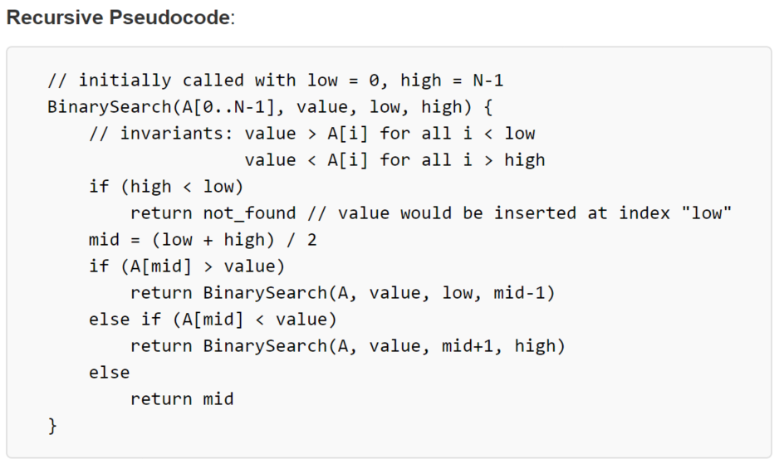
Recursive Binary Search
https://rosettacode.org/wiki/Binary_search

Slide 4
Iteration Method – Binary Search
T(n) = c + T(n/2)
T(n) = c + T(n/2)
= c + c + T(n/4)
= c + c + c + T(n/8)
Stop when n/2^{i} = 1 => i = lgn
T(n) = c + c + … + c + T(1)
= clgn + T(1)
= Θ(lgn)
T(n/2) = c + T(n/4)
T(n/4) = c + T(n/8)
n times

Slide 5
Substitution Method
Guess a solution
T(n) = O(g(n))
Induction goal: apply the definition of the asymptotic notation
T(n) ≤ c g(n), for some c > 0 and n ≥ n₀
Induction hypothesis: T(k) ≤ c g(k) for all k < n
Prove the induction goal
Use the induction hypothesis to find some values of the constants d and n₀ for which the induction goal holds

Slide 6


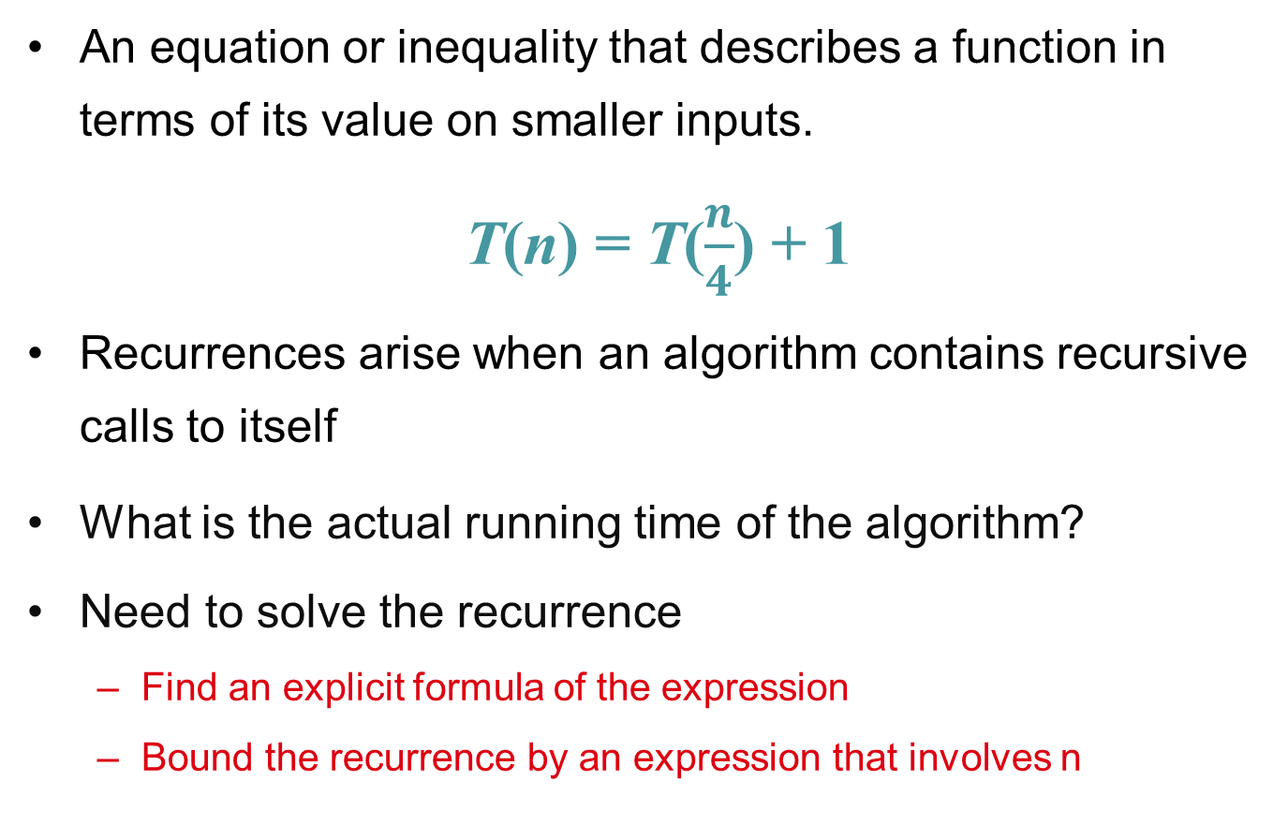
Substitution: T(n) = T(n-1)+T(n-2)
Guess: T(n) = O(φ^{n})
Induction goal: T(n) ≤ cφ^{n}, for some c and n ≥ n₀
Induction hypothesis: T(k) ≤ cφ^{k} for k < n
Proof of induction goal:
T(n) = T(n-1) + T(n-2)
≤ cφ^{n-1} + cφ^{n-2}
≤ cφ^{n-2} (φ +1)
≤ cφ^{n-2} (φ²)
T(n) ≤ c φ^{n}
T(n) = O(φ^{n})
Properties
$$Φ=\frac{1+\sqrt{5}}{2}$$
$$Φ^{2}=\frac{3+\sqrt{5}}{2}$$
$$Φ+1=Φ^{2}$$

Slide 7
Recursion-tree method
A recursion tree models the costs (time) of a recursive execution of an algorithm.
Convert the recurrence into a tree:
Each node represents the cost incurred at various levels of recursion
Sum up the costs of all levels
The recursion-tree method can be unreliable, just like any method that uses ellipses (…).
Usually involves geometric series

Slide 8
Example of recursion tree
Solve T(n) = T(n/4) + T(n/2) + n²:

Slide 9
Example of recursion tree
Solve T(n) = T(n/4) + T(n/2) + n²:
T(n)

Slide 10
Example of recursion tree
Solve T(n) = T(n/4) + T(n/2) + n²:
n²
T(n/4)
T(n/2)

Slide 11
Example of recursion tree
Solve T(n) = T(n/4) + T(n/2) + n²:
n²
(n/4)²
(n/2)²
T(n/16)
T(n/8)
T(n/8)
T(n/4)

Slide 12
Example of recursion tree
Solve T(n) = T(n/4) + T(n/2) + n²:
n²
(n/4)²
(n/2)²
(n/16)²
(n/8)²
(n/8)²
(n/4)²
…
Θ(1)

Slide 13
Example of recursion tree
Solve T(n) = T(n/4) + T(n/2) + n²:
n²
(n/4)²
(n/2)²
(n/16)²
(n/8)²
(n/8)²
(n/4)²
…
Θ(1)

Slide 14
Example of recursion tree
Solve T(n) = T(n/4) + T(n/2) + n²:
n²
(n/4)²
(n/2)²
(n/16)²
(n/8)²
(n/8)²
(n/4)²
…
Θ(1)

Slide 15
Example of recursion tree
Solve T(n) = T(n/4) + T(n/2) + n²:
n²
(n/4)²
(n/2)²
(n/16)²
(n/8)²
(n/8)²
(n/4)²
…
…
Θ(1)

Slide 16
Example of recursion tree
Solve T(n) = T(n/4) + T(n/2) + n²:
n²
(n/4)²
(n/2)²
(n/16)²
(n/8)²
(n/8)²
(n/4)²
…
…
Θ(1)
Total ≤
geometric series
= Ο(n²)

Slide 17
Geometric series
for x ≠ 1
for |x| < 1

Slide 18
Example of recursion tree
Solve T(n) = T(n/4) + T(n/2) + n²:
n²
(n/4)²
(n/2)²
(n/16)²
(n/8)²
(n/8)²
(n/4)²
…
…
Θ(1)
Total ≥ n²
= Ω(n²)
Therefore T(n) = Θ(n²)

Slide 19
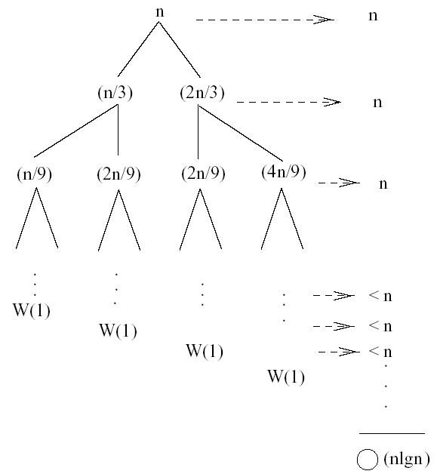
Recursion Tree – Example 2
T(n) = T(n/3) + T(2n/3) + n
The longest path from the root to a leaf is: n → (2/3)n → (2/3)² n → … → 1
Subproblem size hits 1 when 1 = (2/3)^{i}n ⇔ i=log_{3/2}n
cost of the problem at level i = n
Total cost:
⇒ T(n) = O(nlgn)
T(n)

Slide 20
Recursion Tree – Example 3
T(n) = T(n/3) + T(2n/3) + n
T(n) = Ω(n)
T(n) = O(nlgn)

Slide 21
The Master Method
The master method applies to recurrences of the form
T(n) = a T(n/b) + f (n) ,
where a ≥ 1, b > 1, and f is asymptotically positive.

Slide 22
Master Method
“Formula” for solving recurrences of the form:
where, a ≥ 1, b > 1, and f(n) > 0
case 1: if f(n) = O(n^{log}_{b}^{a -ε}) for some ε > 0, then: T(n) = Θ(n^{log}_{b}ª)
case 2: if f(n) = Θ(n^{log}_{b}ª), then: T(n) = Θ(n^{log}_{b}ª lgn)
case 3: if f(n) = Ω(n^{log}_{b}^{a +ε}) for some ε > 0, and if
af(n/b) ≤ cf(n) for some c < 1 and all sufficiently large n, then:
T(n) = Θ(f(n))
regularity

Slide 23
Idea of Master Method
Recursion tree:
f (n)
f (n)
a
f (n/b)
f (n/b)
…
f (n/b)
a f (n/b)
a
h = log_{b}n
f (n/b²)
f (n/b²)
…
f (n/b²)
a² f (n/b²)
…
…
#leaves = a^{h}
= a^{logbn}
= n^{logba}
n^{logba}Τ (1)
Τ (1)

Slide 24
Idea of Master Method
f (n) = O(n^{logba – ε})
Recursion tree:
f (n)
f (n)
a
f (n/b)
f (n/b)
…
f (n/b)
a f (n/b)
a
h = log_{b}n
f (n/b²)
f (n/b²)
…
f (n/b²)
a² f (n/b²)
…
…
CASE 1: The weight increases geometrically from the root to the leaves. The leaves hold a constant fraction of the total weight.
n^{logba}Τ (1)
Τ (1)
Θ(n^{logba})

Slide 25
Three common cases
Compare f (n) with n^{logba}:
f (n) = O(n^{logba – ε}) for some constant ε > 0.
f (n) grows polynomially slower than n^{logba} (by an n^{ε} factor).
Solution: T(n) = Θ(n^{logba}) .

Slide 26
Case 1
Ex. T(n) = 4T(n/2) + n
a = 4, b = 2 ⇒ n^{logba} = n²; f (n) = n.
CASE 1: f (n) = O(n^{2 – ε}) for ε = 1.
∴ T(n) = Θ(n²).

Slide 27
Idea of Master Method
f (n) = Θ(n^{logba})
Recursion tree:
f (n)
f (n)
a
f (n/b)
f (n/b)
…
f (n/b)
a f (n/b)
a
h = log_{b}n
f (n/b²)
f (n/b²)
…
f (n/b²)
a² f (n/b²)
…
…
n^{logba}Τ (1)
Τ (1)
CASE 2: The weight is approximately the same on each of the log_{b}n levels.
Θ(n^{logba}lg n)

Slide 28
Case 2
Ex. T(n) = 4T(n/2) + n²
a = 4, b = 2 ⇒ n^{logba} = n²; f (n) = n².
CASE 2: f (n) = Θ(n²)
∴ T(n) = Θ(n²lg n).

Slide 29
Idea of master theorem
f (n) = Ω(n^{logba + ε})
Recursion tree:
f (n)
f (n)
a
f (n/b)
f (n/b)
…
f (n/b)
a f (n/b)
a
h = log_{b}n
f (n/b²)
f (n/b²)
…
f (n/b²)
a² f (n/b²)
…
…
CASE 3: The weight decreases geometrically from the root to the leaves. The root holds a constant fraction of the total weight.
n^{logba}Τ (1)
Τ (1)
Θ( f (n))

Slide 30
Case 3
Ex. T(n) = 4T(n/2) + n³
a = 4, b = 2 ⇒ n^{logba} = n²; f (n) = n³.
CASE 3: f (n) = Ω(n^{2 + ε}) for ε = 1 and
4(n/2)³ ≤ cn³ (reg. cond.) for c = 1/2.
∴ T(n) = Θ(n³).

Slide 31
Master Method
“Formula” for solving recurrences of the form:
where, a ≥ 1, b > 1, and f(n) > 0
case 1: if f(n) = O(n^{log}_{b}^{a -ε}) for some ε > 0, then: T(n) = Θ(n^{log}_{b}ª)
case 2: if f(n) = Θ(n^{log}_{b}ª), then: T(n) = Θ(n^{log}_{b}ª lgn)
case 3: if f(n) = Ω(n^{log}_{b}^{a +ε}) for some ε > 0, and if
af(n/b) ≤ cf(n) for some c < 1 and all sufficiently large n, then:
T(n) = Θ(f(n))
regularity

Slide 32
Master Method – Binary Search
T(n) = T(n/2) + c a = 1, b = 2, log₂1 = 0
compare n^{log}₂¹=n⁰ = 1 with f(n) = c
Case 2: if f(n) = Θ(n^{log}_{b}ª), then: T(n) = Θ(n^{log}_{b}ª lgn) f(n) = Θ(1) ⇒ case 2
⇒ T(n) = Θ(lgn)

Slide 33
Master Method – Example 1
T(n) = 2T(n/2) + n² a = 2, b = 2, log₂2 = 1
compare n with f(n) = n²
case 3: if f(n) = Ω(n^{log}_{b}^{a +ε}) for some ε > 0
⇒ f(n) = Ω(n^{1+ε}) case 3 ⇒ verify regularity cond.
a f(n/b) ≤ c f(n)
⇔ 2 (n/2)² ≤ c n²
⇔ 2 n²/4 ≤ c n² ⇒ c = ½ is a solution (c<1)
⇒ T(n) = Θ(n²)

Slide 34
Master Method – Example 2
T(n) = 2T(n/2) + a = 2, b = 2, log₂2 = 1
compare n with f(n) = n^{1/2}
⇒ f(n) = O(n^{1-ε}) case 1
⇒ T(n) = Θ(n)

Slide 35
Master Method - Example 3
T(n) = 3T(n/4) + nlgn a = 3, b = 4, log₄3 = 0.793
compare n^{0.793} with f(n) = nlgn
f(n) = Ω(n^{log}₄^{3+ε}) case 3
check regularity condition:
a f(n/b) ≤ c f(n)
3∗(n/4)lg(n/4) ≤ 3/4nlgn ⇒ c = 3/4
T(n) = Θ(nlgn)

Slide 36
Master Method: Merge-Sort
where, a =2, b =2, and f(n) =nn
n^{log}_{b}ª = n^{log}₂² = n
case 1: if f(n) = O(n^{log}_{b}^{a -ε}) for some ε > 0, then: T(n) = Θ(n^{log}_{b}ª)
case 2: if f(n) = Θ(n^{log}_{b}ª), then: T(n) = Θ(n^{log}_{b}ª lgn)
case 3: if f(n) = Ω(n^{log}_{b}^{a +ε}) for some ε > 0, and if
T(n) = Θ(nlgn)

