Slide 1


DataDiggers
Project- Real time analytics with slack and Jira integration
Project name: Real time analytics with Slack and JIRA integration

Slide 2



Overview
1
Ingest data real-time into snowflake
3
Jira tickets are created to different teams based on the ingested data (new hire)
2
Data is transformed and sent as an excel report to slack channels/ user (shuttle data)

Slide 3



Tools and features used
1
Snowpipe- serverless real time data ingestion
2
AWS S3 - file storage location
3
Slack – Collaboration tool for sharing data
4
- Ticketing system
5
- Programming language

Slide 4
DEMO

Slide 5
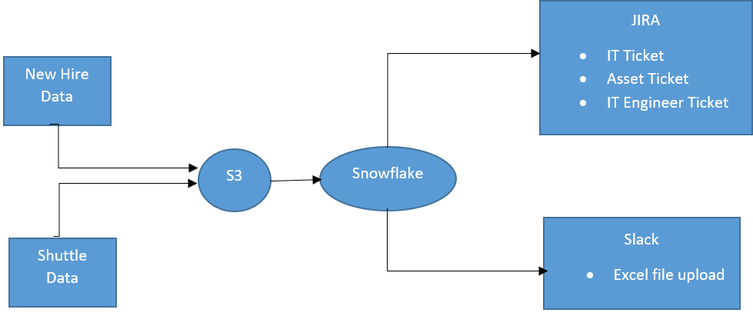
Architectural diagram

Slide 6
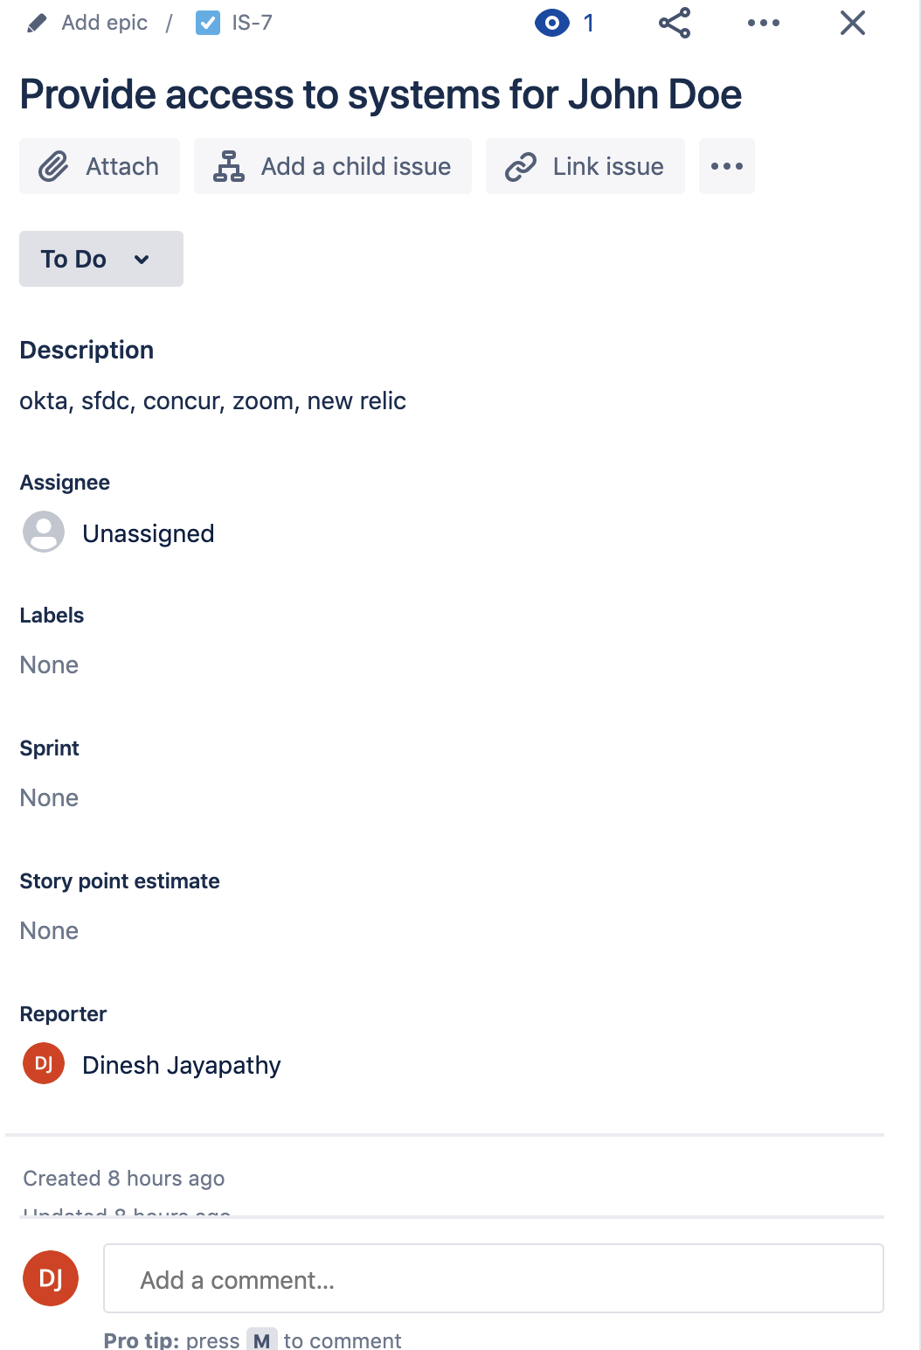
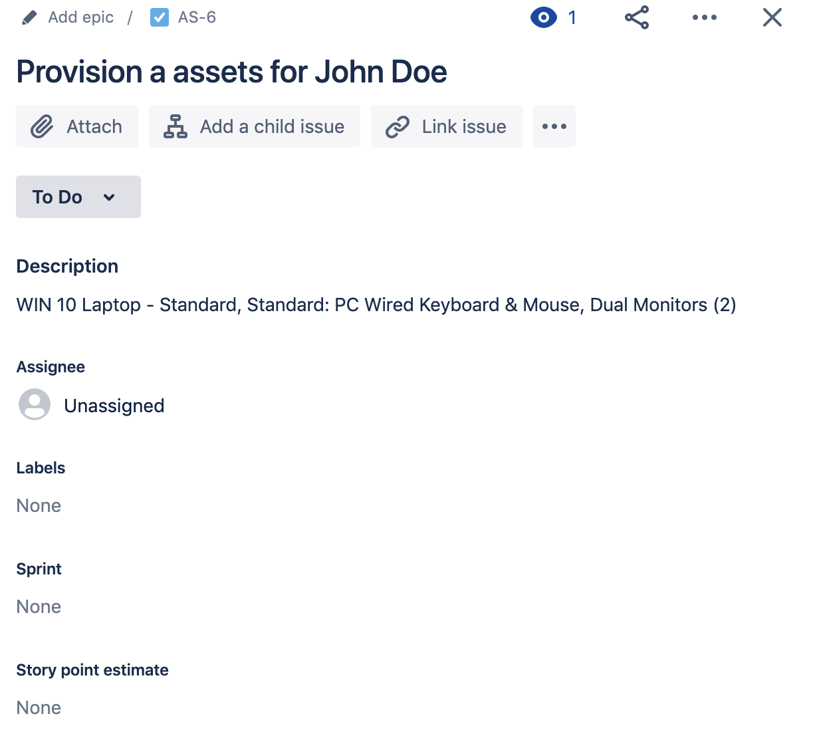
Jira Automation: Tickets created from new hire report

Slide 7
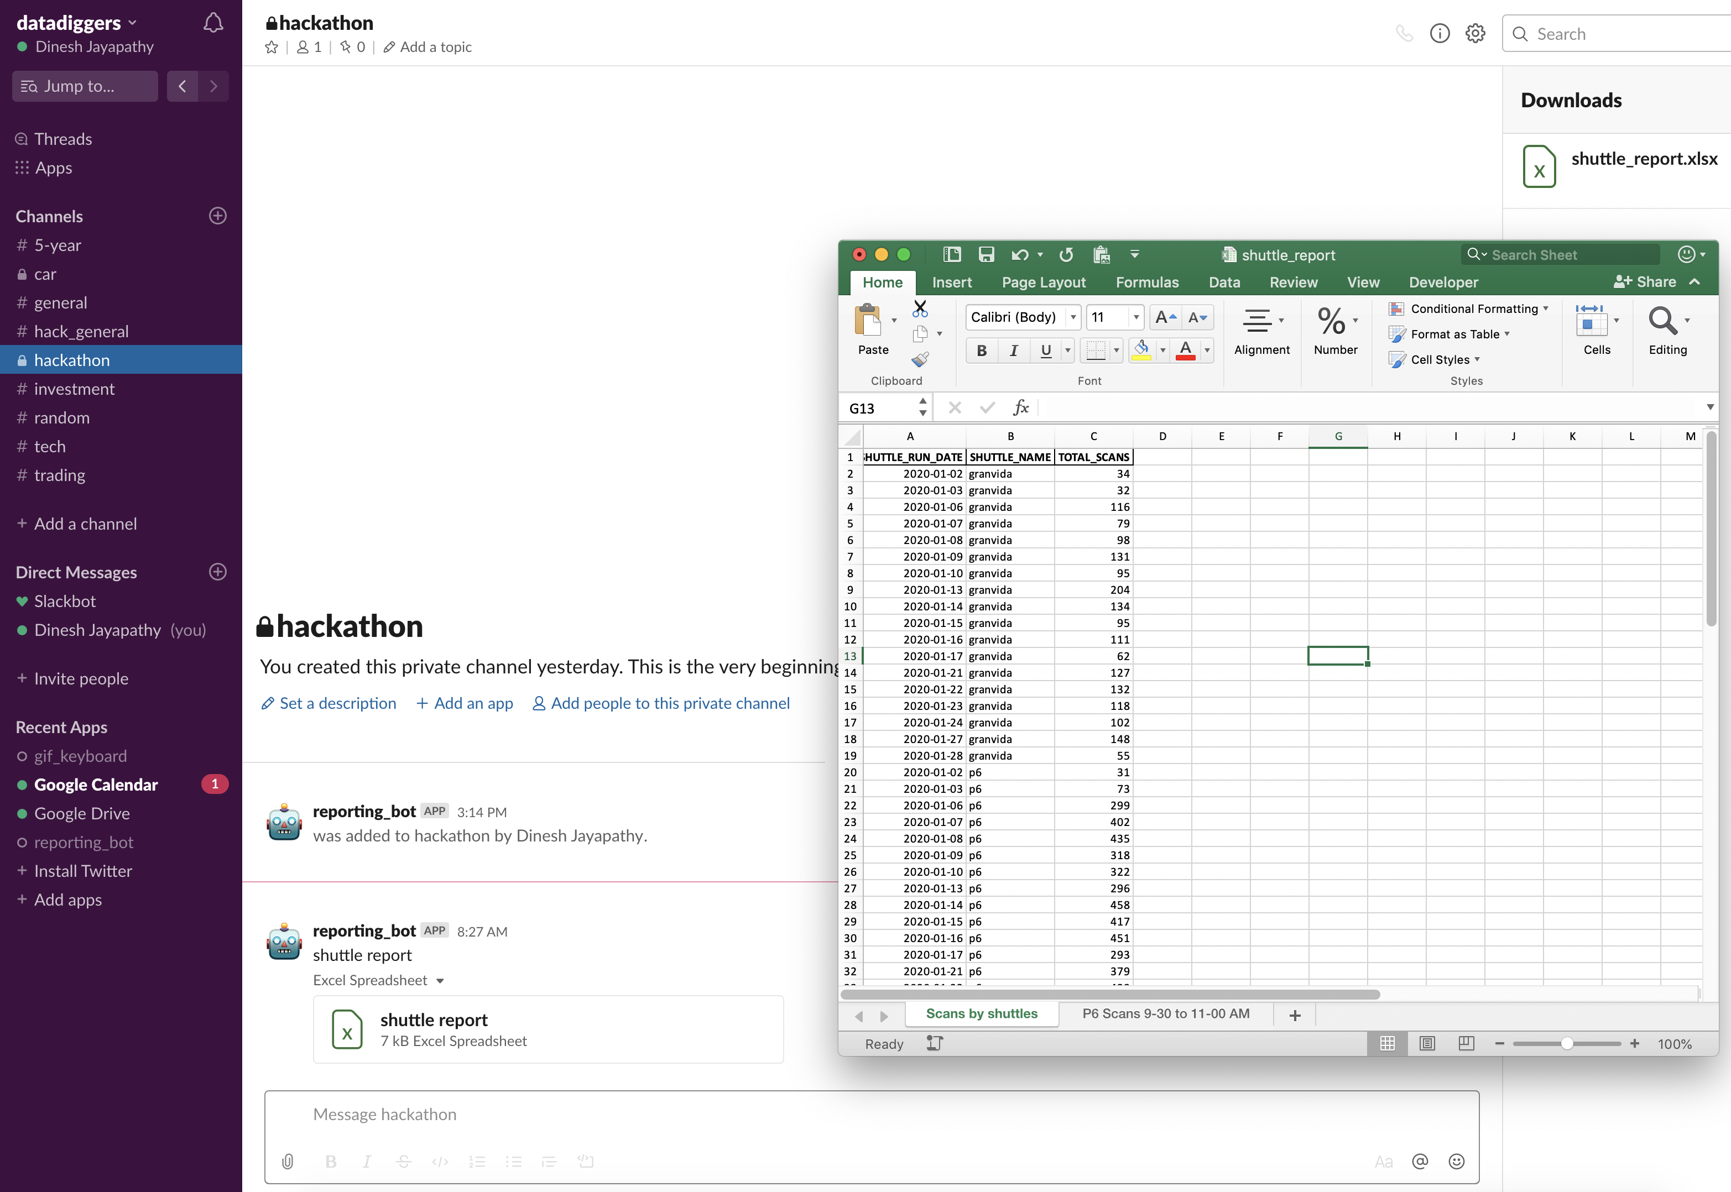
Slack reports from Snowflake

Slide 8
Summary: To make things more simple, pleasant and productive!
Snowpipe: real-time data insights vs stale data
Cost effective, serverless, zero maintenance
Slack upload: Taking analytics to end users vs. asking them to use other tools
JIRA Automation: Jira ticket creation for different teams based on event data without manual entry

