Slide 1
Price Change Notification Bot
Team Members
1. Janani R C
2. Jayapooja R
3. Krishna Divya P
Facultyguide : Industrial guide :
Ms. Poongothai K Ms. Pavithra
Assistant professor
Department of CSE
Department of CSE, KGiSL Institute of Technology, Coimbatore

Slide 2
Abstract
The Price Change Notification Bot is a Robotic Process Automation(RPA) Project. The Bot is majorly created to check the price change(drop/rise) of the various products available on e-Commerce sites like Flip kart, Amazon, etc. The customer can add the desired product to either his Cart or Wish-list waiting for the price drop. The bot actually works on monitoring the price change whenever the product is added on the cart/wish-list. Once the price increases, the bot sends the notification to the customer with a voice message. Similarly whenever the price falls, it notifies the customer with a voice message and an automated email invitation to purchase the product attached with the purchase link.
Department of CSE, KGiSL Institute of Technology, Coimbatore

Slide 3
Area Introduction-Existing system
Manually the customer has to visit the e-commerce site to check for the price drop each and every time.
The customer is not sure of when there will be a drop in the price and may miss the opportunity to buy on that period.
No notification from the e-commerce site on the price change.
Department of CSE, KGiSL Institute of Technology, Coimbatore

Slide 4
Proposed System
Automatically the bot monitors on the price change.
Sends a notification message along with a voice
message to make the customer aware.
In case of price drop ,it sends an email invitation to purchase the product with that product-purchase link
Department of CSE, KGiSL Institute of Technology, Coimbatore

Slide 5
Module Splitup
Data-Scraping the product on the Cart/Wish-List
Excel Automation
Monitoring the price change
Comparing the price with expected price(approx.
Voice message and Notification
E-mail Automation
Department of CSE, KGiSL Institute of Technology, Coimbatore

Slide 6
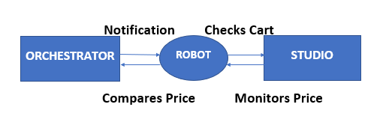
Architectural Design DFD - Level 0

Slide 7
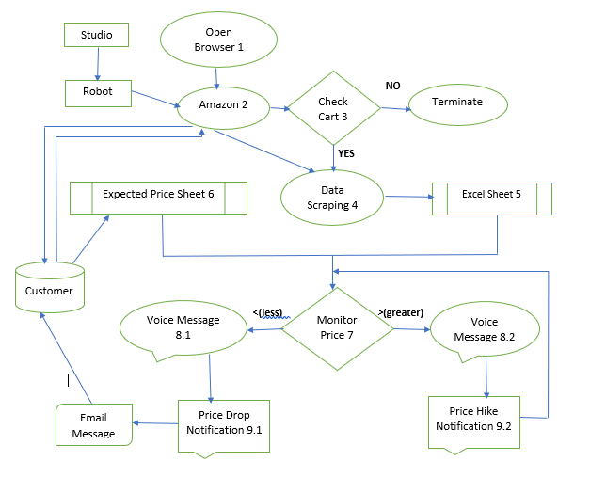
DFD Level - 1

Slide 8
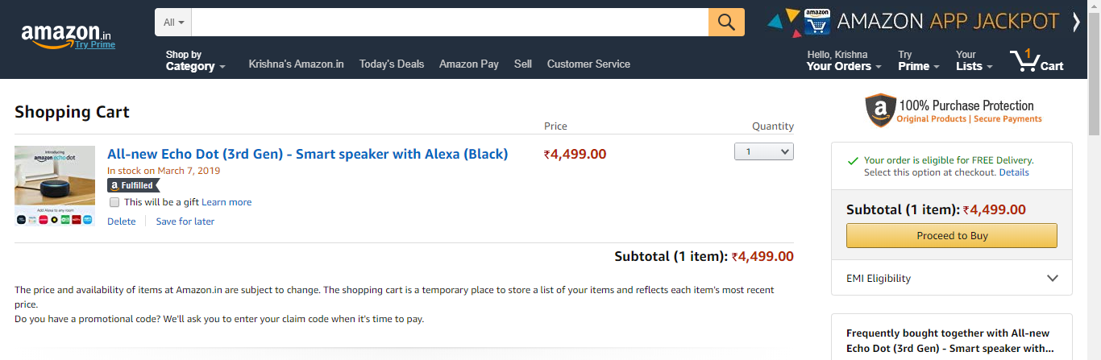
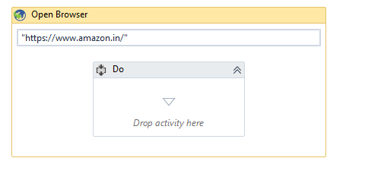
Process Screenshots 1.Opens the e-commerce account

Slide 9
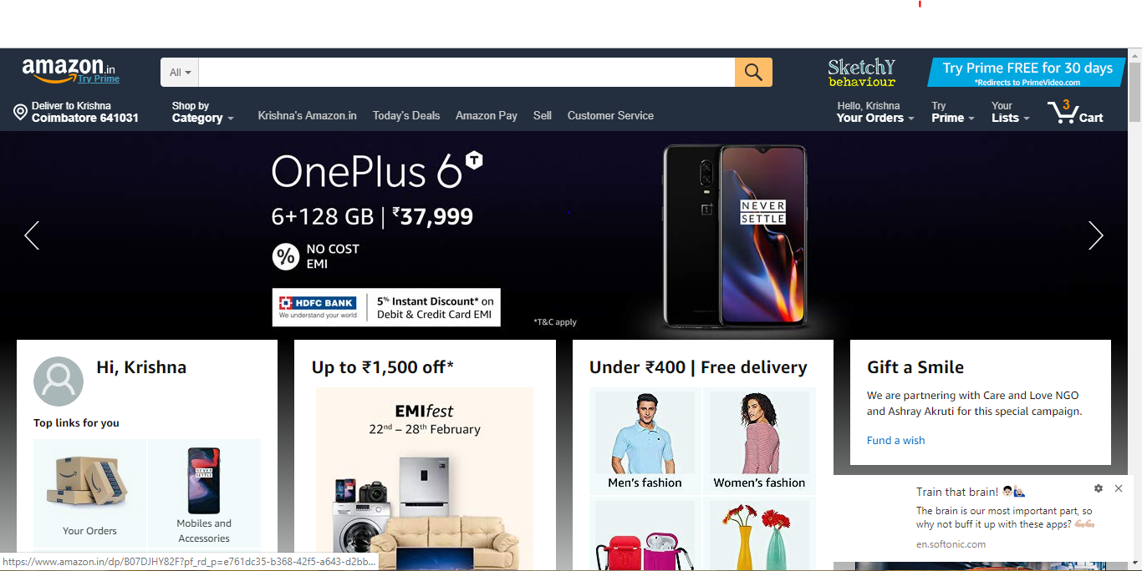
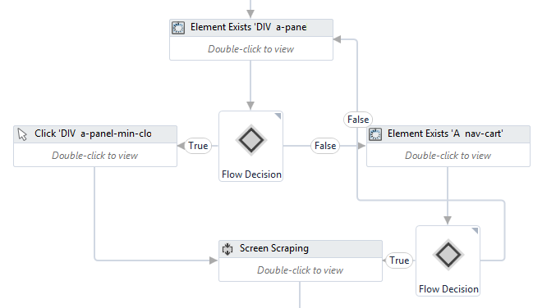
2. Checks for the item in cart.
Department of CSE, KGiSL Institute of Technology, Coimbatore

Slide 10
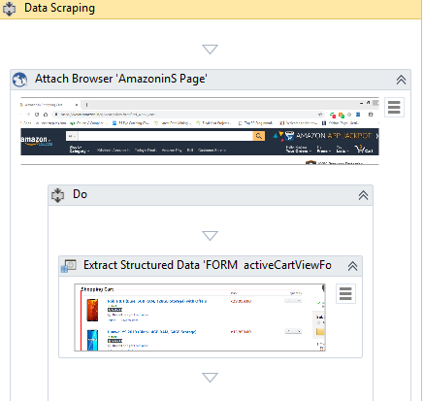
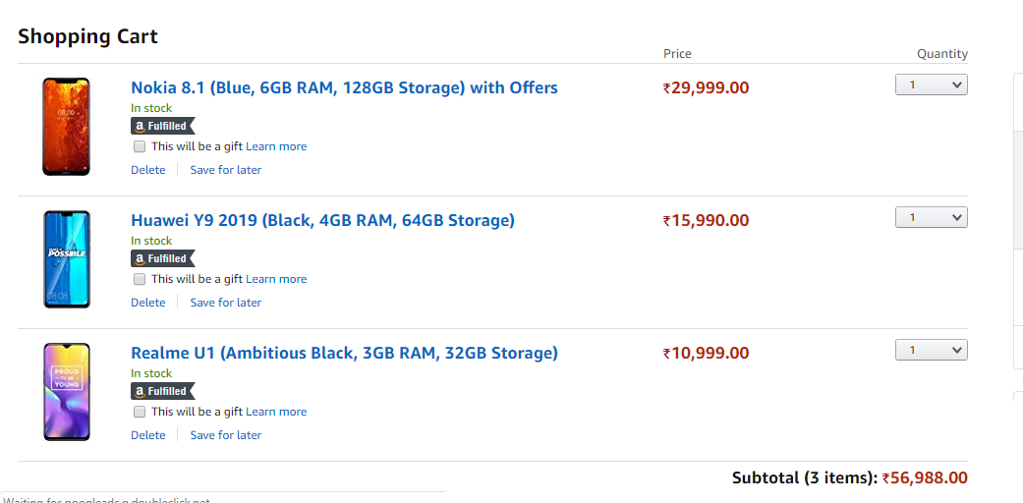
3. Data Scrapes the cart product and its Price for monitoring
Department of CSE, KGiSL Institute of Technology, Coimbatore

Slide 11
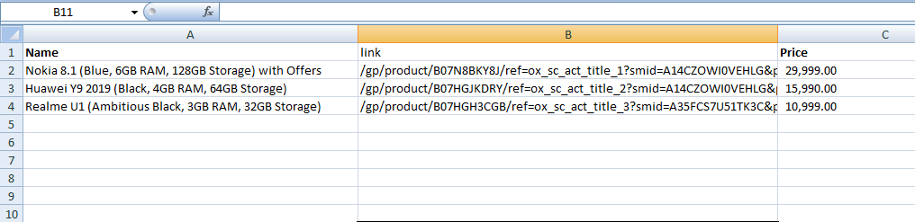
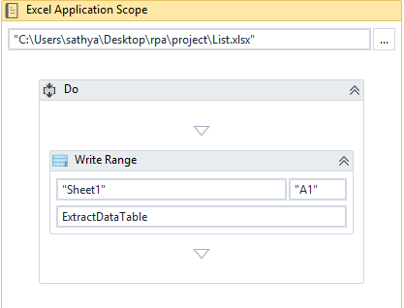
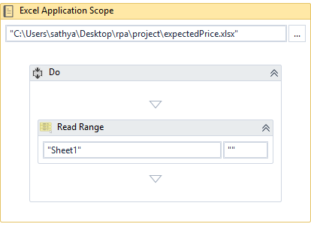
4. Excel Automation

Slide 12
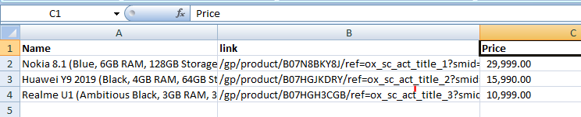
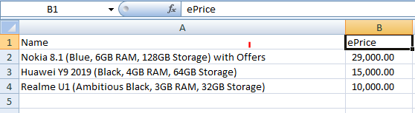
5. Comparison with the expected Price

Slide 13
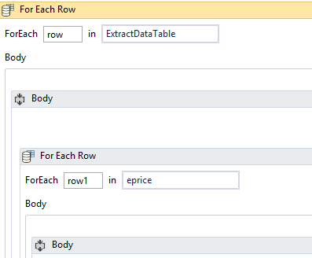
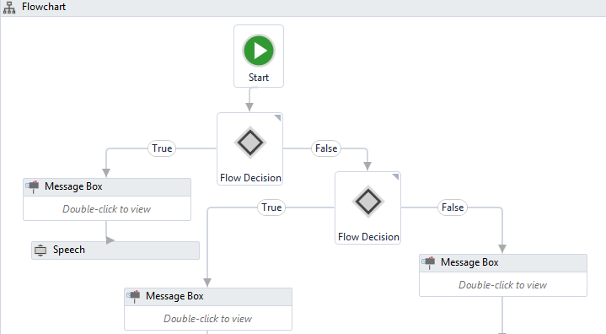

Slide 14
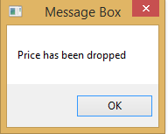
6. Voice Message & Notification
Voice message →
“Price has been dropped”

Slide 15
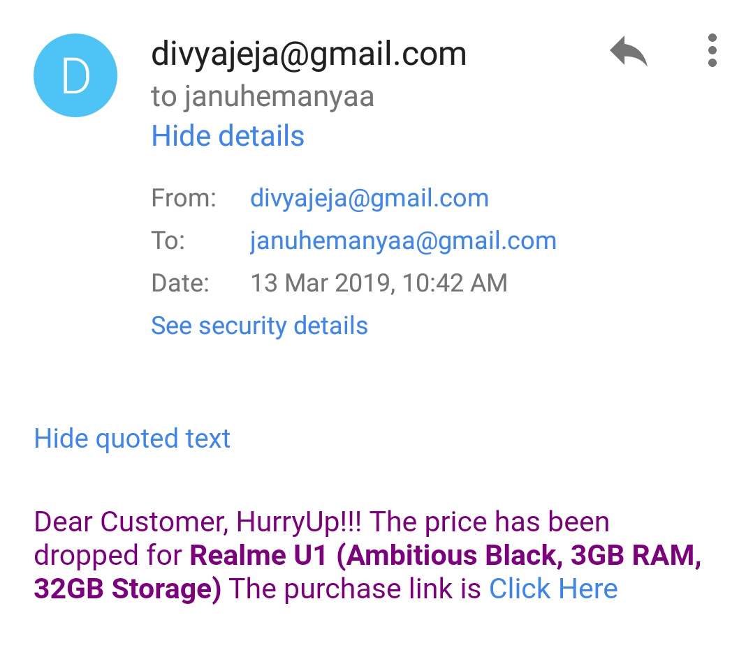
7. E-mail Automation

Slide 16
THANK YOU

