Slide 1


JP Player
Developed by
Jayapradap A

Slide 2
Tools to be used in development
Technologies : Visual Basic
Tools : vb.net
Visual Modeling : media player control

Slide 3
Description
Media player is a software for playing different
types of media files.
This media player will play the different typed of video audio files as well as image.
The main feature of this software is to play the mp4 type of video files and mp3 type of audio file and jpge type of image files.
This Software will be run only in windows operating system.

Slide 4
Features
• There will a button which will pause and resume the running file, by clicking that button user can pause/resume the running media file.
The selected or the added media files will be played one by one after the user press the start button by mouse click. So, there will be a start button.
The running media file can be jump from the one duration to other duration. It can be both the forward and backward direction.

Slide 5
Features
• PLAYLIST:Next time when users will play the same media file , it is not require them to select the file from the specific folder. Because this software is given the facility of playlist of the earlier played media file
This software is able to work in three different mode.
1>Video
2>Audio
photoviewer
According to the file type it will automatically run in its suitable mode.
The menu bar will be displayed at the upper position of the media player where all the option regarding the software and the files will be given. For a particular task the user have to choose the proper option only.

Slide 6
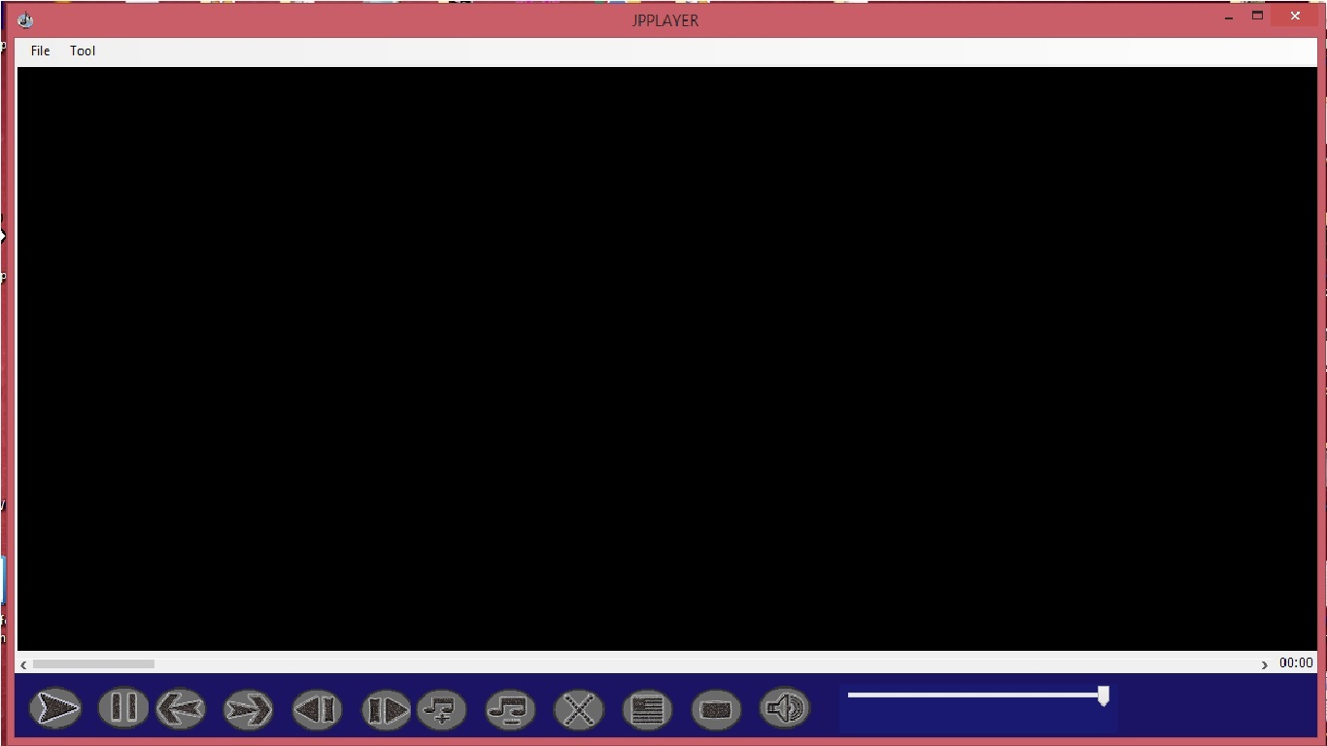
DESIGN
FIG:1

Slide 7
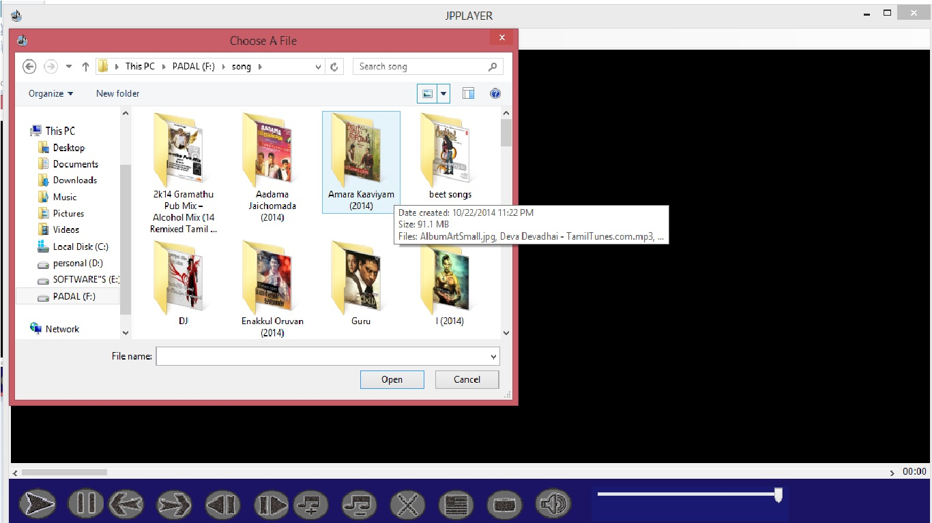
FIG:2

Slide 8
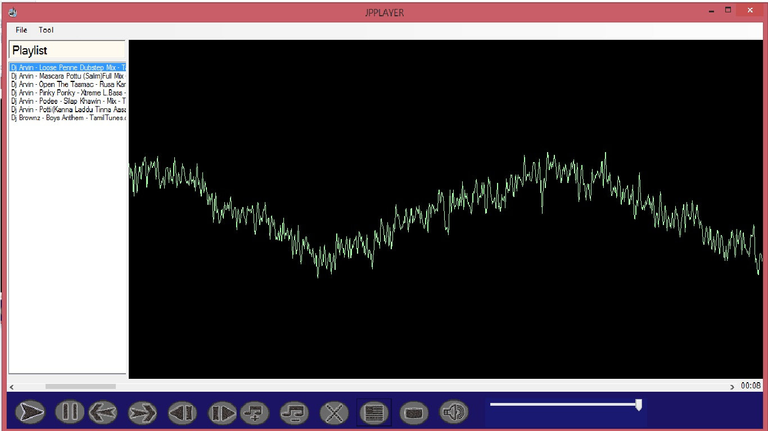
FIG:3

Slide 9
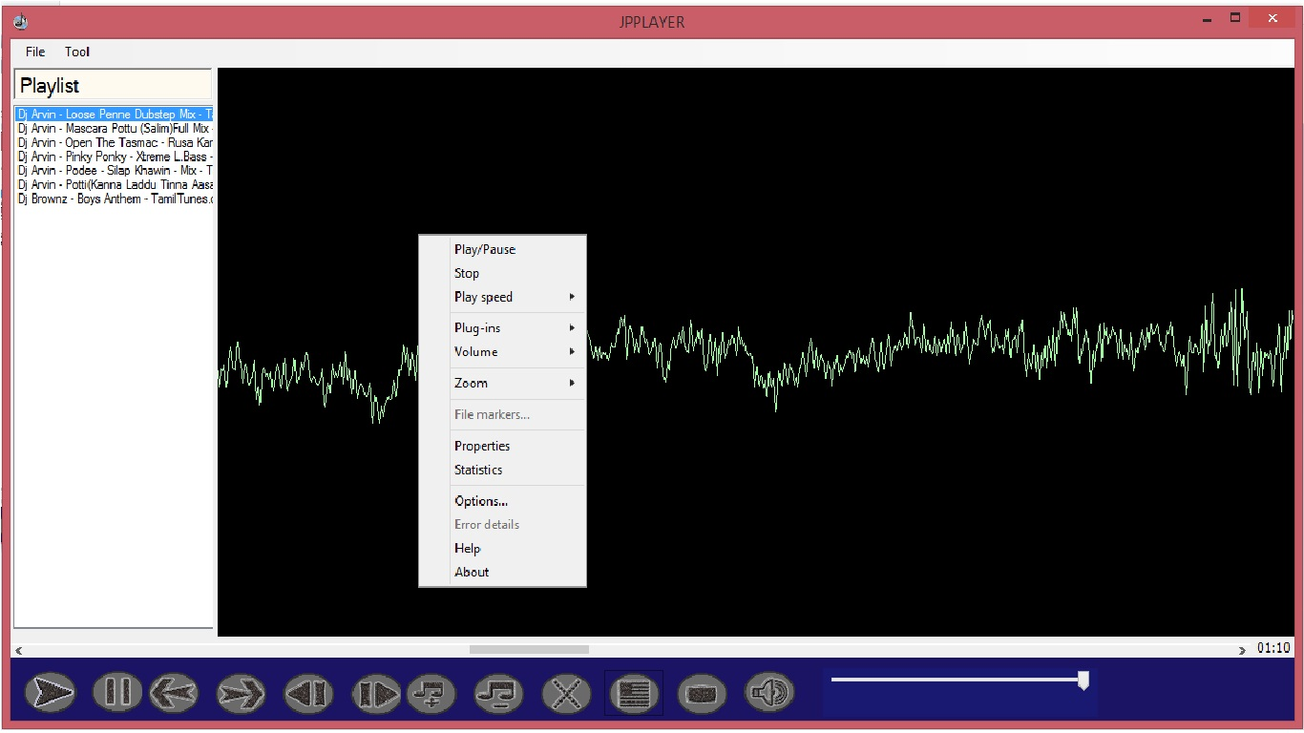
FIG:4

Slide 10
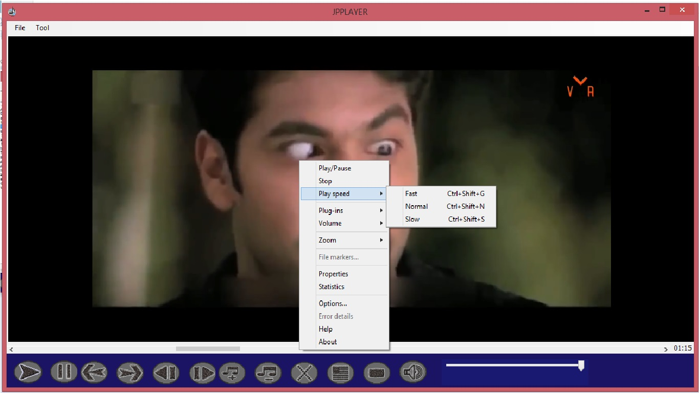
FIG:5

Slide 11
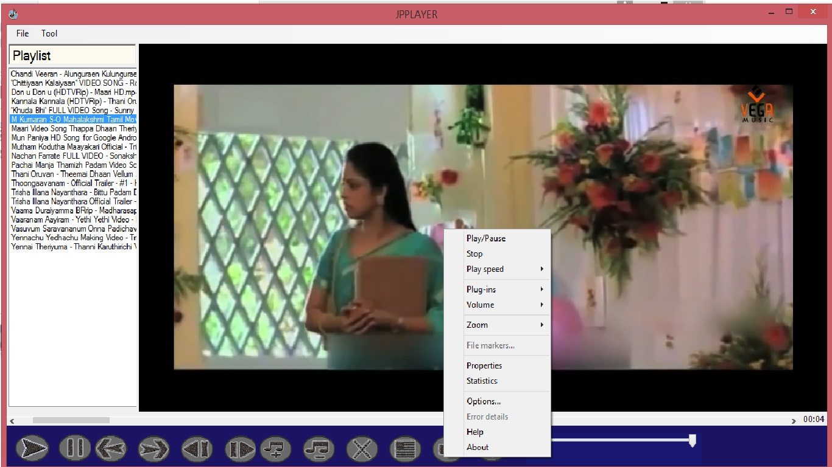
FIG:6

Slide 12
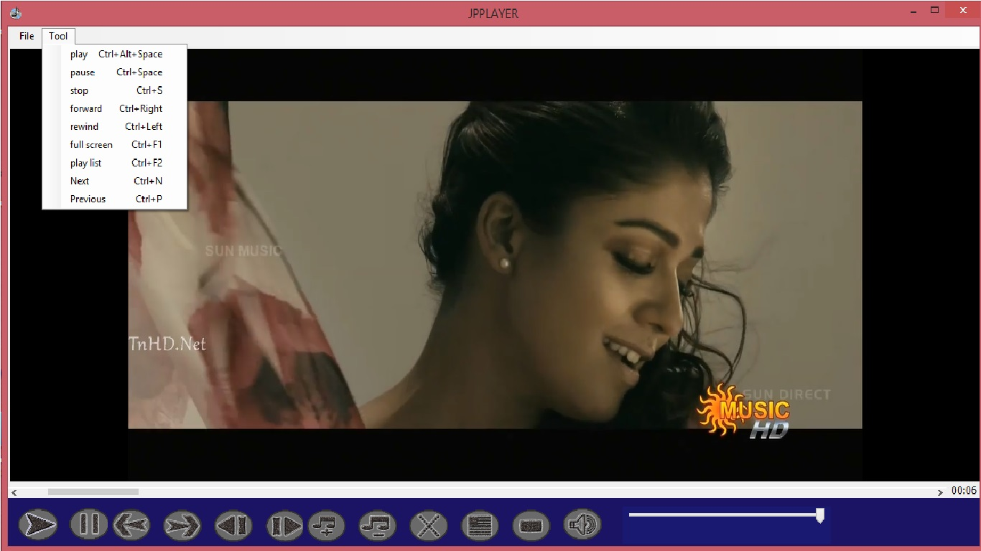
FIG:7

Slide 13
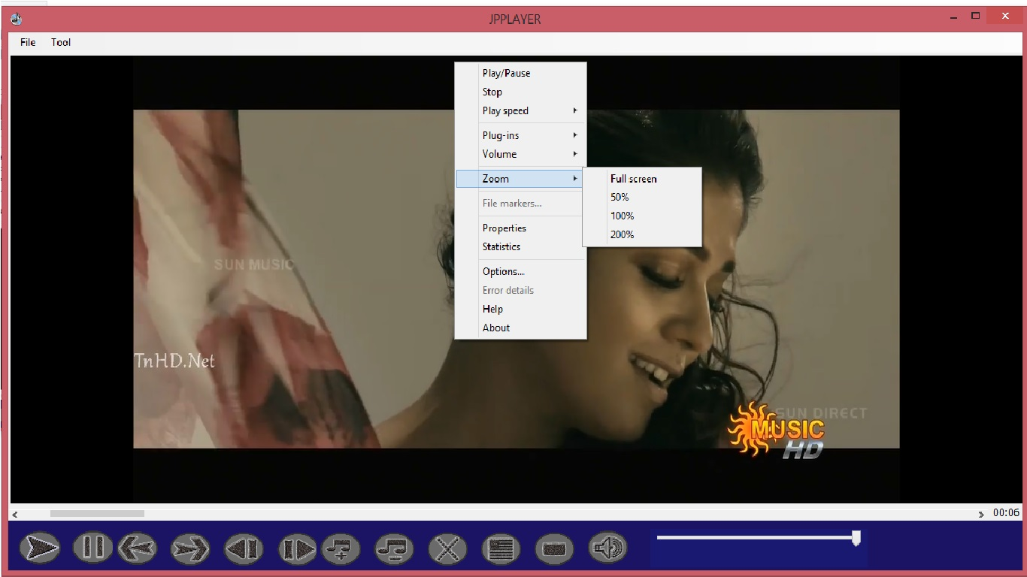
FIG:8

Slide 14
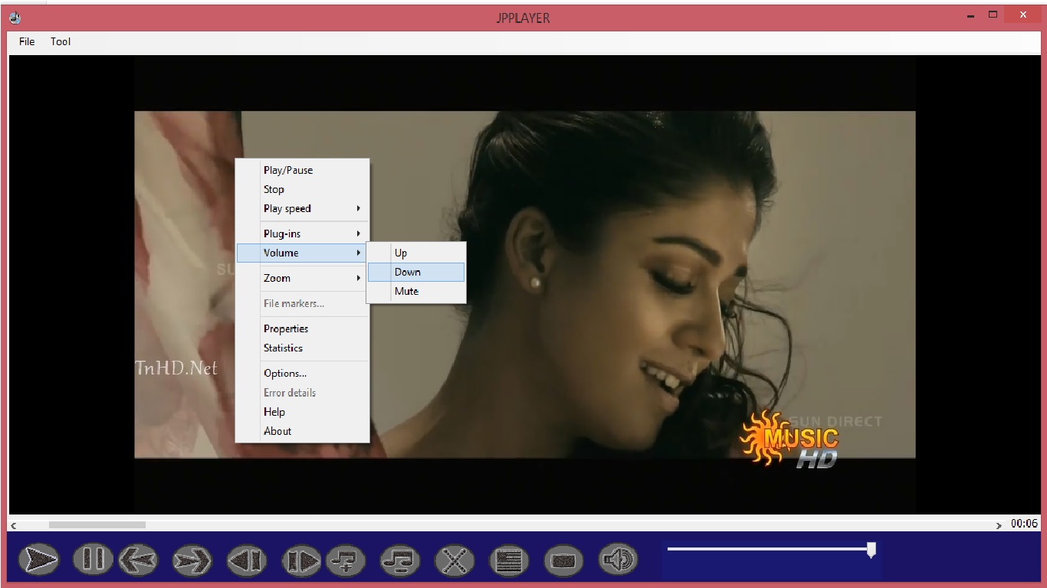
FIG:9

Slide 15
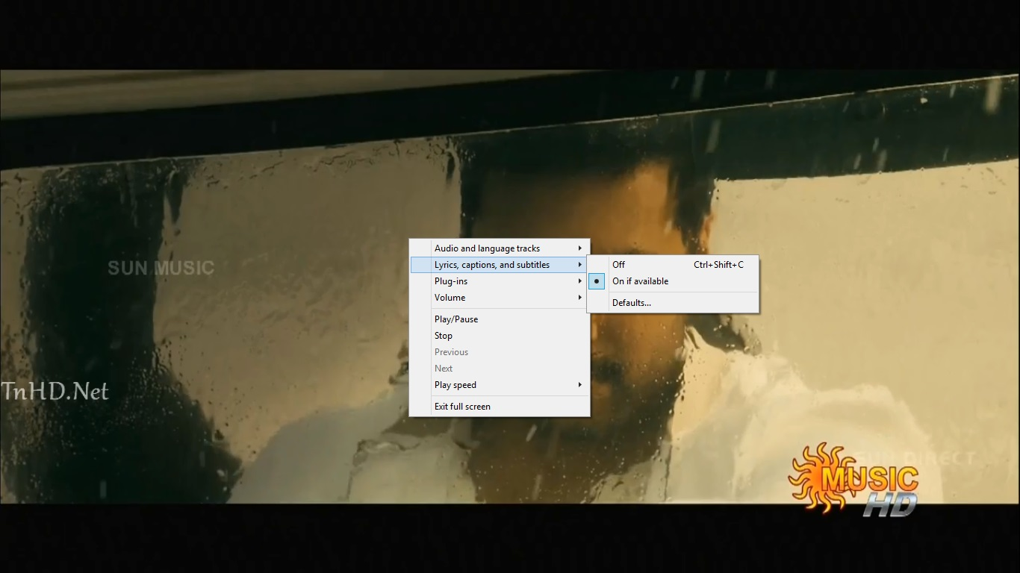
FIG:10

Slide 16
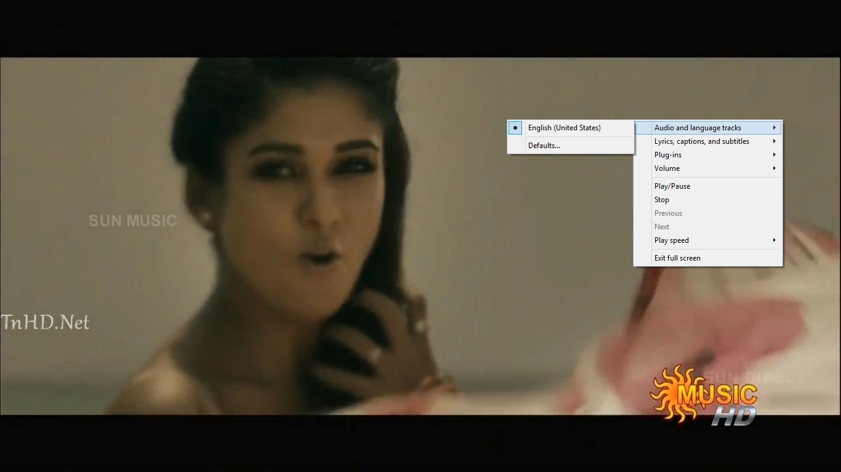
FIG:11

Slide 17
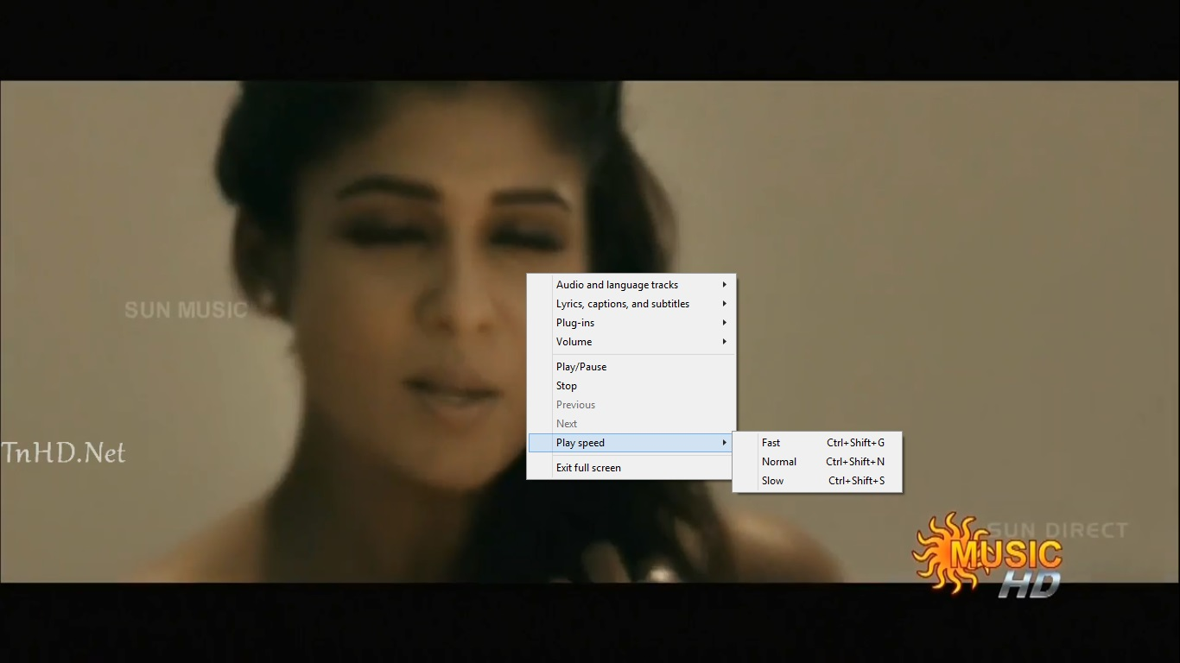
FIG:12

Slide 18
THANK YOU……

