Slide 1

Complaint Register Android Application
IIT PALAKKAD HELP DESK
Made By
B. Nikhil Kumar Reddy
Jayaprakash A
Rohith Reddy G

Slide 2
Benefits
Less usage of data since the complaints registered are stored locally in the phone so retrieving the information uses less internet.
Fast retrieving of information.
User friendly.
Icons are self explanatory.
Only student mailing address are valid for creating account and hence less chances of false complaints.
Error handling taken care extensively.

Slide 3
Working
Currently the application is running on one of the participant’s Google firebase account.
All the complaints are read and written from this firebase account.
Instead of using token number to check status every time , we just displayed the status of the complaint in the list view itself.

Slide 4
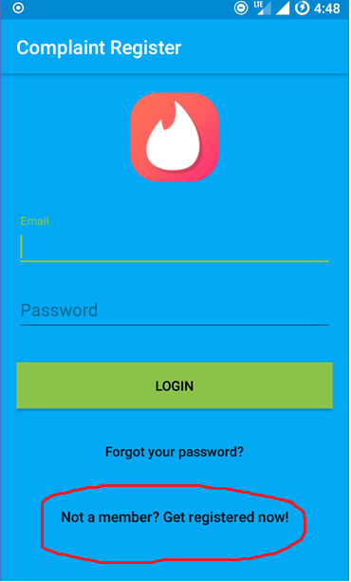
Logging Activity
Enter your email address and password in the given fields.
In case you are using it for the first time.
In the launch screen press the button highlighted.
It redirects you to a page where you can sign up.

Slide 5
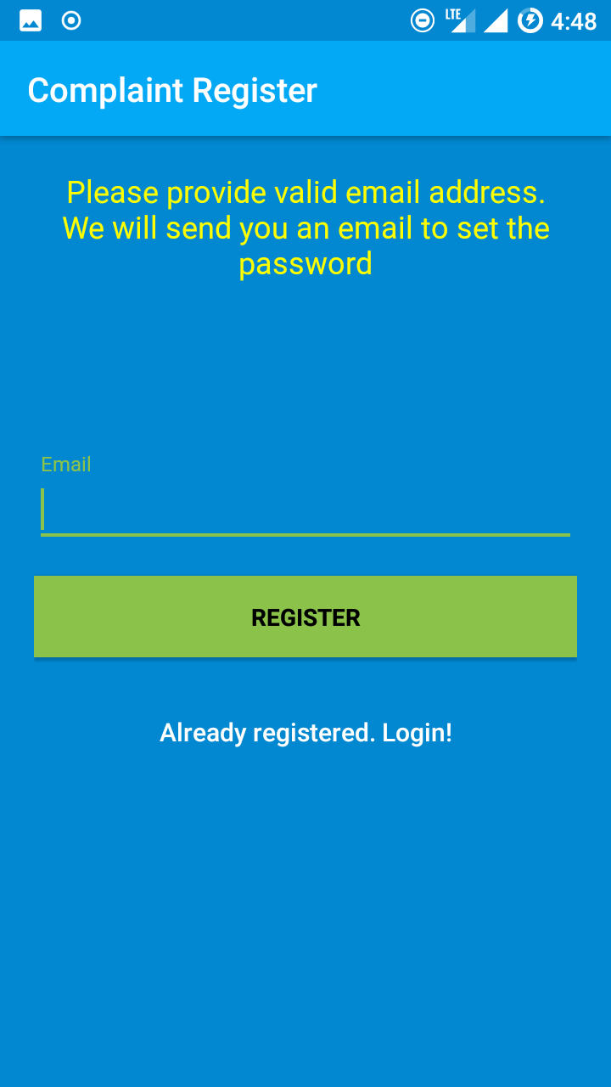
Registration
Enter your email address.
An email will be sent to your email address to verify your identity and also to set your password.
After you set your password login using the logging in activity as previously described.

Slide 6
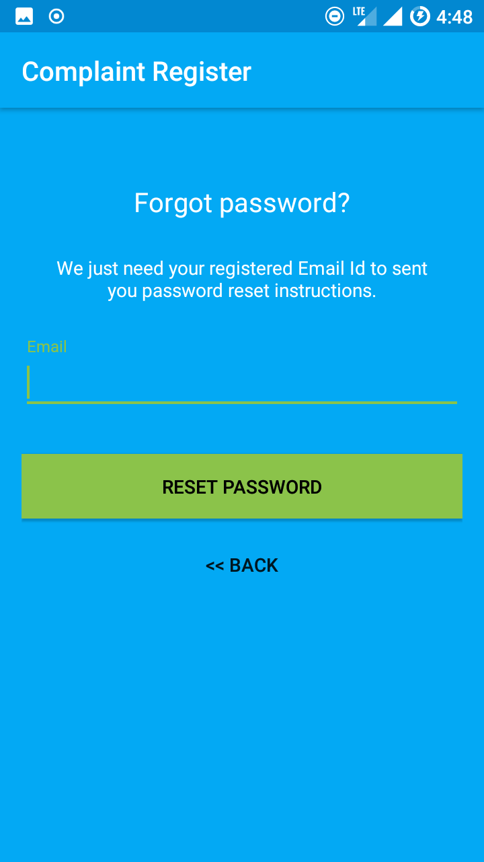
Forgot Password
Enter your email address and details for changing your password will be sent to your account.

Slide 7
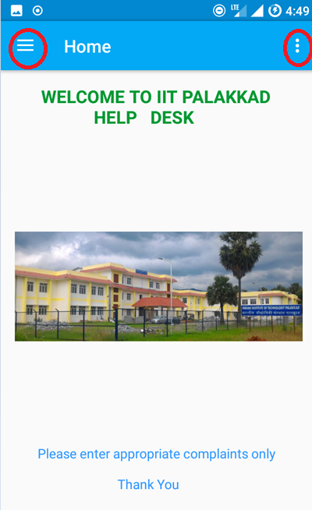
Home Page
After successfully logging in, the home page.
It has a simple display with navigation menu to the top left corner and items menu on top right corner.
To view the various fields just open the navigation menu.

Slide 8
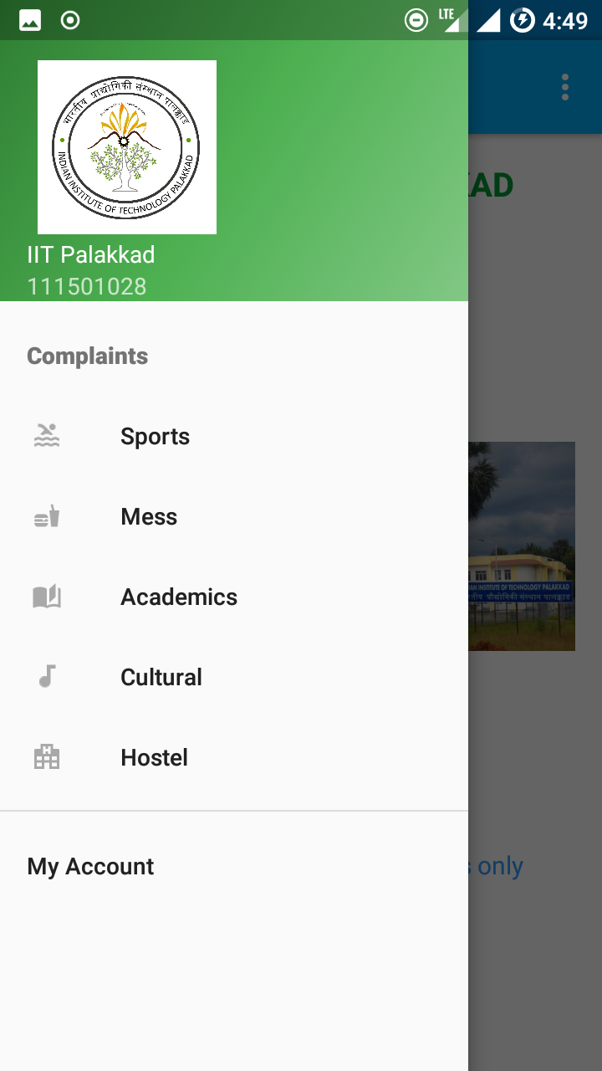
Navigation menu
The navigation header contains college name, username and temporary logo.
The menu has various fields pressing which launches there corresponding activities.
At the bottom there is my account button that links you to your account.

Slide 9
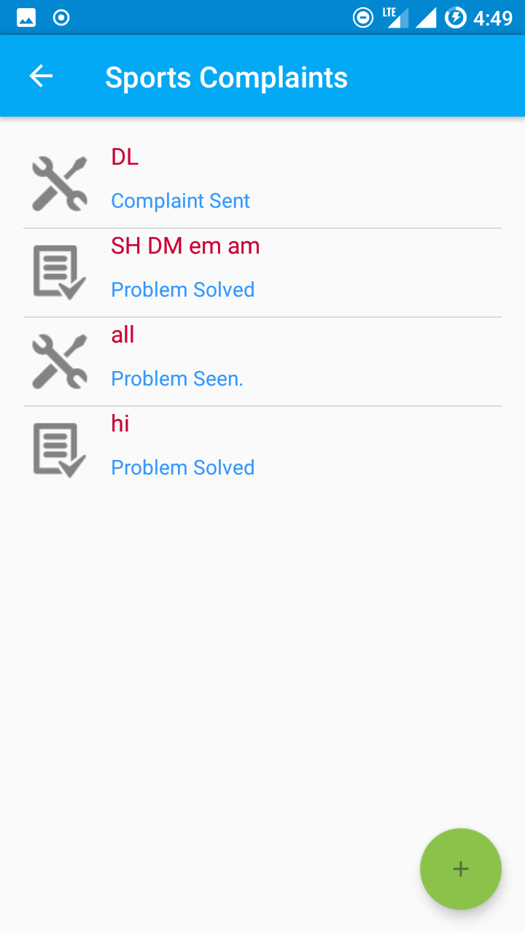
Complaints Section
Open any activity, all the existing complaints of the user loads up.
The subject is set to the top and status of problem is displayed below.
The different icons on the left pictorially describe the status too.

Slide 10
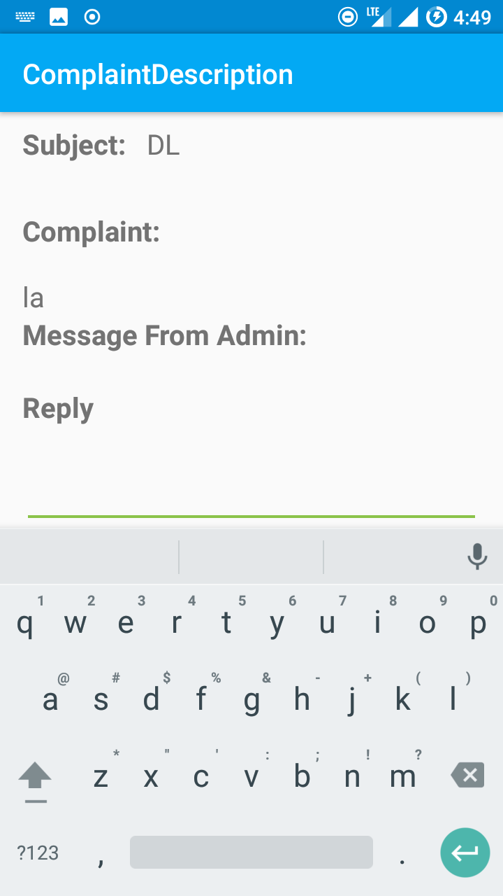
Description
A single tap on the complaint launches its corresponding layout with its entire description.
In case the admin sends any message it gets displayed and you can reply in the text box below.
Reply button sends the message.

Slide 11
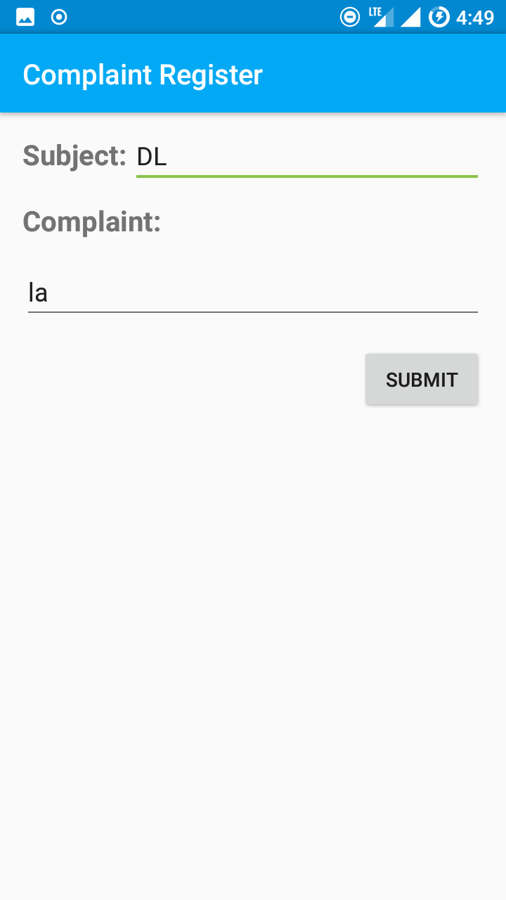
Editing Complaint
As normally long press implies here too on a long press one can edit the complaint he created.
Just make the necessary changes and press the submit button.

Slide 12
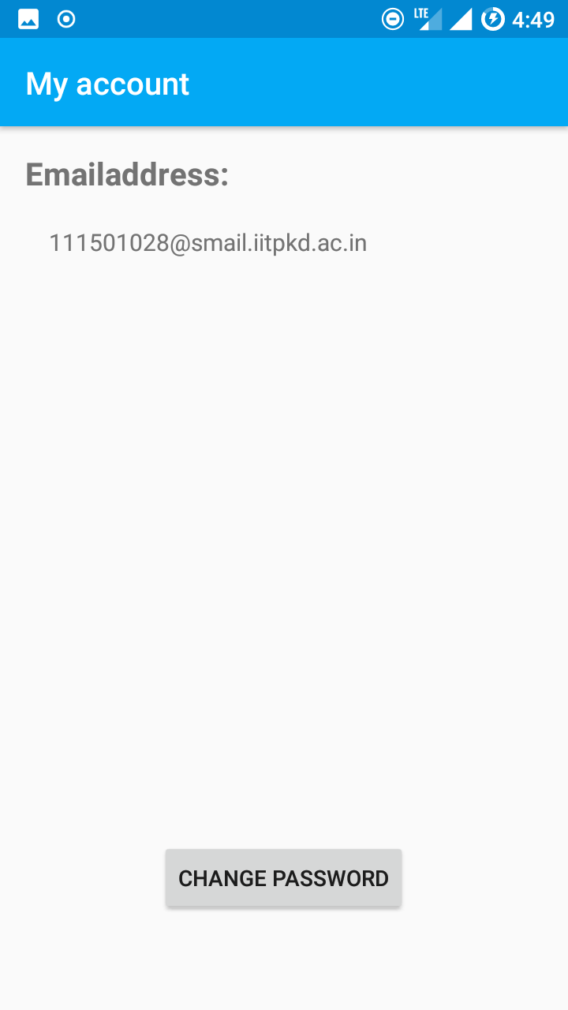
My Account
This activity contains your email address.
It also provides a feature to change your password.
Pressing it will send an email to your email address where you can set your password.

Slide 13
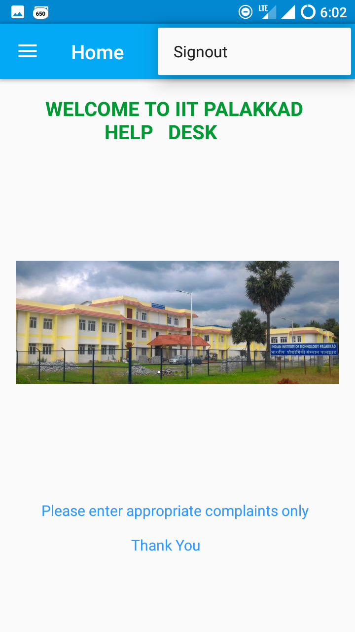
Signing Out
In the options menu in the home layout pressing the items button brings a drop down menu where you select the logout button to safely log out from your account.

