Slide 1
Digital Notice Boardusing Raspberry pi3

Slide 2

DIGITAL NOTICE BOARD USING RASPBERRY PI3
TAKKELLAPATI JAYAPRAKASH-15BQ1A1250
GUDIMETLA VINEETH-15BQ1A1214
DOPPALAPUDI ANUDEEP-15BQ1A1211
Under the Supervision of
Mr. B. RAJESH, M. Tech
Asst. Prof. of IT
Department Of Information Technology
Vasireddy Venkatadri Institute Of Technology
NAMBUR

Slide 3
ABSTRACT
The main objective of this IoT system is to develop a wireless notice board that displays message sent from user using an android application.
user can have track of notice board sent.
The project is built around raspberry-pi which is the heart of the system.
At any time we can add or remove or alter the text or notices according to our requirement using smart phones

Slide 4
INTRODUCTION
Notice Boards are an important medium for displaying information and keeping people aware.
This idea with an aim to increase the usability of electronic notice boards, deals with wireless reception and display of notices using raspberry-pi

Slide 5
EXISTING SYSTEM
The traditional notice boards involve the pinning up of printed or handwritten information on a board.
In colleges separate person required for pinning or sticking notices on the board.
Using the traditional approach there is wastage of paper, printer-ink , man power.

Slide 6
PROPOSED SYSTEM
We deploy a remote accessible system which can employ the real time application of the Internet of Things (IoT) using Python.
This system is now accessible throughout the world from an android application
Digital Notice Board is developed to access the Notice Board connected the an android application. This helps to manage notices easy on Daily basis.

Slide 7
Software REQUIREMENTS
Operating system : Windows 7/8/10, rasbianOS.
Coding Language : Java 1.7,Python
Tool Kit : Android 2.3 ABOVE
IDE : Android Studio
database : Firebase
editor : notepad++

Slide 8
HARDWARE REQUIREMENTS
Raspberry Pi 3
Storage : Samsung 32gb class 10 micro sd card
LED : 16x2 LCD character
Jumper wires(Connecting wires)
USB cable

Slide 9
FUNCTIONAL REQUIREMENTs
FR1:
Type Notice and Click on Send Notice Button Notice will be display
FR2
Click on clear Notice Button Notice will be cleared

Slide 10
NON-FUNCTIONAL REQUIREMENTs
Performance
Security
Availability
Usability
Portability
Maintainability

Slide 11
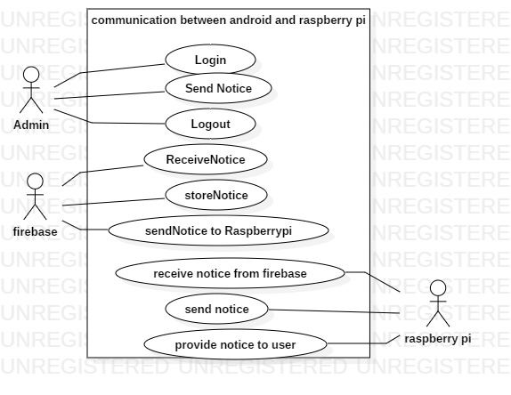
Use diagram For DIGITAL NOTICE BOARD

Slide 12
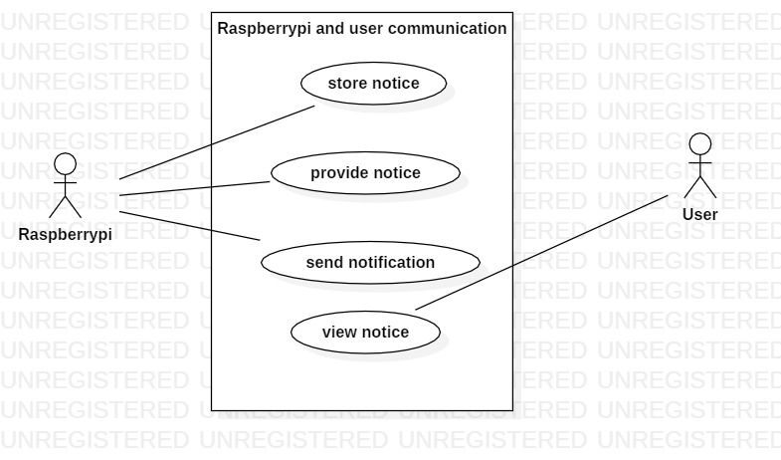
Use diagram For DIGITAL NOTICE BOARD IN THE USER SCENARIO

Slide 13
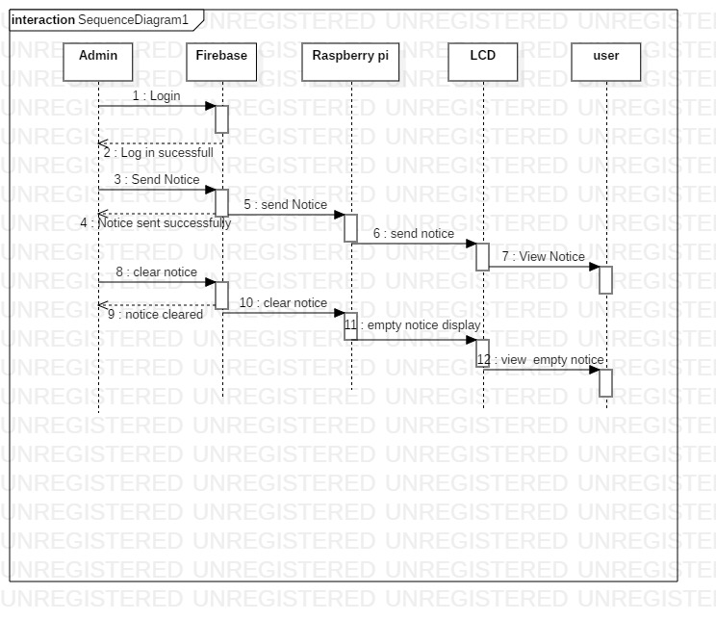
Sequence Diagram
DIGITAL NOTICE BOARD(SSID)

Slide 14
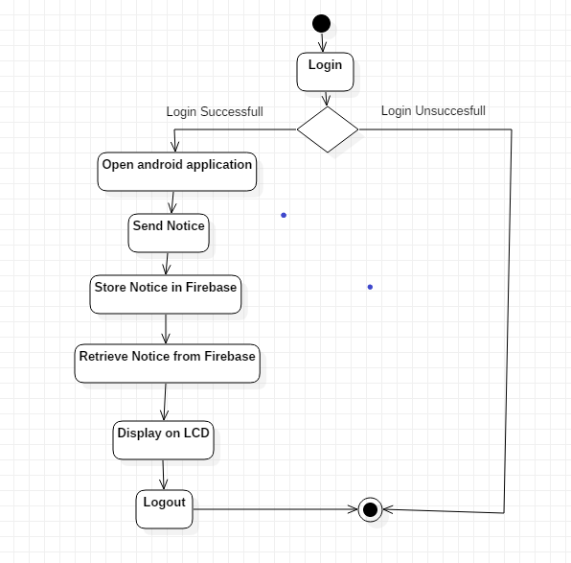
Activity Diagram For Displaying Notice in the Digital Notice Board

Slide 15
MODULES
Send Notice : It display the notice send by user
Clear Notice: it clears the notice

Slide 16
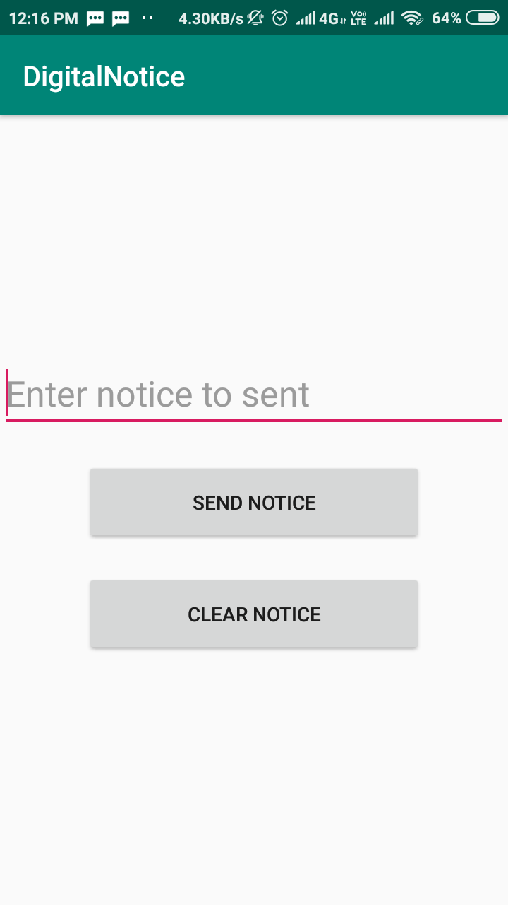
HOME PAGE

Slide 17
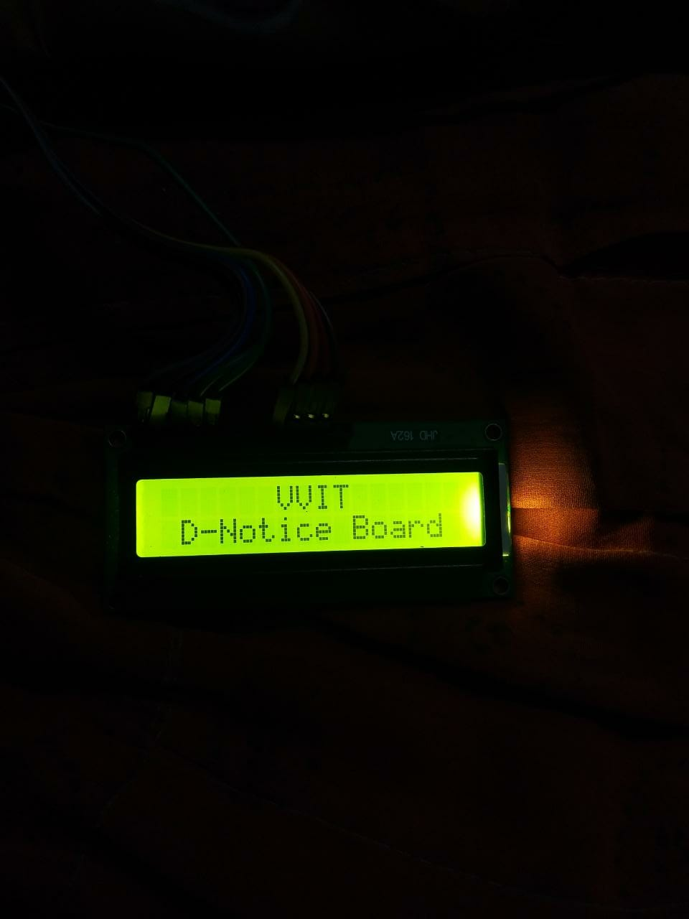
LCD OUTPUT

Slide 18
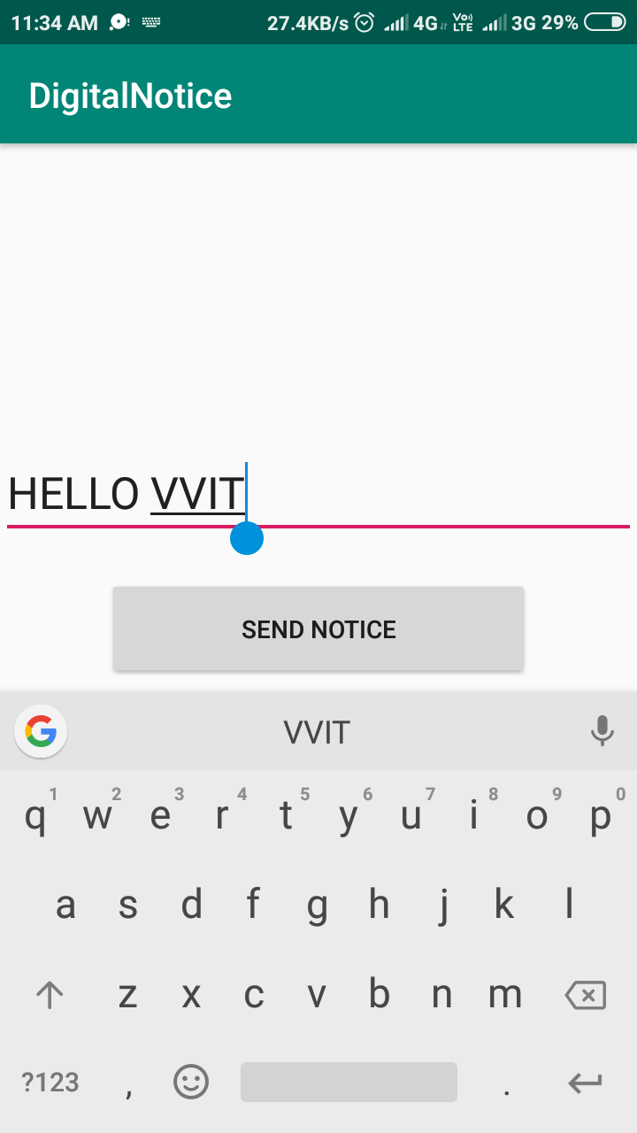
Send Notice Example 1

Slide 19
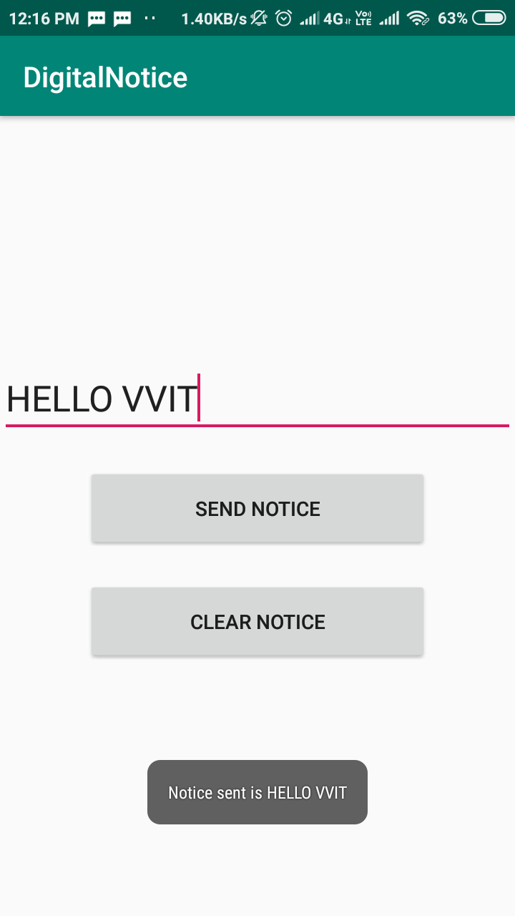

Slide 20
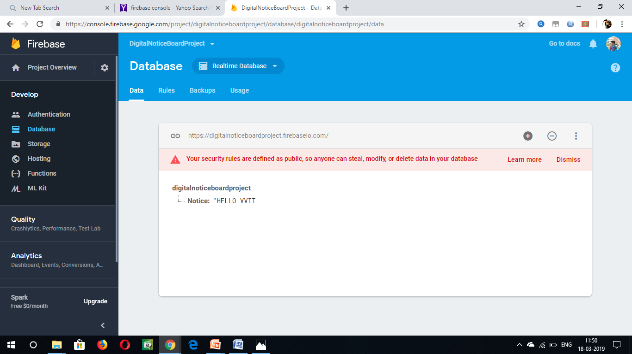
FIRE BASE STORAGE

Slide 21
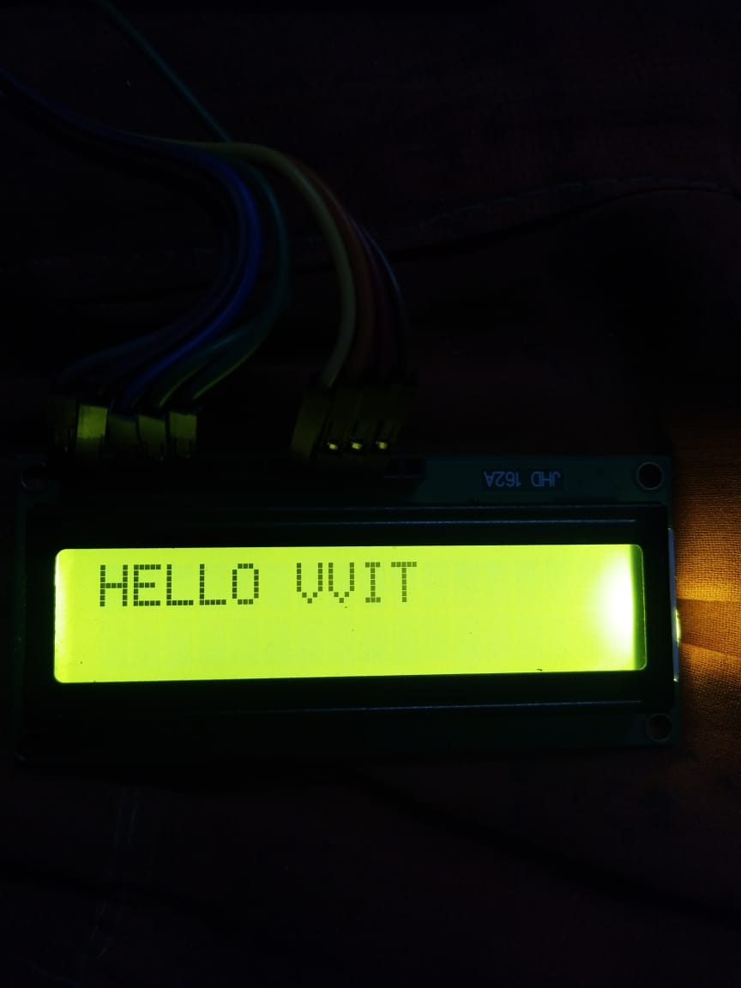
OUTPUT 1

Slide 22
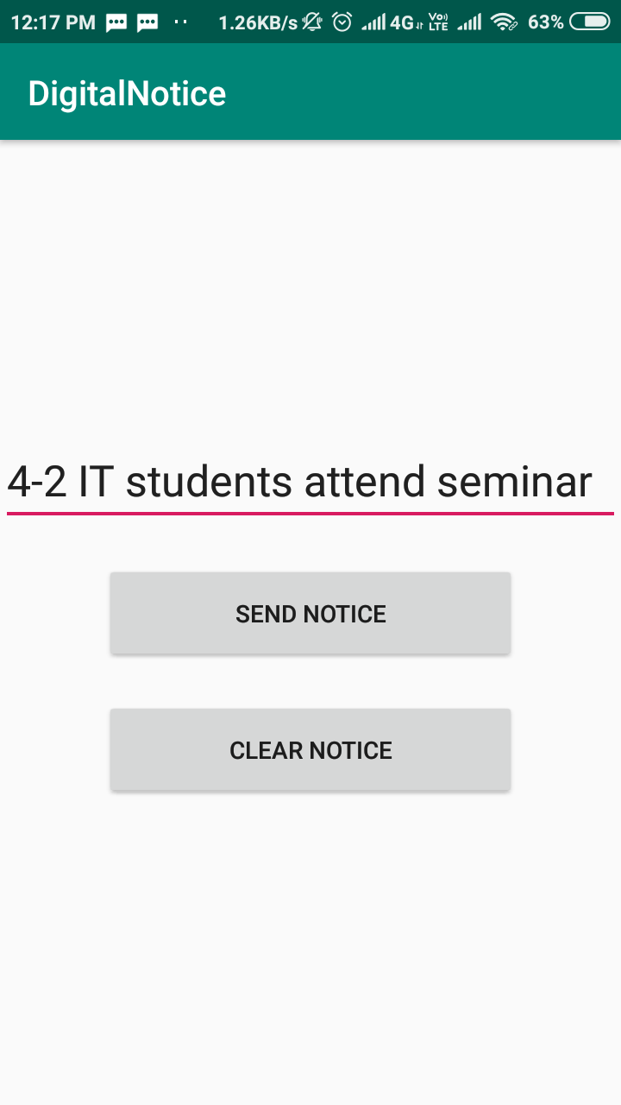
Send Notice Example 2

Slide 23
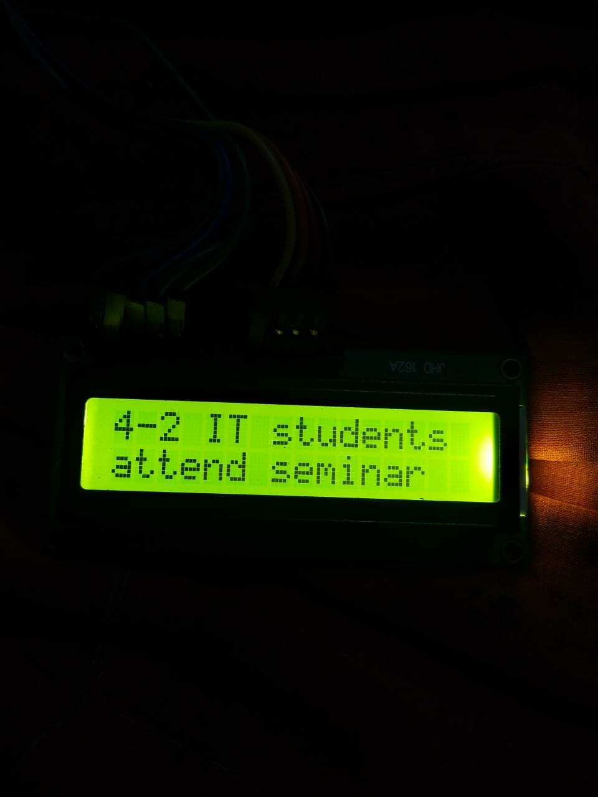
OUTPUT

Slide 24
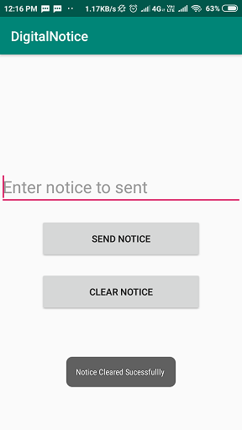
Clear Notice

Slide 25
LCD OUTPUT

Slide 26
TEST CASES
Test case 1 : Character length equals to zero
1 | Test case ID | String length = 0
2 | Precondition | Notice length equals to zero
3 | Description | LCD will be cleared .
4 | Test Steps | Click on SEND NOTICE icon
5 | Expected Output | VVIT D-Notice Board
6 | Actual Output | VVIT D-Notice Board
7 | Status | Pass
8 | Remarks

Slide 27
Test case 2 : Character length less then 16
1 | Test case ID | String length less than 16
2 | Precondition | Enter Notice
3 | Description | Display the Notice on LCD.
4 | Test Steps | Click on SEND NOTICE icon
5 | Expected Output | Enter notice will be display on LCD
6 | Actual Output | Enter Notice displayed successfully
7 | Status | pass
8 | Remarks

Slide 28
Test case 3: Character length greater then 16
1 | Test case ID | String length greater than 16
2 | Precondition | Enter Notice
3 | Description | Display the Notice on LCD.
4 | Test Steps | Click on SEND NOTICE icon
5 | Expected Output | Enter notice will be display on LCD
6 | Actual Output | Enter Notice displayed successfully
7 | Status | Pass
8 | Remarks

Slide 29
Test case 4 : Clear Notice
1 | Test case ID | Clear notice
2 | Precondition | Click on Clear Notice icon
3 | Description | LCD will be cleared .
4 | Test Steps | Click on SEND NOTICE icon
5 | Expected Output | VVIT D-Notice Board
6 | Actual Output | VVIT D-Notice Board
7 | Status | Pass
8 | Remarks

Slide 30
Advantages
Secure operating system - no need to worry about viruses or Windows error messages
Easy to setup and maintain - no need to continually patch or update
Can be programmed to turn screens off when not in use
No Printing and photocopying costs . Thus saves time . Energy and finally environment.

Slide 31
Applications
Educational institutions & organizations
Managing traffic
Advertisement Conference hall
Bus/Railway station
Any public utilize places

Slide 32
Conclusion & Future Scope
Conclusion
This system is now accessible throughout the world from any computer that supports the android application feature.
This system enables the users to receive notifications easily.
Future Scope
It can display the images or the videos that can be played of different types of formats depending upon the screen that is connected to the Raspberry Pi.
It also lets users post gif’s .

Slide 33
REFERENCES
https://www.dexterindustries.com/howto/access -your - raspberry -pi -from - outside -your -home -or -local -network/
https://learn.adafruit.com/character -lcds/circuitpython - code
http://raspberrywebserver.com/html -and -css/making - a - complete -html - page.html
https://fallthrough.io/2017/02/external -access -pi - ngrok/
https://www.raspberrypi.org/help/
https://circuitdigest.com/microcontroller-projects/webcontrolled-iot-notice-board-using-raspberry-pi
https://www.raspberrypi.org/products/raspberry-pi-3- model-b/

Slide 34
Thank You

