Slide 1
Digital Notice Board using Raspberry pi3

Slide 2
BY
Project Team Members
T.Jayaprakash 15BQ1A1250
D.Anudeep 15BQ1A1211
G.RahulVineth 15BQ1A1214
N.AkhilSai 15BQ1A1239
UNDER THE ESTEEMED GUIDANCE OF
B.Rajesh Assistant professor

Slide 3
ABSTRACT
The Internet of Things (IoT) is the network of physical devices, vehicles, home appliances, and other items embedded with electronics, software, sensors, actuators and network conductivity which enable these objects to connect and exchange data.
Notice Board is the primary thing in any institution or public utility places like bus stations, railway stations, colleges, malls, etc. But sticking various notices day to day is a difficult process. The main objective of this IoT system is to develop a wireless notice board that displays message sent from user. It is simple to design, easy to install, user friendly system, which can receive and display notice in a particular manner with respect to date and time, which help the user to easily keep the track of the notice board every day.
The project is built around ARM controller raspberry-pi which is the heart of the system. At any time we can add or remove or alter the text or notices according to our requirement using smart phones, tablets or computers. The raspberry-pi takes the data from the user through internet and displays the same on the notice board.
Keywords: Internet of things; Raspberry Pi; Notice Board; Wireless system.

Slide 4
INTRODUCTION
Notice Boards are an important medium for displaying information and keeping people aware. The traditional notice boards involve the pinning up of printed or handwritten information on a board.
The digital electronics notice board is speedy alternative than the ordinary type of notice board. This idea can display multiple notices at a time to the number of users. This idea with an aim to increase the usability of electronic notice boards, deals with wireless reception and display of notices using raspberry-pi. Notice-board is a thing that can be used in multiple places like any institution or public utility places.

Slide 5
PURPOSE
Notice Boards are an important medium for displaying information and keeping people aware.
In colleges separate person for pinning or sticking notices on the board and wastage of paper printer-ink etc
We are using raspberry-pi (model B) as transmitter, by using raspberry-pi we can make notices at any time and transmit over internet at receiving end after establishing connection between the transmitter (raspberry-pi) and receiver (LCD screen) by providing IP address, then we are able to send the notices remotely from anywhere in the world.

Slide 6
SCOPE
By using multiple screens for displaying the big size advertising purpose and the contents on the screen is made up of several mage files and broadcasting display information such as highway roads, subways, buses and in bus stations, train and railway stations, shopping malls, city squares, hospitals, conference halls, colleges and schools for displaying notice for student information and displaying all instrumental information for visitors and the same application in industries for displaying notices for useful information to their employees

Slide 7
OVERVIEW
In the modern world of technology, computers are affecting our lives in more ways. Our project “DIGITAL NOTICE BOARD USING RASPBERRY PI3” aims at creating an web application which will ease the process of connecting to raspberry pi. Using this it is possible to control electrical devices such as Notice Board. It has good user interface.
Overall description or General description
Specific requirements

Slide 8
OVER ALL DESCRIPTION
PRODUCT PERSPECTIVE
Notice Board is the primary thing in any institution or public utility places like bus stations, railway stations, colleges, malls, etc. The main objective of this IoT system is to develop a wireless notice board that displays message sent from user. It is simple to design, easy to install, user friendly system, which can receive and display notice in a particular manner with respect to date and time, which help the user to easily keep the track of the notice board every day.

Slide 9
OVER ALL DESCRIPTION
PRODUCT FUNCTION
Digital Notice Board is developed to access the Notice Board connected the Web Browser. This helps to manage Updates Daily. It is also useful in a situation when daily sticking notices on notice board .
A summary of major functions that Digital Notice Board will perform:
User must be identified.
In a board it should be flexible to handle messages.
Application also gives some information regarding the daily Notices.

Slide 10
OVER ALL DESCRIPTION
PRODUCT FEATURES
Some of the features of the project Digital Notice Board System are
1.Interpolation 2. Remote Access
3. Expandability
4. Upgradeability
5. Variety of User Interfaces
6. Energy Management
7. Layers of Protection

Slide 11
FUNCTIONAL REQUIREMENTs
FUNCTIONAL REQUIREMENT 1
INTRODUCTION
When we click on submit button on in the browser the signal is transmitted through WIFI to raspberry pi which is Displayed on The Digital Notice Board.
INPUT
Pressing the Submit button in Web Page.
PROCESSING
In the processing the signal is transmitted over WIFI to raspberry pi and raspberry pi sends the signals to the inbuilt programmable GPIO pins from where the signal is sensed by the LED.
OUTPUT
The Text Message is Displayed on The Digital Notice Board.

Slide 12
EXTERNAL REQUIREMENTS
SOFTWARE INTERFACES
Operating System - Raspbian
Mobile Operating System- Android(V4.0-V8.1)/Windows
Programming tool - Node-Red and Android Studio
Web Browser - Google Chrome, Mozilla Firefox

Slide 13
EXTERNAL REQUIREMENTS
HARDWARE INTERFACES
Raspberry Pi 3
SoC: Broadcom BCM2837
CPU: 1.2 GHZ quad-core ARM Cortex A53
GPU: Broadcom VideoCore IV
Memory: 1 GB LPDDR2-900 SDRAM
Storage: Samsung 32gb class 10 microsd card
LED 16x4 LCD character
Router

Slide 14
INTRODUCTION TO UML
The Unified Modeling Language (UML) is used to specify, visualize, modify, construct and documents the artifacts of an object-oriented software intensive system under development. UML offers a standard way to visualize a system’s architectural blueprints including elements such as
Actors
Business processes
Components
Activities
Programming language statements
Database schemes
Reusable software components

Slide 15
USE CASE DIAGRAM
The Use Case Diagram is a graphic depiction of the interactions among the elements of Institutional Database System. It represents the methodology used in system analysis to identify, clarify and organize system requirements of the system

Slide 16
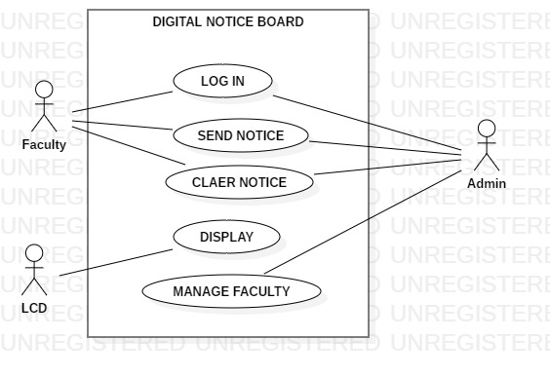
USE CASE DIAGRAM

Slide 17
CLASS DIAGRAM
Class diagram is used to display some of the classes and packages in your system.
A class diagram includes a subset of the classes, attributes, operations, relationships, and packages of classes in the system.
It gives us a static picture of the pieces in the system and of the relationships between them.
Class diagrams help the developers see and plan the structure of the system before the code is written helping to ensure that the system is well designed from the beginning.
Generally, a class is rendered as rectangle, usually including its name, attributes and operations.

Slide 18
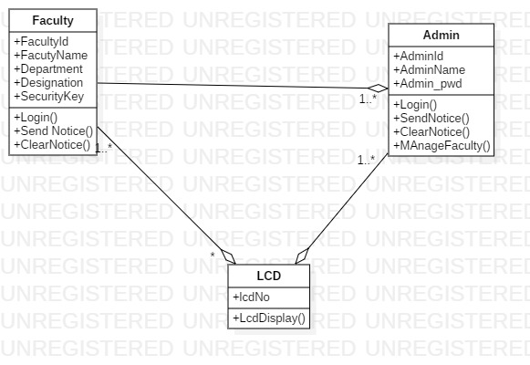
CLASS DIAGRAM

Slide 19
SEQUENCE DIAGRAM
Sequence diagram also known as interaction diagram depicts how elements interact over time.
A horizontal axis shows elements involved in the interaction and the vertical axis represents time proceeding down the page. The sequence diagram has following types of elements.
Classes and objects
A lifeline
A communication between objects

Slide 20
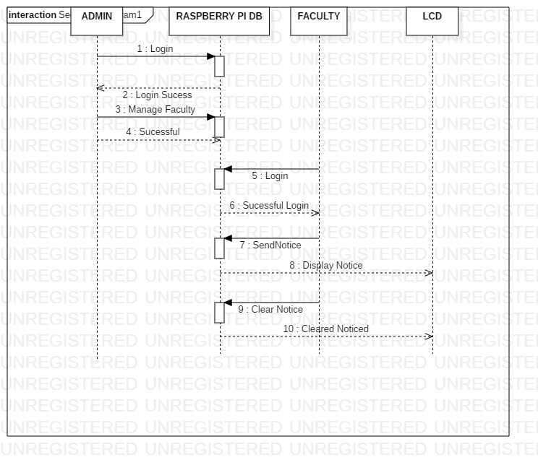
SEQUENCE DIAGRAM

Slide 21
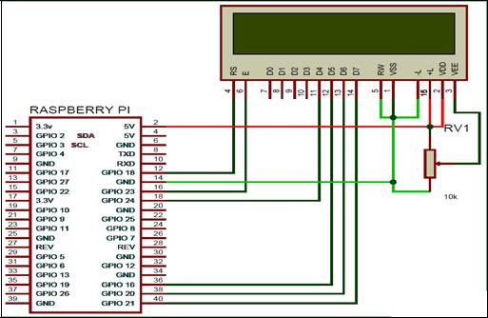
CIRCUIT DIAGRAM

Slide 22
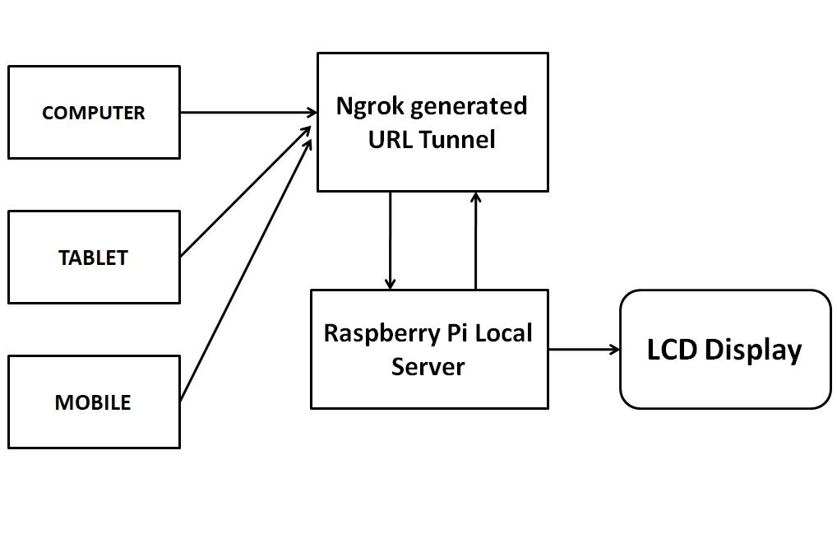
BLOCK DIAGRAM

Slide 23
System Flow Diagram
Installation of Raspberry OS
Installing Virtual Environment Package
Installing Flask Packages

Slide 24
Installing ngork and set up configuration for Terminal
Run the program and get the web URL from ngork
Is Security Key Correct
Stop
Enter Notice To Send
Notice on LCD Display

Slide 25
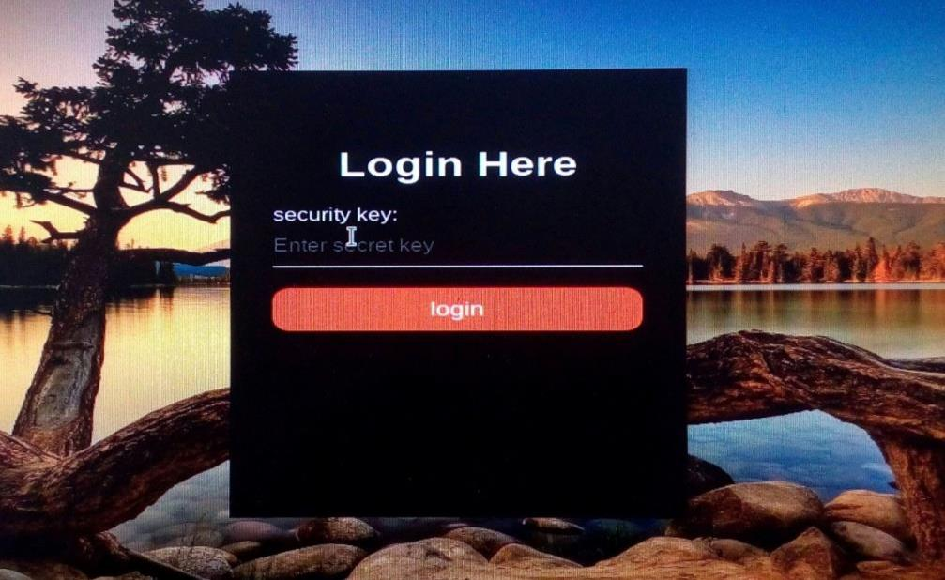
LOGIN PAGE

Slide 26
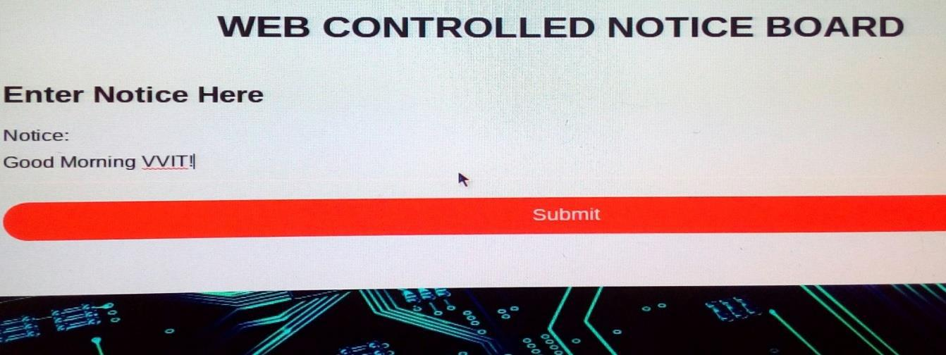
SEND NOTIFICATION

Slide 27
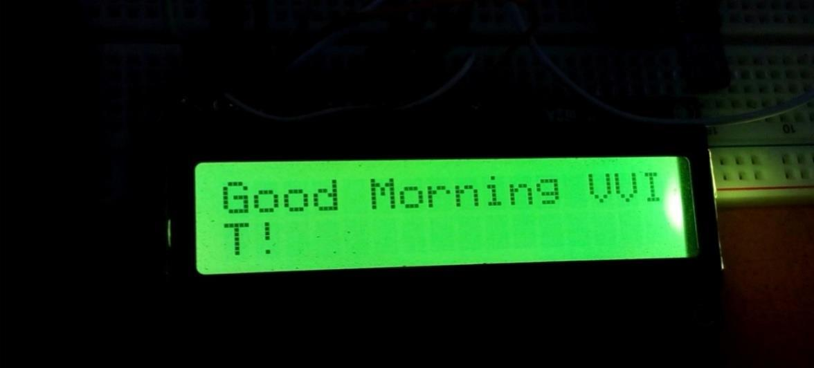
DISPLAY NOTICE

Slide 28
Thank You

