Slide 1
DocAssistIQ
System Architecture & Clinical Decision Support Engineering
Neuro-Symbolic Architecture • Real-Time Ambient Voice • Deterministic Safety • Local GPU Inference

Slide 2
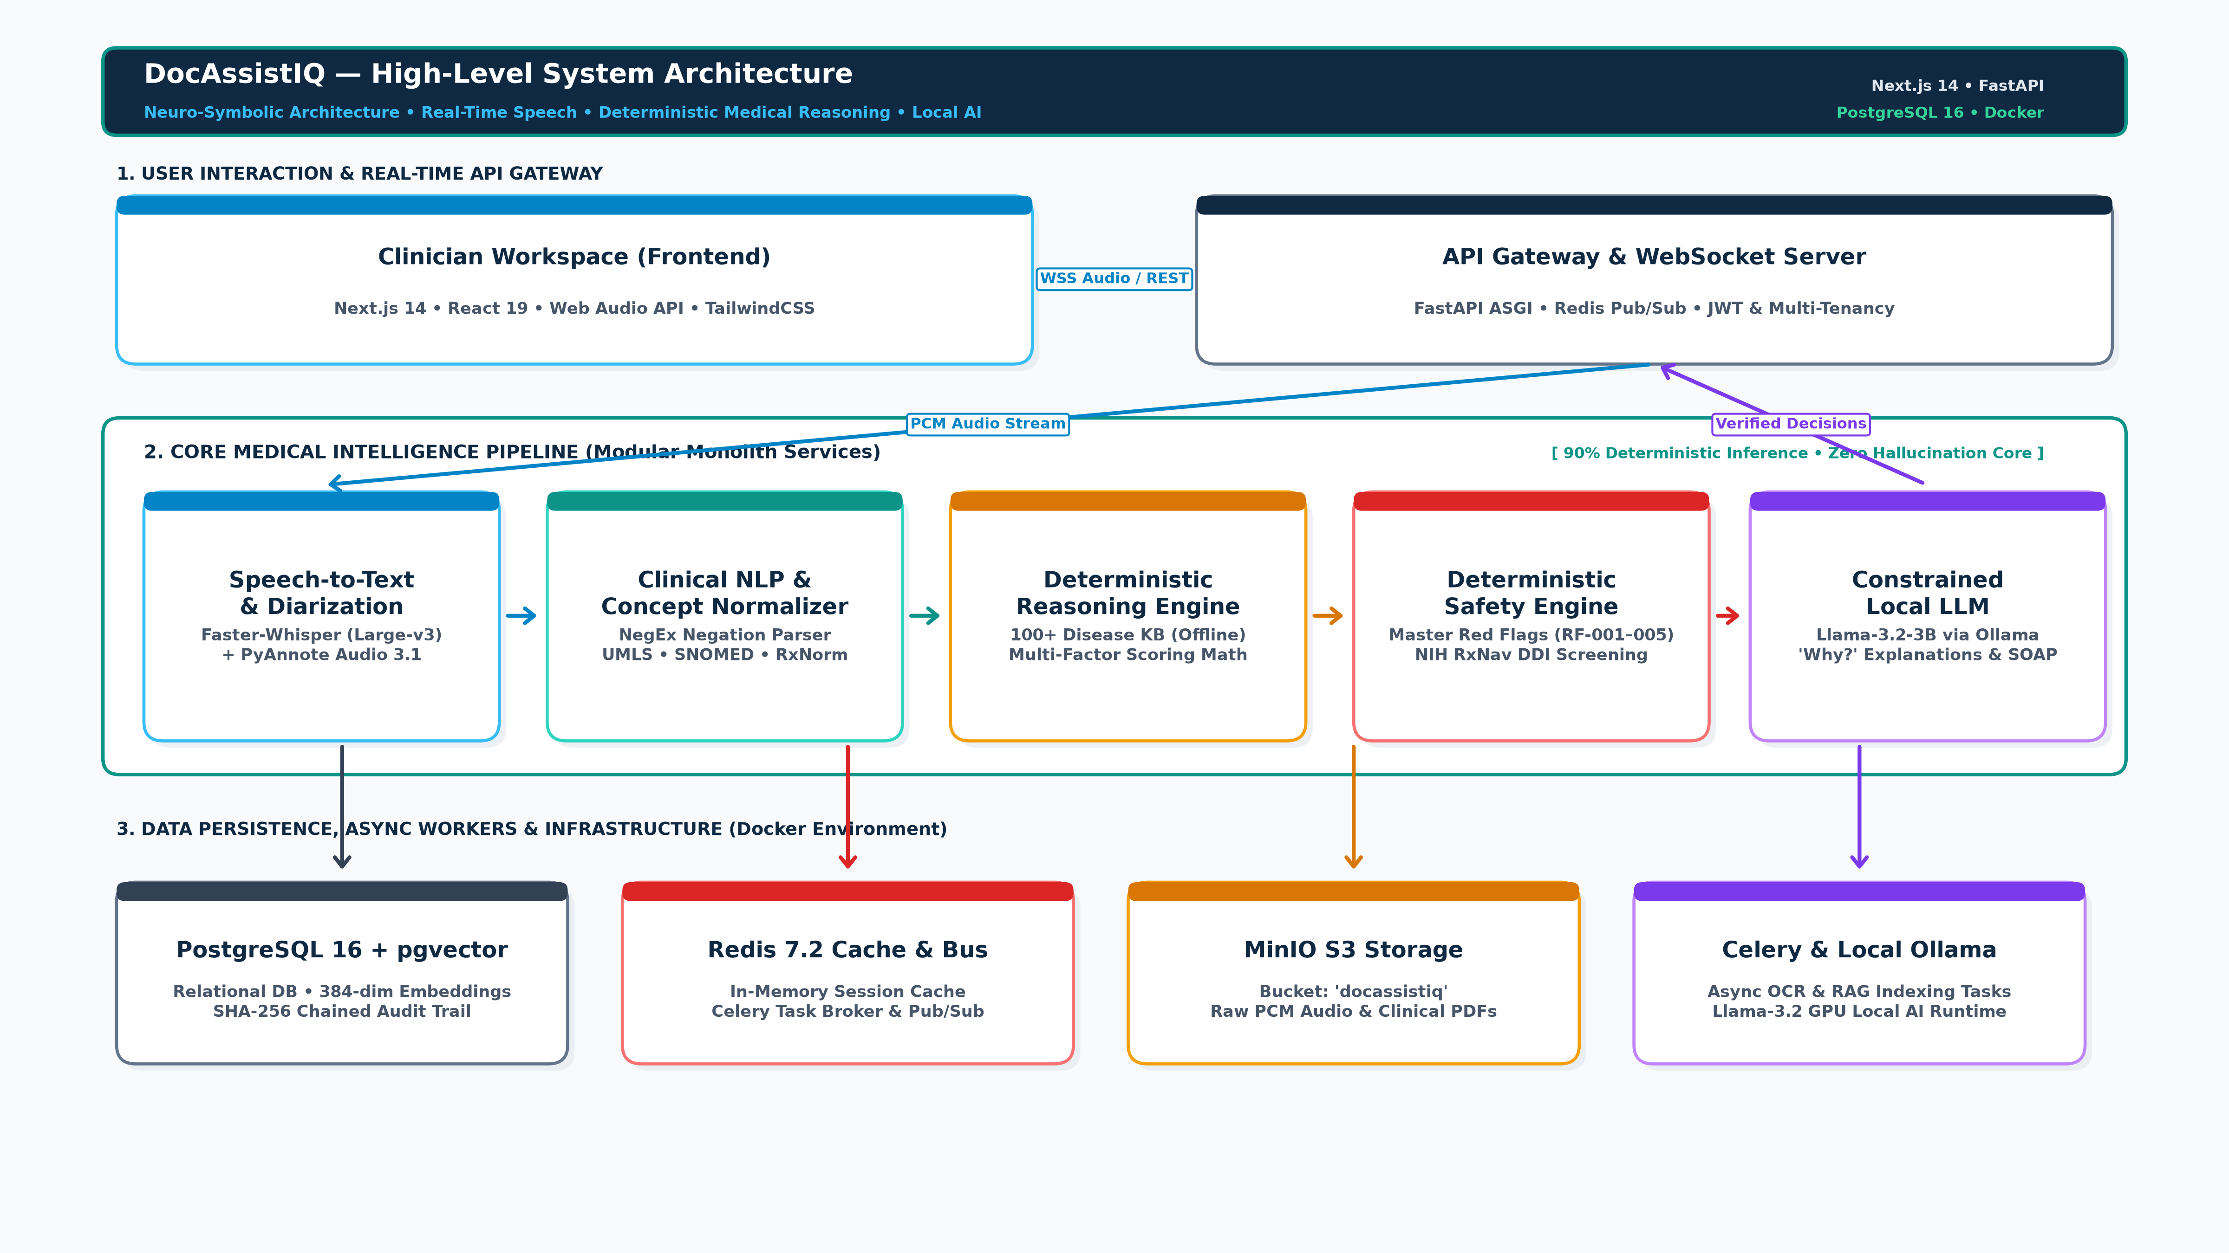

Slide 3
DocAssistIQ: Architectural Pillars & Design Innovations
1. Ambient Voice Pipeline
• Web Audio API (16kHz PCM)
• Faster-Whisper Large-v3
• PyAnnote 3.1 Diarization
• Mandatory Patient Consent Gate
2. Deterministic Reasoning
• 100+ Multi-Specialty Disease KB
• Multi-Factor Jaccard + Cardinal Math
• Incubation & Travel Fit
• <85ms Sub-Second Execution
3. Zero-Bypass Safety
• Master Red Flags (RF-001 to 005)
• 100% Sensitivity on Emergencies
• Live NIH RxNav DDI Screening
• Mandatory Clinician Review
4. Local Privacy & Security
• Constrained Llama-3.2-3B via Ollama
• PostgreSQL 16 + pgvector HNSW
• SHA-256 Chained Audit Trail
• Zero Cloud Data Leakage (HIPAA)

