Slide 1


The Leads – Review 1
The_Leads

Slide 2

AI-Based Email Classifier for Hospitals
Phishing attacks pose a significant threat to hospitals.
Sensitive patient data is at risk.
The_Leads

Slide 3
Solution Approach
AI Classifier
Real-time Monitoring
Identify suspicious emails.
Alert IT staff and key stakeholders.
Employ machine learning.
Detect potential phishing threats.
The_Leads

Slide 4
Model Architecture
Input: [email text]
[Embedding Layer] -- Converts words into vectors
[LSTM Layer] -- Learns word sequence patterns
[Dropout Layer] -- Prevents overfitting
[Dense Layer] -- Fully connected layer to combine features
Output: [spam or ham
Technologies Used
TensorFlow and Keras.
LSTM layer for handling email text.
Steps
Tokenization and padding.
Embedding email text.
Classification
Categorize emails as phishing or legitimate.
The_Leads

Slide 5
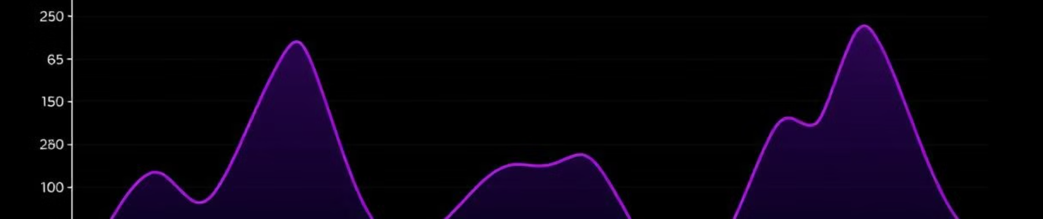
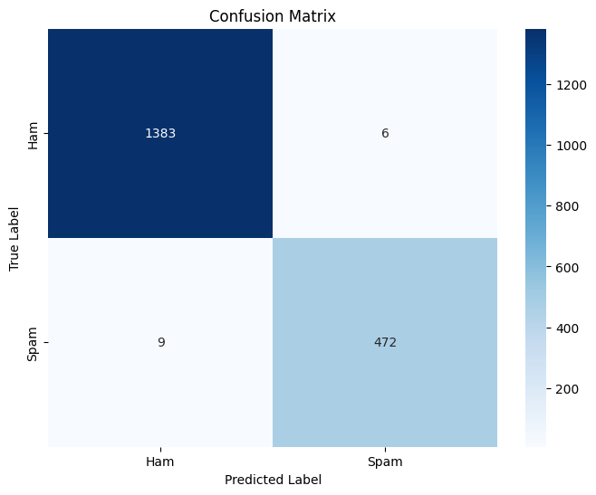
Evaluation & Performance
True Positives (TP): 472 — Correctly predicted Spam emails.
True Negatives (TN): 1383 — Correctly predicted Ham (non-spam) emails.
False Positives (FP): 6 — Incorrectly predicted Spam (actually Ham).
False Negatives (FN): 9 — Incorrectly predicted Ham (actually Spam).
Metrics Tracked
Training & Validation Accuracy.
Loss over epochs.
The_Leads

Slide 6
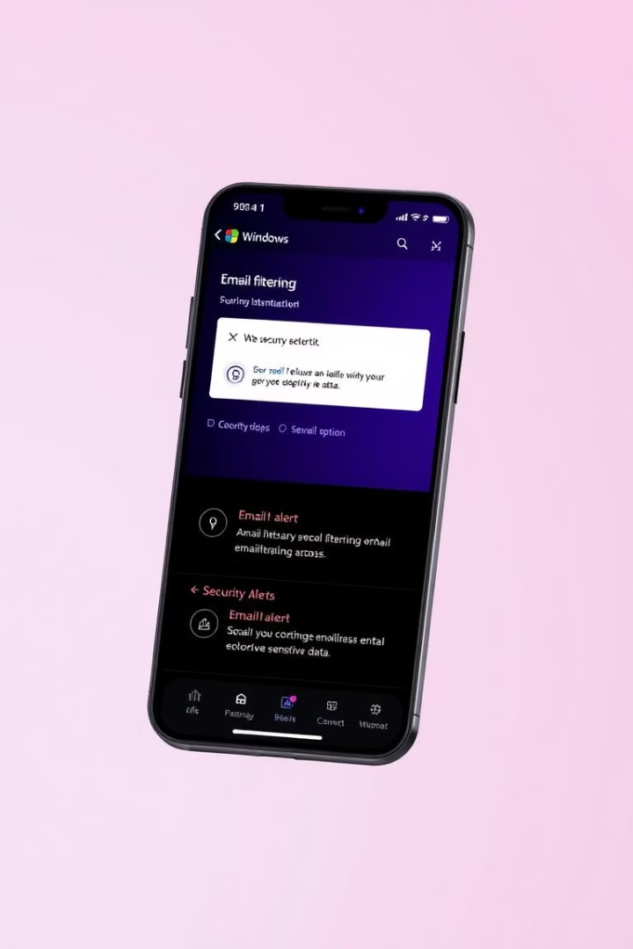



Next Steps
Model Evaluation
Finalize and tune.
Windows App
Implement background functionality.
Send alerts to IT department.
Real-time Monitoring
Complete deployment.
The_Leads

