Slide 1
Idea & Approach Details
Technology Bucket : Software –Mobile App Development Category : software
Ministry/ Organization name : Yamaha Motor solutions India Pvt . Ltd Problem Code: LS1
Team Leader Name: Jayaprakashan A College Code: 7130
Idea Prototype And Solution :
The objective of our project is to create a bike e-catalogue. Here we propose a mobile app with feature of augmented reality .Where the user can able to scan the QR code or original bike to know its features. The mobile App is created for both Android and ios . Here We used two different types of augmented reality namely Marker based AR and Superimposition based AR. Marker based Augmented reality uses a AR camera ,Visual Marker such as 2D code (QR Code) to produce a 3D model .On scanning the QR code Superimposition based AR replaces original view of an object(bike) with a newly augmented view of that same object in
3-dimentions . Here user can choose between available colours of the bike virtually . The important features of the bike displayed on the screen giving user a good experience along with relevant you tube videos and user feedback. Vuforia Unity Engine software tool is used to Develop AR application, 3D model of Bike is created using Adobe Fuse software and Stored in vuforia cloud database . The Target images are also stored in Cloud. AR camera is used in deploying virtual image over Real World objects.

Slide 2
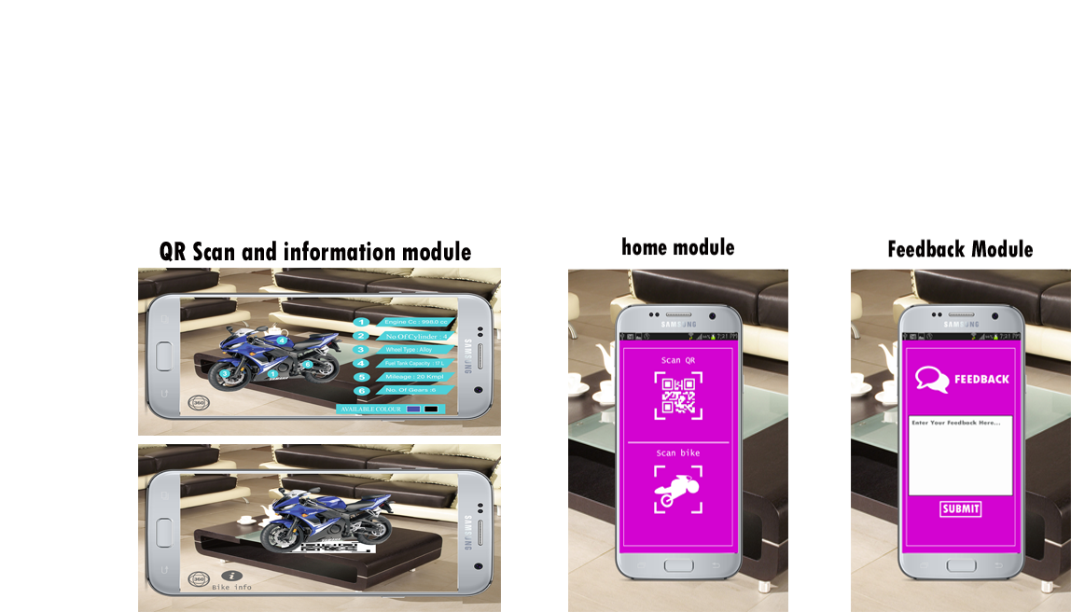
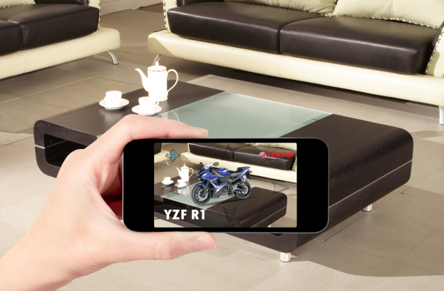
TECHNOLOGY STACK:
1. Unity Engine:
Unity is the most widely used VR development platform, Whether it's AR Unity's highly optimized rendering pipeline and the rapid iteration capabilities of our Editor to make your AR creative vision a reality.
2.Adobe fuse 3D:
Adobe fuse is a 3D computer graphics used to create 3D objects. It has the ability to import and integrate user generated content into the character creator . Here the 3dimentional
3. Augmented Reality(AR):
It is a technology where we can experience real world object. The platform creates visual, auditory effects to create the realistic ness of the situation.
4. Vuforia Cloud Database:
This cloud database is used for applications which has large number of targets. Since our application has to support catalog types with more number of images this database is used.
Augmented view of Bike

Slide 3
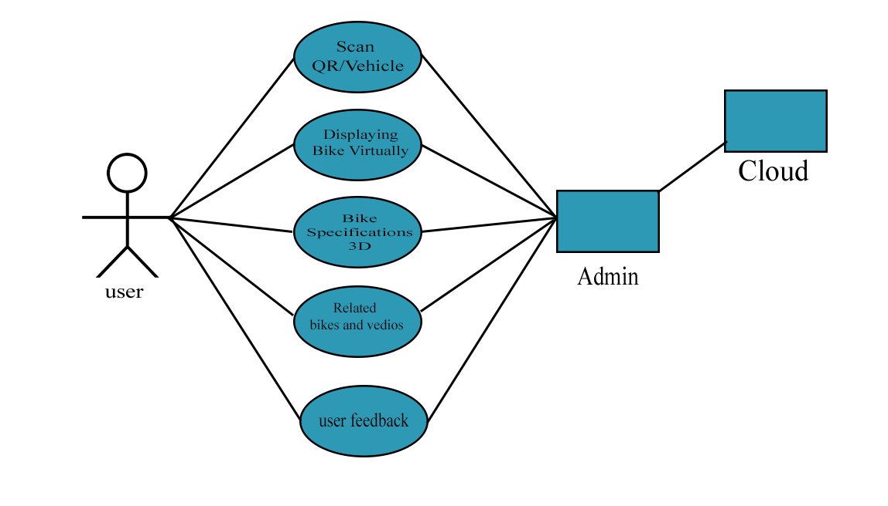
Use case :
Show dependency:
1. Network connectivity is needed.
Show stoppers:
1.Mobile rear cam should be enabled.
2.Availability of lighting.

