Slide 1
PATENT APPLICATION
Smart Insole System for Early Detection of Diabetic Foot Ulcer
Using IoT and Machine Learning
Applicants: Jaya Prasad P
Inventors: Jaya Prasad P, Sanjay , Gunaseelan B, Danush N

Slide 2
Patent Abstract
This invention proposes a smart insole system for continuous monitoring of plantar pressure, temperature, and moisture levels using embedded sensors.
Data is transmitted via an IoT-enabled microcontroller to a cloud platform where machine learning algorithms analyze abnormal patterns, providing early warnings for diabetic foot ulcer risk.
The solution is cost-effective, wearable, and suitable for continuous real-time monitoring, enabling timely medical intervention.

Slide 3
Prior Art: Existing vs. Proposed Systems
Existing System
Proposed System
Periodic clinical examination
Pressure mats and lab-based systems
Lack of continuous monitoring
No real-time alerts
Limited portability
Wearable smart insole
Continuous real-time monitoring
Multi-parameter sensing
Machine learning-based risk detection
IoT connectivity with alerts

Slide 4
Beneficiaries & Cost Advantage
Beneficiaries
Cost Advantage
Diabetic patients
Hospitals and clinics
Elderly individuals
Home healthcare providers
Low-cost components
Portable and reusable
Reduces hospital visits
Prevents expensive surgeries

Slide 5
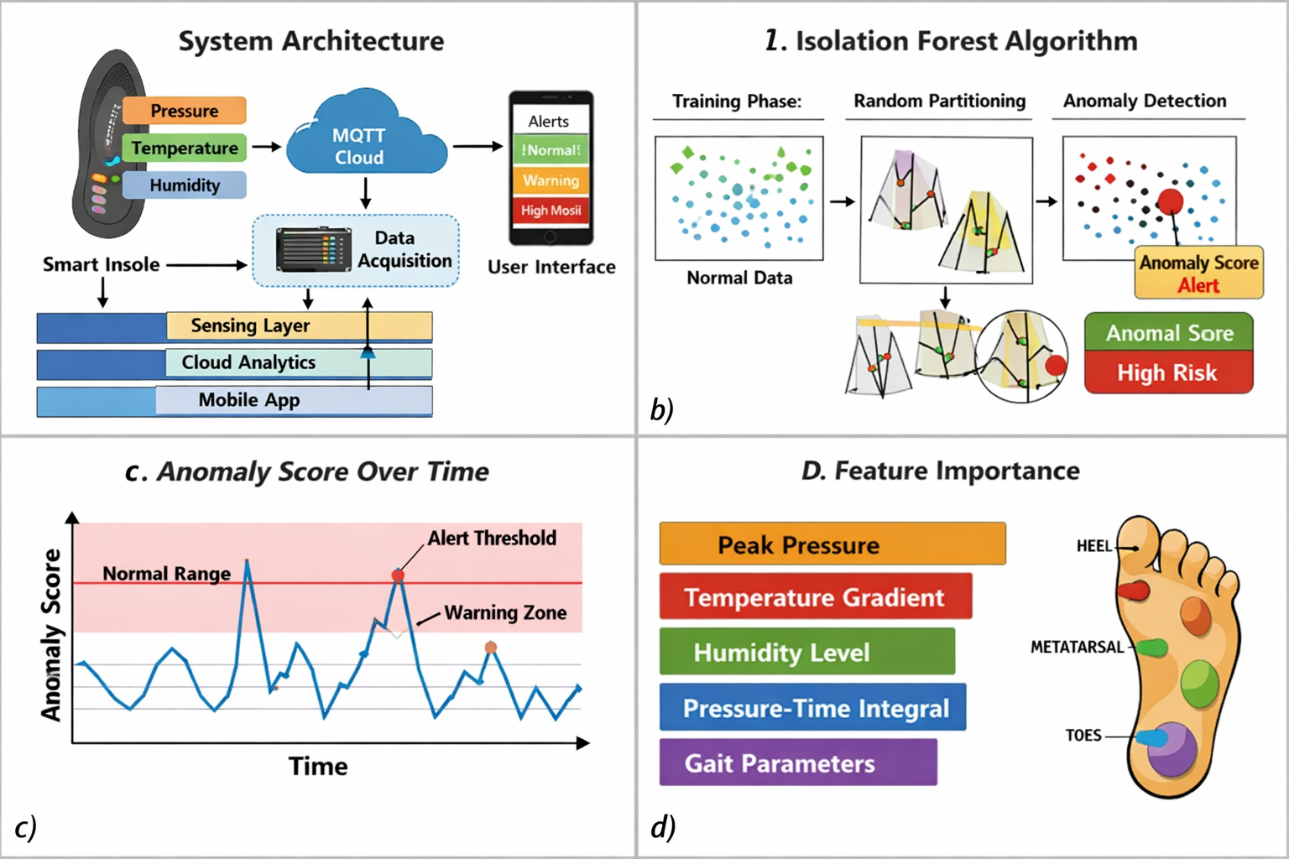
System Block Diagram
Sensors
ESP32
IoT Cloud
ML & Alerts

Slide 6
Key Patent Claims
Claim 1
Claim 2
Smart insole integrating pressure, temperature, and humidity sensors.
IoT-based communication module for real-time data transmission.
Claim 3
Claim 4
Machine learning model for anomaly detection of ulcer risk.
Wearable design embedded within a standard shoe insole.

Slide 7
Additional Patent Claims
Claim 5
Claim 6
Mobile or web interface for monitoring and alerts.
Low-power system suitable for daily use.
Claim 7
Claim 8
Personalized baseline learning mechanism.
Early warning alert system for medical intervention.

Slide 8
References
A. J. M. Boulton et al., “The global burden of diabetic foot disease,” The Lancet, 2005.
D. G. Armstrong and L. A. Lavery, “Diabetic foot ulcers: Prevention, diagnosis and classification,” American Family Physician, 1998.
B. Ali et al., “Graphene-Based Smart Insole Sensor for Pedobarometry and Gait Analysis,” IEEE Sensors Letters, 2023.
H. R. K. M. Emani et al., “Smart Insole: A Wireless Gait Monitoring and Pressure Distribution Device,” IEEE Conference, 2023.
J. Gao et al., “Stand-Alone Soft 3-Axis Force Sensing Array in a Shoe,” IEEE Sensors Conference, 2023.
S. Patel et al., “Wearable Sensors in Rehabilitation,” Journal of NeuroEngineering and Rehabilitation, 2012.
F. T. Liu et al., “Isolation Forest,” IEEE ICDM, 2008.
A. Zanella et al., “Internet of Things for Smart Cities,” IEEE Internet of Things Journal, 2014.

Slide 9
Thank You

