Slide 1
Design and Verification Environment to verify ARM based AMBA AHB-Lite Protocol
ECE 571 – Introduction to SystemVerilog, Winter 2018
Kirtan Mehta
Mohammad Suheb Zameer
Raveena Khandelwal
Sai Tawale

Slide 2
Contribution of each team member
Design – Kirtan, Mohammad
Debugging – Kirtan, Mohammad
Implicit Testbench – Kirtan, Mohammad, Raveena, Sai
Verification Environment – Kirtan, Mohammad
Emulation – Raveena, Sai
Report – Raveena, Sai

Slide 3
Introduction
Proposed Project
Design a synthesizable DUT which includes the design of one master and one slave
Check the basic functionality of the AHB-Lite DUT
SV Verification Environment
Debugging
Emulation in TBx mode

Slide 4
Introduction
Targets Achieved
Designed the protocol for one Master and one Slave.
Made a basic Testbench to test the functionalities of the DUT.
Designed the Environment based on the concept of classes.
Debugging
Emulation in TBx mode

Slide 5
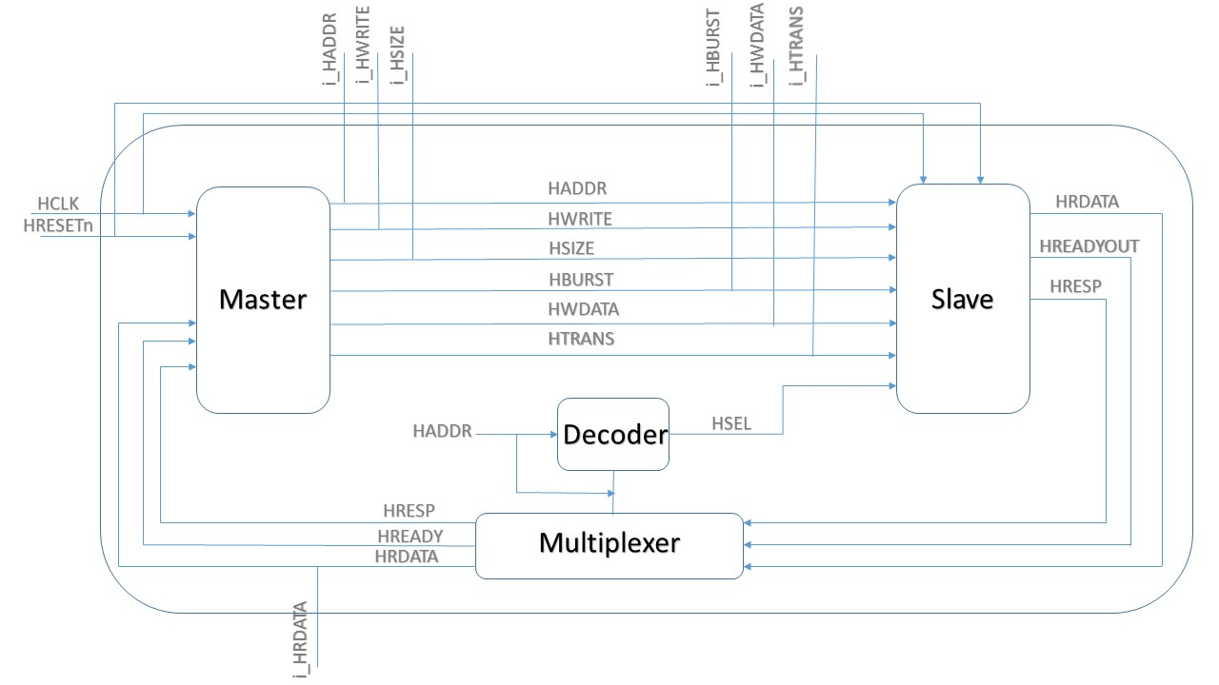
Overview of the design

Slide 6
Verification
Questasim – Normal testing and debugging Using QuestaSim
Verification using Environment in QuestaSim- A SystemVerilog Class based Constraint Random Verification environment build to verify the functionality of the design.
Veloce – Emulation (TBX)

Slide 7
Verification Strategy
Development of implicit test cases and integrate them with DUT in the top module.
Development of the Verification Environment using classes.
Development of packet and generator class based on stimulus plan.
Developing a scoreboard where assertions and checkers are included and the design is tested.

Slide 8
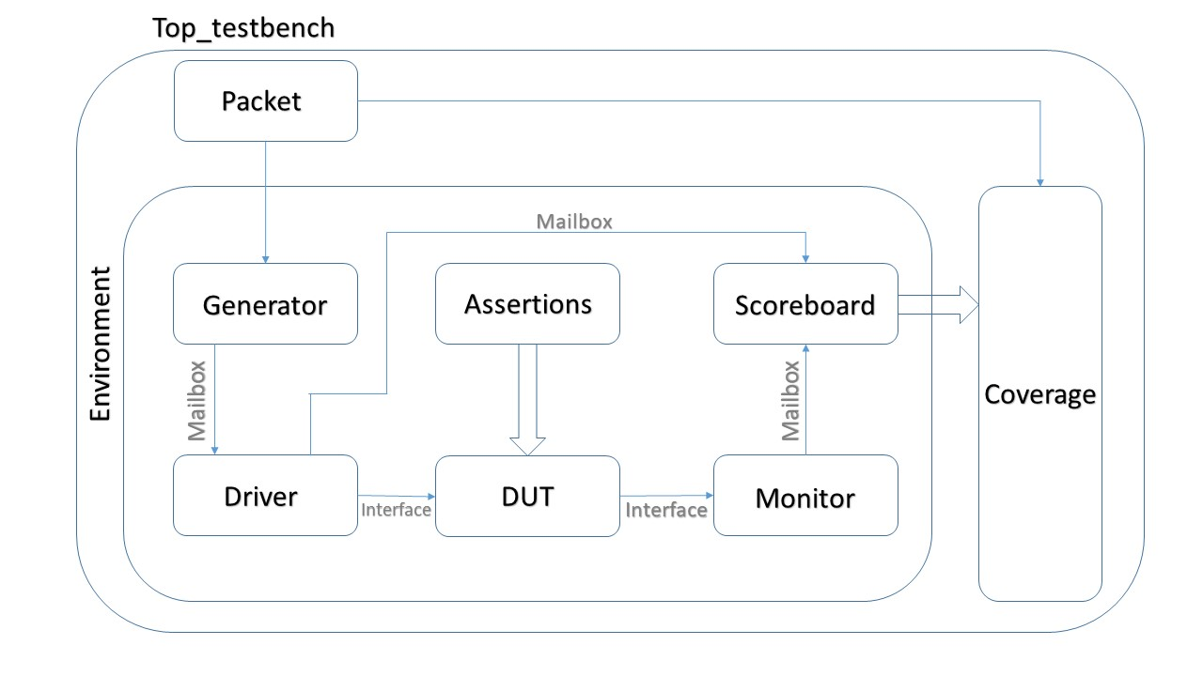
Overview of Verification Environment

Slide 9
Testcases
Write data into memory where random with some constraints and corner cases of address where present.
Data is randomized.
Read from the same location and check the scoreboard for successful data read.
Do the same with burst mode and verify the results.

Slide 10
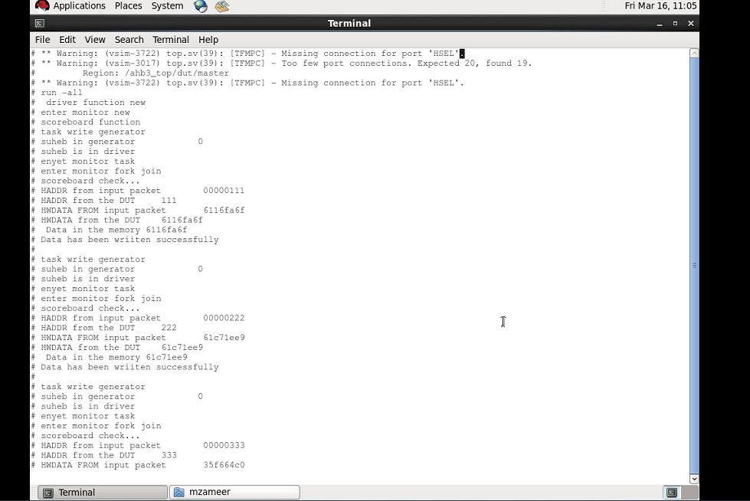
Simulation based verification results

Slide 11
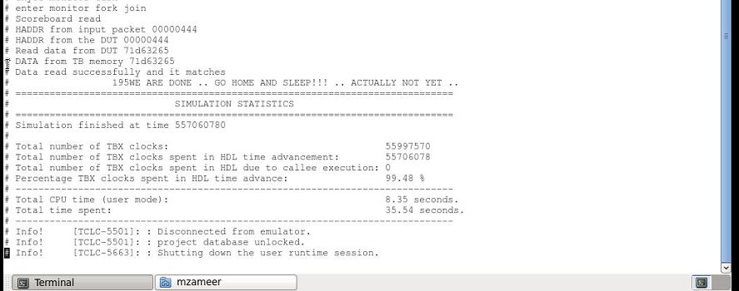
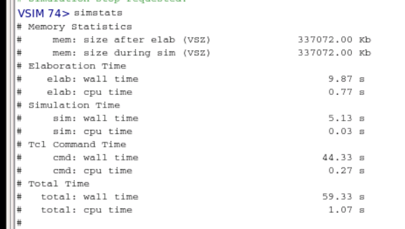
Simulation Vs. Emulation Statistics
SIMULATION (PureSim) | EMULATION (TBx)

Slide 12
Future scope of the project
This code is parameterized to include more slaves in the future.
We can also implement multiple masters and various data signals to send/read data to/from slaves.
More test cases can be included to implement corner cases, checkers and Assertions.
Can implement vacuous pass and fake pass.
Optimization and reusability

Slide 13
Challenges faced
DESIGN | VERIFICATION | EMULATION
Designing DUT from scratch | Designing class based verification Synchronization/Timing issue Major time was consumed in debugging | Synthesizable testbench Deadloops, latches faced Had to improvise design accordingly

Slide 14
Q & A
Thank you

