Slide 1


SMART INDIA HACKATHON 2024
TITLE PAGE
Problem Statement ID –1647
Problem Statement Title- Development of AI-ML based models
for predicting prices of agri-horticultural commodities such
as pulses and vegetable (onion, potato, onion)
Theme- Agriculture, FoodTech & Rural Development
PS Category- Software
Team ID-
Team Name (Registered on portal): ML Forge

Slide 2
Enhanced AI for Agri-Commodity Pricing
ML Forge
Solutions: A web-based application that predicts future price trends using forecasting AI-ML models.
Data Collection: Gathering historical, seasonal, and crop data, along with market intelligence, from websites through APIs and web scraping processes.
Model Creation: Combining data and developing forecasting models to predict future price trends.
Unique Features :
Future Price Predictions: Offers forecasts up to 60 days ahead
Transparent Supply Chain: Enhances visibility and transparency in the supply chain.
Error Identification: Allows users to easily report discrepancies in predictions.
Chatbot Service: Allows users to easily obtain information by submitting queries.
Timely Purchase Alerts: Suggests users on the best times to buy, benefiting them with better prices and helping the organization with improved buffer management.

Slide 3
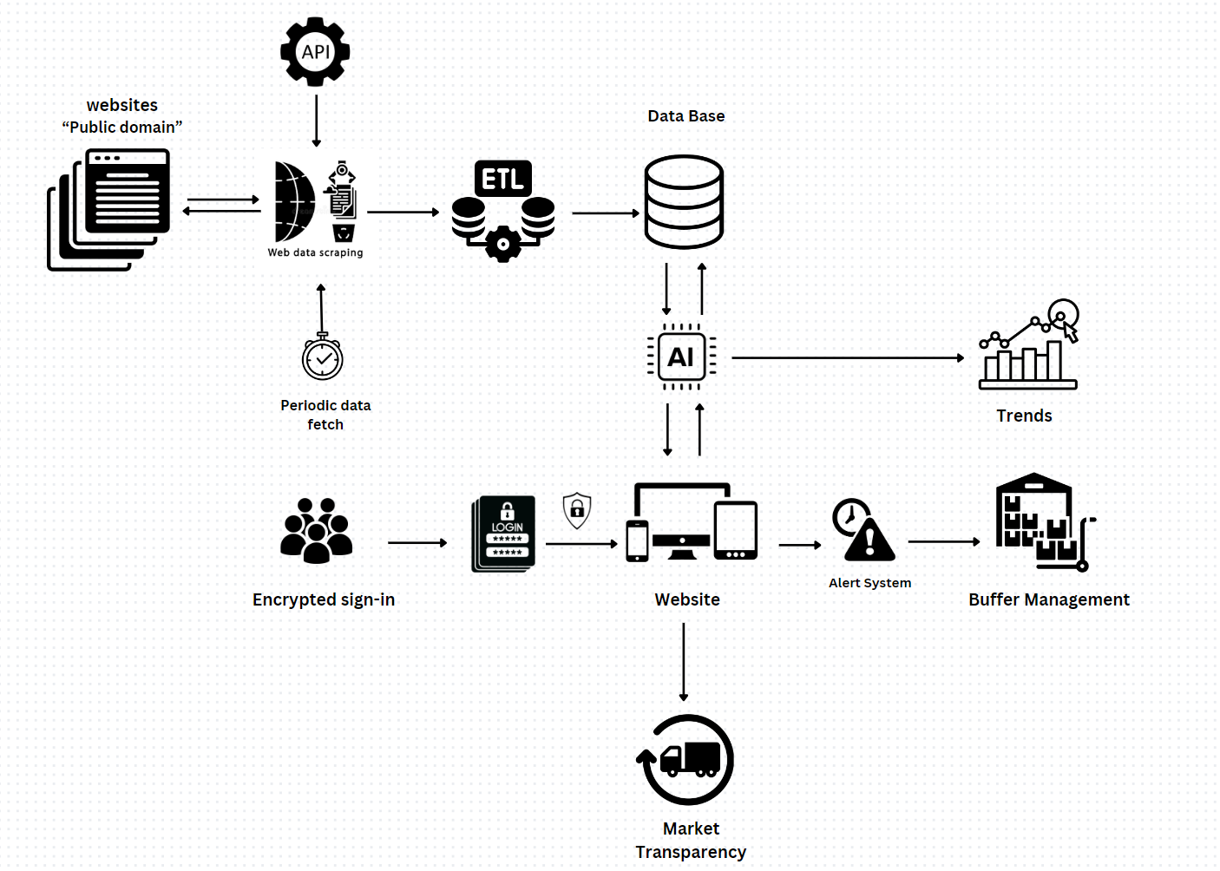
TECHNICAL APPROACH
ML Forge
Model: LSTM for predicting commodities prices.
Framework: Django for managing the backend, handling authentication, and creating a secure user interface.
Scraping: Scrapy, Selenium and BeautifulSoup for crawling and scraping data from source websites.
Database: RDBMS (PostgreSQL) for storing structured products and services cost data. Non-Relational database (MongoDB) for handling unstructured data.
Visualization: Plotly for generating interactive charts and visualizations on the dashboard.

Slide 4
FEASIBILITY AND VIABILITY
ML Forge
Feasibility
Data Availability : Historical price, weather, and crop data are accessible from government sources, APMC, and research institutions.
Technology : AI-ML models like LSTM and regression are well-suited for time series forecasting.
Scalability: The solution can be scaled to cover different regions and commodities with minimal adjustments to the model.
Viability
Economic Impact : Reduces volatility, helping farmers plan better, and stabilizing food prices for consumers.
Sustainability: Ongoing updates to the model with real-time data ensure continuous relevance and accuracy in predictions.
Cost Efficiency : Once the model is developed, maintaining and scaling it involves minimal costs.
Challenges
Solutions
Government interventions like sudden subsidies, import/export restrictions, or policy changes can disrupt predictions.
Continuously update the model with real-time policy announcements and market interventions. Collaborate with policymakers to gain early insights into potential changes.
Market Fluctuations: Sudden market disruptions (e.g., weather events, policy changes) can lead to unpredictable price variations..
Incorporate real-time market intelligence and weather data into models to adjust predictions dynamically.

Slide 5
IMPACT AND BENEFITS
ML Forge
Impacts
Impact on target audience
Benefits
Price Stability: Reduces price volatility for essential commodities.
Supply Chain Efficiency: Optimizes agricultural supply chain and reduces wastage.
Increased Farmer Income: Helps farmers sell at optimal times, improving profitability.
Informed Decisions: Enables government, farmers, and market players to make data-driven choices.
Farmers:Better crop planning and selling strategies.
Government Agencies: Data-driven policy making and buffer stock management.
Retailers: Improved inventory and sales planning.
Consumers: More stable and predictable food prices.
Market Efficiency: Enhances transparency and reduces uncertainty.
Better Agricultural Planning: Helps governments manage supply-demand more effectively.
Consumer Protection: Shields consumers from price spikes.
Food Security: Ensures stable availability of essential commodities..

Slide 6
RESEARCH AND REFERENCES
ML Forge
LSTM : https://en.wikipedia.org/wiki/Long_short-term_memory
Government report :https://nfsm.gov.in/

