Slide 1


SMART INDIA HACKATHON 2024
TITLE PAGE
Problem Statement ID – SIH1682
Problem Statement Title- Centralized Automated Solution for
Price Estimation & Reasonability.
Theme- Smart Automation
PS Category- Software
Team ID- 13125
Team Name (Registered on portal): ML Forge

Slide 2
AI COST ESTIMATOR
ML Forge
Solution: A centralized web application that aggregates products/services from different publicly available sources, estimates the approximate price of certain products/services Machine Learning.
Enhanced search engine that displays results from multiple sources.
Provides products/services names, prices, and hyperlinks to the source websites.
Search queries can be specific make/model, specifications of the products and services.
Estimates the prices of certain products/services using AI.
Unique Features
Total Cost Estimation: Estimates the total cost of the project based on user inputs.
Price Filter: Users can filter products based on price, model, vendor reliability, and product specifications to fine-tune their search.
Expense Dashboard: An interactive expense dashboard provides a breakdown of costs by category, with options to export or save the data for further analysis.

Slide 3
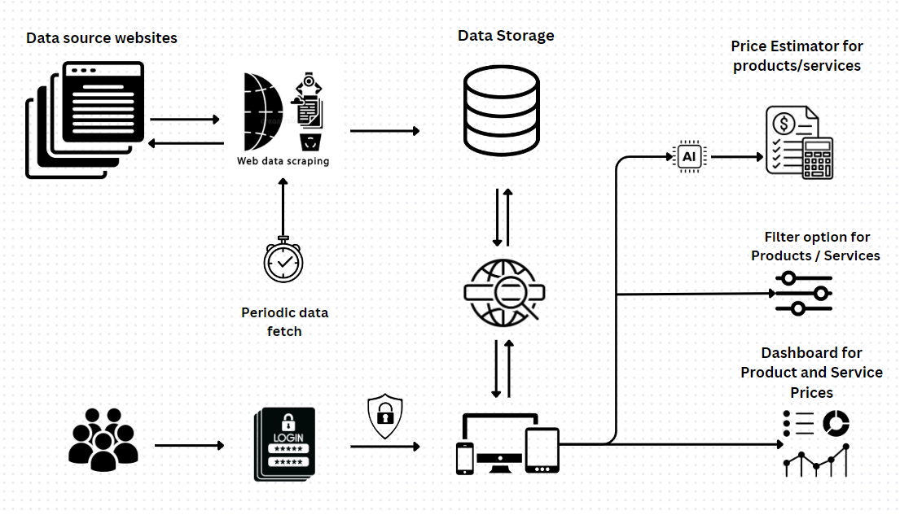
TECHNICAL APPROACH
ML Forge
Search Engine: Elasticsearch for indexing, querying, and managing search results efficiently.
Model: BERT for processing natural language queries related to product
descriptions. XGboost algorithm for estimating the total projects cost.
Framework: Django for managing the backend, handling authentication, and creating a secure user interface.
Scraping: Scrapy, Selenium and Beautiful Soup for crawling and scraping data.
Database: RDBMS (PostgreSQL) for structured products and services data. Non-Relational database (MongoDB) for handling unstructured data.
Visualization: Plotly for generating interactive charts and visualizations on the dashboard.
Project status: 10% of the project is completed.

Slide 4
FEASIBILITY AND VIABILITY
ML Forge
Feasibility
Technical : Uses open source proven technologies like web scraping, BERT models, and Django.
Operational : Automated data extraction and cost estimation reduces manual work.
Unique Market Opportunity: No single platform currently offers a comprehensive project cost estimator.
Viability
Government and B2B Market: There’s a clear market need for procurement tools that reduce manual work and increase price transparency.
Growth Potential: As more data is scraped and indexed, the system will become increasingly valuable due to the richness of the data.
Challenges
Solutions
Legal Issues with Web Scraping: Web scraping from websites may violate their terms and services when commercializing the project.
Obtain legal permission from websites before scraping the data and using Data APIs .
Unavailable Products: Users may input products or services not available on any website, leading to incomplete cost estimates.
If a product is not available, The user can contact vendors to get the products/ services details and information is stored in our data base.

Slide 5
IMPACT AND BENEFITS
ML Forge
Enhanced Decision-Making: Vendors and users gain accurate and comprehensive cost estimates, leading to better financial decisions.
Automation: Automation of data extraction and cost estimation reduces manual effort.
Increased Transparency: Clear view of prices across multiple platforms.
Project Cost Estimation: Users can estimate the total project cost by selecting the products and services, reducing the time spent on manual estimation and searching.

Slide 6
RESEARCH AND REFERENCES
ML Forge
Government e-market place: https://gem.gov.in/
Bert model documentation : https://huggingface.co/docs/transformers/en/model_doc/bert
Elastic search : https://www.elastic.co/guide/en/elasticsearch/reference/current/search- application-overview.html

