Slide 1
Programming in Scilab
Plotting

Slide 2
What is Plotting in Scilab ?
A graphical technique for representing a data set, usually as a graph showing the relationship between two or more variables.
The purpose is to present data that are too numerous or complicated ,adequately in a lesser space to visually illustrate relationships in the data.

Slide 3
Types of plot in scilab
2D Plotting
Special Plots
2D Animation
Plotting Multiple Plots in the Same Graph
3D Plots

Slide 4
Important key words to remember
clear:- removes items from the workspace and frees memory
clc:- cleans the Console; the echo signal is mainly erased
xdel(winsid()):-Close all graphic windows
linspace():- linearly spaced vector. linspace(x1,x2,n) generates a row vector of n linearly equally spaced points between x1 and x2.
title:- displays a title above a graphic axes.

Slide 5
Important key words to remember(cont….)
xlabel:- sets or updates the x-axis label or/and its properties
ylabel:- sets or updates the y-axis label or/and its properties
zlabel:- sets or updates the z-axis label or/and its properties
GlobalProperty:- is an optional argument that can be used inside a plot command. It allows a global customization of all the new plotted lines (respectively surfaces). It has to be given as a {‘colour’, ‘red’ } pair.
axes_handle:- This optional argument forces the plot to appear inside the selected axes given by axes_handle rather than the current axes .
Xgrid:- add a grid on a 2D or 3D plot.

Slide 6
2D Plotting
plot(x,y)
plot2d( )
plot2d2( )
plot2d3( )
plot2d4( )

Slide 7
plot(x,y)
Calling Sequence
plot(x,y,< LineSpecifications >,< GlobalSpecifications >)
x – vector or matrix containing real numbers y – vector or matrix containing real numbers LineSpecifications – string variable used to specify line properties like: style, color and marker type GlobalSpecifications – string variables used to specify figure properties

Slide 8
Example
Let’s define a variable X as the angle from 0 to 2π with an increment of 0.01, and two functions Y and Z as:
Y=𝑠𝑖𝑛(X), Z=𝑐𝑜𝑠(X)
Create the line plot corresponding to this.

Slide 9
plot2d(), plot2d2(), plot2d3() and plot2d4()
plot2d command works similarly to the plot command.
plot2d2 same as plot2d, but the curve is supposed to be piecewise constant
plot2d3 same as plot2d, but the curve is plotted with vertical bars
plot2d4 same as plot2d, but the curve is plotted with arrows

Slide 10
polar plot
During mathematical analysis, polar coordinates become important in cases that do not exhibit symmetry in Cartesian systems, but that show symmetry in polar coordinates.
In these cases, we prefer to plot in polar coordinates rather than Cartesian coordinates.
Here, instead of x, y our coordinates are r, θ, which are related by equations, as shown
x = r × cos(θ)
y = r × sin(θ)

Slide 11
Special Plots
Histograms
Histograms are traditionally used to visualize the number of events occurring within different ranges.
Scilab provides a useful function, histplot(), for this purpose that takes input for the number of bins and data provided as an array.
Bins:- int or sequence of scalars or str.

Slide 12
Special Plots (Cont….)
Matplot
To plot colours representing certain values, the matplot command is used.
Grayplot
Sometimes, we need to see the value of a two-dimensional function on a 2D plot.
This is done by visualizing the components of the functional value z on x and y coordinates.
grayplot plots a graph window for a 2D plot of the surface given by z on a grid defined by x and y.
Each rectangle on the grid is filled with a grey or colour level depending on the average value of z on the corners of the rectangle.

Slide 13
Special Plots (Cont….)
Champ
Scientific and engineering studies employ the theoretical study of vector fields.
To plot vector fields as per a given equation champ is used .
It draws a 2D vector field described by arrows.
The length of the arrows is proportional to the intensity of the field.

Slide 14
Special Plots (Cont….)
Contour Maps
Contour maps are frequently used to visualize the projection of a function on a 2D surface.
They are used in various branches of science and engineering, especially geophysics where information of measurement parameters like temperature, pressure, and humidity is projected onto a map.
In addition, contour maps are also used to visualize the 2D mathematical projection on a plane.

Slide 15
2D Animation
During simulation, it is sometimes useful to animate an equation to understand its evolution. Animations are found to be particularly useful for teaching concepts to students.
comet
The comet() function is a 2D animation tool used to animate. Let us animate the equation x^5 − x^3 + x +5.
paramfplot2d()
Time evolution of a function at multiple points can be represented by the paramfplot2d() function.
Let’s consider the evolution of the function y = sin(x) + sin(2x) + sin(4x) (mixing of a signal with double and four times its own frequency).
The resulting signal is the complex waves combining these three primary waves (sin(x), sin(2x), and sin(4x))

Slide 16
Plotting Multiple Plots
Plotting Multiple Plots in the Same Graph
Multiple plots can be plotted within the same figure by simply supplying x-axis and y- axis
vectors.
Plotting Multiple Plots Separately
The subplot(row, column, index) command is used to plot multiple plots within the same figure
separately.

Slide 17
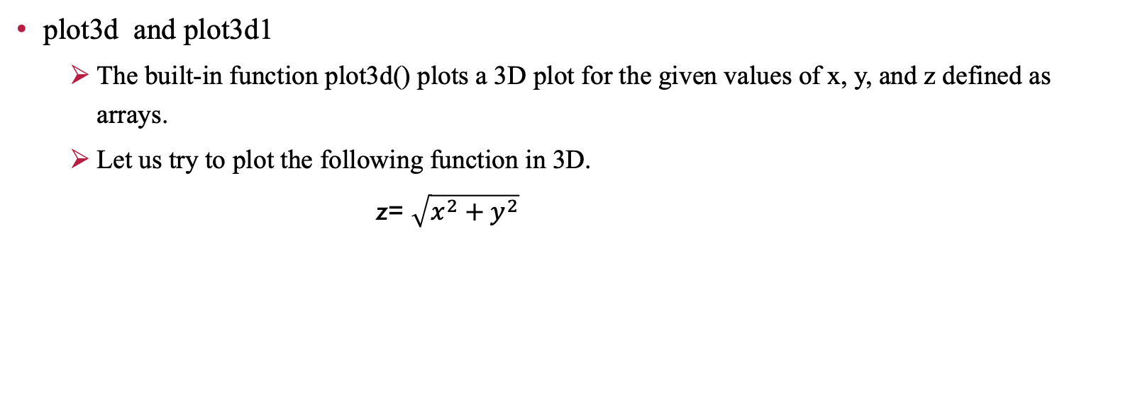
3D Plots
plot3d and plot3d1
The built-in function plot3d() plots a 3D plot for the given values of x, y, and z defined as arrays.
Let us try to plot the following function in 3D.
z= $\sqrt{x^{2}+y^{2}}$

Slide 18
Signal processing using Scilab
GENERATION OF CONTINUOUS SIGNALS
sinewave
cosine wave
triangular wave
signum function
sinc function
Exponential wave

Slide 19
GENERATION OF DISCRETE SIGNALS
unit impulse signal
Unit step signal
discrete exponential wave
unit ramp

Slide 20
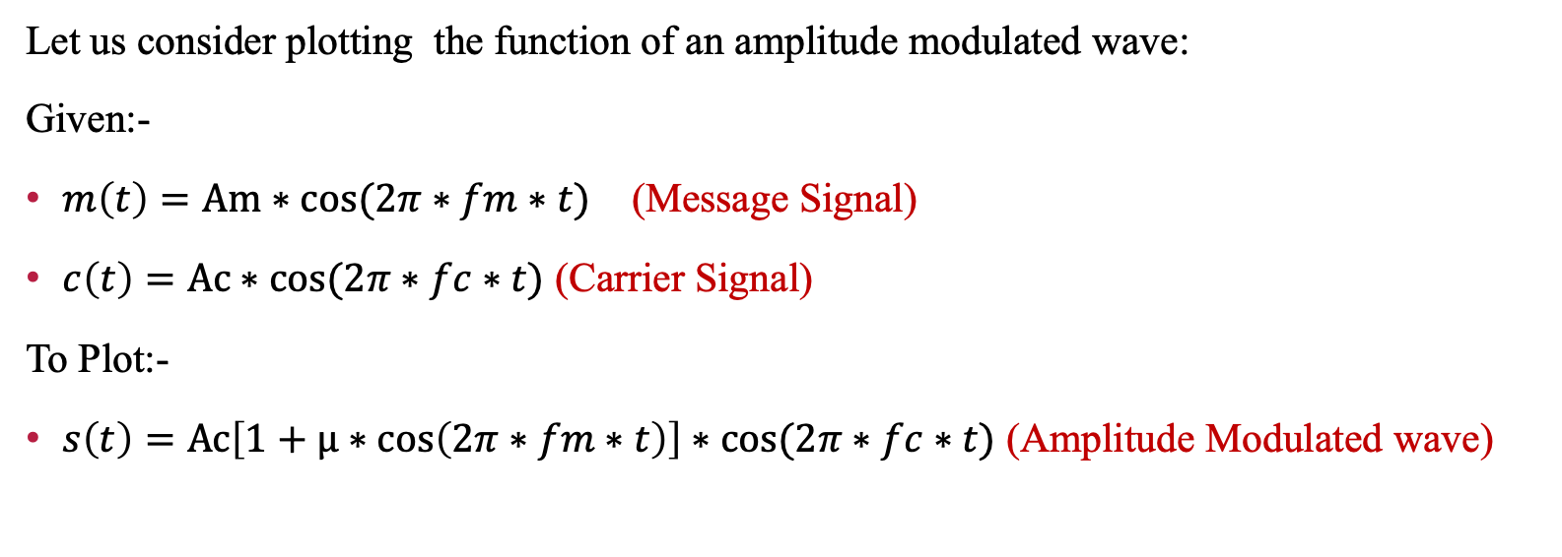
Amplitude modulation

Slide 21
Arduino for real-time Data Acquisition
Arduino is an 8 bit microcontroller development board used for building hobby projects .
For simple data acquisition in real time, Arduino represents an affordable and accessible platform.
One can easily link the sensors to the analog and digital I/O pin of arduino and can read the incoming data in real time by building an Xcos simulation model .
This can be made possible by first downloading the Arduino toolbox and the Serial communication toolbox on ATOMS.

Slide 22
Interface Examples
Interfacing a Light Dependent Resistor
Interfacing a temperature sensor LM35

Slide 23
Thank you

