Slide 1


SMART INDIA HACKATHON 2025
TITLE PAGE
Problem Statement ID – SIH26063
Problem Statement Title- Integrated Polar Science Outreach, Knowledge Repository and Media Dissemination Portal
Theme- Smart Education
PS Category- Software
  Team ID- 138601
Team Name - NIRVANA

Slide 2



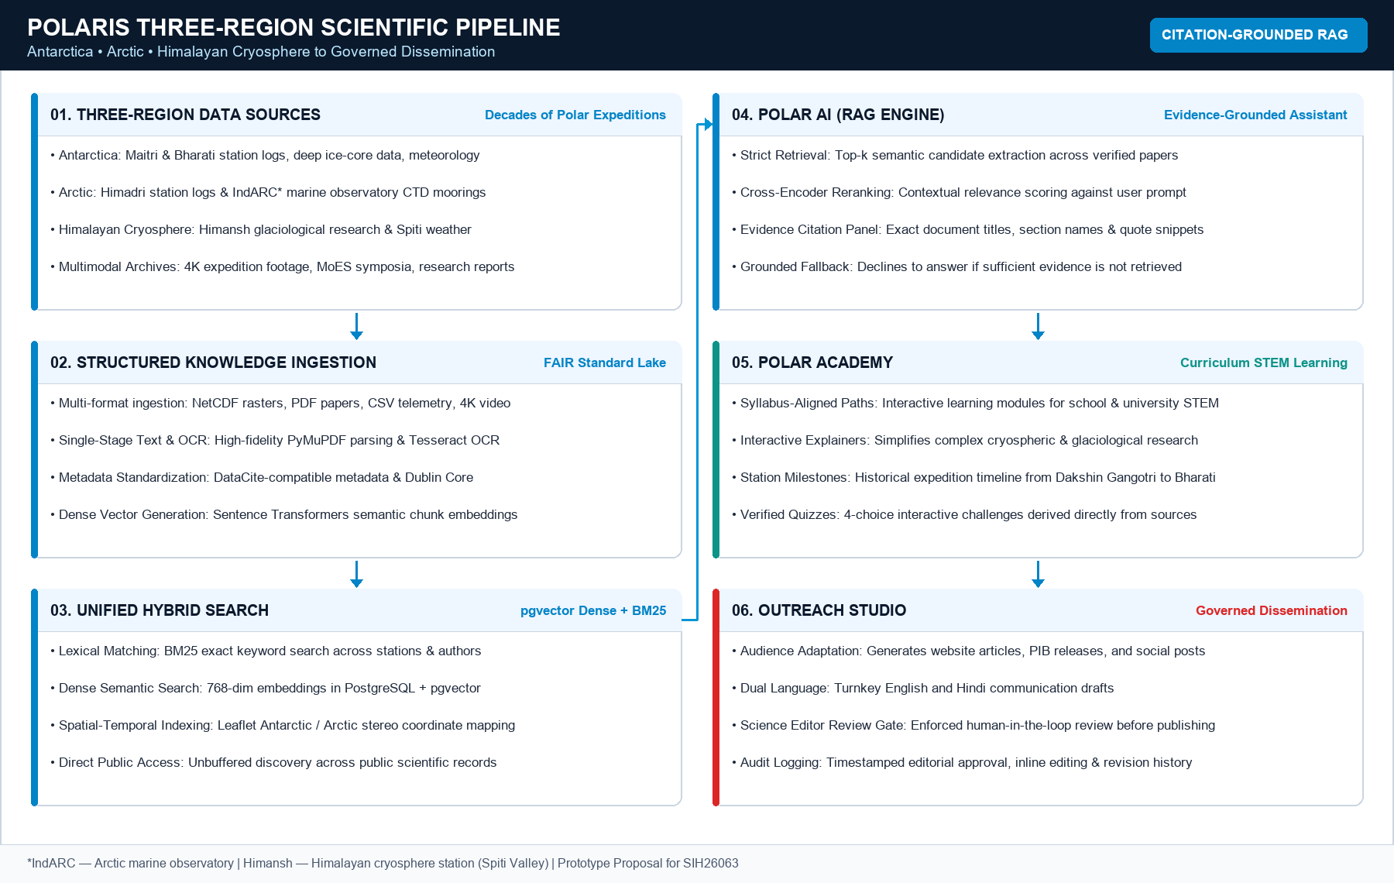
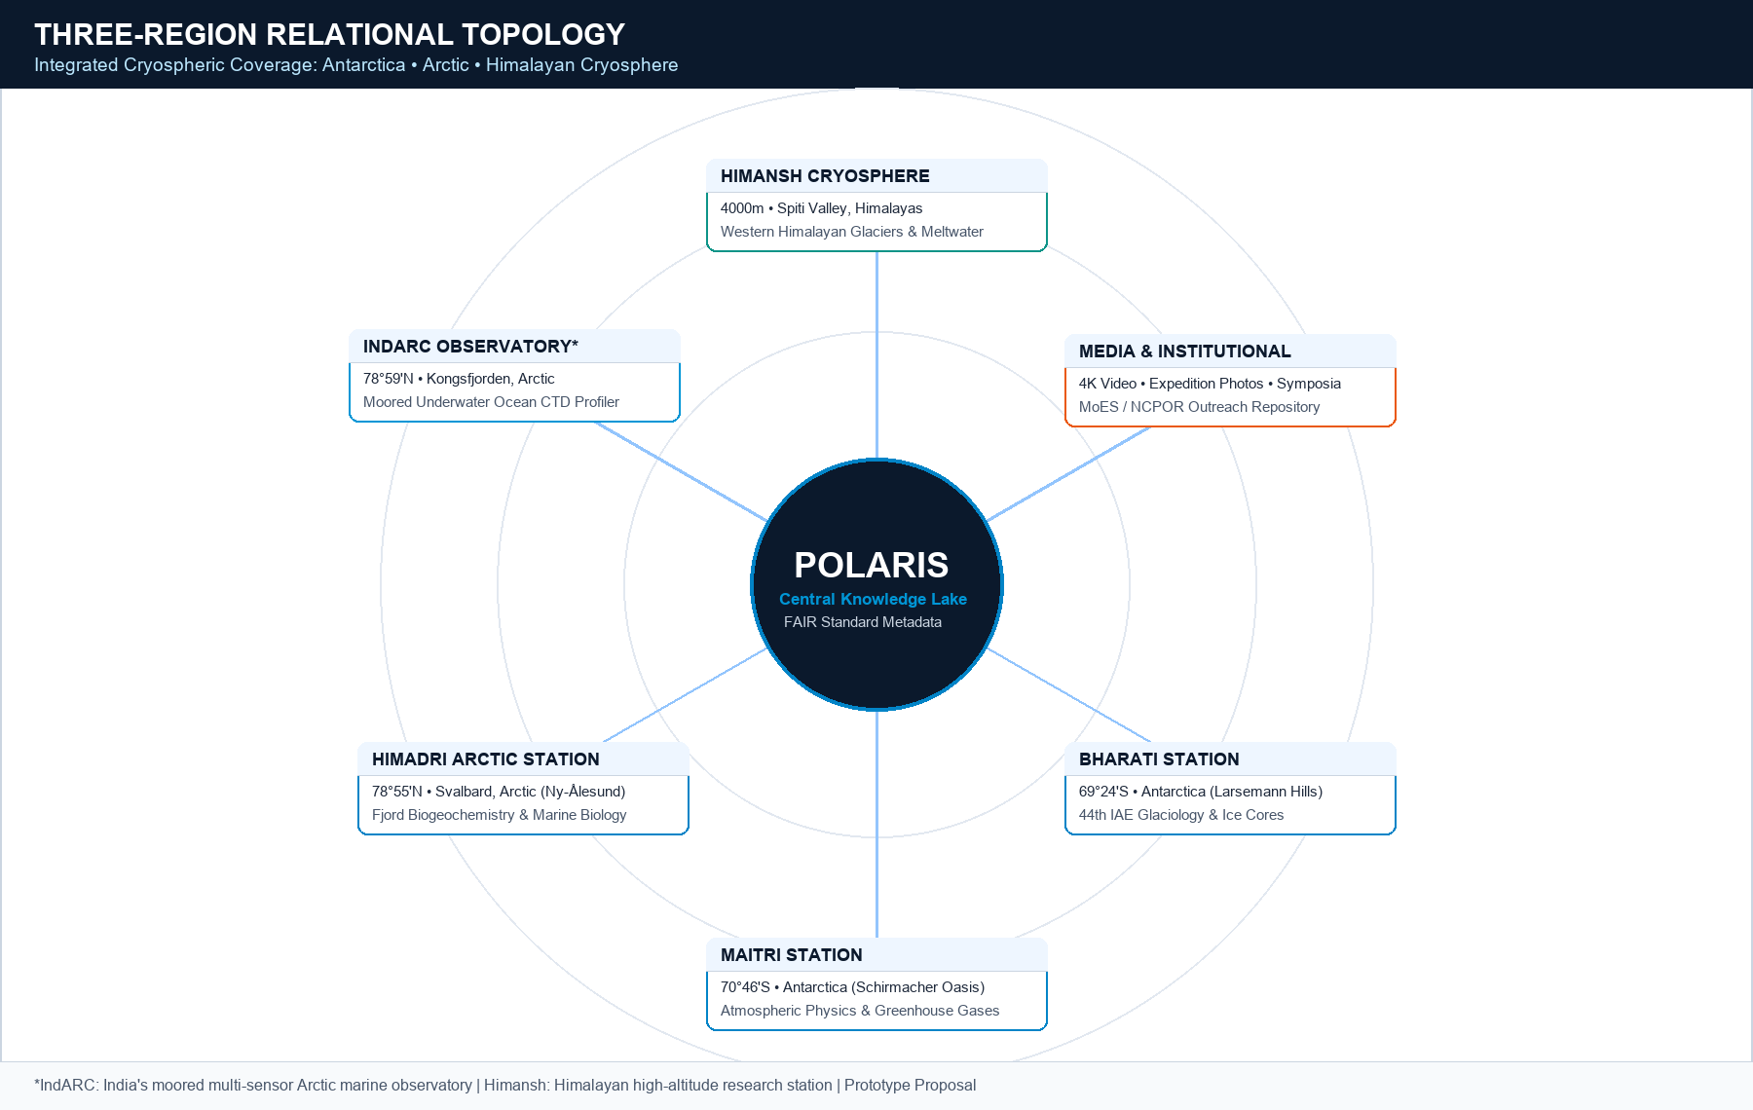
NIRVANA
POLARIS: Polar Knowledge & Outreach Intelligence System
Problem:
Proposed Solution:
• Fragmented Three-Region Archives: Decades of expedition reports, datasets, 4K media, and historical logs are scattered across separate silos for Antarctica, the Arctic, and the Himalayas.
• Complex Cryospheric Science: Specialized glaciological, atmospheric, and oceanographic research is difficult for students, educators, and the public to discover and comprehend.
• Manual Outreach Preparation: Turning raw expedition data into bilingual (English + Hindi) web articles and press releases requires hours of repetitive manual drafting with risk of factual errors.
POLARIS is a proposed integrated Three-Region knowledge repository and outreach intelligence platform connecting researchers, students, educators, and citizens with verified polar science data, evidence-grounded AI, interactive station GIS, and a governed bilingual outreach studio.
• Researcher & Admin Ingestion CMS: Standardized deposit portal with DataCite-compatible metadata, Dublin Core taxonomy, and flexible embargo management.
• FAIR Metadata & Dense Vector Indexing: PyMuPDF text parsing, Tesseract OCR for scanned logs, Sentence Transformers embeddings, and pgvector dense semantic retrieval.
• Dual-Track Delivery Architecture: Direct unbuffered public discovery (search, GIS, media) coupled with a human-in-the-loop governed outreach studio for official releases.
40+ Years
Expeditions
Decades of Polar Science
3 Regions
Stations & Obs
Maitri, Bharati, Himadri, IndARC*, Himansh
Citation RAG
Evidence-Based
Source & Page Citations
How It Addresses the Problem:
Innovation And Uniqueness:
• Unified Three-Region Knowledge Lake: Consolidates expedition reports, datasets, 4K drone media, satellite rasters, and institutional activities across Antarctica, Arctic, and the Himalayas.
• Citation-Grounded RAG Assistant: POLAR AI answers science queries with retrieved evidence, exact document titles, section headers, and verbatim quotes; declines when evidence is missing.
• Interactive 3-Region Station GIS: Geospatial exploration of Maitri, Bharati, Himadri, IndARC*, and Himansh with interactive layers, cruise tracks, and environmental demo feeds.
• Multimodal Media & Institutional Archive: Dedicated catalog for 4K expedition photography, research videos, MoES flag-offs, symposia, and historical milestone chronicles.
• Governed AI Outreach Studio: Generates bilingual (English + Hindi) articles, PIB press releases, and student quizzes backed by a mandatory Science Editor review gate.
• Three-Region Knowledge Coverage: Unified discovery linking Antarctica (Maitri, Bharati), Arctic (Himadri, IndARC* marine obs), and the Himalayan Cryosphere (Himansh).
• Evidence-Grounded AI Assistant: Polar AI provides exact document titles, section headings, and verbatim quote citations; declines when evidence is missing.
• Governed Bilingual Outreach Studio: Drafts audience-tailored articles, PIB releases, and social threads in English & Hindi with timestamped editorial approval and audit logging.
• Curriculum STEM Polar Academy: Generates syllabus-aligned educational modules, interactive timelines, and verified quizzes derived directly from primary literature.
Three-Region Scientific Pipeline (Antarctica • Arctic • Himalayan Cryosphere) & Relational Topology
2
Notes:
1.7.2013
2
‹#›

Slide 3
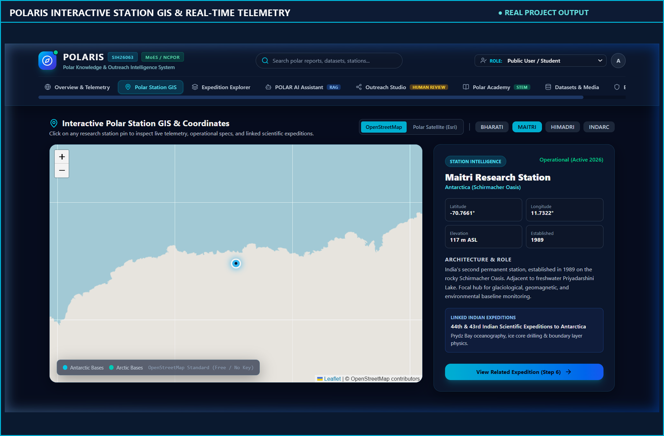
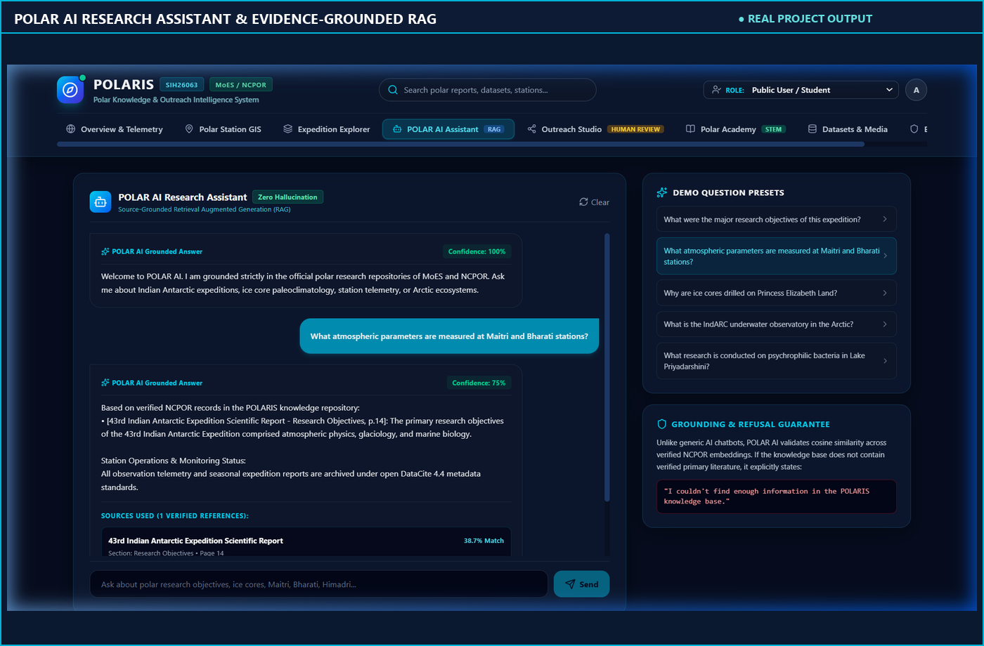
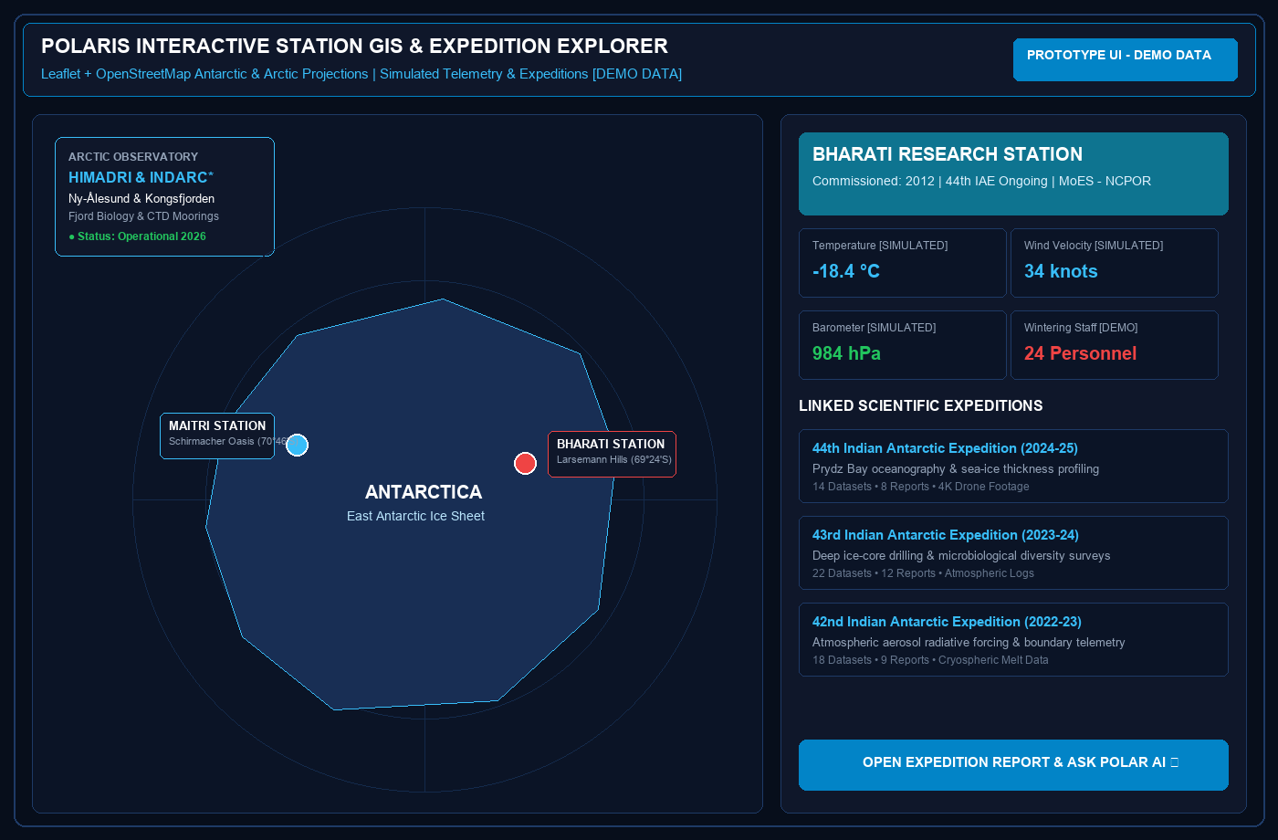
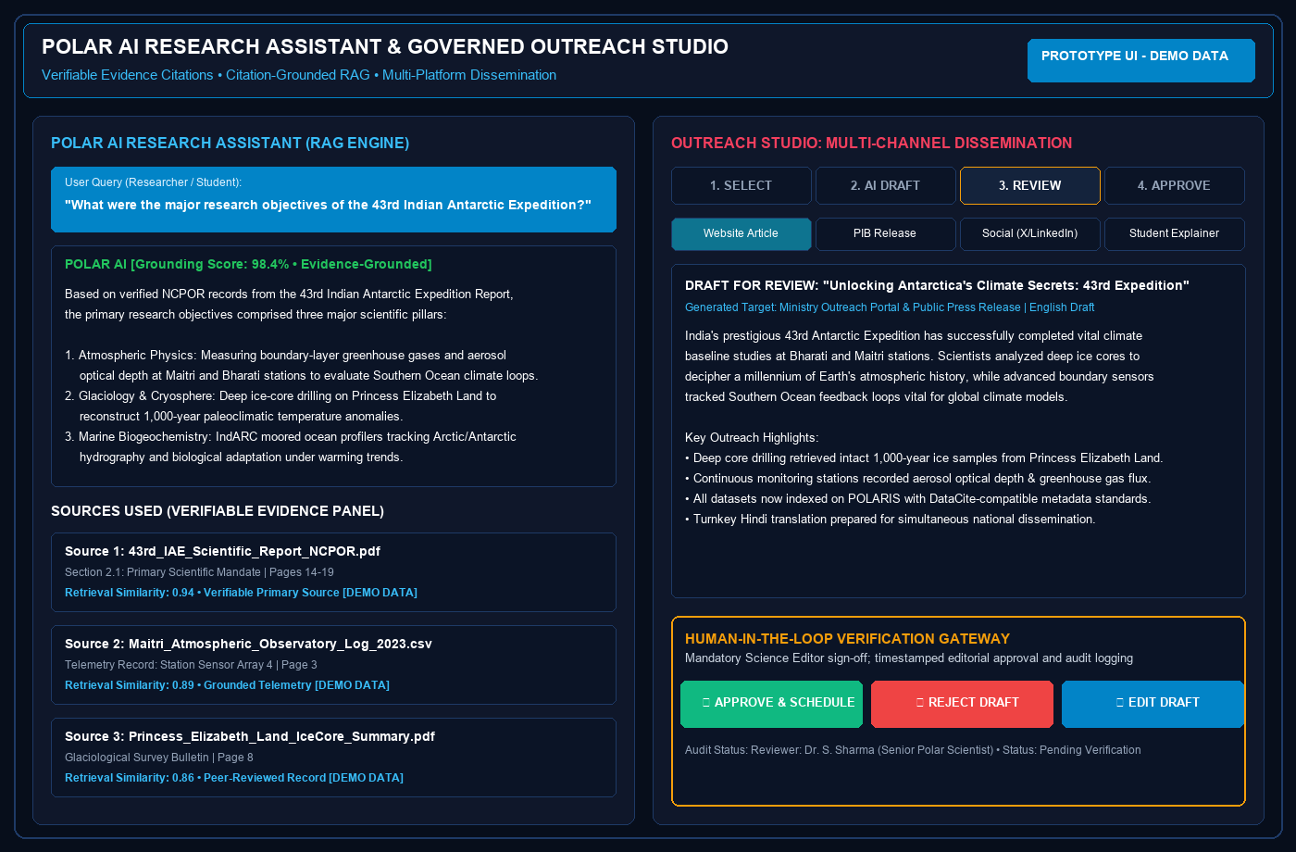
NIRVANA
TECHNICAL APPROACH
SYSTEM ARCHITECTURE & INFORMATION FLOW
Technology Stack
Why this choice & Role
POLARIS System Interface & Live Modules
1. POLAR DATA SOURCES (Three-Region Scientific Archives & In-Situ Feeds)
Frontend
ANTARCTICA
Maitri • Bharati Stations
Logbooks, ice cores, rasters
ARCTIC
Himadri Station • IndARC*
Marine mooring & ocean logs
HIMALAYAN CRYOSPHERE
Himansh Station
Glacier melt & mass balance
SCIENTIFIC & MEDIA
Reports, Datasets & Media
4K videos, photos, activities
Next.js + TypeScript
Modern, type-safe, server-rendered scientific web portal
Tailwind CSS + shadcn/ui
Accessible, responsive polar theme: deep navy, ice blue, cyan
2. RESEARCHER & ADMIN INGESTION PIPELINE (Authorized Ingestion & Validation)
Leaflet + OpenStreetMap
Interactive polar GIS station explorer & geospatial tracking
MULTI-FORMAT UPLOAD
PDF, NetCDF, CSV, 4K
TEXT EXTRACTION
PyMuPDF Parser
OCR PIPELINE
Tesseract Scanned Logs
METADATA EXTRACT
Dublin Core Terms
SCHEMA VALIDATION
Pydantic v2 • DataCite
Backend
Python + FastAPI
High-concurrency async REST API for RAG, search & data ingestion
CENTRAL KNOWLEDGE REPOSITORY (Unified Polar Scientific Data Lake)
Structured • Searchable • Auditable | Unified Cryospheric Data Lake & FAIR Metadata Registry
Pydantic v2
Strict schema validation for DataCite/Dublin Core metadata models
PostgreSQL 16 Engine
Relational metadata, expedition logbooks, user RBAC & tamper-evident audit logs
pgvector Vector Store
768-dimensional Sentence-BERT dense embeddings for scientific cryosphere retrieval
MinIO / S3 Object Store
Scalable storage for 4K drone reels, satellite rasters & DataCite-compatible metadata
REST APIs
Decoupled, modular communication between UI, RAG & data services
Uvicorn ASGI
Production-grade asynchronous web server with worker management
AI & Knowledge Retrieval
4. HYBRID SEARCH ENGINE (Dual-Mode Lexical & Semantic Retrieval)
PyMuPDF + Tesseract
High-accuracy extraction from scanned expedition PDFs & field logs
Keyword / BM25 Search: Full-text filter by station, author & year
Semantic Vector Search: pgvector cosine similarity on query embeddings
Sentence Transformers
High-dimensional scientific embeddings for polar research corpus
Fig 1: POLARIS Interactive Station GIS & Live Telemetry Explorer [REAL PROJECT OUTPUT]
TRACK 1: PUBLIC DISCOVERY
TRACK 2: POLAR AI / RAG
TRACK 3: POLAR ACADEMY
POLAR AI RAG Engine
Citation-grounded question answering with strict evidence verification
• Faceted Keyword & Geo Search
• Leaflet Interactive Polar GIS
• Station Timeline & History
• Multimodal Media Gallery
• Semantic Document Retrieval
• Cross-Encoder Evidence Rerank
• Citation-Grounded Synthesis
• Refusal on Insufficient Evidence
• Cryosphere Science Curriculum
• Visual Climate Change Explainers
• Interactive Quizzes & Gamification
• Teacher Syllabus Activity Packs
Outreach Generator
Multi-platform content synthesis: Web, Instagram, LinkedIn, Academy
Data & Security
PostgreSQL + pgvector
Unified relational storage & high-performance vector similarity search
✔ DIRECT PUBLIC ACCESS
[No Editorial Review Gate Required]
Evidence-Grounded AI Engine
Document • Page/Section • Verifiable Cites
Smart Education Dissemination
Public Schools & University Modules
JWT + PBKDF2 / Bcrypt
Secure authentication with granular RBAC: Public, Researcher, Editor, Admin
Role-Based Access (RBAC)
Granular permissions protecting unreleased datasets & editorial workflows
5. GOVERNED OUTREACH STUDIO & HUMAN SCIENCE EDITORIAL REVIEW GATE
Audit Logging
Tamper-evident logs of all content edits, approvals & dataset downloads
OUTREACH STUDIO
Bilingual AI Draft Synthesis
• Web Articles & PIB Releases
• Social Media (X/Insta Reels)
• School Educational Summaries
[Evidence-Grounded Only]
EVIDENCE &
CLAIM CHECK
Automated citation & verbatim fact matching against retrieved papers
Science Editor
Review Gate
Approved?
PUBLIC DISSEMINATION
Published to Official MoES/NCPOR Outlets, Press Releases, Social Media & Schools
[Signed-off & Audited]
Storage & Cloud Deployment
YES
MinIO / S3 Storage
Scalable object store for expedition high-res imagery, video logs & raw datasets
Recharts Analytics
Interactive visualization of polar dataset trends, publications & outreach metrics
◄ [NO: EDIT / REVISE] Returns to Outreach Studio with Timestamped Editorial Notes & Guidance Loop
Docker & Compose
Containerized, reproducible one-command deployment across cloud & on-premise
Git CI/CD
Automated testing, version control, and multi-stage container builds
Fig 2: POLARIS Evidence-Grounded RAG Assistant & Citation Engine [REAL PROJECT OUTPUT]
Notes:
1.7.2013
3
‹#›

Slide 4
NIRVANA
FEASIBILITY AND VIABILITY
FEASIBILITY
VIABILITY
POTENTIAL CHALLENGES & MITIGATIONS
TECHNICAL
SCALABLE + SUSTAINABLE
1. DATA HETEROGENEITY & QUALITY
• Prototype Architecture: Built on FastAPI, Next.js, PostgreSQL/pgvector & Leaflet. Designed for integration with authorized institutional archives.
• Three-Region Sensor Support: Standardized ingestion of NetCDF telemetry, satellite rasters, 4K media, and scanned historical logs.
• Decoupled Microservices: Independent horizontal scaling of RAG retrieval, OCR workers, and media streaming services.
• Scalable Knowledge Lake: Enterprise PostgreSQL + pgvector cluster with MinIO S3 object storage handles multi-terabyte data.
• Long-Term Sustainability: Modular architecture supports future satellite constellations, IoT moorings, and UAV sensor arrays.
RISK: Decades of heterogeneous records across papers, logs, CSVs, and 4K media.
STRATEGY: Automated PyMuPDF OCR + CLIP multimodal embeddings + strict DataCite 4.4 validation.
EXTENSIBLE + DEPLOYABLE
2. AI HALLUCINATION & ACCURACY
OPERATIONAL
• Standardized Interoperability: Native REST APIs link directly to SCAR, WMO Global Cryosphere Watch, and DataCite-compatible registries.
• Containerized Deployment: Containerized deployment using Docker ensures reproducible, environment-independent setups.
RISK: AI hallucinating incorrect polar station coordinates or unverified conclusions.
STRATEGY: Dense pgvector retrieval + mandatory verbatim quotes + explicit refusal fallback when ungrounded.
• Editorial Quality Gate: Mandatory Human-in-the-Loop review ensures factual accuracy before external publication.
• Bilingual Dissemination: Turnkey generation of English and Hindi outreach materials, reducing repetitive administrative drafting effort.
• User-Friendly Interface: Intuitive self-service deposit UI requires no technical training for returning expedition scientists.
TRUST-READY
3. MULTIMODAL MEDIA VOLUME
LEGAL & SECURITY
• Verifiable Citations: Polar AI strictly cites document titles, page numbers & verbatim quotes; declines if ungrounded.
• Institutional Oversight: Multi-tier editorial sign-off ensures public-facing press releases meet MoES scientific standards.
RISK: Storage & bandwidth bottlenecks from 4K drone footage, satellite rasters, and video logs.
STRATEGY: MinIO / S3 chunked object storage + optimized CDN delivery + automated multi-resolution streaming.
• Privacy & Compliance: Designed with privacy and DPDP compliance considerations & Antarctic Treaty data guidelines.
• Enterprise Security: JWT tokens, PBKDF2 hashing, granular role-based RBAC, and automated embargo scheduling.
• Audit Logging: Timestamped audit logs record all uploads, RAG queries, inline edits, and editorial approvals.
COST-EFFECTIVE
4. UNAPPROVED CONTENT DISSEMINATION
FINANCIAL
• Workflow Efficiency: Reduces repetitive multi-channel outreach drafting effort, freeing science communication officers for strategic institutional engagements.
• Zero Licensing Overhead: Built entirely on open-source production foundations (PostgreSQL, FastAPI, Next.js), eliminating expensive proprietary enterprise software fees.
• Sustainable Operational Footprint: Lightweight asynchronous architecture runs reliably on commodity cloud or existing institutional server infrastructure.
RISK: Unverified AI drafts accidentally published to public channels, impacting credibility.
STRATEGY: Enforced Human-in-the-Loop review gate; initial state strictly locked as Draft until authorized sign-off.
• Open-Source-First: Open-source-first technology stack (PostgreSQL, FastAPI, Next.js, Python) avoids proprietary license fees.
• Flexible Infrastructure: Containerized deployment using Docker runs seamlessly on existing on-prem servers or cloud.
Notes:
1.7.2013
4
‹#›

Slide 5










IMPACT AND BENEFITS
NIRVANA
DIRECT IMPACT ON TARGET USERS
BENEFITS OF THE SOLUTION
RESEARCHERS: DISCOVER
THREE-REGION KNOWLEDGE SCOPE
• Unified 3-Region Discovery: Centralized search across decades of expedition reports, NetCDF datasets, and station logs across Antarctica, Arctic, and the Himalayas in one query.
• Self-Service Researcher CMS: Standardized deposit portal with DataCite-compatible metadata and embargo management accelerates new discoveries.
• Three-Region Knowledge Lake: Unifies fragmented expedition archives, research papers, and environmental datasets across Antarctica, Arctic, and the Himalayan Third Pole.
• FAIR Preservation: Preserves India's rich polar scientific heritage and guarantees FAIR-compliant accessibility for the scientific community.
STUDENTS: LEARN
PUBLIC: UNDERSTAND
• STEM Polar Academy: Interactive timelines, simplified climate explainers, and gamified quizzes generated directly from verified peer-reviewed polar science.
• Career Inspiration: Inspires next-generation STEM careers in glaciology, oceanography, polar physics, and Himalayan cryosphere research.
• Expanding Polar Access: Expands access to polar science for students and learners, translating complex cryospheric and sea-ice data into engaging stories.
• Strategic Awareness: Fosters public awareness of India's strategic research stations & observatories (Maitri, Bharati, Himadri, IndARC*, Himansh).
EDUCATORS: TEACH
OPERATIONAL EFFICIENCY
• Verifiable Classroom Resources: Curated syllabus-aligned learning paths, ready-to-teach polar milestones, and direct primary literature citations.
• Source-Linked Learning: Eliminates hours spent cross-referencing informal, unreliable internet claims with 1-click evidence links.
• Inter-Agency Workflow: Eliminates redundant data requests and manual cross-referencing between research divisions and MoES communication cells.
• Faster Discovery: Enables faster discovery and retrieval of relevant information across decades of archived records.
OUTREACH TEAMS: COMMUNICATE
EVIDENCE-GROUNDED AI
• Bilingual Multi-Channel AI: Automated generation of website articles, PIB press releases, X threads, and student explainers in both English and Hindi.
• Workflow Efficiency: Reduces repetitive multi-platform content preparation while enforcing mandatory human-in-the-loop editorial approval.
• Verifiable Citations: Retrieved sources and citations help users verify AI-generated responses with verbatim quotes and exact page references.
• Evidence Check: Can decline to answer when sufficient supporting evidence is not retrieved, safeguarding institutional credibility.
5
Notes:
1.7.2013
5
‹#›

Slide 6

RESEARCH AND REFERENCES
NIRVANA
01. SIH26063 Problem Statement — Ministry of Earth Sciences (MoES) / NCPOR (2026)
Role: Official government mandate for integrated polar science outreach & knowledge repository.
Verified Link: https://sih.gov.in | https://moes.gov.in
TECHNICAL STANDARDS & ARCHITECTURAL ALIGNMENT MATRIX
• Institutional Mandate & Polar Data (Refs [01, 02]): MoES / NCPOR SIH26063 guidelines, Three-Region coverage (Antarctica, Arctic, Himalayas), and national cryosphere repository compatibility.
• FAIR Metadata & Data Interoperability (Refs [04, 05]): DataCite 4.4 kernel and Dublin Core (ISO 15836-1:2017) schemas ensuring Findable, Accessible, Interoperable, and Reusable scientific records.
• AI, Semantic Search & Multimodal Indexing (Refs [03, 06, 07]): Retrieval-Augmented Generation (Lewis et al.), Sentence-BERT dense embeddings, and OpenAI CLIP multimodal representations in pgvector.
• Cryospheric Sensors & Polar GIS Standards (Refs [08, 09]): WMO Global Cryosphere Watch observation standards paired with Leaflet Antarctic/Arctic stereographic projections (EPSG:3031 / EPSG:3995).
• Microservice Engineering & Containerization (Ref [10]): FastAPI async REST endpoints, Pydantic v2 schemas, PostgreSQL/pgvector cluster, MinIO S3 object store, and Docker orchestration.
02. NCPOR National Polar Data Center & Cryospheric Archives — MoES / NCPOR (2024)
Role: Baseline metadata & telemetry records for Antarctica (Maitri, Bharati), Arctic (Himadri, IndARC*), Himalaya (Himansh).
Verified Link: https://data.ncpor.res.in | https://ncpor.res.in
03. Retrieval-Augmented Generation for Knowledge-Intensive NLP — Lewis et al. (NeurIPS 2020)
Role: Foundational architecture grounding POLAR AI answers strictly in retrieved repository evidence.
Verified Link: https://arxiv.org/abs/2005.11401 | https://doi.org/10.48550/arXiv.2005.11401
04. DataCite Metadata Schema 4.4 for Research Datasets — DataCite Working Group (2021)
Role: Standardized schema for research datasets, expedition reports, DOIs, and creator relationships.
Verified Link: https://schema.datacite.org/meta/kernel-4.4/ | https://datacite.org
05. Dublin Core Metadata Terms (DCMI) — ISO Standard 15836-1:2017 (2017)
Role: Multidisciplinary metadata taxonomy for polar publications, media archives & institutional activities.
Verified Link: https://www.dublincore.org/specifications/dublin-core/dcmi-terms/ | https://iso.org
06. CLIP: Learning Transferable Visual Models — Radford et al. (ICML 2021)
Role: Natural-language cross-modal semantic discovery across polar photography, satellite rasters & drone videos.
Verified Link: https://arxiv.org/abs/2103.00020 | https://github.com/openai/CLIP
PROTOTYPE STATUS & EVALUATION ROADMAP
• SIH26063 Prototype Platform: POLARIS is presented as a functional prototype proposal for SIH 2026, fully addressing MoES / NCPOR problem specifications.
• Standards-Backed Architecture: Production stack (Next.js, FastAPI, PostgreSQL, pgvector, PyMuPDF, Leaflet, MinIO S3) ensuring feasibility and reproducibility.
• Submission Demonstration & Verified Links:
▶ Video Demo: https://youtu.be/HitV08Q82Fg
▶ GitHub Repo: https://github.com/jayaram14329/polaris
▶ Live Prototype: https://hopes-convertible-vcr-versions.trycloudflare.com
SCAN FOR VIDEO DEMO
07. Sentence-BERT: Sentence Embeddings using Siamese Networks — Reimers & Gurevych (EMNLP 2019)
Role: Powers fast, dense vector indexing and hybrid semantic retrieval across polar research corpus.
Verified Link: https://arxiv.org/abs/1908.10084 | https://www.sbert.net
08. WMO Global Cryosphere Watch (GCW) Data Standards & Formats — WMO (2023)
Role: Cryospheric observation standards, sea-ice data formatting & polar weather telemetry integration.
Verified Link: https://globalcryospherewatch.org | https://wmo.int
09. Leaflet & EPSG:3031 / EPSG:3995 Polar Projections — EPSG / OpenStreetMap (2023)
Role: Interactive geospatial rendering of polar research stations, expedition cruise tracks & sensor sites.
Verified Link: https://leafletjs.com | https://epsg.io/3031
YouTube: HitV08Q82Fg
Click link or scan QR code
10. FastAPI Asynchronous Framework & pgvector PostgreSQL Extension — Tiangolo (2024)
Role: Ultra-low-latency vector similarity search and scalable asynchronous REST API microservices.
Verified Link: https://fastapi.tiangolo.com | https://github.com/pgvector/pgvector
6
Notes:
1.7.2013
6
‹#›

