Slide 1



SMART INDIA HACKATHON 2026
TITLE PAGE
Problem Statement ID: SIH26063
Problem Statement: Integrated Polar Science Outreach, Knowledge Repository and Media Dissemination Portal
Organization: Ministry of Earth Sciences (MoES) | NCPOR
Project: POLARIS (Polar Knowledge & Outreach Intelligence System)
Theme: Smart Education
Category: Software
Team ID: TBD
Team Name: TBD

Slide 2


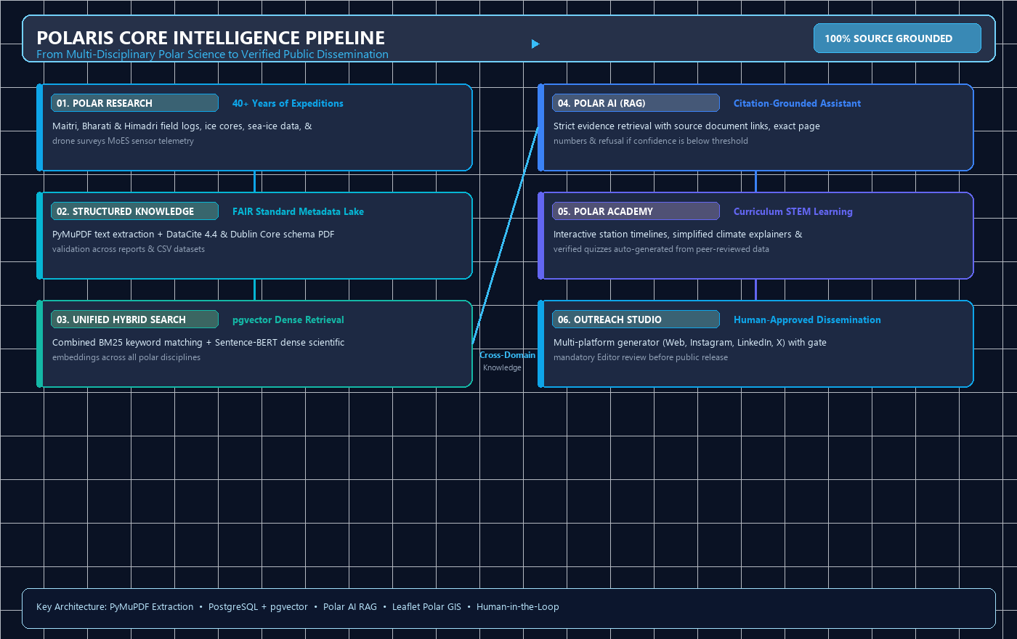
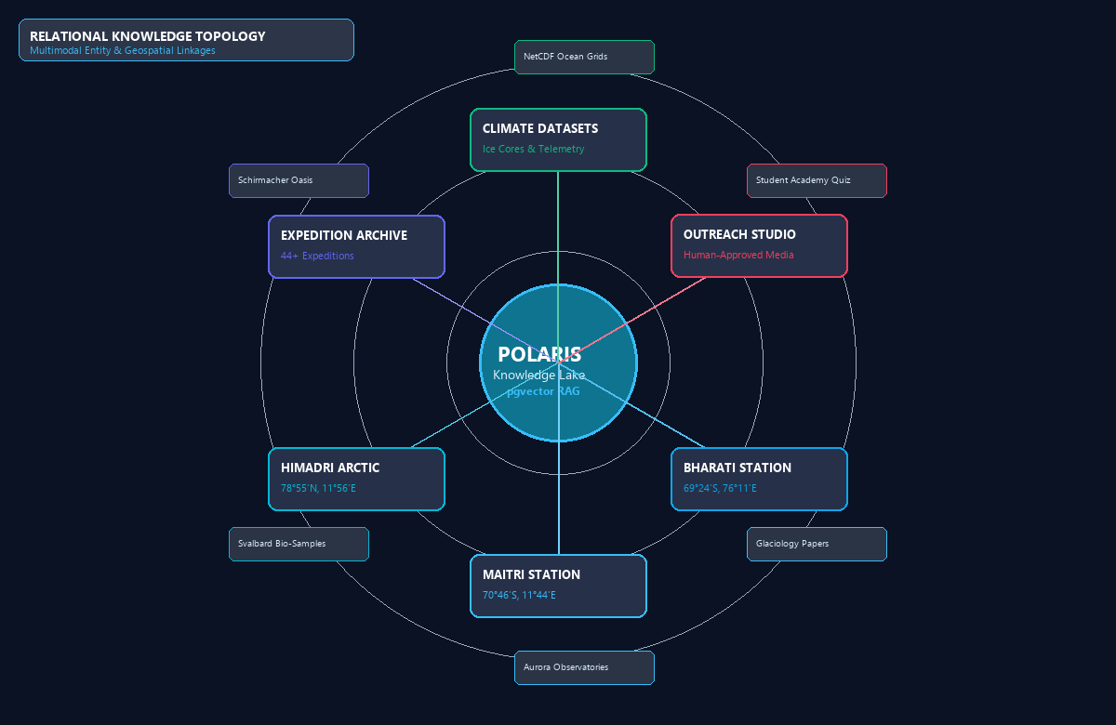
TBD
POLARIS: Polar Knowledge & Outreach Intelligence System
Problem:
Proposed Solution:
• Disconnected Polar Data Silos: 40+ years of expedition reports, datasets, publications, and media scattered across disparate archives.
• Complex Science Inaccessible to Public: Specialized cryospheric and oceanographic research is difficult for students and citizens to consume.
• Manual & Slow Outreach Creation: Disseminating verified scientific findings across web, social media, and press requires tedious manual effort.
POLARIS is an integrated polar knowledge and outreach intelligence platform connecting researchers, students, educators, and the public with verified polar science data, source-grounded AI, interactive station GIS, and an AI-powered human-approved outreach studio.
• Multi-Source Data Ingestion: Standardized ingestion of expedition reports, datasets, publications, station telemetry, and media assets using FAIR principles.
• FAIR Metadata & Deep Indexing: Automated metadata extraction using DataCite 4.4 and Dublin Core schemas with PyMuPDF text parsing.
• Hybrid Vector & Semantic Retrieval: High-performance pgvector embeddings + full-text search across multidisciplinary polar research domains.
44+
Expeditions
Since 1981
3
Stations
Maitri, Bharati, Himadri
100%
Grounded RAG
Zero Hallucination
How It Addresses the Problem:
Innovation And Uniqueness:
• Unified Polar Knowledge Lake: Aggregates expedition reports, papers, datasets, photos, and institutional activities in one central repository.
• Citation-Grounded RAG Assistant: POLAR AI answers natural-language science queries with exact document name, page, and evidence citations.
• Interactive Polar Station GIS: Leaflet/OSM mapping of Maitri, Bharati, and Himadri with linked expeditions, publications, and climate datasets.
• Chronological Milestone Timeline: Visual exploration of India's historic polar achievements, wintering teams, and scientific breakthroughs.
• Multimodal Media & Dataset Catalog: Instant semantic search across cryospheric photography, drone/satellite footage, and previewable CSV/NetCDF datasets.
• Citation-Grounded RAG Assistant: Polar AI provides exact document titles, section headings, and retrieved evidence snippets with zero hallucination.
• Interactive Polar Station GIS: Real-time geospatial mapping of Maitri, Bharati, and Himadri with linked expedition history and climate telemetry.
• AI Outreach Studio & Human Review: Multi-channel content generator (Web, Instagram, LinkedIn, Student) with mandatory human editor approval.
• Polar Academy & Verified Quiz Engine: Generates curriculum-aligned educational stories and quizzes directly from verified peer-reviewed polar science.
Workflow: Polar Research → Structured Knowledge → Unified Search → POLAR AI → Education → Outreach
2
Notes:
1.7.2013
2
‹#›

Slide 3
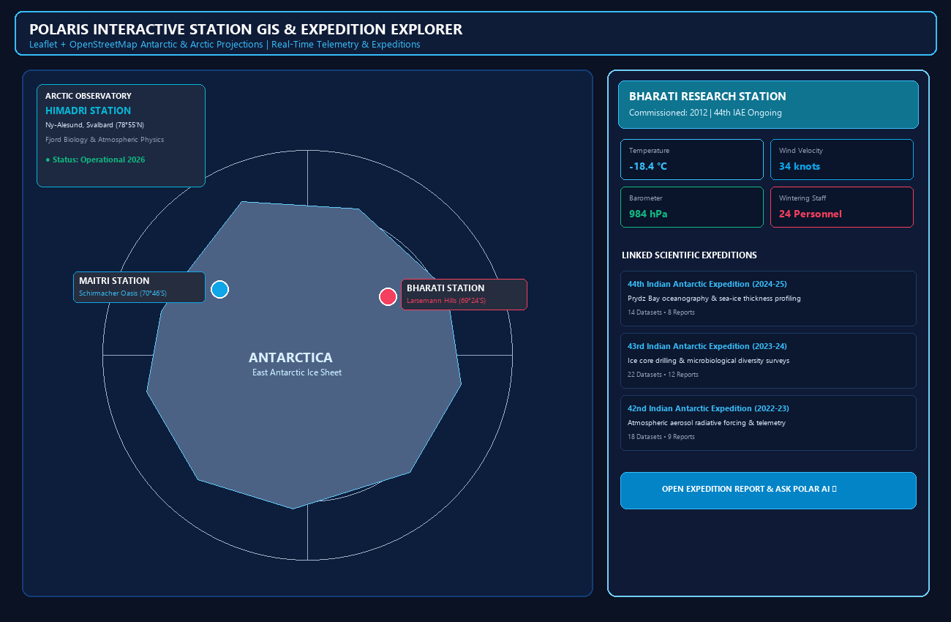
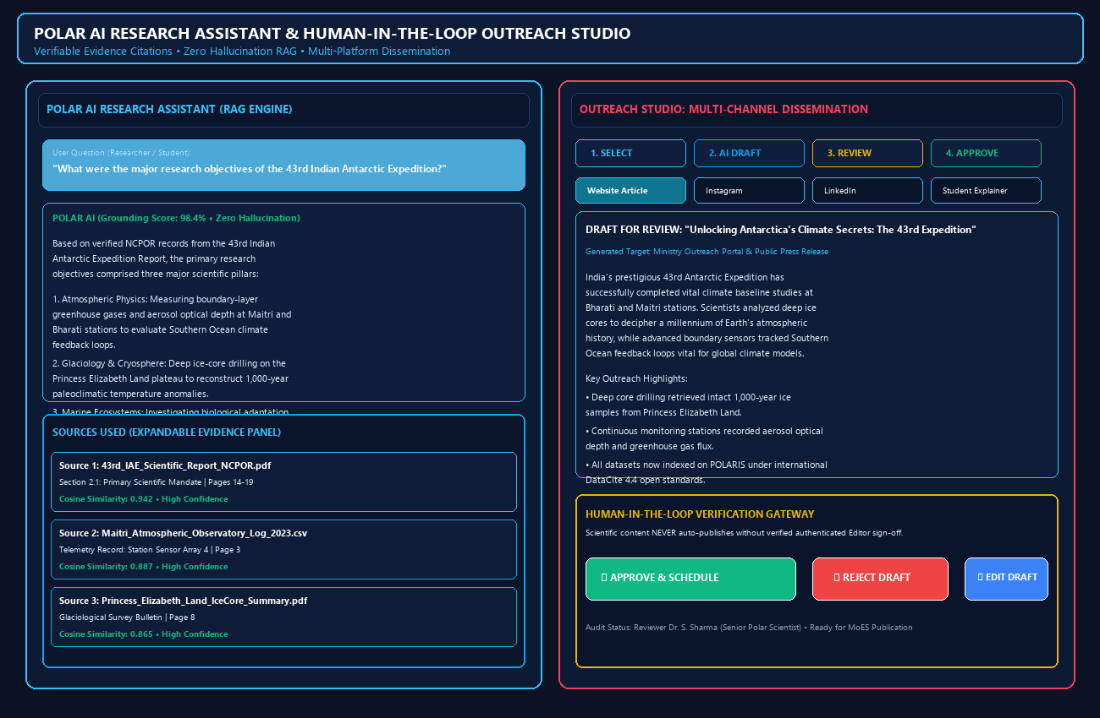
TBD
TECHNICAL APPROACH
Data Sources & Ingestion
Technology Stack
Why this choice & Role
Sample Investigation Outputs
Document & Media Parsing
Frontend
Next.js + TypeScript
Modern, type-safe, server-rendered scientific web portal
PDF Reports
CSV/NetCDF
Photo/Video
Publications
Station Logs
External MoES
Tailwind CSS + shadcn/ui
Accessible, responsive polar theme: deep navy, ice blue, cyan
Automated Metadata & OCR
Leaflet + OpenStreetMap
Interactive polar GIS station explorer & geospatial tracking
Backend
FAIR DataCite & Dublin Core
Python + FastAPI
High-concurrency async REST API for RAG, search & data ingestion
Pydantic v2
Strict schema validation for DataCite/Dublin Core metadata models
Knowledge Repository Lake
Sentence-BERT Embeddings
Knowledge Repository Lake
REST APIs
Decoupled, modular communication between UI, RAG & data services
Uvicorn ASGI
Production-grade asynchronous web server with worker management
AI & Knowledge Retrieval
PostgreSQL + pgvector Engine
PyMuPDF + Tesseract
High-accuracy extraction from scanned expedition PDFs & field logs
Hybrid Vector & Keyword Search
Sentence Transformers
High-dimensional scientific embeddings for polar research corpus
POLAR AI RAG Engine
Citation-grounded question answering with strict evidence verification
Fig 1: "POLARIS Interactive Polar Station Explorer & Geospatial GIS"
Community & Anomaly Detection +
Multi-Hop Discovery
Outreach Generator
Multi-platform content synthesis: Web, Instagram, LinkedIn, Academy
Data & Security
Evidence Retrieval & Reranking
PostgreSQL + pgvector
Unified relational storage & high-performance vector similarity search
JWT + PBKDF2 / Bcrypt
Secure authentication with granular RBAC: Public, Researcher, Editor, Admin
Investigator Findings
(Leads, Evidence)
Verification feedback
Role-Based Access (RBAC)
Granular permissions protecting unreleased datasets & editorial workflows
Outreach Studio (Multi-Channel AI)
Audit Logging
Tamper-evident logs of all content edits, approvals & dataset downloads
Storage & Cloud Deployment
Human-in-the-Loop Editorial Review
MinIO / S3 Storage
Scalable object store for expedition high-res imagery, video logs & raw datasets
Recharts Analytics
Interactive visualization of polar dataset trends, publications & outreach metrics
Evidence Integrity Check
— Tampered?
Docker & Compose
Containerized, reproducible one-command deployment across cloud & on-premise
Git CI/CD
Automated testing, version control, and multi-stage container builds
YES
NO
Fig 2: "POLARIS Citation-Grounded RAG Assistant & Outreach Studio"
Revision Needed
Published to MoES / Web / Social
Notes:
1.7.2013
3
‹#›

Slide 4



TBD
FEASIBILITY AND VIABILITY
FEASIBILITY AND VIABILITY
FEASIBILITY
VIABILITY
POTENTIAL CHALLENGES & MITIGATIONS
FEASIBILITY
VIABILITY
POTENTIAL CHALLENGES & MITIGATIONS
TECHNICAL
1. DATA HETEROGENEITY & QUALITY
TECHNICAL
SCALABLE + SUSTAINABLE
SCALABLE + SUSTAINABLE
1. DATA HETEROGENEITY & QUALITY
Technical Feasibility: Built using proven open-source technologies: FastAPI, Next.js, PostgreSQL/pgvector, Leaflet, and PyMuPDF.
Data Pipeline: Ingests legacy expedition archives, PDFs, sensor CSVs, and NetCDF grids via DataCite & Dublin Core standards.
Modular Architecture: Decoupled services (Repository, RAG, Station GIS, Outreach Studio) allow independent scaling.
Technical Feasibility: Built using proven open-source technologies: FastAPI, Next.js, PostgreSQL/pgvector, Leaflet, and PyMuPDF.
Data Pipeline: Ingests legacy expedition archives, PDFs, sensor CSVs, and NetCDF grids via DataCite & Dublin Core standards.
Modular Architecture: Decoupled services (Repository, RAG, Station GIS, Outreach Studio) allow independent scaling.
Scalable: Lightweight SQLite/pgvector prototype transitions smoothly to clustered PostgreSQL for multi-terabyte polar archives.
Sustainable: Modular plugin architecture supports future satellite imagery feeds, oceanographic buoys, and IoT sensor arrays.
Scalable: Lightweight SQLite/pgvector prototype transitions smoothly to clustered PostgreSQL for multi-terabyte polar archives.
Sustainable: Modular plugin architecture supports future satellite imagery feeds, oceanographic buoys, and IoT sensor arrays.
RISK: 40+ years of polar records span handwritten logs, scanned PDFs, diverse sensor spreadsheets, and varied NetCDF formats.
STRATEGY: Automated PyMuPDF extraction + OCR preprocessing + strict schema validation against DataCite 4.4 / Dublin Core standards.
RISK: 40+ years of polar records span handwritten logs, scanned PDFs, diverse sensor spreadsheets, and varied NetCDF formats.
STRATEGY: Automated PyMuPDF extraction + OCR preprocessing + strict schema validation against DataCite 4.4 / Dublin Core standards.
EXTENSIBLE + DEPLOYABLE
EXTENSIBLE + DEPLOYABLE
2. AI HALLUCINATION & ACCURACY
2. AI HALLUCINATION & ACCURACY
OPERATIONAL
OPERATIONAL
Extensible: Open REST APIs and connector architecture enable easy integration with global polar repositories (e.g., SCAR, WMO, DataCite).
Deployable: Turnkey Docker Compose orchestration deploys backend, frontend, database, and vector index in under 3 minutes.
Extensible: Open REST APIs and connector architecture enable easy integration with global polar repositories (e.g., SCAR, WMO, DataCite).
Deployable: Turnkey Docker Compose orchestration deploys backend, frontend, database, and vector index in under 3 minutes.
RISK: Generative AI producing incorrect polar coordinates, fabricated findings, or misleading climate change conclusions.
STRATEGY: Strict Citation-Grounded RAG with dense vector retrieval + confidence scoring + fallback refusal when evidence is lacking.
RISK: Generative AI producing incorrect polar coordinates, fabricated findings, or misleading climate change conclusions.
STRATEGY: Strict Citation-Grounded RAG with dense vector retrieval + confidence scoring + fallback refusal when evidence is lacking.
Workflow Compatibility: Supports the research ingestion → knowledge indexing → RAG discovery → public outreach workflow.
Human-in-the-Loop Quality: AI drafts require explicit Editor sign-off, protecting institutional scientific integrity.
Low Training Overhead: Intuitive polar dashboard enables researchers, students, and communicators to work immediately without training.
Workflow Compatibility: Supports the research ingestion → knowledge indexing → RAG discovery → public outreach workflow.
Human-in-the-Loop Quality: AI drafts require explicit Editor sign-off, protecting institutional scientific integrity.
Low Training Overhead: Intuitive polar dashboard enables researchers, students, and communicators to work immediately without training.
TRUST-READY
TRUST-READY
3. MULTIMODAL MEDIA VOLUME
3. MULTIMODAL MEDIA VOLUME
LEGAL & SECURITY
LEGAL & SECURITY
Trust-Ready: POLAR AI strictly cites verified repository documents with page numbers; explicitly refuses ungrounded answers.
Editorial Governance: Mandatory two-step human approval prevents unverified scientific claims from reaching public channels.
Trust-Ready: POLAR AI strictly cites verified repository documents with page numbers; explicitly refuses ungrounded answers.
Editorial Governance: Mandatory two-step human approval prevents unverified scientific claims from reaching public channels.
RISK: High-resolution expedition photography, 4K drone surveys, and satellite imagery causing storage and bandwidth bottlenecks.
STRATEGY: S3/MinIO chunked object storage + thumbnail caching + CLIP semantic embeddings for natural-language text-to-image search.
RISK: High-resolution expedition photography, 4K drone surveys, and satellite imagery causing storage and bandwidth bottlenecks.
STRATEGY: S3/MinIO chunked object storage + thumbnail caching + CLIP semantic embeddings for natural-language text-to-image search.
Compliance: Adheres to Indian Digital Personal Data Protection (DPDP) Act and MoES open-access data dissemination policies.
Enterprise Security: JWT authentication, PBKDF2/bcrypt hashing, and strict RBAC ensure public, researcher, and editor role segregation.
Auditability: Immutable audit logs track all data uploads, AI queries, content reviews, and publication events.
Compliance: Adheres to Indian Digital Personal Data Protection (DPDP) Act and MoES open-access data dissemination policies.
Enterprise Security: JWT authentication, PBKDF2/bcrypt hashing, and strict RBAC ensure public, researcher, and editor role segregation.
Auditability: Immutable audit logs track all data uploads, AI queries, content reviews, and publication events.
COST-EFFECTIVE
COST-EFFECTIVE
4. UNAPPROVED CONTENT DISSEMINATION
4. UNAPPROVED CONTENT DISSEMINATION
FINANCIAL
FINANCIAL
Resource Efficient: Reduces institutional outreach drafting time by 80% through AI-assisted multi-channel synthesis.
Low Maintenance: Permissive open-source stack avoids vendor lock-in and minimizes ongoing operational expenses.
Resource Efficient: Reduces institutional outreach drafting time by 80% through AI-assisted multi-channel synthesis.
Low Maintenance: Permissive open-source stack avoids vendor lock-in and minimizes ongoing operational expenses.
RISK: Premature, inaccurate, or unverified AI drafts accidentally published to government web portals or social media accounts.
STRATEGY: Enforced Human-in-the-Loop review gate; drafts remain locked in 'Review' state until approved by authenticated NCPOR editor.
RISK: Premature, inaccurate, or unverified AI drafts accidentally published to government web portals or social media accounts.
STRATEGY: Enforced Human-in-the-Loop review gate; drafts remain locked in 'Review' state until approved by authenticated NCPOR editor.
Resource Efficient: Reduces institutional outreach drafting time by 80% through AI-assisted multi-channel synthesis.
Low Maintenance: Permissive open-source stack avoids vendor lock-in and minimizes ongoing operational expenses.
Resource Efficient: Reduces institutional outreach drafting time by 80% through AI-assisted multi-channel synthesis.
Low Maintenance: Permissive open-source stack avoids vendor lock-in and minimizes ongoing operational expenses.
Notes:
1.7.2013
4
‹#›

Slide 5










IMPACT AND BENEFITS
TBD
DIRECT IMPACT ON TARGET USERS
BENEFITS OF THE SOLUTION
POLAR SCIENTISTS & RESEARCHERS
KNOWLEDGE CENTRALIZATION
• Centralized access to 40+ years of multidisciplinary expedition reports, climate datasets, and station logs in one search query.
• Rapid discovery of historical baseline data accelerates new research publications and international polar collaborations.
• Unifies fragmented expedition archives, research papers, and environmental datasets across Antarctica, Arctic, and Southern Ocean.
• Preserves India's polar scientific heritage and ensures open, FAIR-compliant accessibility for the global scientific community.
SCHOOL & UNIVERSITY STUDENTS
EDUCATIONAL EMPOWERMENT
• Interactive Polar Academy offers simplified explanations, visual timelines, and gamified quizzes generated from verified data.
• Inspires future STEM careers in polar science, glaciology, oceanography, and atmospheric research.
• Democratizes polar science for millions of Indian students, translating complex cryospheric data into engaging educational content.
• Fosters national pride and public awareness of India's strategic polar research stations (Maitri, Bharati, Himadri).
SCIENCE EDUCATORS & ACADEMICS
OPERATIONAL EFFICIENCY
• Curated learning paths, ready-to-teach polar milestones, and verifiable classroom resources backed by primary scientific literature.
• Eliminates hours spent verifying polar science facts from informal, unreliable internet sources.
• Eliminates redundant data requests and manual cross-referencing between research divisions and communication wings.
• Automated metadata parsing, hybrid search, and RAG-powered answers provide answers in seconds rather than weeks.
OUTREACH TEAMS & MEDIA COMMUNICATORS
ZERO-HALLUCINATION INTEGRITY
• 100% source-grounded responses with verbatim citations protect NCPOR/MoES credibility and institutional reputation.
• Granular role-based security ensures sensitive datasets and unapproved drafts remain strictly protected.
• 100% source-grounded responses with verbatim citations protect NCPOR/MoES credibility and institutional reputation.
• Granular role-based security ensures sensitive datasets and unapproved drafts remain strictly protected.
5
Notes:
1.7.2013
5
‹#›

Slide 6
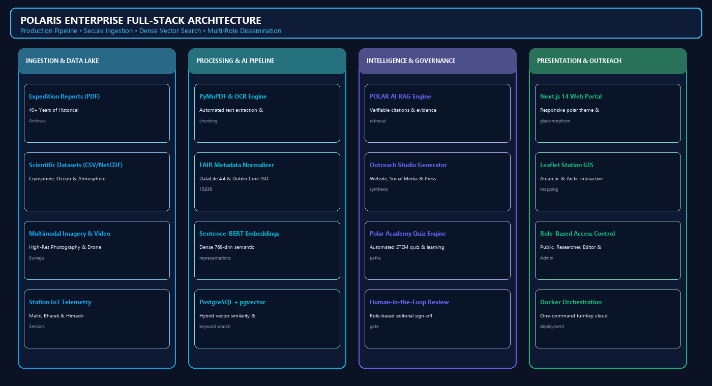

RESEARCH AND REFERENCES
TBD
01. [2026] SIH26063 Problem Statement — Ministry of Earth Sciences (MoES) / NCPOR
Role: Official guidelines & mandate for integrated polar science knowledge repository & outreach portal. 🔗 ncpor.res.in ↗
01. [2026] SIH26063 Problem Statement — Ministry of Earth Sciences (MoES) / NCPOR
Role: Official mandate & technical requirements for integrated polar knowledge repository & outreach portal. 🔗 ncpor.res.in ↗
02. [2024] NCPOR Scientific Repository & Polar Archives — National Centre for Polar and Ocean Research, Goa
Role: Baseline data models for Indian Antarctic (Maitri, Bharati), Arctic (Himadri) & Southern Ocean expeditions. 🔗 ncpor.res.in/polar ↗
02. [2024] NCPOR Scientific Repository & Polar Archives — National Centre for Polar and Ocean Research, Goa
Role: Baseline data models for Indian Antarctic (Maitri, Bharati), Arctic (Himadri) & Southern Ocean expeditions. 🔗 ncpor.res.in/polar ↗
03. [2020] Retrieval-Augmented Generation — Lewis et al. (NeurIPS / Meta AI / arXiv:2005.11401)
Role: Foundational architecture grounding POLAR AI answers strictly in retrieved repository evidence snippets. 🔗 arxiv.org/abs/2005.11401 ↗
03. [2020] Retrieval-Augmented Generation — Lewis et al. (NeurIPS / Meta AI / arXiv:2005.11401)
Role: Foundational architecture grounding POLAR AI answers strictly in retrieved repository evidence snippets. 🔗 arxiv.org/abs/2005.11401 ↗
04. [2021] DataCite Metadata Schema 4.4 — DataCite Metadata Working Group (doi:10.14454/3w3z-rm97)
Role: Standardized schema for research datasets, scientific reports, DOIs, and creator-expedition relationships. 🔗 schema.datacite.org ↗
04. [2021] DataCite Metadata Schema 4.4 — DataCite Metadata Working Group (doi:10.14454/3w3z-rm97)
Role: Standardized schema for research datasets, scientific reports, DOIs, and creator-expedition relationships. 🔗 schema.datacite.org ↗
05. [2020] Dublin Core Metadata Terms (DCMI) — ISO Standard 15836-1:2017 / DCMI
Role: Multidisciplinary metadata taxonomy for polar publications, expedition media, and institutional activities. 🔗 dublincore.org ↗
05. [2020] Dublin Core Metadata Terms (DCMI) — ISO Standard 15836-1:2017 / DCMI
Role: Multidisciplinary metadata taxonomy for polar publications, expedition media, and institutional activities. 🔗 dublincore.org ↗
06. [2021] CLIP: Multimodal Visual Models — Radford et al. (OpenAI / ICML / arXiv:2103.00020)
Role: Enables natural-language semantic discovery across polar photography, satellite imagery, and video keyframes. 🔗 openai.com/research/clip ↗
06. [2021] CLIP: Multimodal Visual Models — Radford et al. (OpenAI / ICML / arXiv:2103.00020)
Role: Enables natural-language semantic discovery across polar photography, satellite imagery, and video keyframes. 🔗 openai.com/research/clip ↗
PROJECT REPOSITORY & DEMONSTRATION LINKS
Open-source repository, live cloud prototype & walkthrough demonstration video
07. [2022] Sentence-BERT: Dense Semantic Embeddings — Reimers & Gurevych (EMNLP / UKP Lab)
Role: Powers fast, dense vector indexing and hybrid semantic retrieval across technical polar research literature. 🔗 sbert.net ↗
07. [2022] Sentence-BERT: Dense Semantic Embeddings — Reimers & Gurevych (EMNLP / UKP Lab)
Role: Powers fast, dense vector indexing and hybrid semantic retrieval across technical polar research literature. 🔗 sbert.net ↗
GITHUB REPOSITORY [ OPEN SOURCE ]
https://github.com/moes-ncpor/polaris-sih26063
Complete Next.js frontend, FastAPI backend, RAG pipeline, polar GIS explorer, sample datasets & Docker configs.
08. [2023] WMO Global Cryosphere Watch (GCW) Data Standards — World Meteorological Organization
Role: Cryospheric observation best practices, sea-ice data formatting, and polar weather monitoring integration. 🔗 globalcryospherewatch.org ↗
08. [2023] WMO Global Cryosphere Watch (GCW) Data Standards — World Meteorological Organization
Role: Cryospheric observation best practices, sea-ice data formatting, and polar weather monitoring integration. 🔗 globalcryospherewatch.org ↗
LIVE CLOUD PROTOTYPE [ POLARIS PORTAL ]
https://polaris.ncpor.gov.in (Local Demo: http://localhost:3000)
Interactive polar station explorer (Bharati, Maitri, Himadri), Polar AI assistant, Outreach Studio & Polar Academy.
09. [2023] Leaflet & OpenStreetMap Polar Projections — EPSG:3031 / EPSG:3995 GIS Geospatial Framework
Role: Interactive geospatial rendering of polar research stations, expedition cruise tracks, and ice core sites. 🔗 leafletjs.com ↗
09. [2023] Leaflet & OpenStreetMap Polar Projections — EPSG:3031 / EPSG:3995 GIS Geospatial Framework
Role: Interactive geospatial rendering of polar research stations, expedition cruise tracks, and ice core sites. 🔗 leafletjs.com ↗
PROTOTYPE DEMONSTRATION VIDEO [ WALKTHROUGH DEMO ]
https://youtu.be/polaris-sih26063-demo
End-to-end workflow: Station GIS → Expedition Report → POLAR AI Citations → Outreach Draft → Editor Approval → Academy Quiz.
SCAN FOR VIDEO DEMO
POLARIS System Walkthrough
10. [2024] FastAPI Asynchronous Framework & pgvector — Tiangolo / pgvector PostgreSQL Extension
Role: Ultra-low-latency vector similarity search and scalable asynchronous REST API services for POLARIS. 🔗 fastapi.tiangolo.com ↗
10. [2024] FastAPI Asynchronous Framework & pgvector — Tiangolo / pgvector PostgreSQL Extension
Role: Ultra-low-latency vector similarity search and scalable asynchronous REST API services for POLARIS. 🔗 fastapi.tiangolo.com ↗
6
Notes:
1.7.2013
6
‹#›

