Slide 1



MINI PROJECT on
STUDENT DATABASE MANAGEMENT SYSTEM
Dept. Of Information Technology
Team Members:
G Tirumala (17121a1240)
Jayaram S V (17121a1241)
K Bhavitha Reddy (17121a1242)
Department of Information Technology

Slide 2
TABLE OF CONTENTS
Abstract
Introduction
Project details
Modules Description
Design of the project
Hardware & Software requirements
Role of Batch Members
Status of the Project
Result
Conclusion
Future works
Reference and Links Used in this project
Department of Information Technology

Slide 3
ABSTRACT:
Main objective:
This work is useful for easy user interface.
we are planning to utilize the powerful database management, data
retrieval and data manipulation system.
An organized and systematic office solution is essential for all universities
and Organizations.
There are many departments of administration for the maintenance of college information and student databases in any institution.
All these departments provide various records regarding students.
Department of Information Technology

Slide 4
Most of these track records need to maintain information about the students.
This information could be the general details like student name, address, performance, attendance etc or specific information related to departments like collection of data.
It will provide more ease for managing the data than manually maintaining in the documents
This work is useful for saving valuable time and reduces the huge paper work.
Department of Information Technology

Slide 5
INTRODUCTION:
Main menu:
Admin
Student
In the admin option user can create store modify display and delete any number of student’s data
In the student option user can search for a student’s record and view records but modifying and deleting can only be done through administrator
Department of Information Technology

Slide 6
Project details:
There are 2 main modules:
1.Admin
2.Student
Department of Information Technology

Slide 7
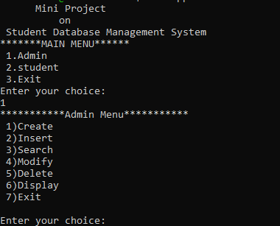
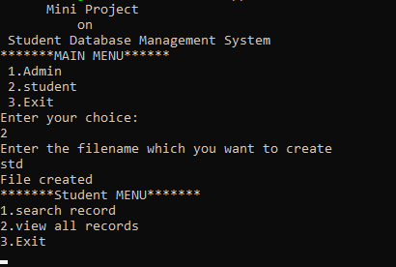
ADMIN MODULE STUDENT MODULE
Department of Information Technology

Slide 8
ADMIN MODULES:
CREATE RECORDS
This can be done by using the touch or cat command.
By using this first a file is created so that records can be added
The user can add details of a student. Like..
Name of the student
Student Roll Numbers
Exams Marks
Average of the student is calculated here
Department of Information Technology

Slide 9
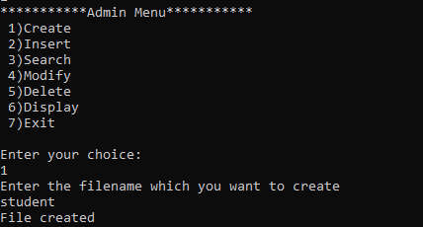
Create record:
Department of Information Technology

Slide 10
DISPLAY RECORDS
In this module sort command with –g option is used to display the following details:
-> The records of students with details like
-> Name
-> Roll number
-> Marks
-> Average can be displayed
Department of Information Technology

Slide 11
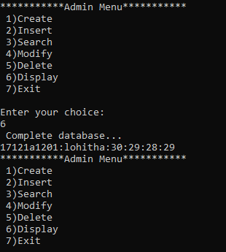
Display record:
Department of Information Technology

Slide 12
SEARCH RECORDS
The user may search the record of any student by entering the roll number of that particular student.
In this module the grep command is used so that the searched roll number can be found.
Then records of that student alone can be displayed.
Department of Information Technology

Slide 13
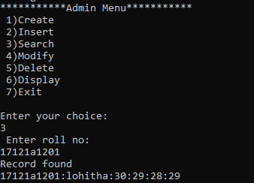
Search record:
Department of Information Technology

Slide 14
MODIFY RECORDS
The user may modify the records of any student(if it exists)
In this module the grep command is used to search a roll number
Then by using cut command the records of that student are moved to a temporary file
The necessary changes can be done on the record(modifications)
Then again the data on this temporary file is copied and is updated to the main file containing records of all students
Department of Information Technology

Slide 15
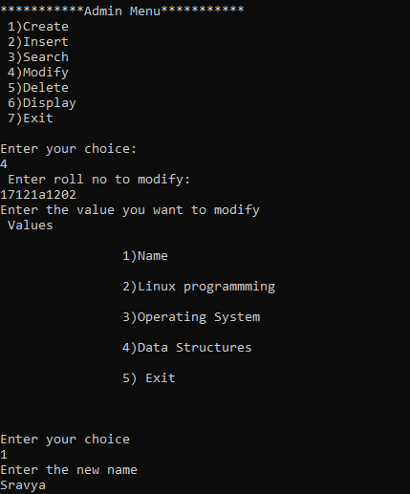
Modify record:
Department of Information Technology

Slide 16
DELETE RECORD
The user may delete any student’s data from the record list.
For deleting a record first the roll number is read from the user
Then grep command is used to match with that roll number.
By using mv command the details of that student are moved to a temporary file.
So the record is deleted
Department of Information Technology

Slide 17
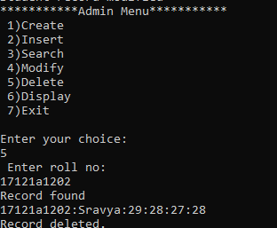
Delete record:
Department of Information Technology

Slide 18
STUDENT MODULE:
SEARCH RECORDS
The user may search the record of any student by entering the roll number of that particular student.
In this module the grep command is used so that the searched roll number can be found.
Then records of that student alone can be displayed.
Department of Information Technology

Slide 19
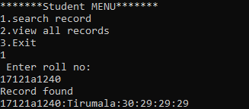
Search record
Department of Information Technology

Slide 20
DISPLAY RECORDS
In this module sort command with –g option is used to display the following details:
-> The records of students with details like
-> Name
-> Roll number
-> Marks
-> Average can be displayed
Department of Information Technology

Slide 21
Display records
Department of Information Technology

Slide 22
Flow chart:
Design Of The Project:
start
1.Admin 2.student 3.exit
read choice
1.
ADMIN
2.
STUDENT
3.
stop
Department of Information Technology

Slide 23
ADMIN
1.Create 2.Insert 3.search 4.modify 5.delete 6.display.7.exit
1
create
2
insert
3
search
4
modify
5
delete
6
display
7
exit
Department of Information Technology

Slide 24
create
read the name of file
touch file name
File created successfully
Department of Information Technology

Slide 25
INSERT
if
-z $filename
Read number of records to insert
No records
While
$n >0
Read roll number
Srno=grep r.no db
record already exist
if
-z $srno
Read name, marks of 3 subjects
Avg=subjects(1+2+3)/3
Department of Information Technology

Slide 26
SEARCH
Read roll no
Record=grep rno db
If
$?!= 0
Record found
No records
Department of Information Technology

Slide 27
MODIFY
Read roll number
Grep srno db>temp1.txt
Grep –v srno db>temp2.txt
mv>temp2.txt $db
Name,sub1,sub2,sub3=cut –d temp1.txt
If
$?!=0
Record does not exist
Read new name, sub1, sub2, sub3 marks
New Average=subjects(1+2+3)/3
Record is modified
Department of Information Technology

Slide 28
DELETE
read the roll number
Record=grep –v rno db>temp.txt
mv temp.txt $db
Record deleted
Department of Information Technology

Slide 29
display
Sort –g $db
Displaying complete data base
Department of Information Technology

Slide 30
Student:
1.search 2.view 3.exit
1
search
2
view
3
exit
Department of Information Technology

Slide 31
SEARCH
Read roll no
Record=grep rno db
If
$?!= 0
Record found
No records
Department of Information Technology

Slide 32
display
Displaying complete data base
Sort –g $db
Department of Information Technology

Slide 33
This project is about storing the records of students.
The user will have two options:
1.admin 2.student
The administrator can do the following operations :
1.create 2.insert 3.search 4.modify 5.delete 6.display records
The student can do the following operations: 1.search 2.view records
SIMPLE DESCRIPTION OF PROJECT:
Department of Information Technology

Slide 34
SYSTEM REQUIREMENTS
SOFTWARE REQUIREMENTS:
OPERATING SYSTEM : UBUNTU 16.04 LTS
HARDWARE REQUIREMENTS:
RAM : 256 MB or More
PROCESSOR : P3 or More
INTERPRETER : SHELL INTERPRETER
Department of Information Technology
Dept.of Information Technology

Slide 35
ROLES OF THE STUDENTS
NAME
ROLE
G.TIRUMALA
DEVELOPER
JAYARAM.S.V
DESIGNER
K.BHAVITHA REDDY
ANALYSER
Department of Information Technology

Slide 36
STATUS OF THE PROJECT
8
7
6
5
coding analysis documentation
4
3
2
1
0
Row 1
Department of Information Technology

Slide 37
REFERENCE TO THE PROJECT:
Software :
https://www.ubuntu.com/#download.
Drafted on: 10:00AM [02/10/2018]
Reference :
Neil Matthew and Richard Stones, Beginning Linux Programming, Wiley Dreamtech, Fourth Edition, 2008.
Richard Petersen, Linux: The Complete Reference, Tata McGraw-Hill, Sixth Edition, 2007.
Sumitabha Das, Your UNIX: The Ultimate Guide, Tata McGrawHill, 2007
Department of Information Technology

Slide 38
RESULT: enter your choice
1.admin 2.student :=>1 enter your choice
1.create 2.insert 3.search 4.modify 5.delete 6.display:=>1 enter file name: jayram file created enter your choice
1.create 2.insert 3.search 4.modify 5.delete 6.display:=>2 enter number of records to insert: 1 enter roll number : 40 enter name : rama enter 3 subjects marks: 30 30 30 average of three subjects is:30
Department of Information Technology

Slide 39
CONCLUSION:
Final conclusion of the project is storing ,displaying, modifying and deleting of student’s data
Department of Information Technology

Slide 40
FUTURE WORKS:
Student data can be easily stored modified and retrieved easily
This can save a lot paper.
Department of Information Technology

Slide 41

Department of Information Technology

