Slide 1
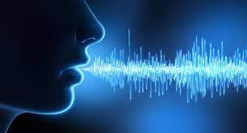
Gender Analysis using Speech signal
ADSP project – ECL412
Instructor: Dr.Vipin Kamble
Done by:
ALLAMSETTI JAYARAM
BT21ECE052

Slide 2
Introduction
Objective of the project:
To develop a system that can analyze the speech signal of an individual and determine their gender (male or female)
Importance:
Speaker recognition
Speech-based user interfaces
Audio forensics

Slide 3
Theoretical Background
Key Concepts
Signal Filtering
Feature Extraction
Fundamental Frequency
Zero- Crossing
Short-Term Enengy

Slide 4
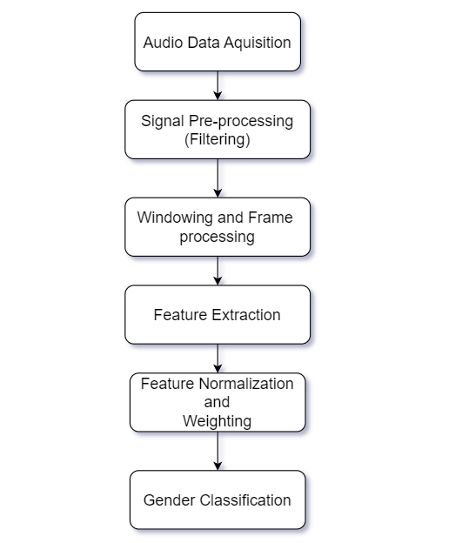
Methodology

Slide 5
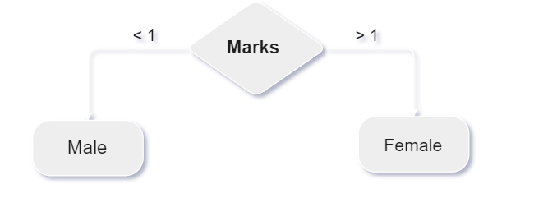


Classification Approach
Gender classification was done based on the marks (weighted sum of Normalised features) evaluated

Slide 6
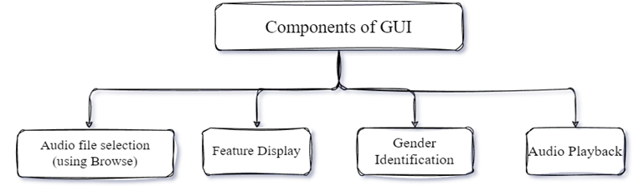
GUI Design
GUI provides a user-friendly interface for the gender analysis system.

Slide 7
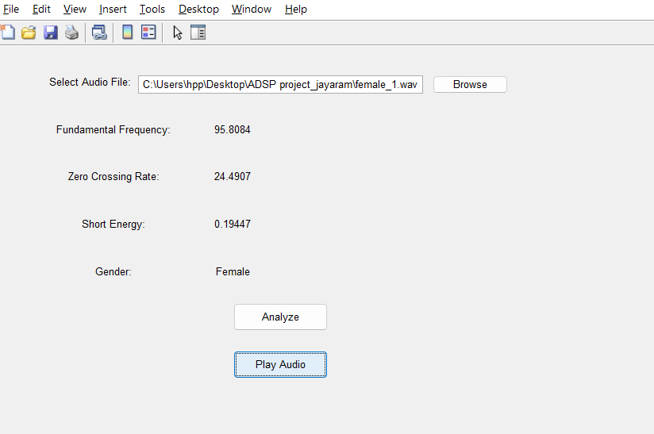
Output Observed in GUI
When we run the “GenderAnalysisGUI.m” file then the following pop-up will be shown, there after by selecting the audio file and by analysing it we can find the output shown on that window.

Slide 8
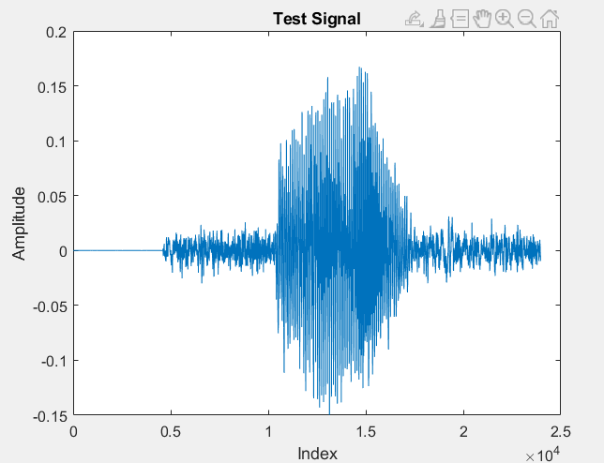
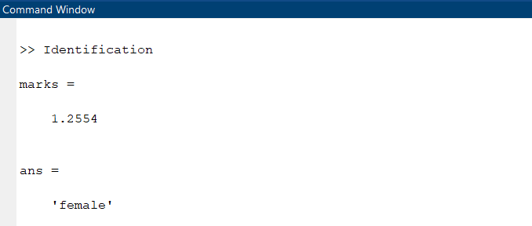
Output
Output observed in the command window of MATLAB.

Slide 9
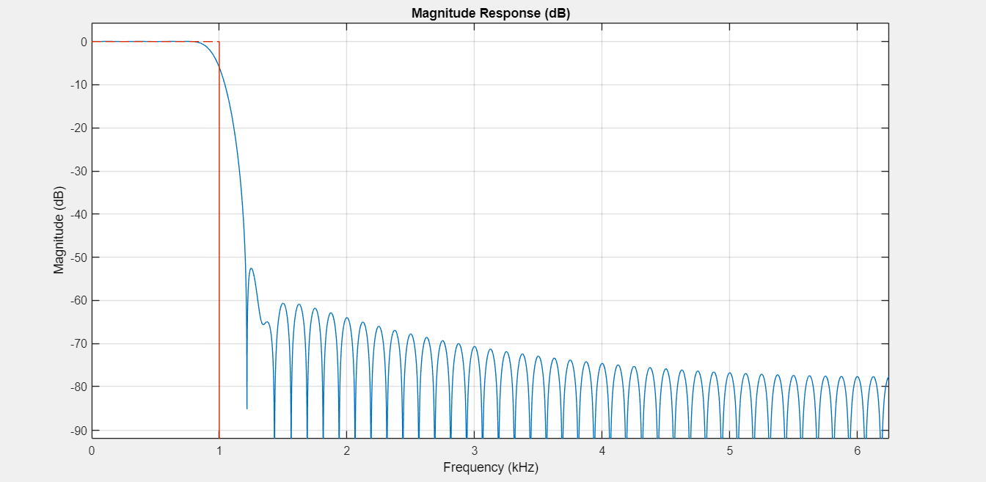
Magnitude response of the designed Low pass filter (LPF)

Slide 10
Limitations
The key limitations and areas for improvement for the "Gender analysis using speech signal" project are:
Limited dataset
Relied on threshold-based classification
Lack of real-time processing
Limited evaluation on different domains

Slide 11
Future work
Explore advanced classification algorithms:
The use of more sophisticated machine learning techniques, such as support vector machines or deep neural networks, to potentially improve the accuracy and robustness of the gender classification.
Investigate multi-modal approaches:
integration of speech signal analysis with other modalities, such as video or text, to potentially improve the accuracy and reliability of gender identification.
Evaluate performance on different domains:
Assess the system's performance on different types of audio data, such as telephone conversations, broadcast media, or audio recordings in different languages or environments.

Slide 12
Implement real-time processing:
Develop a real-time version of the system that can perform gender analysis on live audio input, enabling immediate identification of the speaker's gender.
Expand the dataset:
Collect a larger and more diverse dataset of audio recordings to improve the system's performance and generalization capabilities.
Ensure the dataset covers a wide range of speakers, accents, languages, and recording conditions.

Slide 13
Conclusion
Developed a gender analysis system based on speech signal processing
Implemented a GUI to provide a user-friendly interface
Demonstrated the potential of using signal processing and feature-based classification for gender identification
Potential applications and impact of the gender analysis system
1) Speaker recognition
2) Speech-based user interfaces
3) Audio forensics

Slide 14
References
[1]. Prabhakar, S., Pankanti, S., and Jain, A. “Biometric recognition: security and privacy concerns”IEEE Security and Privacy Magazine 1(2003), 33-42.
[2]. Huang X., Acero, A., and Hon, H.-W. “Spoken Language Processing: a Guideto Theory, Algorithmand System Development” prentice-Hall, New Jersey, 2001.
[3]. Martin, A., and Przybocki, M. Speaker recognition in a multi-speaker environment.In Proc. 7thEuropean Conference on Speech Communication and Technology (Eurospeech 2001) (Aalborg,Denmark, 2001), pp. 787–90.
[4]. Tomi Kinnunen “ Spectral Feature for Automatic Voice-independent Speaker Recognition”Depertment of Computer Science, Joensuu University,Finland. December 21, 2003.
[5]. John R. Deller, John G Proakis and John H. L. Hansen, “Discrete- Time Processing of SpeechSignals” Macmillan Publishing company, 866 Third avenue, New York 10022.
[6]. Rabiner Lawrence, Juang Bing-Hwang, “Fundamentals of Speech Recognitions”, Prentice Hall NewJersey, 1993, ISBN 0-13-015157-2.

Slide 15
Thank you

